Slide 1
VHA’s Journey to High Reliability
Advancing Toward Zero Harm and
Becoming a Learning Health System
Presenters:
Gerard R. Cox, MD, MHA
Assistant Under Secretary for Health for Quality & Patient Safety
Edward E. Yackel, DNP, FNP-C, FAANP
Executive Director, VHA National Center for Patient Safety
September 26, 2023

Slide 2
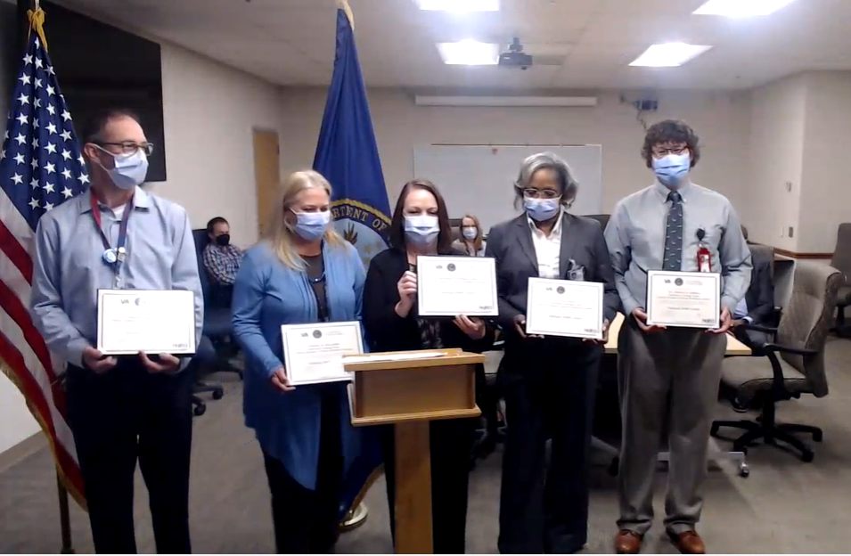
Start Every Meeting With A Safety Story
Every day across VHA, we work to deliver exceptional care to Veterans.
“[The Laboratory Package Team] identified, investigated and resolved a process failure…and took action using HRO Principles.”
– Dr. Margie Scott, VA Medical Center (VAMC) Director at
Central Arkansas
Laboratory Package Team
Central Arkansas VA Health Care System
(CY 2022 Quarter 2 National HeRO Awardee)
Pre-Decisional Deliberative Document
Internal VA Use Only

Slide 3
VHA’s Journey to High Reliability
Foundation
Pivotal studies on patient harm in the U.S. are published (e.g., To Err is Human).
Health care organizations, including VHA’s National Center for Patient Safety (NCPS), led the way in adapting high reliability practices from aviation and nuclear industries to health care.
Foundation
1990-2017
Re-commitment
Chartered national (VHA) HRO Steering Committee
Established Veterans Integrated Services Networks (VISN) and VA Medical Center (VAMC) HRO Work Groups
Initiated VHA-wide formal implementation activities
Re-Commit
2018-2019
VHA’s Journey
to High Reliability
Build and Expand HRO Knowledge
Deployed common curriculum for Baseline Training, Team Training and Lean Improvement
Conducted HRO cultural assessment, site-specific planning and coaching efforts
Fostered leadership engagement and Just Culture
Expand
2020-2022
Next
2023+
Make HRO Part of the Fabric of VHA
Integrate HRO behaviors and strong practices into VHA operations at every organizational level
Lead organized, measured and systematic continuous improvement efforts
Pre-Decisional Deliberative Document
Internal VA Use Only

Slide 4



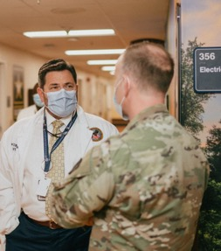


What is a High Reliability Organization?
HROs experience fewer than anticipated accidents or events of harm, despite operating in complex, high-risk environments
Fewer than anticipated accidents or events of harm
Operating in complex, high-risk environments
An “accident or event of harm” could be more broadly defined as any event that causes disruption to safe and reliable operations across the system
VHA leaders and staff members help manage business processes for the most complex health care system in the nation
Unclear Policy
Error in Data Report
Unjust Response to Adverse Event
Unique Veteran Health Care Needs
Legislative Requirements
Community Partnership
Pre-Decisional Deliberative Document
Internal VA Use Only

Slide 5



HRO Pillars, Principles and Values
3
5
7
Pillars
Principles
Values
Leadership Commitment
Sensitivity to Operations
Preoccupation with Failure
Reluctance to Simplify
Commitment to Resilience
Deference to Expertise
It’s About the Veteran
Support a Culture of Safety
Commit to Zero Harm
Learn, Inquire and Improve
Duty to Speak Up
Respect for People
Clear Communications
Safety and reliability are reflected in leadership’s vision, decisions and actions.
Culture of Safety
Safety values and practices are used to prevent harm and learn from mistakes.
Continuous Process Improvement (CPI)
Teams use effective tools for continuous learning and improvement.
Pre-Decisional Deliberative Document
Internal VA Use Only

Slide 6
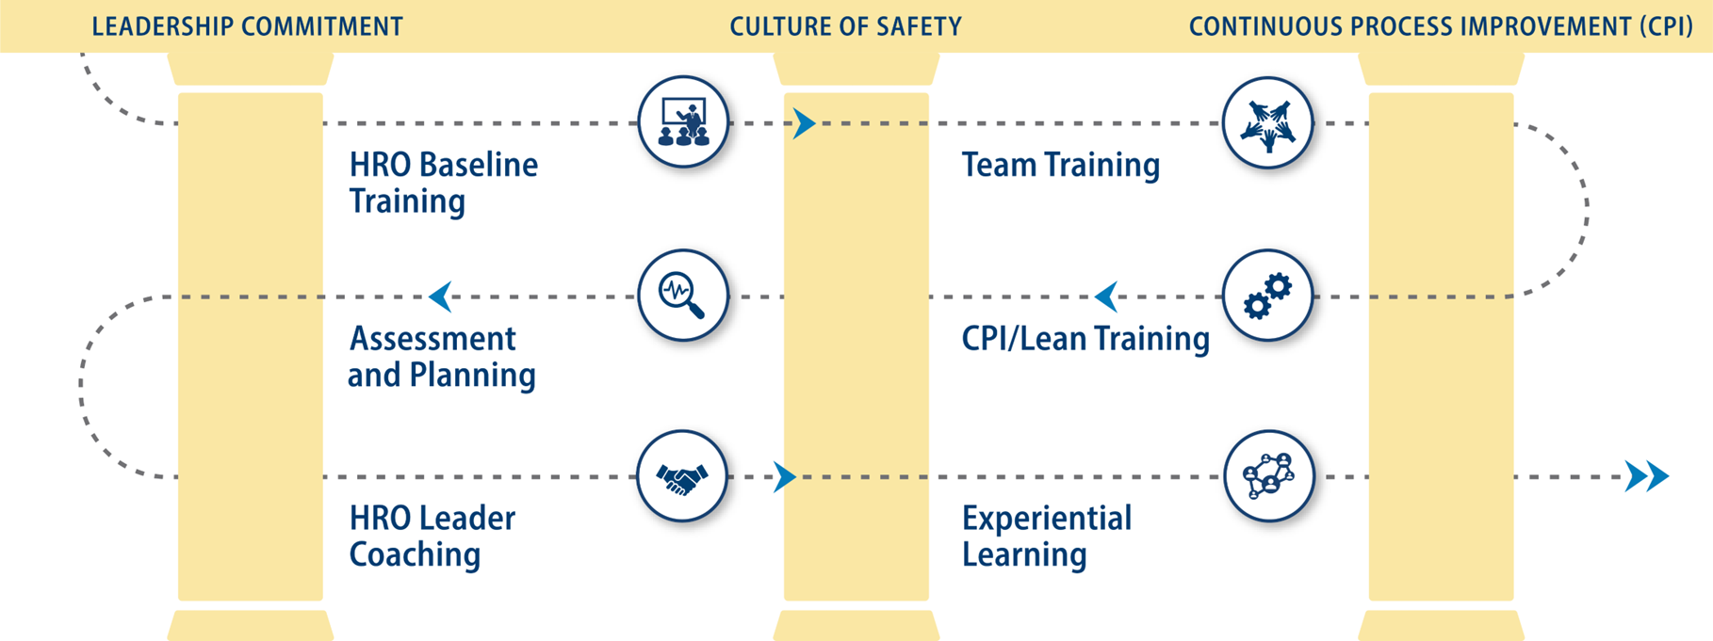
VHA Enterprise HRO Activities
Pre-Decisional Deliberative Document
Internal VA Use Only

Slide 7
VHA Enterprise HRO Activities
Pre-Decisional Deliberative Document
Internal VA Use Only

Slide 8
VHA Enterprise HRO Activities
Pre-Decisional Deliberative Document
Internal VA Use Only

Slide 9
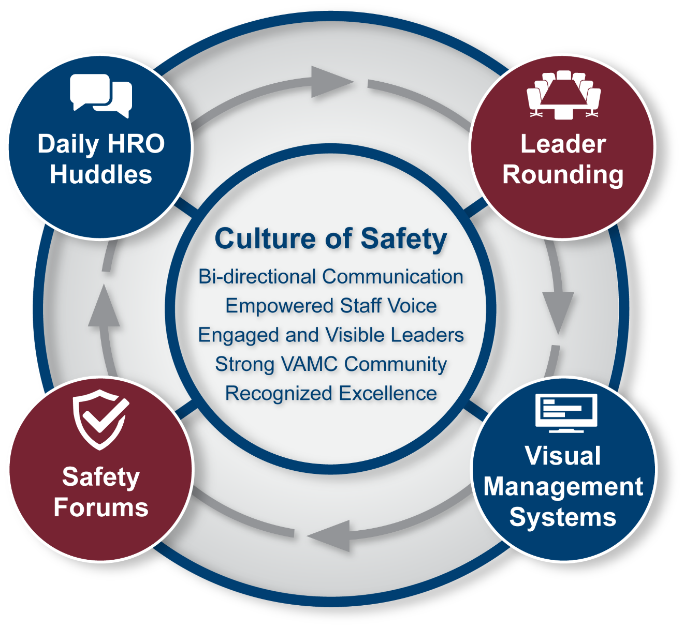
HRO Foundational Practices to Improve Culture
Goal: Curate work environments in which everyone:
a) feels safe to speak up,
b) knows their voice influences what takes place and
c) believes their co-workers care about them
(Leape, 2021, pg. 431)

Slide 10

How does practicing high reliability play a pivotal role in quality and patient safety?
Pre-Decisional Deliberative Document Internal VA Use Only

Slide 11
Can you apply some, or all, of these HRO Principles to your facility or organization?
Pre-Decisional Deliberative Document Internal VA Use Only

Slide 12




Foundational VHA HRO Training
HRO Baseline Training
NCPS Team Training
CPI (Lean) Training
Foundational training in HRO concepts, Just Culture principles and error management tools
Safety behaviors and practices to manage errors and improve team communications
Tools for continuous improvement, applying the Lean improvement methodology
Experiential HRO Learning Opportunities: HRO Learning Ecosystem
HRO 101 and 201
HRO 101: VHA Journey to High Reliability – Overview
HRO 201: Continued VHA Journey to High Reliability – HRO Principles
HRO Community of Practice
Provides user-friendly access to curated materials, learning opportunities and a network of peer-to-peer connections
Knowledge Exchange Site
A streamlined process to track and measure the access and spread of HRO information and identify impact
Pre-Decisional Deliberative Document
Internal VA Use Only

Slide 13
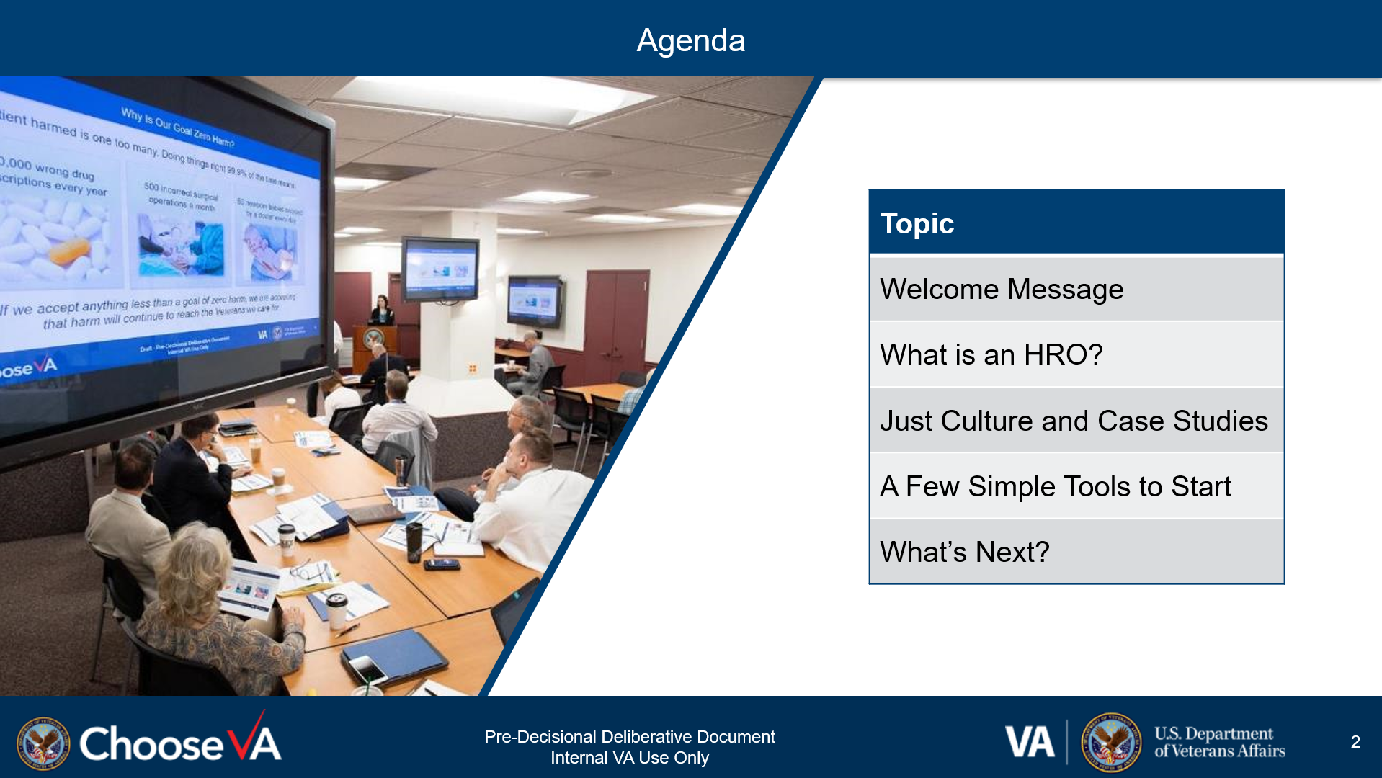
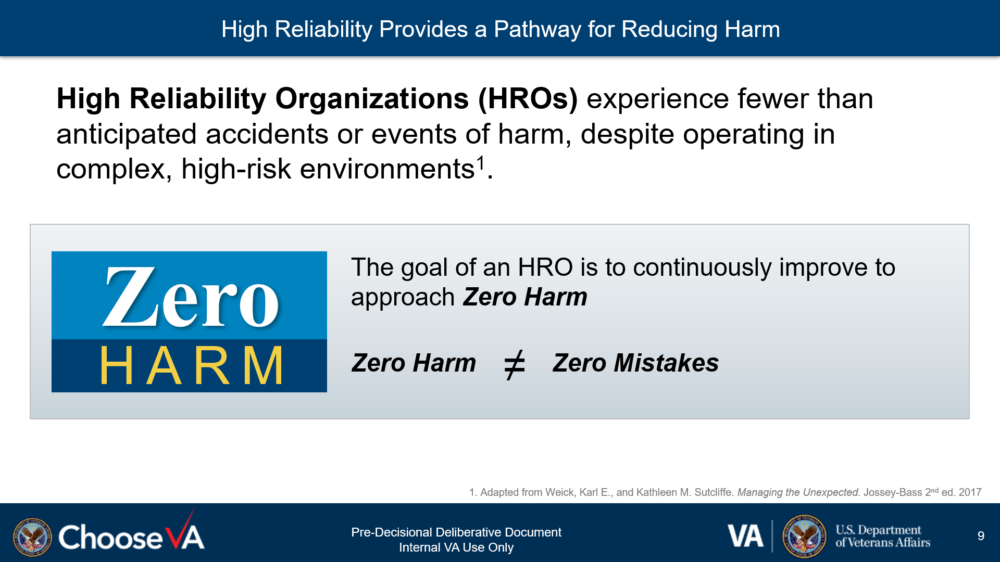
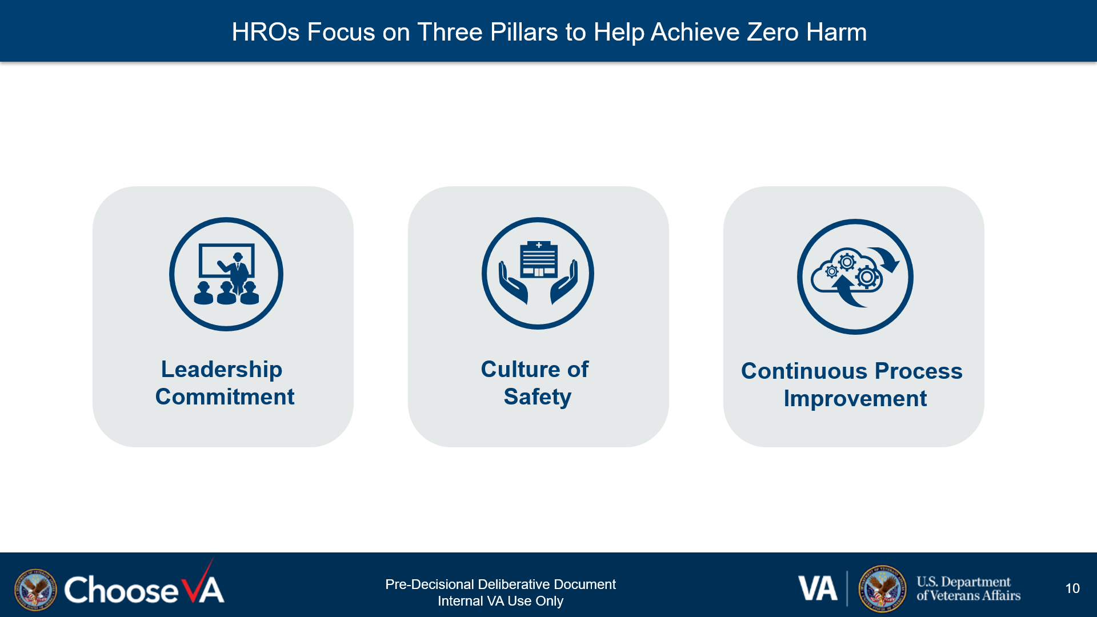
HRO Baseline Training
“I am comfortable identifying and reporting mistakes and feel a sense of responsibility to do so.”
“When something goes wrong, I trust my organization and leaders will correct it and treat everyone in a just and fair manner.”
Pre-Decisional Deliberative Document
Internal VA Use Only

Slide 14
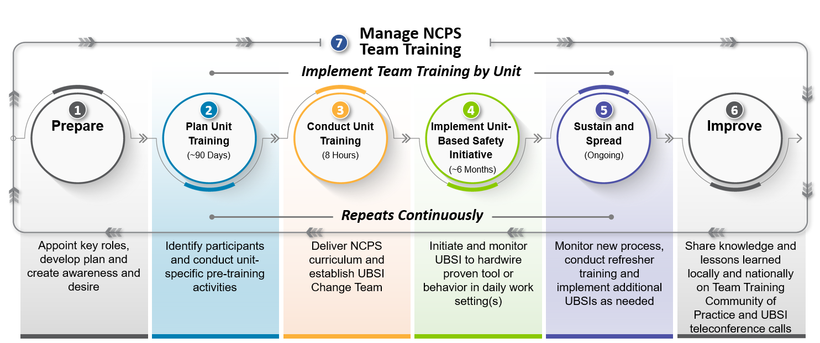
VHA National Center for Patient Safety (NCPS) Team Training
Pre-Decisional Deliberative Document
Internal VA Use Only

Slide 15
Continuous Process Improvement (CPI)/Lean Training
VHA national curriculum is available for the following belted and non-belted Lean training:
Master Black Belt (In Development): Trains and coaches Black and Green Belts; coaches and consults on improvement projects across VISN and/or facility
Black Belt: Trains, coaches and consults with improvement project teams to help guide efforts
Green Belt: Knowledge and skills to lead and manage improvement projects at a unit or department level
Yellow Belt: Knowledge and skills to participate as an improvement project member or lead small projects
White Belt: Introductory knowledge of improvement science and problem solving
Non-belted Lean Training Options:
Leading Organizational Improvement (Executive Leaders)
Lean for Leaders (Supervisors/Managers)
Pre-Decisional Deliberative Document
Internal VA Use Only

Slide 16



HRO Community of Practice (CoP)
Purpose
An inclusive HRO CoP launched on February 1, 2023, to provide HRO implementers (broad group of interested colleagues) across VHA with user-friendly access to curated materials, learning opportunities and a network of peer-to-peer connections. Building a community for connection and sharing enhances Veteran care and focuses our mission around the HRO Value “It’s About the Veteran.”
Broadens access to HRO learning, practice sharing, ideas and knowledge exchange
Fosters inclusion across facilities, VISNs and VHA Program Offices
Strengthens peer-to-peer connections
Aligns with VHA’s HRO Principles and Values

Slide 17
How does the approach to HRO training at VHA compare to patient safety training at your organization?
Pre-Decisional Deliberative Document
Internal VA Use Only

Slide 18
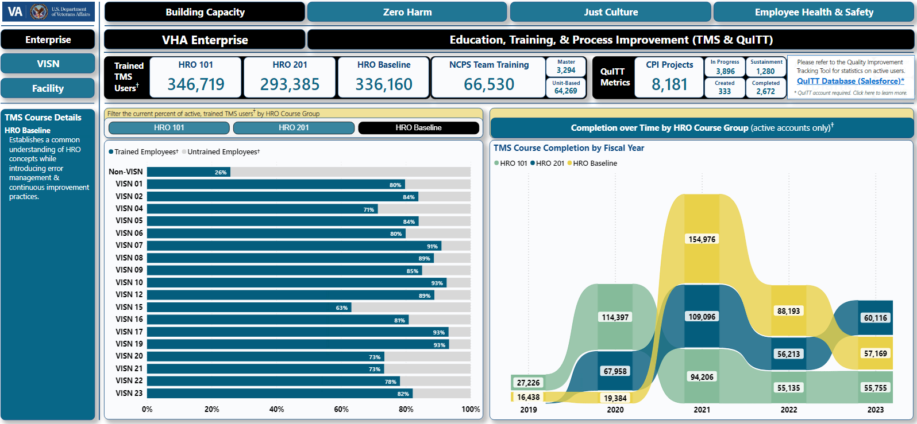
Measuring HRO Transformation: VHA HRO Dashboard
Pre-Decisional Deliberative Document
Internal VA Use Only

Slide 19







HRO Culture Measures and Reporting Trends
Becoming
an HRO
(As of FY23 Q3)
“I am normally one who doesn’t speak up, but now I realize that I NEED to speak up.”
– New VHA staff member at HRO training
Leadership Engagement
Close Call (CC)/Adverse Event (AE) Reporting
Stop the Line
“I have trust and confidence in my supervisor.”
Between FY 19, at the beginning of VHA’s Journey, and FY 22, positive responses to this question rose from 3.94 to 4.06, increasing each year.
“Staff will freely speak up if they see something that may negatively affect patient care.”
All Employee Survey scores for this question steadily increased across all HRO Cohorts.
A high CC/AE reporting ratio may indicate a positive reporting culture in which Close Calls are reported and Adverse Events are prevented.
The health system-wide ratio of CC/AE rose from FY 22 Q2 to FY 23 Q3 (0.66 to 3.43).
These documents or records (or information contained herein) are confidential and privileged under the provisions of 38 U.S.C. § 5705 and its implementing regulations at C.F.R. § 17.500 through 17.511, which provide for fines up to $20,000 for unauthorized disclosures thereof. This material shall not be disclosed to anyone without authorization as provided for by that law or the implementing regulations.

Slide 20

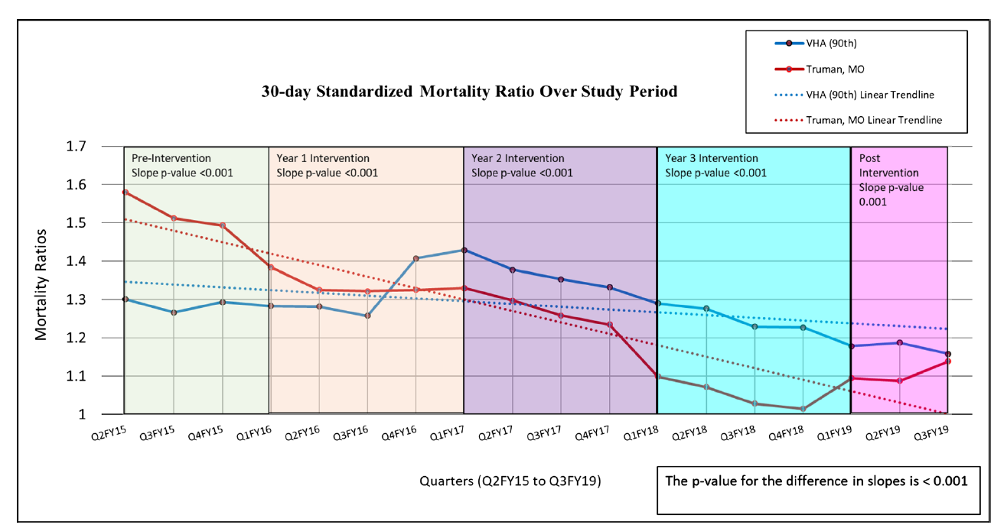
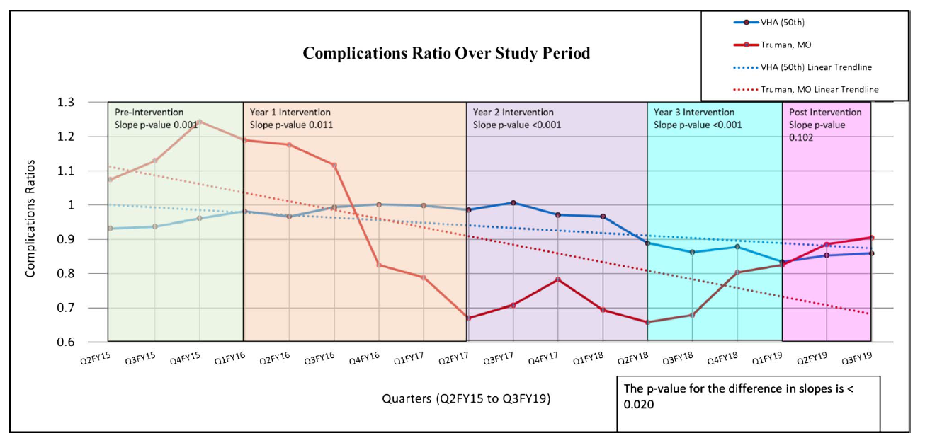
HRO Outcomes Measures – Truman VA Medical Center (VAMC) Study
Achieving Results
(Targeted CPI efforts at Truman VAMC
Jan 2016-Dec 2019)
VHA’s National Center for Patient Safety collaborated with Truman VAMC to implement system-wide HRO activities. The effort resulted in an improved patient safety culture, improved reporting of Patient Safety Events and improved clinical outcomes of Standardized Mortality Ratio and Complication Ratio.
Reference: A High-Reliability Organization Framework for Health Care: A Multiyear Implementation Strategy and Associated Outcomes. Gary L. Sculli, MSN, ATP, Robin Pendley-Louis, DrPH, MPH, CPH, Julia Neily, RN, MS, MPH, Timothy M. Anderson, RN, MS, David B. Isaacks, MA, Regina Knowles, MEd, BSN, RN, Yinong Young-Xu, ScD, MA, MS, and William Gunnar, MD, JD. Journal of Patient Safety. October 2020. doi: 10.1097/PTS.0000000000000788
These documents or records (or information contained herein) are confidential and privileged under the provisions of 38 U.S.C. § 5705 and its implementing regulations at C.F.R. § 17.500 through 17.511, which provide for fines up to $20,000 for unauthorized disclosures thereof. This material shall not be disclosed to anyone without authorization as provided for by that law or the implementing regulations.

Slide 21
What are some key takeaways from today’s webinar that you would like to explore further within your organization?
Pre-Decisional Deliberative Document Internal VA Use Only

