Slide 1
Best Practices in the Diagnosis and Treatment of Sepsis
AHRQ Safety Program for Improving Antibiotic Use
Acute Care
AHRQ Pub. No. 17(20)-0028-EF
November 2019

Slide 2
Objectives
Review approaches to the diagnosis of sepsis
Describe approaches to empiric treatment of sepsis
Recognize when to stop and narrow antibiotic therapy in patients with suspected sepsis
Discuss durations of therapy for patients with sepsis

Slide 3
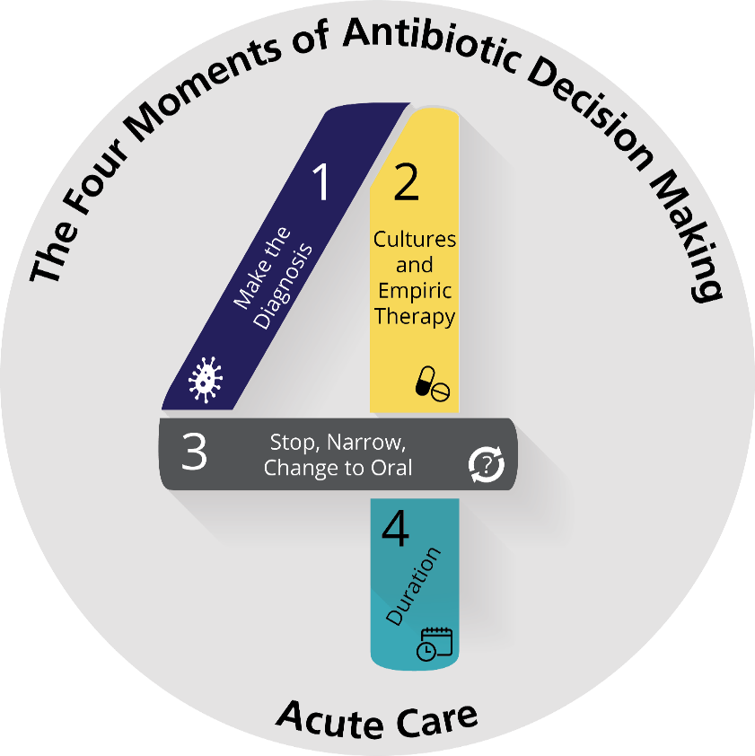
The Four Moments of Antibiotic Decision Making
Does my patient have an infection that requires antibiotics?
Have I ordered appropriate cultures before starting antibiotics? What empiric therapy should I initiate?
A day or more has passed. Can I stop antibiotics? Can I narrow therapy or change from IV to oral therapy?
What duration of antibiotic therapy is needed for my patient’s diagnosis?

Slide 4
The Four Moments of Antibiotic Decision Making
Does my patient have an infection that requires antibiotics?

Slide 5
Moment 1: Diagnosing Sepsis
Sepsis is a syndrome caused by the host response to an infection
Severe sepsis: associated organ dysfunction
Septic shock: associated hemodynamic instability
Sepsis diagnostic approaches continue to evolve¹
Systemic inflammatory response syndrome (SIRS)-based
Sequential organ failure assessment (SOFA)-based
Quick SOFA (qSOFA) criteria: altered mentation, systolic blood pressure ≤ 100 mmHg, respiratory rate ≥ 22 breaths per minute
Ongoing discussion of how to diagnose sepsis

Slide 6
Moment 1: Diagnosing Sepsis
Accurate diagnosis in a timely fashion can be challenging¹
TIME 1
TIME 2
TIME 3

Slide 7
The Four Moments of Antibiotic Decision Making
Does my patient have an infection that requires antibiotics?
Have I ordered appropriate cultures before starting antibiotics? What empiric therapy should I initiate?

Slide 8
Sepsis: Cultures
Blood cultures before antibiotics
Obtain cultures from other suspected sites of infection

Slide 9
Sepsis: Antibiotic Timing
Antibiotics should be given as quickly as possible after sepsis is recognized
Study of 49,331 patients with sepsis/septic shock with sepsis protocol initiated within 6 hours after arrival in the ED and completed within 3 hours²
Median time to antibiotic administration was 0.95 hours
For each hour that antibiotic administration was delayed there was a 4% increase in risk adjusted in-hospital mortality
This finding was driven mainly by patients who required vasopressors—those with septic shock

Slide 10
Sepsis: Antibiotic Timing²
From N Engl J Med, Seymour CW, Gesten F, Prescott HC, et al. Time to treatment and mortality during mandated emergency care for sepsis, 376: 2235-44. ©2017
Massachusetts Medical Society. Reprinted with permission from Massachusetts
Medical Society.

Slide 11
Sepsis: Considerations When Making Empiric Choices
Source of infection
Vancomycin covers MRSA and is not always needed
Community-acquired pneumonia
Intra-abdominal infections
Urinary tract infections
Nonpurulent cellulitis
Anti-pseudomonal coverage is not always needed
Community-acquired pneumonia
Community-acquired intra-abdominal, skin and soft tissue, and urinary tract infections
The patient’s severity of illness
The patient’s past infections and previous antibiotic exposure³
The patient’s travel history and exposures

Slide 12
Sepsis: Role of Combination Empiric Therapy
Theories about combination therapy
Increases the likelihood that the infecting pathogen will be covered
Utility depends on knowing the additive benefit of the second agent at the institution or unit level
Prevention of emergence of resistance
Synergistic effect → faster killing
Nonspecific immunomodulatory effect

Slide 13
Combination Antibiograms To Assess the Potential Benefit of Combination Therapy⁴
Agent | Monotherapy | Tobramycin | Ciprofloxacin
Cefepime | 82% | 93% | 84%
Meropenem | 83% | 93% | 83%
Piperacillin/tazobactam | 78% | 92% | 80%

Slide 14
Combination Therapy: Original Data
Retrospective, multicenter propensity matched cohort study found that combination therapy was associated with a decreased 28-day mortality in septic shock⁵
64% survival with monotherapy
71% survival with combination therapy
Monotherapy: 887 (30%) received a narrow-spectrum agent: (e.g., vancomycin, macrolide, clindamycin, anti-staphylococcal penicillins, 1st/2nd generation cephalosporins
Combination therapy: any two of beta-lactam or vancomycin, aminoglycoside, quinolone, macrolide, clindamycin

Slide 15
Combination Therapy: Original Data
 | Monotherapy | Combination Therapy | Hazard Ratio (95% CI)
 | # deaths/total (%)
β-Iactams | 339/930 (36.5%) | 260/928 (28%) | 0.73 (0.62–0.86)
Penicillins | 142/391 (36.3%) | 118/400 (29.5%) | 0.79 (0.62–1.00)
Penicillin/ampicillin | 27/62 (43.6%) | 22/71 (31.0%) | 0.68 (0.39–1.20)
Anti-staph penicillin | 19/40 (47.5%) | 11/36 (30.6%) | 0.56 (0.27–1.18)
β-lactam/inhibitor | 96/289 (33.2%) | 85/293 (29.0%) | 0.85 (0.64–1.14)
Cephalosporins | 196/538 (38.6%) | 139/511 (26.6%) | 0.69 (0.55–0.85)
1st Gen Ceph | 8/21 (28.1%) | 1/18 (5.6%) | 0.12 (0.02–0.99)
2nd Gen Ceph | 23/60 (38.3%) | 10/62 (16.1%) | 0.38 (0.18–0.81)
Non-Ps 3rd Gen Ceph | 113/339 (33.3%) | 83/332 (25.0%) | 0.71 (0.54–0.94)
Anti-Ps 3rd/4th Gen Ceph | 53/119 (44.5%) | 48/116 (41.4%) | 0.89 (0.60–1.31)
Carbapenems | 56/154 (36.4%) | 52/152 (34.2%) | 0.95 (0.65–1.38)
Vancomycin | 32/82 (39.0%) | 27/76 (35.5%) | 0.89 (0.53–1.49)
Fluoroquinolones | 14/50 (28.0%) | 15/60 (25.0%) | 0.90 (0.44–1.87)
Macrolide/clindamycin | 3/6 (50.0%) | 1/6 (16.7%) | 0.30 (0.03–2.89)

Slide 16
Combination Therapy: More Recent Data
Meropenem plus moxifloxacin in severe sepsis/septic shock⁶
RCT in 44 German ICUs
298 patients received meropenem alone
302 patients received meropenem and moxifloxacin
No difference in mean daily SOFA score over 14 days (primary outcome)
No difference in 28-day or 90-day all-cause mortality

Slide 17
Combination Therapy: More Recent Data
Beta-lactam plus gentamicin in severe sepsis/septic shock⁷
Prospective cohort in 2 Dutch ICUs
403 patients received no gentamicin
245 patients received gentamicin
Median of 2 days
Most patients had an intra-abdominal source
Minimal resistance to beta-lactams (< 10%)
No difference in shock duration or 14-day mortality
Association with renal failure (OR 1.39, 95% CI 1.00–1.94)

Slide 18
Combination Therapy Summary
Consider empiric combination antibiotic therapy for suspected Gram-negative bacteremia/sepsis when local epidemiology suggests a second agent can be helpful and the patient has septic shock, or if there is strong concern that the patient is infected with a resistant Gram-negative organism
Generally will be an aminoglycoside given fluoroquinolone resistance

Slide 19
The Four Moments of Antibiotic Decision Making
Does my patient have an infection that requires antibiotics?
Have I ordered appropriate cultures before starting antibiotics? What empiric therapy should I initiate?
A day or more has passed. Can I stop antibiotics? Can I narrow therapy or change from IV to oral therapy?

Slide 20
Sepsis: De-escalation
De-escalation, either stopping or narrowing antibiotics, should be considered a critical component of sepsis management⁸
Daily assessment of patient status, source of infection, and culture results
Three scenarios:
No evidence of infection and antibiotics can be stopped
Evidence of infection and culture data are available to guide narrowing of therapy
Evidence of infection and no culture data are available

Slide 21
Stopping Antibiotics Started Empirically
If there is not evidence to support bacterial infection after additional workup, and there is a plausible alternative explanation for the signs and symptoms that the patient presented with, then strongly consider stopping antibiotics.
There is no requirement to “complete a course of antibiotics” just because they were started empirically.

Slide 22
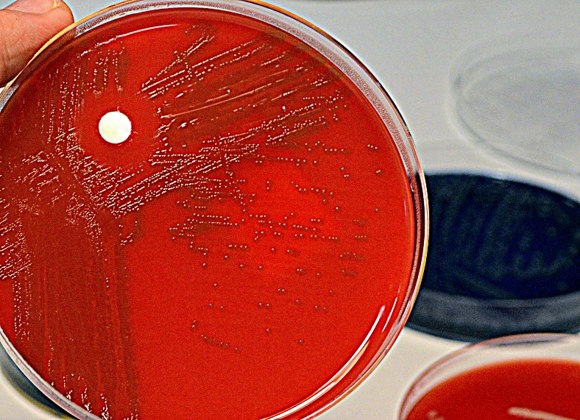
Narrowing Antibiotics Started Empirically
If the patient has an infection and cultures have grown, narrow based on culture results

Slide 23
Narrowing Antibiotics Started Empirically
If the patient has an infection and cultures have not grown, consider the following
Stop any combination therapy directed at Gram negatives that was started empirically
MRSA and Pseudomonas grow easily in cultures and if they are not isolated, coverage for them can generally be stopped
If cultures from blood and urine obtained before antibiotics were started are not growing organisms, there is probably not bacteremia or a UTI

Slide 24
Use of Negative MRSA Nasal Swabs To Guide Vancomycin Discontinuation
Evaluation of the proportions of patients with positive and negative MRSA nasal surveillance swabs upon ICU admission who subsequently developed MRSA infections during the same hospitalization.⁹
Patient Encounters (12,215)
Excluded: Prior MRSA colonization/infection; no swab
MRSA-positive swabs
n=441 (4%)
MRSA-negative swabs
n=11,441 (96%)
Treated for MRSA infection during current admission
n=65 (15%)
Treated for MRSA infection during current admission
n=25 (0.22%)

Slide 25
Is Antibiotic De-escalation Safe?
Study | Relative risk of mortality (95% confidence interval)
Alvarez-Lerma, 2006 | 0.58 (0.24–1.42)
Giantsou, 2007 | 0.16 (0.05–0.51)
Eachempati, 2009 | 1.08 (0.69–1.71)
De Waele, 2010 | 0.35 (0.08–1.52)
Morel, 2010 | 0.74 (0.38–1.45)
Joung, 2011 | 0.16 (0.02–1.2)
Heenan, 2012 | 0.72 (0.36–1.41)
Gonzalez, 2013 | 0.91 (0.52–1.59)
Knack, 2013 | 0.39 (0.2–0.75)
Mokart, 2014 | 0.52 (0.22–1.23)
Garnacho-Montero, 2014 | 0.68 (0.5–0.93)
Leone, 2014 | 1.34 (0.72–2.47)
Paskovaty, 2015 | 0.79 (.037–1.7)
Overall relative risk of mortality | 0.68 (0.52–0.88)
De-escalation of antibiotics led to a 28% reduced risk of death compared to no de-escalation.¹⁰

Slide 26
Procalcitonin
Elevated in inflammation
Sepsis
But also burns, heat stroke, pancreatitis, major surgery
In ICU patients with suspected sepsis, studied both as a trigger to initiate or escalate therapy and to stop therapy

Slide 27
PCT-Guided Antibiotic Initiation/Escalation
RCT of 1,200 adult ICU patients who received treatment according to guidelines (control) or according to daily PCT and escalation algorithm¹¹
No difference in 28-day mortality (32% vs 32%)
LOS increased by 1 day and ventilation by 5% in PCT group
Significant increases in meropenem, piperacillin/tazobactam and ciprofloxacin use

Slide 28
PCT-Guided Antibiotic De-escalation
Several studies with different sizes, populations, and PCT algorithms
Common limitations
Poor algorithm compliance
Use of PCT plus C-reactive protein
Very limited data from U.S. sites

Slide 29
Impact of Use of PCT on Mortality and Antibiotic Duration
Cochrane systematic review of 10 trials with 1,215 patients¹²
No significant difference in mortality with PCT vs without PCT: 22% vs 26% (RR 0.81, 95% CI 0.65–1.01)
1.3 days fewer antibiotics with PCT
Patient-level meta-analysis of 11 trials with 4,482 patients¹³
Significant difference in mortality with PCT vs without PCT: 21% vs 24% (aOR 0.89, 95% CI 0.8–0.99)
1.2 days fewer antibiotics with PCT (9 vs 10 days)
Meta-analysis of 16 trials with 5,000 patients¹⁴
Significant difference in mortality with PCT vs without PCT: RR 0.89, 95% CI 0.83–0.97
No statistically significant mortality reduction in studies including patients with clear sepsis, > 80% protocol adherence, and in which PCT was the only biomarker used
1.3 days fewer antibiotics with PCT

Slide 30
PCT Summary
PCT has not been shown to be useful in guiding decision to start or escalate antibiotic therapy in ICU patients with sepsis.
PCT-based algorithms to guide de-escalation can lead to modest reductions in antibiotic use in ICU patients.
Strategy used should be developed by end-users and periodic evaluation of compliance with algorithm is advisable
Given the long courses of antibiotics seen in studies of PCT (~9 days), critical evaluation of need for continuing antibiotics on a daily basis may allow for the same or greater reductions in antibiotic use.

Slide 31
The Four Moments of Antibiotic Decision Making
Does my patient have an infection that requires antibiotics?
Have I ordered appropriate cultures before starting antibiotics? What empiric therapy should I initiate?
A day or more has passed. Can I stop antibiotics? Can I narrow therapy or change from IV to oral therapy?
What duration of antibiotic therapy is needed for my patient's diagnosis?

Slide 32
Duration of Therapy
If you know what you are treating and patient has steady improvement
If you don’t know what you are treating and the patient has steady improvement, 7 days is likely an adequate course
If the patient is not improving, then additional evaluation is required
Disease Process | Duration
Community-acquired pneumonia | 5-7 days
Hospital/healthcare-acquired pneumonia | 7 days
Ventilator-associated pneumonia | 7 days
Urosepsis | 7 days
Pyelonephritis | 7 days
Skin and soft-tissue infection | 5-7 days
Intra-abdominal infection with source control | 4 days

Slide 33
Improving Prescribing for Sepsis at Your Hospital
Antibiotics are often initiated in the setting of diagnostic uncertainty
Antibiotic stewardship teams and frontline clinicians should take an active role in optimizing antibiotic therapy throughout the Four Moments of Antibiotic Decision Making
Moment 1: assist with development of tools for early detection
Moment 2: ensure strategies are in place to so that patients receive appropriate antibiotics in a timely fashion when they are needed, such as by using guidelines and order sets
Moment 3: develop approaches to ensure that frontline providers re-assess antibiotic choice and need on a daily basis and develop approaches and algorithms to assist with interpretation of rapid diagnostic tests and biomarkers
Moment 4: develop recommendations for duration of therapy

Slide 34
Summary
The diagnosis of sepsis is challenging due to the lack of a gold standard diagnostic tool or algorithm; thus there is often clinical uncertainty.
Empiric treatment of sepsis should be based on the suspected source of infection, the severity of illness of the patient, and local data on antibiotic susceptibility and should be started in a timely fashion.
Stewardship teams and prescribers should actively work to narrow therapy in patients with sepsis who improve on therapy and stop antibiotics when a bacterial infection is no longer suspected.

Slide 35
Disclaimer
The findings and recommendations in this presentation are those of the authors, who are responsible for its content, and do not necessarily represent the views of AHRQ. No statement in this presentation should be construed as an official position of AHRQ or of the U.S. Department of Health and Human Services.
Any practice described in this presentation must be applied by health care practitioners in accordance with professional judgment and standards of care in regard to the unique circumstances that may apply in each situation they encounter. These practices are offered as helpful options for consideration by health care practitioners, not as guidelines.

Slide 36
References
Singer M, Deutschman CS, Seymour CW, et al. The Third International Consensus Definitions for Sepsis and Septic Shock (Sepsis-3). JAMA. 2016 Feb 23;315(8):801-10. PMID: 26903338.
Seymour CW, Gesten F, Prescott HC, et al. Time to treatment and mortality during mandated emergency care for sepsis. N Engl J Med. 2017 Jun 8;376(23): 2235-44. PMID: 28528569.
Bhat S, Fujitani S, Potoski BA, et al. Pseudomonas aeruginosa infections in the intensive care unit: can the adequacy of empirical beta-lactam antibiotic therapy be improved? Int J Antimicrob Agents. 2007 Nov;30(5):458-62. PMID: 17703923.
Pogue JM, Alaniz C, Carver PL, et al. Role of unit-specific combination antibiograms for improving the selection of appropriate empiric therapy for Gram-negative pneumonia. Infect Contr Hosp Epidemiol. 2011 Mar;32(3):289-92. PMID: 21460516.
Kumar A, Zarychanski R, Light B, et al. Early combination antibiotic therapy yields improved survival compared with monotherapy in septic shock: a propensity-matched analysis. Crit Care Med. 2010 Sep;38(9):1773-85. PMID: 20639750.

Slide 37
References
Brunkhorst FM, Oppert M, Marx G, et al. Effect of empirical treatment with moxifloxacin and meropenem vs meropenem on sepsis-related organ dysfunction in patients with severe sepsis: a randomized trial. JAMA. 2012 Jun 13;307(22): 2390-9. PMID: 22692171.
Ong DSY, Frencken JF, Klein Klouwenberg PMC, et al. Short-course adjunctive gentamicin as empirical therapy in patients with severe sepsis and septic shock: a prospective observational cohort study. Clin Infect Dis. 2017 Jun 15;64(12):1731-6. PMID: 28329088.
Dellinger RP, Levy MM, Rhodes A, et al. Surviving sepsis campaign: international guidelines for management of severe sepsis and septic shock. Crit Care Med. 2013 Feb;41(2):580-637. PMID: 23353941.
Chotiprasitsakul D, Tamma PD, Gadala A, et al. The role of negative methicillin-resitant Staphylococcus aureus nasal surveillance swabs in predicting the need for empiric vancomycin therapy in intensive care unit patients. Infect Control Hosp Epidemiol. 2018 Mar;39(3):290-96. PMID: 29374504.

Slide 38
References
Tabah A, Cotta MO, Garnacho-Montero J, et al. A systematic review of the definitions, determinants, and clinical outcomes of antimicrobial de-escalation in the intensive care unit. Clin Infect Dis. 2016 Apr 15;62(8):1009-17. PMID: 26703860.
Jensen JU, Hein L, Lundgren B, et al. Procalcitonin-guided interventions against infections to increase early appropriate antibiotics and improve survival in the intensive care unit: a randomized trial. Crit Care Med. 2011 Sep;39(9):2048-58. PMID: 21572328.
Andriolo BN, Andriolo RB, Salomão R, et al. Effectiveness and safety of procalcitonin evaluation for reducing mortality in adults with sepsis, severe sepsis or septic shock. Cochrane Database Syst Rev. 2017 Jan 18;1:CD010959. PMID: 28099689.
Wirz Y, Meier MA, Bouadma L, et al. Effect of procalcitonin-guided antibiotic treatment on clinical outcomes in intensive care unit patients with infection and sepsis patients: a patient-level meta-analysis of randomized trials. Crit Care. 2018 Aug 15;22(1):191. PMID: 30111341.

Slide 39
References
Pepper DJ, Sun J, Rhee C, et al. Procalcitonin-guided antibiotic discontinuation and mortality in critically ill adults: a systematic review and meta-analysis. Chest. 2019 Feb 14. pii: S0012-3692(19)30154-0. PMID: 30772386.

