Slide 1
High-Level Data Analysis Presentation Slide Deck
October 15, 2013
Sari Siegel, Ph.D.
Project Director
ARRA CER Dissemination Evaluation

Slide 2
Overview
Quarterly Metrics
Continuing Education Retention Test Analysis
Web and Clearinghouse Report
Survey
  Consumer
  Clinician
Focus Groups
  Consumer
  Clinician
  Business Leader/Purchaser
Summary

Slide 3
Quarterly Metrics
Reach and Dissemination

Slide 4
Quarterly Metrics
As part of the ARRA CER Dissemination Evaluation, IMPAQ/Battelle collects:
  Quarterly metrics on dissemination activities and audience exposure to PCOR from the four dissemination contractors (Academic Detailing, Continuing Education, National Initiative, and Regional Offices)
  Quarterly data on EHC Program Web site traffic and AHRQ Publications Clearinghouse orders

Slide 5
Cumulative Exposures by Dissemination Strategy
Academic Detailing
11,667 Exposures
10,203
Detailing Visits
Continuing Education
61,297 Exposures
45
CE Modules
Media and Marketing
111,967 Exposures
133
Completed Projects
Partnerships
38,949,853 Exposures
1,417
Partner Activities
Virtual Centers
1,870,663 Exposures
20 Virtual Centers

Slide 6
Cumulative Exposures from All Strategies by Audience
Audience | Total Exposures
Consumers | 7,131,478
Clinical Decisionmakers | 5,270,264
Health System Decisionmakers | 2,022
Other Health Care Professionals | 28,901
Unspecified | 28,572,782
Total | 41,005,447

Slide 7
Academic Detailing
 | FY11 Q2 | FY11 Q3 | FY11 Q4 | FY12 Q1 | FY12 Q2 | FY12 Q3 | FY12 Q4 | FY13 Q1 | FY13Q2 | FY13 Q3 Plus July
Unique Sites | 98 | 443 | 429 | 661 | 678 | 685 | 753 | 680 | 900 | 1,483
Detailing Visits | 98 | 443 | 471 | 1,099 | 1,060 | 1,196 | 1,437 | 1,147 | 1,145 | 2,107
Exposures | 145 | 583 | 608 | 1,199 | 1,228 | 1,414 | 1,599 | 1,324 | 1,289 | 2,278

Slide 8
Continuing Education
 | FY11 Q2 | FY11 Q3 | FY11 Q4 | FY12 Q1 | FY12 Q2 | FY12 Q3 | FY12 Q4 | FY13 Q1 | FY13 Q2 | FY13 Q3 Plus July
Modules Released | 4 | 2 | 6 | 5 | 10 | 9 | 8 | 0 | 0 | 1
Learners This Period | 0 | 1,061 | 1,745 | 2,685 | 3,307 | 3,076 | 3,348 | 3,296 | 3,297 | 3,805
Course Completions | 0 | 1,776 | 2,951 | 5,187 | 6,779 | 8,280 | 8,672 | 9,402 | 8,902 | 9,348

Slide 9
Media and Marketing
 | FY11 Q2 | FY11 Q3 | FY11 Q4 | FY12 Q1 | FY12 Q2 | FY12 Q3 | FY12 Q4 | FY13 Q1 | FY13 Q2 | FY13 Q3 Plus July
Completed Projects | 1 | 6 | 9 | 15 | 4 | 16 | 19 | 15 | 18 | 30
Potential Exposures | - | - | 4,086,519 | 9,465,714 | 1,874,995 | 4,307,154 | 4,637,516 | 4,723,930 | 3,835,529 | 66,303,384
Documented Exposures | 46 | 1,625 | 5,032 | 18,040 | 6,523 | 13,567 | 13,094 | 10,481 | 8,566 | 34,993

Slide 10
Dissemination Partnerships
 | FY11 Q2 | FY11 Q3 | FY11 Q4 | FY12 Q1 | FY12 Q2 | FY12 Q3 | FY12 Q4 | FY13 Q1 | FY13 Q2 | FY13 Q3 Plus July
Partners with Activity | 0 | 9 | 71 | 78 | 69 | 90 | 115 | 142 | 101 | 218
Activities | 0 | 9 | 120 | 103 | 92 | 139 | 152 | 233 | 144 | 425
Exposures | 292 | 2,030,451 | 1,742,282 | 4,194,675 | 3,937,185 | 3,290,273 | 3,352,345 | 7,923,213 | 740,654 | 11,738,483

Slide 11
Virtual Centers
 | FY13 Q2 | FY13 Q3 Plus July
New Virtual Centers Launched this Period | 9 | 11
Potential Exposures | 11,870,401 | 57,868,397
Documented Exposures | 637,204 | 1,233,459

Slide 12
Continuing Education Retention Test Analysis

Slide 13
Continuing Education Retention Tests
Learners were generally more likely to answer content questions correctly after taking a CE module
More learners rated their confidence in applying PCOR as “high” after taking a module
More learners rated their perceived value of PCOR as “high” after taking a module

Slide 14
Continuing Education Retention Tests: Confidence in Applying PCOR
High
Low
2011-2012
2012-2013
* Statistically significant difference from pre-test

Slide 15
Continuing Education Retention Tests: Perceived Value of PCOR
High
Low
2011-2012
2012-2013
* Statistically significant difference from pre-test

Slide 16
Web and Clearinghouse Reports

Slide 17
EHC Program Web Site Visits
CY 2009* through CY 2013 Totals
Calendar Year | Total Number of Visits
2009 (Nov-Dec) | 86,739
2010 | 567,650
2011 | 858,922
2012 | 1,822,343
2013 (through July) | 1,903,058
* The Eisenberg Center took over the EHCP Web site contract in November 2009; CY 2010 is the full first year of data available.

Slide 18
Total Web Site Visits Since Start of Dissemination Contracts
* This total includes visits from April-July 2013.

Slide 19
Clearinghouse Results
Between January 2011 and July 2013:
  Audience members placed 661 major orders (representing 56 percent of all major orders in this time frame) to the Publications Clearinghouse using contractor codes
  Result: 171,665 ordered units (53 percent of the product volume from large orders in this time frame)

Slide 20
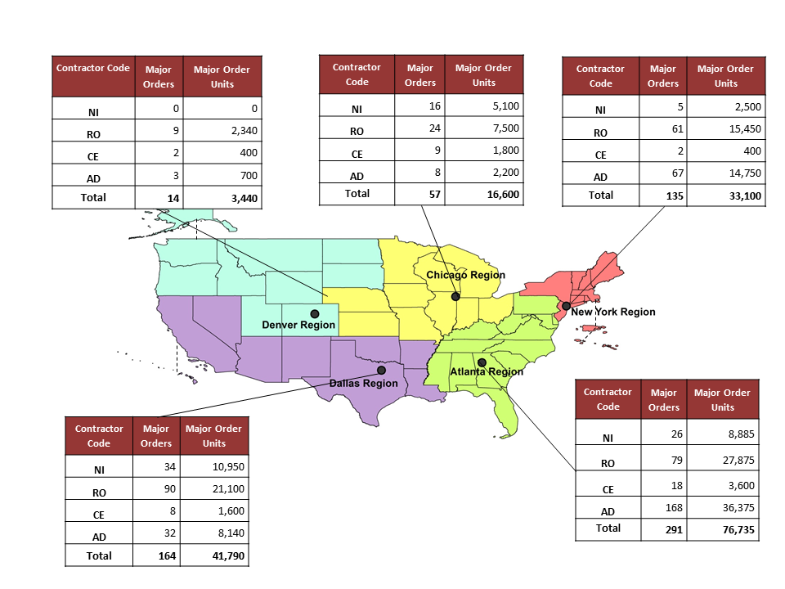
Distribution of Major Orders Placed Using Contractor Codes

Slide 21
Consumer and Clinician Surveys
Understanding, Knowledge, Use,
and Benefits

Slide 22
Surveys: Background
Team developed one instrument for consumers and one for clinicians
Data collection was completed at two points in time one year apart (Wave 1 and Wave 2)
Surveys were designed to assess:
  Levels of awareness, understanding, use, and perceived benefits of CER
  If and how levels of awareness, understanding, use, and perceived benefits of CER have changed
  Trends in awareness of AHRQ and its EHC Program

Slide 23
Consumer Survey Findings (Wave 1 )
18% of surveyed consumers reported awareness of CER when prompted with a definition
Of those who indicated aided awareness of CER, just over half (56%) currently use the research to help make medical decisions
The most common sources of information of CER were health care providers (29%), Web sites (26%), and print media (24%)
Very few surveyed consumers had heard of AHRQ (4%) or the EHC Program (4%); just under 1% had used its products

Slide 24
Consumer Survey Findings (Wave 2)
21% of surveyed consumers reported awareness of CER when prompted with a definition
Of those who indicated aided awareness of CER, just over half (52%) currently use the research to help make medical decisions
The most common sources of information of CER were printed media (21%), Web Sites (19%), television/radio (19%) and health care providers (18%)
Very few surveyed consumers had heard of AHRQ (11%) or the EHC Program (7%); just under 3% had used its products

Slide 25
Consumer Survey Findings (Longitudinal)
Consumers’ unaided and aided awareness of CER increased over time (61% to 65%, 18% to 21% respectively), although the increase was not statistically significant
Consumers reported a statistically significant increase in awareness of AHRQ from wave 1 to wave 2 (4% to 11%)
Consumers reported an increased awareness of the EHC Program from Wave 1 to Wave 2 (4% to 7%), although this increase was not statistically significant

Slide 26
Consumer Survey Findings (Longitudinal con’t)
Consumer interest in learning more about CER increased over time (37% to 51%) and was statistically significant
There was a statistically significant increase in interest in learning about the EHC Program over time (44% to 58%)
Consumers reported an increased intention to use AHRQ’s products or other studies to inform decisionmaking (39% to 45%), although the increase was not statistically significant

Slide 27
Clinician Surveys
Understanding, Knowledge, Use,
and Benefits

Slide 28
Clinician Survey Findings (Wave 1)
18% of clinician respondents indicated awareness of CER when prompted with its name
  A larger portion of clinicians indicated awareness of PCOR (46%) or evidence-based medicine (93%)
The most common sources of exposure to CER were medical or science journal article (23%), conference or professional meeting (17%), and a continuing education course (10%)
One-third (33%) of surveyed clinicians were aware of AHRQ
  The vast majority of clinicians (92%) were unaware of the EHC Program
Slightly over half of clinicians indicated interest in learning more about CER (54%) or the EHC Program (57%)

Slide 29
Clinician Survey Findings (Wave 2)
20% of clinician respondents indicated awareness of CER when prompted with its name
  A larger portion of clinicians indicated awareness of PCOR (49%) or evidence-based medicine (94%)
The most common sources of exposure to CER were medical or science journal article (24%), conference or professional meeting (17%), and a continuing education course (11%)
One-third (38%) of surveyed clinicians were aware of AHRQ
  The vast majority of clinicians (88%) were unaware of the EHC Program
Slightly over half of clinicians indicated interest in learning more about CER (54%) or the EHC Program (57%).

Slide 30
Clinician Survey Findings (Longitudinal)
Clinicians’ aided awareness of CER increased over time (18% to 20%), although the increase was not statistically significant
Clinicians reported a statistically significant increase in awareness of AHRQ from Wave 1 to Wave 2 (33% to 38%)
Clinicians also reported a statistically significant increase in awareness of the EHC Program (8% to 12%)

Slide 31
Clinician Survey Findings (Longitudinal con’t)
Interest in learning more about CER and about the EHC Program increased over time, although the change was not significant
Of those who had heard of the EHC Program Web site, the number of clinicians who reported visiting the EHCP Web site increased statistically significantly between the two survey administrations (28% to 41%)
Clinicians reported a slight increase in their intention to use EHC Program clinician products in the near future, although the change was not statistically significant

Slide 32
Focus Groups
Understanding, Knowledge, Use,
and Perceived Benefits

Slide 33
Focus Groups
Focus groups were conducted with the following stakeholder groups:
Consumers/patients
Clinicians
Business Leaders/Purchaser

Slide 34
Consumer Focus Group Findings
A majority of participants expressed interest in CER and noted that they plan to use CER (from AHRQ and other reliable sources) to inform future medical decisions
Aware participants used online medical information more frequently and robustly than unaware participants to inform medical decisions
Unaware participants relied heavily on medical professionals for medical information and used online medical sources to supplement this information
To help make medical decisions, participants most frequently desired an assessment of the pros, cons, and costs of available treatment options
Almost all participants approved of the government’s role in sponsoring CER and the EHC Program

Slide 35
Clinician Focus Group Findings
While clinicians rely on several information sources, they rely on those with which they have developed a comfort level and will continue to use that source, often to the exclusion of other new and potentially useful sources
Clinicians are cautious about biases or conflicts of interest from information sources, including commercial and government-sponsored research
The majority of clinicians had little to no experience with the EHC Program
To increase interest in the EHC Program, clinicians suggested that AHRQ more visibly promote the benefits and credibility of EHC Program-sponsored CER, and then integrate the results and products into existing, easy-to-access sources of medical information, with special emphasis on packaging to support point-of-care decisionmaking

Slide 36
Business Leader Findings
All participants indicated awareness either specifically of CER or generally of research that compares treatment options
Most focus group participants indicated awareness of AHRQ; several had heard of AHRQ’s EHC Program
Those participants familiar with CER attributed their awareness to the ACA, AHRQ, and business-focused coalitions
Participants’ organizations did not disseminate information on CER specifically; however, organizations did share general health care information with their employees and members
Participants were interested in how employers can use CER to help prepare employees make medical decisions and affect outcomes for specific diagnoses (including arthritis, obesity, diabetes, cancer, and cardiovascular conditions)

Slide 37
Summary
The findings from our multiple data sources (dissemination contractor metrics, Web and Clearinghouse metrics, and surveys and focus groups with target audiences) indicate interest in CER/PCOR and a growing engagement with AHRQ’s brand of this research.
As the dissemination contractors increased their efforts over time, we saw corresponding increase in the number of exposures to the EHC Program. These exposures lead to measurable outcomes of engagement with EHC Program products, including the fact that the majority of large-volume Clearinghouse orders referenced a dissemination contractor code.
Survey and focus group data show that clinicians, consumers, and business leaders are interested in CER to inform medical decisions. Similarly, these audiences have had some exposure to AHRQ’s EHC Program and are interested in learning more about and engaging with EHC Program materials.

