Slide 1
Decolonization of
Non-ICU Patients With Devices
Section 11-6
Nursing Protocol Training
Basin Bed Bathing With 2% Chlorhexidine (CHG)
and Showering With 4% CHG Liquid Soap
AHRQ Pub. No. 20(22)-0036
March 2022

Slide 2
Targeted Decolonization Introduction
Our hospital is adopting a targeted decolonization protocol
for adult non-intensive care unit (ICU) patients with selected medical devices:
  Central lines
  Midline catheters*
  Lumbar drains
From this training you will learn:
  How to implement targeted decolonization with chlorhexidine (CHG)
  How to address special circumstances related
  to decolonization
This training module will take approximately 20 minutes
to complete
*NOTE: The ABATE Infection Trial showed the same 32 percent reduction in bloodstream infection for midlines as it did for central lines.
Basin CHG Cloth/Shower 2

Slide 3
What Is Decolonization?
Decolonization is the use of topical antiseptic soaps and nasal products to remove bacteria from the body surface
Decolonization is proven in hospitals to prevent
antibiotic-resistant bacteria and bloodstream infections
The decolonization products used include:
  2% CHG no-rinse liquid for basin bed baths
  4% CHG rinse-off liquid for showering
Basin CHG Cloth/Shower 3

Slide 4
Why Are We Targeting Patients With Medical Devices?
Body bacteria can cause infection in hospitals and nursing homes due to wounds, devices, and poor health of the patient
Decolonization has been shown to prevent infections
  For patients with multidrug-resistant organisms
  In hospital ICUs
  In long-term acute care hospitals
  In hospital non-ICU patients with devices
The Active Bathing to Eliminate (ABATE) Infection Trial found that decolonization for adult non-ICU patients with specific medical devices reduced all-cause bloodstream infections by 32 percent and positive methicillin-resistant Staphylococcus aureus (MRSA) and vancomycin-resistant enterococcus (VRE) cultures by 37%¹
¹ Lancet. 2019 Mar 23;393(10177):1205-15
Basin CHG Cloth/Shower 4

Slide 5
How Do I Perform Targeted Decolonization?
Use CHG, instead of regular soap, for all daily bathing or shower needs for all adult patients with selected medical devices, every day, for entire unit stay
Applies to patients on non-ICU units
Basin CHG Cloth/Shower 5

Slide 6
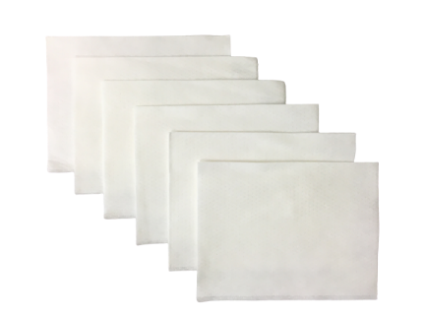
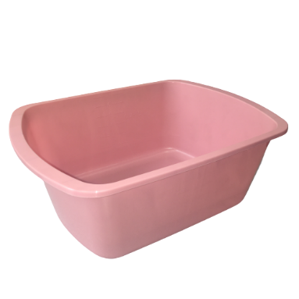
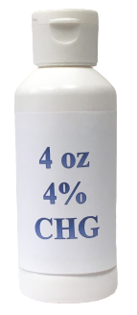
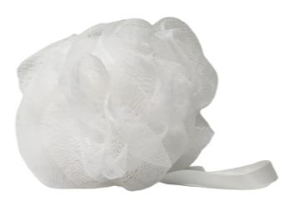
Options for CHG Bed Bath or Shower
2% CHG liquid with disposable cloths
  Dilute 4% 4 oz. bottle to 2% liquid
  No rinse, air dry
4% liquid CHG
  Rinse-off for showering
Basin CHG Cloth/Shower 6

Slide 7
CHG for Bath or Shower
Patients with devices should be cleansed with CHG in one of two ways
Basin bed bath with 2% CHG liquid, applied as no-rinse soap with disposable non-cotton cloths
Shower with 4% rinse-off CHG liquid soap with mesh sponge
CHG is the bathing/cleansing soap. It replaces regular soap. Do NOT use other soaps which can inactivate CHG.
CHG works better than soap and water to remove bacteria. It should be firmly massaged into the skin. Once applied, it will continue to work to keep germs off the skin for 24 hours.
CHG is less drying than regular soap and water
Basin CHG Cloth/Shower 7

Slide 8
CHG Talking Points
Patients need encouragement to take their daily bath
Your enthusiasm is critical to protect patients with bathing
Talking points to patients:
  CHG reduces germs on your skin better than soap
  and water
  CHG serves as your protective bath to prevent infection
  The bath will only take about 10 minutes
  If you wish to bathe yourself, I can give you directions on how to use the soap in the right way to get rid of bacteria and protect you from infection. Let me help with
  hard-to-reach areas.
If your patient declines a bath, try again later in the day
Basin CHG Cloth/Shower 8

Slide 9
CHG Basin Bed Bath Instructions
What you will need:
One 4 oz. Bottle of 4% Liquid CHG
  Bath Basin Six Disposable Non-Cotton Cloths
Basin CHG Cloth/Shower 9
Notes:
You had 7 cloths, I made it 6

Slide 10
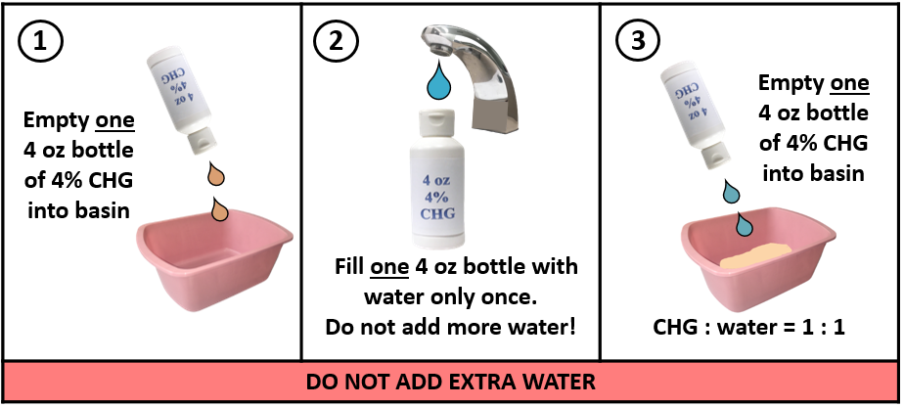
CHG Basin Bed Bath Instructions
  Obtain a bath basin and dispense one 4 oz. bottle of 4% CHG liquid into basin
  Fill one emptied 4 oz. bottle with water and dispense it into basin with 4% CHG liquid in it. (IMPORTANT: Do NOT overdilute. Use only equal parts of water and CHG. Goal is to achieve 2% CHG.)
  Soak disposable cloths in basin. Wring each cloth prior to application. Only soak and wring each cloth once. Do NOT apply cloth to patient and place back in basin to rinse and apply again.
Basin CHG Cloth/Shower 10

Slide 11
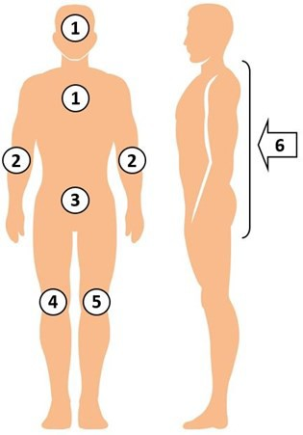
CHG Bed Bath Bathing Procedure
Firmly massage to remove bacteria.
Use ALL six disposable cloths in the following order:
  Face, neck, and chest. Avoid eyes and ears.
  Both shoulders, arms, and hands
  Abdomen, then groin/perineum
  Right leg and foot
  Left leg and foot
  Back of neck, back, then buttocks
For all tubes, lines, and drains, clean 6 inches
closest to the body and over non-gauze dressings
Use additional cloths for larger patients
Safe on perineum, including female labia and genital surface
Air dry. Do NOT rinse.
Basin CHG Cloth/Shower 11

Slide 12
CHG and Devices
Decolonization should be targeted to patients with selected medical devices, such as central lines, midline catheters, and lumbar drains.
Breaks in the skin due to medical devices increase risk for infection.
Use a clean CHG cloth to clean not only skin around the device, but the device itself to prevent infection. CHG is safe on devices.
  Ensure careful cleansing of skin around lines to remove bacteria.
  After cleaning skin, clean 6 inches of line closest to the body.
  Clean over non-gauze dressings.
  If dressing in place, clean over dressing. After skin is cleaned, use clean part of cloth to clean at least the 6 inches of the device that are closest to the body.
Basin CHG Cloth/Shower 12

Slide 13
Clean ALL Devices
Patients with selected devices, such as central venous catheters, midline catheters, or lumbar drains, may have other devices as well.
Remember to clean EVERY device that the patient has. This was the protocol in the ABATE Infection Trial.
This includes not only the devices that identified the patient for decolonization, but also any other devices. These may include:
  Urinary catheters
  G-tube, J-tubes
  Chest tubes
  Rectal tubes
  EKG leads and wires
Basin CHG Cloth/Shower 13

Slide 14
Special Circumstances
Incontinence
Wounds
Obese patients
Allergies and refusals

Slide 15
CHG and Incontinence
Do NOT use soap to cleanse incontinent patients. Soap can inactivate CHG. Use barrier products compatible with CHG.*
Remove urine/stool with usual incontinence wipes/cloths and water. Do NOT use soap.
After removing soilage, if evidence of skin breakdown or wounds in the area, clean skin again with CHG wipes and
air dry.
Apply CHG-compatible barrier protection, if needed.
If additional barrier protection is needed during day, OK to use additional CHG compatible barrier protection products.
If additional bathing is required throughout the day, follow the same CHG bed basin bathing protocol, then reapply CHG compatible barrier protection products, as needed.
*Contact product manufacturers to confirm CHG compatibility
Basin CHG Cloth/Shower 15

Slide 16
CHG and Wounds
Use of CHG on wounds helps remove bacteria and prevent infection. CHG wipes or liquid CHG for showering can be used on all superficial wounds. These include:
  Superficial decubitus ulcers (stages 1 and 2)
  Friable skin/rashes
  Superficial burns
Clean the wound carefully with CHG, including over wound VACs (vacuum-assisted closures)
CHG should be used over semipermeable/occlusive dressings
CHG should be applied over sutured or stapled wounds
CHG cloths do not have alcohol and will not cause stinging
in wounds
Do NOT use on large or deep wounds (e.g., packed wounds)
Basin CHG Cloth/Shower 16

Slide 17
CHG Bathing of Obese Patients
Nurses should use as many CHG wipes as necessary
and throughout the day if additional bathing is required (incontinence, sweating, or other reasons)
Ensure neck and all skin folds are well cleaned
Dry CHG well. Do not wipe off.
Basin CHG Cloth/Shower 17

Slide 18
Targeted Decolonization Allergies and Refusals
If a patient with a device is allergic to CHG, do NOT use
CHG for bathing or showering. Provide an alternative soap.
As is the case with any medical care, patients can refuse the protocol, but your enthusiasm and encouragement can often help them understand the value of removing germs on their body to protect them from infection.
Basin CHG Cloth/Shower 18

Slide 19
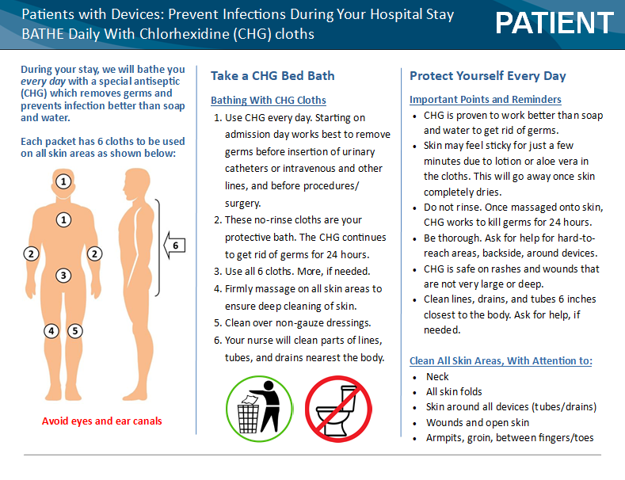
Can a Patient Self-Bathe?
Yes, with instruction and encouragement
Give handout to patient an hour or two before bathing
At bath time, go over the one-page CHG cloth
bathing handout
Basin CHG Cloth/Shower 19

Slide 20
Can a Patient Self-Bathe? (continued)
Be sure to mention:
  CHG is their protective bath, kills germs for 24 hours
  CHG is safe, over-the-counter, and better than soap
  Air dry, do NOT rinse
  Massage (rather than wipe) into all areas of skin for effect
  Pay special attention to the neck, skin folds
  Remember, patients only feel comfortable cleaning normal skin
    You will help them with hard-to-reach areas
    Clean all lines, tubes, drains within 6 inches of the body
    Clean over semipermeable dressings (not gauze)
    Safe on rashes, burns, wounds that are not deep or large
Basin CHG Cloth/Shower 20

Slide 21

Bathing Cleanup
Dispose of each cloth in the trash
Do NOT flush cloths in
the toilet
Cloths CLOG toilets
Basin CHG Cloth/Shower 21

Slide 22
Long-Term Use of CHG
CHG has been used to safely bathe millions of patients, including patients in ICUs and burn units, and before and after surgery.
Long-term use of CHG does not cause deterioration of skin or other problematic skin conditions. It is safe to use for routine bathing in patients who require prolonged care and has been shown to be better for the skin than regular soap and water.
It is safe to use repeatedly in patients with multiple incontinent episodes.
Basin CHG Cloth/Shower 22

Slide 23
CHG Bathing: Critical Points To Remember
DO
  Use CHG cloths for all bathing
  Firmly massage skin
  to cleanse
  Pay special attention to neck and tubes, drains, lines
  Use CHG on rashes,
  cuts, scrapes
  Use CHG on burns, superficial wounds
  Only use CHG compatible lotions*
  *Contact product manufacturers to confirm CHG compatibility
DON’T
  Do NOT wipe off. Let
  air dry.
  Do NOT save open
  packs for later use
  Do NOT flush
  Do NOT use on deep/large wounds
  Do NOT use on patient
  if allergic
Basin CHG Cloth/Shower 23
Notes:
23

Slide 24
CHG Showering Instructions
Patients who wish to shower should receive:
  One-page CHG shower instruction sheet prior
  to showering
  Verbal review of instruction sheet
  4 oz. bottle of 4% CHG liquid
  Mesh sponge or non-cotton cloth to lather CHG onto body. Do NOT use cotton cloths—cotton binds CHG and does not release CHG well onto the skin.
Wrap all devices (e.g., central lines and midline catheters), as needed, to protect from water in shower
After shower, unwrap devices and clean with 2% CHG wipes
Basin CHG Cloth/Shower 24

Slide 25
Shampoo and Face Wash
Encourage use of CHG for all shampoo and soap needs
If patients insist on using personal shampoo or face wash, but are willing to use CHG for body wash, have them wash hair and face first, taking care to avoid contacting other skin areas as much as possible so that CHG will work on those areas.
Basin CHG Cloth/Shower 25

Slide 26
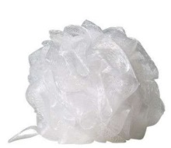
CHG Showering Instructions
Be sure to mention:
  CHG works better than soap and water to kill germs and keep germs off the body for 24 hours if applied correctly
  Safe for shampoo and face/body wash. Avoid eyes,
  ear canals.
  If available, use a mesh sponge
    CHG foams well with it, but not without
  Apply to skin out of water stream for 2 minutes
  before rinsing
  Lathering all body areas twice before rinsing generally takes about 2 minutes
  Massage all over skin. Pay attention to neck and
  skin folds.
  Rinse and towel dry
Basin CHG Cloth/Shower 26

Slide 27
Post-Shower Device Cleaning
After the shower, unwrap devices and perform the
following with a single packet of two 2% CHG cloths:
  For ALL lines and tubes, and drains (e.g., central lines, urinary catheters, G-tube/J-tubes, rectal tubes, chest tubes), clean the 6 inches closest to the body.
  Wipe over non-gauze dressings. CHG is safe to use
  on devices and should also be used over non-gauze dressings.
Basin CHG Cloth/Shower 27

Slide 28
Decolonization: Key Points
Use CHG for entire unit stay for adult non-ICU patients with medical devices
Be encouraging. Remind patients that this bath protects them from infection
Give the bathing/showering handout to read before the bath/shower
Patients who self-bathe still need verbal directions
Clean ALL devices (lines, tubes, drains), dressings,
and wounds unless large or deep
Allow CHG to air dry
The protocol begins again if patients with devices
are readmitted
Basin CHG Cloth/Shower 28

