Slide 1
Decolonization of
Non-ICU Patients With Devices
Section 11-5
Nursing Protocol Training
Bed Bathing With 2% No-Rinse Chlorhexidine (CHG) Cloths and Showering With 4% Rinse-Off CHG Liquid Soap
AHRQ Pub. No. 20(22)-0036
March 2022

Slide 2
Targeted Decolonization Introduction
Our hospital is adopting a targeted decolonization protocol
for adult non-intensive care unit (ICU) patients with selected medical devices:
  Central lines
  Midline catheters*
  Lumbar drains
From this training you will learn:
  How to implement targeted decolonization
  with chlorhexidine (CHG)
  How do address special circumstances related to
  CHG bathing
This training module will take approximately
15 minutes to complete
*NOTE: The ABATE Infection Trial showed the same 32% reduction in bloodstream infection for midlines as it did for central lines.
Decolonization of Non-ICU Patients With Devices

Slide 3
What Is Decolonization?
Decolonization is the use of topical antiseptic soaps and nasal products to remove bacteria from the body surface
Decolonization is proven in hospitals to prevent
antibiotic-resistant bacteria and bloodstream infections
The decolonization products in this training module include:
  2% CHG no-rinse impregnated cloths for bed baths
  4% CHG rinse-off liquid for showering
Decolonization of Non-ICU Patients With Devices

Slide 4
Why Are We Targeting Patients With Medical Devices?
Body bacteria can cause infection in hospitals and nursing homes due to wounds, devices, and poor health of the patient
Decolonization has been shown to prevent infections
  For patients with multidrug-resistant organisms
  In hospital ICUs
  In long-term acute care hospitals
  In hospital non-ICU patients with devices
The Active Bathing to Eliminate (ABATE) Infection Trial found that decolonization for adult non-ICU patients with specific medical devices reduced all-cause bloodstream infections by 32 percent and positive methicillin-resistant Staphylococcus aureus (MRSA) and vancomycin-resistant enterococcus (VRE) cultures by 37 percent¹
¹ Lancet. 2019 Mar 23;393(10177):1205-15
Decolonization of Non-ICU Patients With Devices

Slide 5
How Do I Perform Targeted Decolonization?
Use CHG, instead of regular soap, for all daily bathing or shower needs for all adult patients with selected medical devices, every day, for entire unit stay
Applies to patients on non-ICU units
Decolonization of Non-ICU Patients With Devices

Slide 6
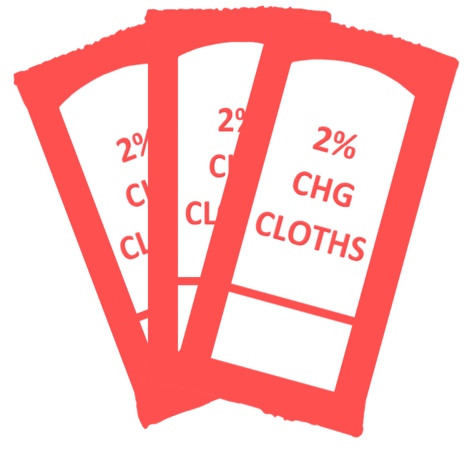
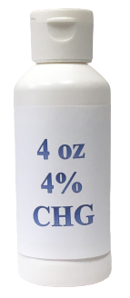
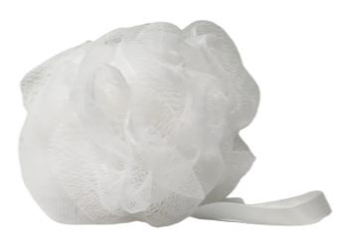
Options for CHG Bed Bath or Shower
2% CHG cloths (bed baths)
No rinse, air dry
4% liquid CHG
Rinse-off for showering
Decolonization of Non-ICU Patients With Devices

Slide 7
CHG for Bath or Shower
Patients with devices should be cleaned with CHG in one of two ways
Bed bath with 2% no-rinse CHG disposable cloths
Shower with 4% rinse-off CHG liquid soap with mesh sponge
CHG is the bathing/cleansing soap. It replaces regular soap. Do NOT use other soaps that can inactivate CHG.
CHG works better than soap and water to remove bacteria. It should be firmly massaged into the skin. Once applied, it will continue to work to keep germs off the skin for 24 hours.
CHG is less drying than regular soap and water
Decolonization of Non-ICU Patients With Devices

Slide 8
CHG Talking Points
Patients need encouragement to take their daily bath
Your enthusiasm is critical here
Talking points to patients:
  CHG reduces germs on your skin better than soap
  and water
  CHG serves as your protective bath to prevent infection
  The bath will only take about 10 minutes
  If you wish to bathe yourself, I can give you directions on how to use the soap in the right way to get rid of bacteria and protect you from infection. Let me help with hard-to-reach areas.
If your patient declines a bath, try again later in the day
Decolonization of Non-ICU Patients With Devices

Slide 9
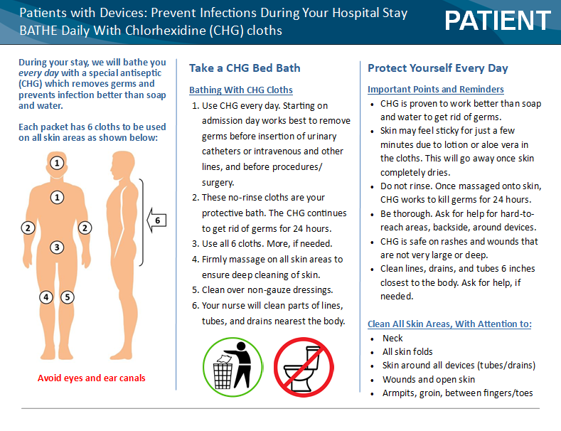
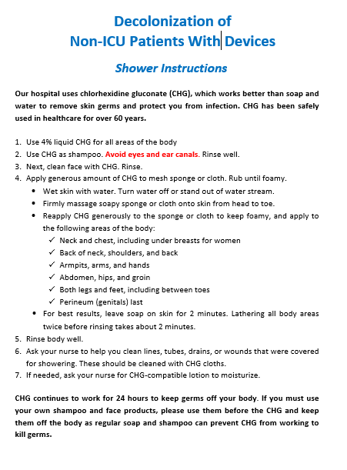
Patient Informational Handouts
One-page CHG bathing informational handout is available for patients (see Section 10)
Providing patients with handout prior to bathing will save time, but should not replace verbal instructions
Decolonization of Non-ICU Patients With Devices

Slide 10
CHG Cloth Bathing
For non-ICU patients with selected medical devices who need a bed bath:
  Use CHG cloths for all bathing needs
  Bathe with CHG cloths for entire hospital stay
  Use all six CHG cloths provided (three packets of
  two cloths each)
  Obtain cloths from warmer
  Use cloths wisely, take only what you need
  Do NOT reuse cloths
Decolonization of Non-ICU Patients With Devices

Slide 11
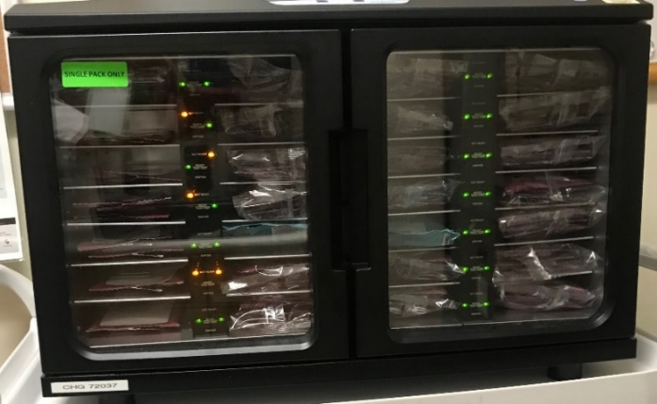
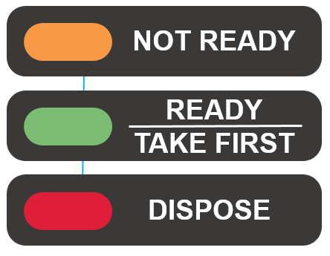
CHG Bathing Cloth Warming Instructions
Warming is for comfort only. CHG works at room temperature.
Place CHG packs in warmer based on number of baths needed.
Follow manufacturer guidance for use of warmer.
  Ensure the warmer indicates the packet is ready for use (usually takes about 2 hours to warm).
Warmer will indicate if packet needs to be disposed if it has been in the warmer too long.
After removing, replace with a new package.
Caution: Check temperature of cloth prior to use. Gloves diminish sense of heat.
Example warmer displayed above. Appearance and indicator lights may vary by manufacturer.
Decolonization of Non-ICU Patients With Devices

Slide 12


Extra CHG Bathing Cloths
Extra CHG bathing cloths sometimes will be needed for:
  Large body size (>300 lbs)
  Freshening up
  Reapplication after incontinence cleanup
Use a two-cloth packet or “single” instead of the full six-cloth bath:
  Separate packets and place into an individual slot
  in warmer
  Same warming instructions apply for separated packets
  Do NOT rewarm cloths
  Single two-cloth packet A slot can hold up to three singles
Decolonization of Non-ICU Patients With Devices

Slide 13
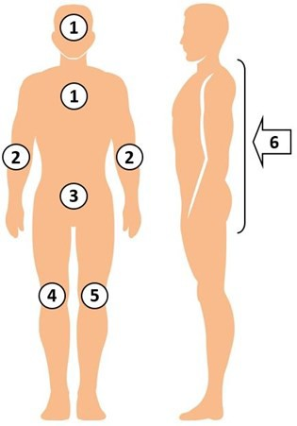
CHG Bed Bath Bathing Procedure
Firmly massage to remove bacteria.
Use ALL six disposable cloths in the following order:
  Face, neck, and chest. Avoid eyes and ears.
  Both shoulders, arms, and hands
  Abdomen, then groin/perineum
  Right leg and foot
  Left leg and foot
  Back of neck, back, then buttocks
For all tubes, lines, and drains, clean 6 inches
closest to the body and over non-gauze dressings
Use additional cloths for larger patients
Safe on perineum, including female labia and genital surface
Air dry. Do NOT rinse.
Decolonization of Non-ICU Patients With Devices

Slide 14
Importance of Allowing CHG To Fully Dry
CHG cloths contain moisturizers
  Moisturizers may feel sticky on patient’s skin until fully dry
  Provide reassurance to the patient that the sticky feeling only lasts several minutes and then will leave skin soft
Dressing changes
  Dressings will not adhere to skin if CHG has not fully dried
  Ensure CHG is fully dried before changing and replacing dressings
Decolonization of Non-ICU Patients With Devices

Slide 15
CHG and Devices
Decolonization should be targeted to patients with selected medical devices, such as central lines, midline catheters, and lumbar drains
Breaks in the skin due to medical devices increase risk
for infection
Use a clean CHG cloth to clean not only skin around the device but also the device itself to prevent infection. CHG
is safe on devices.
Ensure careful cleansing of skin around devices to
remove bacteria
After cleaning skin, clean 6 inches of the device that are closest to the body
Clean over non-gauze dressings
If dressing in place, clean over dressing. After skin is cleaned, use clean part of cloth to clean at least the 6 inches of the device that are closest to the body
Decolonization of Non-ICU Patients With Devices

Slide 16
Clean ALL Devices
Patients with selected devices, such as central venous catheters, midline catheters, or lumbar drains, may have other devices as well.
Remember to clean ALL devices that these patients
have. This was the protocol in the ABATE Infection Trial.
This includes not only the devices that identified the patient for decolonization, but also any other devices. These may include:
  Urinary catheters
  G-tube, J-tubes
  Chest tubes
  Rectal tubes
  EKG leads and wires
Decolonization of Non-ICU Patients With Devices

Slide 17
Special Circumstances
Incontinence
Wounds
Obese patients
Allergies and refusals
Decolonization of Non-ICU Patients With Devices

Slide 18
CHG Cloths and Incontinence
Do NOT use soap to cleanse incontinent patients. Soap can inactivate CHG. Use barrier products compatible with CHG.*
Remove urine/stool with usual incontinence wipes/cloths and water. Do NOT use soap.
After removing soilage, if evidence of skin breakdown or wounds in the area, clean skin again with CHG cloths and
air dry.
Apply CHG-compatible barrier protection, if needed.
If additional barrier protection is needed during day, OK to use additional CHG compatible barrier protection products.
If additional bathing is required throughout the day, clean with CHG cloths, then reapply CHG-compatible barrier protection products as needed.
*Contact product manufacturers to confirm CHG compatibility
Decolonization of Non-ICU Patients With Devices

Slide 19
CHG and Wounds
Use of CHG on wounds helps remove bacteria and prevent infection. CHG cloths or liquid CHG for showering can be used on all superficial wounds. These include:
  Superficial decubitus ulcers (stages 1 and 2)
  Friable skin/rashes
  Superficial burns
Clean the wound carefully with CHG, including over wound VACs (vacuum-assisted closures)
CHG should be used over semipermeable/occlusive dressings
CHG should be applied over sutured or stapled wounds
CHG cloths do NOT have alcohol and will not cause stinging in wounds
Do NOT use on large or deep wounds (e.g., packed wounds)
Decolonization of Non-ICU Patients With Devices

Slide 20
CHG Bathing of Obese Patients
Nurses should use as many CHG cloths as necessary
and throughout the day if additional bathing is required (incontinence, sweating, or other reasons)
Ensure neck and all skin folds are well cleaned
Dry CHG well in skin folds. Do NOT wipe off.
Decolonization of Non-ICU Patients With Devices

Slide 21
Targeted Decolonization Allergies and Refusals
If a patient with a device is allergic to CHG, do NOT use
CHG for bathing or showering. Provide an alternative soap.
As is the case with any medical care, patients can refuse the protocol, but your enthusiasm and encouragement can often help them understand the value of removing germs on their body to protect them from infection.
Decolonization of Non-ICU Patients With Devices

Slide 22
Can a Patient Self-Bathe?
Yes, with instruction and encouragement
Give one-page CHG cloth bathing handout (see Section 10) to patient an hour or two before bathing
At bath time, go over the handout with patient
Decolonization of Non-ICU Patients With Devices

Slide 23
Can a Patient Self-Bathe?
Be sure to mention:
  CHG is their protective bath, kills germs for 24 hours
  CHG is safe, over-the-counter, and better than soap
  CHG may feel sticky due to lotion or aloe in the cloths,
  but this is temporary and will go away once dry
  Air dry, do NOT rinse
  Massage (rather than wipe) into all areas of skin for effect
  Pay special attention to the neck, skin folds
  Remember, patients only feel comfortable cleaning normal skin:
    You will help them with hard-to-reach areas
    Clean all lines, tubes, drains within 6 inches of the body
    Clean over semipermeable dressings (not gauze)
    Safe on rashes, burns, wounds that are not deep or large
Decolonization of Non-ICU Patients With Devices

Slide 24

Bathing Cleanup
Dispose of each cloth in the trash
Do NOT flush cloths in
the toilet
Cloths CLOG toilets
Decolonization of Non-ICU Patients With Devices

Slide 25
Long-Term Use of CHG
CHG has been used to safely bathe millions of patients, including patients in ICUs and burn units, and before and after surgery.
Long-term use of CHG does not cause deterioration of skin or other problematic skin conditions. It is safe to use for routine bathing in patients who require prolonged care and has been shown to be better for the skin than regular soap and water.
It is safe to use repeatedly in patients with multiple incontinent episodes.
Decolonization of Non-ICU Patients With Devices

Slide 26
CHG Bathing: Critical Points To Remember
DO
  Use CHG cloths for
  all bathing
  Firmly massage skin
  to cleanse
  Pay special attention to neck and tubes, drains, lines
  Use CHG on rashes,
  cuts, scrapes
  Use CHG on burns, superficial wounds
  Only use CHG compatible lotions*
  *Contact product manufacturers to confirm CHG compatibility
DON’T
  Do NOT wipe off. Let
  air dry.
  Do NOT save open packs for later use
  Do NOT flush
  Do NOT use on deep/large wounds
  Do NOT use on patient
  if allergic
Decolonization of Non-ICU Patients With Devices
Notes:
26

Slide 27
CHG Showering Instructions
Patients who wish to shower should receive:
  One-page CHG shower instruction sheet prior
  to showering
  Verbal review of instruction sheet
  4 oz. bottle of 4% CHG liquid
  Mesh sponge or non-cotton cloth to lather CHG onto body. Do NOT use cotton cloths—cotton binds CHG and does not release CHG well onto the skin.
Wrap all devices (e.g., central lines and midline catheters), as needed, to protect from water in shower
After shower, unwrap devices and clean with 2% CHG cloth
Decolonization of Non-ICU Patients With Devices

Slide 28
Shampoo and Face Wash
Encourage use of CHG for all shampoo and soap needs
If patients insist on using personal shampoo or face wash, but are willing to use CHG for body wash, have them wash hair and face first, taking care to avoid contacting other skin areas as much as possible so that CHG will work on those areas.
Decolonization of Non-ICU Patients With Devices

Slide 29
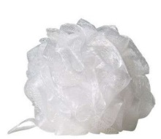
CHG Showering Instructions
Be sure to mention:
  CHG works better than soap and water to kill germs and keep germs off the body for 24 hours if applied correctly
  Safe for shampoo and face/body wash. Avoid eyes,
  ear canals.
  If available, use a mesh sponge
    CHG foams well with it, but not without
  Apply to skin out of water stream for 2 minutes
  before rinsing
  Lathering all body areas twice before rinsing generally takes about 2 minutes
  Massage all over skin. Pay attention to neck and
  skin folds.
  Rinse and towel dry
Decolonization of Non-ICU Patients With Devices

Slide 30
Post-Shower Device Cleaning
After the shower, unwrap devices and perform the following with a single packet of two 2% CHG cloths:
  For ALL lines and tubes, and drains (e.g., central lines, urinary catheters, G-tube/J-tubes, rectal tubes, chest tubes), clean the 6 inches closest to the body.
  Wipe over non-gauze dressings. CHG is safe to use
  on devices and should also be used over non-gauze dressings.
Decolonization of Non-ICU Patients With Devices

Slide 31
Decolonization: Key Points
Use CHG for entire unit stay for adult non-ICU patients with medical devices
Be encouraging. Remind patients that this bath protects them from infection
Give the bathing/showering handout to read before the bath/shower
Patients who self-bathe still need verbal directions
Clean ALL devices (lines, tubes, drains), dressings,
and wounds unless large or deep
Allow CHG to air dry
The protocol begins again if patients with devices
are readmitted
Decolonization of Non-ICU Patients With Devices

