Slide 1
Preventing CAUTI in the ICU Setting
AHRQ Safety Program for Reducing CAUTI in Hospitals
Module 2: Urinary Catheter Maintenance
AHRQ Pub No. 15-0073-4-EF
September 2015

Slide 2
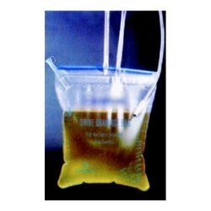
Setting the Stage
ICU patient has a urinary catheter because of recent extensive urological surgery
Nurse and transporter need to take the patient to radiology for followup study
Transporter grabs the urinary catheter bag and places the bag on patient’s abdomen
Nurse notices patient’s urinary catheter isn’t secured to her leg

Slide 3
Question
What did you notice that could lead to the development of a CAUTI?

Slide 4
Answer
Three issues:
  Urinary catheter bag placement
  No securement device
  Urine drainage bag was not emptied

Slide 5
Question
If you were the nurse in this scenario, what would you do?

Slide 6
Answer
Nurse and transporter talk outside the patient’s room

Slide 7
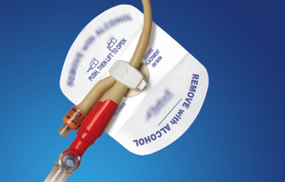
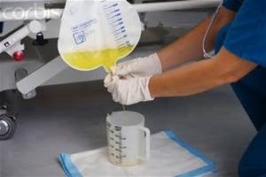
Back in the Patient’s Room
Nurse uses the securement device
Nurse empties the urinary catheter bag
  Important to do this aseptically

Slide 8
Moving the Patient
Nurse and transporter move the patient from the bed to the cart
What would you do about the urinary catheter bag?

Slide 9
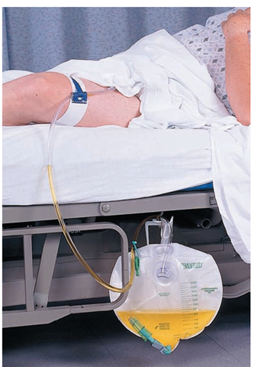
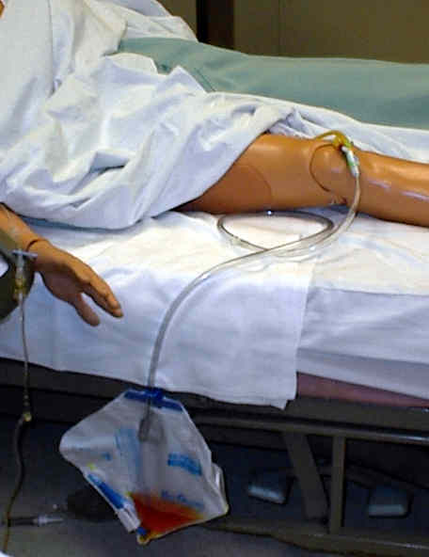
Important To Remember and Communicate
Arrange tubing to avoid dependent loops or kinks

Slide 10
Summary
Observe
Communicate

