Slide 1
Central Venous Catheter
Indications and Alternatives
AHRQ Safety Program for Intensive Care Units:
Preventing CLABSI and CAUTI
Avoiding Placement and Determining Appropriateness
AHRQ Pub. No. 17(22)-0019
April 2022

Slide 2
Case Scenario: Mr. Vargas
Mr. Vargas, an 81-year-old man, living independently at home with his wife, comes to hospital with the flu.
He is hypotensive, having trouble breathing, and delirious. He is admitted to the ICU, is intubated, and has a central line placed. He is treated supportively and is doing well, and is extubated a few days later.
His team has kept the central line in because the patient said he has had trouble in the past with healthcare workers “finding veins on him.”
The day before his discharge, he develops a fever. He is found to have MRSA in his blood.
Disclaimer: All case studies are hypothetical and not based on any actual patient or hospital information. Any similarity between a case study and actual patient or hospital experience is purely coincidental.

Slide 3
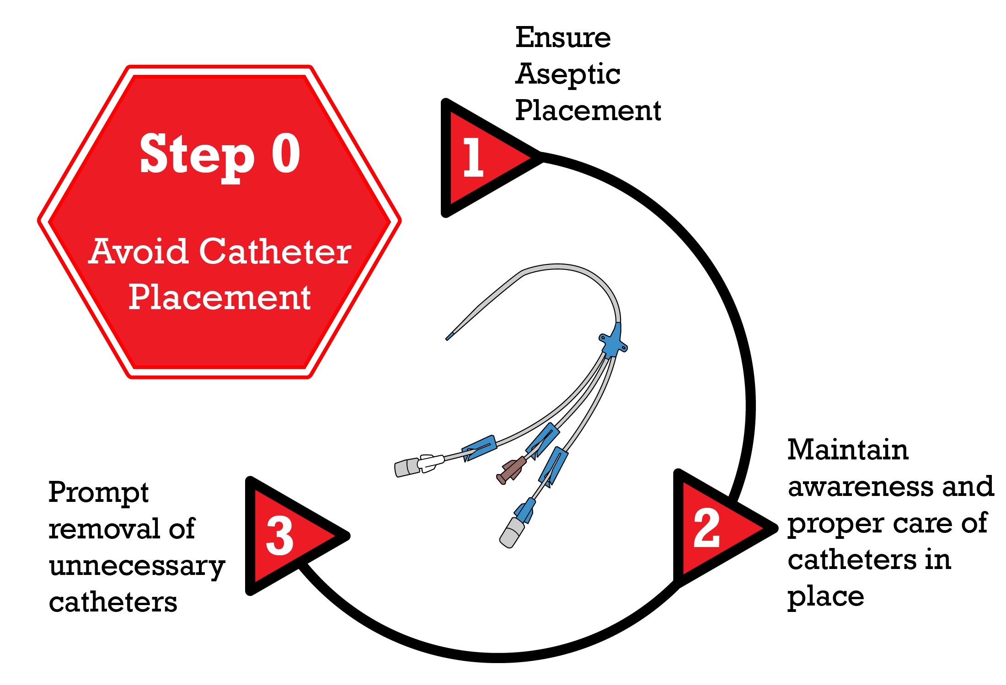
Step 0. Avoid Placement
Disrupting the Lifecycle of A Catheter Device^{1,2}
Patel PK, Gupta A, Vaughn VM, et al. Review of strategies to reduce central line-associated bloodstream infection (CLABSI) and catheter-associated urinary tract infection (CAUTI) in adult ICUs. J Hosp Med. 2018 Feb 1;13(2):105-16. Epub 2017 Nov 8. Used with permission of Journal of Hospital Medicine.

Slide 4
Clinical Indications for CVC Placement³⁻⁶
Administration of vasopressors, chemotherapy, or total parenteral nutrition
Support of high-volume flow for therapy
Hemodynamic monitoring
Venous access for placement of device
Inadequate/difficult peripheral venous access when ultrasound guidance has failed
Diagnostic indications
Appropriateness = Benefit > Harm

Slide 5
Examples of Indications & Choice of CVC⁵⁻⁷
Titles | Infusion Therapy Standards of Practice | Society for Interventional Radiology Clinical Practice Guidelines for Central Venous Access | Michigan Appropriateness Guide for Intravascular Catheters (MAGIC)
Indications | Clinical instability Episodic chemotherapy or continuous infusion Intravenous therapy inappropriate for peripheral infusion (vesicant, parenteral nutrition, etc.) Invasive hemodynamic monitoring Failed or difficult access when ultrasound guidance has failed | Diagnostic indications Confirm diagnosis Establish prognosis Monitor response to a treatment | PICC in critical illness Inappropriate for infusion of peripherally compatible infusate unless duration of treatment > 15 days CVC in critical illness Appropriate in duration of 6–15 days If hemodynamically unstable or monitoring required <14 days CVC & PICC preferred if patient hemodynamically unstable or receiving vasopressors
Choice of CVC | Use CVC with fewest lumens and smallest diameter | N/A | Guides decision on what type of intravascular catheter to use based on length of time of therapy and compatible infusate Algorithms available to help make these decisions

Slide 6
Making a Choice⁷
Choosing the right line, for the right infusate, for the right length of time can help with ensuring the team does not use unnecessary central lines
Peripherally Compatible Infusate
Peripherally Incompatible Infusate
Length & type of therapy
Choice of Catheter
CVC Appropriateness ׀

Slide 7
Challenges to Using Indications⁸
Each critically ill patient is different
Do not distinguish between different types of CVCs
  Risk of complications vary
    Insertion versus downstream risks
  Types of complications vary
    Infectious versus thrombotic
  Provider skills vary
Not all recommendations account for duration of use and the length of time a venous catheter is in place.

Slide 8
Strategies To Overcome Challenges
Identify champions to reinforce use of indications and alternatives
Educate staff on appropriate indications, including the use and benefits of alternatives
  Address staff attitudes and beliefs toward changing practices
Provide staff and physicians with a checklist
  Provide staff with opportunities to discuss and problem-solve how to use checklists
Make sure that alternatives are available and accessible to unit staff
  Frontline nursing staff are trained in ultrasound guided PIV insertion
  Assign staff and hold them accountable for assuring alternative products are available

Slide 9
Alternatives to CVC^{7,8}
Peripheral IV catheter (PIV) with vein finder
Ultrasound-guided PIV
Midline catheter

Slide 10
Site Selection for CVC Placement^{9,10}
Subclavian
Femoral
Internal Jugular
Which site should be used?

Slide 11
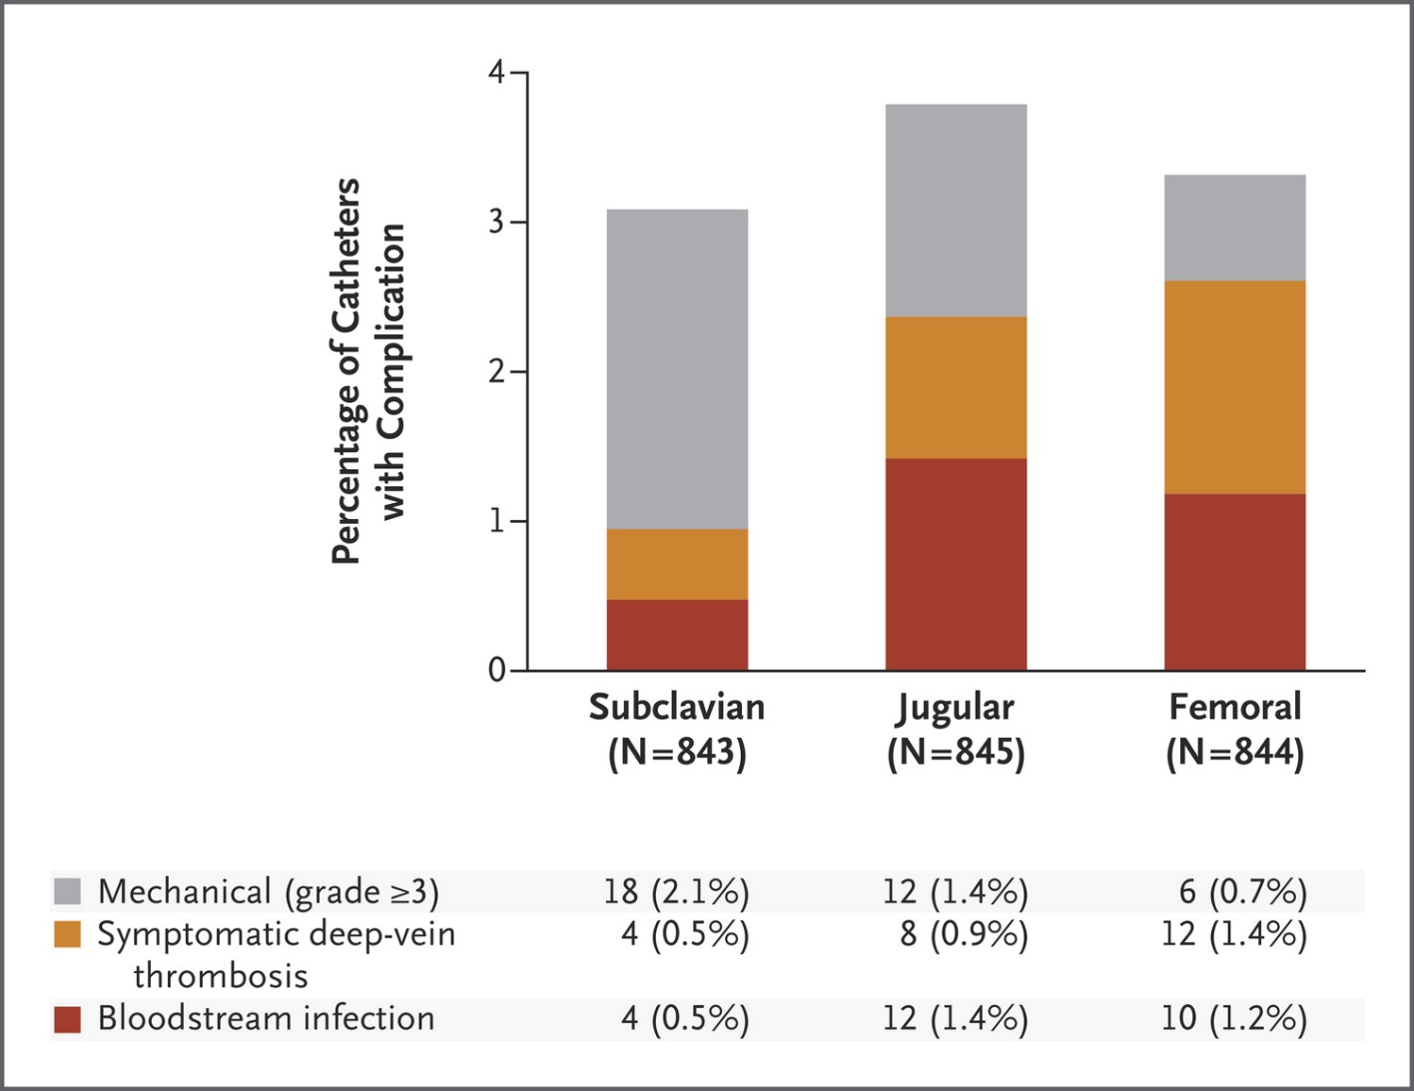
Evidence for Site Selection⁹
Complications in the Three-Choice Comparison, According to Insertion-Site Group
New England Journal of Medicine. Parienti JJ, Mongardon N, Megarbene B et al. Intravascular complications of central venous catheterization by insertion site. 2015:373:1220-9. Copyright © Massachusetts Medical Society. Reprinted with permission from Massachusetts Medical Society.

Slide 12
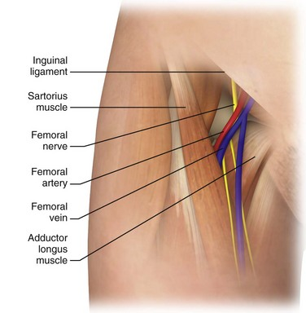
Keystone ICU Project: Site Selection¹¹
Keystone Bundle Intervention:
Performing hand hygiene
Using maximal sterile barrier precautions
Cleaning skin with chlorhexidine before insertion
Avoiding femoral site
Removing unnecessary catheters as soon as possible

Slide 13
Take-Home Points¹²⁻¹³
Clinical guidelines can help you decide if a CVC is appropriate
Appropriateness of CVC depends on the patient, device, and provider characteristics
Utilize alternatives to CVCs when possible
Use checklists and other tools to engage staff in decisionmaking
Remove CVCs as soon as possible
Avoid femoral site for CVC placement

Slide 14
References
Meddings J, Saint S. Disrupting the life cycle of the urinary catheter. Clin Infect Dis. 2011 Jun;52(11):1291-3. PMID: 21596672.
Patel PK, Gupta A, Vaughn VM, et al. Review of strategies to reduce central line-associated bloodstream infection (CLABSI) and catheter-associated urinary tract infection (CAUTI) in adult ICUs. J Hosp Med. 2018 Feb 1;13(2):105-16. PMID: 29154382.
Fitch K, Bernstein SJ, Aguilar MD, et al. The RAND/UCLA Appropriateness Method User's Manual. Santa Monica, CA:.RAND Corporation; 2001.
Lee-Llacer J, Seneff MG. Central Venous Catheters. In: Irwin RS, Rippe JM, eds. Irwin and Rippe’s Intensive Care Medicine. 7th ed. Philadelphia: LWW; 2011: chapter 2.
Dariushnia SR, Wallace MJ, Siddiqi, NH, et al. Quality Improvement Guidelines for Central Venous Access. J Vasc Interv Radiol. 2010;21:976-81. PMID: 20610180.
Gorski LA, Hadaway L, Hagle ME, et al. Infusion Therapy Standards of Practice, 8th Edition. J Infus Nurs. 2021;44(1S Suppl 1):S1-S224. PMID: 33394637.
Chopra V, Flanders SA, Saint S, et al. The Michigan appropriateness guide for intravenous catheters (magic): results from a multispecialty panel using the RAND/UCLA appropriateness method. Ann Intern Med. 2015 Sep 15; (6 Suppl):S1-40. PMID: 26369828.
Swaminathan L, Flanders S, Horowitz Jet al. Safety and outcomes of midline catheters vs peripherally inserted central catheters for patients with short-term indications: a multicenter study. JAMA Intern Med. 2021;e216844. PMID: 34842905.
Timsit JF, Bouadma L, Mimoz O, et al. Jugular versus femoral short-term catheterization and risk of infection in intensive care unit patients. Causal analysis of two randomized trials. Am J Respir Crit Care Med. 2013 Nov 15;188(10):1232-9. PMID: 24127770.
Parienti JJ, Mongardon N, Megarbene B, et al. Intravascular complications of central venous catheterization by insertion site. N Engl J Med. 2015 Sep 24;373(13):1220-9. PMID: 26398070.
Pronovost P, Needham D, Berenholtz, et al. An intervention to decrease catheter-related bloodstream infections in the ICU. N Engl J Med. 2006 Dec 28;355(26):2725-32. PMID: 17192537.
Centers for Disease Control and Prevention. 2019 National and State Healthcare-Associated Infections Progress Report. https://www.cdc.gov/hai/data/portal/progress-report.html#2018. Accessed September 3, 2021.
Agency for Healthcare Research and Quality. Toolkit for Reducing Central Line-Associated Blood Stream Infections. https://www.ahrq.gov/hai/clabsi-tools/index.html. Accessed November 12, 2021.
Agency for Healthcare Research and Quality. Resident Physicians as Champions in Preventing Device-Associated Infections Pocket Guide. https://www.ahrq.gov/hai/cauti-tools/phys-championsgd/pocketguide.html. Accessed November 12, 2021.
Agency for Healthcare Research and Quality. Daily Goals. https://www.ahrq.gov/hai/cusp/videos/06c-daily-goals/index.html. Accessed November 12, 2021.

