Slide 1
AHRQ Safety Program for MRSA Prevention
Prevention of Central Line-Associated Bloodstream Infections
ICU & Non-ICU
AHRQ Pub. No. 25-0007
October 2024

Slide 2
Educational Objectives
Define a central line-associated bloodstream infection (CLABSI) and identify its significance to patient safety and methicillin-resistant Staphylococcus aureus (MRSA) prevention.
Outline key evidence-based strategies and targets for CLABSI prevention.
Describe implementation approaches to ensure that evidence-based best practices are in place for every patient with a central line.

Slide 3
Key Strategies To Take Aim & Target MRSA Infection

Slide 4
Preventing Device- & Procedure-Related Infections
Devices and procedures place patients at increased risk for healthcare-associated infections (HAIs).
On any given day, approximately 1 in 31 hospital patients has at least one HAI.¹
Methicillin-resistant Staphylococcus aureus (MRSA) caused 48.4 percent of device-associated HAIs and 41.9 percent of surgical site infections in acute care facilities between 2015 and 2017.²
This presentation will link regularly to resources and materials from AHRQ’s Toolkit for Preventing CLABSI and CAUTI in Intensive Care Units (ICUs).³

Slide 5
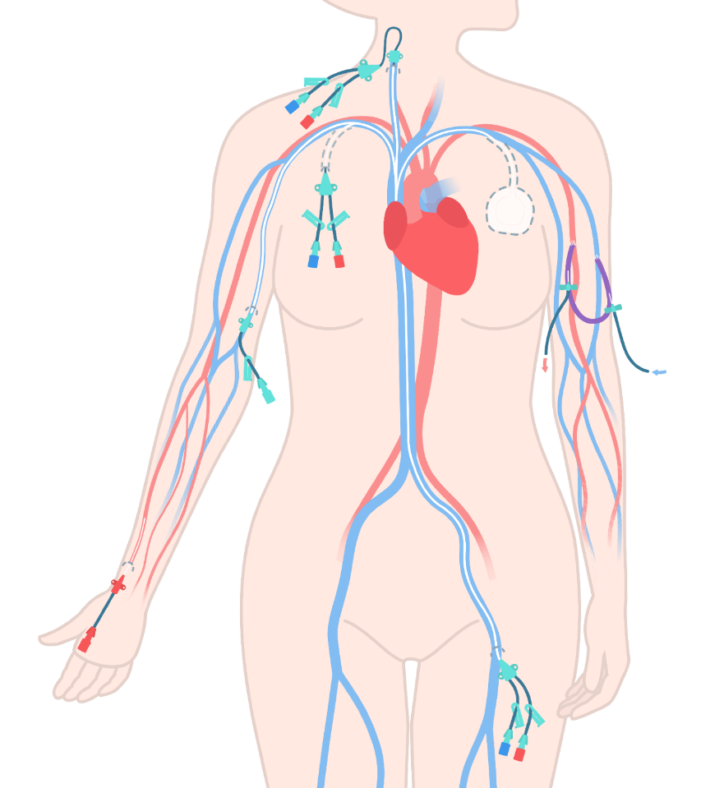
What Is a CLABSI?
CLABSI occurs when pathogens enter the bloodstream through a central line.
The National Healthcare Safety Network (NHSN) defines a central line as:
“An intravascular catheter that terminates at or close to the heart, or in one of the great vessels AND is used for infusion, withdrawal of blood, or hemodynamic monitoring.”⁴
Often, physicians insert and remove central lines, while nurses access the lines and provide ongoing maintenance and care of catheters and catheter sites.
Arterial lines are not considered central lines for purposes of CLABSI surveillance.⁵

Slide 6
Central Lines Create Entry Points

Slide 7
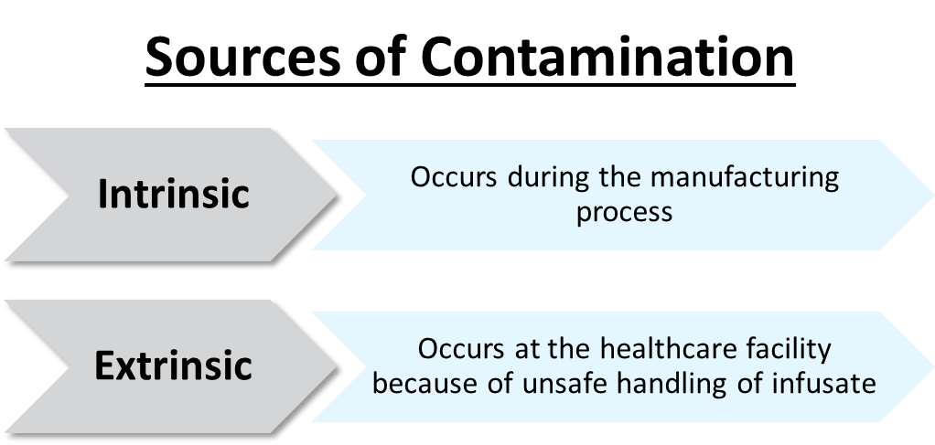
Entry Points: Contaminated Infusate
Contaminated fluids or medication infused into a central line can lead to a CLABSI.

Slide 8
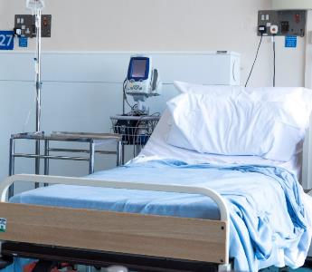
Entry Points: Contaminated Catheter Hub
Central line access points can become contaminated with organisms from—
The patient’s skin
Healthcare personnel hands
Environmental sources

Slide 9
Entry Points: Migration of Bacteria on Skin
Bacteria on patients’ skin or from the environment or healthcare personnel’s hands can contaminate the external portion of the central line.
A central line dressing that is not occlusive, clean, and dry may allow pathogens to follow the central line into the bloodstream. Patient movement and line manipulation of a poorly secured line may cause the external portion of central line to slide beneath skin.
Bacteria can migrate or be dragged into the catheter entry site of skin and gain access to the bloodstream.

Slide 10
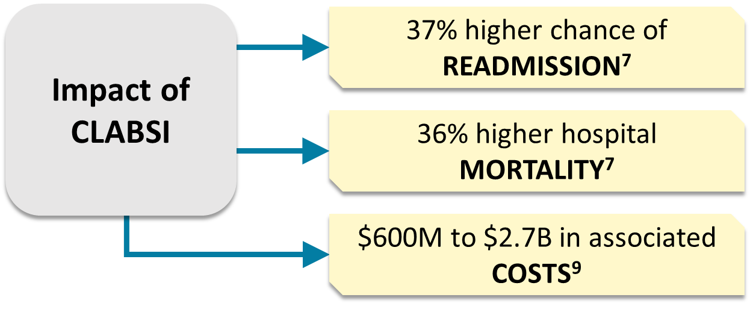
CLABSI Impact
CLABSI is associated with significant morbidity, mortality, and costs.⁶⁻⁹

Slide 11
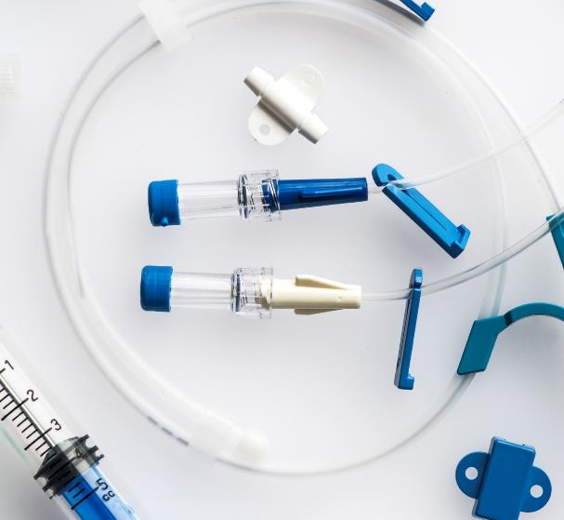
CLABSI Risk Factors^{10,11}
Nonmodifiable Risk Factors¹⁰
Comorbidities
Age
Modifiable Risk Factors¹⁰
Location and duration of central line access
Use of sterile barriers and technique during line insertion
Minimization or prevention of microbial colonization and contamination at the line entry site

Slide 12
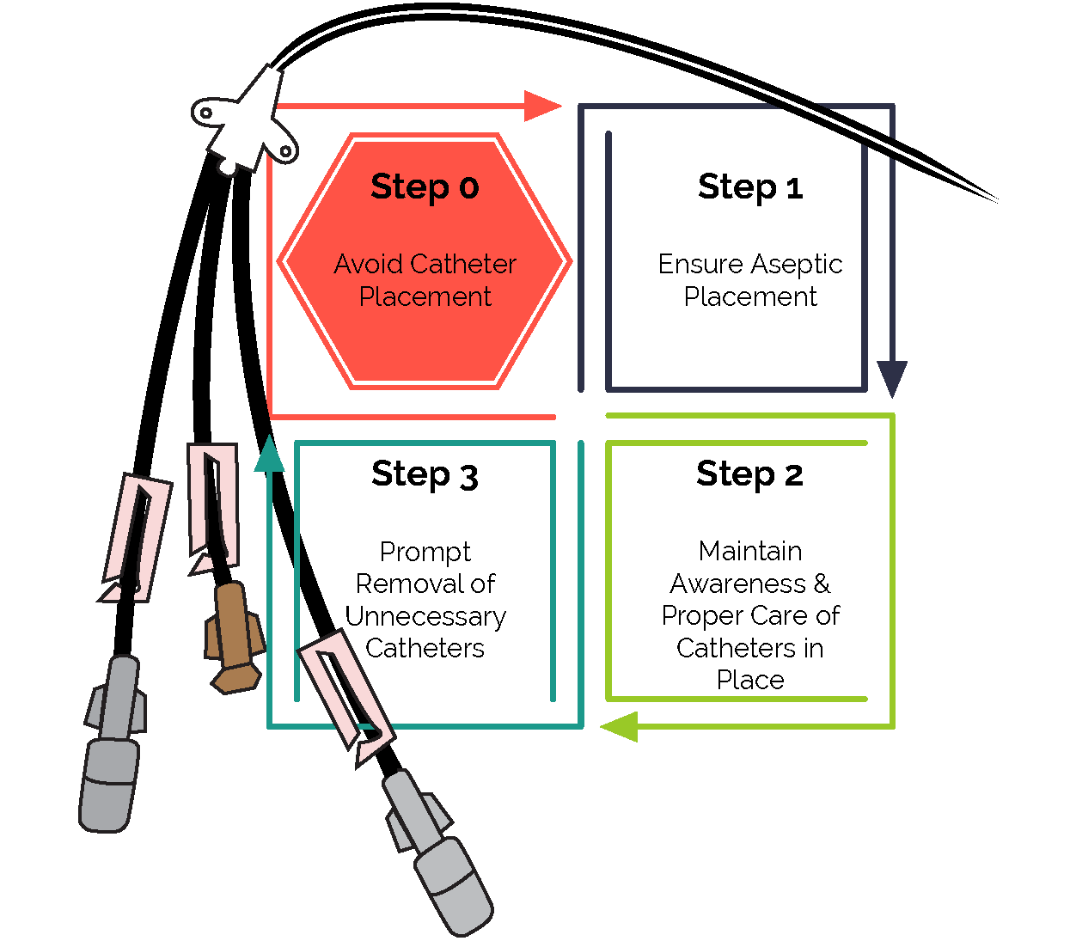
Central Line Catheter Utilization
Step 0: The best way to prevent CLABSI is to avoid placing a central line.¹²
AHRQ’s A Playbook for Preventing CLABSI and CAUTI in the ICU Setting¹² provides a guide to implementing best practices.

Slide 13
Central Line Appropriateness & Alternatives^{6,13}
Clinical indications for central line placement include:
Administration of vasopressors, chemotherapy, or total parenteral nutrition
Support of high-volume flow for intravenous therapy
Hemodynamic monitoring
Venous access for placement of a device
Inadequate/difficult peripheral access when ultrasound guidance has failed
Diagnostic indications
Alternatives to central lines include:
Peripheral IVs inserted with vein-finder technology
Ultrasound-guided peripheral IVs
Midline catheters
For more on clinical indications and alternative strategies, review AHRQ’s CLABSI/CAUTI Prevention Module on Central Venous Catheter Indications & Alternatives.¹³

Slide 14
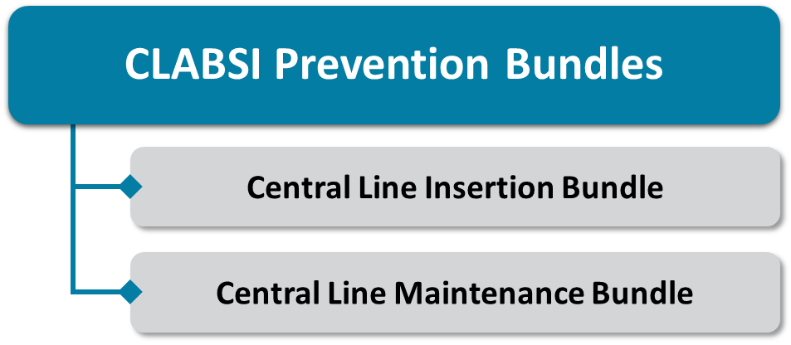
CLABSI Prevention Bundles^{14,15}
Bundles are groups of key evidence-based practices that, when implemented together, result in a better outcome than when executed individually.
Studies show that the incidence of infections decreases significantly after CLABSI bundles are implemented.¹⁴

Slide 15
Central Line Insertion
Recommendations and Best Practices for Central Venous Catheter Insertion

Slide 16
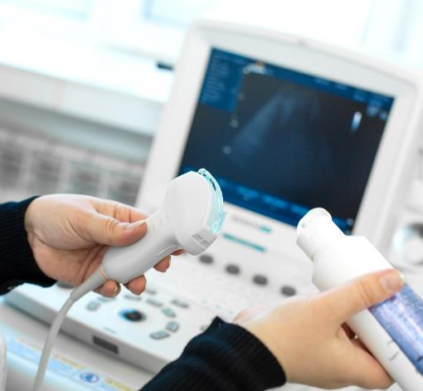
Central Line Insertion Bundle^{3,10,15,16}
Essential components of central line insertion include:
Optimal site selection
Competency of healthcare personnel involved in insertion
Proper hand hygiene
Chlorhexidine gluconate (CHG) skin preparation
Maximal sterile barrier precautions
Use of a central line insertion checklist
Use of a central line cart or kit
Use of ultrasound to assist with line placement

Slide 17
Optimal Site Selection^{15,17-23}
Site Selection Matters!
Subclavian Vein¹⁸
Considered the best choice for most patients
Risks include:
Iatrogenic pneumothorax during insertion
Central vein stenosis
Femoral Vein¹⁸
Avoid using if possible
Risks include:
Infection due to proximity to the groin
Catheter-related thrombosis
Internal Jugular Vein
Risks include:
Central vein stenosis
Catheter-related thrombosis
Peripherally inserted central catheter, inserted through a large upper arm vessel
CLABSI rates are statistically similar to central venous catheters²³
Risks include:
Central vein stenosis
Catheter-related thrombosis

Slide 18
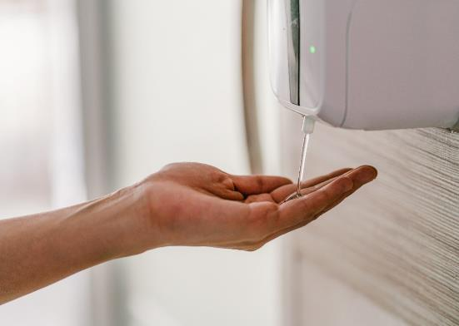
Proper Hand Hygiene²⁴⁻²⁸
Perform hand hygiene…
Before and after palpating central line site
Before and after inserting, replacing, accessing, repairing, or dressing an intravascular catheter
Remember, using gloves does not eliminate the need for hand hygiene!

Slide 19
Chlorhexidine Gluconate Skin Preparation²⁹⁻³²
Clean entry site with alcoholic CHG, following manufacturer instructions.
Use a back-and-forth motion to create friction for at least 30 seconds for most sites and 1 minute for the groin.
Do not wipe or blow dry the skin. Allow skin preparation to completely dry before puncturing the skin.
CHG skin preparations are preferred.
Povidone-iodine should only be considered if use of CHG is contraindicated.³¹

Slide 20
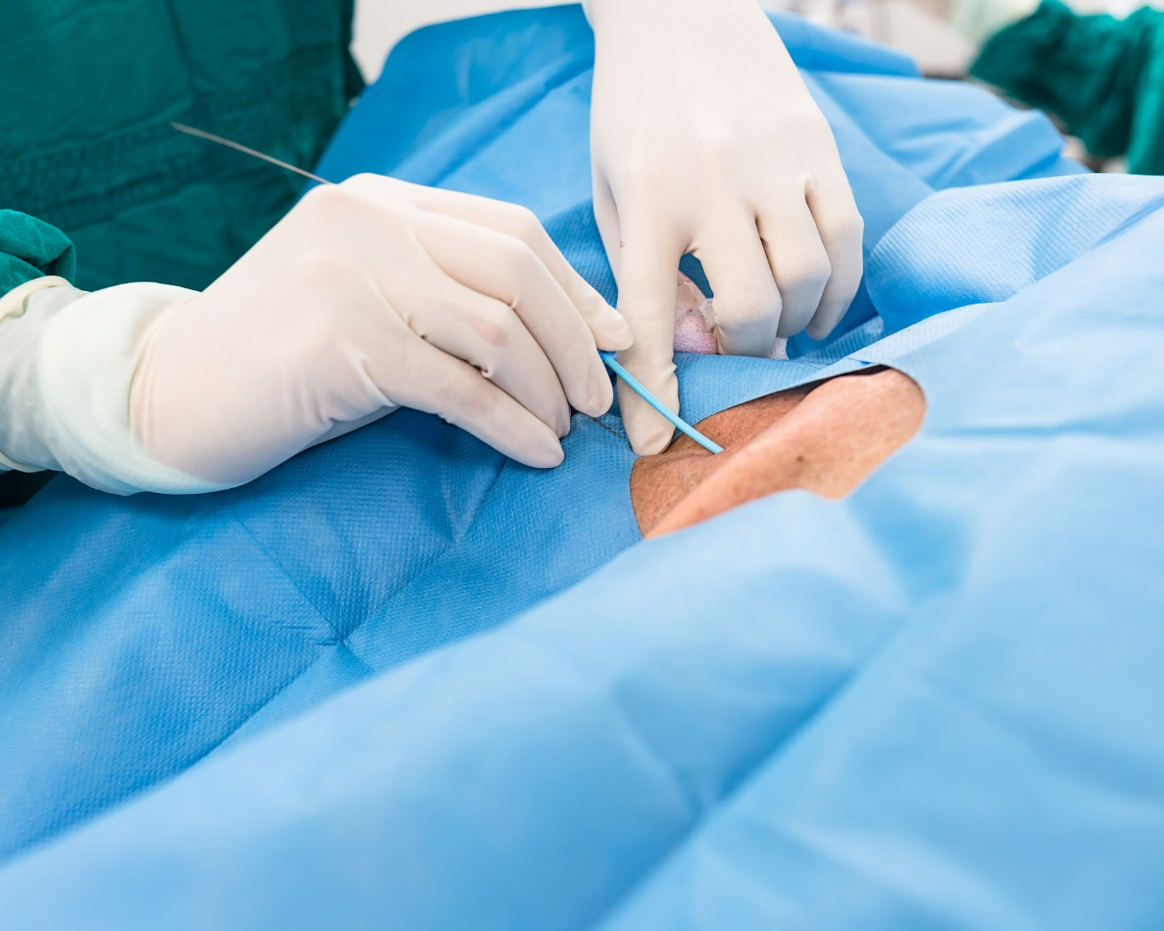
Maximal Sterile Barrier Precautions³³⁻³⁶
Use maximal sterile barrier precautions when placing a central line.
Inserter wears a cap (that fully covers hair), mask, sterile gown, and sterile gloves
Patient is completely covered (head to toe) with large sterile drape
Maximal sterile barrier precautions substantially reduce the incidence of CLABSI compared to use of standard precautions (i.e., use of sterile gloves and a small drape).

Slide 21
Use of Central Line Insertion Checklist¹⁰
Use of a standardized checklist ensures insertion procedures are performed optimally.
The checklist is completed in real time by someone who is not participating in the line insertion.
Staff must feel empowered to alert the team if there is a breach in aseptic technique.
Available Checklists
AHRQ Central Line Insertion Care Team Checklist³⁷
CDC Checklist for Prevention of CLABSI³⁸
Johns Hopkins Central Line Insertion Checklist³⁹
Joint Commission Central Line Insertion Checklist⁴⁰
AHRQ’s TeamSTEPPS provides an educational module on communication strategies and drills to help train staff to feel comfortable speaking up.

Slide 22
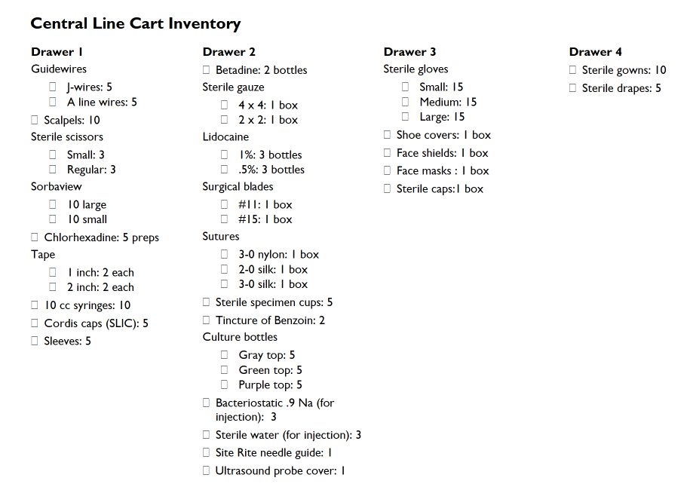
Use of Central Line Insertion Cart/Kit^{10,41}
A readily accessible cart or kit should be available in all areas where central lines are inserted.
Carts/kits should include all supplies and items needed to prepare, place, secure, and dress the central line.
Refreshers and/or re-education should be provided whenever changes are made to products or the layout of carts.

Slide 23
Central Line Maintenance
Recommendations and Best Practices for Central Venous Catheter Maintenance

Slide 24
Central Line Maintenance Bundle^{3,10,15,16}
Components of a central line maintenance bundle include:
Proper hand hygiene
Central line site care
Hub disinfection
Central line dressing changes
Daily CHG treatment/ bathing
Daily review of line necessity
Other considerations:
Ensure appropriate nurse-to-patient ratios
Minimize the use of float nurses in ICUs
Perform ongoing CLABSI surveillance
Conduct root cause analysis on all CLABSI events

Slide 25
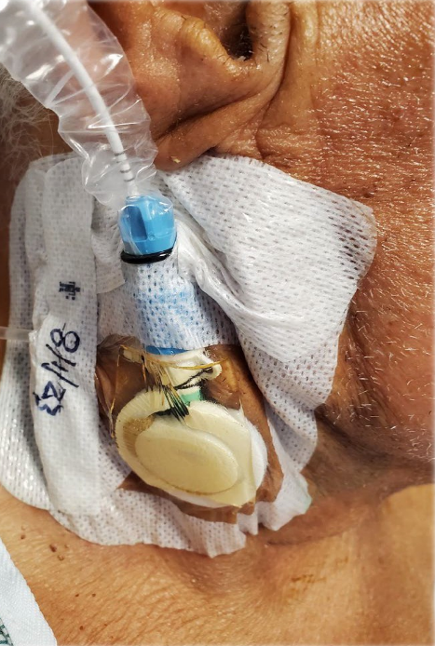
Central Line Site Care^{3,10}
Assess central line site regularly, particularly for any pain and redness.
Ensure dressings are clean, dry, intact, and sealed.
“Scrub the Hub”: Scrub all connection points for 5 seconds prior to every access.⁴²
Replace all tubing and administration sets every 7 days.
Include needleless access connectors/caps.
Tubing used for blood products, parenteral nutrition, and lipids should be replaced every 24 hours.
View the “Scrub the Hub” training video, produced by Johns Hopkins Medicine.

Slide 26
Central Line Dressing Change^{10,43}
Use transparent, CHG-containing dressings for central lines for patients at least 2 months old.
Change transparent dressings on non-tunneled lines every 5 to 7 days, or sooner if they become loose, damp, or visibly soiled.
Gauze dressings should be changed every 2 days.
During dressing changes, cleanse the site with a CHG-based skin antiseptic.
Transparent dressings are preferred.
However, if the site is oozing, a gauze dressing may be used instead.

Slide 27
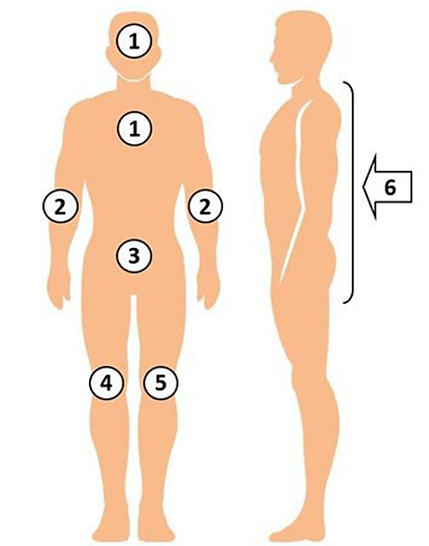
Daily CHG Treatment or Bathing⁴⁴⁻⁴⁹
Patients with central lines should be bathed daily with CHG to help remove bacteria and prevent infection.
At least six wipes should be used for each bath.
Clean ALL areas of skin. Avoid the eyes and ear canals.
Include the most proximal 6 inches of every line, tube, or drain.
Explain to the patient that this treatment is to protect them from infection.
Image adapted from Decolonization Toolkit: Instructional Handouts for Staff and Patients. March 2022. Agency for Healthcare Research and Quality. https://www.ahrq.gov/hai/tools/abate/handouts.html.

Slide 28
Daily Review of Central Line Necessity⁵⁰⁻⁵³
A multidisciplinary team should systematically evaluate each day whether any central line catheters can be removed.
Discuss lines at each handoff.
Remove lines promptly.
Conducting daily central line rounds is a good way to do this systematically.
Central Lines Rounds Form
Central Line Maintenance Info Sheet
Lines that cannot be removed should not be changed prophylactically or at routine/scheduled intervals.

Slide 29
Think About It…
How many of these central line insertion and maintenance strategies for CLABSI prevention would you say that your unit has successfully implemented?
A. Our unit hasn’t really implemented any of these strategies.
B. Our unit has successfully implemented a few of these strategies.
C. Our unit has successfully implemented some of these strategies.
D. Our unit has implemented all these strategies but has not succeeded in all of them.
E. Our unit has implemented all these strategies and has succeeded in all of them.

Slide 30
Implementation
Tips, Tricks, and Overcoming Common Barriers

Slide 31
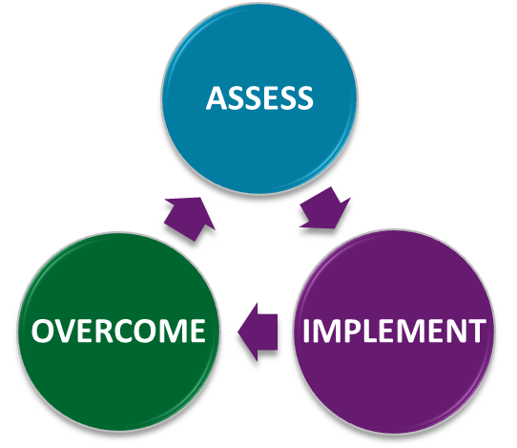
Assess Current Practice³
Conduct an accurate assessment of current practices.
Don’t assume you know what the current practice is.
Go to the gemba!
Gemba: where the work happens
Observe the actual workflow.
Engage with frontline personnel.
Access AHRQ’s Tools for Assessing Progress on CLABSI Prevention.⁵⁴

Slide 32
Team Engagement^{54,55}
Staff need to be aware of CLABSI issues to be engaged.
Be transparent with data.
Executive leadership should also be aware and engaged.
Use education and training tools to address gaps in understanding about practices and policies.
Access AHRQ’s Tools to Overcome Common Challenges.⁵⁶

Slide 33
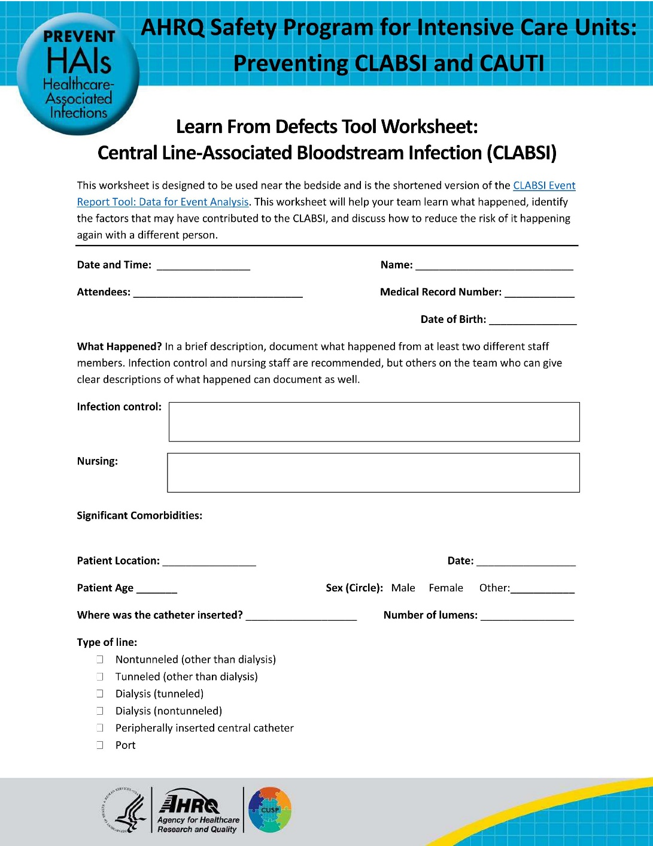
Learning From Defects³
Complete a Learn From Defects (LFD) Tool after CLABSI events.
Identify gaps in practice and opportunities for improvement.
Encourage frontline clinicians to take the lead on completing the LFD Tool.
For more info, access the Learning From Defects section in this Toolkit.
Download the Learn From Defects Tool Worksheet for CLABSI.

Slide 34
Case Example: Rising CLABSI Rates in ICU
The ICU has seen a significant increase in CLABSI rates.
The CUSP Team assesses current practices and conducts a Learning From Defects process.
Identified contributory factors:
Central lines often left inserted for longer than necessary
Variable compliance with line insertion and maintenance best practices
Selected interventions:
Central line kits
Line insertion checklists
Daily central line rounds
Daily Goals

Slide 35
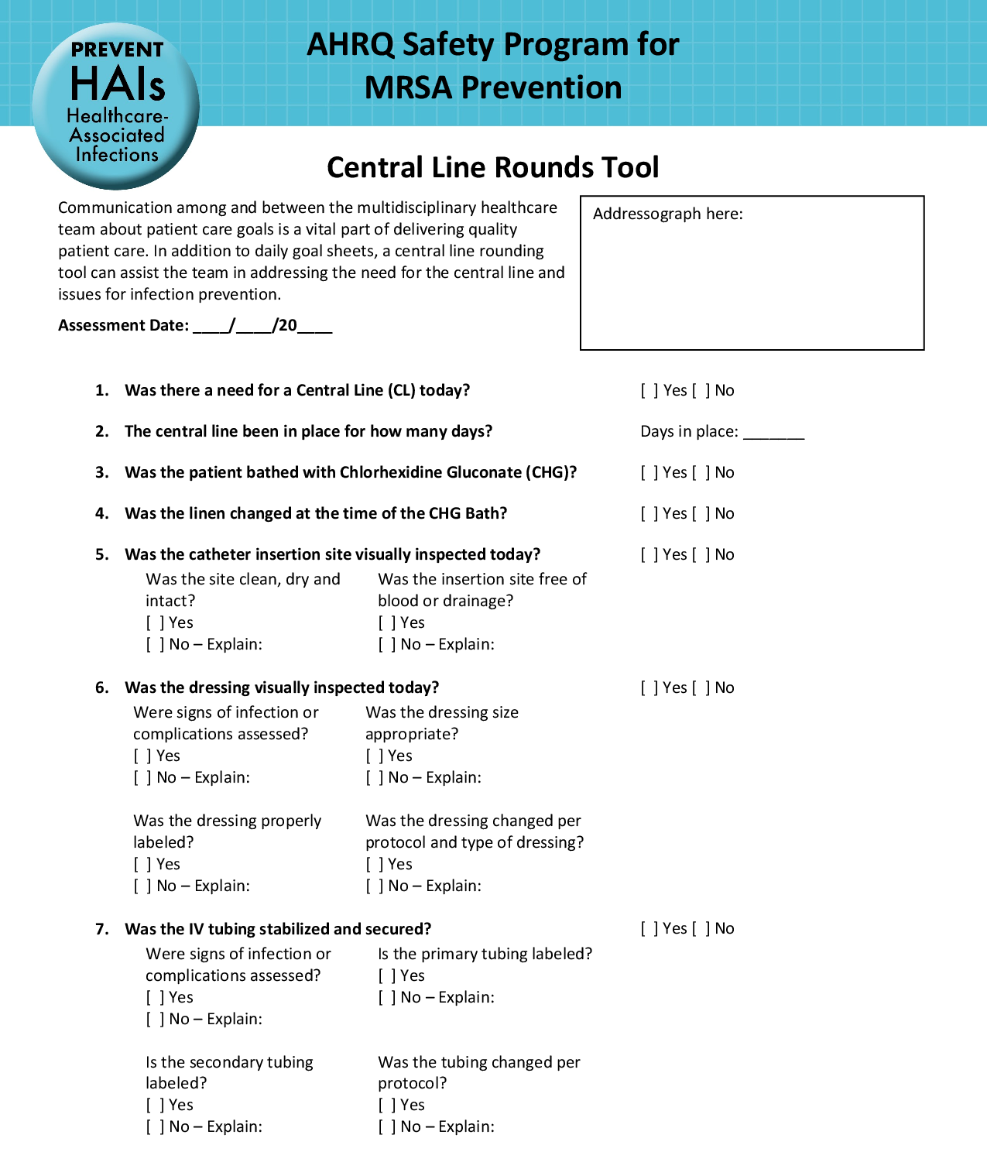
Case Example: Central Line Rounds^{12,57}
Central line rounds: Daily evaluation of each patient’s central line.
Determine necessity and ensure prompt removal.
Assess adherence to maintenance protocols.
Rounds should include nurse, provider, infection preventionist, and leadership.
Collect process measure data.
Collected data can guide the creation of action plans.
This form for central line rounds is available as part of this Toolkit.

Slide 36
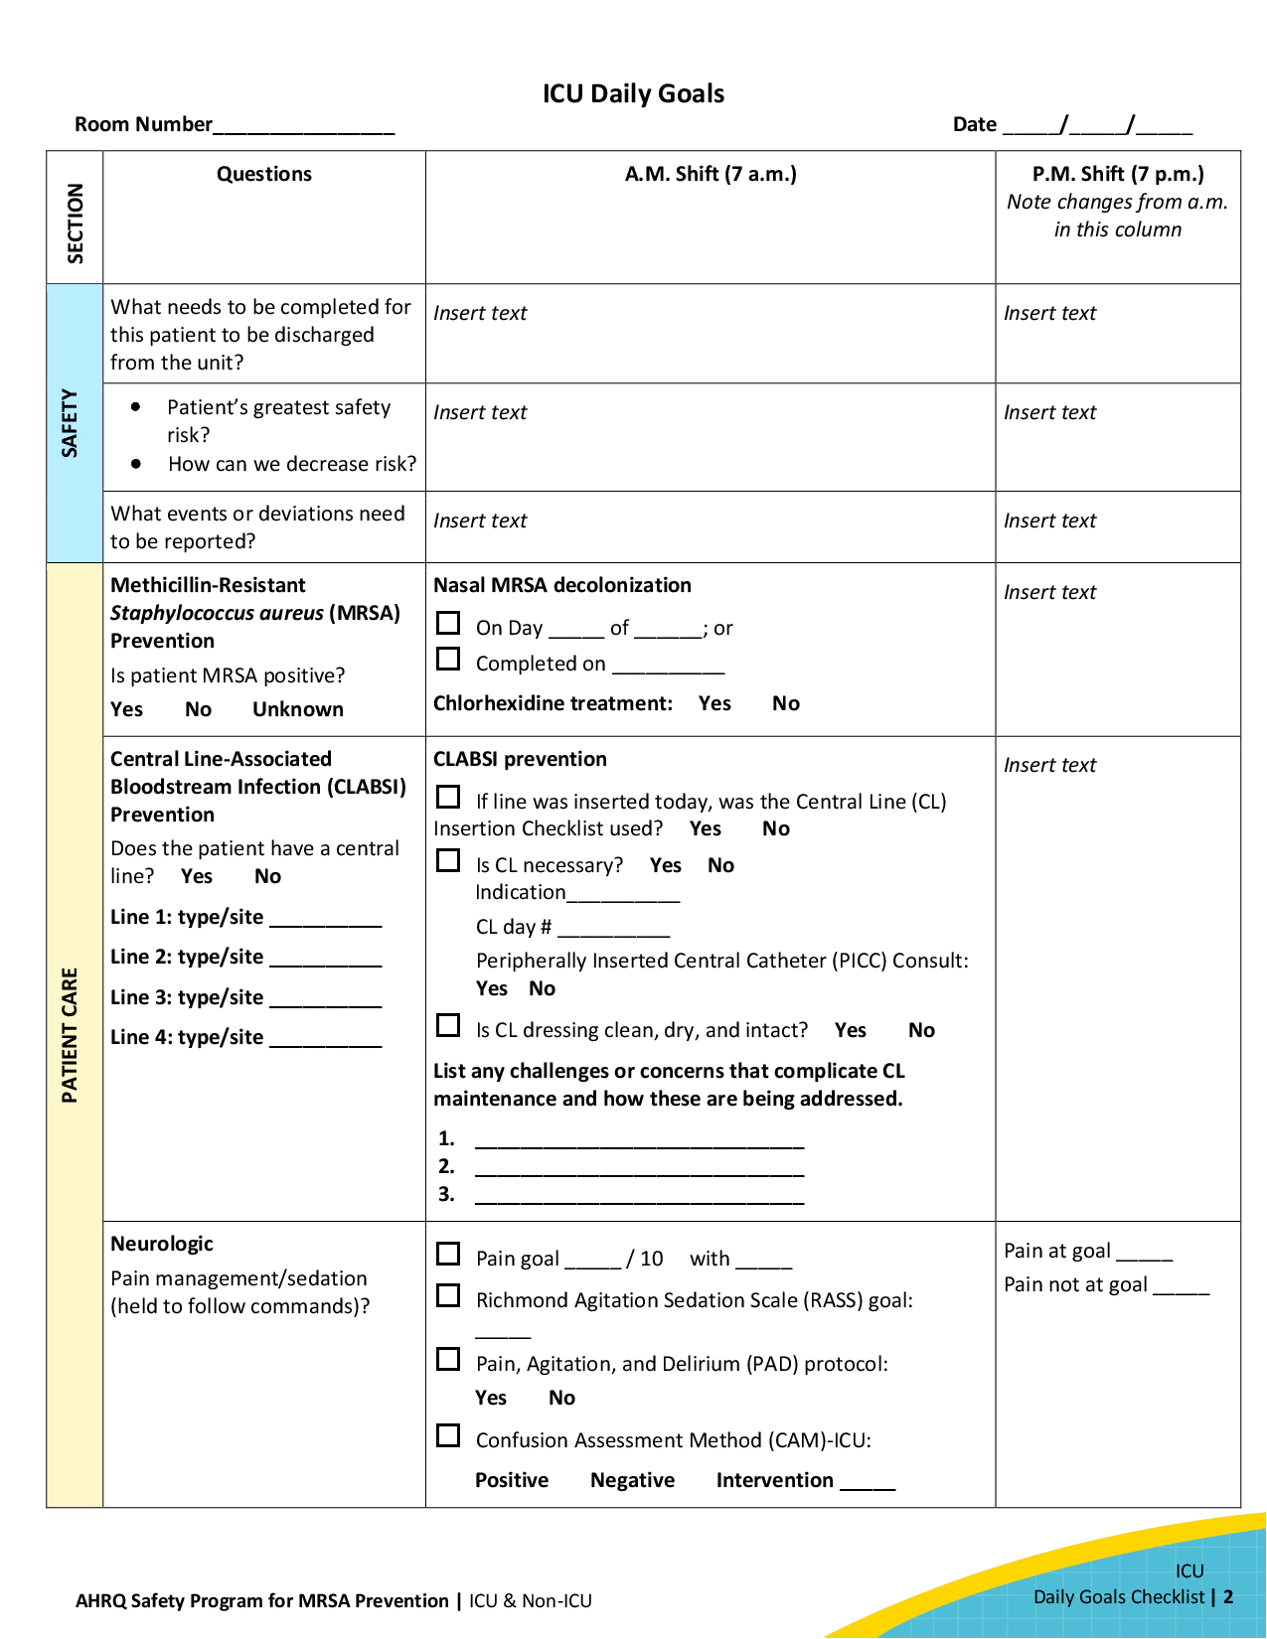
Case Example: Daily Goals Checklist⁵⁸⁻⁶⁰
The Daily Goals Checklist prompts the team to review needs and define the day’s goals for each patient.
Daily Goals integrates well with central line rounds.
Ensures the team are all on the same page for patient’s plan of care.
Sample Daily Goals Checklists are provided as part of this toolkit.
Daily Goals Checklist for ICU
Daily Goals Checklist for Non-ICU
Learn more about the Daily Goals process on AHRQ’s website.⁶⁰

Slide 37
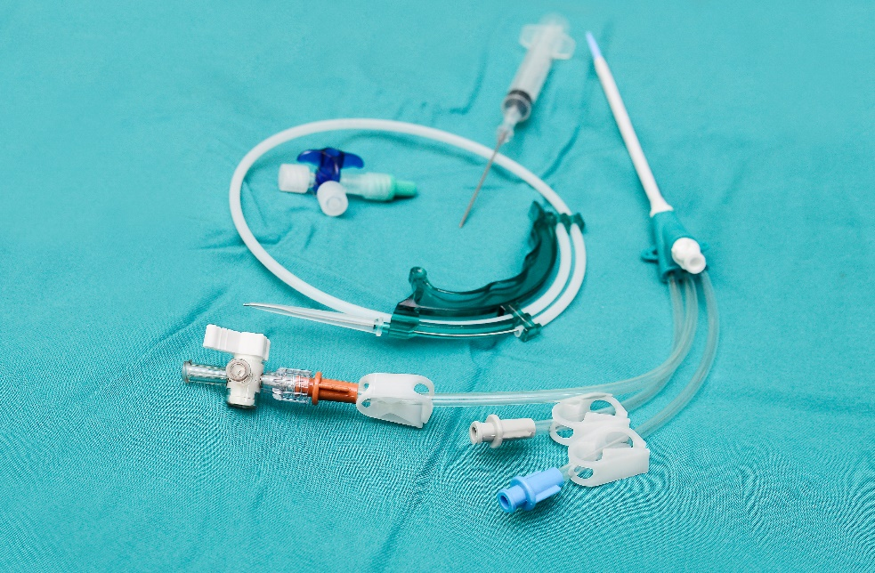
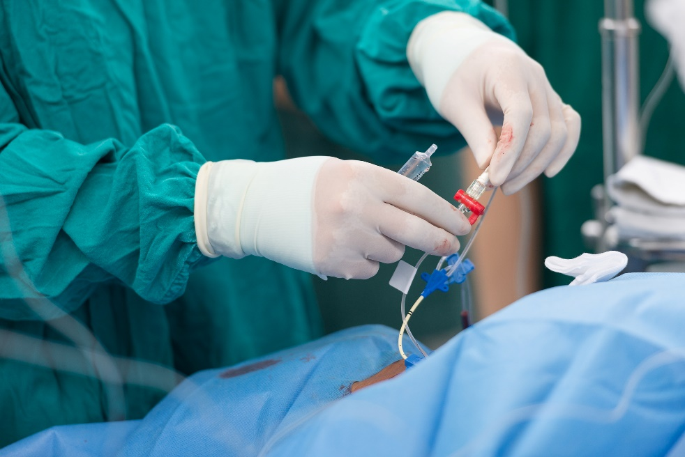
Case Example: Implementation
ICU sees a significant decrease in CLABSI rates over the next 6 months.
Daily central line rounds become embedded in the ICU workflow.
Notable reduction in total central-line days.
Line insertion kits well-accepted and widely used.
Some staff members are hesitant to enforce compliance with the checklist.

Slide 38
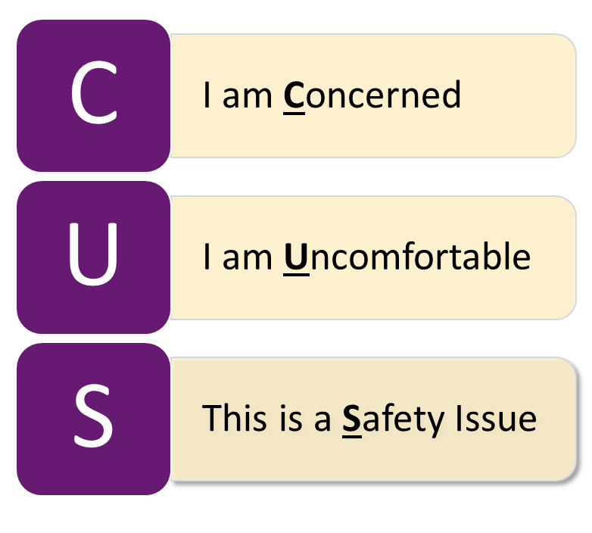
Culture and Safety Climate
Establish a culture and climate of safety.
Empower staff to speak up when they see a breach in practice.
Access more info and training videos on the TeamSTEPPS CUS technique.⁶¹
Notes:
61. Tool: CUS. Agency for Healthcare Research and Quality. https://www.ahrq.gov/teamstepps-program/curriculum/mutual/tools/cus.html. Accessed January 17, 2024.

Slide 39
Key Takeaways
CLABSI are often preventable.
CLABSI increase mortality, length of stay, and healthcare costs.
There are widely accepted best practices and standards to guide CLABSI prevention efforts.
Central line insertion and maintenance bundles are highly effective at reducing the risk of CLABSI when implemented consistently.
There are several well-established education materials, tools, and resources available to assist with prevention efforts.

Slide 40
Disclaimer
The findings and recommendations in this presentation are those of the authors, who are responsible for its content, and do not necessarily represent the views of AHRQ. No statement in this presentation should be construed as an official position of AHRQ or of the U.S. Department of Health and Human Services.
Any practice described in this presentation must be applied by healthcare practitioners in accordance with professional judgment and standards of care in regard to the unique circumstances that may apply in each situation they encounter. These practices are offered as helpful options for consideration by healthcare practitioners, not as guidelines.

Slide 41
Reference List—1
Healthcare-Associated Infections (HAIs). Centers for Disease Control and Prevention. https://www.cdc.gov/hai/data/index.html. Accessed January 17, 2024.
Weiner-Lastinger L, Abner S, Edwards J, et al. Antimicrobial-resistant pathogens associated with adult healthcare-associated infections: summary of data reported to the National Healthcare Safety Network, 2015-7. Infect Control Hosp Epidemiol. 2020;41(1):1-18. PMID: 31767041.
Toolkit for Preventing CLABSI and CAUTI in ICUs. Agency for Healthcare Research and Quality. https://www.ahrq.gov/hai/tools/clabsi-cauti-icu/index.html. Accessed January 17, 2024.
Centers for Disease Control & Prevention (CDC). National Healthcare Safety Network (NHSN) Patient Safety Component. https://www.cdc.gov/nhsn/psc/index.html. Accessed January 17, 2024.
O’Horo JC, Maki DG, Krupp AE, et al. Arterial catheters as a source of bloodstream infection: a systematic review and meta-analysis. Crit Care Med. 2014;42(6): 1334-9. PMID: 24413576.
2022 National and State Healthcare-Associated Infections Progress Report. Centers for Disease Control and Prevention. https://www.cdc.gov/hai/data/portal/progress-report.html. Accessed January 17, 2024.
Chovanec K, Arsene C, Gomez C, et al. Association of CLABSI with hospital length of stay, readmission rates, and mortality: A retrospective review. Worldviews Evid Based Nurs. 2021;18(6):332-8. PMID: 34779128.

Slide 42
Reference List—2
Ziegler MJ, Pellegrini DC, Safdar N. Attributable mortality of central line associated bloodstream infection: Systematic review and meta-analysis. Infection. 2015;43(1):29-36. PMID: 25331552.
Stevens V, Geiger K, Concannon C. Inpatient costs, mortality and 30-day readmission in patients with central-line-associated bloodstream infections. Clin Microbiol Infect. 2014;20(5):0318-24. PMID: 24112305.
Buetti N, Marschall J, Drees M, et al. Strategies to prevent central line-associated bloodstream infections in acute-care hospitals: 2022 update. Infect Control Hosp Epidemiol. 2022;43(5):1-17. PMID: 35437133.
Umscheid CA, Mitchell MD, Doshi, TA, et al. Estimating the proportion of healthcare-associated infections that are reasonably preventable and the related mortality and costs. Infect Control Hosp Epidemiol. 2011;32(2):101-14. PMID: 21460463.
A Playbook for Preventing CLABSI and CAUTI in the ICU Setting. Agency for Healthcare Quality and Research and Quality. https://www.ahrq.gov/hai/tools/clabsi-cauti-icu/implement/playbook.html. Accessed January 17, 2024.
Central Venous Catheter Indications and Alternatives: Avoiding Placement and Determining Appropriateness. Agency for Healthcare Research and Quality. https://www.ahrq.gov/sites/default/files/wysiwyg/hai/tools/clabsi-cauti-icu/central-catheter-indications.pptx. Accessed January 17, 2024.

Slide 43
Reference List—3
Ista E, van der Hoven B, Kornelissa RF, et al. Effectiveness of insertion and maintenance bundles to prevent central-line-associated bloodstream infections in critically ill patients of all ages: a systematic review and meta-analysis. Lancet Infect Dis. 2016;16(6):724-34. PMID: 269077034.
Central Line-Associated Bloodstream Infections Toolkit and Monograph. The Joint Commission. https://www.jointcommission.org/resources/patient-safety-topics/infection-prevention-and-control/central-line-associated-bloodstream-infections-toolkit-and-monograph/. Accessed January 17, 2024.
APIC Implementation Guide: Guide to Preventing Central Line-Associated Bloodstream Infections. Association for Professionals in Infection Control and Epidemiology. https://apic.org/Resource_/TinyMceFileManager/2015/APIC_CLABSI_WEB.pdf. Accessed January 17, 2024.
Forente L, Henry C, Martin MM, et al. Central venous catheter‐related infection in a prospective and observational study of 2,595 catheters. Crit Care. 2005;9(6):R631‐5. PMID: 16280064.
Goetz AM, Wagener MM, Miller JM, et al. Risk of infection due to central venous catheters: effect of site of placement and catheter type. Infect Control Hosp Epidemiol. 1998;19(11):842‐5. PMID: 9831940.
Merrer J, De Jonghe B, Golliot F, et al. Complications of femoral and subclavian venous catheterization in critically ill patients: a randomized controlled trial. JAMA. 2001;286(6):700‐7. PMID: 11495620.

Slide 44
Reference List—4
Robinson JF, Robinson WA, Cohn A, et al. Perforation of the great vessels during central venous line placement. Arch Intern Med. 1995;155(11):1225-8. PMID: 7763129.
Patel AR, Patel AR, Singh S, et al. Central line catheters and associated complications: a review. Cureus. 2019;11(5):e4717. PMID: 31355077.
Parienti JJ, Mongardon N, Mégarbane B, et al. Intravascular complications of central venous catheterization by insertion site. N Engl J Med. 2015;373(13):1220-9. PMID: 26398070.
Chopra V, O'Horo JC, Rogers MAM, et al. The risk of bloodstream infection associated with peripherally inserted central catheters compared with central venous catheters in adults: a systematic review and meta-analysis. Infect Control Hosp Epidemiol. 2013;34(9):908-18. PMID: 23917904.
Linenberger ML. Catheter-related thrombosis: risks, diagnosis, and management. J Natl Compr Canc Netw. 2006;4(9):889-901. PMID: 17020667.
Yilmaz G, Koksal I, Aydin K, et al. Risk factors of catheter‐related bloodstream infections in parenteral nutrition catheterization. JPEN J Parenter Enteral Nutr. 2007;31(4):284‐7. PMID: 17595436.
Boyce JM, Pittet D. Guideline for hand hygiene in health‐care settings: recommendations of the Healthcare Infection Control Practices Advisory Committee and the HICPAC/SHEA/APIC/IDSA Hand Hygiene Task Force. Infect Control Hosp Epidemiol. 2002;23(12 Suppl):S3-40. PMID: 12515399.

Slide 45
Reference List—5
Coopersmith CM, Rebmann TL, Sack JE, et al. Effect of an education program on decreasing catheter-related bloodstream infections in the surgical intensive care unit. Crit Care Med. 2002;30(1):59-64. PMID: 11902288.
Pittet D, Dharan S, Touveneau S, et al. Bacterial contamination of the hands of hospital staff during routine patient care. Arch Intern Med. 1999;159(8):821-6. PMID: 10219927.
Maki DG, Ringer M, Alvarado CJ. Prospective randomized trial of povidone‐iodine, alcohol, and chlorhexidine for prevention of infection associated with central venous and arterial catheters. Lancet. 1991;338(8763):339‐43. PMID: 1677698.
Garland JS, Buck RK, Maloney P, et al. Comparison of 10% povidone‐iodine and 0.5% chlorhexidine gluconate for the prevention of peripheral intravenous catheter colonization in neonates: a prospective trial. Pediatr Infect Dis J. 1995;14(6):510‐6. PMID: 7667056.
Humar A, Ostromecki A, Direnfeld J, et al. Prospective randomized trial of 10% povidone‐iodine versus 0.5% tincture of chlorhexidine as cutaneous antisepsis for prevention of central venous catheter infection. Clin Infect Dis. 2000;31(4):1001‐7. PMID: 11049783.
Chaiyakunapruk N, Veenstra DL, Lipsky BA, et al. Chlorhexidine compared with povidone‐iodine solution for vascular catheter‐site care: a meta‐analysis. Ann Intern Med. 2002;136(11):792‐801. PMID: 12044127.
Raad II, Hohn DC, Gilbreath BJ, et al. Prevention of central venous catheter‐related infections by using maximal sterile barrier precautions during insertion. Infect Control Hosp Epidemiol. 1994;15(4 pt 1):231‐8. PMID: 8207189.

Slide 46
Reference List—6
Hu KK, Lipsky BA, Veenstra DL, et al. Using maximal sterile barriers to prevent central venous catheter‐related infection: a systematic evidence‐based review. Am J Infect Control. 2004;32(3):142‐6. PMID: 15153925.
Young EM, Commiskey ML, Wilson SJ. Translating evidence into practice to prevent central venous catheter‐associated bloodstream infections: a systems‐based intervention. Am J Infect Control. 2006;34(8):503‐6. PMID: 17015155.
Carrer S, Bocchi A, Bortolotti M, et al. Effect of different sterile barrier precautions and central venous catheter dressing on the skin colonization around the insertion site. Minerva Anestesiol. 2005;71(5):197-206. PMID: 15834348.
Central Line Insertion Care Team Checklist. Agency for Healthcare Research and Quality. https://www.ahrq.gov/hai/patient-safety-resources/cli-checklist/index.html. Accessed January 17, 2024.
Checklist for Prevention of Central Line Associated Blood Stream Infections. Centers for Disease Control and Prevention. https://www.cdc.gov/healthcare-associated-infections/media/pdfs/checklist-for-CLABSI-P.pdf. Accessed January 17, 2024.
Infection Surveillance and Prevention. Johns Hopkins Medicine. https://www.hopkinsmedicine.org/heic/infection-surveillance. Accessed January 17, 2024.
CLABSI Toolkit- Chapter 3: CVC Maintenance: Central Line Insertion Checklist- Template. The Joint Commission. https://www.jointcommission.org/resources/patient-safety-topics/infection-prevention-and-control/central-line-associated-bloodstream-infections-toolkit-and-monograph/clabsi-toolkit---chapter-3/. Accessed January 17, 2024.

Slide 47
Reference List—7
Reducing CLABSI Toolkit: Appendix 4: Central Line Cart Inventory. Agency for Healthcare Research and Quality. https://www.ahrq.gov/hai/clabsi-tools/appendix-4.html. Accessed January 17, 2024.
Rupp ME, Yu S, Huerta T, et al. Adequate disinfection of a split-septum needleless intravascular connector with a 5-second alcohol scrub. Infect Control Hosp Epidemiol. 2012;33(7):661-5. PMID: 22669226.
Reducing CLABSI Toolkit: Appendix 3: Guidelines to Prevent Central Line-Associated Blood Stream Infections. Agency for Healthcare Research and Quality. https://www.ahrq.gov/hai/clabsi-tools/appendix-3.html. Accessed January 17, 2024.
Climo MW, Yokoe DS, Warren DK, et al. Effect of daily chlorhexidine bathing on hospital-acquired infection. N Eng J Med. 2013;368(6):533-42. PMID: 23388005.
Sharara SL, Maragakis LL, Cosgrove SE. Decolonization of Staphylococcus aureus. Infect Dis Clin North Am. 2021;35(1):107-22. PMID: 33303331.
Kassakian SZ, Mermel LA, Jefferson JA, et al. Impact of chlorhexidine bathing on hospital-acquired infections among general medical patients. Infect Control Hosp Epidemiol. 2011;32(3):238-43. PMID: 21460508.
Huang H-P, Chen B, Wang H-Y, et al. The efficacy of daily chlorhexidine bathing for preventing healthcare-associated infections in adult intensive care units. Korean J Intern Med. 2016;31(6):1159-70. PMID: 27048258.

Slide 48
Reference List—8
Huang SS, Septimus E, Kleinman K, et al. Chlorhexidine versus routine bathing to prevent multidrug-resistant organisms and all-cause bloodstream infections in general medical and surgical units (ABATE Infection trial): a cluster-randomised trial. Lancet. 2019;393(10177):1205-15. PMID: 30850112.
Pallotto C, Fiorio M, De Angelis V, et al. Daily bathing with 4% chlorhexidine gluconate in intensive care settings: a randomized controlled trial. Clin Microbiol Infect. 2019;25(6):705-10. PMID: 30267930.
Lederle FA, Parenti CM, Berskow LC, et al. The idle intravenous catheter. Ann Intern Med. 1992;116(9):737‐8. PMID: 1558345.
Parenti CM, Lederle FA, Impola CL, et al. Reduction of unnecessary intravenous catheter use: internal medicine house staff participate in a successful quality improvement project. Arch Intern Med. 1994;154(16):1829‐32. PMID: 8053750.
Pronovost P, Needham D, Berenholtz S, et al. An intervention to decrease catheter-related bloodstream infections in the ICU. N Engl J Med. 2006;355(26):2725-32. PMID: 17192537.
Berenholtz SM, Pronovost PJ, Lipsett PA, et al. Eliminating catheter-related bloodstream infections in the intensive care unit. Crit Care Med. 2004;32(10):2014-20. PMID: 15483409.
Team Engagement. Agency for Healthcare Research and Quality. https://www.ahrq.gov/hai/tools/clabsi-cauti-icu/overcome/engagement.html. Accessed January 17, 2024.

Slide 49
Reference List—9
Assessing Progress on CLABSI and CAUTI Prevention. Agency for Healthcare Research and Quality. https://www.ahrq.gov/hai/tools/clabsi-cauti-icu/assess/index.html. Accessed January 17, 2024.
Overcome Common Challenges. Agency for Healthcare Research and Quality. https://www.ahrq.gov/hai/tools/clabsi-cauti-icu/overcome/index.html. Accessed January 17, 2024.
DeMuth F, Dambrino KL, Phillippi D. Implementation of a central line rounding tool. Am J Infect Control. 2023;51(7):S53.
Daily Goals Checklist. Agency for Healthcare Research and Quality. https://www.ahrq.gov/hai/cusp/toolkit/daily-goals.html. Accessed June 13, 2024.
Centofanti JE, Duan EH, Hoad NC, et al. Use of a daily goals checklist for morning ICU rounds: a mixed-methods study. Crit Care Med. 2014 Aug;42(8):1797-803. PMID: 24674928.
Daily Goals During Interdisciplinary Rounds: Facilitator Guide. Agency for Healthcare Research and Quality. https://www.ahrq.gov/hai/tools/mvp/modules/cusp/daily-goals-rounds-fac-guide.html. Accessed June 13, 2024.
Tool: CUS. Agency for Healthcare Research and Quality. https://www.ahrq.gov/teamstepps-program/curriculum/mutual/tools/cus.html. Accessed January 17, 2024.

