Slide 1
AHRQ Safety Program for MRSA Prevention
Learning From Defects
ICU & Non-ICU
AHRQ Pub. No. 25-0007
October 2024

Slide 2
Educational Objectives
Describe a process to help teams learn from defects
Explore the Comprehensive Unit-based Safety Program (CUSP) Learning From Defects (LFD) tools and resources
Work through an example of a defect and the process of LFD with the Investigating A Defect Worksheet

Slide 3
What Is a Defect?
Defects: Clinical or operational events or situations that you do not want to happen again
Examples of defects:
Transmission of methicillin-resistant Staphylococcus aureus (MRSA) from one patient to another patient
Incomplete cleaning of high-touch surfaces in a patient's room as evidenced by residual fluorescent material during EVS assessment
Failure to perform the intended chlorhexidine gluconate (CHG) bathing and nasal decolonization for a patient at high risk for MRSA infection
Learn from defects: an important CUSP method¹
Access How To Integrate a CUSP Approach on the toolkit website for more information on incorporating CUSP in the unit practice.

Slide 4
How To Identify Defects
Staff Safety Assessment: Ask all staff the following—
“Please describe how you think the next patient in your unit or clinical area will be harmed.”
“Please describe what you think can be done to prevent or minimize the harm from the identified defects.”
Adverse event reporting system
Discussion
Huddle
Access How To Integrate a CUSP Approach on the toolkit website for more information on various ways to identify defects and to engage all staff.

Slide 5
Purpose of the LFD Process
Enables teams to analyze defects at a systems level
Focuses on identifying system factors that contribute to defects, planning interventions and improvements to prevent the defects, and sustaining those improvements
Targets the root causes of defects

Slide 6
CUSP LFD Tools and Resources¹
Examples of CUSP LFD tools and resources:
Learning From Defects Tool for MRSA Prevention
Example of a Completed Learning From Defects Tool
Investigating A Defect Worksheet
Access Learning From Defects on the toolkit website for CUSP tools and resources on the LFD process.

Slide 7
The Four Questions
The following four questions help teams address and prevent defects system-wide:
What happened?
Why did it happen?
How will you reduce the likelihood of this
defect from happening again?
How will you know the risk is reduced?

Slide 8
Question 1
What Happened?

Slide 9
LFD Process: What Happened?
Consider and interview everyone involved to get a wide range of perspectives.
Common interview questions include the following:
Who was involved?
What actions occurred?
What were people thinking and feeling?
What else was happening at the time the defect occurred?
What tools or technologies were being used and how were they being used?
Tips:
Take time to listen and seek to understand rather than judge.
Ask clarifying questions and followup questions.

Slide 10
Who To Interview To Understand the Defect
Nurses, providers, technicians, vascular access and respiratory therapy personnel, environmental services personnel, patients and families, and infection prevention and control—the diverse team behind patient care

Slide 11
Other Strategies To Understand the Defect
Observe the process and seek out similar situations.
Event reports
Electronic medical records

Slide 12
Question 2
Why Did It Happen?

Slide 13
LFD Process: Why Did It Happen?
Avoid assumptions.
There are numerous contributing factors behind each defect.
Contributing factors from all levels of the healthcare system impact care delivery and, ultimately, patient outcomes.²⁻⁴
Capture all contributing factors before considering any interventions or solutions.
Ask “why” five times to drill down to the root of understanding each cause and the relevant factors.

Slide 14
Contributing Factors²⁻⁴
Contributing factors often include the following:
Patient factors, related to the clinical conditions of patients
Technical factors, related to devices, procedures, and information technology
Healthcare personnel factors, related to members of the healthcare team
Team factors, related to teamwork and communication
Institutional factors, related to the institution’s policies, workflow, culture, and resources

Slide 15
Question 3
How Will You Reduce the Likelihood of This Defect From Happening Again?

Slide 16
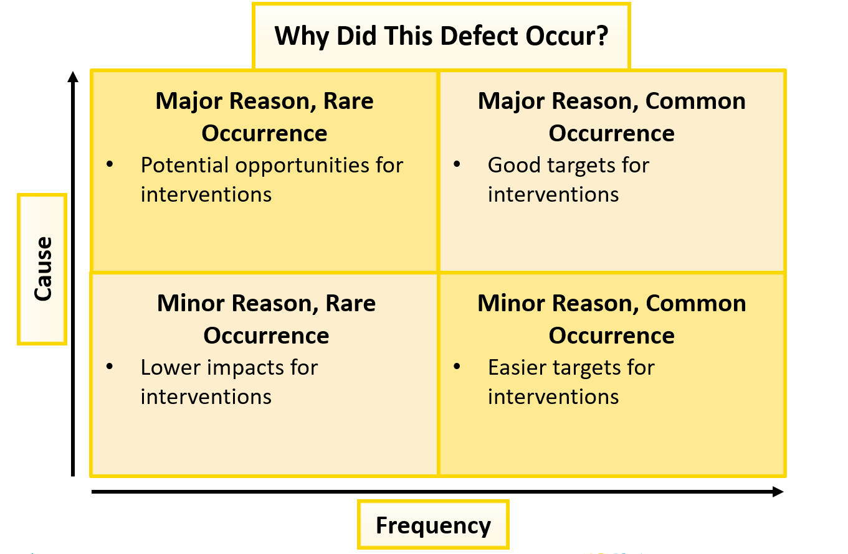
Evaluating Contributing Factors: Cause-Frequency Grid

Slide 17
SMART Goals
Specific: Target a specific task, area, or metric for improvement
Measurable: Include a clear quantifiable measurement of success
Assignable: Include who will own the goals
Realistic: Should not be impossible
Time-specific: Should have a clear deadline or timeline

Slide 18
Tips To Reduce the Risk of the Defects From Happening Again
Tips to begin brainstorming interventions:
Brainstorm with the entire team to identify interventions that address key contributing factors
Connect with other CUSP teams who may be working on the same defect
Not all interventions are created equal
Engage all stakeholders in the process

Slide 19
Building Resiliency Into Interventions
Examples of interventions, in order of decreasing strength of effectiveness, include the following:
Forcing functions and constraints
Automation and computerization
Standardization and protocols
Checklists and independent check systems
Rules and policies
Education and information
Vague warnings
When considering interventions, reflect on and maximize the strength of effectiveness.

Slide 20
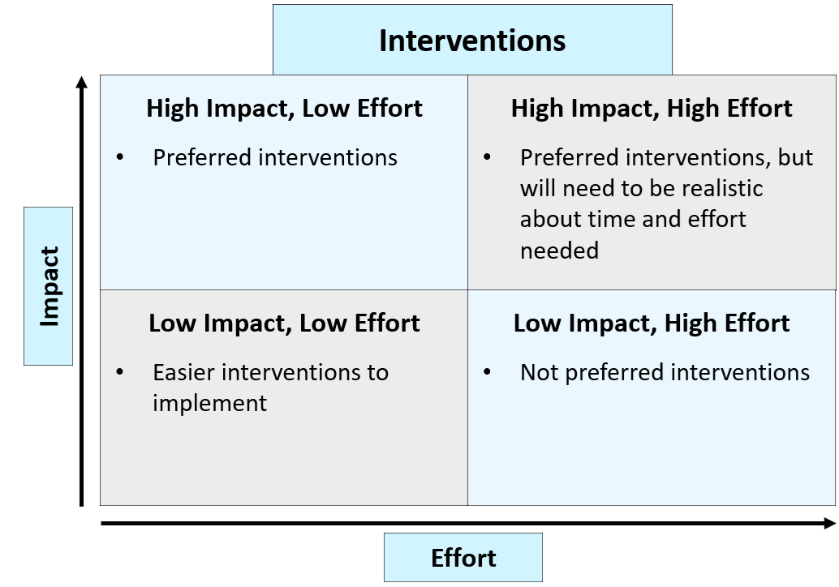
Evaluating Interventions: Impact-Effort Grid

Slide 21
Question 4
How Will You Know the Risk Is Reduced?

Slide 22
How To Determine the Risk is Reduced
Identify how to measure success.
Put an audit plan into place to track that measure.
Incorporate data feedback from all stakeholders.
Review audits and adjust interventions as needed.
May require thinking about defects again.
The LFD process is continuous.

Slide 23
Anticipating Challenges to Using LFD
Data capture challenges
Aim to simplify the data capture process (e.g., observational audits or surveys)
Time consuming
Set realistic expectations on time needed
Team buy-in challenges
Engage supervisors to allot time for LFD work to be done

Slide 24
Case Example
An Increase in Healthcare-Acquired MRSA Infections

Slide 25
Case Example Using the Investigating a Defect Worksheet: Reflect
Access the worksheet here.

Slide 26
Case Example 1 Using the Investigating a Defect Worksheet: Reflect
Access the worksheet here.

Slide 27
Case Example Evaluating Contributing Factors: Cause-Frequency Grid

Slide 28
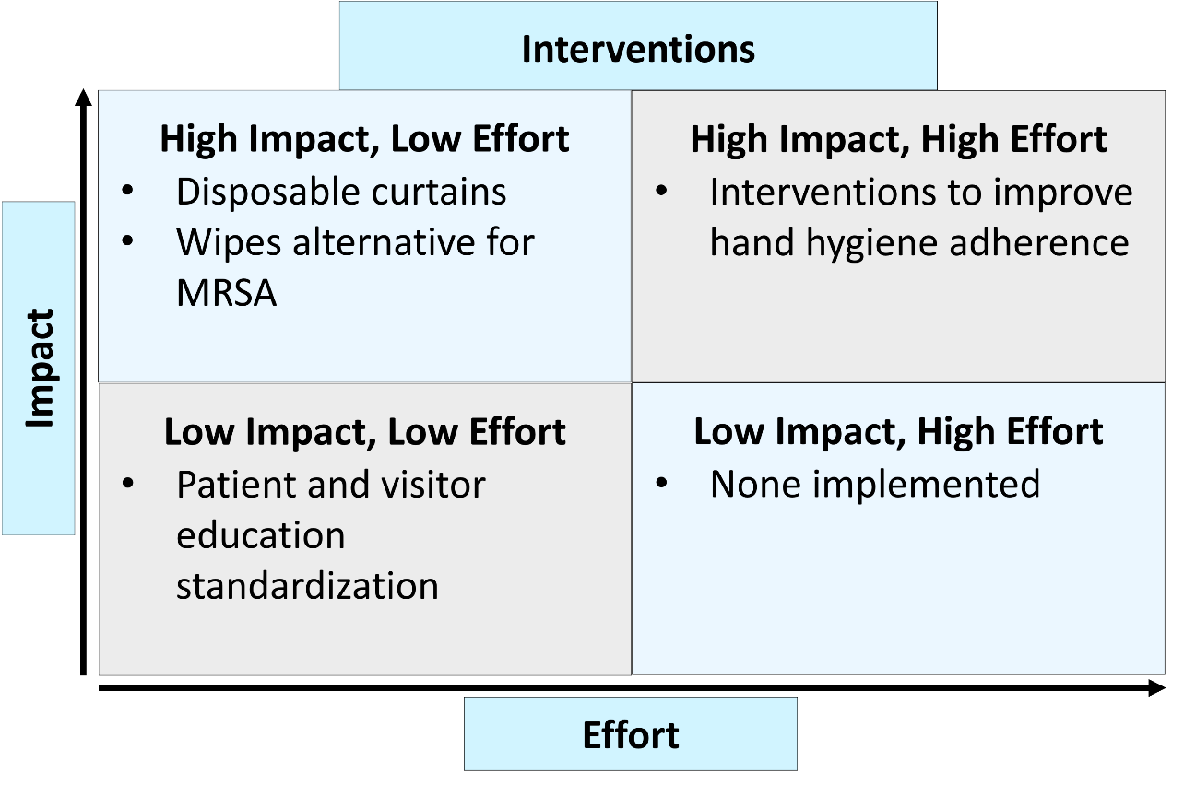
Case Example Evaluating Interventions: Impact-Effort Grid

Slide 29
Case Example 2 Using the Investigating a Defect Worksheet: Reflect
Access the worksheet here.

Slide 30
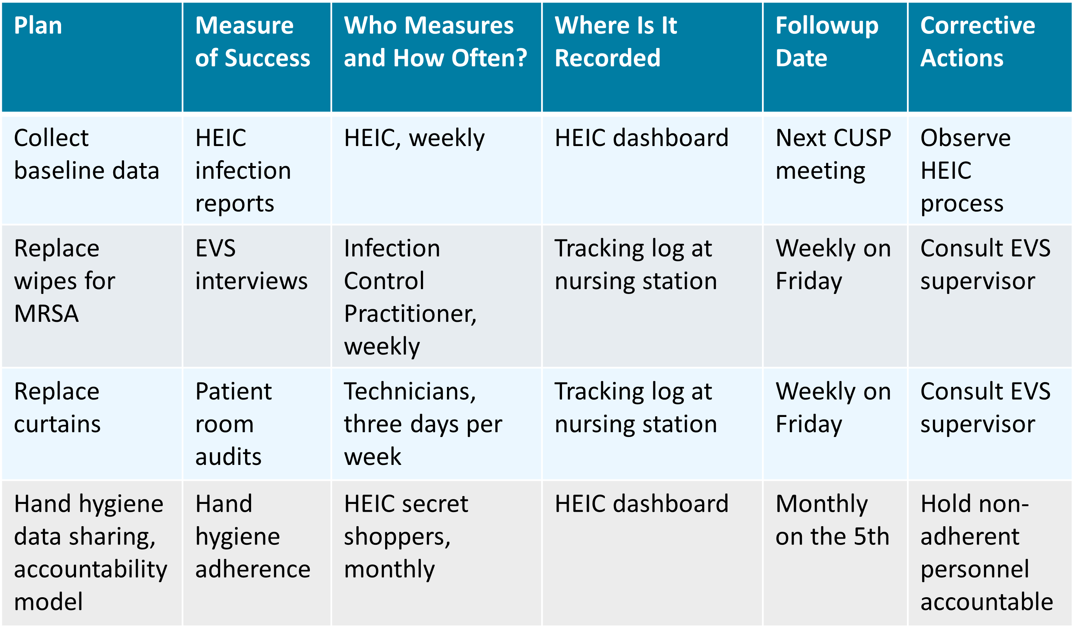
Case Example Interventions and Metrics

Slide 31
Case Example 3 Using the Investigating a Defect Worksheet: Reflect
Access the worksheet here.

Slide 32
Celebrate Successes
The LFD process is hard work and requires effort and feedback
from all leadership levels.
Remember to acknowledge and celebrate successes!

Slide 33
CUSP Tools Summary
As a reminder, the following tools exist to guide teams through the LFD process:
Access the Staff Safety Assessment on the toolkit
Access the Learning From Defects Tool for MRSA Prevention on the toolkit
Access the Example of a Completed Learning From Defects Tool on the toolkit
Access the Investigating a Defect Worksheet on the toolkit

Slide 34
Key Takeaways
Defects are clinical or operational events that you do not want to happen again.
The LFD process enables teams to look at the system surrounding the defects and their underlying causes, often resulting in highly effective interventions.
The following four questions help teams analyze and prevent defects:
What happened?
Why did it happen?
How will you reduce the likelihood of this defect happening again?
How will you know the risk is reduced?
There is no quick fix when it comes to LFD and mitigating MRSA risk. Remember to work together and to celebrate successes!

Slide 35
Disclaimer
The findings and recommendations in this presentation are those of the authors, who are responsible for its content, and do not necessarily represent the views of AHRQ. No statement in this presentation should be construed as an official position of AHRQ or of the U.S. Department of Health and Human Services.
Any practice described in this presentation must be applied by healthcare practitioners in accordance with professional judgment and standards of care in regard to the unique circumstances that may apply in each situation they encounter. These practices are offered as helpful options for consideration by healthcare practitioners, not as guidelines.

Slide 36
Reference List
Pronovost P, Weast B, Rosenstein B, et al. Implementing and validating a comprehensive unit-based safety program. J Patient Saf. 2005. 1(1):33-40.
Tucker AL. The impact of operational failures on hospital nurses and their patients. J Oper Manage. 2004;22(2):151.
Edmondson AC. Learning from failure in health care: frequent opportunities, pervasive barriers. Qual Saf Health Care. 2004 Dec;13 Suppl 2(Suppl 2):ii3-9. PMID: 15576689.
Vincent C, Taylor-Adams S, Stanhope N. Framework for analysing risk and safety in clinical medicine. BMJ. 1998 Apr 11;316(7138):1154-7. PMID: 9552960.

