Slide 1
AHRQ Safety Program for MRSA Prevention
Antibiotic Stewardship and MRSA Reduction
ICU & Non-ICU
AHRQ Pub. No. 25-0007
October 2024

Slide 2
Educational Objectives
Understand the goals of antibiotic stewardship.
Discuss the association between antibiotic use and MRSA colonization and infection.
Describe evidence that antibiotic stewardship can impact risk of MRSA colonization and infection.
Identify approaches that a hospital unit can implement to improve antibiotic decision making.

Slide 3
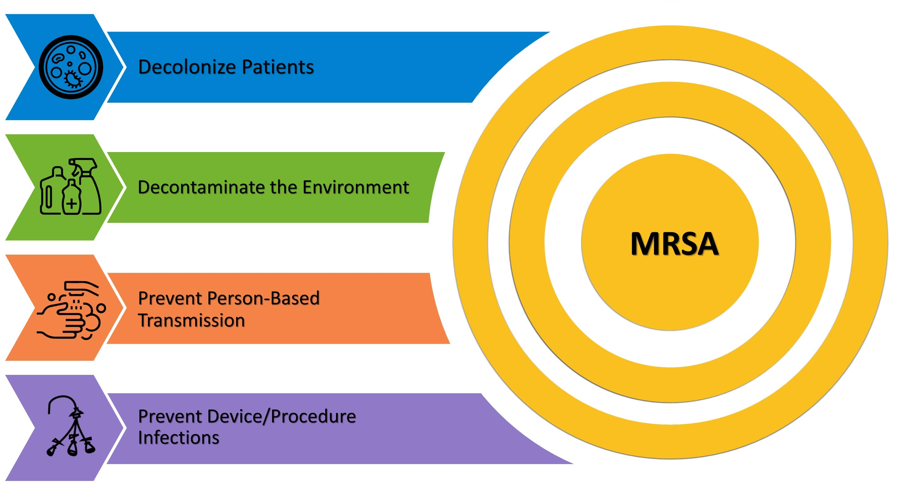
Take Aim to Prevent MRSA

Slide 4


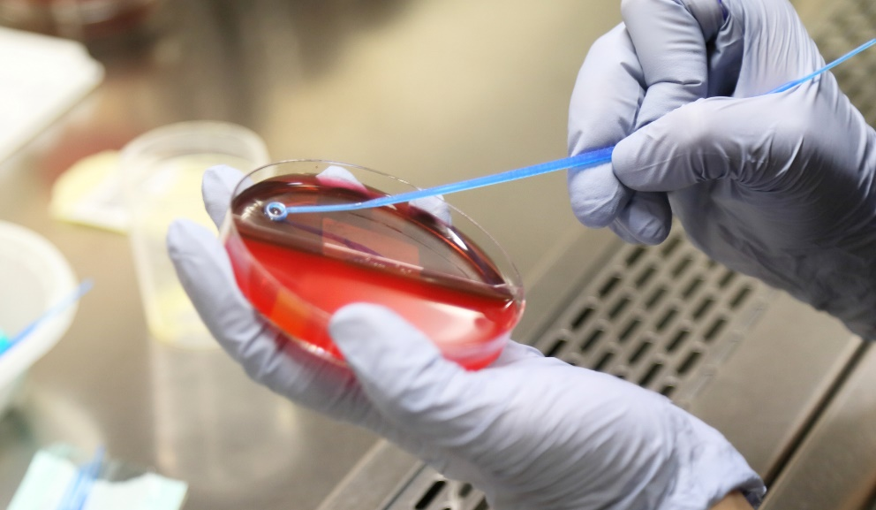
Fundamental Best Practices
Antibiotic Stewardship
Blood Culture Stewardship
These practices don’t fit into any one of the four key strategic areas but underpin all of them.
They promote and preserve the effectiveness of antibiotic treatments and diagnostic accuracy. They are crucial for MRSA prevention.

Slide 5

Some Facts About Antibiotic Use
Although antibiotics have saved countless lives, their use is not benign or risk neutral.
At least 20 percent of hospitalized patients experience an adverse reaction.¹
  Rash
  Nephrotoxicity
  Clostridioides difficile infection
  Emergence of antibiotic resistance
Greater than 95 percent of adverse events have clinical ramifications.¹
  Additional hospitalizations (3 percent)
  Prolonged hospital stay (24 percent)
  Additional clinic or ED visits (9 percent)
  Additional laboratory tests,
  electrocardiograms, or imaging (61 percent)
30 to 50 percent of antibiotics use in hospitals is inappropriate.^{2,3}

Slide 6

What Is Antibiotic Stewardship?
Coordinated interventions to improve and measure the appropriate use of antibiotics by promoting the selection of the optimal antibiotic drug regimen, dose, duration of therapy, and route of administration.
Ensuring that every patient gets:
An antibiotic only when one is needed
The right agent
At the right dose
For the right duration

Slide 7
Antibiotic Exposure and MRSA Risk
Fluoroquinolones have been most strongly and consistently associated with MRSA colonization and infection.
  Fluoroquinolone exposure independently associated with MRSA nasal colonization in a prospective cohort of LTC patients who underwent weekly screening.⁴
  Fluoroquinolone exposure independently associated with MRSA infection in hospitalized patients.⁵
Glycopeptides, cephalosporins, and beta-lactam antibiotics also associated with MRSA colonization and infection in a meta-analysis.⁶

Slide 8
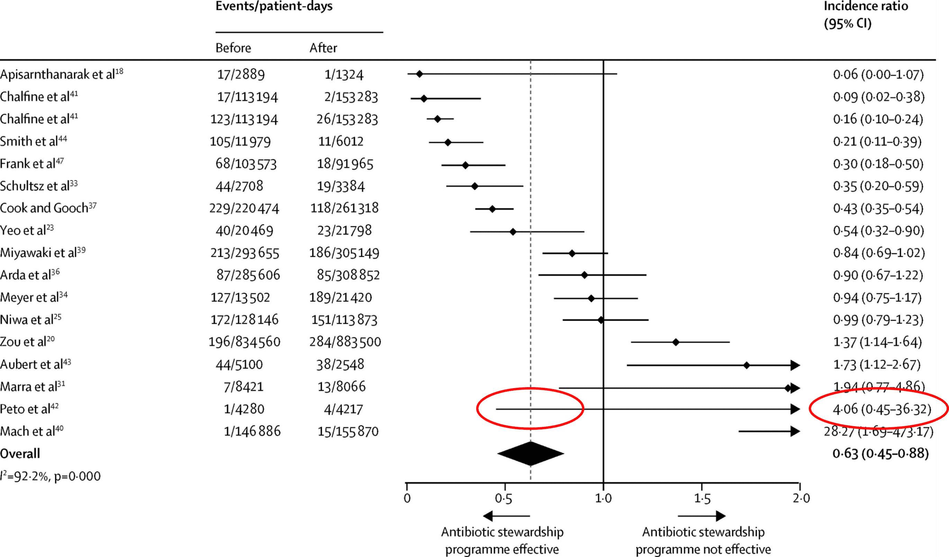
Association Between Antibiotic Stewardship and MRSA Reduction
37 percent reduction of MRSA⁷
Used with permission of Elsevier Science & Technology Journals, from “Effect of antibiotic stewardship on the incidence of infection and colonization with antibiotic-resistant bacteria and Clostridium difficile infection: a systematic review and meta-analysis” in Lancet Infectious Disease, by Baur D, Gladstone BP, Burkert F, et al., Volume 17, Issue 9, 2017; permission conveyed through Copyright Clearance Center, Inc.

Slide 9
Reductions in MRSA Associated With Reduction of Antibiotic Use in Scotland⁸
Quasi-experimental studies conducted to assess the impact of the Scottish antibiotic stewardship and infection control plan on hospital and community MRSA rates.
A total of 1,289,929 hospital admissions and 455,508 adult primary care patients in northeast Scotland between 1997 and 2012.

Slide 10
Multiple Interventions⁸
Antibiotic Stewardship Interventions
  Regional ASP with pharmacists and infectious diseases specialists funded by NHS Scotland starting in 2008
  Guidelines recommending against the use of 4C antibiotics:
    Fluoroquinolones
    Cephalosporins
    Amoxicillin-clavulanate
    Clindamycin
  Required approval to use 4C agents from an ID specialist if not used for approved indications
Infection Control Interventions
  Monthly auditing of hospital cleaning (started 2006)
  National hand hygiene campaign (started 2007)
  MRSA admission screening (universal screening from 2008 to 2011; targeted surveillance with decolonization starting in 2011)

Slide 11
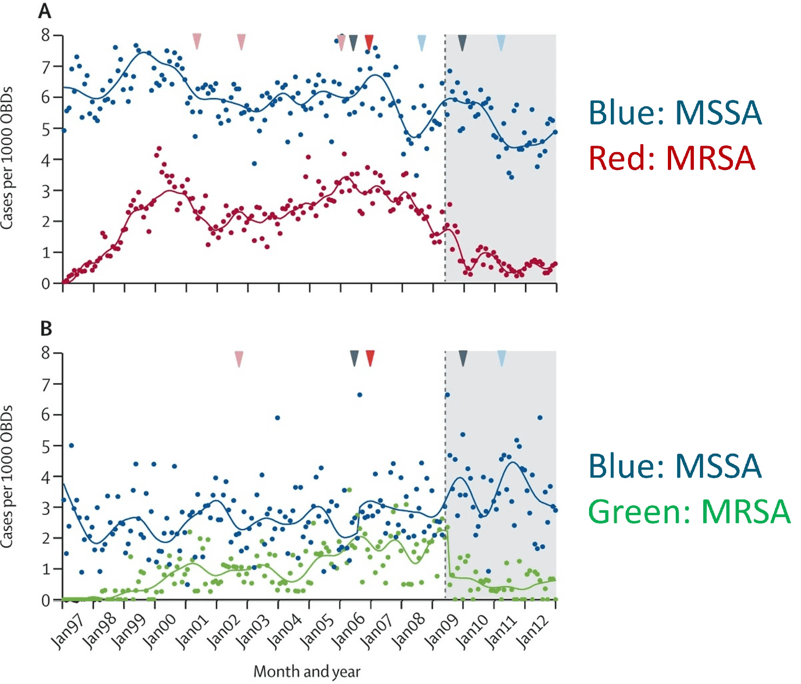
MRSA Reduction in the Hospital⁸
Interventions implemented:
2006: Environmental cleaning
2007: Hand hygiene
2008: MRSA admission screening
2011: MRSA decolonization
50 percent reduction in hospital cases of MRSA
Used with permission of Elsevier Science & Technology Journals, from “Effects of national antibiotic stewardship and infection control strategies on hospital-associated and community-associated meticillin-resistant Staphylococcus aureus infections across a region of Scotland: a non-linear time-series study” in Lancet Infectious Disease, by Lawes T, Lopez-Lozano JM, Nebot CA et al., Volume 15, Issue 12, 2015; permission conveyed through Copyright Clearance Center, Inc.

Slide 12
Steps to Improve Antibiotic Stewardship on a Unit
Identify unit-based champions for improving antibiotic stewardship.
Contact your hospital’s Antibiotic Stewardship Program (ASP) to ask for assistance.
In conjunction with the ASP, identify areas for improvement in antibiotic prescribing.
Design and execute an intervention.
Engage frontline providers in routine, daily self-stewardship.

Slide 13

Step 1: Unit-Based Stewardship Champions
Physician and/or Advanced Practitioner
  Thought-leader trusted by other prescribers
  Review current practice, develop guidance for specific prescribing situations, and execute interventions
Pharmacist
  Daily review of antibiotic use with feedback to prescribers
  Liaison to the stewardship program
  Review current practice, develop guidance for specific prescribing situations, and execute interventions
Nurse
  Evaluation of patients for adverse events and administration of antibiotics
  Assistance with prompting need for antibiotic review

Slide 14

Step 2: Working With the Hospital ASP
The Centers for Medicare & Medicaid Services and The Joint Commission both require hospitals to have antibiotic stewardship programs (ASPs).
ASPs are responsible for tracking antibiotic use and resistance, developing guidelines for common infectious diseases syndromes, and performing and evaluating interventions to improve antibiotic prescribing.
Your ASP should be able to provide your unit with useful information, including:
  Antibiotic use rates stratified by antibiotic class
    Ideally benchmarked based on national data reported to CDC, or relative to other similar units in the hospital
  Appropriateness of antibiotic use
    Based on existing interventions in your unit or assessment of compliance with local prescribing guidelines

Slide 15

Step 3: Identify Areas for Improved Prescribing
Determine what antibiotics or syndromes you want to target.
  Antibiotics
    Fluoroquinolones⁹
    Other commonly prescribed antibiotics (e.g., ceftriaxone, cefepime, piperacillin/tazobactam)
  Syndromes
    Asymptomatic bacteriuria/
    urinary tract infection^{10,11}
    Pneumonia^{12,13}
    Suspected sepsis
Access the AHRQ Toolkit To Improve Antibiotic Use in Acute Care here.¹⁴

Slide 16
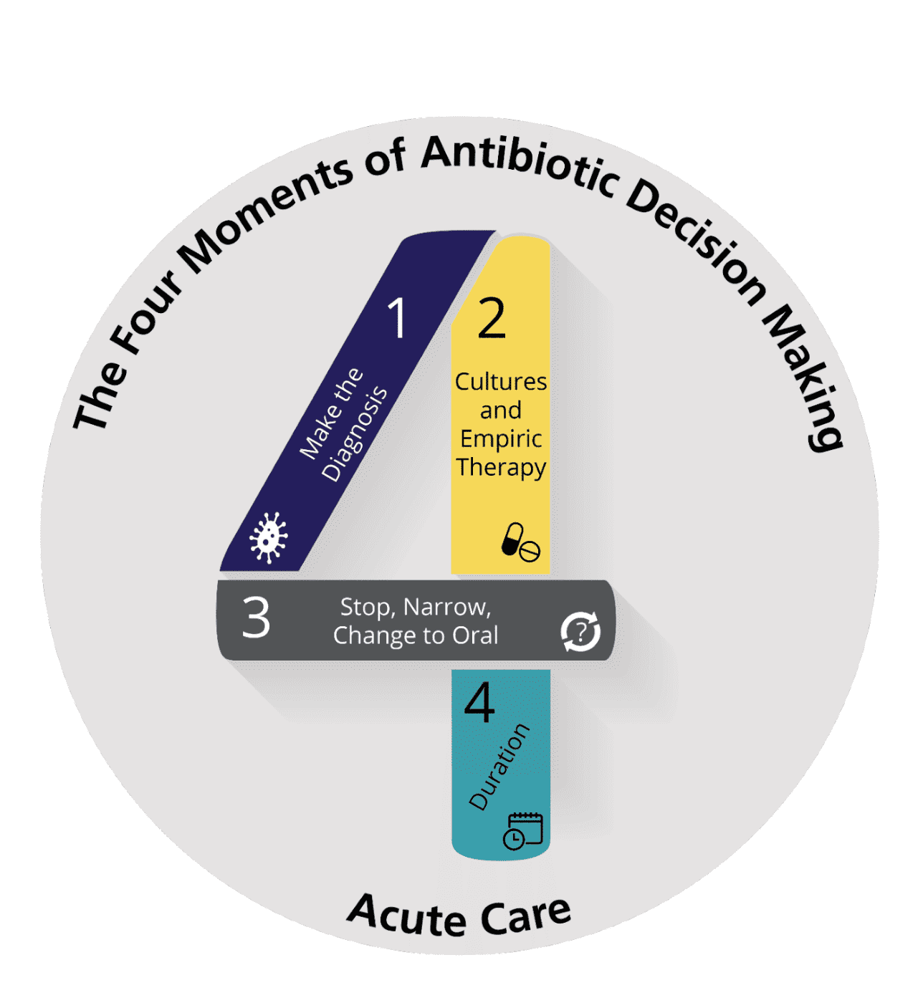
Four Moments of Antibiotic Decision Making¹⁵
Does my patient have an infection that requires antibiotics?
Have I ordered appropriate cultures before starting antibiotics? What empiric therapy should I initiate?
A day or more has passed. Can I stop antibiotics? Can I narrow therapy or change from IV to oral therapy?
What duration of antibiotic therapy is needed for my patient's diagnosis?

Slide 17
Step 4: Design and Execute an Intervention
Review existing hospital guidelines for the targeted antibiotics and syndromes with the hospital ASP to determine if changes are needed or if new guidelines need to be developed.
  Guidelines for antibiotics should contain information on when they are indicated and when they are not.
  Guidelines for syndromes should contain information on diagnosis, empiric therapy stratified by illness severity and relevant host factors, step-down and oral therapy, and duration.
Develop strategies to integrate guidelines into practice.
  Order sets
  Post-prescription review with feedback from the ASP or unit pharmacist
  Feedback of data to chart progress
  Integrate the Four Moments of Antibiotic Decision Making into routine practice such as during rounds or in progress notes

Slide 18

Step 5: Engage Frontline Prescribers
Disseminate information on what you want frontline prescribers to do.
  Meetings
  Emails
  One-on-one detailing
Provide strategies to prompt them to critically review their own antibiotic use on a daily basis.
Make available the necessary tools, along with the evidence and prescribing recommendations, at the point of care.
Provide feedback to them on how they are doing.
  Can be unit-based or individual prescriber-based

Slide 19
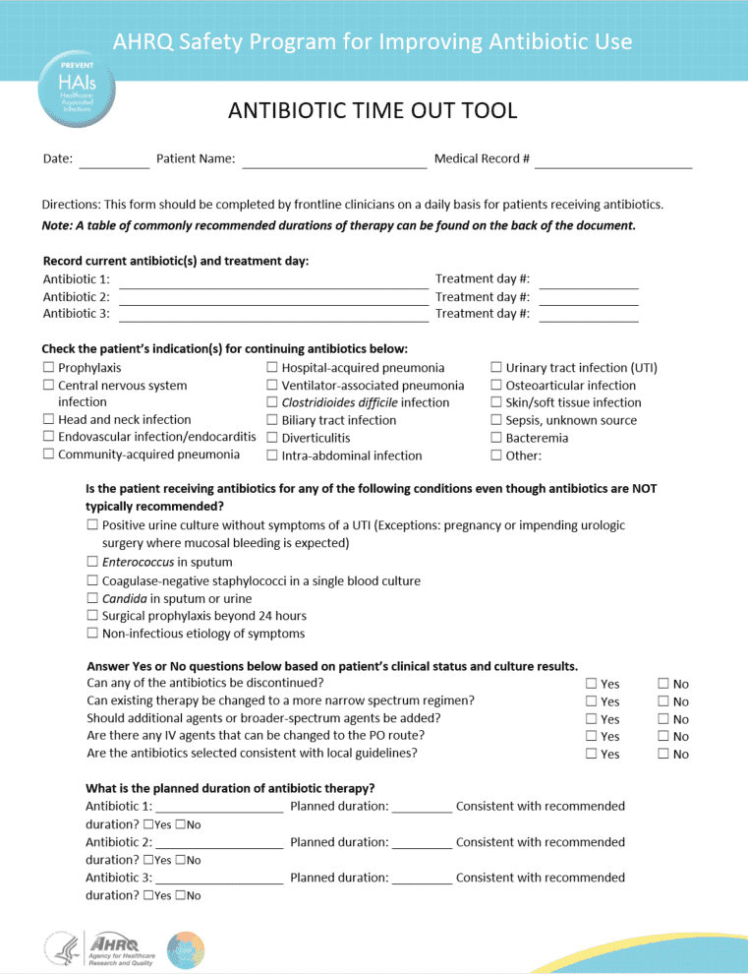
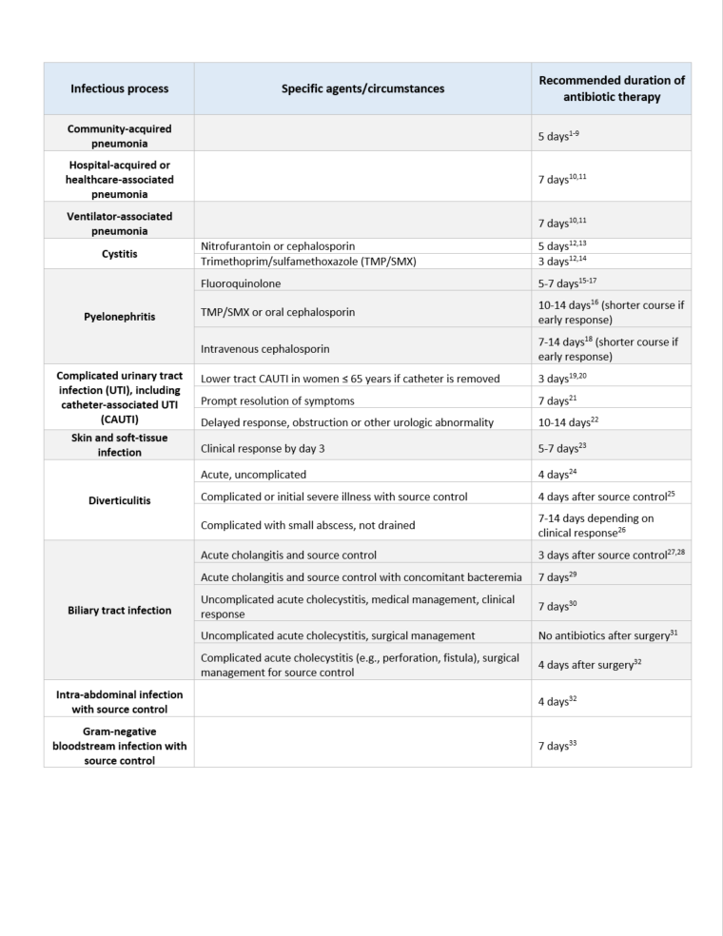
Antibiotic Time Out Tool¹⁶
Download this tool from the AHRQ Antibiotic Stewardship Toolkit.

Slide 20
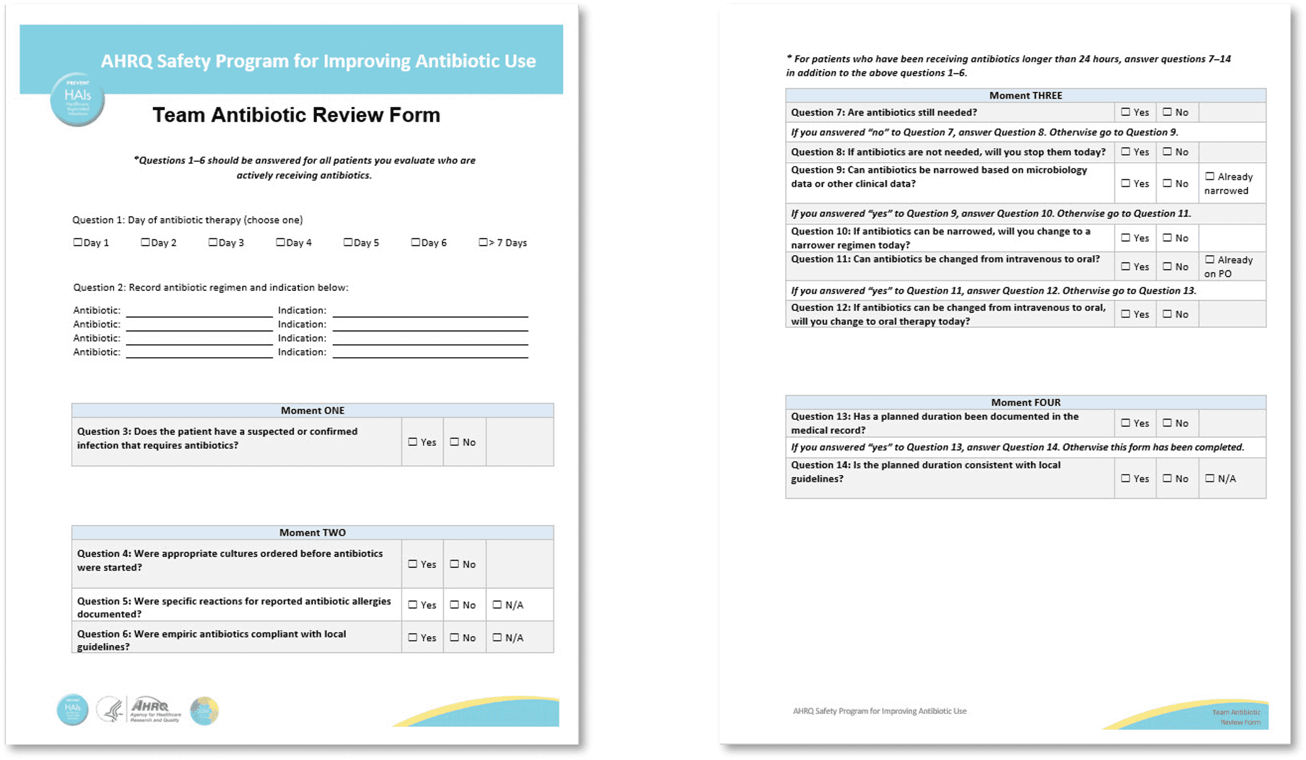
Team Antibiotic Review Form¹⁷
Download this tool from the AHRQ Antibiotic Stewardship Toolkit.

Slide 21

Communicating With Colleagues About Antibiotic Decisions
Your Goal is Improving Antibiotic Use

Slide 22
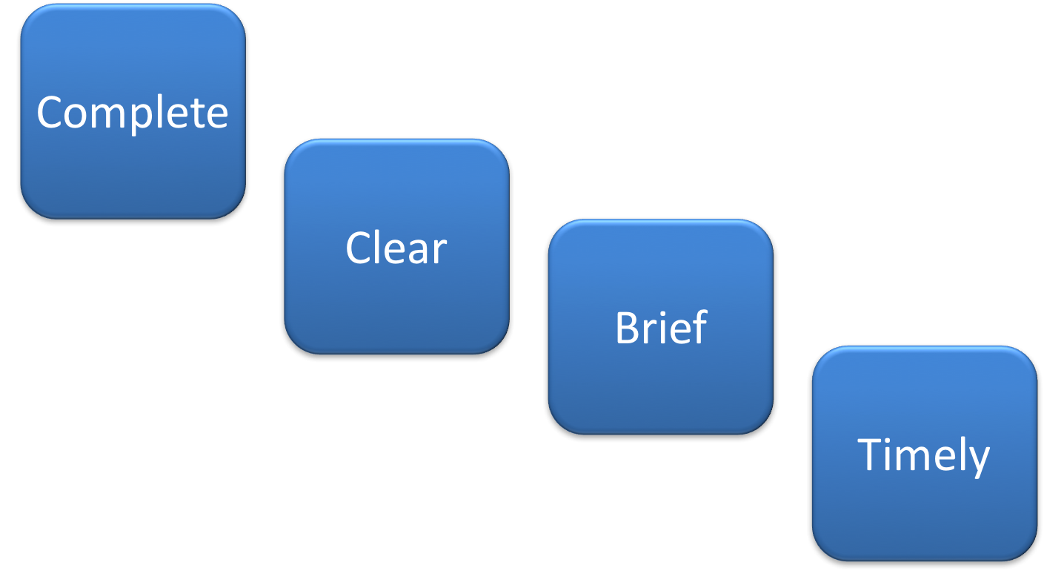
Four Key Components of Effective Communication¹⁸

Slide 23
Use Assertive (Not Aggressive) Statements
Assertive | Aggressive
Approach for effective communication | Approach that impairs communication
Standing up for your own or a patient’s interests Remaining calm and positive Not being actively or passively aggressive | Attacking other’s opinions in favor of your own Ignoring other’s opinions in favor of your own

Slide 24

Elements of Appropriate Assertion
Provide evidence or data to support your concerns and recommendations.
Focus on the common goals of quality care and the welfare of the patient.
Avoid the issue of who’s right and who’s wrong.
Actively avoid being perceived as judgmental.
Gather your thoughts before speaking.

Slide 25

Case: Possible Vancomycin Toxicity?
An 80-year-old man admitted from a nursing home with suspected pneumonia, showing clinical improvement but with a rise in creatinine.
Initial treatment: Vancomycin and piperacillin/tazobactam
Diagnostic results: Negative sputum Gram-stain and cultures, negative blood cultures.
Proposed treatment adjustment: Stop vancomycin and piperacillin/tazobactam, start oral cephalosporin for 5 days.
Colleague’s concern: Stopping MRSA and pseudomonal coverage due to nursing home origin and initial severity of illness.
Think about ways that you could resolve these different views regarding antibiotic therapy.

Slide 26

Case: Try an Aggressive Stance
Example #1:
You could say:
“That’s ridiculous! Why do you want to keep giving the patient antibiotics that are hurting his kidneys just because you’re nervous?”
However, that sounds like a judgmental, personal attack on the other physician and is unlikely to bring about resolution.

Slide 27

Case: Alternatively, Use an Assertive Tack
Example #2:
Alternatively, you could say:
“I appreciate your insight as the person who admitted the patient. It’s great that the patient is now doing so much better.”
“I am concerned that his creatinine is increasing on the current regimen. Since his cultures don’t show MRSA or Pseudomonas, I think it would be reasonable to stop the vancomycin today, perhaps then narrow the piperacillin/tazobactam tomorrow if he still looks good. I feel like the risk of vancomycin toxicity is greater than the risk that he has an MRSA infection. Would that approach work for you?”

Slide 28

Case: Pull It Together
Overview:
In the second example, you have acknowledged the legitimate concerns of a colleague and offered a reasonable compromise and provided a rationale with the patient’s best interest in mind.
If the colleague agrees, it is best to restate the plan out loud to ensure consensus and make the plan clear.
  “Let’s stop the vancomycin today. If he looks good on rounds tomorrow, we will switch the piperacillin/tazobactam to cefpodoxime for three more days.”

Slide 29

Advocacy and Assertion¹⁹
An assertive approach includes:
  Initiating the discussion
  Stating the concern
  Acknowledging other’s points of view
  Offering a solution
  Providing evidence for your concern and recommendations
  Obtaining agreement

Slide 30
Key Takeaways
There is an association between antibiotic use and MRSA colonization and infection, particularly with fluoroquinolones
Antibiotic stewardship interventions targeted at reducing use of broad-spectrum agents is associated with MRSA reduction
Improving antibiotic prescribing can be facilitated by implementation of five steps:
  Identify unit-based champions for improving antibiotic stewardship.
  Engage the hospital’s Antibiotic Stewardship Program for assistance.
  In conjunction with the ASP, identify areas for improvement in antibiotic prescribing.
  Design and execute an intervention.
  Engage frontline providers in routine, daily self-stewardship.
Individuals and teams should identify and implement opportunities to improve communication around antibiotic prescribing.

Slide 31
Disclaimer
The findings and recommendations in this presentation are those of the authors, who are responsible for its content, and do not necessarily represent the views of AHRQ. No statement in this presentation should be construed as an official position of AHRQ or of the U.S. Department of Health and Human Services.
Any practice described in this presentation must be applied by healthcare practitioners in accordance with professional judgment and standards of care in regard to the unique circumstances that may apply in each situation they encounter. These practices are offered as helpful options for consideration by healthcare practitioners, not as guidelines.

Slide 32
Reference List—1
Tamma PD, Avdic E, Li DX, et al. Association of adverse events with antibiotic use in hospitalized patients. JAMA Intern Med. 2017 Sep 1;177(9):1308-15. PMID: 28604925.
Hecker MT, Aron DC, Patel NP, et al. Unnecessary use of antimicrobials in hospitalized patients: current patterns of misuse with an emphasis on the antianaerobic spectrum of activity. Arch Intern Med. 2003 Apr 28;163(8):972-8. PMID: 12719208.
Magill SS, O'Leary E, Ray SM, et al. Emerging infections program hospital prevalence survey team. Assessment of the appropriateness of antimicrobial use in US hospitals. JAMA Netw Open. 2021 Mar 1;4(3):e212007. JAMA Netw Open. 2021 Apr 1;4(4):e219526. PMID: 3373441.
Couderc C, Jolivet S, Thiébaut AC, et al. Fluoroquinolone use is a risk factor for methicillin-resistant Staphylococcus aureus acquisition in long-term care facilities: a nested case-case-control study. Clin Infect Dis. 2014 Jul 15;59(2):206-15. PMID: 24729496.
Weber SG, Gold HS, Hooper DC, et al. Fluoroquinolones and the risk for methicillin-resistant Staphylococcus aureus in hospitalized patients. Emerg Infect Dis. 2003 Nov;9(11):1415-22. PMID: 14718085.
Tacconelli E, De Angelis G, Cataldo MA, et al. Does antibiotic exposure increase the risk of methicillin-resistant Staphylococcus aureus (MRSA) isolation? A systematic review and meta-analysis. J Antimicrob Chemother. 2008 Jan;61(1):26-38. PMID: 17986491.

Slide 33
Reference List—2
Baur D, Gladstone BP, Burkert F, et al. Effect of antibiotic stewardship on the incidence of infection and colonization with antibiotic-resistant bacteria and Clostridium difficile infection: a systematic review and meta-analysis. Lancet Infect Dis. 2017 Sep;17(9):990-1001. PMID: 28629876.
Lawes T, Lopez-Lozano JM, Nebot CA, et al. Effects of national antibiotic stewardship and infection control strategies on hospital-associated and community-associated meticillin-resistant Staphylococcus aureus infections across a region of Scotland: a non-linear time-series study. Lancet Infect Dis. 2015 Dec;15(12):1438-49. PMID: 26411518.
Sankar A, Swanson KM, Zhou J, et al. Association of fluoroquinolone prescribing rates with black box warnings from the US Food and Drug Administration. JAMA Netw Open. 2021 Dec 1;4(12):e2136662. PMID: 34851398.
Nicolle LE, Gupta K, Bradley SF, et al. Clinical practice guideline for the management of asymptomatic bacteriuria: 2019 update by the Infectious Diseases Society of America. Clin Infect Dis. 2019 May 2;68(10):e83-e110. PMID: 30895288.
Gupta K, Hooton TM, Naber KG, et al. International clinical practice guidelines for the treatment of acute uncomplicated cystitis and pyelonephritis in women: a 2010 update by the Infectious Diseases Society of America and the European Society for Microbiology and Infectious Diseases. Clin Infect Dis. 2011 Mar 1;52(5):e103-20. PMID: 21292654.

Slide 34
Reference List—3
Metlay JP, Waterer GW, Long AC, et al. Diagnosis and treatment of adults with community-acquired pneumonia. An official clinical practice guideline of the American Thoracic Society and Infectious Diseases Society of America. Am J Respir Crit Care Med. 2019 Oct 1;200(7):e45-67. PMID: 31573350.
Kalil AC, Metersky ML, Klompas M, et al. Management of adults with hospital-acquired and ventilator-associated pneumonia: 2016 clinical practice guidelines by the Infectious Diseases Society of America and the American Thoracic Society. Clin Infect Dis. 2016 Sep 1;63(5):e61-111. PMID: 27418577.
Agency for Healthcare Research and Quality (AHRQ). Toolkit To Improve Antibiotic Use in Acute Care Hospitals. Updated October 2022. Agency for Healthcare Research and Quality. Rockville MD.
https://www.ahrq.gov/antibiotic-use/acute-care/index.html. Accessed January 4, 2023.
Agency for Healthcare Research and Quality (AHRQ). Four Moments of Antibiotic Decision Making. https://www.ahrq.gov/antibiotic-use/acute-care/four-moments/index.html. Agency for Healthcare Research and Quality. Rockville, MD. Accessed January 4, 2023.
Agency for Healthcare Research and Quality (AHRQ). Antibiotic Time Out Tool. https://www.ahrq.gov/sites/default/files/wysiwyg/antibiotic-use/improve/antibiotic-time-out-tool.docx. Accessed January 12, 2023.

Slide 35
Reference List—4
Agency for Healthcare Research and Quality (AHRQ). Team Antibiotic Review Form. https://www.ahrq.gov/antibiotic-use/acute-care/improve/team-review.html. Accessed January 12, 2023.
TeamSTEPPS for Office-Based Care: Communication. Content last reviewed September 2015. Agency for Healthcare Research and Quality, Rockville, MD. Source: http://www.ahrq.gov/teamstepps/officebasedcare/module3/office_comm.html. Accessed June 19, 2024.
Conflict Resolution (Slide Presentation). Content last reviewed October 2014. Agency for Healthcare Research and Quality, Rockville, MD. Source: http://www.ahrq.gov/professionals/education/curriculum-tools/cusptoolkit/toolkit/contentcalls/conflict_resolution-slides/conflictresslides.html. Accessed June 19, 2024.

