Slide 1
AHRQ Safety Program for MRSA Prevention
Blood Culture Practices and Stewardship
ICU & Non-ICU
AHRQ Pub. No. 25-0007
October 2024

Slide 2
Educational Objectives
Discuss the importance of promoting blood culture stewardship in hospitals
Discuss the definition and risk associated with blood culture contamination
Discuss strategies to promote blood culture stewardship and reduce blood culture contamination
Discuss how to implement blood culture stewardship interventions
Notes:
*Revise script

Slide 3
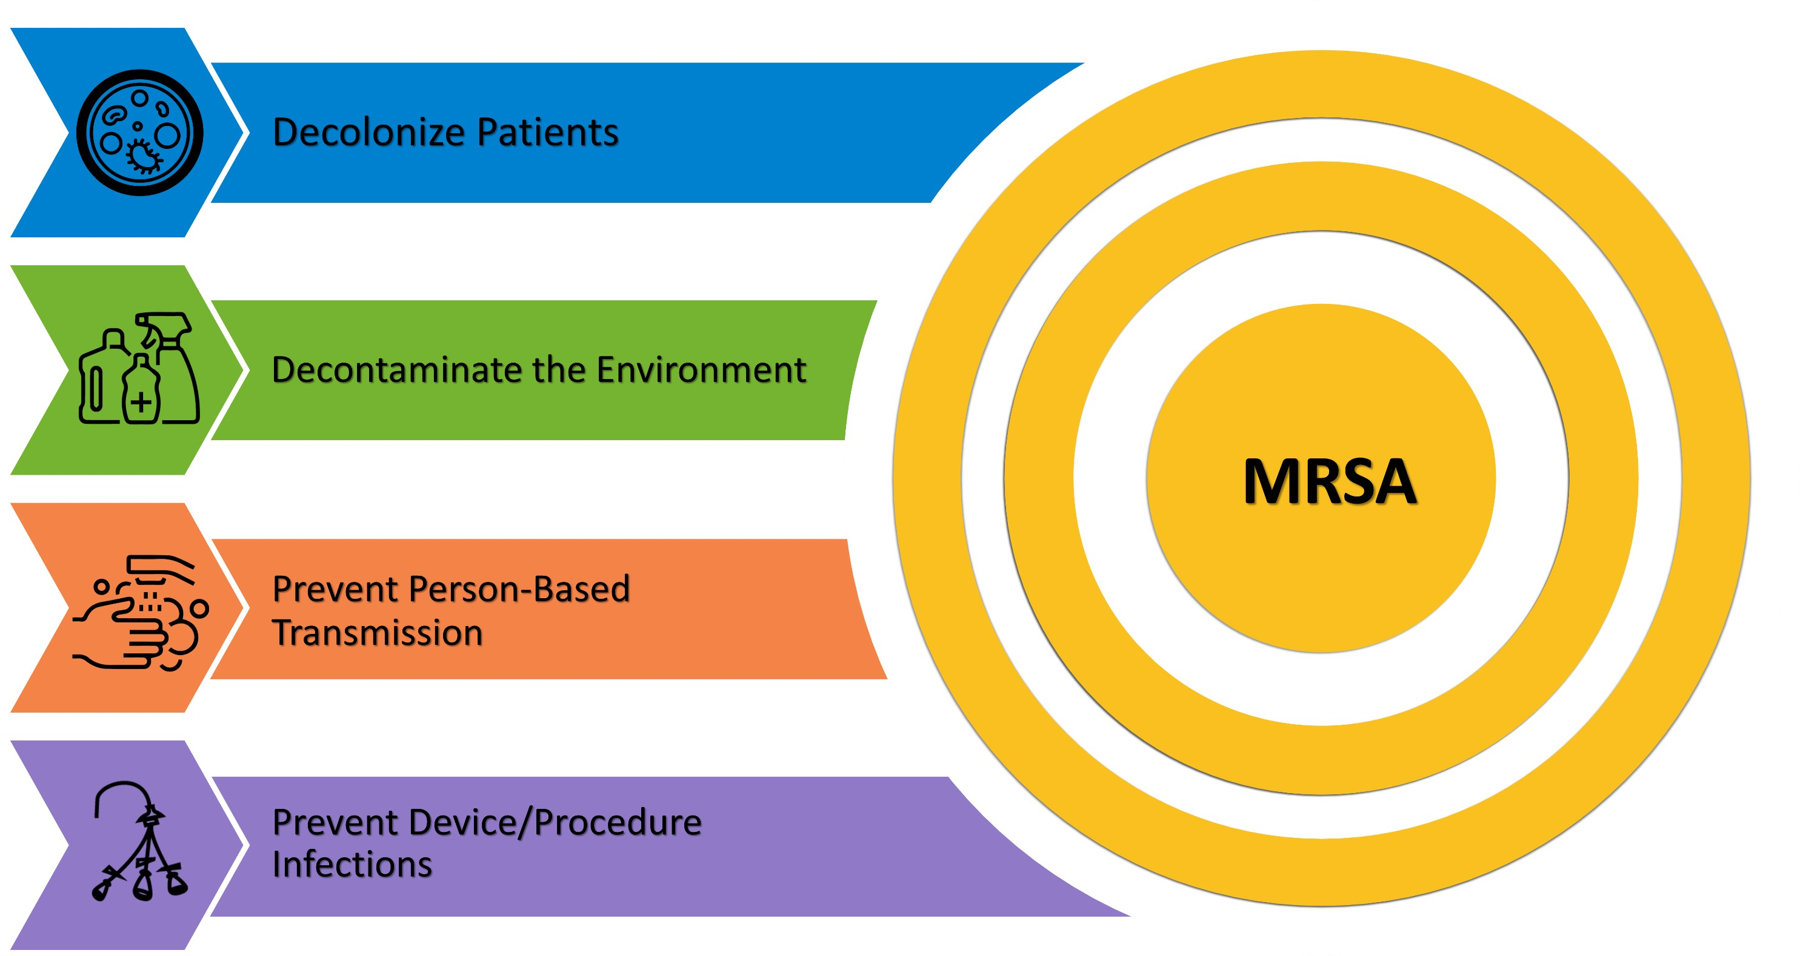
Take Aim To Prevent MRSA

Slide 4


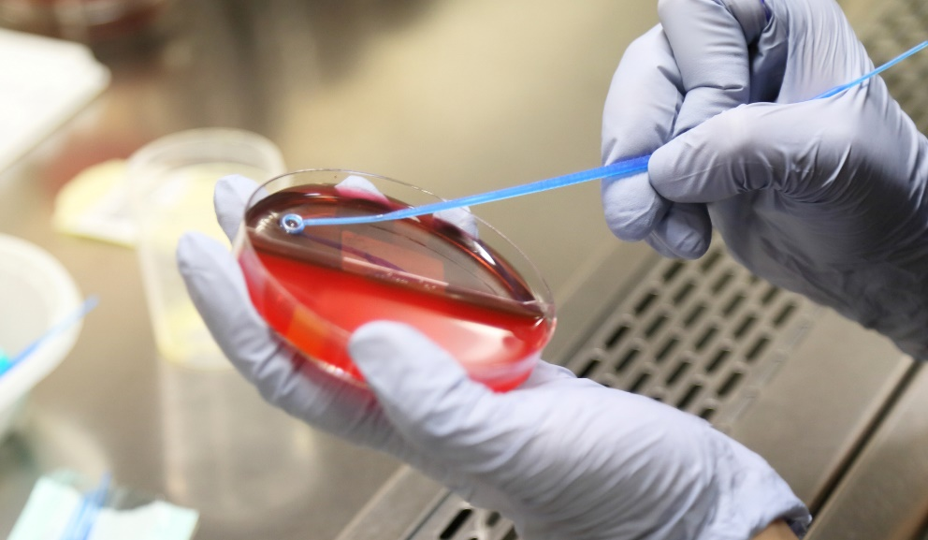
Fundamental Best Practices
Antibiotic Stewardship
Blood Culture Stewardship
These practices don’t fit into any one of the four key strategic areas but underpin all of them.
They promote and preserve the effectiveness of antibiotic treatments and diagnostic accuracy. They are crucial for MRSA prevention.

Slide 5

Diagnostic Stewardship
Diagnostic Stewardship: “Prioritizing the right test, for the right patient, to prompt the right action.”¹
  Over-testing can lead to overdiagnosis, unnecessary treatment, and excess cost.
  Optimizing testing reduces false positives, facilitates accurate diagnosis, promotes appropriate antimicrobial treatment, and reduces antimicrobial resistance.
Antimicrobial and diagnostic stewardship have been shown to improve antibiotic use and patient outcomes, such as reducing length of stay and MRSA infections.²

Slide 6
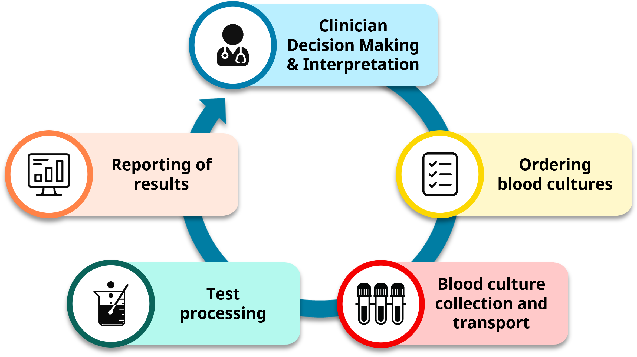
Blood Culture Stewardship¹
Blood culture (BCx) stewardship aims to optimize bacteremia detection and reduce inappropriate diagnostic testing and antibiotic use related to false-positive results.³

Slide 7
Importance of Blood Culture Stewardship
Blood cultures are one of the most common microbiologic tests among hospitalized patients.
Only 2 to 10 percent of blood cultures grow.³ Up to half of these positive results represent blood culture contamination.⁵⁻⁷
Blood culture contamination (BCC) leads to:
  Unnecessary antibiotic use (e.g., vancomycin)
  Additional blood draws and testing
  Increased average length of stay by 2–5 days
  Cancellation of procedures
  Increased CLABSIs (up to 30% of CLABSIs may be attributed to BCC)⁷
Coagulase-negative staphylococci are the single most common organism identified in hospital-onset bacteremia.^{7,8}

Slide 8
Blood Culture Contamination⁶
Definition: One or more skin commensals are found in only one of a series of blood cultures within a 24-hour period⁹
  Skin commensals: CoNS, C. acnes, Micrococcus, viridans group streptococci, Corynebacterium spp., Aerococcus spp., or Bacillus spp.
Blood culture contamination (BCC) rates are calculated by dividing the total number of contaminated BCx sets by the total number of BCx sets received from a particular location.
  Rates are calculated monthly for adult units with >50 blood cultures per month.
  Rates are calculated quarterly for adult units with <50 blood cultures per month.
In 2022, the Clinical & Laboratory Standards Institute (CLSI) contamination benchmark for BCC rates was lowered from ≤3 percent to ≤1 percent.⁹

Slide 9

Diagnostic Stewardship and Patient Selection
Avoid BCx when not clinically appropriate.¹⁰
The guidance on indications for drawing BCx is limited.¹¹
BCx are commonly ordered in the context of leukocytosis or fever to evaluate for bacteremia.³
  However, leukocytosis and fever do not correlate well with bacteremia.³
Blood culture bottles incubating

Slide 10
Blood Culture Utilization
Published literature shows a wide range of reported blood culture utilization rates.¹²⁻¹⁵
Study | Blood culture (BCx) utilization rate | Setting
Karch et al¹⁴ | 60 BCx per 1,000 patient-days | 23 ICUs (Europe)
Fabre et al¹² | 220–270 BCx per 1,000 patient-days | 1 medical ICU (USA)
Mahatanan et al¹⁵ | 80–110 BCx per 1,000 patient-days | 5 medicine units (USA)
Friedman et al¹³ | 125–129 BCx per 1,000 patient-days | 9 medicine units (Israel)
A retrospective study found inappropriate utilization of blood cultures in 30 percent of cases in a medical ICU and 50 percent of cases in medicine units in a tertiary hospital in Baltimore, MD.^{12,14}

Slide 11
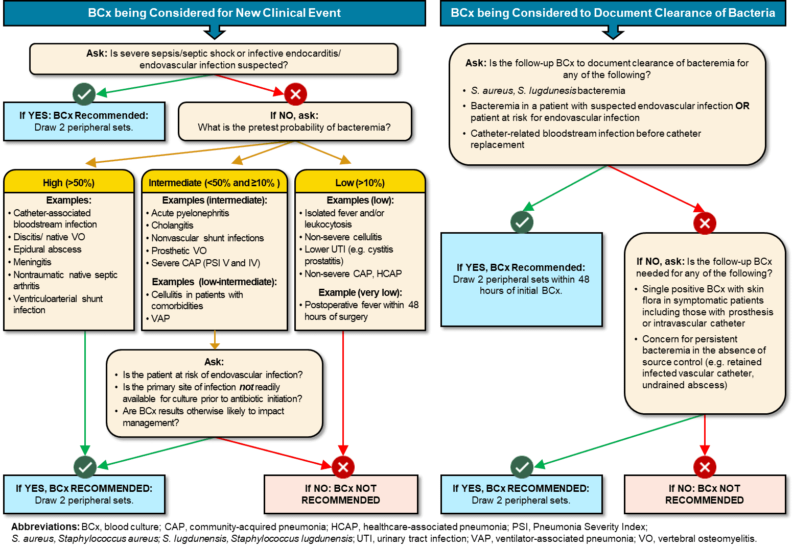
Blood Culture Decision Algorithm
Evidence-Based Algorithm to Inform When to Obtain Blood Cultures (BCx)^{11,12}
Follow this link for a one-page version of this algorithm.
Originally published in “Does This Patient Need Blood Cultures? A Scoping Review of Indications for Blood Cultures in Adult Nonneutropenic Patients” by Fabre et al in Clinical Infectious Diseases, September 2020. Used with permission.

Slide 12


Blood Culture Decision Support
Evidence-Based Algorithm to Inform When to Obtain Blood Cultures^{11,12}
INITIAL BLOOD CULTURES
FOLLOWUP BLOOD CULTURES
High probability (>50%)
  Infective endocarditis
  Meningitis
  Septic shock
Intermediate probability (>10% to <50%)
  Cholangitis
  Pyelonephritis
Low probability (<10%)
  Non-severe CAP
  Post-op fever within 48 hrs
Organism
  S. aureus
  S. pneumoniae
Type of infection
  Endovascular infection
  Urosepsis
Source control
  Lack of source control
Host factors
  Risk of endovascular infection
Host factors
  Risk of endovascular infection

Slide 13
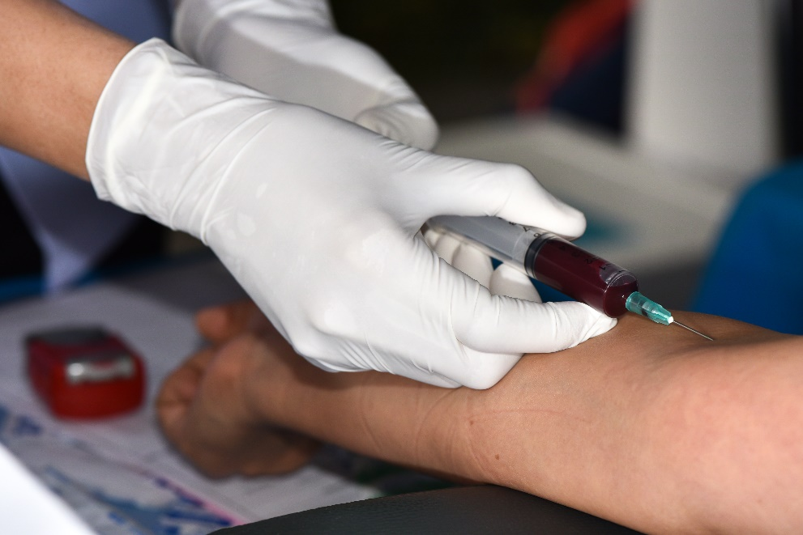
Site Selection: Peripheral vs. Central^{16,17}
A systematic review of lab quality improvement best practices compared central venous catheter (CVC) vs. peripheral venipuncture to obtain a sample for blood culture.¹⁶
The review found very strong evidence that use of venipuncture reduces blood culture contamination in all settings.¹⁶
Limit CVC blood cultures to rare circumstances (e.g., patients with extremely difficult venous access).

Slide 14

Hand Hygiene⁶
Aseptic technique during blood culture collection is paramount to prevent contamination.
Guidelines for hand hygiene and glove use must be observed.
Estimates of hand hygiene adherence range from 5 percent to 81 percent, with an average adherence of 40 percent.^{18,19}
For more details, refer to the Hand Hygiene section of the AHRQ Toolkit for MRSA Prevention for ICU and Non-ICU settings.

Slide 15
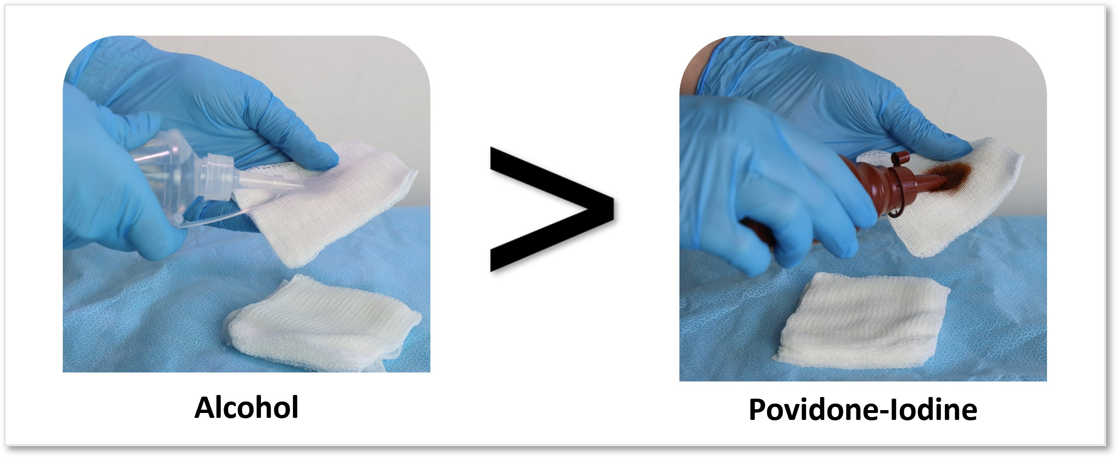
Skin Antisepsis^{6,20,21}
The main source of blood culture contamination is commensal bacteria that colonize skin.
Skin antiseptics containing alcohol are recommended over povidone-iodine preparations.

Slide 16
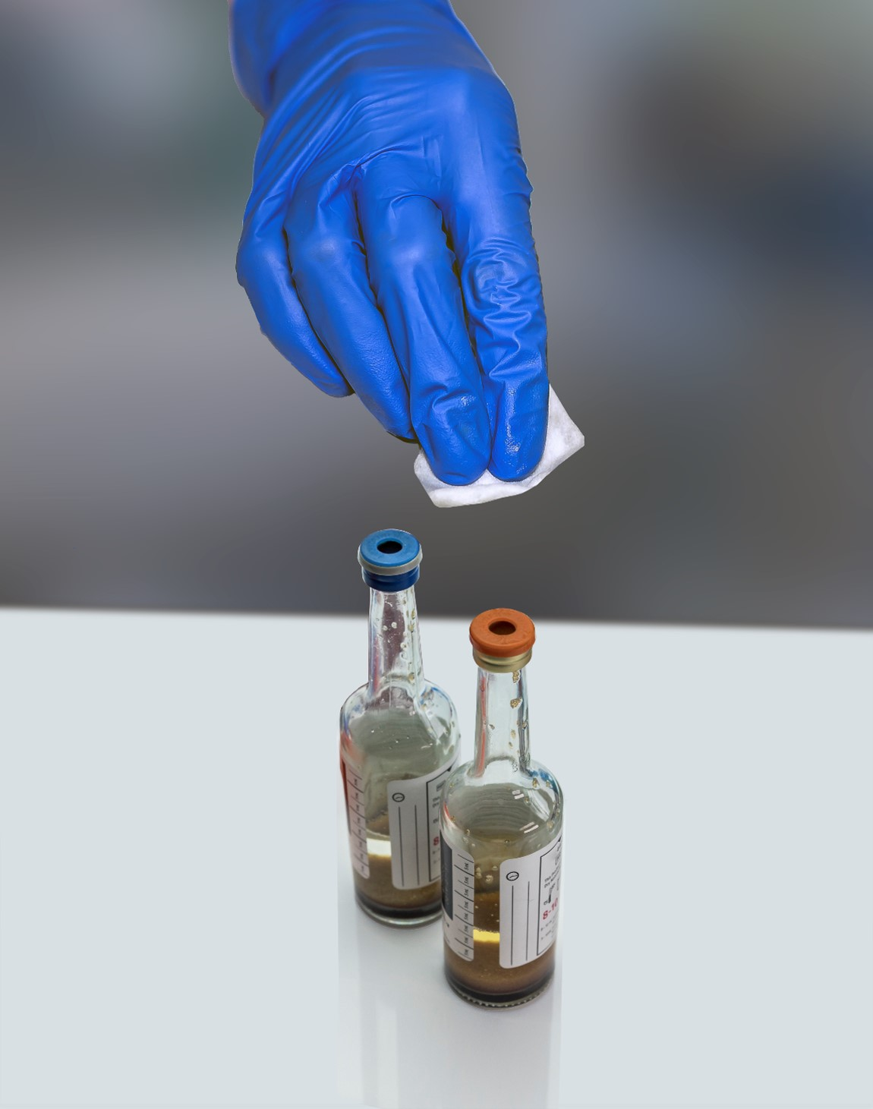
Blood Culture Bottle Disinfection^{6,21-23}
The top diaphragm of blood culture bottles is not sterile and must be disinfected prior to use.
70 percent isopropyl alcohol is recommended; use of iodine alone is not recommended.

Slide 17
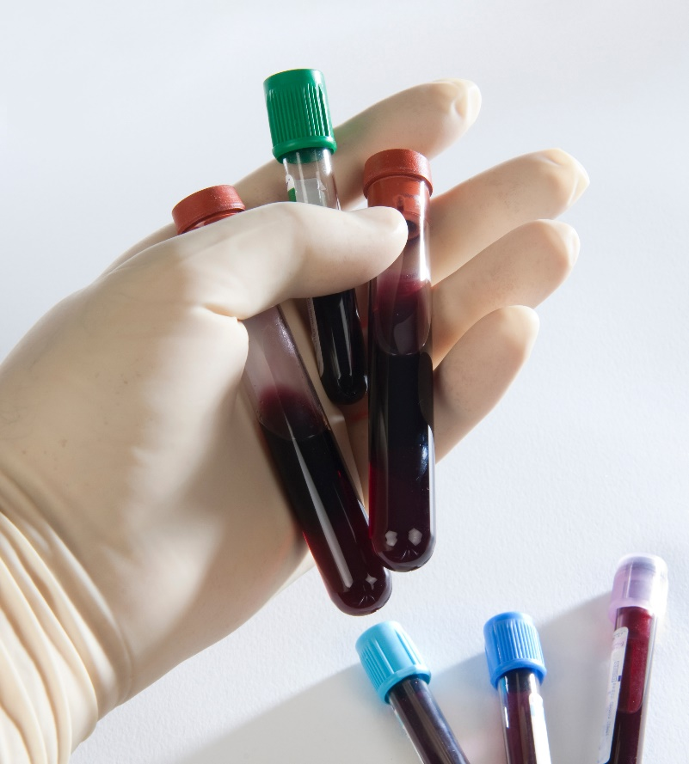
Blood Culture Collection Process
Number of sets: The gold standard is to collect 2 or more sets of blood cultures.^{3,24}
  Sets should be drawn from separate venipunctures.¹⁰
Up to 40 percent of blood culture collections are single sets.¹²
  Single sets can miss 30 to 40 percent of bacteremias due to enterococci, Pseudomonas, yeast, 20 percent of streptococci, and 10 percent of S. aureus.²⁵
Blood volumes: Inappropriate blood volume decreases blood culture sensitivity.^{3,12}
  Up to 80 percent of blood culture samples are inappropriately filled.²⁶

Slide 18
Phlebotomy Teams and Education on Proper Technique
Studies show there are often considerable gaps in education among staff regarding proper blood culture sample collection technique.²⁷
Ideally, specially trained phlebotomy teams should draw samples for blood cultures.
  Specimens are less likely to be contaminated compared to blood cultures collected by non-phlebotomy staff in hospital settings.^{21,23}
If a specialized phlebotomy team is not possible:
  Training of clinical staff in best practices is crucial.²²
  Continual reinforcement after training also necessary.²⁸

Slide 19
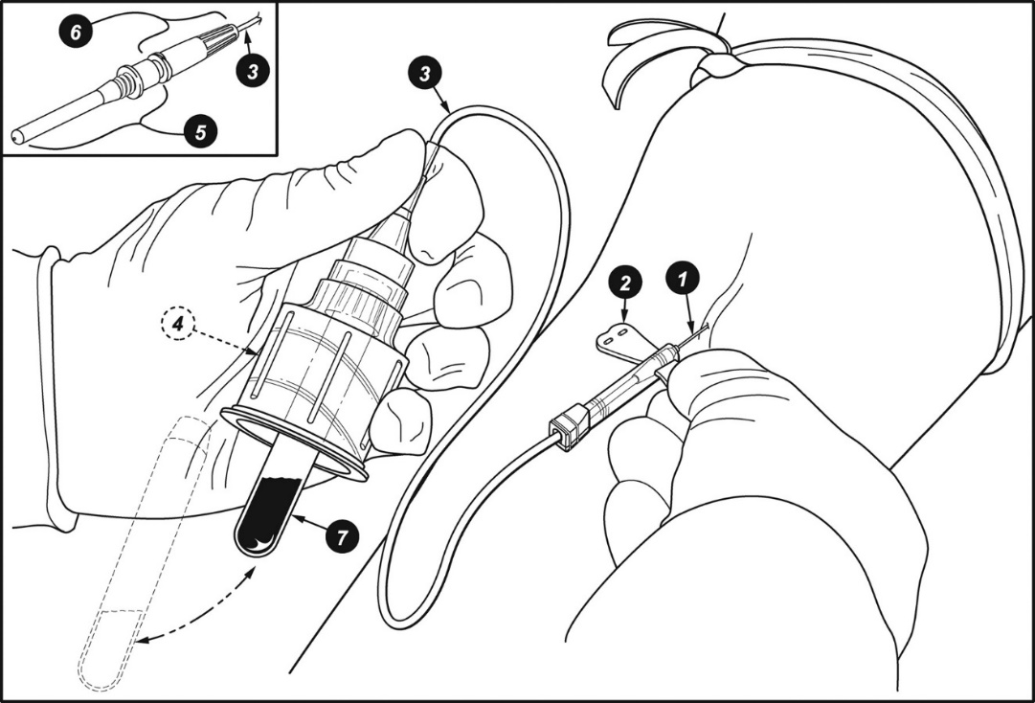

Other Strategies To Consider
Initial Specimen Diversion²⁹⁻³¹
Diversion of the first milliliter of blood to mitigate contamination from skin fragments.
Manual initial specimen diversion technique (IDST) is demonstrated in the first image on the right.
The initial diverted blood can be used for other labs, such as chemistries or Complete Blood Count.
Closed diversion devices are also commercially available.
Evidence is encouraging but limited.
© 2010 American Society for Microbiology. Reprinted with permission from Patton RG, Schmitt T. Innovation for reducing blood culture contamination: initial specimen diversion technique. J Clin Microbiol. 2010 Dec;48(12):4501-3. PMID: 20943870. No further reproduction or distribution is permitted without the prior written permission of American Society for Microbiology.
Blood Culture Collection Kits
Providing standardized blood culture collection kits ensures that staff have ready access to all the supplies needed for antisepsis and disinfection.⁶
Some studies suggest that standardized kits may reduce contamination rates and costs.²³

Slide 20

Implementation
Adopting Best Practices for Blood Culture Collection

Slide 21
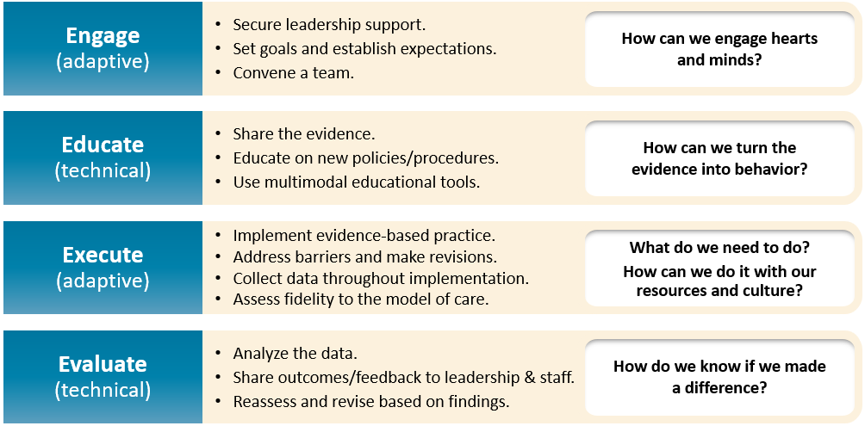
Implementation Strategies: The 4 Es³²⁻³⁷
More material, including a presentation, can be accessed in the section on the 4 Es on the Toolkit website.

Slide 22

Case Example: ABC Hospital
ABC Hospital (ABCH) is a small rural hospital with limited resources.
The hospital has long-standing challenges with contamination during blood culture collection.
Blood culture contamination rates at ABC Hospital are estimated at 16% to 20% over the past two quarters.
Members of ABCH staff decide to initiate a blood stewardship program to examine and address these problems.

Slide 23



Case Example: Engaging Team, Leadership, and Staff
ABCH personnel assemble a blood culture improvement team, with all relevant roles and teams represented.
They use baseline data, published evidence, national benchmarks, and storytelling to outline the problem and the potential harm.
They share their goals and set expectations for how success will be measured and defined.
The team benefits from including a senior executive member on the team to connect them to resources and address barriers.

Slide 24



Case Example: Assessing Current Practice
The ABCH team conducts a thorough assessment to build an accurate picture of current practice.
The team engages directly with staff, speaking at rounds, talking to staff one-on-one, and observing practices directly.
Most staff were unaware of the contamination problem because rates were previously not widely shared.
Once aware, staff are eager to contribute to the assessment of current practice and to help fix the problem.

Slide 25




Case Example: Identifying Contributory Factors
Collection mainly conducted by unit staff: Most units have unit staff collect samples for blood cultures.
Significant gaps in training: Unit staff generally lack knowledge of best practices, and there is no consistent training or standardized guidance.
Inappropriate blood culture ordering: Records show blood cultures are often ordered for cases that do not meet clinical indicators.
No standardized blood culture policy: A review of ABCH policies shows that they are confusing, inconsistent, and not standardized.

Slide 26



Case Example: Identifying Interventions
ABCH’s Interventions:
Standardize and streamline blood culture collection process for all units in the hospital.
Install a robust blood culture contamination surveillance and feedback system.
Implement use of a decision-making algorithm to guide ordering of blood cultures.

Slide 27


Case Example: Educating^{6,21}
ABCH team rolls out a standardized training package to accompany a new standardized blood culture policy.
  Education is effective as part of a multi-modal performance improvement plan.
Simulation training sessions are established.
  Simulation-based education is more effective to teach complex skills.³⁸
The training is mandatory, and annual refresher training is also required.
Available Procedural Recommendations:
CLSI M47 | Principles and Procedures for Blood Cultures, 2nd Edition⁹
CDC: Prevent Adult Blood Culture Contamination: A Quality Tool for Clinical Laboratory Professionals²⁴
Elsevier: Specimen Collection: Blood Cultures (Ambulatory) - CE/NCPD³⁹

Slide 28
Case Example: Executing^{6,9,22,40}
Over the next year, ABCH rolls out its interventions.
  Maintain open lines of communication.
  Track performance and metrics.
Adjustments are made to the program based on ongoing feedback and evaluation.
Follow principles of safe system design:
  Simplify the system.
  Create redundancy.
  Learn from mistakes
Make it easy for staff to make the right decision.

Slide 29
Case Example: Evaluating^{6,9,21,24,41-43}
Studies have shown that improving surveillance and feedback mechanisms can improve blood culture contamination rates.⁴³
  Established laboratory quality best practice
The ABCH team makes sure the surveillance data are widely available, and data sharing is timely.
The surveillance and feedback system proves very successful. The blood culture contamination dashboard is well-liked by staff.
Data are used to learn from defects and adjust focus/tweak interventions as needed.

Slide 30

Case Example: Results
Over the next four quarters, ABCH reduces its blood culture contamination rates to 3% to 5%.
ABCH recognizes and celebrates the improvement, boosting staff morale and confidence.
The success helps to establish a patient safety culture for improvements in the future.
The team resolves to keep up its efforts for further improvement to the CLSI standard of <1%.

Slide 31
Key Takeaways
Blood culture contamination is associated with negative patient outcomes, prolonged hospital stays, and unnecessary treatments.
Site selection, hand hygiene, standardization, and training on proper blood culture sample collection can reduce contamination rates to below 1%.
Blood culture stewardship aims to optimize diagnostic testing, reduce false positives, and minimize inappropriate antibiotic use, thus improving patients’ risk of harm.
Decision-making algorithms can guide appropriate blood culture utilization based on clinical scenarios and the probability of bacteremia.
Blood culture stewardship interventions based on education, feedback, and evidence-based clinical guidance have safely reduced and improved blood culture use.

Slide 32
Disclaimer
The findings and recommendations in this presentation are those of the authors, who are responsible for its content, and do not necessarily represent the views of AHRQ. No statement in this presentation should be construed as an official position of AHRQ or of the U.S. Department of Health and Human Services.
Any practice described in this presentation must be applied by healthcare practitioners in accordance with professional judgment and standards of care in regard to the unique circumstances that may apply in each situation they encounter. These practices are offered as helpful options for consideration by healthcare practitioners, not as guidelines.

Slide 33
Reference List—1
Fabre V, Davis A, Diekema DJ, et al. Principles of diagnostic stewardship: A practical guide from the Society for Healthcare Epidemiology of America Diagnostic Stewardship Task Force. Infect Control Hosp Epidemiol. 2023 Feb;44(2):178-85. PMID: 36786646.
Lawes T, Lopez-Lozano JM, Nebot CA, et al. Effects of national antibiotic stewardship and infection control strategies on hospital-associated and community-associated meticillin-resistant Staphylococcus aureus infections across a region of Scotland: a non-linear time-series study. Lancet Infect Dis. 2015 Dec;15(12):1438-49. PMID: 26411518.
Fabre V, Carroll KC, Cosgrove SE. Blood culture utilization in the hospital setting: a call for diagnostic stewardship. J Clin Microbiol. 2022 Mar 16;60(3):e0100521. PMID: 34260274.
Yokoe DS, Anderson DJ, Berenholtz SM, et al. Introduction to "A compendium of strategies to prevent healthcare-associated infections in acute care hospitals: 2014 updates." Infect Control Hosp Epidemiol. 2014 May;35(5):455-9. PMID: 24709713.
Madden GR, Weinstein RA, Sifri CD. Diagnostic stewardship for healthcare-associated infections: opportunities and challenges to safely reduce test use. Infect Control Hosp Epidemiol. 2018 Feb;39(2):214-8. PMID: 29331159.
Notes:
Reference numbers are correct

Slide 34
Reference List—2
Doern GV, Carroll KC, Diekema DJ, et al. Practical guidance for clinical microbiology laboratories: a comprehensive update on the problem of blood culture contamination and a discussion of methods for addressing the problem. Clin Microbiol Rev. 2019 Oct 30;33(1):e00009-19. PMID: 31666280.
Dantes RB, Rock C, Milstone AM, et al. Preventability of hospital onset bacteremia and fungemia: a pilot study of a potential healthcare-associated infection outcome measure. Infect Control Hosp Epidemiol. 2019 Mar;40(3):358-61. PMID: 30773166.
Boyce JM, Nadeau J, Dumigan D, et al. Obtaining blood cultures by venipuncture versus from central lines: impact on blood culture contamination rates and potential effect on central line-associated bloodstream infection reporting. Infect Control Hosp Epidemiol. 2013 Oct;34(10):1042-7. PMID: 24018920.
Clinical and Laboratory Standards Institute. Principles and Procedures for Blood Cultures, 2nd edition. CLSI Guideline M47. Clinical and Laboratory Standards Institute; 2022.
O'Grady NP, Barie PS, Bartlett JG, et al. Guidelines for evaluation of new fever in critically ill adult patients: 2008 update from the American College of Critical Care Medicine and the Infectious Diseases Society of America. Crit Care Med. 2008 Apr;36(4):1330-49. 2008 Jun;36(6):1992. PMID: 18379262.
Notes:
Reference numbers are correct

Slide 35
Reference List—3
Fabre V, Sharara SL, Salinas AB, et al. Does this patient need blood cultures? A scoping review of indications for blood cultures in adult nonneutropenic inpatients. Clin Infect Dis. 2020 Aug 22;71(5):1339-47. PMID: 31942949.
Fabre V, Klein E, Salinas AB, et al. A diagnostic stewardship intervention to improve blood culture use among adult nonneutropenic inpatients: the DISTRIBUTE study. J Clin Microbiol. 2020 Sep 22;58(10):e01053-20. PMID: 32759354.
Friedman ND, Braun T, Fallach N, et al. Blood culture sampling practices among internal medicine inpatients. Clin Microbiol Infect Dis. 2017;2(1).
Karch A, Castell S, Schwab F, et al. Proposing an empirically justified reference threshold for blood culture sampling rates in intensive care units. J Clin Microbiol. 2015 Feb;53(2):648-52. PMID: 25520442.
Mahatanan R, Gomez G, Olsen B, et al. 91. Implementing criteria to reduce blood cultures ordering: a pre- and post-intervention retrospective study in a critical access hospital. Open Forum Infect Dis. 2020 Dec 31;7(Suppl 1):S61.
Stohl S, Benenson S, Sviri S, et al. Blood cultures at central line insertion in the intensive care unit: comparison with peripheral venipuncture. J Clin Microbiol. 2011 Jul;49(7):2398-403. PMID: 21525219.
Notes:
Reference numbers are correct

Slide 36
Reference List—4
Snyder SR, Favoretto AM, Baetz RA, et al. Effectiveness of practices to reduce blood culture contamination: a Laboratory Medicine Best Practices systematic review and meta-analysis. Clin Biochem. 2012 Sep;45(13-14):999-1011. PMID: 22709932.
World Health Organization. WHO guidelines on hand hygiene in health care. World Health Organization and WHO Patient Safety. 2009. https://www.who.int/publications/i/item/9789241597906. Accessed May 21, 2024.
World Health Organization. Evidence of hand hygiene to reduce transmission and infections by multidrug resistant organisms in health-care settings. https://www.who.int/teams/integrated-health-services/infection-prevention-control/hand-hygiene/guidelines-and-evidence. Accessed May 21, 2024.
Miller JM, Binnicker MJ, Campbell S, et al. Guide to utilization of the microbiology laboratory for diagnosis of infectious diseases: 2024 update by the Infectious Diseases Society of America (IDSA) and the American Society for Microbiology (ASM). Clin Infect Dis. 2024 Mar 5:ciae104. PMID: 38442248.
Centers for Disease Control & Prevention. Blood Culture Contamination: An Overview For Infection Control And Antibiotic Stewardship Programs Working With The Clinical Laboratory. CS 331454-B. Atlanta, GA: Centers for Disease Control & Prevention; July 2022. https://stacks.cdc.gov/view/cdc/123257/cdc_123257_DS1.pdf. Accessed May 3, 2024.
Notes:
Reference numbers are correct

Slide 37
Reference List—5
Bamber AI, Cunniffe JG, Nayar D, et al. Effectiveness of introducing blood culture collection packs to reduce contamination rates. Br J Biomed Sci. 2009;66(1):6-9. PMID: 19348119.
Self WH, Talbot TR, Paul BR, et al. Cost analysis of strategies to reduce blood culture contamination in the emergency department: sterile collection kits and phlebotomy teams. Infect Control Hosp Epidemiol. 2014 Aug;35(8):1021-8. PMID: 25026619.
Centers for Disease Control & Prevention. Prevent Adult Blood Culture Contamination: A Quality Tool for Clinical Laboratory Professionals. https://www.cdc.gov/lab-quality/php/prevent-adult-blood-culture-contamination/index.html. Accessed October 1, 2024.
Gonsalves WI, Cornish N, Moore M, et al. Effects of volume and site of blood draw on blood culture results. J Clin Microbiol. 2009 Nov;47(11):3482-5. PMID: 19794050.
Lee A, Mirrett S, Reller LB, et al. Detection of bloodstream infections in adults: how many blood cultures are needed?. J Clin Microbiol. 2007 Nov;45(11):3546-8. PMID: 17881544.
Nair A, Elliott SP, Al Mohajer M. Knowledge, attitude, and practice of blood culture contamination: a multicenter study. Am J Infect Control. 2017 May 1;45(5):547-8. PMID: 28214162.
Notes:
Reference numbers are correct

Slide 38
Reference List—6
Moeller D. Eliminating blood culture false positives: harnessing the power of nursing shared governance. J Emerg Nurs. 2017 Mar;43(2):126-32. PMID: 28277262.
Patton RG, Schmitt T. Innovation for reducing blood culture contamination: initial specimen diversion technique. J Clin Microbiol. 2010 Dec;48(12):4501-3. PMID: 20943870.
Al Mohajer M, Lasco T. The impact of initial specimen diversion systems on blood culture contamination. Open Forum Infect Dis. 2023 Apr 5;10(5):ofad182. PMID: 37152189.
Callado GY, Lin V, Thottacherry E, et al. Diagnostic stewardship: a systematic review and meta-analysis of blood collection diversion devices used to reduce blood culture contamination and improve the accuracy of diagnosis in clinical settings. Open Forum Infect Dis. 2023 Aug 11;10(9):ofad433. PMID: 37674630.
Ellingson K, Haas JP, Aiello AE, et al. Strategies to prevent healthcare-associated infections through hand hygiene. Infect Control Hosp Epidemiol. 2014 Aug;35(8):937-60. PMID: 25026608.
Romig M, Goeschel C, Pronovost P. Integrating CUSP and TRIP to improve patient safety. Hosp Pract (1995). 2010 Nov;38(4):114-21. PMID: 21068535.

Slide 39
Reference List—7
Pronovost PJ, Berenholtz SM, Needham DM. Translating evidence into practice: a model for large scale knowledge translation. BMJ. 2008 Oct 6; 337:a1714. PMID: 18838424.
The 4 E’s. Agency for Healthcare Research and Quality. https://www.ahrq.gov/hai/cusp/videos/02b-the-4e/index.html. Accessed May 24, 2024.
Assemble the Team, Facilitator Notes. Agency for Healthcare Research and Quality. https://www.ahrq.gov/hai/cusp/modules/assemble/team-notes.html#slide12. Accessed May 24, 2024.
Engage the Senior Executive Facilitator Notes. Agency for Healthcare Research and Quality. https://www.ahrq.gov/hai/cusp/modules/engage/exec-notes.html#sl3. Accessed May 24, 2024.
Chernikova O, Heitzmann N, Stadler M, et al. Simulation-based learning in higher education: A meta-analysis. Review of Educational Research. 2020;90(4):499-541.
Specimen Collection: Blood Cultures (Ambulatory)- CE/NCPD. Elsevier. https://elsevier.health/en-US/preview/blood-collection-blood-cultures-ambulatory. Accessed May 24, 2024.

Slide 40
Reference List—8
Bool M, Barton MJ, Zimmerman PA. Blood culture contamination in the emergency department: an integrative review of strategies to prevent blood culture contamination. Australas Emerg Care. 2020 Sep;23(3):157-65. PMID: 32253130.
Hopkins K, Huynh S, McNary C, et al. Reducing blood culture contamination rates: a systematic approach to improving quality of care. Am J Infect Control. 2013 Dec;41(12):1272-4. PMID: 23747025.
Harding AD, Bollinger S. Reducing blood culture contamination rates in the emergency department. J Emerg Nurs. 2013 Jan;39(1):e1-6. PMID: 23295096.
Gibb AP, Hill B, Chorel B, et al. Reduction in blood culture contamination rate by feedback to phlebotomists. Arch Pathol Lab Med. 1997 May;121(5):503-7. PMID: 9167605.

