Slide 1
AHRQ Safety Program for MRSA Prevention
Contact Precautions for MRSA Prevention
ICU & Non-ICU
AHRQ Pub. No. 25-0007
October 2024

Slide 2
Educational Objectives
Discuss the purpose behind using contact precautions
Discuss what other interventions should be used in conjunction with contact precautions, making it part of a bundle
Enumerate the different elements of contact precautions
Discuss how to implement contact precautions in their units

Slide 3
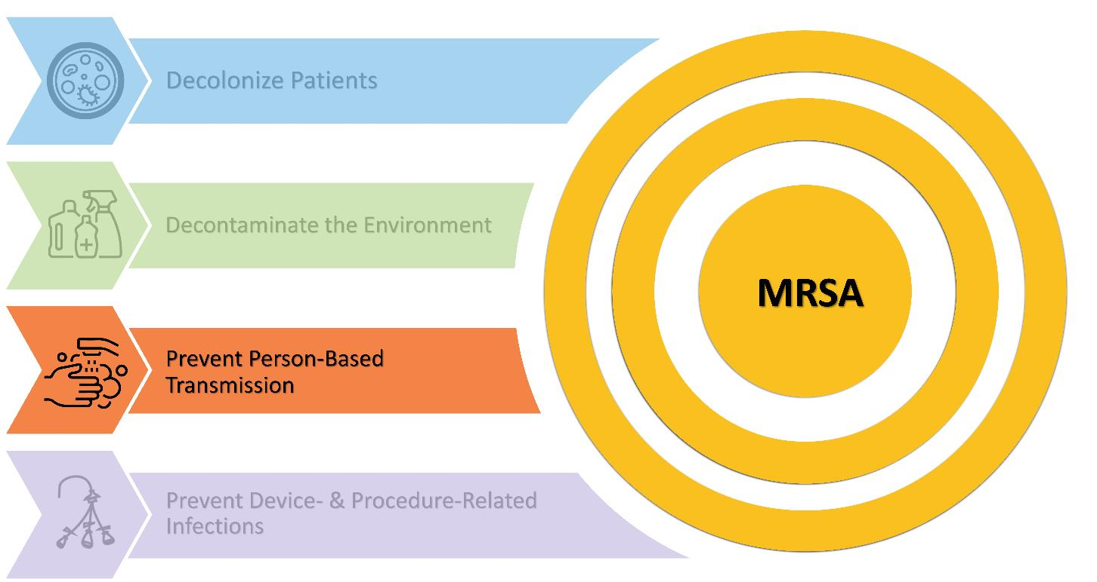
Key Strategies To Take Aim & Target MRSA Infection

Slide 4
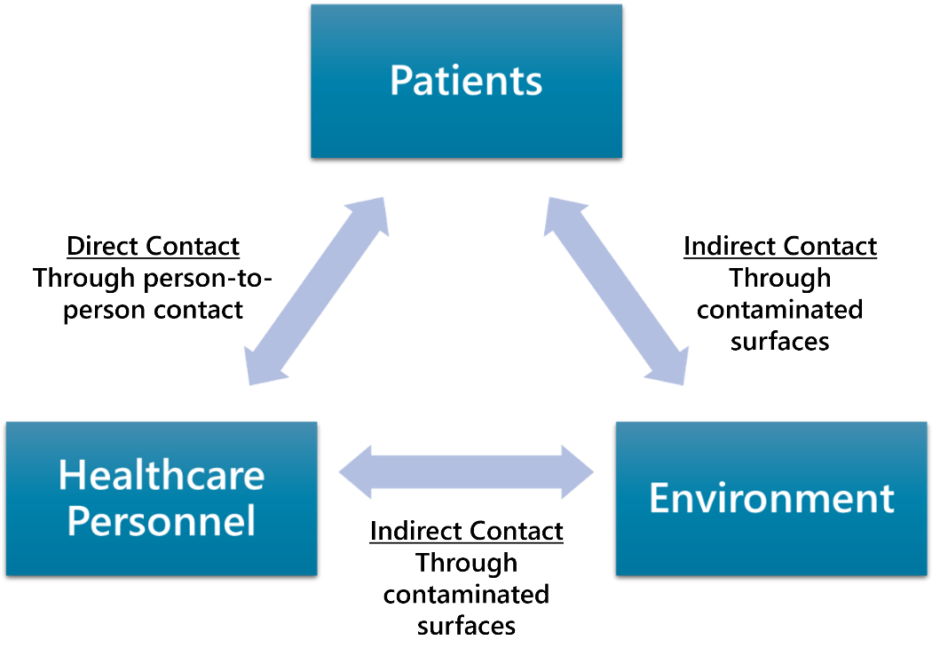
MRSA Transmission Pathways

Slide 5
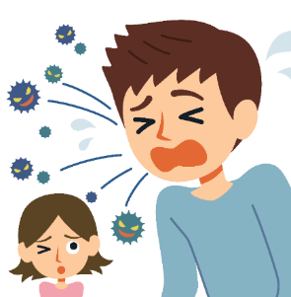
Standard Precautions
Per CDC: “Standard precautions are the minimum infection prevention practices that apply to all patient care, regardless of suspected or confirmed infection status”.¹
Standard precautions should be used with ALL patients during EVERY encounter!
These precautions include:
Performing hand hygiene²
Using personal protective equipment (PPE) when indicated²
Observing respiratory hygiene and cough etiquette^{2,3}
Cleaning and disinfection²
Practicing sharps safety²
Using safe injection practices^{2,3}
Safely handling textiles and laundry²

Slide 6
Contact Precautions⁴
Per CDC: “Transmission-based precautions are the second tier of basic infection control and are to be used in addition to standard precautions for patients who may be infected or colonized with certain infectious agents for which additional precautions are needed to prevent infection transmission.”⁴
Contact precautions are used for patients with known or suspected infections or colonization that represent an increased risk for contact transmission.
In addition to requirements for standard precautions, contact precautions require the following:
Ensure appropriate patient placement
Use personal protective equipment (PPE) appropriately (at least gowns and gloves)
Limit transport and movement of patients
Use disposable or dedicated patient-care equipment where feasible
Prioritize cleaning and disinfection of the rooms
Notes:
1, 2024.

Slide 7
Why Use Contact Precautions?
Evidence Regarding the Use of Contact Precautions

Slide 8
Do Healthcare Workers (HCW) Become Contaminated From the Environment?
Observational studies have shown:
MRSA frequently contaminates the environment of hospital patients colonized or infected with MRSA.⁵⁻⁷
HCWs become contaminated with MRSA in 16 percent of the interactions with these patients^{.8,9}
The odds of becoming contaminated vary with role, specific activities performed, and items and surfaces touched.⁹
In the absence of hand hygiene, contaminated HCWs may frequently transmit MRSA to subsequent patients.⁹
Contact precautions are intended to reduce these risks.

Slide 9
Reduction in Transmission at the VA¹⁰
Retrospective VA study using bundle*
Showed reductions of 62 percent and 45 percent in MRSA HAI infections.
Modeling later showed that contact precautions reduced MRSA transmission by 47 percent over a 10-year period.
*Bundle included: universal MRSA surveillance, contact precautions for patients identified as carriers of MRSA, hand hygiene, and an institutional culture change that placed the responsibility for infection control on everyone with patient contact.

Slide 10
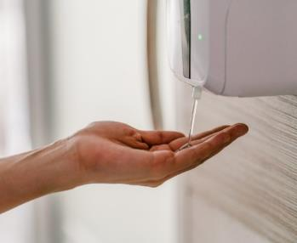
BUGG Study¹¹⁻¹³
Assessed whether universal gloves and gowns for all patient contact in the ICU affected acquisition of MRSA or VRE.
There was a 40.2 percent decrease in acquisition of MRSA in the intervention group as compared to a 15.0 percent reduction in the control group, p=.007.¹²
44 percent of the decrease in MRSA and VRE acquisition was attributable to universal contact precautions, 38.1 percent from hand hygiene upon exiting a patient’s room, and 14.5 percent from reduced contact with patients.¹¹
Hand hygiene adherence upon exiting a patient room increased when universal contact precautions were implemented.^{11,12}
Universal contact precautions reduced healthcare personnel clothing contamination by 70 percent.¹³
Later, mathematical modeling attributed 44 percent of the improvement to the use of gowns and gloves.

Slide 11
Recommendations and Guidelines Regarding the Use of Contact Precautions
Agencies and organizations that recommend or endorse contact precautions for MRSA Prevention include:
Centers for Disease Control and Prevention (CDC)¹⁴
Association of Professionals in Infection Control (APIC)¹⁵
The Society for Healthcare Epidemiology of America (SHEA)¹⁶
The Infectious Disease Society of American (IDSA)¹⁷

Slide 12
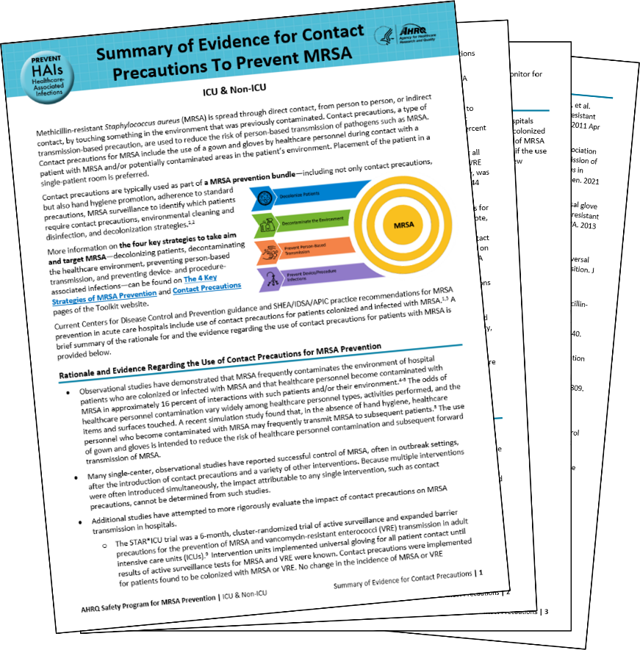
Summary of the Evidence
Provides a variety of data and perspectives on when, how, where, and even whether to employ Contact Precautions
Click here to access this document.

Slide 13
How Are Other Facilities Using Contact Precautions?
Never – Some health systems don’t use contact precautions for MRSA prevention.
Always – Some use contact precautions, together with MRSA surveillance on admission, to assure all infected and colonized patients are isolated.
Sometimes –
Some use a risk-based strategy – gowns and gloves are used in situations and settings within a hospital where the risk of contamination of healthcare personnel is greatest.
Use if MRSA rates are high or rising.
Supported by some of the guidelines mentioned earlier.^{16,17}

Slide 14
Contact Precautions for MRSA Prevention
Correct Use To Prevent Contamination and Interrupt Transmission

Slide 15
Contact Precautions^{3,4}
Specific patient placement¹⁸
Proper hand hygiene¹⁸
Use of gloves by healthcare personnel¹⁸
Use of gowns by healthcare personnel¹⁸
Removal of PPE prior to leaving patient’s room or care area¹⁸
Dedicated patient care equipment and disinfection of any reusable equipment between patients¹⁸
Communicate contact precautions by using signage and flagging the patients’ medical records¹⁹

Slide 16
Patient Placement and MRSA Surveillance
Patients with known or suspected MRSA colonization or infection should be placed in a private room.^{3,18-20}
If a private room is not available, patients should be cohorted as follows:
Ensure at least 3 feet between patient beds.³
Place colonized or infected patients in a room with another patient who has the same organism and has low risk for adverse outcome.³
Avoid cohorting patients with draining wounds or uncontrolled secretions, or who are incontinent.³

Slide 17
Donning and Doffing PPE
DONNING PPE
Wash hands
Don gown
Don gloves
DOFFING PPE
Doff gown
Doff gloves
Wash hands
For specific and detailed instructions for how to appropriately don and doff your PPE, please review this CDC document.

Slide 18
Importance of Proper PPE Use
Studies found frequent errors in PPE doffing, particularly when gloves are removed, that can lead to hand contamination.²¹
Improve healthcare personnel PPE use by focusing on education, training, and practice sessions.²²
Provide hands-on training sessions that demonstrate how to don and doff PPE without self-contamination.
Emphasize the importance of hand hygiene upon removing gloves and exiting a patient’s room.
Give participants time to practice PPE donning, doffing, and hand hygiene techniques.

Slide 19
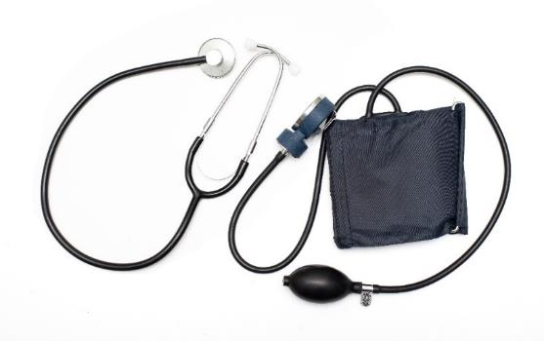
Dedicated Patient Care Equipment
Use dedicated equipment for patients on contact precautions whenever possible.^{19,23}
Ensure that shared equipment is disinfected between patients with an approved disinfectant.^{19,24}
Verify that staff are familiar with wet/contact times.²³

Slide 20
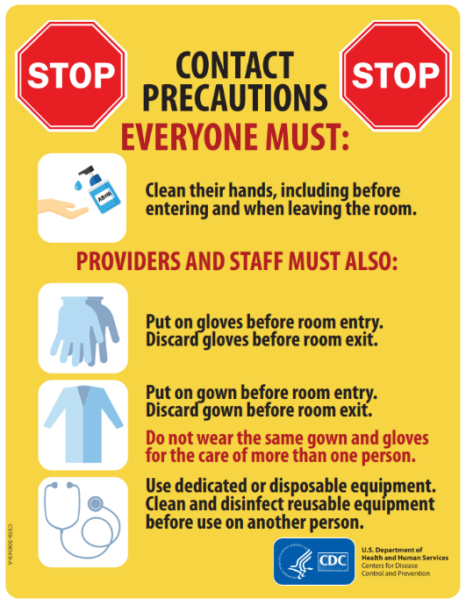
Communication, Signage, and Flagging
Use of contact precautions in conjunction with other evidence-based best practices interrupts MRSA transmission from healthcare personnel to patients.^{3,18,19}
Source: Centers for Disease Control and Prevention https://www.cdc.gov/infection-control/media/pdfs/contact-precautions-sign-P.pdf.²⁵

Slide 21
Implementation
Putting Contact Precautions Into Practice

Slide 22
Implementation Strategies: The 4 Es²⁶⁻³¹
Engage (adaptive)
Secure leadership support.
Set goals and establish expectations.
Convene a team.
How can we engage hearts and minds?
Educate (technical)
Share the evidence.
Educate on new policies/procedures.
Use multimodal educational tools.
How can we turn the evidence into behavior?
Execute (adaptive)
Implement evidence-based practice.
Address barriers and make revisions.
Collect data throughout implementation.
Assess fidelity to the model of care.
What do we need to do?
How can we do it with our resources and culture?
Evaluate (technical)
Analyze the data.
Share outcomes/feedback to leadership & staff.
Reassess and revise based on findings.
How do we know if we made a difference?
More material, including a presentation, can be accessed in the section on the 4 Es on the Toolkit website.

Slide 23
Case Example: County General Hospital
County General Hospital’s Infection Prevention Department notices the hospital’s MRSA rates have been slowly increasing after 3 years of not using contact precautions.
The department checked adherence to the other MRSA prevention strategies currently used in the hospital.
Hand hygiene
Environmental services monitoring

Slide 24
Case Example: Investigate the Current Status
As a first step, they checked the following rates:
Hand hygiene adherence
Environmental services monitoring
Adherence rates were good
What is happening on the floors?
Went to the gemba
Staff were following protocols
Discussions with staff yielded nothing
Performed a literature review and reviewed the current MRSA prevention guidelines
Determined contact precautions are an “Essential” practice for MRSA prevention, if other essential practices are in place and MRSA rates continue to rise.

Slide 25
Case Example: Heart To Heart Discussion
The team was worried about pushback
Decided to use the 4 Es to help them bring the program to leadership and staff
Found articles that addressed common concerns about implementing contact precautions:
Patients become depressed and anxious when they’re on contact precautions^{32,33}
Staff do not like having to use contact precautions³⁴

Slide 26
Case Example: Engaging Leadership and Teams
IP Team members meet with—
Leadership
Share MRSA data and explain rationale regarding reinstituting contact precautions
Discuss costs and projected savings, based on the current and projected numbers of cases and costs of supplies
Unit CUSP teams
Share MRSA data and explain rationale regarding reinstituting contact precautions
Discuss how contact precautions can lower MRSA rates
Better outcomes for patients
Discuss anticipated issues regarding patient anxiety and depression
Plan to develop patient education materials and staff strategies to address this problem^{32,33}

Slide 27
Case Example: Educate Staff
CUSP teams review information from the IPs with the frontline staff
Discuss implementation strategies for their unit
Staff have concerns about quality of care and their patients’ mental health
Discuss evidence that quality of care can be maintained and mental health issues can be avoided
Emphasize the positive aspects of contact precautions for staff

Slide 28
Case Example: Execute
On December 1, the new contact precautions program was rolled out in the ICUs and on the floors.
Stocked isolation carts were in place, signs were posted as appropriate, decisions were made before launch regarding which patients needed to be moved, and patients and families were given educational material.
Observers were in place to track appropriate usage of gowns, gloves, and hand hygiene.
Source: Centers for Disease Control and Prevention https://www.cdc.gov/infection-control/media/pdfs/contact-precautions-sign-P.pdf.²⁵

Slide 29
Case Example: Evaluate
Adherence rates for contact precautions were shared with hospital leadership and fed back to the units.
After 6 months, adherence rates rose from 54% to 95%.
MRSA rates dropped a bit over the first quarter. Then they dropped significantly through the following year and remained at the lower rate.

Slide 30
Celebrate Success!
Interventions were a major success
In the first 12-month period:
the 95% PPE adherence target was met
the other strategies were still in place
MRSA rates decreased and seemed to be stabilizing!!!
The CUSP Team highlighted the unit’s improvement in the hospital newsletter
It’s important to acknowledge and celebrate successes!

Slide 31
Key Takeaways
Contact precautions help reduce MRSA transmission, especially when used as part of a multifaceted approach.
Your unit(s) can use either active or passive MRSA surveillance to identify patients who are colonized or infected with MRSA
Important elements of contact precautions are patient placement, hand hygiene, appropriate use of PPE, and dedicated patient care equipment.
Communication, signage, and a system for flagging in the medical record are also important aspects the implementation of contact precautions
We must consider and balance the benefits and potential disadvantages of contact precautions, including spending appropriate amounts of time with patients on precautions and promoting their wellbeing
Notes:
Siegel JD, Rhinehart E, Jackson M, Chiarello L, Healthcare Infection Control Practices Advisory Committee. Multidrug-Resistant Organisms (MDRO) Management. https://www.cdc.gov/infectioncontrol/guidelines/mdro/index.html. Accessed October 24, 2022.

Slide 32
Disclaimer
The findings and recommendations in this presentation are those of the authors, who are responsible for its content, and do not necessarily represent the views of AHRQ. No statement in this presentation should be construed as an official position of AHRQ or of the U.S. Department of Health and Human Services.
Any practice described in this presentation must be applied by healthcare practitioners in accordance with professional judgment and standards of care in regard to the unique circumstances that may apply in each situation they encounter. These practices are offered as helpful options for consideration by healthcare practitioners, not as guidelines.

Slide 33
Reference List—1
Standard Precautions. Centers for Disease Control and Prevention. https://www.cdc.gov/dental-infection-control/hcp/summary/standard-precautions.html#:~:text=Standard%20Precautions%20are%20the%20minimum,Hand%20hygiene. Accessed August 1, 2024.
Standard Precautions for All Patient Care. Centers for Disease Control and Prevention. https://www.cdc.gov/infection-control/hcp/isolation-precautions. Accessed July 31, 2024.
Siegel JD, Rhinehart E, Jackson M, et al. Healthcare Infection Control Practices Advisory Committee. Guideline for Isolation Precautions: Preventing Transmission of Infectious Agents in Healthcare Settings (2007). https://www.cdc.gov/niosh/docket/archive/pdfs/niosh-219/0219-010107-siegel.pdf. Accessed August 12, 2027.
CDC Infection Control. Transmission-Based Precautions. https://www.cdc.gov/infection-control/hcp/basics/transmission-based-precautions.html. Accessed October 1, 2024.
Hardy KJ, Oppenheim BA, Gossain S, et al. A study of the relationship between environmental contamination with methicillin-resistant Staphylococcus aureus (MRSA) and patient’s acquisition of MRSA. Infect Control Hosp Epidemiol. 2006 Feb;27(2):127-32. PMID: 16465628.
Wolfensberger A, Mang N, Gibson KE, et al. Understanding short-term transmission dynamics of methicillin-resistant Staphylococcus aureus in the patient room. Infect Control Hosp Epidemiol. 2022 Sep;43(9):1147-54. PMID: 34448445.

Slide 34
Reference List—2
Tanner WD, Leecaster MK, Shang Y, et al. Environmental contamination of contact precaution and non-contact precaution patient rooms in six acute care facilities. Clin Infect Dis. 2021 Jan 29;72(Suppl 1):S8-16. PMID: 33512527.
O’Hara LM, Calfee DP, Miller LG, et al. Optimizing contact precautions to curb the spread of antibiotic resistant bacteria in hospitals: a multicenter cohort study to identify patient characteristics and healthcare personnel interactions associated with transmission of methicillin-resistant Staphylococcus aureus. Clin Infect Dis. 2019 Sep 13;69(Suppl 3):S171-7. PMID: 31517979.
Adediran TY, Robinson GL, Johnson JK, et al. Factors associated with patients-to-healthcare personnel (HCP) and HCP-to-subsequent patient transmission of methicillin-resistant Staphylococcus aureus. Infect Control Hosp Epidemiol. 2024 May;45(5):583-9. PMID: 38234192.
Khader K, Thomas A, Stevens V, et al. Association between contact precautions and transmission of methicillin-resistant Staphylococcus in Veterans Affairs Hospitals. JAMA Netw Open. 2021 Mar 1;4(3):e210971. PMID: 33720369.
Harris AD, Morgan DJ, Pineles L, et al. Deconstructing the relative benefits of a universal glove and gown intervention on MRSA acquisition. J Hosp Infect. 2017 May;96(1):49-53. PMID: 28410760.
Harris AD, Pineles L, Belton B, et al. Universal glove and gown use and acquisition of antibiotic-resistant bacteria in the ICU: a randomized trial. JAMA. 2013 Oct 16;310(15):1571-80. PMID: 24097234.

Slide 35
Reference List—3
Williams C, McGraw P, Schneck EE, et al. Impact of universal gowing and gloving on health care worker clothing contamination. Infect Control Hosp Epidemio. 2015 Apr;36(4):431-7. PMID: 25782898.
Infection Control Guidance: Preventing Methicillin-resistant Staphylococcus aureus (MRSA) in Healthcare Facilities. Centers for Disease Control and Prevention. Methicillin-resistant Staphylococcus aureus (MRSA). Last reviewed April 12, 2024. https://www.cdc.gov/mrsa/hcp/infection-control/index.html. Accessed July 31, 2024.
FAQs about “MRSA”. Association for Professionals in Infections Control and Epidemiology. https://www.apic.org/Resource_/TinyMceFileManager/Practice_Guidance/NNL_MRSA.pdf. Accessed July 31, 2024.
Updated Guidance Shows How Hospitals Should Protect Patients from Resistant Infections. The Society for Healthcare Epidemiology of America. Last reviewed June 29, 2023. https://shea-online.org/updated-guidance-shows-how-hospitals-should-protect-patients-from-resistant-infections/. Accessed July 31, 2024.
Popovich KJ, Aurenden K, Ham DC, et al. SHEA/IDSA/APIC Practice Recommendation: Strategies to prevent methicillin-resistant Staphylococcus aureus transmission and infection in acute-care hospitals: 2022 Update. Infect Control Hosp Epidemiol. 2023 Jul;44(7):1039-67. PMID: 37381690.
Aureden K, Arias K, Burns LA, et al. Guide to the Elimination of Methicillin-Resistant Staphylococcus aureus (MRSA) Transmission in Hospital Settings. 2nd ed. Washington, DC:APIC; 2010. https://apic.org/wp-content/uploads/2019/07/MRSA-elimination-guide-2010.pdf. Accessed October 24, 2022.
Siegel JD, Rhinehart E, Jackson M. Healthcare Infection Control Practices Advisory Committee. Multidrug-Resistant Organisms (MDRO) Management. https://cdc.gov/infectioncontrol/guidelines/mdro/index.html . Accessed October 24, 2022.

Slide 36
Reference List—4
Calfee DP, Salgado CD, Milstone AM, et al. Society for Healthcare Epidemiology of America. Strategies to prevent methicillin-resistant Staphylococcus aureus transmission and infection in acute care hospitals:2014 update. Infect Control Hosp Epidemiol. 2014 Jul;35(7):772-96. PMID: 24915205.
Okamoto K, Rhee Y, Schoeny M, et al. Centers for Disease Control and Prevention Epicenters Program. Impact of doffing errors on healthcare workers self-contamination when caring for patients on contact precautions. Infect Control Hosp Epidemiol. 2019 May;40(5):559-65. PMID: 30890193.
Andonian J, Kazi S, Therkorn J, et al. Effect of an intervention package and teamwork training to prevent healthcare personnel self-contamination during personal protective equipment doffing. Clin Infect Dis. 2019 Sep 13;69(Suppl 3):S248-55. PMID: 31517976.
Infection Control Guidance: Preventing Methicillin-resistant Staphylococcus aureus (MRSA). https://www.cdc.gov/mrsa/hcp/infection-control/index.html. Accessed July 31, 2024.
Kramer A, Schwebke I, Kampf G. How long do nosocomial pathogens persist on inanimate surfaces? A systematic review. BMC Infect Dis. 2006 Aug 16;6:130. PMID: 16914034.
Contact Precautions Sign. Centers for Disease Control and Prevention. Contact Precautions. https://www.cdc.gov/infection-control/media/pdfs/contact-precautions-sign-P.pdf. Accessed August 1, 2024.

Slide 37
Reference List—5
Ellingson K, Haas JP, Aiello AE, et al. Strategies to prevent healthcare-associated infections through hand hygiene. Infect Control Hospital Epidemiol. 2014 Aug;35(8):937-60. PMID: 25026608.
Romig M, Goeschel C, Pronovost P. Integrating CUSP and TRIP to improve patient safety. Hosp Pract (1995). 2010 Nov;38(4):114-21. PMID: 21068535.
Pronovost PJ, Berenholtz SM, Needham DM. Translating evidence into practice: a model for large scale knowledge translation. BMJ. 2008 Oct 6;337:a1714. PMID: 18838424.
The 4 E’s. Agency for Healthcare Research and Quality. https://www.ahrq.gov/hai/cusp/videos/02b-the-4e/index.html. Accessed May 24, 2024.
Assemble the Team, Facilitator Notes. Agency for Healthcare Research and Quality. https://www.ahrq.gov/hai/cusp/modules/assemble/team-notes.html#slide12. Accessed May 24, 2024.
Engage the Senior Executive Facilitator Notes. Agency for Healthcare Research and Quality. https://www.ahrq.gov/hai/cusp/modules/assemble/team-notes.html#slide12. Accessed May 24, 2024.
Day HR, Perencevich EN, Harris AD, et al. Do contact precautions cause depressions? A two-year study study at a tertiary care medical centre. J Hosp Infect. 2011 Oct;79(2):103-7. PMID: 21664000.
Day HR, Perencevich EN, Harris AD, et al. Depression, anxiety, and moods of hospitalized patients under contact precautions. Infect Control Hosp Epidemiol. 2013 Mar;34(3):251-8. PMID: 23388359.
O’Hara LM, Harris AD, Calfee DP, et al. Healthcare personnel opinions regarding the feasibility of a risk-tailored approach to contact precautions for methicillin-resistant Staphylococcus aureus in the acute care setting. Infect Control Hosp Epidemiol. 2024 Jul;45(7):900-2. PMID: 38646712.

