Slide 1
AHRQ Safety Program for MRSA Prevention
Assessing Environmental Cleaning Effectiveness
ICU & Non-ICU
AHRQ Pub. No. 25-0007
October 2024

Slide 2
Educational Objectives
Discuss aspects of an effective environmental cleaning (EVC) monitoring program
Describe strategies and considerations of quality of cleaning monitoring methods, with a focus on fluorescent gel (FG) monitoring systems
Discuss essential steps when implementing an EVC monitoring program
Explore roles best positioned to conduct EVC monitoring
Review methods for effective data feedback to drive improvement efforts and accountability of an EVC monitoring program

Slide 3
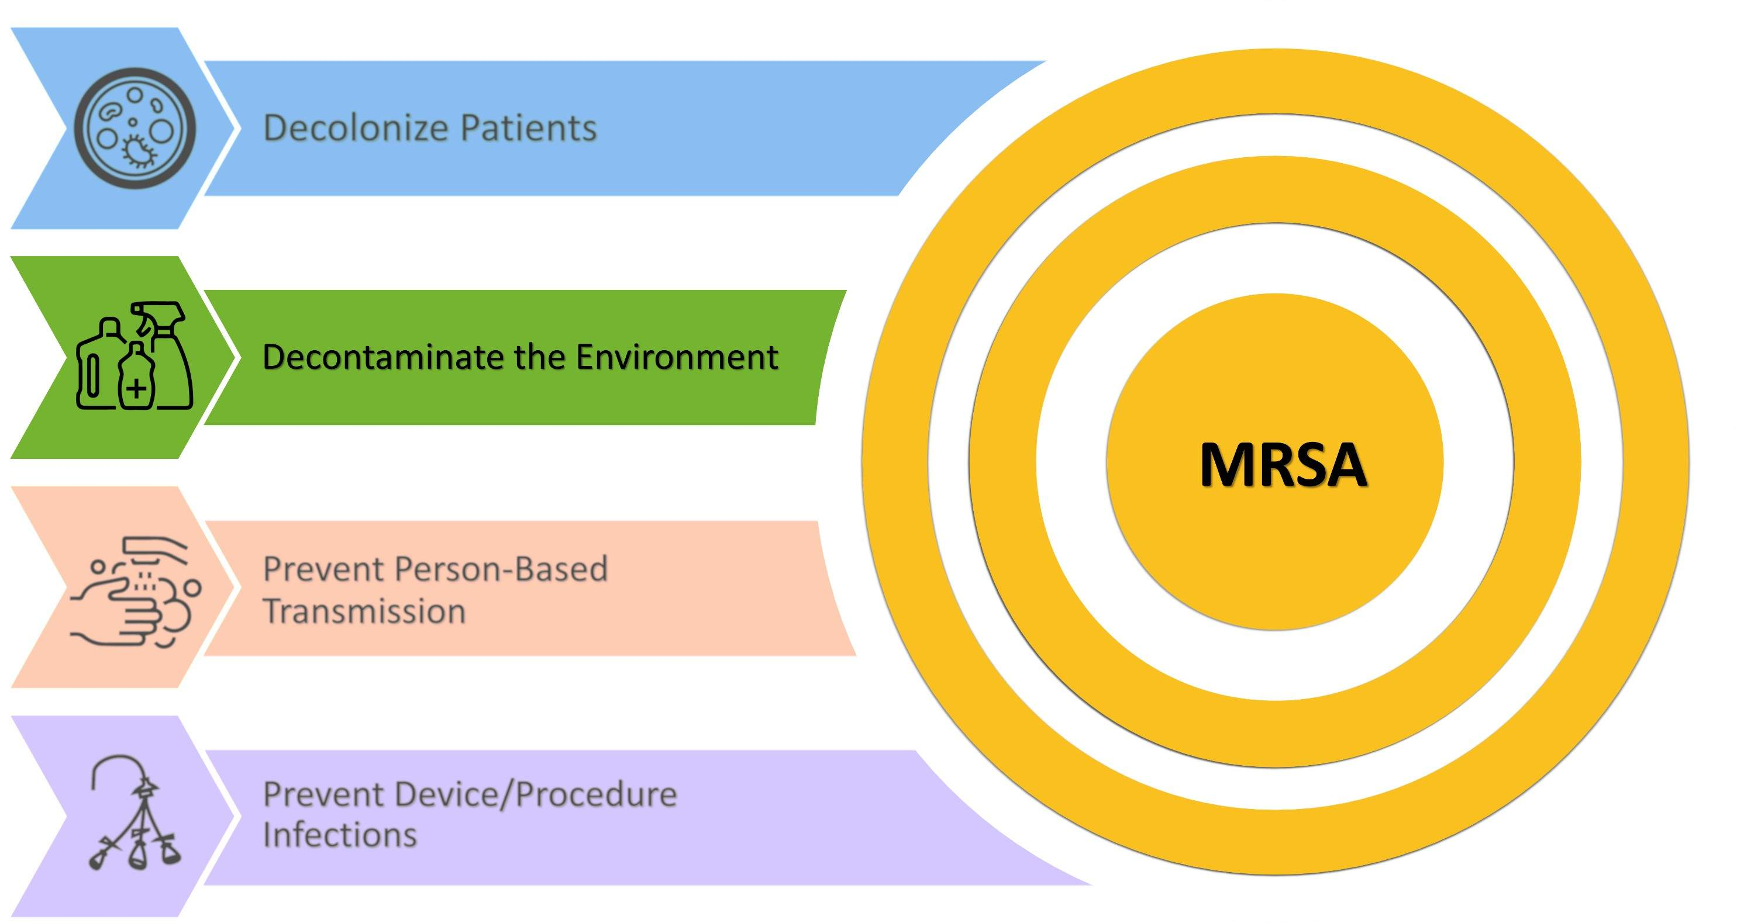
Key Strategies To Take Aim and Target MRSA Infection

Slide 4

EVC Monitoring Program
Essential Aspects of an Effective EVC Monitoring Program

Slide 5

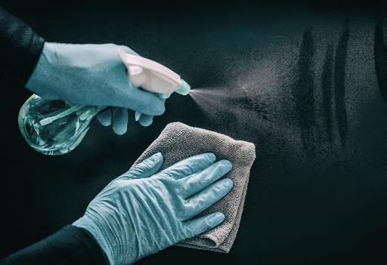
Cornerstone of EVC Improvement
Effective performance assessment and constructive feedback in a non-blame, empowering culture
Strong and collaborative team effort based on trust
Key members of the team include the following:
EVC associates, supervisors, and other EVC members
Nursing staff, providers
Patient safety personnel, and other Comprehensive Unit-based Safety Program (CUSP) team members

Slide 6
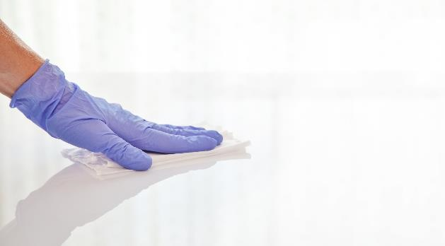
Points To Consider for an Effective EVC Monitoring Program
Understand the current process and how effectively it is being carried out.
Bring the team and stakeholders together to discuss the process of evaluating EVC.
Establish a clear purpose along with expectations and goals.
Share information with all stakeholders and facilitate a supportive environment.
Ensure a clear layout of data feedback.

Slide 7
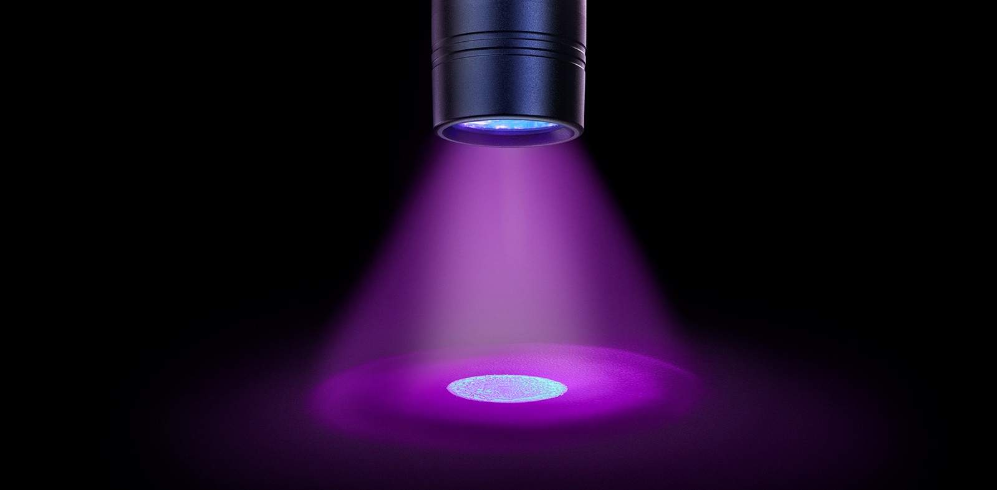
Fluorescent Gel Monitoring Systems
Strategies and Considerations of Fluorescent Gel Monitoring Systems
Source: Ecolab USA Inc. Image used with permission.

Slide 8
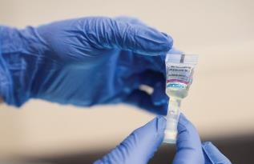
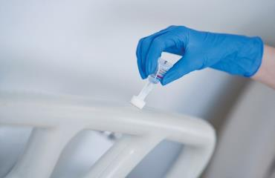
Fluorescent Gel Monitoring¹⁻⁴
Fluorescent gel (FG) is invisible except under an ultraviolet (UV) light.
High-touch surfaces (HTSs)—such as bed rails, intravenous (IV) poles, and overbed tables—in the patient environment are marked with the gel.
After a set interval, the surfaces are re-checked with a UV flashlight.
If the surface glows, then it indicates that cleaning was not done effectively.
Source: Ecolab USA Inc. Images used with permission.
For information on methods to monitor quality of cleaning including observation, culturing, FG monitoring, and adenosine triphosphate (ATP) systems, access the Environmental Cleaning section of the Toolkit website.

Slide 9
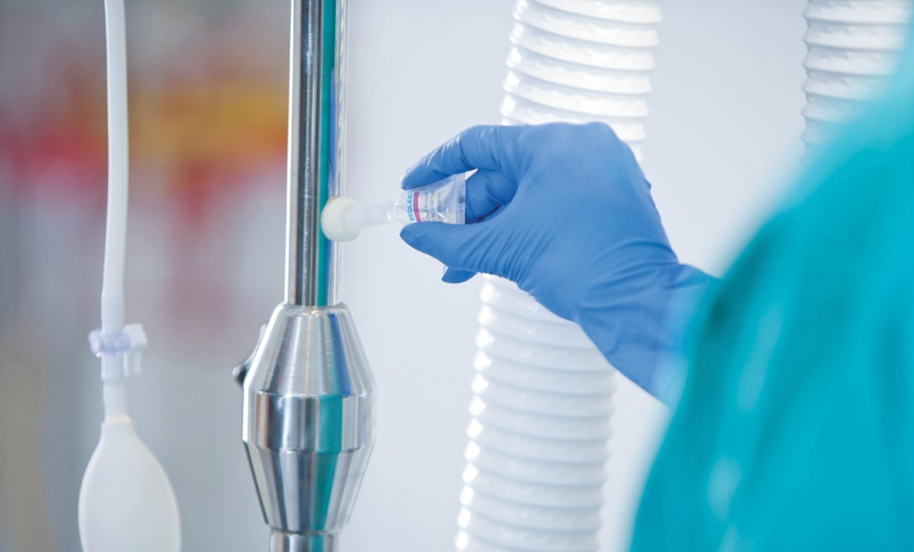
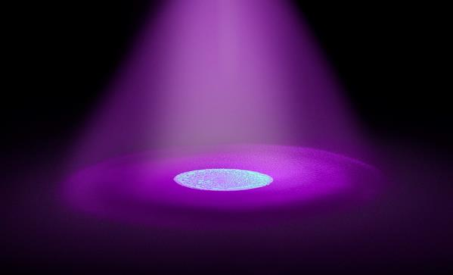
Questions To Ask When Implementing FG Monitoring
The following are key questions to ask when implementing FG monitoring systems:
Which FG product should be used?
How many rooms and HTSs should be checked?
How should they be selected?
Who should take on the task of EVC monitoring?
Source: Ecolab USA Inc. Image used with permission.

Slide 10
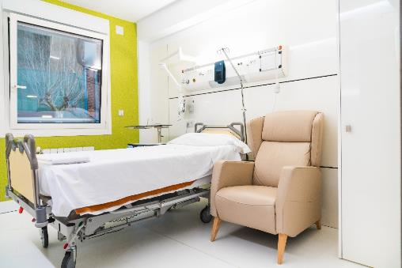
Which FG Product Should Be Used?⁶
Study by Rock, Xie, Andonian, et al. (2019):
Examined the effectiveness of different FG markers (FGMs) for monitoring
  Purpose-made metered applicator
  Generic cotton swab dipped in FG lotion
Other FGMs excluded because the gel was visible to the naked eye or would not be removed despite thorough cleaning
Phase 1:
  Evaluated 787 HTSs across 38 random patient rooms in nine different units
  Different FGM applied to each half of every HTS
Phase 2:
  Involved eight trained “markers”
  Applied the different FGMs on an HTS of an unoccupied patient room used for training and simulation

Slide 11
Evaluation of Different FGMs⁶
Purpose-made Metered Applicator for FGM
Generic Cotton Swab Dipped in FG Lotion
60.5 percent removal rate (476 of 787 HTSs)
Less variability of FG dot sizes
Less visible to the naked eye
Harder to remove
More expensive
64.3 percent removal rate (506 of 787 HTSs)
More variability of FG dot sizes
More visible to the naked eye
Easier to remove
Less expensive

Slide 12

How Many Rooms and HTSs Should Be Checked?
How Should They Be Selected?⁵
The time and resources for FG monitoring is often cited as a barrier.
A 2019 study sought to determine the least number of HTSs per room and rooms per unit needed to accurately reflect cleaning quality.⁵
  Conducted in an academic hospital with 2,942 HTSs in 228 randomly selected rooms on 13 units.
Source: Ecolab USA Inc. Image used with permission.

Slide 13
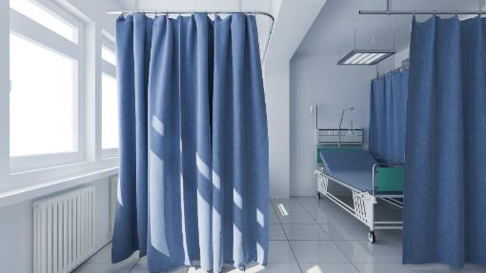
FG Monitoring Strategies⁵
Six different sampling strategies tested:
  One random HTS per room
  Two random HTSs per room
  Three random HTSs per room
  Four random HTSs per room
  Five random HTSs per room
  One random HTS in the main room and one HTS in the bathroom
Definition of optimal sampling strategy:
  Least number of HTSs for which all samples have less than or equal to 10 percent sampling error frequency
Rooms stratified by:
  High (i.e., greater than or equal to 80 percent) FG removal rate
  Low (i.e., less than 80 percent) FG removal rate
  Discharge cleaning
  Daily cleaning

Slide 14
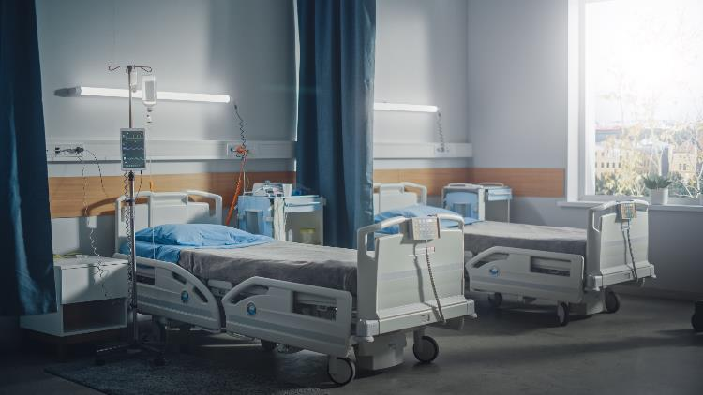
Optimal Number of Rooms and HTSs for FG Monitoring⁵
Study results: Three randomly selected HTSs from two randomly selected rooms per unit every 2 weeks is the optimal strategy
  Optimal strategy to predict FG removal on a unit
For five units, an estimated 5 hours total required per month
Indicates FG monitoring is less resource intensive than anticipated

Slide 15

EVC Monitoring
Essential Steps of an EVC Monitoring Program

Slide 16

Evaluating EVC
Step 1: Randomize rooms and HTSs.
Step 2: Place FG.
Step 3: Clean patient rooms.
Step 4: Check for FG with UV light.
Step 5: Share data feedback.
For more information on evaluating EVC and methods to monitor quality of cleaning that include observation, culturing, FG monitoring, and ATP systems, access the Environmental Cleaning section of the Toolkit website.

Slide 17


The Monitoring Process
The following tools can help with the data collection process for EVC as well as ensure a randomized and systematic method to determine rooms and HTSs for FG placement.
Evaluating Environmental Cleaning With Fluorescent Gel: Data Collection Instructions and Form
How To Randomly Order Lists of Rooms and High-Touch Surfaces Tool

Slide 18
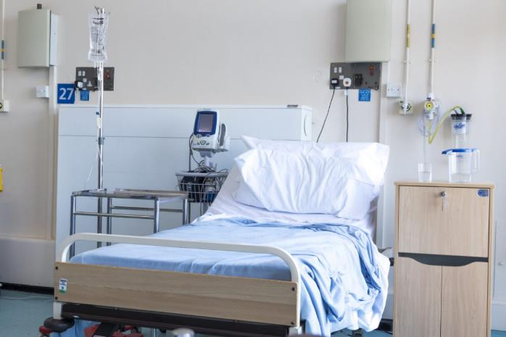
Step 1: Randomize Rooms and HTSs⁵
Before assessing the cleaning, randomize patient rooms and HTSs.
Evaluate two rooms of a unit and three HTSs within those rooms.
Set up random and blinded monitoring.

Slide 19
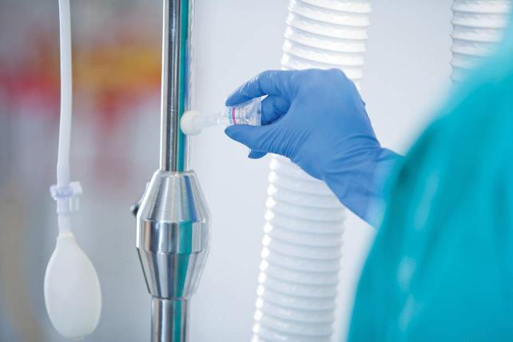
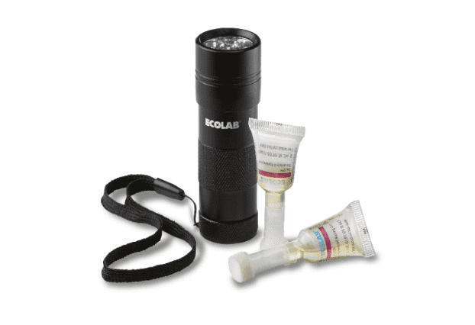
Step 2: Place FG
Apply an approximately 2-centimeter FG dot on the selected HTSs of the patient rooms.
Source: Ecolab USA Inc. Images used with permission.

Slide 20

Step 3: Clean Patient Rooms
EVC associate cleans patient rooms.
During cleaning of HTSs, FG dots are easily wiped away.
FG will remain on uncleaned HTSs.

Slide 21
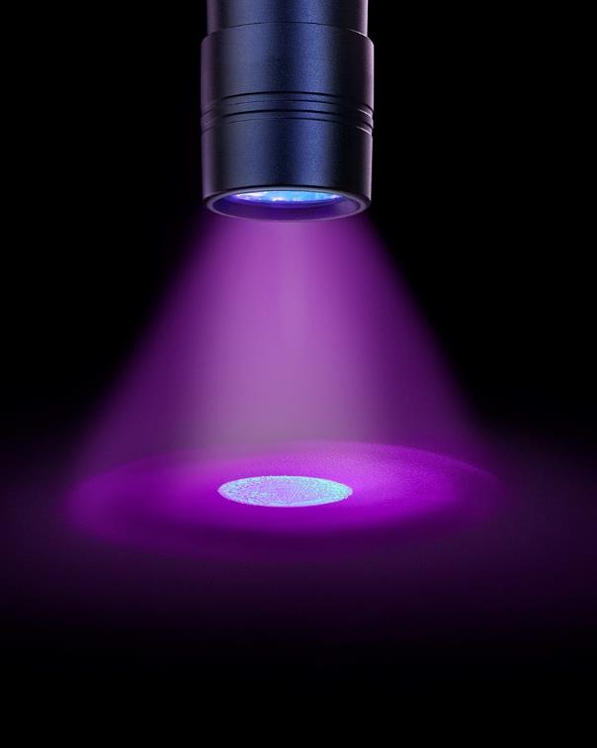
Step 4: Check For FG With UV Light
Evaluate cleaning approximately 1 day later.
Check for the presence or absence of FG on marked HTSs.
  If the FG is not visible under the UV flashlight, the surface is considered clean.
  However, if the FG remains, the surface is considered not adequately cleaned.
Source: Ecolab USA Inc. Image used with permission.

Slide 22

Step 5: Share Data Feedback
Share findings in real time with the EVC associate, either with or without their EVC supervisor present.
For HTSs where FG remains, identify and explore barriers to EVC.
Share findings more broadly with EVC leadership and hospital committees.

Slide 23

Task of EVC Monitoring
Who Should Take on the Task of EVC Monitoring?

Slide 24

Infection Control Practitioner (ICP)
Role
  Infection Preventionist
Advantages
  Objective
  Vested interest in accurate results
  Understands the importance of the task
  Experienced with giving constructive feedback
Disadvantages
  Resource intensive, as ICPs have many other priorities and commitments

Slide 25

Unit Nurse
Role
  Unit Nurse
Advantages
  Strengthens collaboration and facilitates discussion between EVC and Nursing
  Helps delineate cleaning responsibilities
  Able to monitor all shifts
Disadvantages
  May not have experience with constructive feedback
  Competing nursing priorities
  Requires training

Slide 26

EVC Supervisor
Role
  EVC Supervisor
Advantages
  Facilitates feedback and accountability between EVC associates and supervisor
  Well-positioned to identify systemic problems
Disadvantages
  May be less objective
  Need to ensure data are communicated outside the EVC team

Slide 27
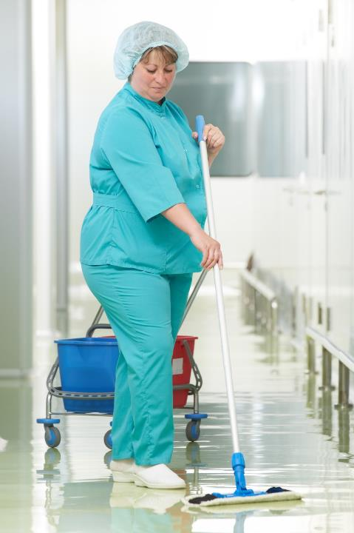
EVC Associate
Role
  EVC Associate
Advantages
  Empowers ownership and performance improvements
  Identifies problems which can lead to improved process
  Able to monitor all shifts
Disadvantages
  Can be less objective
  Can be challenging to give and receive peer-to-peer monitoring and feedback

Slide 28

“Secret Shopper”
Role
  “Secret Shopper”
Advantages
  Less risk of the Hawthorne Effect—the observer’s effect on the behavior being assessed
Disadvantages
  Needs significant oversight to ensure valid data
  May require frequent turnover
  Requires training

Slide 29

Mixed: Nurse and EVC Associate
Role
  Mixed: Nurse and EVC Associate
Advantages
  Clarification of cleaning responsibilities (e.g., IV pole)
  Joint accountability
  Bidirectional feedback
Disadvantages
  Can lead to lack of ownership
  Need to ensure respectful, constructive feedback processes

Slide 30

Data Feedback
Promoting an Environment of Shared Knowledge and Common Goals

Slide 31



Effective Data Feedback to the EVC Associate
Provide immediate feedback.
Include the EVC associate in the process of checking FG dots as a good learning opportunity.
Recognize strong performers.
  Merit uniform t-shirt, meal vouchers, pizza parties.
  Hospital-wide recognition on digital displays and newsletters.
  Certificates of appreciation.
Establish a supportive improvement plan with re-training, clear milestones, and an accountability plan if needed.
Share data at EVC morning huddles and identify common barriers to effective cleaning.

Slide 32

Effective Data Feedback to the EVC Supervisor
Present overall performance data to the EVC supervisor and leadership team.
  This allows for early heightened awareness and appropriate real-time interventions.
Data feedback may be done by sending the Evaluating Environmental Cleaning With Fluorescent Gel: Data Collection Instructions and Form in real time to EVC leadership.

Slide 33

Effective Unit Level Feedback
Disseminate data at unit CUSP and quality improvement meetings.
Discuss collaborative performance improvement plans.
EVC associates are integral members of the CUSP team.
Invite and encourage attendance of EVC associates.
The ICP is often in a position to support EVC associates and facilitate meaningful discussions to improve processes.

Slide 34

Effective Data Feedback:
Hospital-Wide Committees and Executives
Share data with hospital-wide committees and executives.
  Hospital infection control committee meetings
  Quality and safety meetings
  Executive meetings

Slide 35
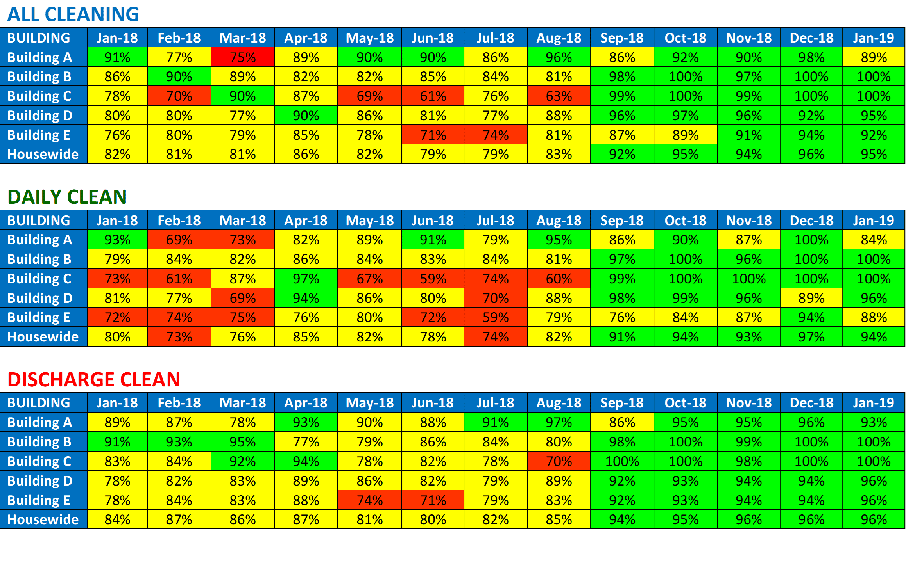
Evaluation and Aggregation of EVC Data
Access the template to help evaluate and aggregate EVC data through the Evaluating Environmental Cleaning With Fluorescent Gel: Data Collection Instructions and Form.

Slide 36

Analyze and Disseminate Data
Remember to analyze the data collected and share the results widely with all levels of the organization.
Inform and engage stakeholders about environmental cleaning program performance to drive improvement efforts and accountability.

Slide 37

Case Example
An Uptick in MRSA Rates in a Surgical Unit

Slide 38

Using the Learning From Defects Tool
The following are four questions to help guide the CUSP (Comprehensive Unit-based Safety Program) team in problem-solving and defect identification:
  What happened?
  Why did it happen?
  How do we reduce the likelihood of this defect from happening again?
  How do we know the risk is reduced?
Access the AHRQ Learning From Defects Tool.

Slide 39
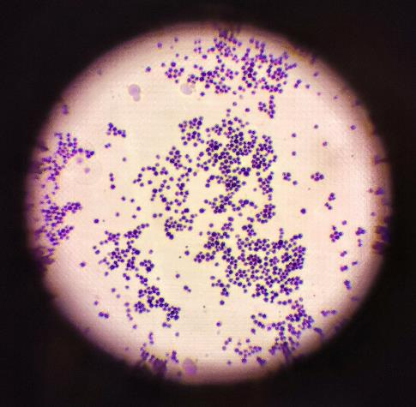
Case Example: What Happened?
There was an uptick in healthcare-associated MRSA rates.
Most cases occurred in rooms where the previous patient also had MRSA.
An FG monitoring program was conducted secretly.
Results of assessment were poor.
The results were then shared with hospital leadership.
A lack of trust developed between the Environmental Services (EVS) and Infection Prevention and Control (IPC) teams.

Slide 40


Case Example: Identify Contributing Factors
Negative Contributing Factors
Definition: Factors that increased the risk of harm.
Assumptions were made for why there were increased MRSA cases.
The fluorescent gel monitoring program was activated without staff knowledge.
Results were shared with staff with a request for an immediate performance improvement plan.
Lack of trust developed among stakeholders (i.e., EVS and IPC).
Positive Contributing Factors
Definition: Factors that limited the impact of harm.
There was an established CUSP team.
There was an established partnership between the EVS and IPC teams.

Slide 41

Case Example: How Do We Reduce the Likelihood of This Defect From Happening Again?
Collaboratively reviewed and designed a new fluorescent gel monitoring program
  Discussed the changes in CUSP meetings and engaged IPC and EVS collaboration
Educated staff on its importance and use in the clinical setting.
  Piloted the program on one floor with the help of the CUSP team

Slide 42

Case Example: Review of Data and Interventions
EVS training was implemented through more formalized on-boarding and annual training.
To improve the EVS’ access to adequately stocked carts, the process of stocking and restocking cleaning carts was improved along with plans to evaluate the changes.
All members of the quality improvement program worked together to communicate and create a plan to improve EVC and patient care.

Slide 43

Case Example: How Do We Know the Risk Is Reduced?
Obtained staff feedback.
  Rate the effectiveness of the intervention.
  How has it changed the workflow?
  What impact did it have on the identified problems?
  What impact did it have on the infection rates?

Slide 44

Celebrate Successes
Establishing an effective environmental cleaning program is hard work and
requires effort and feedback from all leadership levels.
Remember to acknowledge and celebrate successes!

Slide 45
Key Takeaways
The cornerstone of EVC improvement is effective performance assessment and constructive feedback in a non-blame, supportive culture.
Additional strategies and considerations for FG monitoring systems include what products to use, and which and how many rooms and HTSs to assess.
Steps to evaluate EVC such as with FG monitoring systems include the following: randomize rooms and HTSs, place FG, clean patient rooms, check FG with UV light, and share data feedback.
Consider which role is best to take on the task of performing EVC monitoring such as the ICP, unit nurse, EVC supervisor, EVC associate, secret shopper, or mixed roles including nurse and EVC associate.
Effective data feedback is essential to drive improvement efforts and accountability of an EVC monitoring program.
Successfully reducing healthcare EVC and mitigating MRSA and other multidrug-resistant organism transmissions requires sustained efforts from all levels of healthcare personnel. Remember to celebrate successes!

Slide 46
Disclaimer
The findings and recommendations in this presentation are those of the authors, who are responsible for its content, and do not necessarily represent the views of AHRQ. No statement in this presentation should be construed as an official position of AHRQ or of the U.S. Department of Health and Human Services.
Any practice described in this presentation must be applied by healthcare practitioners in accordance with professional judgment and standards of care in regard to the unique circumstances that may apply in each situation they encounter. These practices are offered as helpful options for consideration by healthcare practitioners, not as guidelines.

Slide 47
Reference List
Carling PC, Bartley JM. Evaluating hygienic cleaning in health care settings: what you do not know can harm your patients. Am J Infect Control. 2010 Jun 1;38(5):S41-50. PMID: 20569855.
Boyce JM. Modern technologies for improving cleaning and disinfection of environmental surfaces in hospitals. Antimicrob Resist Infect Control. 2016 Apr;5:10. PMID: 27069623.
Mitchell BG, Wilson F, Dancer SJ, et al. Methods to evaluate environmental cleanliness in healthcare facilities. Healthcare Infect. 2013 Feb;18(1):23-30.
Hung IC, Chang HY, Cheng A, et al. Application of a fluorescent marker with quantitative bioburden methods to assess cleanliness. Infect Control Hosp Epidemiol. 2018 Nov;39(11):1296-300. PMID: 30221609.
Rock C, Small B, Hsu Y, et al. Evaluating accuracy of sampling strategies for fluorescent gel monitoring of patient room cleaning. Infect Control Hosp Epidemiol. 2019 Jul;40(7):794-7. PMID: 31172902.
Rock C, Xie A, Andonian J, et al. Evaluation of environmental cleaning of patient rooms: impact of different fluorescent gel markers. Infect Control Hosp Epidemiol. 2019. Jan;40(1):100-2. PMID: 30419977.

