Slide 1
AHRQ Safety Program for MRSA Prevention
Hand Hygiene Promotion
ICU & Non-ICU
AHRQ Pub. No. 25-0007
October 2024

Slide 2
Educational Objectives
Describe the key best practice recommendations for hand hygiene in healthcare settings.
Discuss the advantages and disadvantages of various hand hygiene measurement methodologies.
Review the current recommendations for implementation of a comprehensive hand hygiene promotion and measurement program to prevent MRSA transmission and infection.

Slide 3
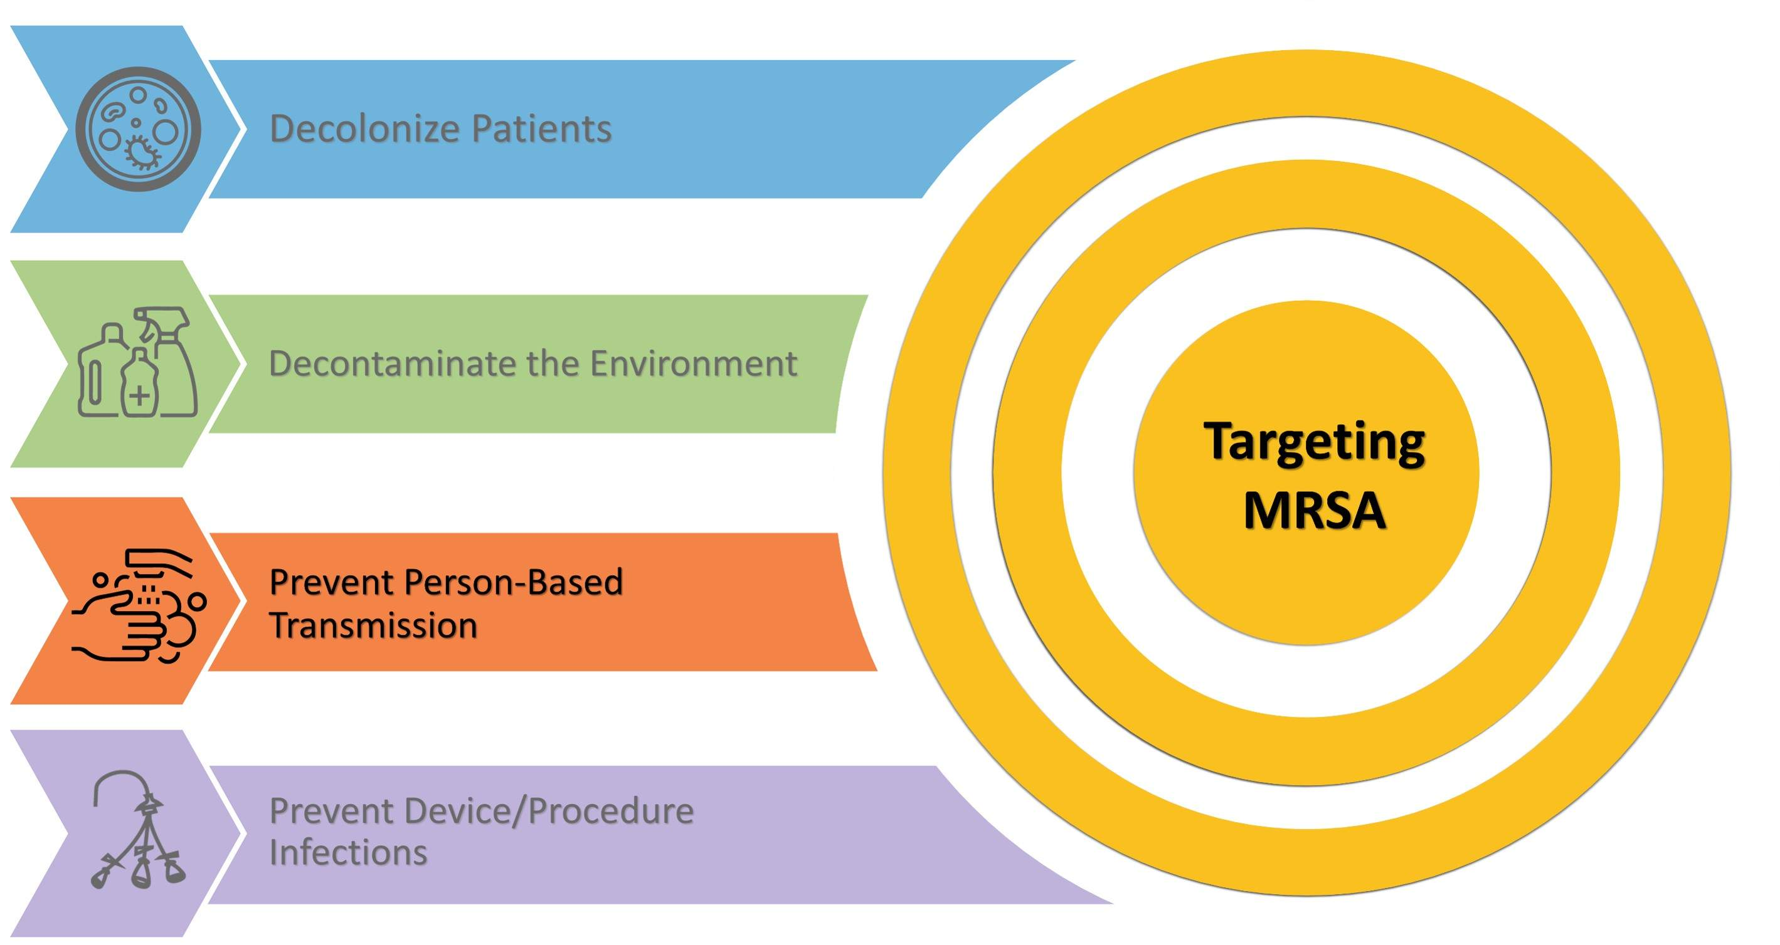
Key Strategies To Prevent MRSA Infection
Four Key Strategies To Take Aim and Target MRSA Infection

Slide 4
Prevent Person-Based MRSA Transmission¹
Performing hand hygiene at key moments using appropriate technique in combination with other evidence-based best practices interrupts MRSA transmission from healthcare personnel to patients.
Refer here to The Joint Commission’s 2024 National Patient Safety Goals.

Slide 5
Hand Hygiene Adherence Is Often Low¹⁻⁴
Hand hygiene is fundamental and vitally important in preventing healthcare-associated infections (HAIs) and reducing the transmission of multidrug-resistant organisms (MDROs).⁵⁻⁶
However, estimates of hand hygiene adherence range from 5 percent to 81 percent, with an average adherence of 40 percent.⁷⁻⁸
A multimodal or bundled approach to hand hygiene promotion is more effective than implementing one or two interventions alone.⁵⁻⁸

Slide 6
Evidence-Based Practices
Indications for Hand Hygiene and Recommended Procedures

Slide 7
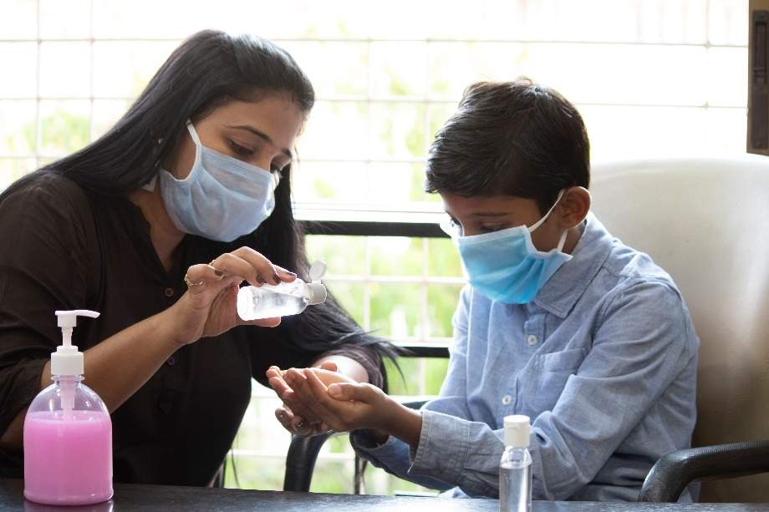
Hand Hygiene Guidance
Healthcare Infection Control Practices Advisory Committee (HICPAC) Guideline for Hand Hygiene in Health-Care Settings (2002)⁵
Society for Healthcare Epidemiology of America (SHEA)
Association for Professionals in Infection Control and Epidemiology (APIC)
Infectious Diseases Society of America (IDSA) Hand Hygiene Task Force
World Health Organization (WHO) Guidelines on Hand Hygiene in Health Care (2009)⁷
Inclusion of Five Moments for Hand Hygiene⁹
SHEA/IDSA/APIC Practice Recommendation: Strategies to Prevent Healthcare Associated Infections through Hand Hygiene: 2022 Update²
Part of the Compendium of Strategies to Prevent HAIs

Slide 8
Start With Healthy Hands^{2,5,7}
According to the Centers for Disease Control and Prevention (CDC), healthcare providers may wash their hands over 100 times per 12-hour shift.¹⁰
Among providers, 15 to 69 percent report some level of skin compromise.^{11,12}
Skin conditions increase risk of pathogen colonization and transmission.
Involving staff in the selection process for hand hygiene products can help promote acceptance and use.
Healthy Hands
Hand Hygiene Indications
Hand Hygiene Technique

Slide 9
Considerations for Healthy Hands^{2,5,7}
Intact skin
Clean, short, natural fingernails¹³
Include acceptable length in policy
Consider policy on gel/shellac overlays
Consider policy on jewelry^{14,15}
Assure ready access to hand moisturizer
Ensure compatibility with all hand hygiene products

Slide 10
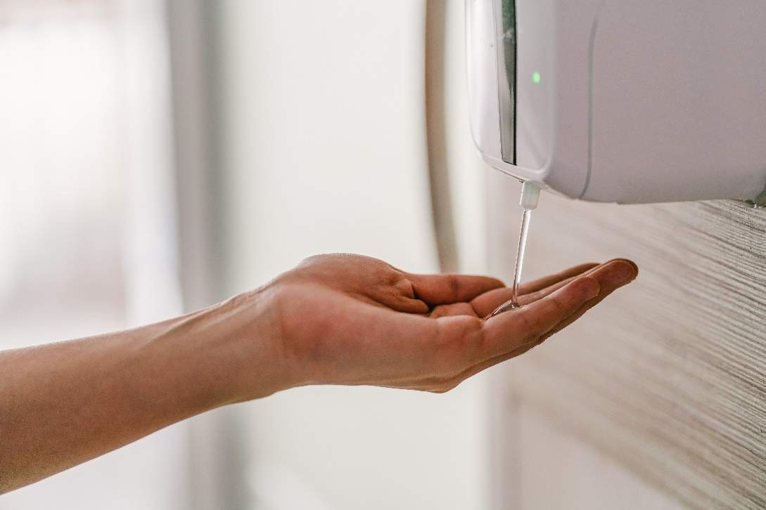
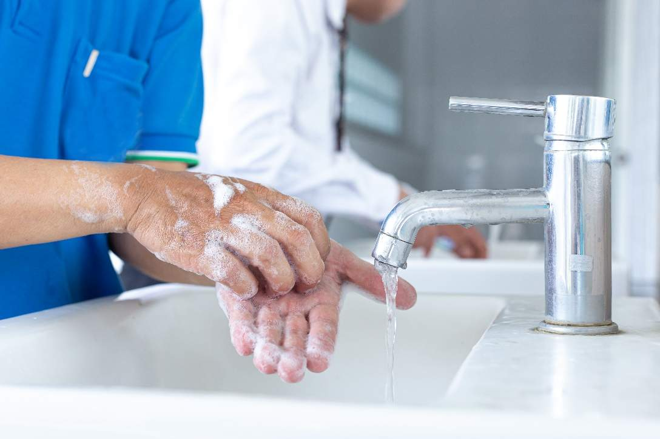
Hand Hygiene Products
Studies have found alcohol-based hand rub (ABHR) to be superior to both non-antimicrobial soap with water and antimicrobial soap with water.¹
The WHO strongly recommends ABHR over soap and water.⁷

Slide 11
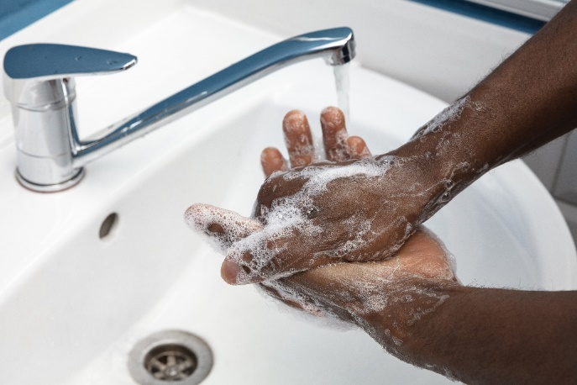
When To Use ABHR or Soap and Water?^{1,2,7,8}
ABHR
Preferred method for hand hygiene in most situations.
Shown to have significantly better efficacy in removing different viruses than antimicrobial and non-antimicrobial soap and water.
Soap and Water
Use when hands are visibly soiled, when there is a noticeable buildup from ABHR, and after using the bathroom.
Use when patients have an infection from a spore-producing organism like Clostridioides difficile.^{16,17}
If ABHR is readily available for staff, it is recommended that plain, non-antimicrobial soap should be provided when hand washing with soap and water is required.⁷

Slide 12
Hand Hygiene Indications
WHO¹⁸
CDC¹⁹
Before Touching a Patient
Immediately before touching a patient
1
Before performing an aseptic task (e.g., placing an indwelling device) or handling invasive medical devices
Before Clean/Aseptic Procedure
2
After contact with blood, body fluids, or contaminated surfaces
After Body Fluid Exposure Risk
3
After touching a patient
After Touching a Patient
4
After touching the patient’s environment
Before moving from a soiled body site to a clean body site on the same patient
Immediately after glove removal
5
After Touching Patient Surroundings
Wash hands when visibly soiled, before eating, and after using the restroom.

Slide 13
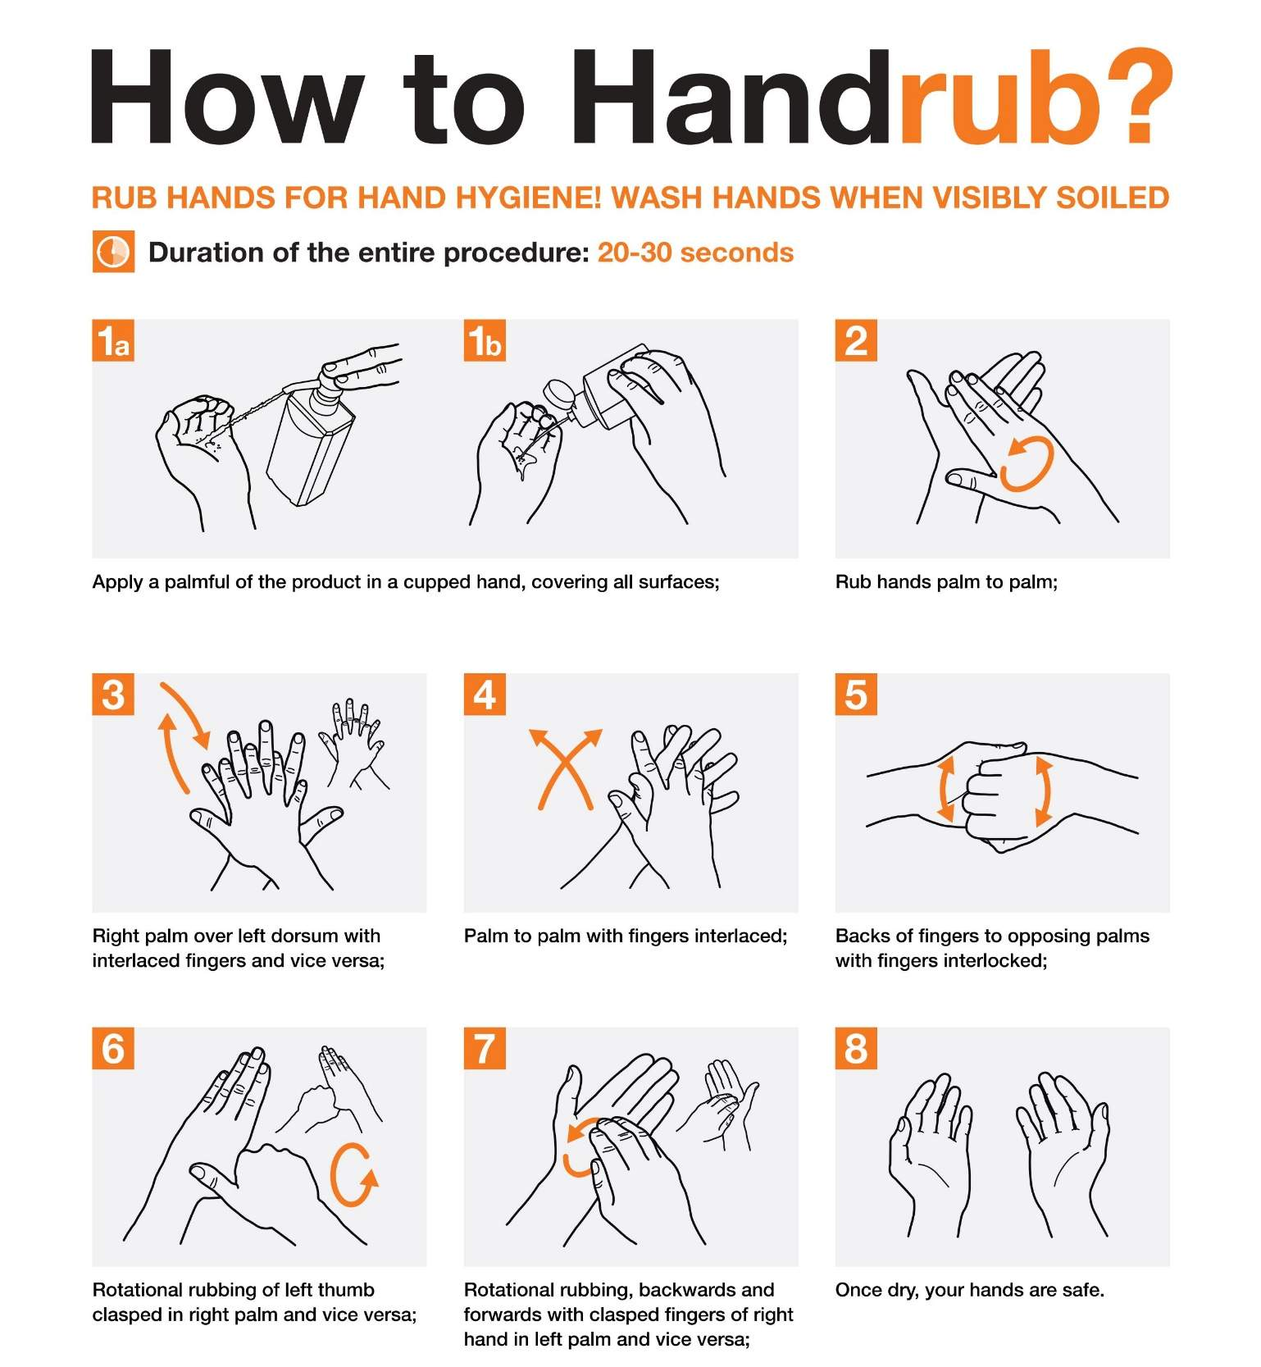
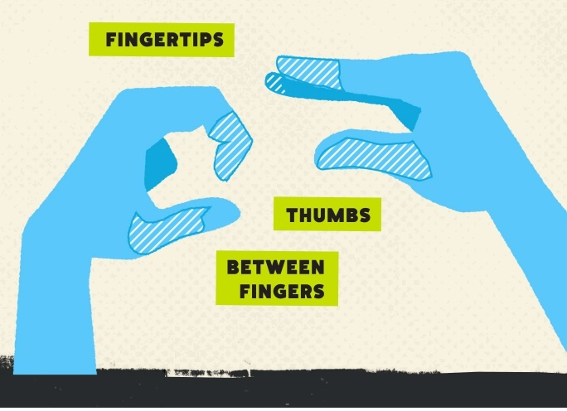
Hand Hygiene Technique: ABHR^{2,5,7,20}
Areas Most Frequently Missed During ABHR²¹
Source: Centers for Disease Control and Prevention. March 2024. https://www.cdc.gov/clean-hands/media/pdfs/provider-factsheet-508.pdf. Accessed May 21, 2024.
Source: World Health Organization. May 2009. https://www.who.int/publications/m/item/how-to-handrub. Accessed May 21, 2024.

Slide 14
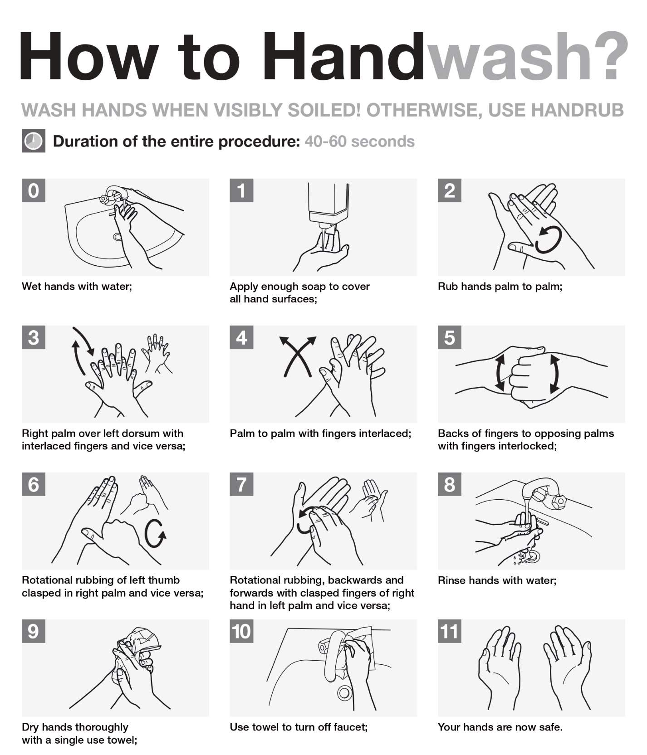
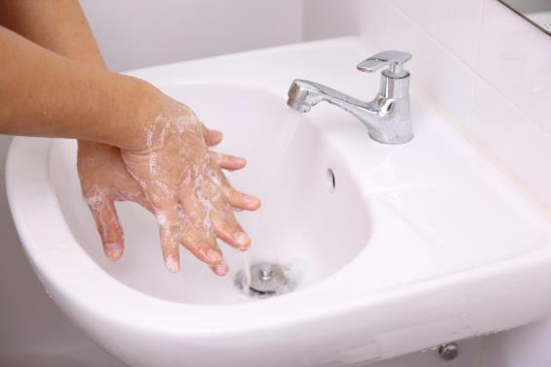
Hand Hygiene Technique: Soap and Water^{7,22}
Soap and ABHR dispensers should be clearly marked.
Source: World Health Organization. May 2009. https://www.who.int/publications/m/item/how-to-handwash. Accessed May 21, 2024.

Slide 15
Appropriate Glove Use
Indications for Donning Gloves^{2,5,8,18}
Before an aseptic procedure
When anticipating contact with blood or bodily fluid
When in contact with a patient or patient equipment/environment during contact isolation precautions
Perform hand hygiene BEFORE donning gloves and promptly AFTER removing gloves.
Indications for Removing Gloves^{2,18}
When gloves are damaged or integrity is suspect
After contact with blood, another body fluid, non-intact skin, or mucous membrane occurred
After contact with a patient and their surroundings, or a contaminated body site
When care moves from a dirty site to a clean site
When there is an indication for hand hygiene

Slide 16
Glove Donning and Doffing Technique^{2,19,23}
Hand hygiene must be performed before donning gloves and after doffing gloves.
A 2019 study found that 37 percent of healthcare providers inadvertently contaminated their hands during glove removal.²⁴
The fingertips and wrists are the most-often contaminated areas.
WHO Glove Use Guidelines²³
https://www.who.int/publications/m/item/glove-use-information-leaflet-(revised-august-2009).
Source: Centers for Disease Control and Prevention. April 2024. https://www.cdc.gov/clean-hands/media/images/Provider-Infographic-6-Gloves-are-Not-Enough.png. Accessed May 21, 2024.

Slide 17
Adherence Monitoring
Methods for Monitoring and Measuring Hand Hygiene Adherence

Slide 18
Before You Start²⁵
What are your goals?
What do you want to measure?
How are you going to measure it?
Who is going to measure it?
How are you going to share the data?

Slide 19
What To Monitor?^{2,16}
One approach is to monitor hand hygiene adherence at the time of entry and time of exit from a patient’s room or clinical care environment.
ENTERING
EXITING

Slide 20
How To Monitor Hand Hygiene Adherence^{2,5,7,8}
Hand Hygiene Adherence Monitoring Methods
Direct Observation
Automated Adherence Monitoring
Product Volume/Event Count Measurement
Staff Surveys/ Patient Reports

Slide 21
Direct Observation^{2,5,7,8}
Covert
Overt
Technology- Assisted
Pros
Minimizes Hawthorne effect so more accurate
Identifies trends and barriers to adherence
Pros
Can provide immediate feedback to personnel
Engages personnel in education and dialogue
Pros
Minimizes Hawthorne effect so more accurate
Allows assessment of more hand hygiene opportunities
Cons
No opportunity for real-time intervention
Fewer observations
Observers may become known
Resource intensive
Cons
Hawthorne effect
Overestimates adherence
Requires training and skill to provide feedback
Resource intensive
Cons
No opportunity for real-time intervention
High cost
Patient privacy risk

Slide 22
Indirect Observation^{2,5,25}
Product Volume/Event Count Measurement
Automated Adherence Monitoring
Definition
Tracks the amount of product used or dispensed over time.
Definition
Uses devices worn by staff to record hand hygiene behavior via motion sensor devices, badge technology, or reminder and feedback systems.
Pros
Useful in tracking trends of hand hygiene frequency over time or between units.
Pros
Eliminates selection and recall bias of human observers.
Cons
Cannot tell who used the product (e.g., healthcare personnel, patients, or visitors).
Cannot be used to determine adherence rates because hand hygiene opportunities are not recorded.²⁶
Dispensing hardware can malfunction.
Cons
Technology can be costly to install and/or maintain.
Systems can be unreliable due to dead batteries, nonoperative dispensing units, and recording errors.¹

Slide 23
Staff Surveys And Patient Reports^{2,25}
Staff Surveys
Self-reported hand hygiene adherence
Product satisfaction
Knowledge level
Safety culture
Patient Reports
Staff hand hygiene adherence
Patient satisfaction

Slide 24
Data Collection²
Example Of Direct Observation
Numerator (n): Number of successful hand hygiene actions performed
Denominator (d): Number of hand hygiene opportunities observed
Adherence rate by percentage:
n divided by d, times 100
Importance Of Data Analysis
Identify trends in hand hygiene adherence rates by discipline, shift, department, and unit.
Target future interventions.
Conduct periodic data validation.
Share with leadership and staff to motivate improvement.
Example Of Indirect Observation
Numerator (n): Milliliters of product used over a specified time
Denominator (d): 1,000 patient days during the specified time
Product Usage: Milliliters per 1,000 patient days

Slide 25
Dissemination²
Share data at all levels,
in multiple ways.

Slide 26
Program Implementation
Developing and Implementing a Hand Hygiene Monitoring Program and Intervention Strategies

Slide 27
Program Implementation Strategies: The 4 Es^{2,27-31}
Engage (adaptive)
Secure leadership support.
Set goals and establish expectations.
Convene a team.
How can we engage hearts and minds?
Educate (technical)
Share the evidence.
Educate on new policies/procedures.
Use multimodal educational tools.
How can we turn the evidence into behavior?
Execute (adaptive)
Implement evidence-based practice.
Address barriers and make revisions.
Collect data throughout implementation.
Assess fidelity to the model of care.
What do we need to do?
How can we do it with our resources and culture?
Evaluate (technical)
Analyze the data.
Share outcomes/feedback to leadership & staff.
Reassess and revise based on findings.
How do we know if we made a difference?
Access additional resources on the 4 Es—presentation, facilitator guide, and one-pager.

Slide 28
Engage²
Secure support from hospital leadership.
Set clear priorities and goals.
Invest in resources for program implementation.
Assist with mitigation of barriers that personnel may experience (e.g., staffing issues, poor accountability for hand hygiene adherence).
Set goals that align with organizational strategic priorities.
Determine metrics that will be used and how they will be captured and reported.
Ensure adequate resources are available for data collection and analysis.

Slide 29
Engage: Establishing Clear Expectations^{2,5,7}
Develop or review existing hand hygiene policies to ensure they outline clear expectations for healthcare workers on when and how to perform hand hygiene.
Policies should contain all required elements from The Joint Commission.
They should align with nationally recognized standards and guidelines
Consider including an accountability structure.
Outline processes and expectations for noncompliance.
Policies and procedures can be unit based or individual based.

Slide 30
Engage: Sample Accountability Models^{2,5,7}
Example of a unit based accountability model for noncompliance
Time In Noncompliance | Unit Based Accountability
After 2 continuous months of compliance below goal | Unit manager develops an improvement plan in partnership with infection control
After 3 continuous months of compliance below goal | Unit manager presents an updated plan to hospital leadership
Example of an individual accountability model for noncompliance
Time in Noncompliance | Individual Accountability Model
One formal observation | Manager notified of noncompliance
Two formal observations within a 12-month period | Receives training and develops a personal improvement plan
Three formal observations within a 12-month period | Suspended

Slide 31
Engage: Hand Hygiene Team^{2,32}
Coordinate overarching activities of the hand hygiene monitoring program
Develop and review hand hygiene policies and plans
Operationalizing the system being used to gather data
Disseminating data to hospital leadership, unit leadership, and any outside organizations required for public reporting

Slide 32
Engage: Convening a Team^{2,32}
Hand Hygiene Champions:
Ensure efforts make it to the local level.
Act as the liaison during implementation planning and program evaluation.
Communicate compliance data to colleagues.
Identify and address barriers.
Hand Hygiene Observers:
Observe and monitor hand hygiene adherence.
Can consist of staff hired directly for the role, redeployed staff from other facilities, or staff on light duty.
Consider risks and benefits of including “secret shoppers” in public committee meetings.

Slide 33
Educate^{2,33}
Initial hand hygiene education at time of hire
Policy
Products
Technique
Return demonstration
Annual refresher training
CDC Hand Hygiene in Healthcare Settings³³
Videos
Slide decks
Computer-based learning
WHO Training Tools⁷
Slide decks
Leaflets
FAQs
Videos
Source: Centers for Disease Control and Prevention. May 2024. https://www.cdc.gov/clean-hands/hcp/training/Cdiff-Course.html. Accessed May 16, 2024.

Slide 34
Execute: Intervention Strategies⁵
Hand Hygiene Promotion Strategies^{34,35}
Education
Routine observation and feedback
Engineering controls
Patient education
Reminders
Accountability and reward models
Facilitation of skin health
Improvement of safety climate
Enhancement of self-efficacy
Management of staffing and workload
HICPAC Guideline for Hand Hygiene in Health-Care Settings⁵
https://www.cdc.gov/mmwr/PDF/rr/rr5116.pdf

Slide 35
Execute: Multimodal Hand Hygiene Programs^{5,34,35}
An example of a multimodal hand hygiene program at a local unit.
Intervention Strategies | Actions
Education | Sponsor a monthlong campaign. Educate staff about hand hygiene importance, current hand hygiene rates, and recent updates to hospital policy.
Facility design | Install several new alcohol-based hand rub dispensers in prominent locations.
Performance feedback | Conclude month with a request for staff to sign a “pledge” to adhere to policy. Share new data in a timely manner so staff can see the impact of their efforts.

Slide 36
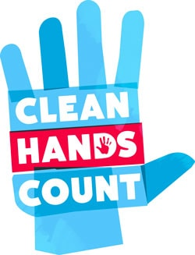
Execute: Promotion and Communication³⁶
October 15: Global Handwashing Day
Access additional resources here: https://www.cdc.gov/clean-hands/globalhandwashingday/index.html
Promotional Materials
Videos, posters, factsheets, and brochures
Media and Social Media
Infographics, press releases, web buttons
Educational Resources
Source: Centers for Disease Control and Prevention. March 2024. https://www.cdc.gov/clean-hands/hcp/clean-hands-count/index.html. Accessed May 10, 2024.

Slide 37
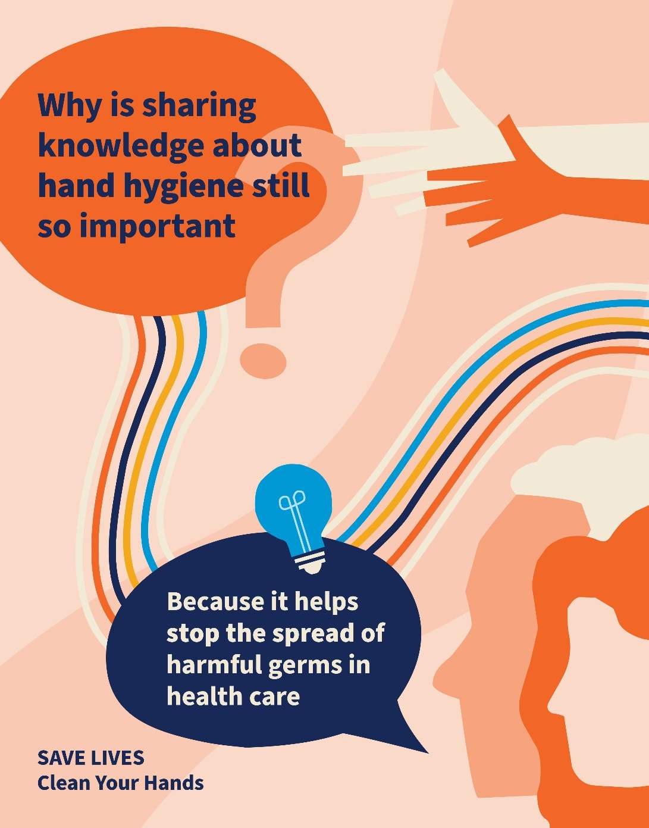
Execute: Implementation Tools^{37,38}
May 5: World Hand Hygiene Day
Access additional resources here:
https://www.WHO.int/campaigns/world-hand-hygiene-day
Templated letter to managers
Templated letter to patients
Engagement of patients
Self-assessment framework
Action plan and observation form
Surveys and questionnaires
Source: World Health Organization. March 2024. https://www.who.int/campaigns/world-hand-hygiene-day/2024. Accessed May 21, 2024.

Slide 38
Evaluate: Data Analysis and Sharing^{2,27-29}
Executive and Senior Leadership
Departmental/ Unit Leadership, Champion
Hand Hygiene Program Lead
Departmental/ Unit Leadership
Frontline Staff
Frontline Staff Champion

Slide 39
Celebrate Successes
Developing and implementing hand hygiene programs, such as through the 4 Es framework
require hard work, multiple approaches, and consistent effort from all leadership levels.^{2,27-31}
Acknowledge and celebrate successes!

Slide 40
Case Example of Low Adherence: Background
A community hospital recently transitioned from using overt observation to an automated adherence monitoring system.
Rates dropped dramatically after the new system was implemented.
Previously, hand hygiene adherence was 91 to 94 percent.
Following the transition, hand hygiene adherence was 52 to 56 percent.

Slide 41
Case Example Continued: Examination of the Problem
Infection Prevention conducted a point prevalence audit to validate the data.
Focus group sessions—including representation from all clinical and ancillary staff departments—sought to understand the barriers.

Slide 42
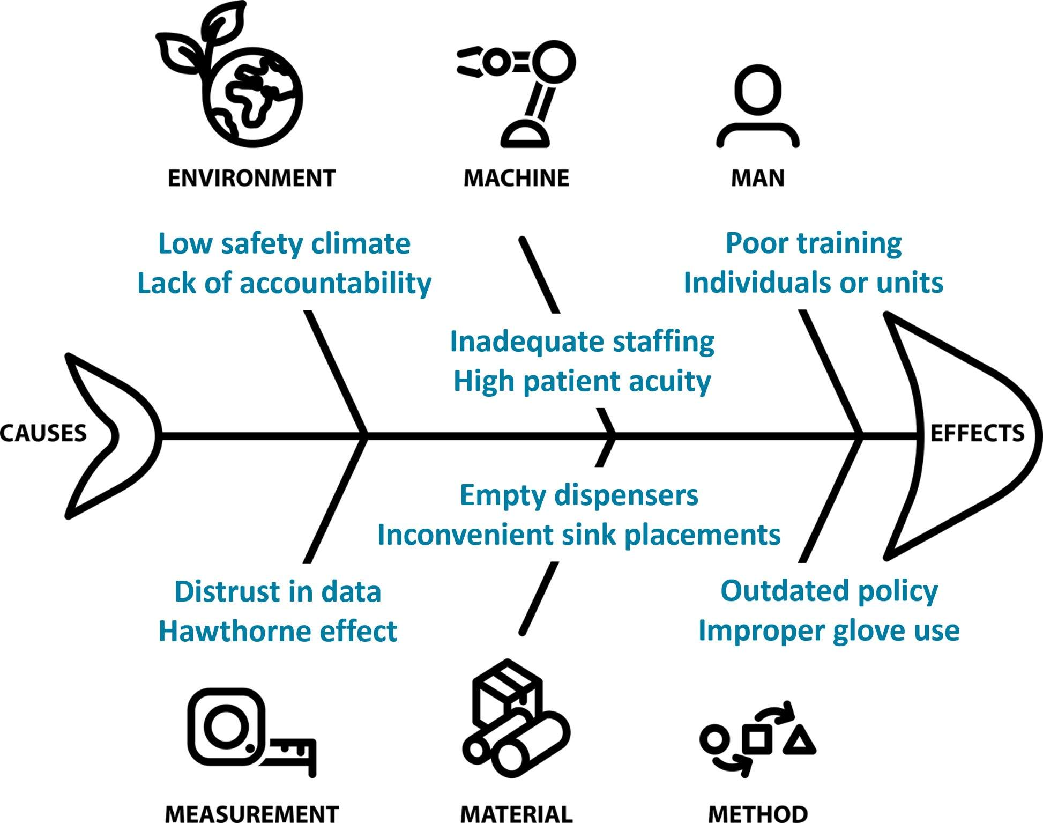
Case Example: Ishikawa Diagram^{1,5,39}
HICPAC Guideline for Hand Hygiene in Health-Care Settings⁵
https://www.cdc.gov/mmwr/PDF/rr/rr5116.pdf

Slide 43
Case Example: Action Planning^{2,5,7,8}
Policy Review
Education Campaign
Accountability Model
Overview
Reviewed and updated current hospital policy.
Actions
Utilized the CDC and the WHO recommendations to clarify expectations.
Addressed local workflows.
Overview
Developed multimodal educational resources.
Actions
Implemented training and annual refreshers.
Created individualized content for disciplines and departments.
Translated materials into common first-languages.
Facilitated hospitalwide education with giveaways.
Overview
Collaborated with executive leadership for an accountability model.
Actions
Involved recognition for top performers and sanctions for repeated nonadherence.
Encompassed individual and unit or departmental level.

Slide 44
Case Example: Results of Intervention

Slide 45
Key Takeaways
Hand hygiene is a fundamental strategy to mitigate the risk of HAIs and reduce the transmission of MDROs including MRSA.
Promoting and facilitating healthy hands is an often overlooked but essential component of any hand hygiene program.
The WHO and the CDC emphasize the importance of hand hygiene in healthcare and provide indications, techniques, and appropriate glove use methods.
Hand hygiene adherence monitoring programs should meet the needs of an organization and incorporate accurate, consistent, and ongoing data collection and dissemination.
The 4 Es implementation strategy framework is effective for hand hygiene improvement.
Successful and consistent hand hygiene promotion campaigns typically require more than one approach.

Slide 46
Disclaimer
The findings and recommendations in this presentation are those of the authors, who are responsible for its content, and do not necessarily represent the views of AHRQ. No statement in this presentation should be construed as an official position of AHRQ or of the U.S. Department of Health and Human Services.
Any practice described in this presentation must be applied by health care practitioners in accordance with professional judgment and standards of care in regard to the unique circumstances that may apply in each situation they encounter. These practices are offered as helpful options for consideration by healthcare practitioners, not as guidelines.

Slide 47
Reference List—1
The Joint Commission. 2024 Hospital National Patient Safety Goals. https://www.jointcommission.org/-/media/tjc/documents/standards/national-patient-safety-goals/2024/hap-npsg-simple-2024-v2.pdf. Accessed May 21, 2024.
Glowicz JB, Landon E, Sickbert-Bennett EE, et al. SHEA/IDSA/APIC practice recommendation: strategies to prevent healthcare-associated infections through hand hygiene: 2022 Update. . Infect Control Hosp Epidemiol. 2023 Mar;44(3):355-76. PMID: 36751708.
Lane HJ, Blum N, Fee E. Oliver Wendell Holmes (1809-1894) and Ignaz Philipp Semmelweis (1818-1865): preventing the transmission of puerperal fever. Am J Public Health. 2010 Jun;100(6):1008-9. PMID: 20395569.
Gould IM. Alexander Gordon, puerperal sepsis, and modern theories of infection control--Semmelweis in perspective. Lancet Infect Dis. 2010 Apr;10(4):275-8. PMID: 20334850.
Boyce JM, Pittet D; Healthcare Infection Control Practices Advisory Committee; HICPAC/SHEA/APIC/IDSA Hand Hygiene Task Force. Guideline for hand hygiene in health-care settings. Recommendations of the Healthcare Infection Control Practices Advisory Committee and the HICPAC/SHEA/APIC/IDSA Hand Hygiene Task Force. Society for Healthcare Epidemiology of America/Association for Professionals in Infection Control/Infectious Diseases Society of America. MMWR Recomm Rep. 2002 Oct 25;51(RR-16):1-45. PMID: 12418624.

Slide 48
Reference List—2
Erasmus V, Daha TJ, Brug H, et al. Systematic review of studies on compliance with hand hygiene guidelines in hospital care. Infect Control Hosp Epidemiol. 2010 Mar;31(3):283-94. PMID: 20088678.
World Health Organization (WHO), WHO Patient Safety. WHO Guidelines on Hand Hygiene in Health Care. WHO/IER/PSP/2009/01.2009. https://www.who.int/publications/i/item/9789241597906. Accessed May 21, 2024.
World Health Organization (WHO). Evidence of Hand Hygiene to Reduce Transmission and Infections by Multidrug Resistant Organisms in Health-Care Settings. https://cdn.who.int/media/docs/default-source/integrated-health-services-(ihs)/infection-prevention-and-control/mdro-literature-review.pdf. Accessed May 21, 2024.
World Health Organization (WHO). Five Moments for Hand Hygiene. https://www.who.int/publications/m/item/five-moments-for-hand-hygiene. Accessed May 21, 2024.
Centers for Disease Control and Prevention (CDC). Clean Hands Count for Healthcare Providers Brochure. https://www.cdc.gov/clean-hands/media/pdfs/provider-brochure-508.pdf. May21, 2024.
Campion KM. A survey of occupational skin disease in UK health care workers. Occup Med (Lond). 2015 Jan;65(1):29-31. PMID: 25481193.

Slide 49
Reference List—3
Stutz N, Becker D, Jappe U, et al. Nurses' perceptions of the benefits and adverse effects of hand disinfection: alcohol-based hand rubs vs. hygienic handwashing: a multicentre questionnaire study with additional patch testing by the German Contact Dermatitis Research Group. Br J Dermatol. 2009 Mar;160(3):565-72. PMID: 19067700.
Wu AG, Lipner SR. A potential hidden reservoir: The role of nail hygiene in preventing transmission of COVID-19. J Am Acad Dermatol. 2020 Sep;83(3):e245-e246. PMID: 32497691.
Hoffman PN, Cooke EM, McCarville MR, Emmerson AM. Micro-organisms isolated from skin under wedding rings worn by hospital staff. Br Med J (Clin Res Ed). 1985 Jan 19;290(6463):206-7. PMID: 3917754.
Jacobson G, Thiele JE, McCune JH, Farrell LD. Handwashing: ring-wearing and number of microorganisms. Nurs Res. 1985 May-Jun;34(3):186-8. PMID: 3889854.
Deschênes P, Chano F, Dionne LL, et al. Efficacy of the World Health Organization-recommended handwashing technique and a modified washing technique to remove Clostridium difficile from hands. Am J Infect Control. 2017 Aug;45(8):844-848. PMID: 28526314.
Feng W, Lin S, Huang D, et al. Surgical hand rubbing versus surgical hand scrubbing: systematic review and meta-analysis of efficacy. Injury. 2020 Jun;51(6):1250-1257. PMID: 32331847.

Slide 50
Reference List—4
World Health Organization (WHO), WHO Patient Safety. A Guide to the Implementation of the WHO Multimodal Hand Hygiene Improvement Strategy. WHO/IER/PSP/2009/02. 2009. https://apps.who.int/iris/handle/10665/70030. Accessed May 21, 2024.
Centers for Disease Control and Prevention (CDC). Clinical Safety: Hand Hygiene for Healthcare Workers. https://www.cdc.gov/clean-hands/hcp/clinical-safety/index.html. Accessed May 21, 2024.
World Health Organization (WHO) ), WHO Patient Safety. How to Handrub?. https://www.who.int/publications/m/item/how-to-handrub. Accessed May 21, 2024.
Centers for Disease Control and Prevention (CDC). Clean Hands Count Fact Sheet. https://www.cdc.gov/clean-hands/media/pdfs/provider-factsheet-508.pdf. Accessed May 21, 2024.
World Health Organization, WHO Patient Safety. How to Handwash?. https://www.who.int/publications/m/item/how-to-handwash. Accessed May 21, 2024.
World Health Organization, WHO Patient Safety. Glove Use Information Leaflet. https://www.who.int/publications/m/item/glove-use-information-leaflet-(revised-august-2009). Accessed May 21, 2024.

Slide 51
Reference List—5
Sweeney D, Maita D, Moritz DC, et al. Respiratory viruses on personal protective equipment and bodies of healthcare workers. Infect Control Hosp Epidemiol. 2019 Dec;40(12):1356-1360. PMID: 31668149.
The Joint Commission. Measuring Hand Hygiene Adherence: Overcoming the Challenges [monograph online]. Oakbrook Terrace, IL: The Joint Commission; 2009. https://www.jointcommission.org/-/media/tjc/documents/resources/hai/hh_monograph.pdf. Accessed May 21, 2024.
Boyce JM. Current issues in hand hygiene. Am J Infect Control. 2019 Jun;47S:A46-A52. PMID: 31146850.
Agency for Healthcare Research and Quality (AHRQ). The 4 E’s. https://www.ahrq.gov/hai/cusp/videos/02b-the-4e/index.html. Accessed May 21, 2024.
Agency for Healthcare Research and Quality (AHRQ). Slide 12. Engage Team Members Using the 4 E’s. https://www.ahrq.gov/hai/cusp/modules/assemble/team-notes.html#slide12. Accessed May 21, 2024.
Agency for Healthcare Research and Quality (AHRQ). Slide 3. Using The 4 E’s for Technical and Adaptive Work. https://www.ahrq.gov/hai/cusp/modules/engage/exec-notes.html#sl3. Accessed May 21, 2024.

Slide 52
Reference List—6
Romig M, Goeschel C, Pronovost P, et al. Integrating CUSP and TRIP to improve patient safety. Hosp Pract (1995). 2010 Nov 1;38(4):114-21. PMID: 21068535.
Pronovost PJ, Berenholtz SM, Needham DM. Translating evidence into practice: a model for large scale knowledge translation. Bmj. 2008 Oct 6;337. PMID: 18838424.
Johns Hopkins Armstrong Institute for Patient Safety and Quality. Core CUSP Team Member Roles and Responsibilities. https://www.hopkinsmedicine.org/-/media/armstrong-institute/documents/cusp_toolkit_new/cusp-roles-and-responsibilities.pdf. Accessed May 21, 2024.
Centers for Disease Control and Prevention (CDC). Clean Hands in Healthcare Training. https://www.cdc.gov/clean-hands/hcp/training/index.html. Accessed May 21, 2024.
Neo JR, Sagha-Zadeh R, Vielemeyer O, Franklin E. Evidence-based practices to increase hand hygiene compliance in health care facilities: an integrated review. Am J Infect Control. 2016 Jun;44(6):691-704. PMID: 27240800.
Grayson ML, Stewardson AJ, Russo PL, et al. Effects of the Australian National Hand Hygiene Initiative after 8 years on infection control practices, health-care worker education, and clinical outcomes: a longitudinal study. Lancet Infect Dis. 2018 Nov;18(11):1269-1277. PMID: 30274723.

Slide 53
Reference List—7
Centers for Disease Control and Prevention (CDC). Clean Hands Count Materials. https://www.cdc.gov/clean-hands/hcp/clean-hands-count/index.html. Accessed May 21, 2024.
World Health Organization (WHO). World Hand Hygiene Day. https://www.who.int/campaigns/world-hand-hygiene-day. Accessed May 21, 2024.
World Health Organization (WHO). Implementation Tools. https://www.who.int/teams/integrated-health-services/infection-prevention-control/hand-hygiene/tools-and-resources. Accessed May 21, 2024.
Institute for Healthcare Improvement. Quality Improvement Essentials Toolkit. https://www.ihi.org/resources/Pages/Tools/Quality-Improvement-Essentials-Toolkit.aspx. Accessed May 21, 2024.

