Slide 1
AHRQ Safety Program for MRSA Prevention
The Importance of MRSA Prevention
ICU & Non-ICU
AHRQ Pub. No. 25-0007
October 2024

Slide 2
Educational Objectives
Recognize the harm and adverse outcomes associated with methicillin-resistant Staphylococcus aureus (MRSA)
Recognize the sources of MRSA on people and in the ICU and non-ICU healthcare environments
Recognize the key strategies and targets for MRSA prevention
Define the concepts of MRSA surveillance and MRSA decolonization

Slide 3
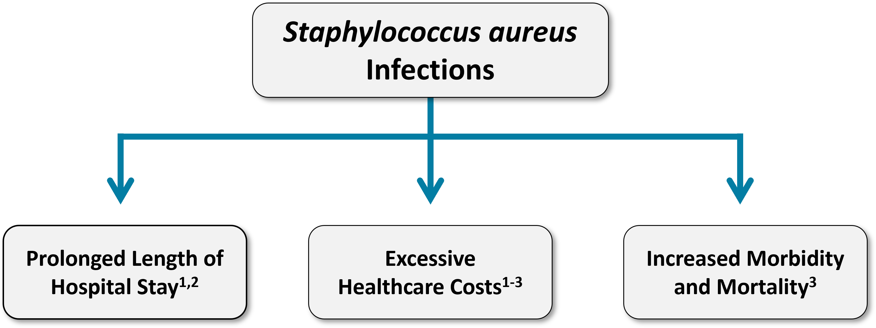
MRSA Is a Serious Threat¹⁻³
MRSA affects people in both community settings and healthcare facilities, but most of the morbidity and mortality occurs in critically and chronically ill patients.¹⁻⁴

Slide 4

MRSA Is Invasive and Deadly
MRSA is one of the most invasive and deadly multidrug-resistant organism (MDRO) pathogens.
More than 2.8 million antibiotic-resistant infections occur in the U.S. each year, and more than 35,000 people die as a result.⁵

Slide 5

MRSA and Hospitalized Patients
More than 323,000 MRSA cases are detected in hospitalized patients and over 10,000 deaths are reported each year.⁵
Data from 2020 shows an increase in hospital-onset resistant infections, including MRSA, during the COVID-19 pandemic.⁶

Slide 6

Healthcare-Associated Infections (HAIs)
MRSA is a prominent cause of:⁷
  Central line-associated bloodstream infections (CLABSI).
  Ventilator-associated pneumonia (VAP).
  Surgical site infections (SSI).
Laboratory-identified (LabID) MRSA bacteremia is a publicly reported HAI, as is CLABSI.
HAIs, including those caused by MRSA:
  Cause patient harm.
  Are publicly reported.
  Affect hospital reimbursement.

Slide 7
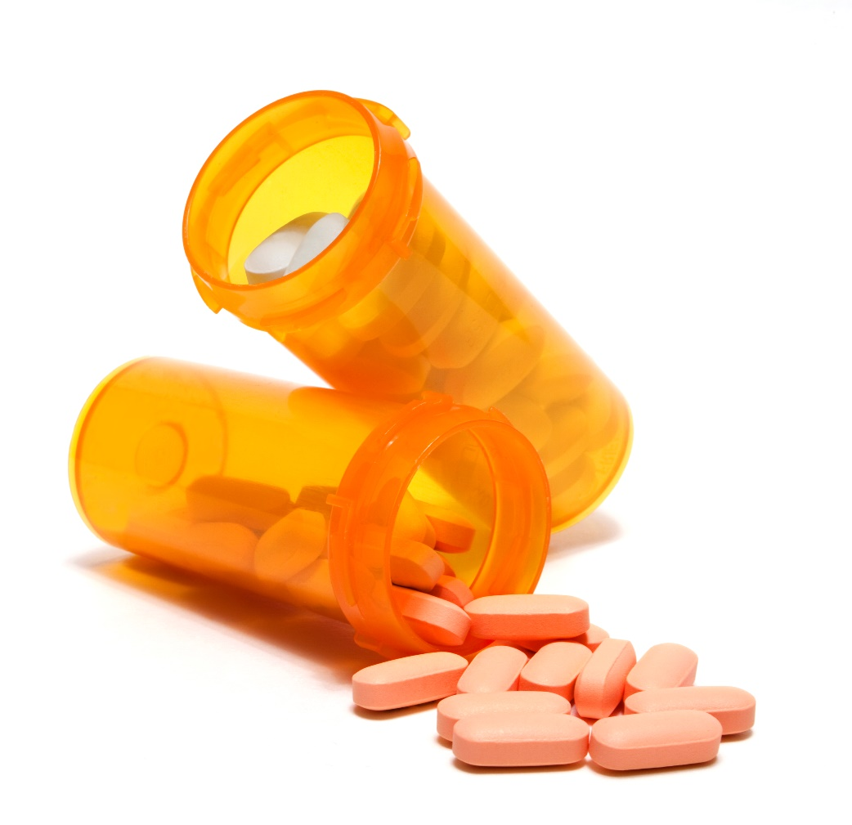
Antibiotic Resistance⁸
MRSA increases antibiotic use and therefore puts further pressure on the emergence and proliferation of antimicrobial resistant organisms.
Antibiotic pressure can:
  Lead to selective advantage for resistance of S. aureus.
  Induce the expression of antibiotic resistance gene.
About 75 percent of ICU S. aureus infections are methicillin-resistant.⁷
Upwards of 60 percent of non-ICU inpatient S. aureus infections are methicillin-resistant.⁷

Slide 8
Summarizing MRSA as a Threat
MRSA prolongs hospitalizations.
MRSA increases morbidity and mortality, especially in critically and chronically ill patients.
It increases healthcare costs.
Hospital reputation and reimbursement are impacted.
Increases the risk of HAIs, including CLABSI, VAP, and SSIs.
MRSA leads to increased antibiotic utilization, putting further pressure on the emergence and proliferation of antimicrobial resistant organisms.

Slide 9
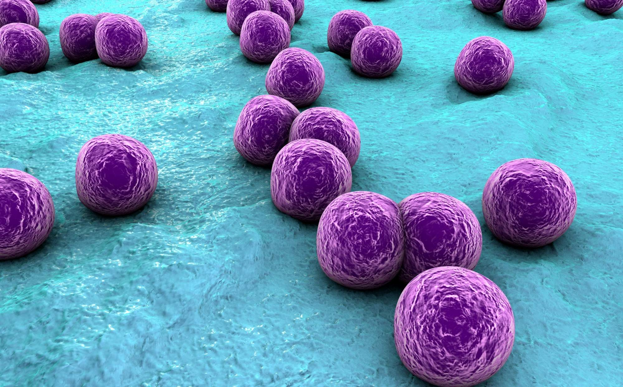
MRSA Transmission
The Sources and Pathways of MRSA Transmission

Slide 10
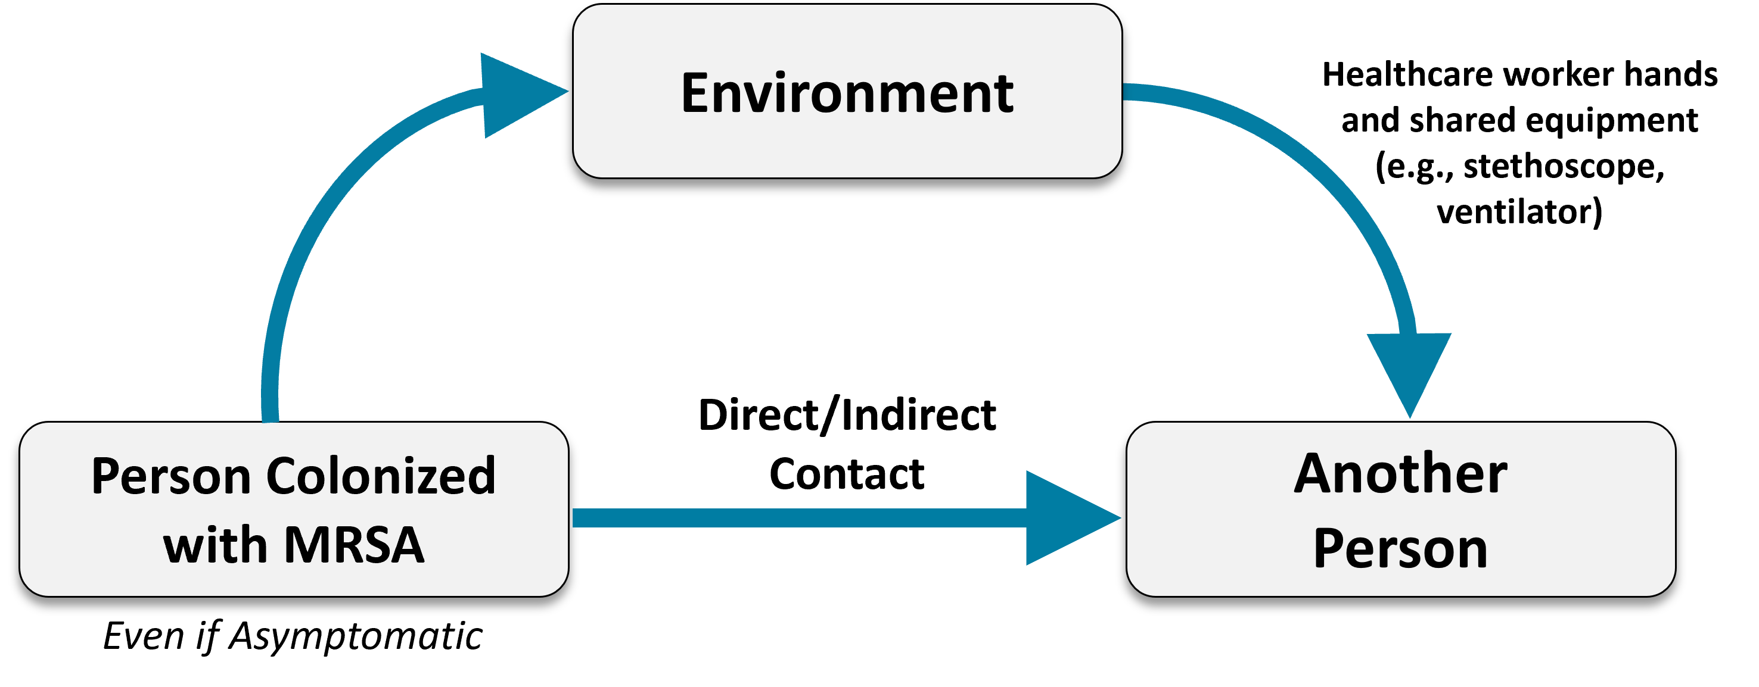
Pathways of MRSA Transmission and Infection
A person’s own MRSA colonization can lead to invasive disease.
Medical devices and procedures can increase the risk of MRSA infection.
MRSA can be transmitted to patients by healthcare personnel or others.
Environmental reservoirs of MRSA can lead to colonization or infection.

Slide 11
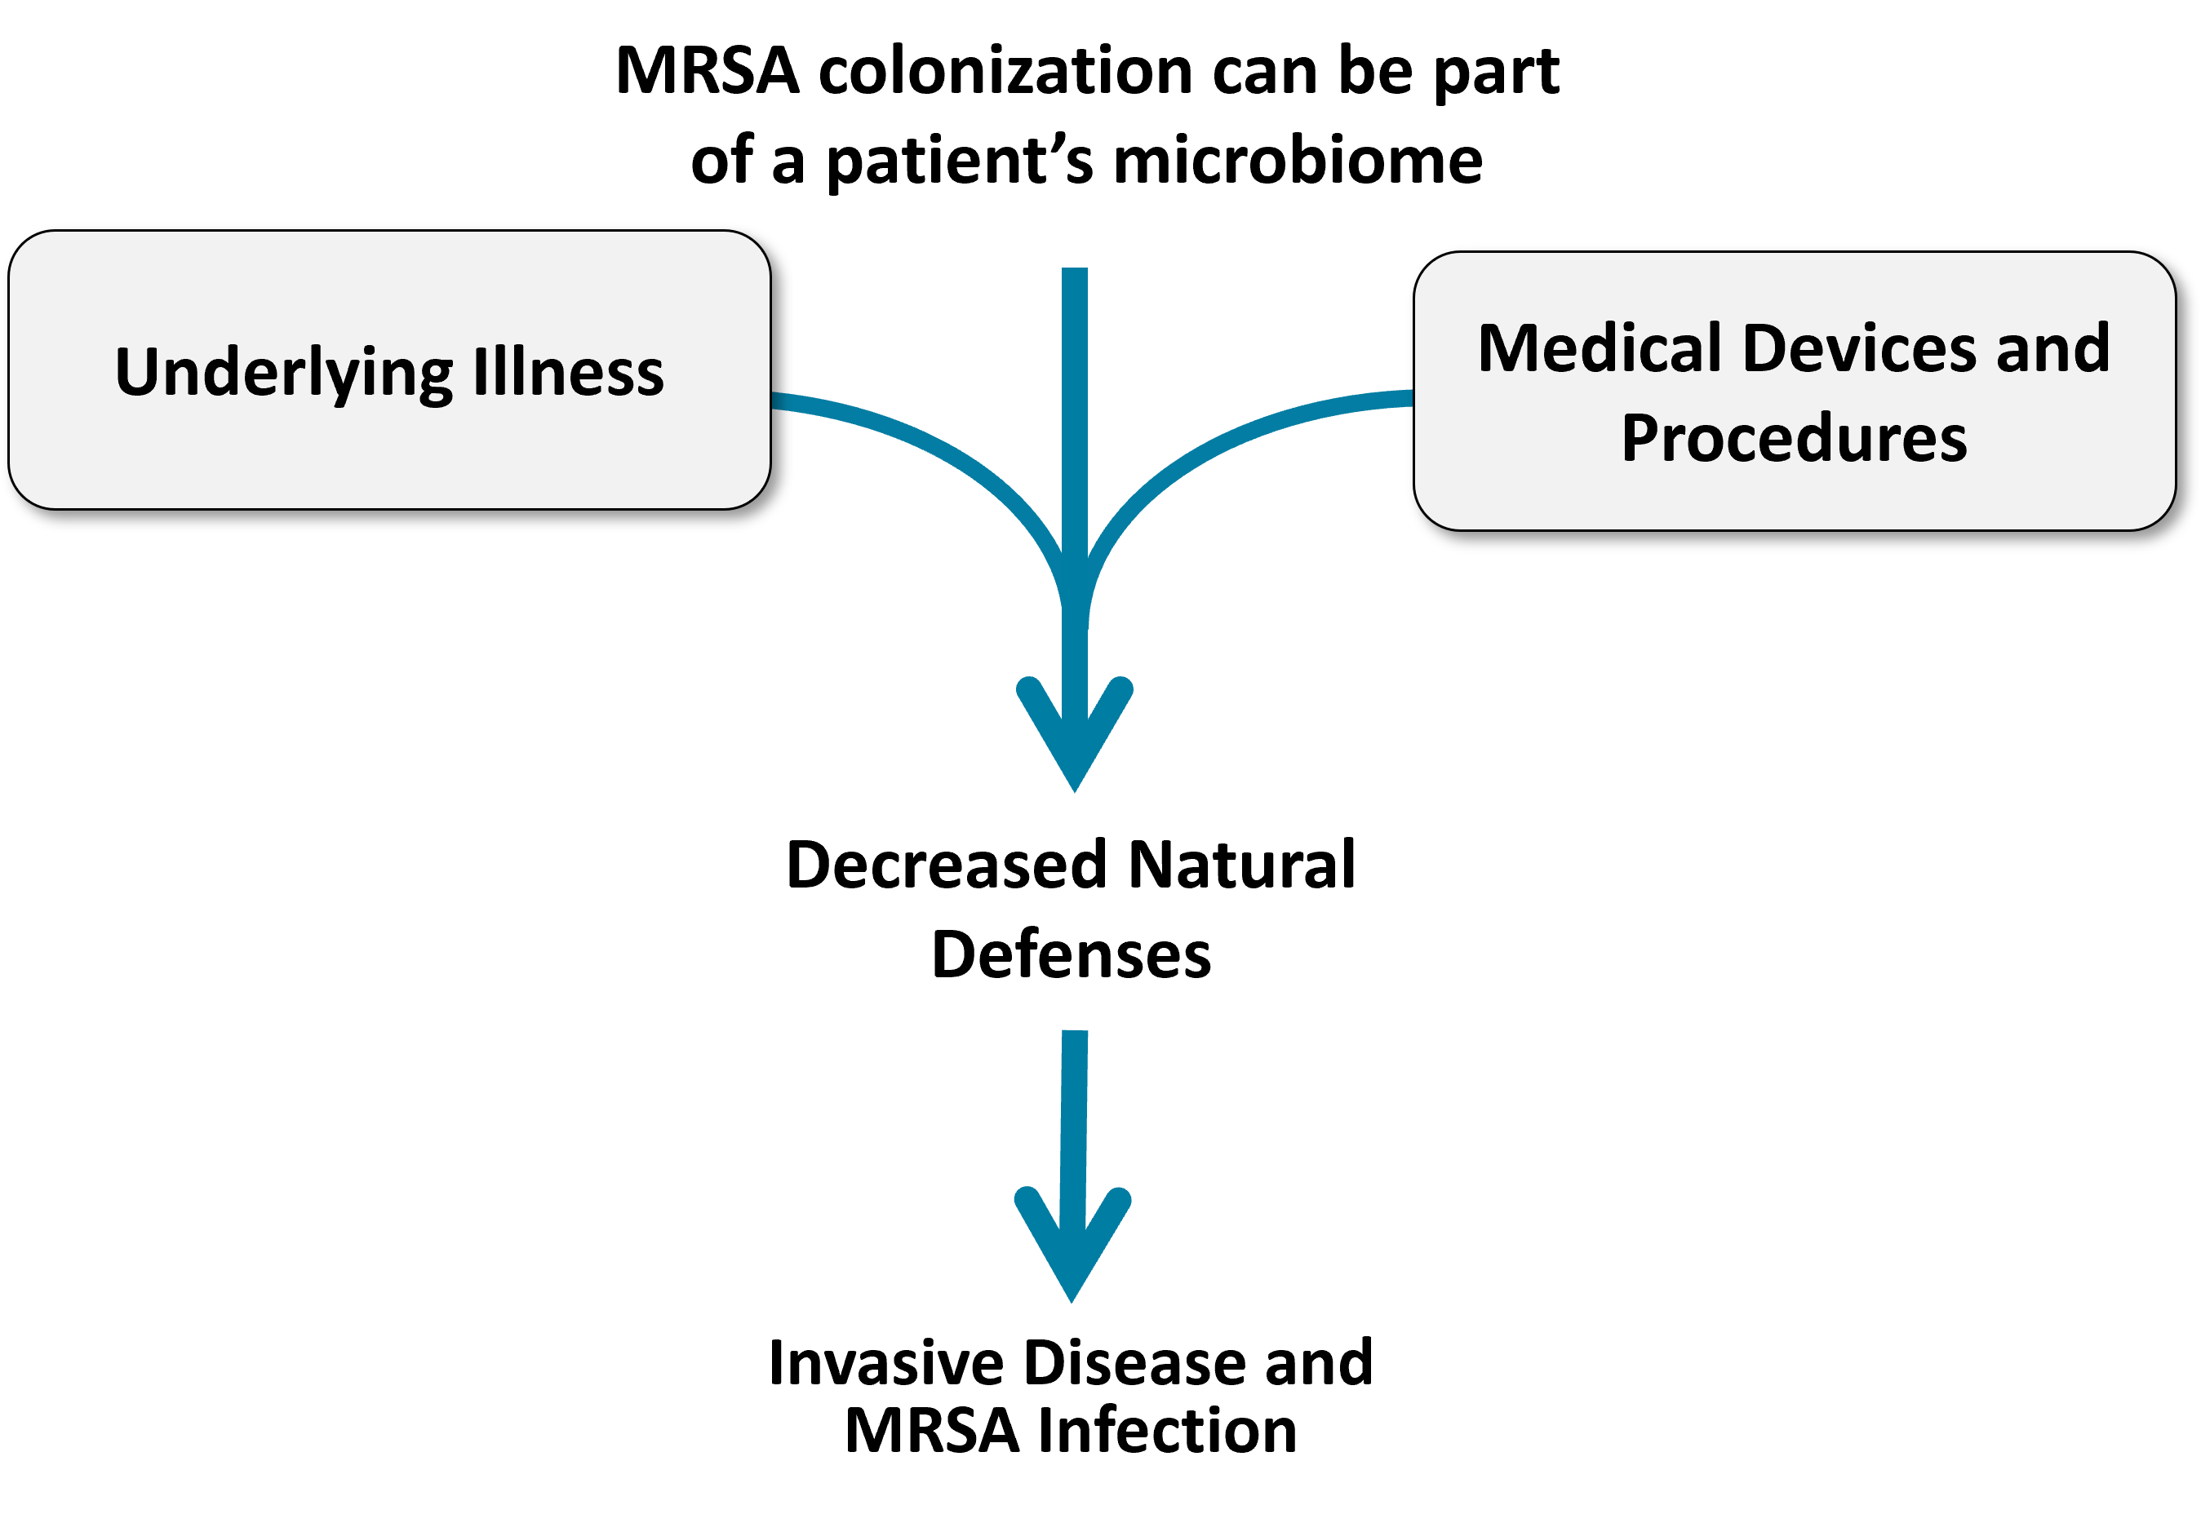
Colonization Is One Pathway to MRSA Infection

Slide 12
Patients Colonized With MRSA
MRSA carriage is common in healthcare settings, affecting around 7 percent of patients upon hospital admission.⁹
Risk of progression to clinical disease among hospitalized patients colonized with MRSA is high.
Up to 11 percent of inpatients who are colonized with MRSA develop MRSA disease during their hospital stay, and this risk increases to 30 percent among the critically ill.¹⁰
33 percent of newly-identified MRSA carriers experienced invasive MRSA disease in the subsequent year, and 17 percent of these infections caused MRSA-attributable death.¹¹
Therefore, active MRSA surveillance is important.

Slide 13
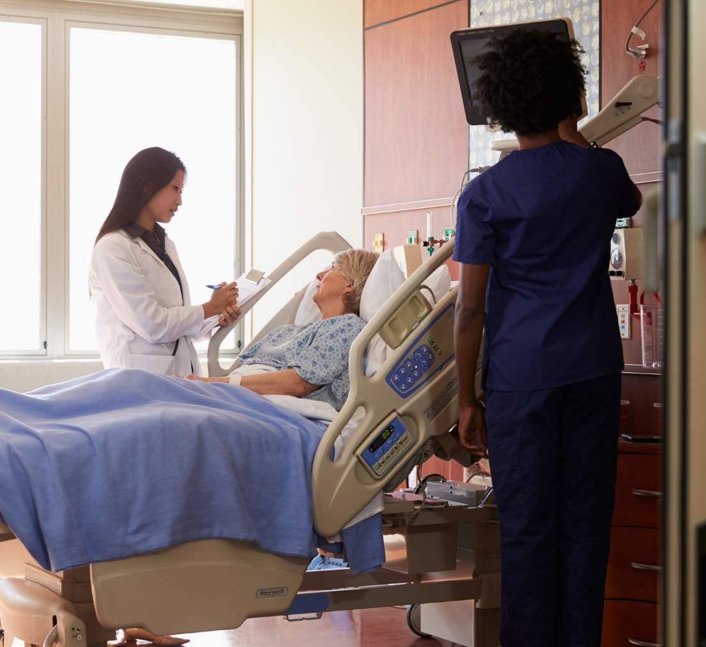
Sources of MRSA: Patient Care Environments
High-touch surfaces and fomites in the patient care environment can harbor MRSA and can support MRSA transmission.
Examples of high-touch surfaces:
  Door handles
  Phones
  Counters
  Chairs
  Faucets
  Keyboard
  IV Pumps
  Bedrails
  Curtains

Slide 14
Sources of MRSA: Healthcare Personnel
Healthcare personnel can inadvertently pick up and transmit MRSA from one patient to another or from the environment to patient(s).¹⁰⁻¹⁴
Hands of healthcare workers can transfer organisms to and from patients or surfaces and lead to colonization or infection.¹⁰⁻¹⁵
  Improving hand hygiene practices and the use of contact isolation precautions can reduce HAIs and transmission and colonization by MDROs, including MRSA.¹⁰⁻¹⁵
Hand hygiene compliance rates vary widely, ranging from 5 percent to 81 percent, with an average compliance of 40 percent.¹⁶

Slide 15
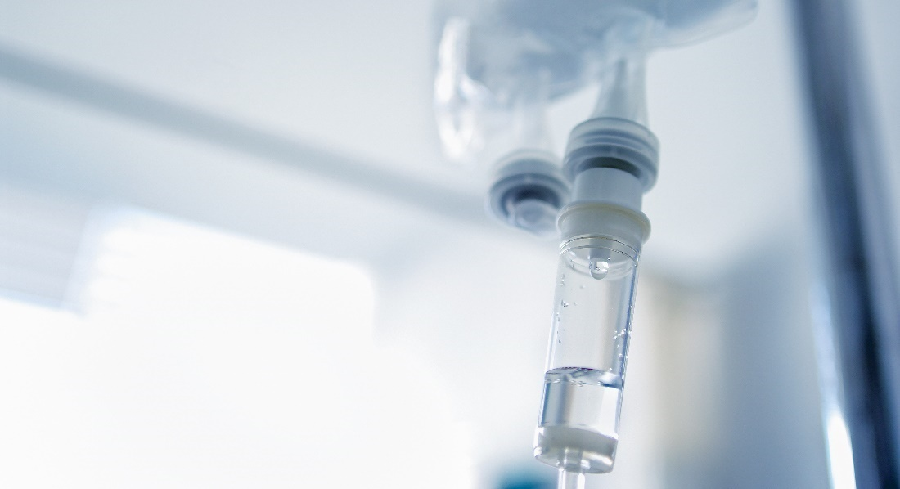
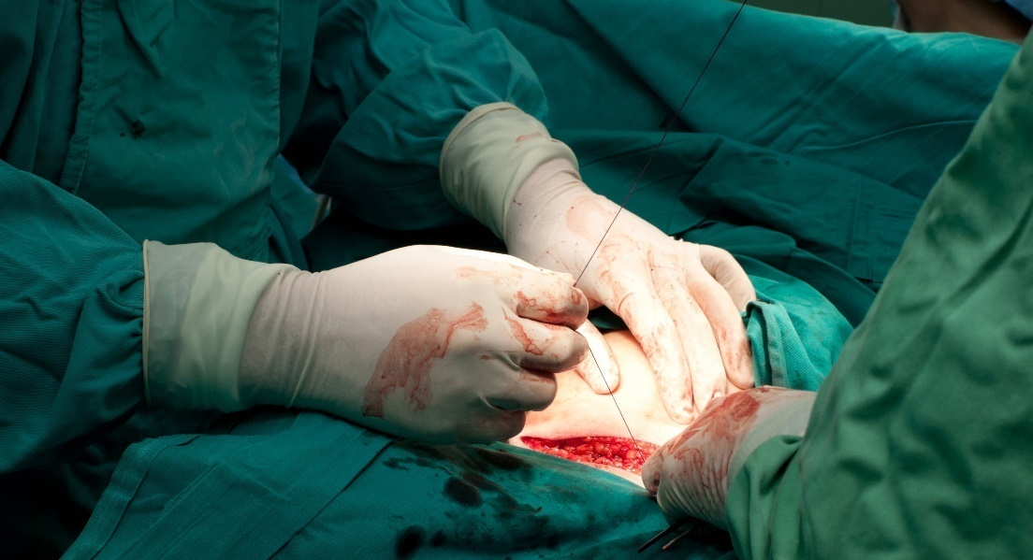
Portals of Entry for MRSA: Medical Devices and Procedures
Medical devices and procedures can lead to MRSA infection.
Central lines are well-known portals of entry for MRSA.

Slide 16
Summarizing Sources of MRSA
Patients colonized or infected with MRSA can be a source of MRSA transmission.
Contaminated environmental and high-touch surfaces can lead to MRSA infection.
Healthcare personnel can inadvertently transmit MRSA.
Medical devices and procedures can be portals of entry for MRSA.

Slide 17
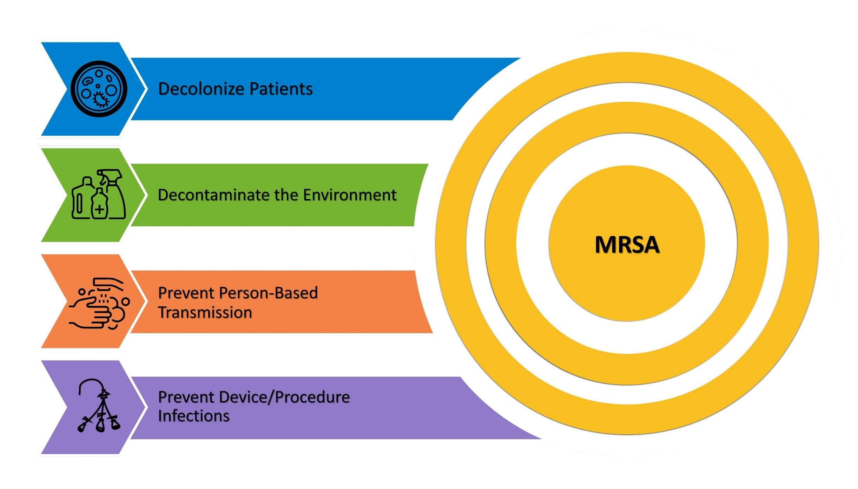
Take Aim and Target MRSA
The Four Key Strategies to Prevent MRSA

Slide 18
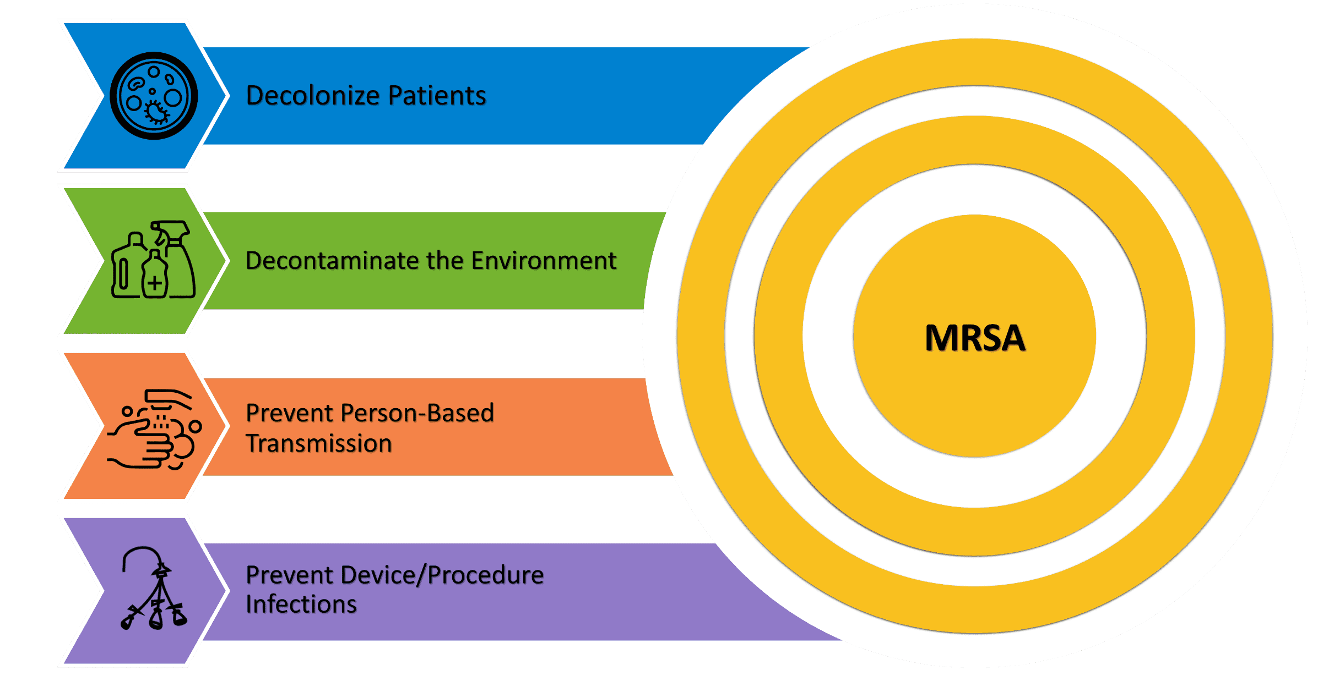
Key Strategies to Take Aim and Target MRSA Infection
Other Fundamental Best Practices, including antibiotic stewardship and optimization of blood culture practices, support and supplement the four key strategies.

Slide 19

MRSA Colonization and Infection
MRSA Colonization: Presence of MRSA without any current signs or symptoms of infection
  Even without current infection, MRSA can still be dangerous to both to the colonized patient and to others.
MRSA Infection: Presence of MRSA causing invasive disease or adverse effects, observed as signs and symptoms of infection

Slide 20

Transition From MRSA Colonization to Infection
Transition from MRSA colonization to MRSA infection can happen due to:
    Reduced immune capacity.
    Devices, procedures, wounds, or other portals of entry.
    Virulence and pathogenic properties of the MRSA strain.
    Antibiotic treatment and shifting microbiome.

Slide 21
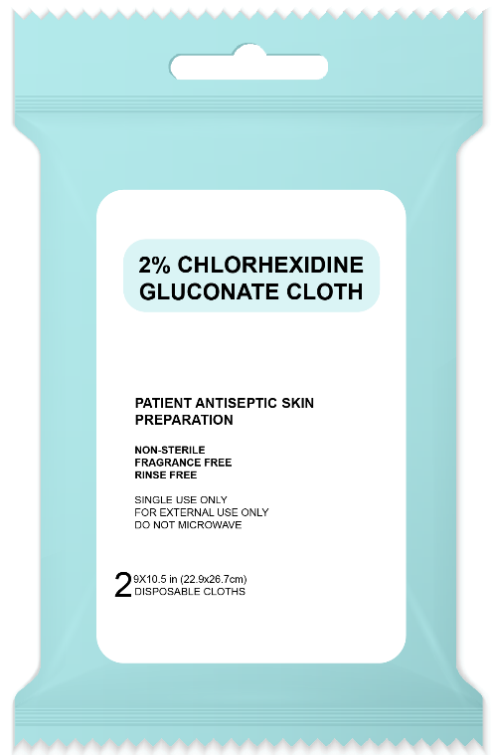
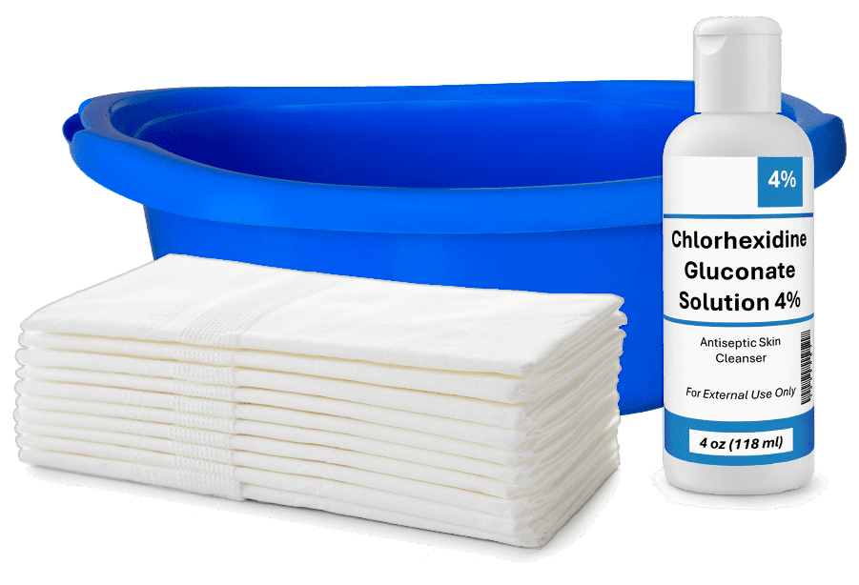
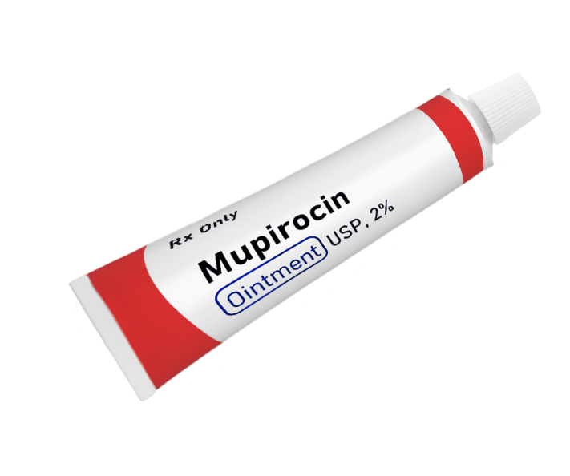
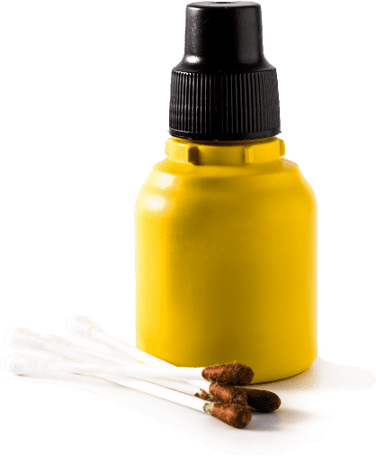
Decolonization Methods
Decolonizing patients’ skin and nares is key for MRSA prevention.
Skin Decolonization:
  Chlorhexidine gluconate (CHG)
  Once per day for duration of stay
Nasal Decolonization:
  Mupirocin or Iodophor
  Once per day for 5 days

Slide 22

Benefits of Decolonization¹⁷
Reduces the likelihood of progression from MRSA colonization to MRSA infection via medical devices, wounds, or other portals of entry.
Reduces the risk of MRSA transmission to other patients through environmental reservoirs or via healthcare personnel or medical devices.

Slide 23

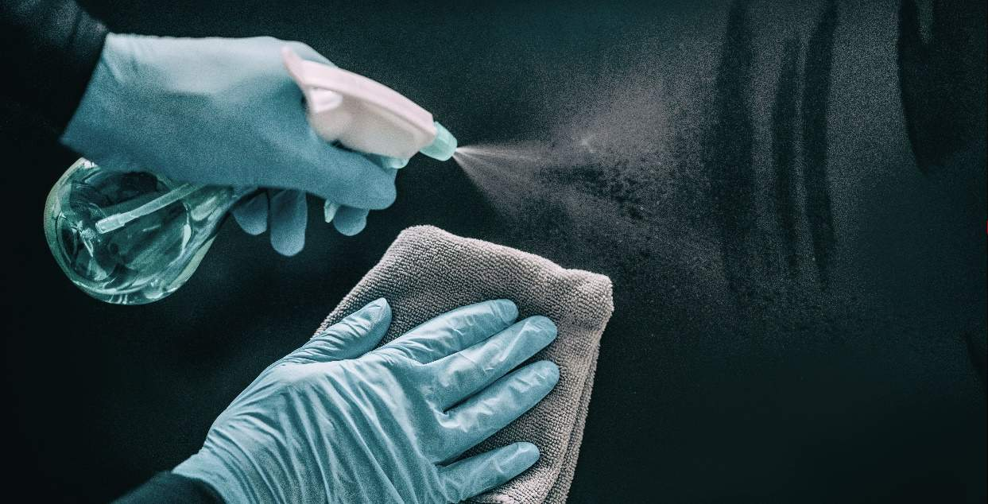
Decontaminate the Environment
Daily whole room cleaning should be supplemented with frequent cleaning and disinfection of high-touch surfaces.
  Monitoring
  Reporting
  Ensuring the effectiveness of cleaning and disinfection

Slide 24
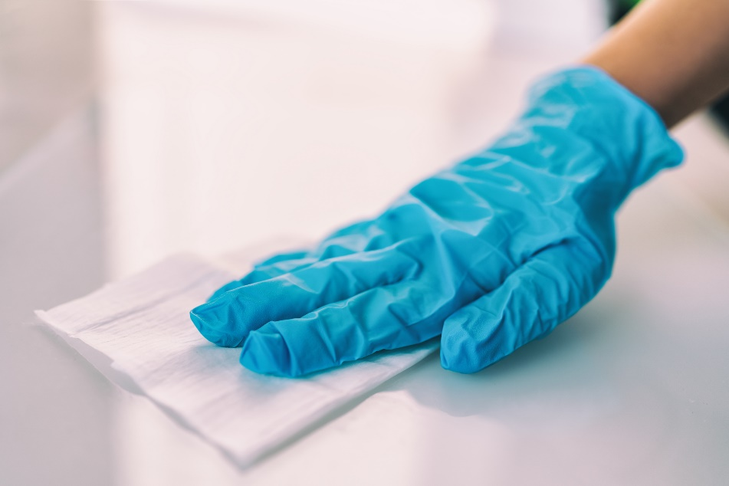
Environmental Cleaning
Enhance training and clarify protocols.
Monitor and report data on the effectiveness of cleaning for high touch surfaces.
Engage cleaning personnel in improvement and interventions to improve and sustain excellent environmental cleaning.

Slide 25

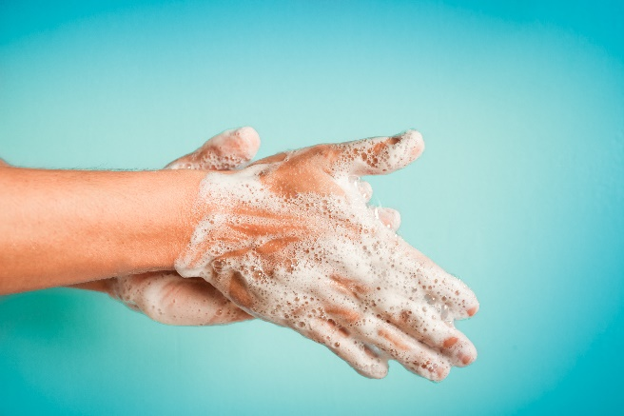
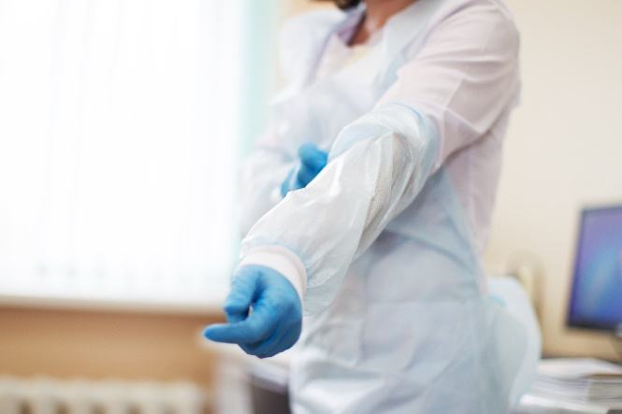
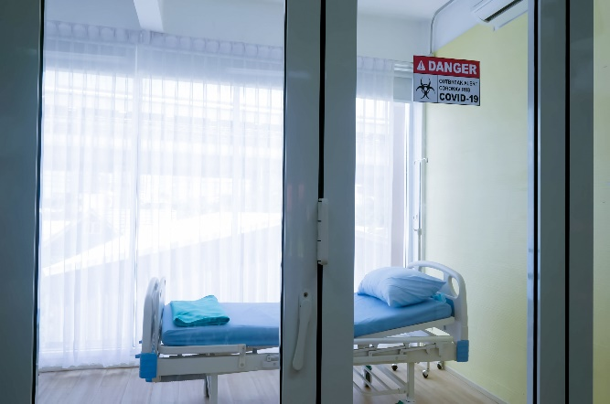
Prevent Person-Based Transmission
Promote hand hygiene.
Use personal protective equipment (PPE).
Promote adherence to standard precautions and isolation precautions.

Slide 26

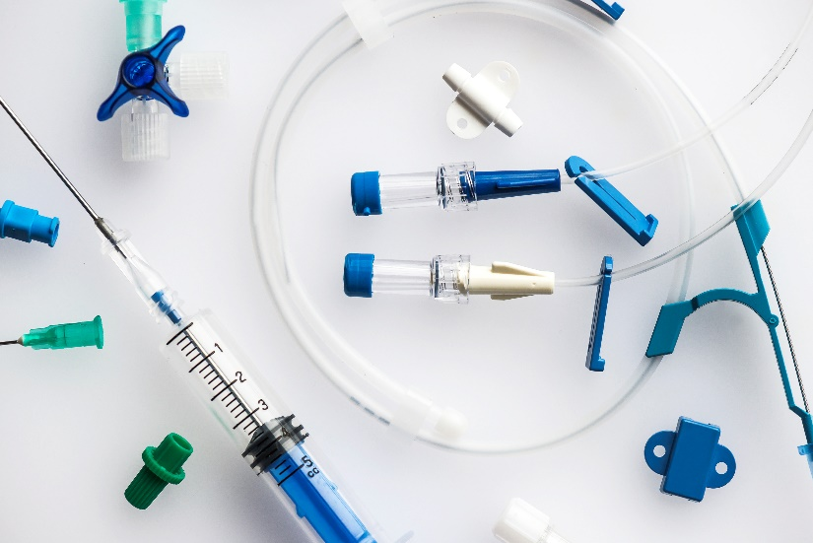
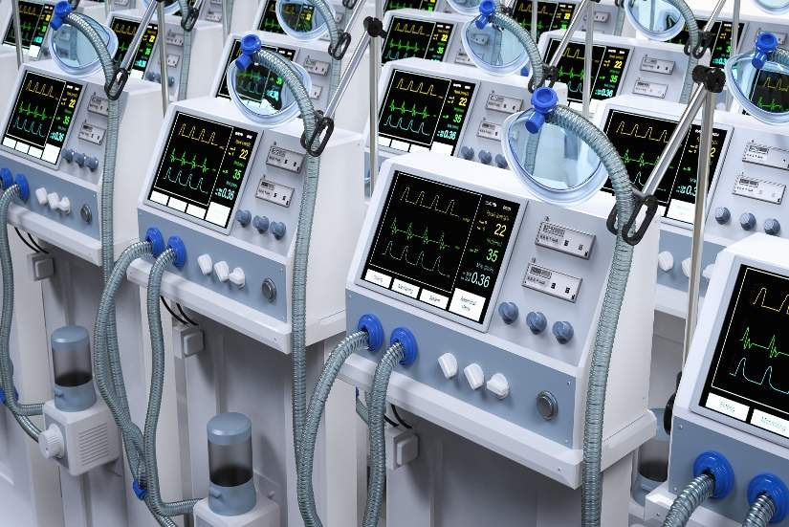
Prevent Device- and Procedure-Related Infections
Evidence-based interventions should be used to prevent device- and procedure-related infections that are often caused by MRSA.
Common, preventable device- and procedure-related infections include central-line-associated bloodstream infection (CLABSI) and ventilator-associated pneumonia (VAP).

Slide 27


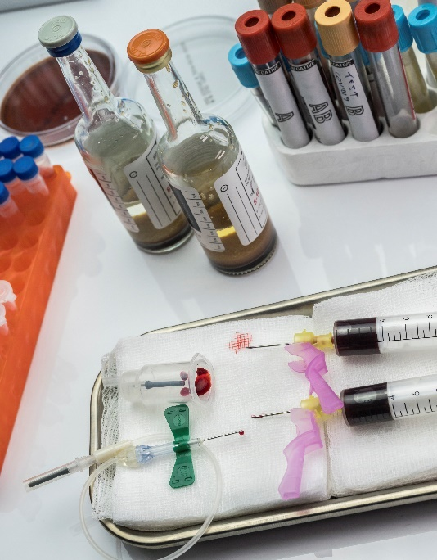
Fundamental Best Practices
Antibiotic Stewardship
  Reducing unnecessary antibiotic use
  Combating the emergence of resistant strains
Blood Culture Stewardship:
  Optimizing use of blood culture testing
  Improving blood culture collection practices to minimize contamination
These practices don’t fit into the four key strategic areas.
They promote diagnostic accuracy and preserve the effectiveness of antibiotic treatments. They are crucial for MRSA prevention.

Slide 28
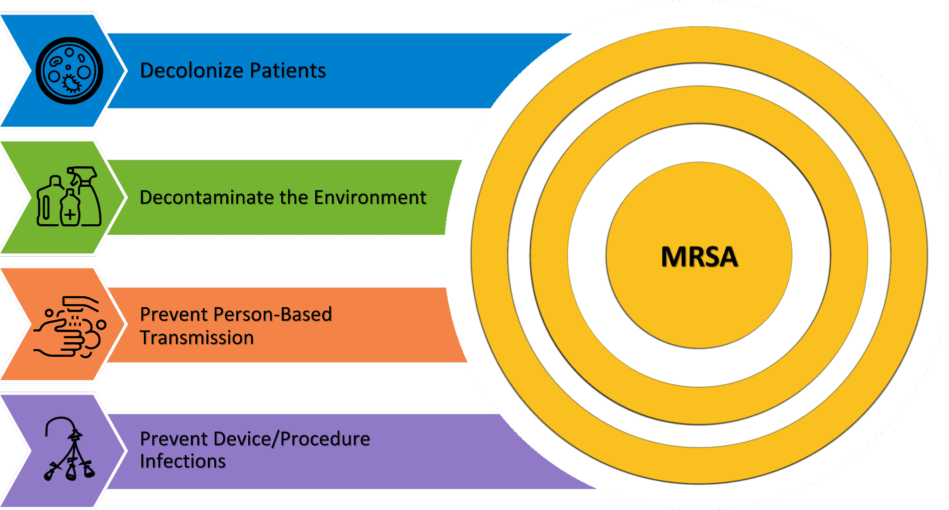
Key Strategies: Take Aim and Target MRSA Infection

Slide 29
Key Takeaways
MRSA is associated with many adverse outcomes, but key strategies can prevent transmission and infection.
Sources of MRSA transmission can include people and high-touch surfaces.
MRSA can be targeted through cleaning, disinfection, decolonization, proper hygiene, and PPE.
The four key strategies to target MRSA include:
  Decolonization of patients
  Decontamination of patients
  Prevention of person-based transmission
  Prevention of device- and procedure-related infection

Slide 30
Disclaimer
The findings and recommendations in this presentation are those of the authors, who are responsible for its content, and do not necessarily represent the views of AHRQ. No statement in this presentation should be construed as an official position of AHRQ or of the U.S. Department of Health and Human Services.
Any practice described in this presentation must be applied by healthcare practitioners in accordance with professional judgment and standards of care in regard to the unique circumstances that may apply in each situation they encounter. These practices are offered as helpful options for consideration by healthcare practitioners, not as guidelines.

Slide 31
Reference List—1
Schmidt A, Bénard S, Cyr S. Hospital cost of Staphylococcal infection after cardiothoracic or orthopedic operations in France: A retrospective database analysis. Surg Infect (Larchmt). 2015 Aug;16(4):428-35. PMID: 26207403.
Anderson DJ, Kaye KS, Chen LF, et al. Clinical and financial outcomes due to methicillin resistant Staphylococcus aureus surgical site infection: a multi-center matched outcomes study. PLoS One. 2009 Dec 15;4(12):e8305. PMID: 20016850.
McGarry SA, Engemann JJ, Schmader K, et al. Surgical-site infection due to Staphylococcus aureus among elderly patients: mortality, duration of hospitalization, and cost. Infect Control Hosp Epidemiol. 2004 Jun;25(6):461-7. PMID: 15242192.
Klein E, Smith DL, Laxminarayan R. Hospitalizations and deaths caused by methicillin-resistant Staphylococcus aureus, United States, 1999-2005. Emerg Infect Dis. 2007 Dec;13(12):1840-6. PMID: 18258033.
Centers for Disease Control and Prevention (CDC). Antibiotic Resistance Threats in the United States, 2019. Atlanta, GA: U.S. Department of Health and Human Services, CDC; 2019. https://www.cdc.gov/antimicrobial-resistance/media/pdfs/2019-ar-threats-report-508.pdf. Accessed July 23, 2024.

Slide 32
Reference List—2
Lai CC, Chen SY, Ko WC, et al. Increased antimicrobial resistance during the COVID-19 pandemic. Int J Antimicrob Agents. 2021 Apr;57(4):106324. PMID: 33746045.
Weiner-Lastinger LM, Abner S, Edwards JR, et al. Antimicrobial-resistant pathogens associated with adult healthcare-associated infections: summary of data reported to the National Healthcare Safety Network, 2015-2017. Infect Control Hosp Epidemiol. 2020 Jan;41(1):1-18. PMID: 31767041.
Hidron AI, Edwards JR, Patel J, et al. NHSN annual update: antimicrobial-resistant pathogens associated with healthcare-associated infections: annual summary of data reported to the National Healthcare Safety Network at the Centers for Disease Control and Prevention, 2006-2007. Infect Control Hosp Epidemiol. 2008 Nov;29(11):996-1011. PMID: 18947320.
Hidron AI, Kourbatova EV, Halvosa JS, et al. Risk factors for colonization with methicillin-resistant Staphylococcus aureus (MRSA) in patients admitted to an urban hospital: emergence of community-associated MRSA nasal carriage. Clin Infect Dis. 2005 Jul 15;41(2):159-66. PMID: 15983910.
Coello R, Glynn JR, Gaspar C, et al. Risk factors for developing clinical infection with methicillin-resistant Staphylococcus aureus (MRSA) amongst hospital patients initially only colonized with MRSA. J Hosp Infect. 1997 Sep;37(1):39-46. PMID: 9321727.

Slide 33
Reference List—3
Huang SS, Hinrichsen VL, Datta R, et al. Methicillin-resistant Staphylococcus aureus infection and hospitalization in high-risk patients in the year following detection. PLoS One. 2011;6(9):e24340. PMID: 21949707.
Pujol M, Peña C, Pallares R, et al. Risk factors for nosocomial bacteremia due to methicillin-resistant Staphylococcus aureus. Eur J Clin Microbiol Infect Dis. 1994 Jan;13(1):96-102. PMID: 8168571.
Ellingson K, Haas JP, Aiello AE, et al. Strategies to prevent healthcare-associated infections through hand hygiene. Infect Control Hosp Epidemiol. 2014 Sep;35 Suppl 2:S155-78. PMID: 25376074.
Gould IM. Alexander Gordon, puerperal sepsis, and modern theories of infection control--Semmelweis in perspective. Lancet Infect Dis. 2010 Apr;10(4):275-8. PMID: 20334850.
Lane HJ, Blum N, Fee E. Oliver Wendell Holmes (1809-1894) and Ignaz Philipp Semmelweis (1818-1865): preventing the transmission of puerperal fever. Am J Public Health. 2010 Jun;100(6):1008-9. PMID: 20395569.

Slide 34
Reference List—4
Boyce JM, Pittet D; Healthcare Infection Control Practices Advisory Committee; HICPAC/SHEA/APIC/IDSA Hand Hygiene Task Force. Guideline for hand hygiene in health-care settings. Recommendations of the Healthcare Infection Control Practices Advisory Committee and the HICPAC/SHEA/APIC/IDSA Hand Hygiene Task Force. MMWR Recomm Rep. 2002 Oct 25;51(RR-16):1-45. PMID: 12418624.
World Health Organization. Evidence of hand hygiene to reduce transmission and infections by multi-drug resistant organisms in health-care settings. https://cdn.who.int/media/docs/default-source/integrated-health-services-(ihs)/infection-prevention-and-control/mdro-literature-review.pdf. Accessed September 20, 2024.

