Slide 1
AHRQ Safety Program for MRSA Prevention
MRSA Surveillance
ICU & Non-ICU
AHRQ Pub. No. 25-0007
October 2024

Slide 2
Educational Objectives
Describe both active and passive approaches to surveillance of methicillin-resistant Staphylococcus aureus (MRSA)
Understand the pros and cons of different MRSA surveillance approaches
Outline how to use MRSA surveillance data to inform MRSA prevention approaches and optimize antibiotic treatment decisions

Slide 3
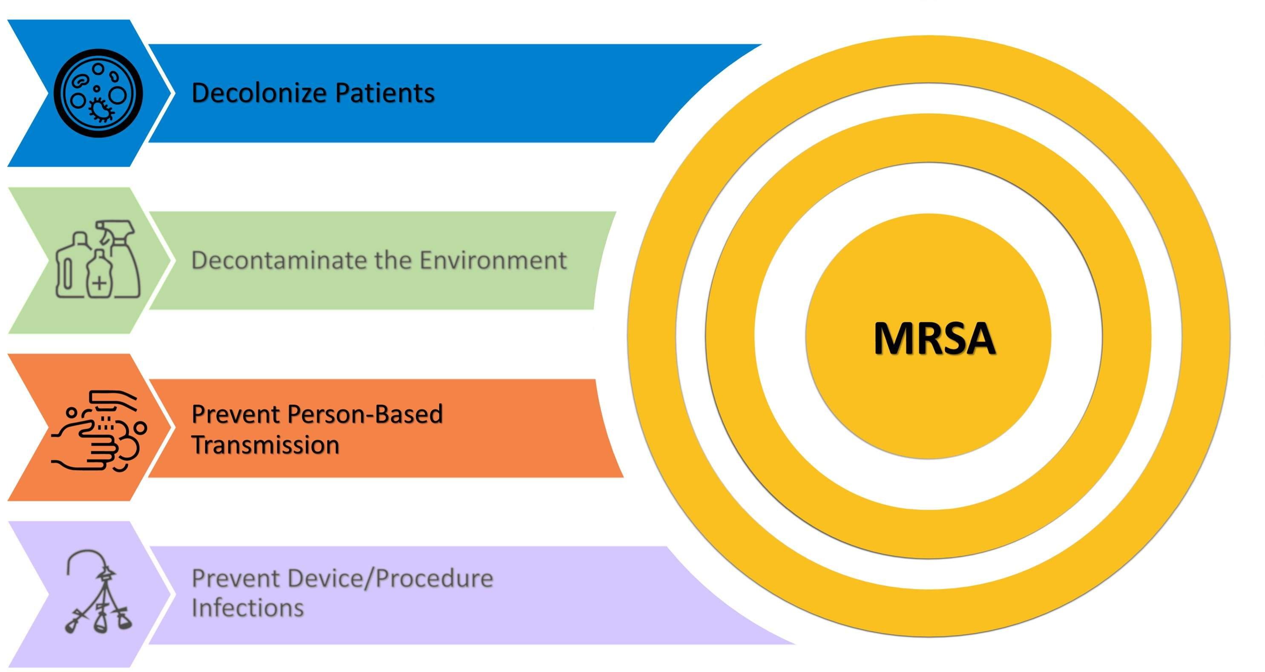
Key Strategies To Take Aim & Target MRSA Infection

Slide 4


MRSA Is a Serious Threat¹
More than 323,000 MRSA cases are detected in hospitalized patients and over 10,000 deaths reported each year.
Estimated attributable healthcare costs are $1.7 billion.

Slide 5

MRSA Carriage Is Common in Healthcare Settings²⁻⁴
Colonization is defined as the presence of a microorganism on or in a patient’s body without any signs or symptoms of infection.
An estimated 5 to 7 percent of hospitalized patients harbor MRSA (carrier prevalence).

Slide 6
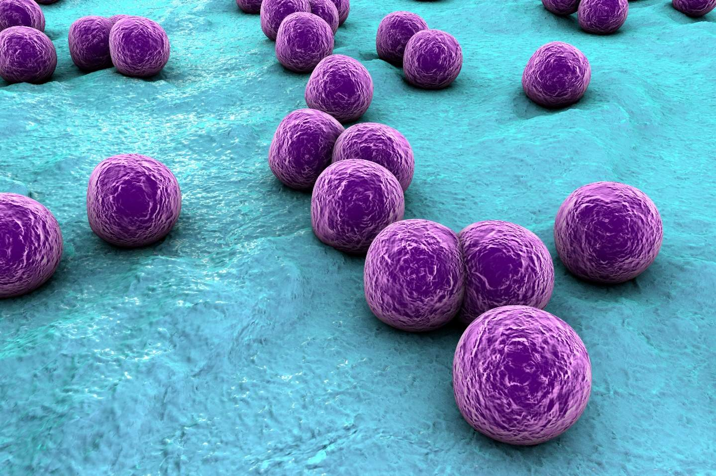
High Risk of MRSA Progressing to Clinical Disease⁵⁻⁸
Infection occurs when microorganisms on a patient cause adverse effects, which is observed as symptoms of infection.
Between 18 and 33 percent of adult patients colonized with MRSA will subsequently develop MRSA invasive infection including pneumonia, skin and soft tissue infection, or bloodstream infection.
Among pediatric patients, 8.5 percent of children are colonized with MRSA upon hospital admission.
In pediatric ICUs, 47 percent of children who acquired MRSA developed invasive MRSA infections.

Slide 7
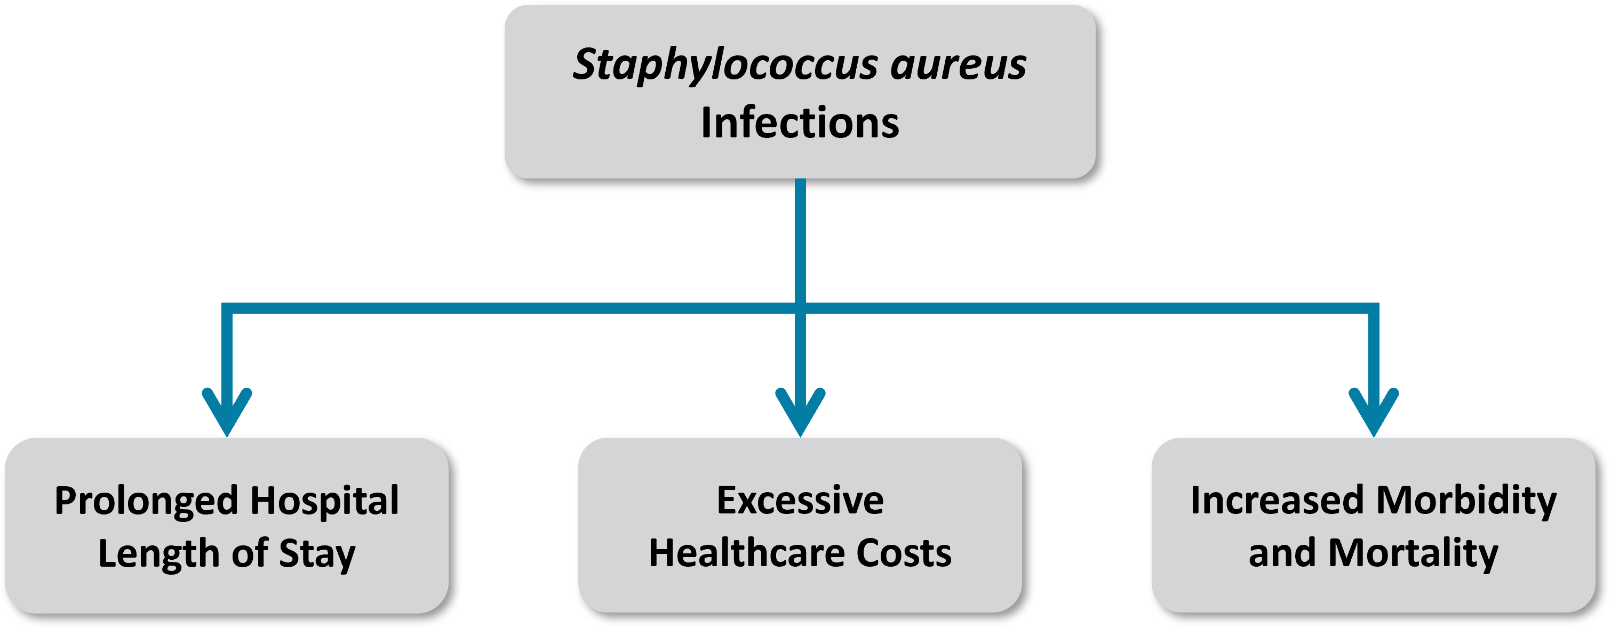
Consequences of MRSA Infections⁹⁻¹²
MRSA affects people in both community settings and healthcare facilities, but most of the morbidity and mortality occurs in critically and chronically ill patients.

Slide 8
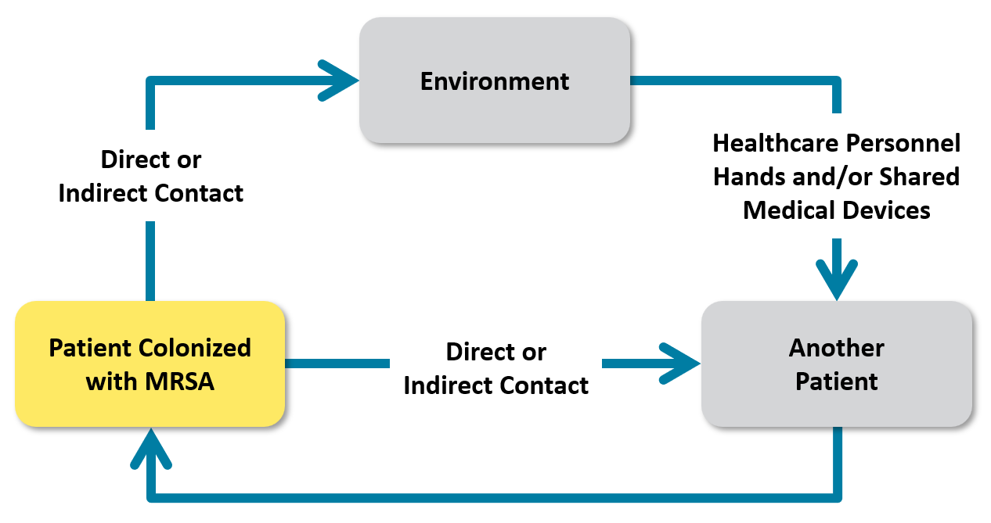
Benefits of Detecting MRSA¹³
NOTE: A patient’s MRSA colonization can progress to invasive disease.

Slide 9
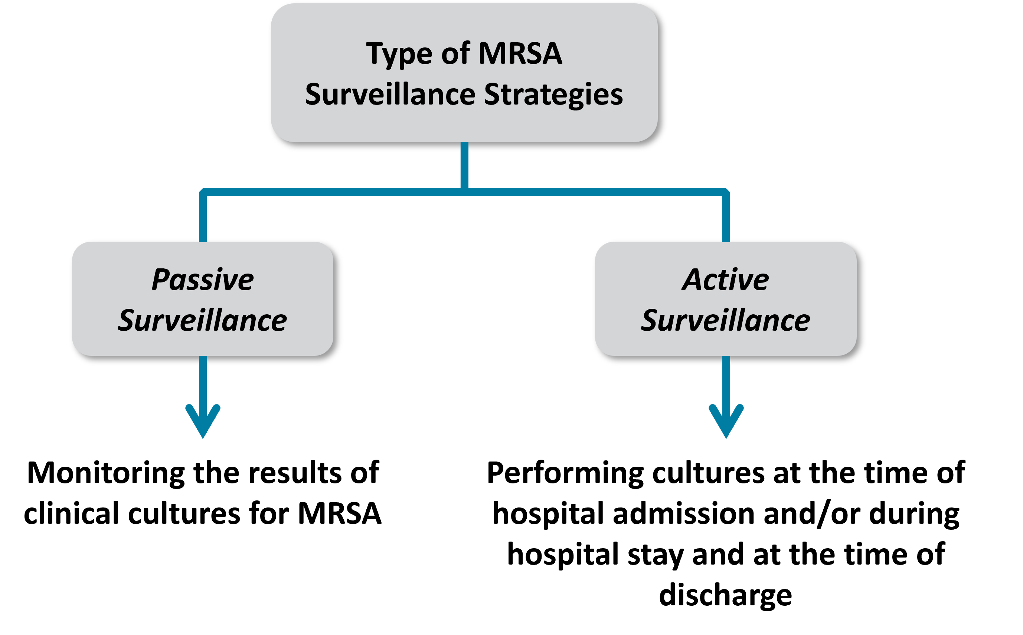
MRSA Surveillance

Slide 10

Passive MRSA Surveillance¹⁴
Passive surveillance only identifies the tip of the iceberg.
Laboratory-Identified (LabID) MRSA Bacteremia Surveillance Data: Only detects patients with MRSA central line-associated blood stream infections.
Positive MRSA Clinical Cultures: Studies show that this method underestimates overall hospital-wide prevalence of MRSA by as much as 85 percent.
Passive surveillance misses cases of asymptomatic MRSA colonization and makes it harder to determine if an infection detected later was community or hospital-acquired.
Infected
Colonized

Slide 11
Active MRSA Surveillance¹⁴
Active surveillance shows the full burden of MRSA among patients, allowing hospital units to:
Take the appropriate steps to prevent transmission to other patients.
Stop the progression from colonization to invasive infection among patients who are already colonized.
Cons of Active Surveillance:
Additional costs and staff time to collect samples and perform cultures
Infected
Colonized

Slide 12

Decline in Active MRSA Surveillance¹⁵
Active MRSA surveillance declined from 90 percent in 2013 to 69 percent in 2018.
Active surveillance has benefits, especially for high-risk patients to identify MRSA colonization and infection.

Slide 13
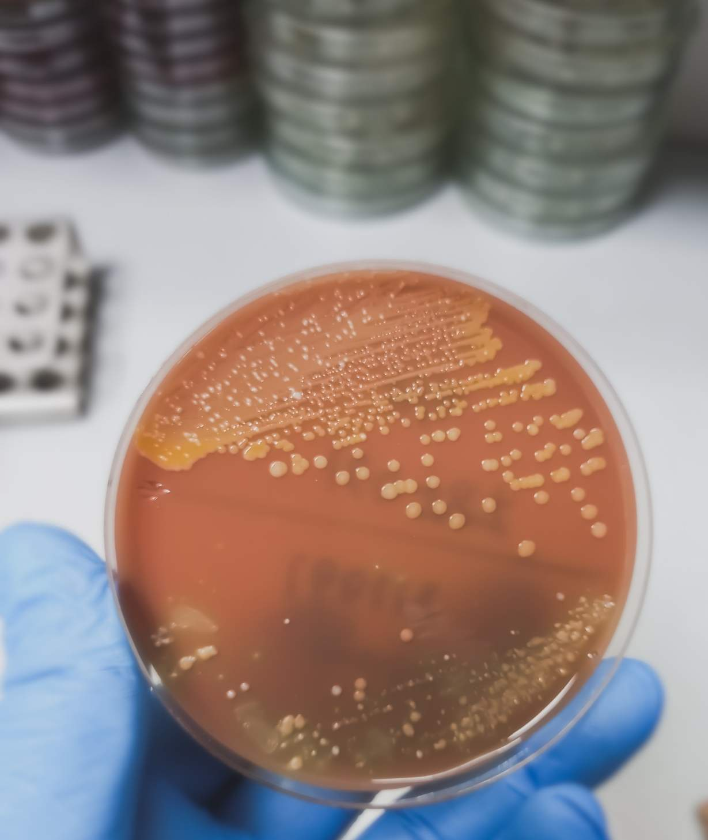
Establishing an Active Surveillance Program
Consider the following when developing an active surveillance program:
Which patient population group will be cultured (e.g., all patients, patients from selected units, or high-risk patients)?
Who will collect the cultures?
Which body site(s) will be cultured?
When will the cultures be collected?

Slide 14

Culture Collection Sites¹⁶
No single testing site will detect all colonized persons.
However, the anterior nares is considered primary site for sampling due to:
  Ease of accessibility.
  Frequency of positive results (sensitivity ranges from 48 to 93 percent).
Other testing sites include wounds, axillae, and groin.

Slide 15
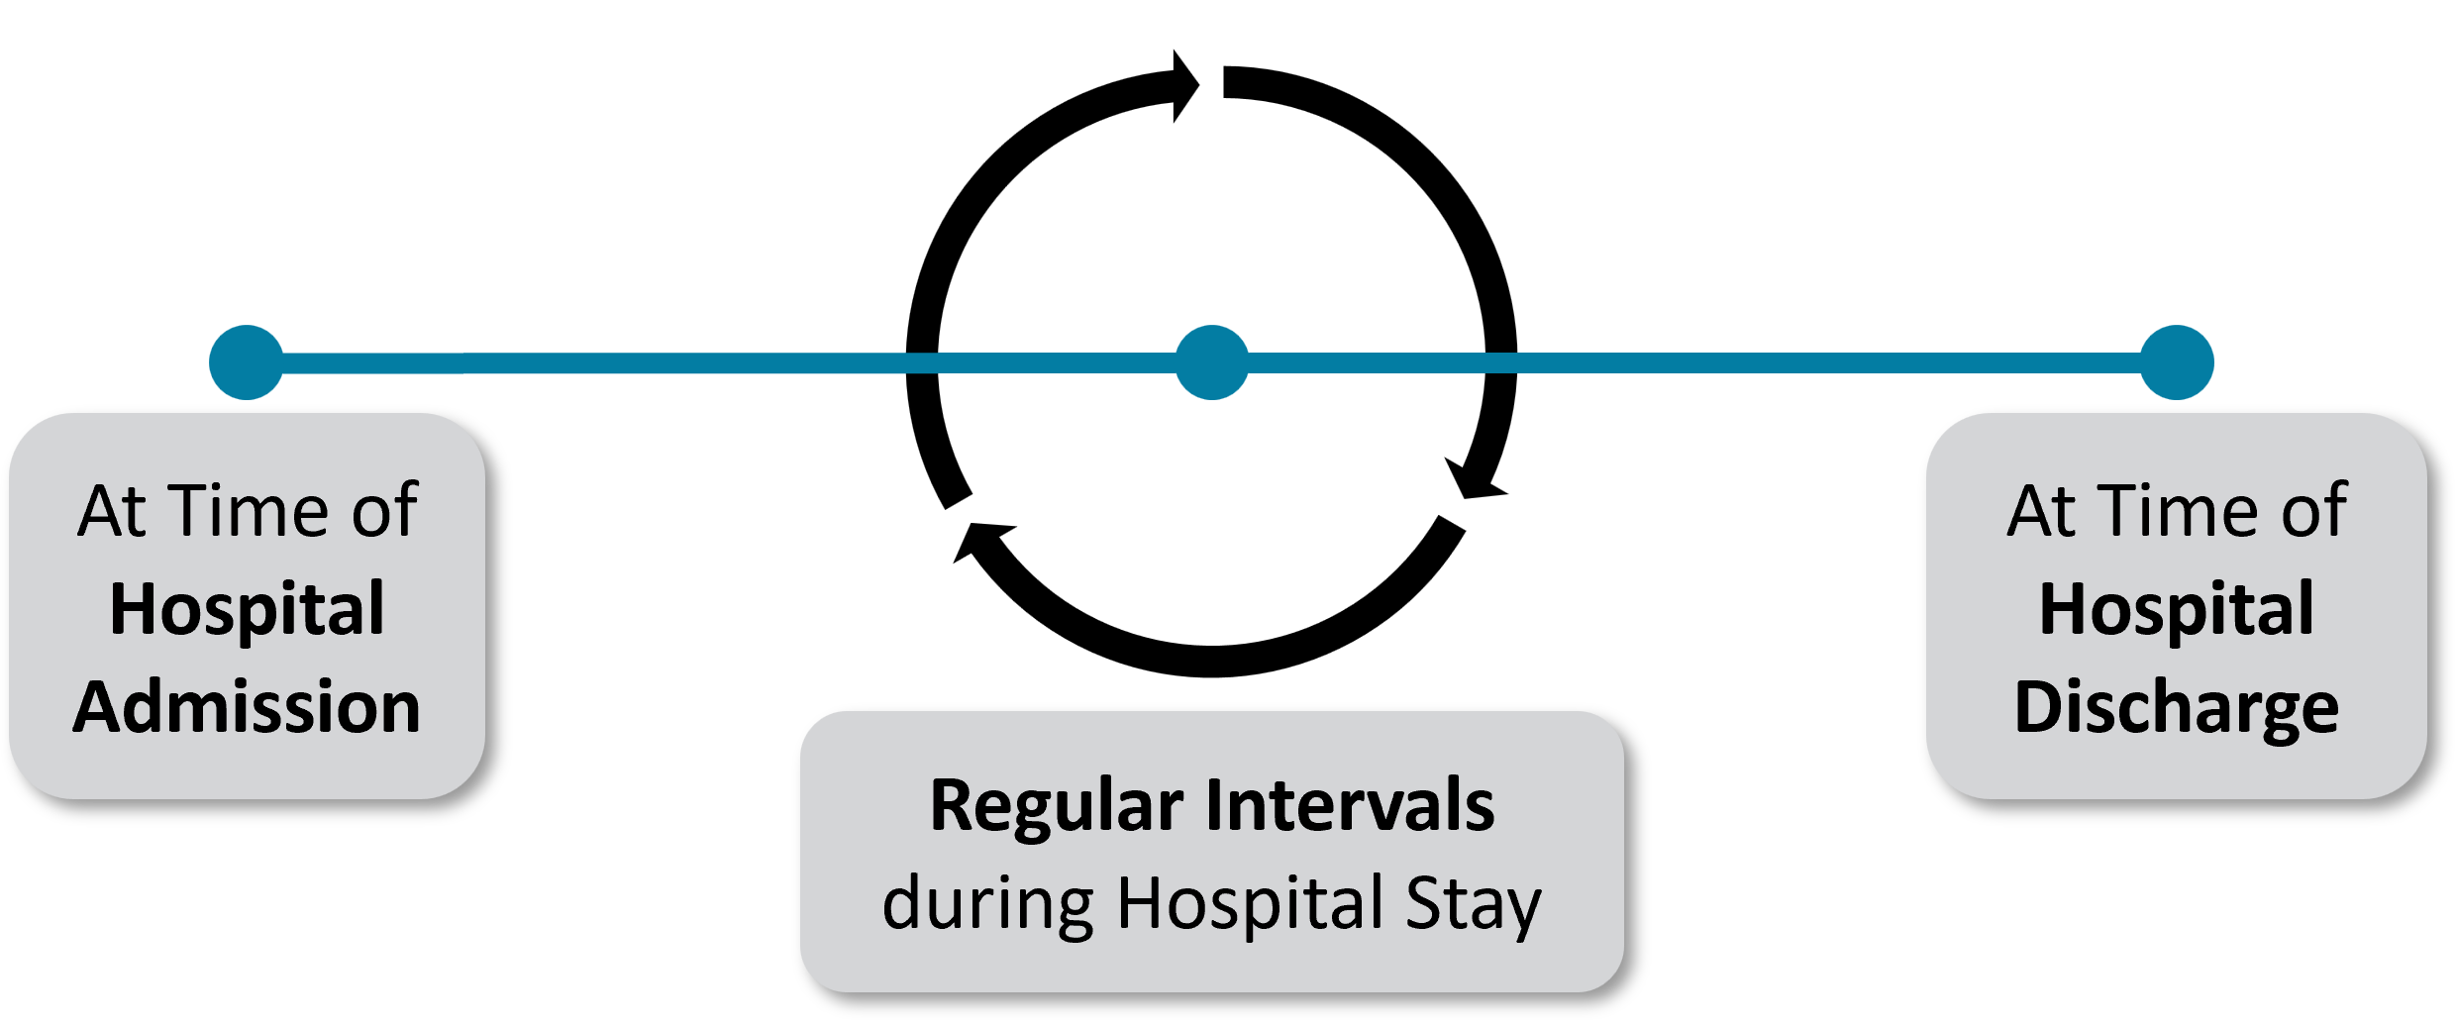
When To Collect Cultures
Surveillance upon admission.
Detects patients who became colonized while in the community (present on admission). Prompt intervention can decrease the risk of transmission to other patients.
Surveillance performed upon hospital admission and at a regular interval offers an advantage.
Detects patients who became colonized while in the hospital. Prompt intervention can decrease the risk of transmission to other patients. Data can be tracked to assess the effectiveness of interventions to interrupt MRSA transmission.

Slide 16

Tracking and Utilizing MRSA Surveillance Data
Surveillance data tracked over time allows facilities to:
Detect outbreaks
Spot unexpected increases in disease occurrence
Evaluate and adjust the effectiveness of intervention strategies

Slide 17
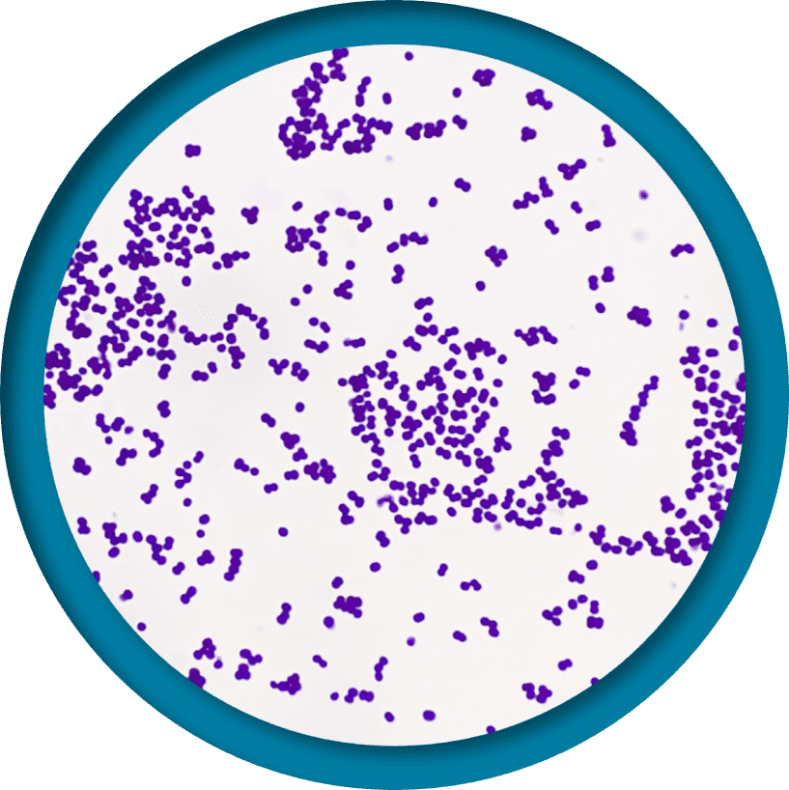
Contact Precautions
Promptly place patients colonized or infected with MRSA on contact precautions.
  Contact precautions prevent the spread of diseases through direct contact with the patient or indirect contact with environmental surfaces or patient-care items in the patient’s environment.
  Wear gloves and gown to enter a patient room regardless of whether patient contact will occur.
IMPORTANT: Contact precautions must be used with other strategies to meaningfully reduce MRSA transmission
  A study found that the use of contact precautions reduced MRSA transmission by 47 percent when it was part of a multidimensional approach, but not alone.¹⁷
Learn more on the Contact Precautions section of the Toolkit website.

Slide 18
MRSA Decolonization Is Incomplete¹⁸
Hospital Trial* | Mupirocin & Chlorhexidine Gluconate (CHG) | Placebo & CHG | p-value
Nares cleared | 44 percent | 25 percent | 0.06
All body sites cleared | 25 percent | 18 percent | 0.40
MRSA Infection | 6 percent | 14 percent | 0.32
*The followup period was up to 26 days (plus or minus 3 days) after initiation of therapy. Regarding decolonization effectiveness, the study researchers indicated that the trial results were not related to exogenous recolonization or high-level resistance.
For more on the importance of mupirocin and CHG for decolonization, access the Decolonization section of the Toolkit website.

Slide 19

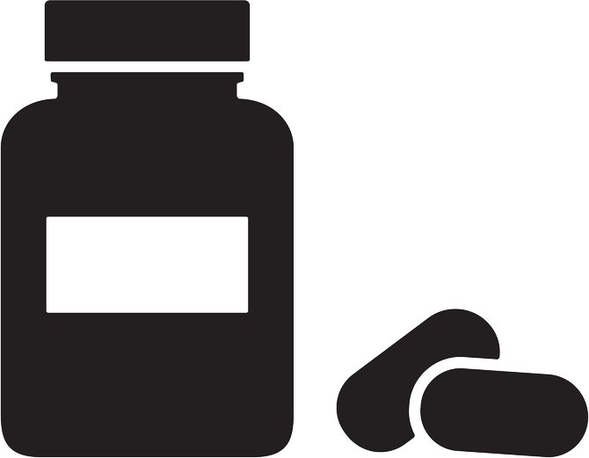
Antibiotic Treatment Selection
Antibiotic stewardship is another reason to consider conducting MRSA surveillance.
Knowledge that a patient is colonized with MRSA can facilitate choosing wisely regarding vancomycin and other antimicrobial agents if they develop signs or symptoms of an infection that requires empiric antimicrobial therapy.
Access the Antibiotic Stewardship section of the Toolkit website.

Slide 20

MRSA Surveillance Recommendations
Review the interventions in the AHRQ Toolkit for MRSA Prevention.
Assess your current practice, your available resources, and the information covered in this presentation to determine whether you want to add or change any aspect of your current MRSA surveillance program.

Slide 21

Case Example
An Increase in MRSA Rates at ABC Hospital

Slide 22

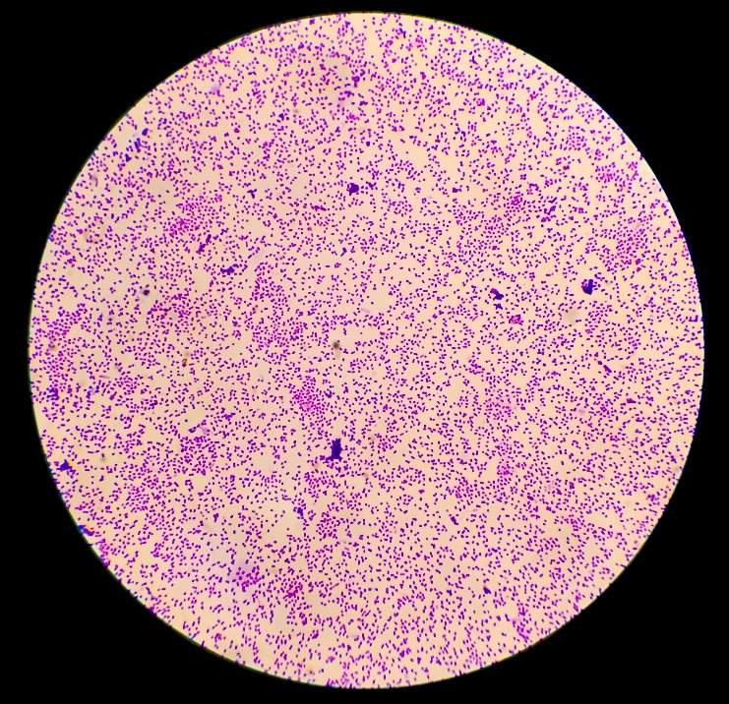
Case Example: Increasing MRSA Rates
Four years ago, ABC Hospital instituted universal decolonization in all units to prevent MRSA.
The MRSA rates remained low for 2 years, but then started to increase.

Slide 23

Case Example: What Is Happening?
The Infection Preventionists (IPs) found that most of the cases were residents of nearby nursing homes.
  Only a few of these patients were known to have had MRSA in the past.
Reviewing the literature, the Comprehensive Unit-based Safety Program (CUSP) team noted in a study by Harbarth et al. that only 25 percent of the patients who were known to be colonized had all their body sites cleared of MRSA after finishing a 5-day decolonization process.¹⁸
The team decided to adjust their MRSA prevention protocol.

Slide 24



Case Example: New Plan
The CUSP team made the following adjustments:
  All patients known to have had MRSA infections or to have been colonized with MRSA will be placed on contact isolation precautions upon hospital admission.
  All patients will be tested for MRSA upon hospital admission.
  While waiting for results, patients who were in another hospital or nursing home prior to admission will be placed on contact isolation precautions.
  If a tested patient has a negative MRSA surveillance test, they will be removed from contact precautions.
  If a tested patient has a positive MRSA surveillance test, they will remain on contact isolation precautions throughout their stay in the hospital.

Slide 25

Case Example: Next Steps and Results
Unit and hospital leadership agreed to the plan.
MRSA rates decreased again after 6 months of the new interventions.
The rates of MRSA colonization in the surrounding nursing homes were driving the increase in MRSA.
The use of an active surveillance program, together with contact precautions, helped to effectively decrease the MRSA rate.

Slide 26

Celebrate Successes
Implementing MRSA surveillance and using the four key strategies to break the chain of MRSA transmission and infection is hard work and requires effort and feedback from all personnel.
Remember to acknowledge and celebrate successes!

Slide 27
Key Takeaways
A multifaceted approach is needed to successfully prevent MRSA infection and transmission.
Active and passive MRSA surveillance allows for detection of patients colonized and infected with MRSA, initiation of targeted interventions such as decolonization and isolation, and evaluation of the effectiveness of MRSA prevention intervention strategies.
Since MRSA surveillance will not reduce MRSA transmission by itself, it is important to intervene to break the chain of MRSA transmission and infection.
The four key strategies to aim and target for MRSA prevention are (1) decolonizing patients, (2) intervening to prevent person-based transmission, including from healthcare personnel, (3) cleaning and disinfecting the healthcare environment, and (4) implementing evidence-based interventions to prevent device and procedure-associated infections.
Working together and using these key strategies can protect patients and take aim to prevent MRSA.

Slide 28
Disclaimer
The findings and recommendations in this presentation are those of the authors, who are responsible for its content, and do not necessarily represent the views of AHRQ. No statement in this presentation should be construed as an official position of AHRQ or of the U.S. Department of Health and Human Services.
Any practice described in this presentation must be applied by healthcare practitioners in accordance with professional judgment and standards of care in regard to the unique circumstances that may apply in each situation they encounter. These practices are offered as helpful options for consideration by healthcare practitioners, not as guidelines.

Slide 29
Reference List—1
Centers for Disease Control and Prevention (CDC). Antibiotic Resistance Threats in the United States, 2019. Atlanta, GA: U.S. Department of Health and Human Services, CDC; 2019. https://www.cdc.gov/drugresistance/pdf/threats-report/2019-ar-threats-report-508.pdf.
Jarvis WR, Schlosser J, Chinn RY, et al. National prevalence of methicillin-resistant Staphylococcus aureus in inpatients at US health care facilities, 2006. Am J Infect Control. 2007 Dec;35(10):631-7. PMID: 18063126.​
Hidron AI, Kourbatova EV, Halvosa JS, et al. Risk factors for colonization with methicillin-resistant Staphylococcus aureus (MRSA) in patients admitted to an urban hospital: emergence of community-associated MRSA nasal carriage. Clin Infect Dis. 2005 Jul 15;41(2):159-66. PMID: 15983910.​
Robicsek A, Beaumont JL, Paule SM, et al. Universal surveillance for methicillin-resistant Staphylococcus aureus in 3 affiliated hospitals. Ann Intern Med. 2008 Mar 18;148(6):409-18. PMID: 18347349.
Huang SS, Platt R. Risk of methicillin-resistant Staphylococcus aureus infection after previous infection or colonization. Clin Infect Dis. 2003 Feb 1;36(3):281-5. PMID: 12539068.

Slide 30
Reference List—2
Huang SS, Hinrichsen VL, Datta R, et al. Methicillin-resistant Staphylococcus aureus infection and hospitalization in high-risk patients in the year following detection. PLoS One. 2011;6(9):e24340. PMID: 21949707.
Datta R, Huang SS. Risk of infection and death due to methicillin-resistant Staphylococcus aureus in long-term carriers. Clin Infect Dis. 2008 Jul 15;47(2):176-81. PMID: 18532892.
Milstone AM, Goldner BW, Ross T, et al. Methicillin-resistant Staphylococcus aureus colonization and risk of subsequent infection in critically ill children: importance of preventing nosocomial methicillin-resistant Staphylococcus aureus transmission. Clin Infect Dis. 2011 Nov;53(9):853-9. PMID: 21878424.
Schmidt A, Bénard S, Cyr S. Hospital cost of staphylococcal infection after cardiothoracic or orthopedic operations in France: a retrospective database analysis. Surg Infect (Larchmt). 2015 Aug;16(4):428-35. PMID: 26207403.​
Anderson DJ, Kaye KS, Chen LF, et al. Clinical and financial outcomes due to methicillin resistant Staphylococcus aureus surgical site infection: a multi-center matched outcomes study. PLoS One. 2009 Dec 15;4(12):e8305. PMID: 20016850.​

Slide 31
Reference List—3
McGarry SA, Engemann JJ, Schmader K, et al. Surgical-site infection due to Staphylococcus aureus among elderly patients: mortality, duration of hospitalization, and cost. Infect Control Hosp Epidemiol. 2004 Jun;25(6):461-7. PMID: 15242192.​
Klein E, Smith DL, Laxminarayan R. Hospitalizations and deaths caused by methicillin-resistant Staphylococcus aureus, United States, 1999-2005. Emerg Infect Dis. 2007 Dec;13(12):1840-6. PMID: 18258033.​
Kramer A, Schwebke I, Kampf G. How long do nosocomial pathogens persist on inanimate surfaces? a systematic review. BMC Infect Dis. 2006 Aug 16;6:130. PMID: 16914034.
Calfee DP, Salgado CD, Classen D, et al. Strategies to prevent transmission of methicillin-resistant Staphylococcus aureus in acute care hospitals. Infect Control Hosp Epidemiol. 2008 Oct;29 Suppl 1:S62-80. PMID: 18840090.
Chiotos K, Rock C, Schweizer ML, et al. Current infection prevention and antibiotic stewardship program practices: a survey of the Society for Healthcare Epidemiology of America (SHEA) Research Network (SRN). Infect Control Hosp Epidemiol. 2019 Sep;40(9):1046-9. PMID: 31311610.

Slide 32
Reference List—4
Calfee DP, Salgado CD, Milstone AM, et al. Strategies to prevent methicillin-resistant Staphylococcus aureus transmission and infection in acute care hospitals: 2014 update. Infect Control Hosp Epidemiol. 2014 Sep;35 Suppl 2:S108-32. PMID: 25376072.
Khader K, Thomas A, Stevens V, et al. Association between contact precautions and transmission of methicillin-resistant Staphylococcus aureus in Veterans Affairs hospitals. JAMA Netw Open. 2021 Mar 1;4(3):e210971. PMID: 33720369.
Harbarth S, Dharan S, Liassine N, Herrault P, Auckenthaler R, Pittet D. Randomized, placebo-controlled, double-blind trial to evaluate the efficacy of mupirocin for eradicating carriage of methicillin-resistant Staphylococcus aureus. Antimicrob Agents Chemother. 1999 Jun;43(6):1412-6. PMID: 10348762.

