Slide 1
AHRQ Safety Program for MRSA Prevention
Prevention of
Ventilator-Associated Pneumonia &
Non-Ventilator Healthcare-Associated Pneumonia
ICU & Non-ICU
AHRQ Pub. No. 25-0007
October 2024

Slide 2
Educational Objectives
Discuss the causes and risks associated with healthcare-associated pneumonia
Describe the current guidelines and key best practice recommendations for preventing healthcare-associated pneumonia
Review the current recommendations for implementation of a bundled approach to reduce healthcare-associated pneumonia

Slide 3
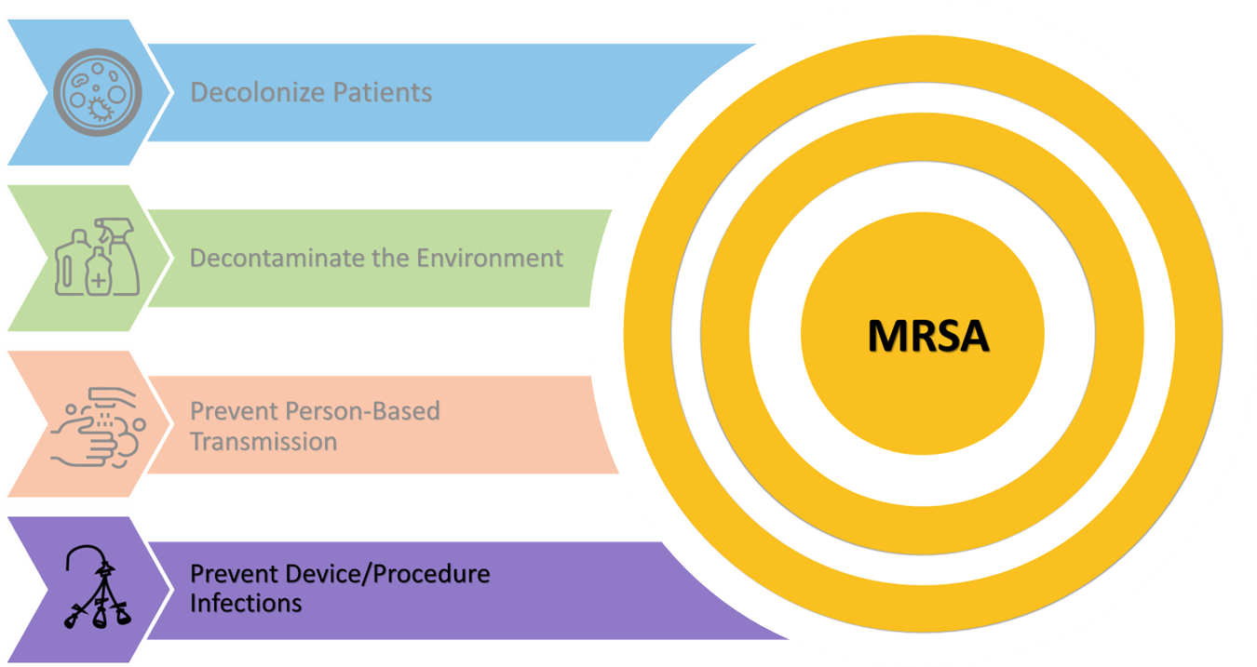
Key Strategies To Take Aim & Target MRSA Infection

Slide 4

Preventing Device- & Procedure-Related Infections¹⁻⁴
Healthcare-associated pneumonia (HAP) is the most common nosocomial infection.¹⁻⁴
It affects approximately 1 in 100¹ patients overall and 5 to 20 percent^{1,3,5} of patients receiving invasive mechanical ventilation.

Slide 5
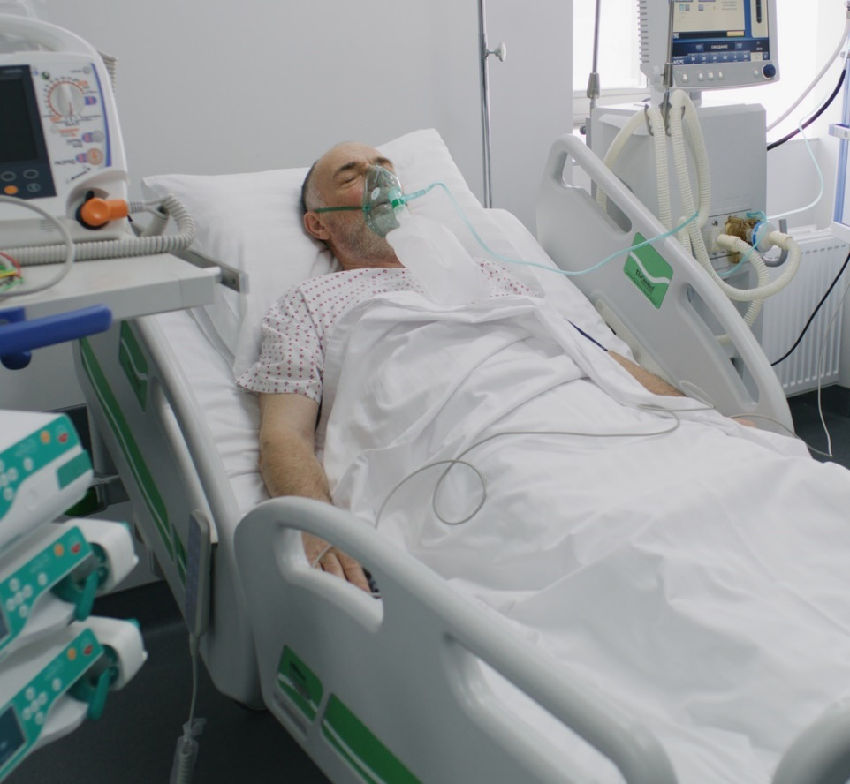
Pneumonia^{1,5-10}
Pneumonia: An inflammatory condition that affects one or both lungs, caused by an infectious pathogen
  Can be caused by bacteria, virus, or fungi
Clinical diagnosis based on:
Signs
fever, rales, purulent sputum, decreased oxygen saturation
Symptoms
chills, cough, shortness of breath
Diagnostic Testing
abnormal chest radiographic findings, leukopenia/leukocytosis,
positive clinical microbiology

Slide 6
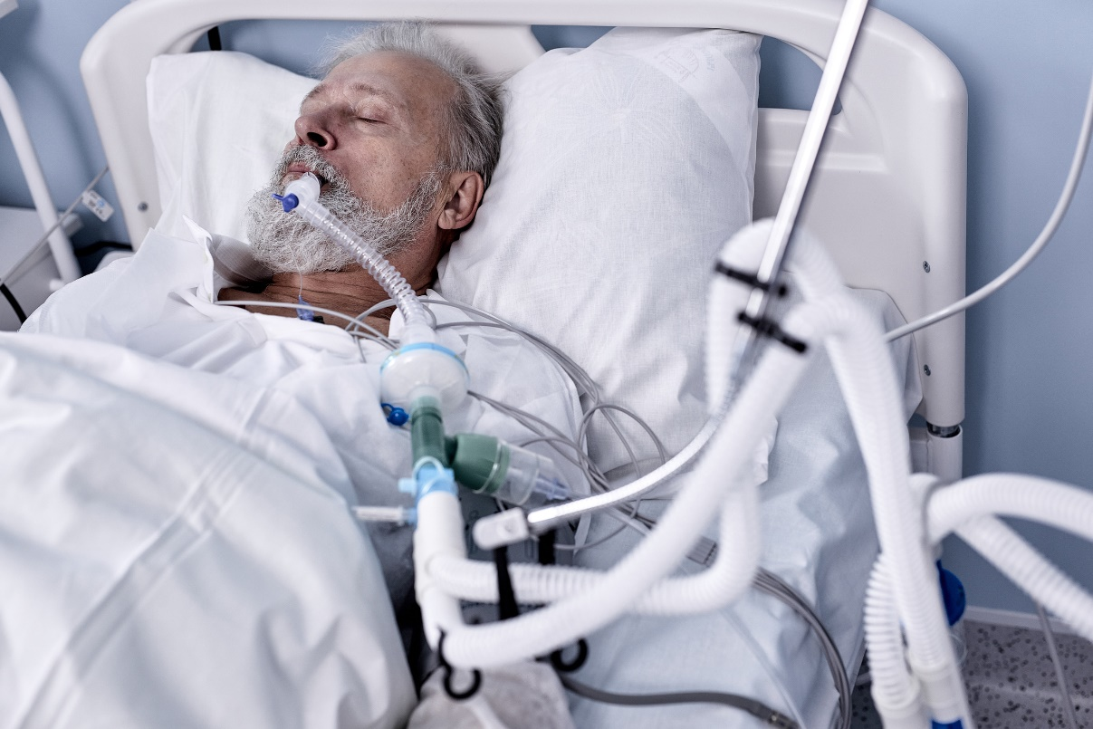
Ventilator-Associated Pneumonia (VAP) Risk Factors^{1,11,12}
Patients with certain underlying medical conditions/
comorbidities are at higher risk.
  Cardiovascular or pulmonary conditions
  Cancer
  Trauma
Some risk factors are modifiable.
  Maintaining positive fluid balance
  Reducing medications that can affect gastrointestinal pH
  Avoiding gastric distention

Slide 7
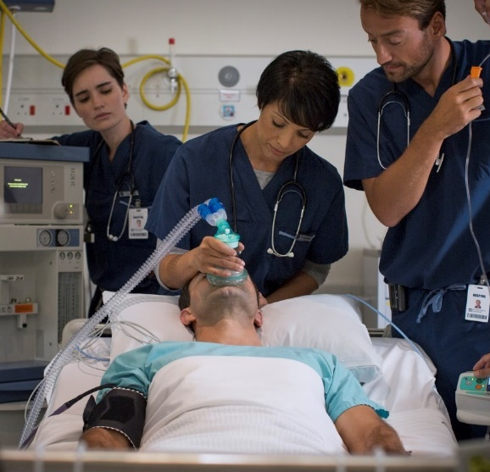
VAP Risk Factors: Medical Interventions^{1,11,12}
Certain medical interventions can increase risk of VAP.
Reintubation
Ventilator settings
Opioids/sedatives
Transport of ventilated patients
Blood transfusions
Neuromuscular blockade
Oral care with chlorhexidine gluconate (CHG)
  Guideline updates in 2022 explicitly recommend against CHG oral care for ventilated patients due to potential for increased mortality.

Slide 8

VAP Morbidity and Mortality
Attributable mortality associated with VAP is about 10 percent^{1,5,8}
5 to 15 percent of mechanically ventilated patients are treated for VAP¹
Associated with—^{1,5,7,8,10-14}
  Increased duration of mechanical ventilation
  Increased intensive care and overall length of stay
  Increased cost of care
  Increased use of antimicrobials

Slide 9

Non-Ventilator Healthcare-Associated Pneumonia (NV-HAP) Risk Factors^{1-3,5,15-19}
Underlying Medical Conditions/Comorbidities:
  Altered immune status
  Existing cardiovascular or pulmonary conditions
Modifiable Risk Factors:
  Gastrointestinal pH
  Malnutrition/nutritional deficiency
  Optimal glucose control/diabetes
  Increased mobility
  Aspiration
Nonmodifiable Risk Factors:
  Age
Risks From Medical Interventions:
  Surgery (thoracic or abdominal)
  Enteral feeding
  Prior antimicrobial use

Slide 10
NV-HAP Morbidity and Mortality^{1-4,8,16-19}
NV-HAP’s overall incidence is 1.6 percent.¹⁷
  Rate of 3.63 per 1,000 patient days
Estimates of mortality range from 15 to 31 percent.¹⁹
Associated with twice the length of stay and increased cost of care.³
Bacterial pathogens cause 50% to 80% of all NV-HAPs.¹⁶
  Gram-negative are the most common.
Influenza and RSV are most associated with viral pneumonias.¹⁶
Fungal pneumonia is more likely among immunocompromised patients.¹⁶

Slide 11
Published Recommendations for NV-HAP
APIC Practice Position Statement: Non-Ventilator Healthcare-Associated Pneumonia (NV-HAP)¹⁸
APIC Implementation Guide on Non-Ventilator Healthcare-Associated Pneumonia (NV-HAP)¹⁹
Joint Commission Quick Safety Newsletter: Preventing Non-Ventilator Hospital-Acquired Pneumonia²⁰

Slide 12
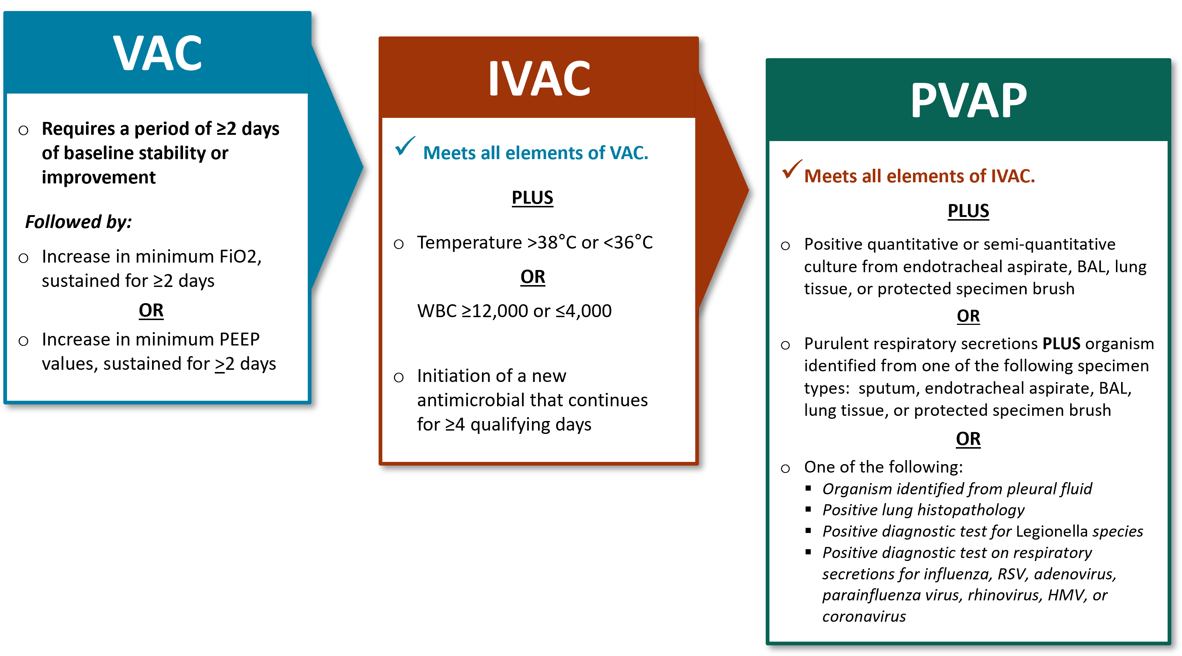
NHSN Ventilator-Associated Event (VAE)^{1,21}
From the VAE Module of the CDC NHSN Patient Safety Component Manual:²¹
Note: This VAE module is applicable to adult patients only.
The NHSN Pediatric VAE (PedVAE) module is available here.²²
IVAC= Infection-related Ventilator-Associated Complications, NHSN= National Healthcare Safety Network , PVAP= Possible Ventilator-Associated Pneumonia , VAC= Ventilator-Associated Condition

Slide 13
NHSN Resources
NHSN Patient Safety Component Training²³
PNEU Training²⁴
  Self-Paced Training
  Training Videos
VAE Training²⁵
  Self-Paced Training
  Training Videos
  Case Studies
PedVAE Training²⁶
  Self-Paced Training
  Training Videos
Additional training is also available for infection window and POA criteria!²⁷

Slide 14
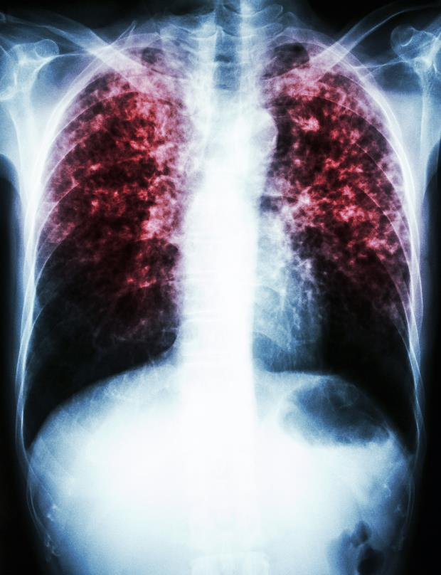
Pneumonia and S. aureus²⁸⁻³⁰
Most common bacterial causes of VAP:²⁸
Staphylococcus aureus: 28.8 percent
Pseudomonas aeruginosa: 21.8 percent
Klebsiella species: 9.8 percent
Escherichia coli: 6.9 percent
Acinetobacter species: 6.8 percent
Enterobacter species: 6.3 percent

Slide 15


Guidelines & Resources
VAP:
2022 SHEA Compendium¹
SCCM ICU Liberation Bundle³¹
AHRQ Toolkit for Mechanically Ventilated Patients⁴
NV-HAP:
2022 SHEA Compendium¹
2020 APIC Implementation Guide¹⁹

Slide 16

VAP Preventive Interventions
Best Practices and Guidelines to Prevent Ventilator-Associated Pneumonia

Slide 17

VAP Essential Practices 1^{1,4,31}
Avoid intubation when possible.
  Alternative strategies:
    High-flow oxygen
    Noninvasive positive pressure ventilation (NIPPV)
    Placing patients in prone position
Minimize sedation.
  Avoid benzodiazepines
  Daily sedation awakening trials (SAT)
Conduct daily spontaneous breathing trials.
  Coordinate to conduct concurrently with SAT

Slide 18

VAP Essential Practices 2^{1,4,31}
Early mobility
Elevation of head of bed >30°
Daily oral care
  Use of CHG is NOT recommended
Early enteral feeding
  Preferred over parenteral nutrition
Maintain ventilator circuits
  Only change when soiled or nonfunctioning
  Drain condensation away from the patient

Slide 19
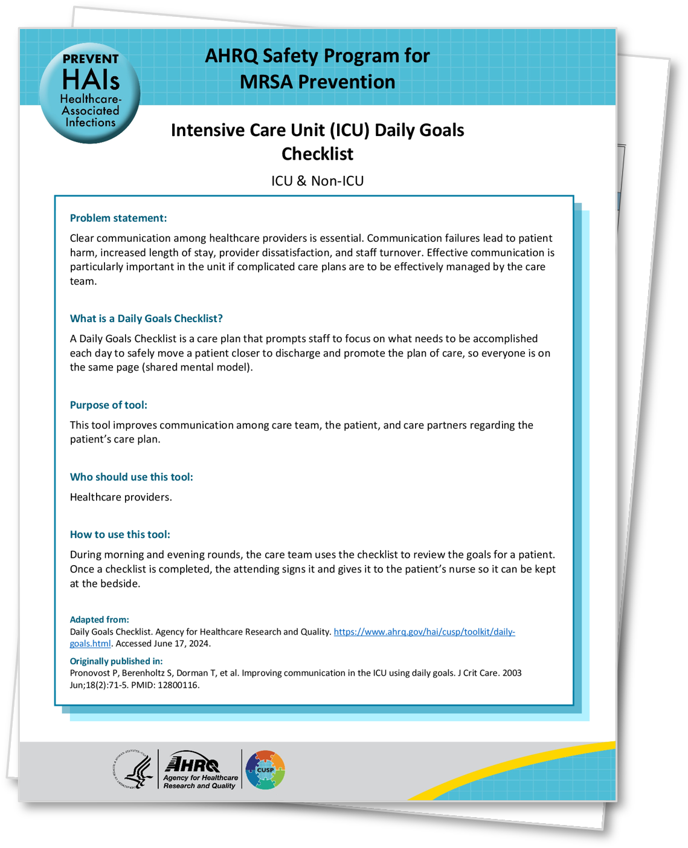
Daily Goals Checklist³²⁻³⁴
The Daily Goals Checklist is an effective way to track these essential practices.
Prompts the team to review care and define the day’s goals for each patient.
Ensures the team are all on the same page for each patient’s plan of care.
Sample Daily Goals Checklists are provided as part of this toolkit.
  Daily Goals Checklist for ICU
  Daily Goals Checklist for Non-ICU
Learn more about the Daily Goals process.³⁴

Slide 20

VAP Additional Interventions^{1,35}
Oropharynx and digestive tract decontamination
  Must monitor effect on antimicrobial resistance and C. difficile
Subglottic suction endotracheal tubes
  Can significantly reduce VAP rates
  Not shown to affect mortality, duration of intubation, or length of stay
Early tracheostomy
  Can reduce VAP rates
  Invasive, has lifelong effects on patient
Post-pyloric feeding
  Associated with lower incidence of pneumonia
  Requires a specially trained practitioner

Slide 21

NV-HAP Preventive Interventions
Best Practices and Guidelines to Prevent Non-Ventilator Healthcare-Associated Pneumonia

Slide 22

NV-HAP Essential Practices^{1,30,36,37}
Routine oral care
  Strong relationship between oral microbiome and HAP
Dysphagia and aspiration
  Screening tools
  Management
Early mobilization
  Consider fall risk
Stress ulcer prophylaxis stewardship
  Evaluate PPI use daily

Slide 23

NV-HAP Essential Practices^{1,30}
Nutrition
  Conduct regular nutritional screenings
Glycemic control
  Hyperglycemia raises susceptibility to infection
Prevention of viral infections
  Transmission-based precautions
  Symptom/surveillance screening
  Universal masking during periods of high transmission
  Immunizations
  Hand hygiene

Slide 24

Implementation
Putting Guidelines Into Practice

Slide 25
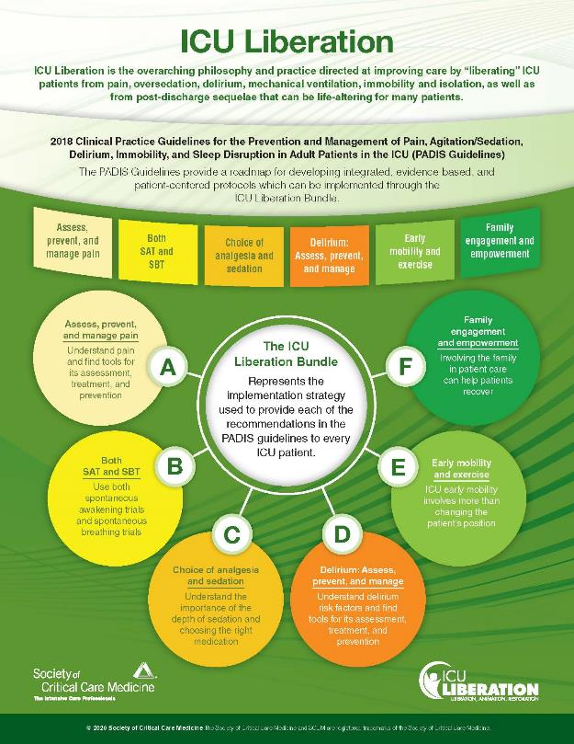
SCCM ICU Liberation Toolkit^{31,38,39}
ICU Liberation Bundle (A-F)³¹
A Element: Assess, Prevent, and Manage Pain
B Element: Both Spontaneous Awakening Trials (SATs) and Spontaneous Breathing Trials (SBTs)
C Element: Choice of Analgesia and Sedation
D Element: Delirium: Assess, Prevent, and Manage
E Element: Early Mobility and Exercise
F Element: Family Engagement and Empowerment
Reproduced with permission. ICU Liberation Infographic. Mount Prospect, IL: Society of Critical Care Medicine. Copyright © 2020 The Society of Critical Care Medicine.

Slide 26

Steps To Improve Care Delivery
Identify the problem.
Review the evidence.
Identify local barriers to improvement.
Identify metrics to measure performance.
Implement the intervention for all patients.
Follow the 4 Es:
  Engage
  Educate
  Execute
  Evaluate

Slide 27
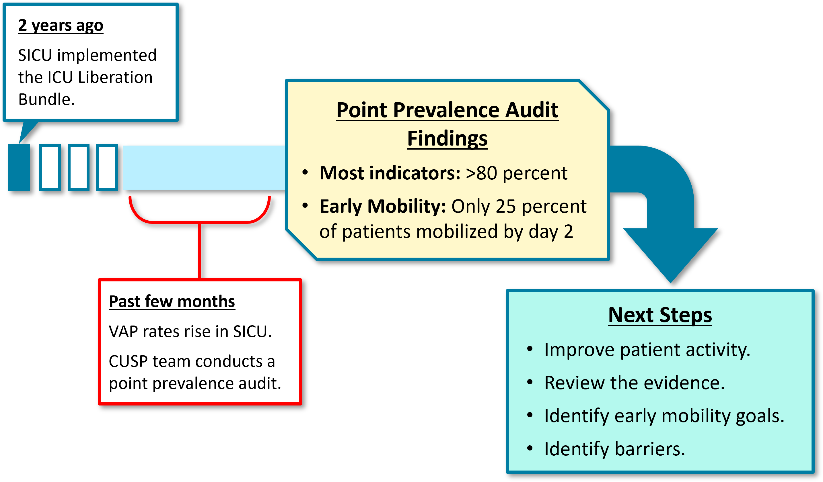
VAP Case Example: A Recent Increase in VAP Rates

Slide 28

VAP Case Example: Reviewing the Evidence
Evidence supports early mobility within the first 36 to 48 hours of intubation.⁴¹
CUSP team conducted staff observations and reviewed mobility documentation.
Current mobility interventions includes passive range of motion.
However, only 25 percent of patients were getting out of bed.

Slide 29

VAP Case Example: Identifying Barriers and Challenges to Early Mobility
CUSP Team investigated two questions:
  Why aren’t ventilated patients getting out of bed?
  What needs to change to get ventilated patients out of bed?
Barriers identified:
  Workload issues and coordination with PT
  Nurse turnover rates and new staff
  Knowledge gaps of early mobility

Slide 30

VAP Case Example: Measuring Performance^{40,42}
The team identified tools to guide data collection.
  ICU Mobility Scale⁴²
Mobility goals were added to the daily checklist.
A team of “mobility champions” was created.
Mobility champions are staff members focused on increasing patient mobility and are available to other staff as an “at the elbow” resource.

Slide 31
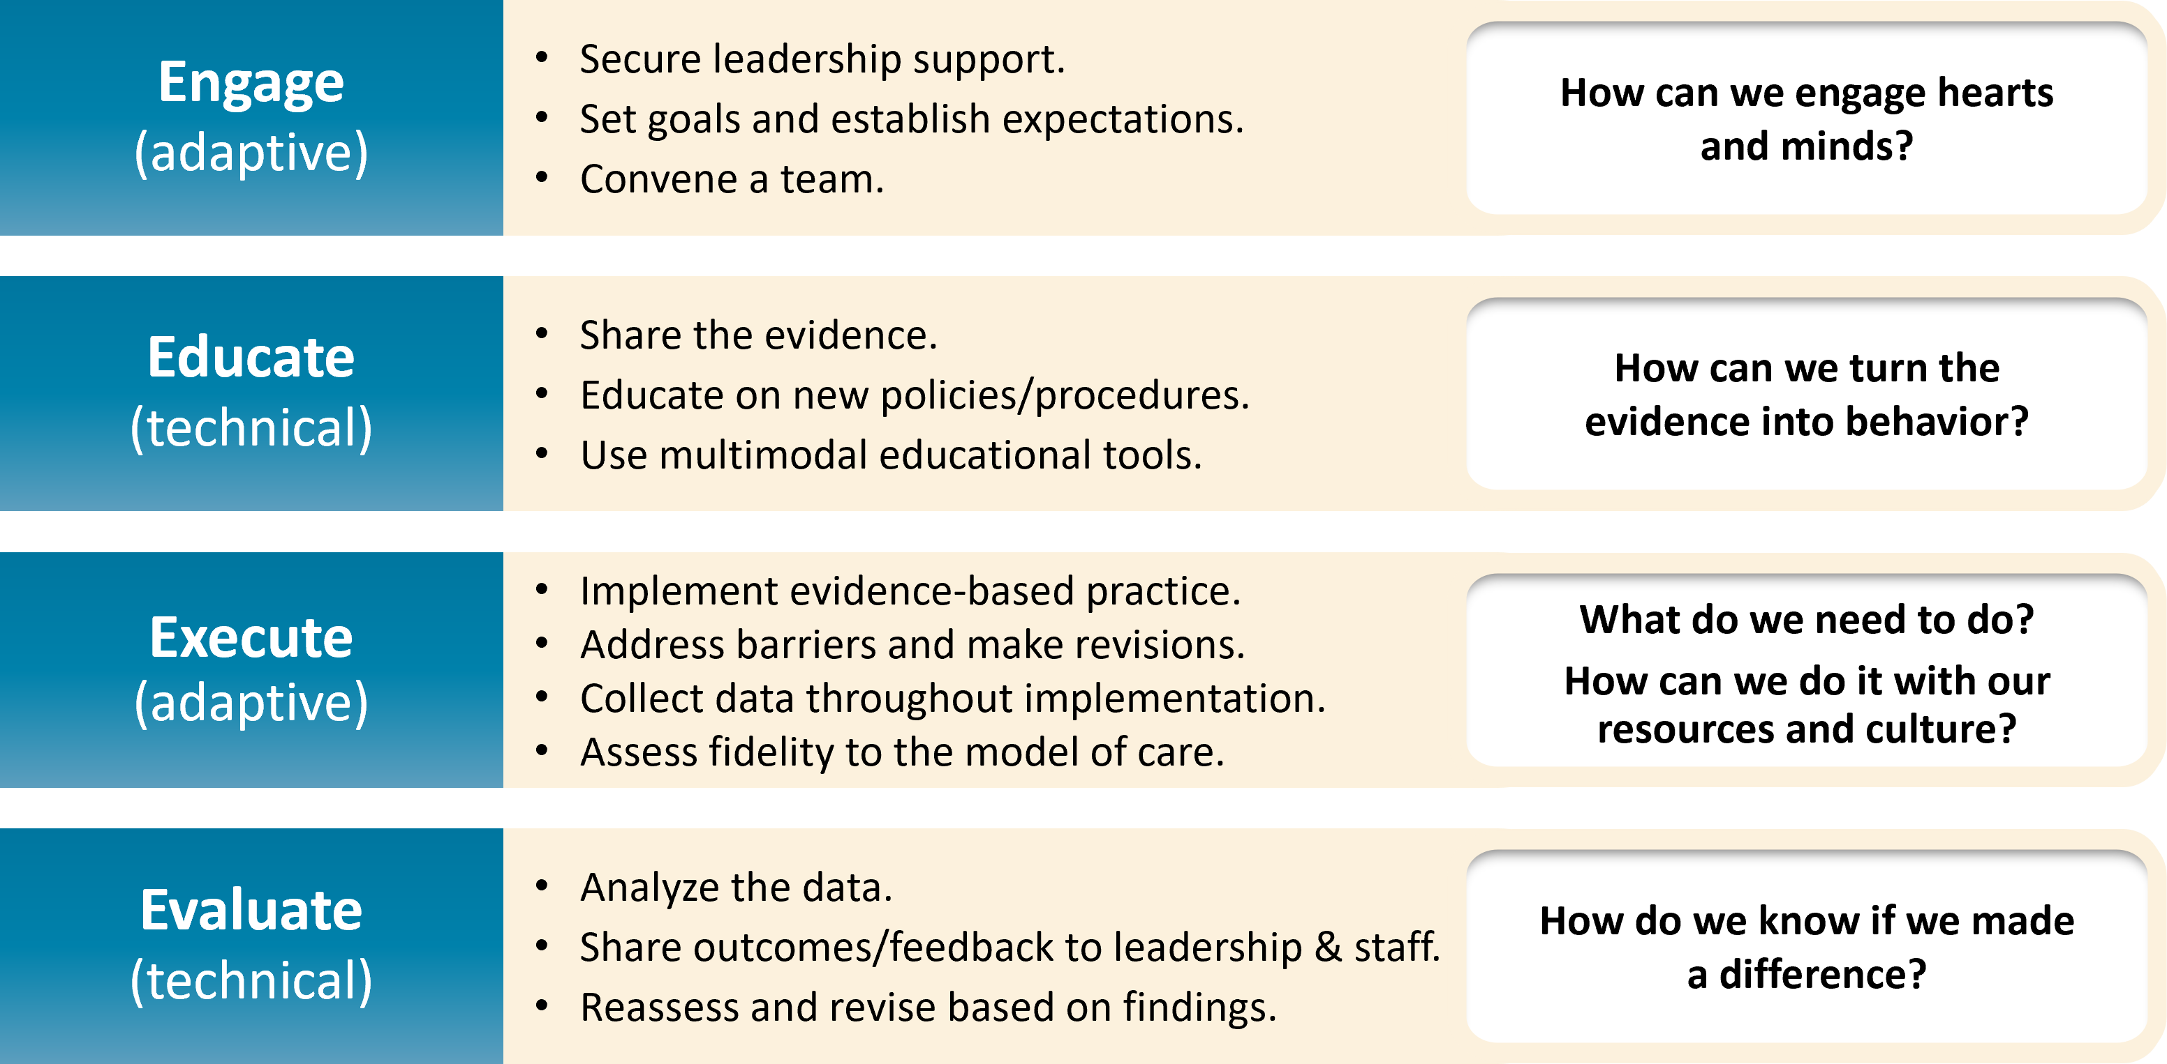
Implementation Strategies: The 4 Es⁴³⁻⁴⁷
Learn more in the section on the 4 Es on the Toolkit website.

Slide 32

VAP Case Example: Ensuring All Patients Receive the Intervention⁴⁸
Mobility champions, with PT and Respiratory Therapy, perform daily rounds on all ventilated patients.
Team speaks at staff meetings, huddles, and daily rounds.
Education campaign distributes info and fast fact sheets for staff, patients, and family on early mobility.
Orientation packets are provided for new staff.
Performance goal targets and progress are posted on the huddle board and shared with staff.

Slide 33

NV-HAP Case Example: Implementing an Oral Hygiene Prevention Bundle
There has been a recent spike in NV-HAP rates from 1.1 to 2.4 percent in the unit.
The CUSP team follows the steps to improve care delivery.
  Identify the problem.
  Review the evidence.
  Identify barriers and challenges.
  Identify metrics to evaluate performance.
  Educate staff and implement intervention.

Slide 34
NV-HAP Case Example: Reviewing Evidence for Oral Care^{1,19,49-51}
The CUSP team conducts literature review of oral care strategies.
  What has been done?
  What is documented?
They find that NV-HAP rates are underreported.
  APIC Practice Position Statement on NV-HAP¹⁸
There is strong evidence to support oral care interventions to prevent NV-HAP.⁴⁹⁻⁵¹
  Hospital Acquired Pneumonia Prevention by Engaging Nurses (HAPPEN) initiative⁵²

Slide 35

NV-HAP Case Example: Identifying Barriers and Challenges
Challenges identified from staff feedback:
  Buy-in from staff AND leadership
  Knowledge deficit on the importance of oral care
  Perception that oral care is an optional activity
  Availability/accessibility of oral care kits
  Reluctance from patients or families
  Operational issues (e.g., staffing, PT/RT support)

Slide 36

NV-HAP Case Example: Evaluating Performance
The team determines the metrics it can use to measure the impact of its intervention.
  HAI rates
  Process measures
  Outcome measures
The team establishes a procedure for documenting oral care completion in the patient record, which can be used as a process metric.

Slide 37

NV-HAP Case Example: Implementing the Intervention
The team implements oral care protocol based on HAPPEN trial.⁴⁹
  Protocol materials are developed and custom oral care kits for bedside use are stocked on the unit.
CUSP team uses the 4Es in the implementation process.
Staff are engaged and educated on the importance and expectations of the new oral care protocol.
The intervention is implemented over 2 months.
Compliance with kit use and documentation is tracked.
Patient surveys are conducted.
Data are shared at unit meetings and on the staff huddle board.

Slide 38



NV-HAP Case Example: Celebrating and Recognizing Success!
Significant reduction in NV-HAP rates observed within 6 months.
Compliance with the oral care protocol is consistently above 90 percent.
The unit receives internal and health system-wide recognition.
Improvements are internalized and sustained.
Their success inspires hospital-wide adoption of similar protocols.

Slide 39


Recognize Efforts and Celebrate!
Remember to recognize efforts and successes!
  Newsletters
  Huddle Boards
  CUSP team and staff meetings
Encourage staff to present at local and national conferences.

Slide 40
Key Takeaways
Healthcare-associated pneumonia is a common HAI with the potential to have a mortality rate over 30 percent in high-risk populations.^{1,19}
NV-HAP is more common than VAP.¹⁹
Implementation of nationally recognized essential practices can significantly reduce the risk of NV-HAP and VAP in all inpatient populations.^{1,19,37}
  Bundled approaches should include:
    Policies aligned with national standards and guidelines
    Educational needs assessment and tailored training
    Routine HAI surveillance and auditing of process measure data
    Consistent and timely feedback of data
A model to translate research into practice can help facilities and teams bridge the gap between current state and desired state.⁴⁰
If your organization is struggling with HAP after implementation of essential practices, consider additional approaches.¹

Slide 41
Disclaimer
The findings and recommendations in this presentation are those of the authors, who are responsible for its content, and do not necessarily represent the views of AHRQ. No statement in this presentation should be construed as an official position of AHRQ or of the U.S. Department of Health and Human Services.
Any practice described in this presentation must be applied by healthcare practitioners in accordance with professional judgment and standards of care in regard to the unique circumstances that may apply in each situation they encounter. These practices are offered as helpful options for consideration by healthcare practitioners, not as guidelines.

Slide 42
Reference List—1
Klompas M, Branson R, Cawcutt K, et al. Strategies to prevent ventilator-associated pneumonia, ventilator-associated events, and nonventilator hospital-acquired pneumonia in acute-care hospitals: 2022 Update. Infect Control Hosp Epidemiol. 2022 Jun;43(6):687-713. PMID: 35589091.
Centers for Disease Control & Prevention. National and State Healthcare-Associated Infections Progress Report. https://www.cdc.gov/hai/data/portal/progress-report.html. Accessed March 8, 2024.
Magill SS, O'Leary E, Janelle SJ, et al. Changes in prevalence of health care-associated infections in U.S. hospitals. N Engl J Med. 2018 Nov;379(18):1732-44. PMID: 30380384.
Agency for Healthcare Research and Quality. Toolkit To Improve Safety for Mechanically Ventilated Patients. Content last reviewed August 2017. Agency for Healthcare Research and Quality, Rockville, MD. https://www.ahrq.gov/hai/tools/mvp/index.html. Accessed March 8, 2024.
American Thoracic Society, Infectious Diseases Society of America. Guidelines for the management of adults with hospital-acquired, ventilator-associated, and healthcare-associated pneumonia. Am J Respir Crit Care Med. 2005 Feb;171(4):3s88–416. PMID: 15699079.
National Heart, Lung, and Blood Institute. What Is Pneumonia? https://www.nhlbi.nih.gov/health/pneumonia. Accessed March 8, 2024.

Slide 43
Reference List—2
Rotstein C, Evans G, Born A, et al. Clinical practice guidelines for hospital-acquired pneumonia and ventilator-associated pneumonia in adults. Can J Infect Dis Med Microbiol. 2008 Jan;19(1):19-53. PMID: 19145262.
Shebl E, Gulick PG. Nosocomial Pneumonia. In: StatPearls. StatPearls Publishing: Treasure Island, FL; 2023. PMID: 3051062. https://www.ncbi.nlm.nih.gov/books/NBK535441.
American Thoracic Society. Hospital-acquired pneumonia in adults: diagnosis, assessment of severity, initial antimicrobial therapy, and preventive strategies. A consensus statement, American Thoracic Society, November 1995. Am J Respir Crit Care Med. 1996 May;153(5):1711-25. PMID: 8630626.
Klompas M. Does this patient have ventilator-associated pneumonia? JAMA. 2007 April 11;297(14):1583–93. PMID: 17426278.
Papazian L, Klompas M, Luyt CE. Ventilator-associated pneumonia in adults: a narrative review. Intensive Care Med. 2020 May;46(5):888-906. PMID: 32157357.
Kalil AC, Metersky ML, Klompas M, et al. Management of adults with hospital-acquired and ventilator-associated pneumonia: 2016 Clinical Practice Guidelines by the Infectious Diseases Society of America and the American Thoracic Society. Clin Infect Dis. 2016 Sep 1;63(5):e61-111. PMID: 27418577.

Slide 44
Reference List—3
Steen J, Vansteelandt S, De Bus L, et al. Attributable mortality of ventilator-associated pneumonia. Replicating findings, revisiting methods. Ann Am Thorac Soc. 2021 May;18(5):830-7. PMID: 33285078.
Agency for Healthcare Research and Quality. Estimating the Additional Hospital Inpatient Cost and Mortality Associated With Selected Hospital- Acquired Conditions: Results. Content last reviewed November 2017. Agency for Healthcare Research and Quality, Rockville, MD. https://www.ahrq.gov/hai/pfp/haccost2017-results.html#exh8. Accessed March 10, 2024.
Vignari M. Non-ventilator health care-associated pneumonia (NV-HAP): NV-HAP risk factors. Am J Infect Control. 2020 May;48(5S):A10-3. PMID: 32331557.
Fine LS. Non-ventilator health care-associated pneumonia (NV-HAP): Pathogenesis and microbiology of NV-HAP. Am J Infect Control. 2020 May;48(5S):A7-9. PMID: 32331565.
Giuliano KK, Baker D, Quinn B. The epidemiology of nonventilator hospital-acquired pneumonia in the United States. Am J Infect Control. 2018 Mar;46(3):322-7. PMID: 29050905.
Baker D, Davis J, Quinn B. APIC Practice Position Statement: Non-Ventilator Healthcare-Associated Pneumonia (NV-HAP). https://apic.org/wp-content/uploads/2019/10/PositionPaper_NVHAP_2019_v3.pdf. Accessed March 8, 2024.

Slide 45
Reference List—4
Association for Professionals in Infection Control and Epidemiology. APIC Implementation Guide Series: Non-Ventilator Health Care-Associated Pneumonia (NV-HAP). Am J Infect Control. 2020 May;48(5S):A1-38. https://www.ajicjournal.org/issue/S0196-6553(20)X0005-8. Accessed March 8, 2024.
The Joint Commission. Preventing Non-Ventilator Hospital-Acquired Pneumonia. Quick Safety Issue 61. Oakbrook Terrace, IL: The Joint Commission. September 2021. https://www.jointcommission.org/resources/news-and-multimedia/newsletters/newsletters/quick-safety/quick-safety-issue-61. Accessed March 7, 2024.
Centers for Disease Control & Prevention National Healthcare Safety Network. Patient Safety Component: Ventilator-Associated Events (VAE). https://www.cdc.gov/nhsn/psc/vae/index.html. Accessed March 8, 2024.
Centers for Disease Control & Prevention National Healthcare Safety Network. Patient Safety Component: Pediatric Ventilator-Associated Events (PedVAE). https://www.cdc.gov/nhsn/psc/pedvae/index.html. Accessed March 8, 2024.
Centers for Disease Control & Prevention National Healthcare Safety Network. Patient Safety Component (PSC) Training. https://www.cdc.gov/nhsn/training/patient-safety-component/index.html. Accessed March 8, 2024.

Slide 46
Reference List—5
Centers for Disease Control & Prevention National Healthcare Safety Network. PNEU Training. https://www.cdc.gov/nhsn/training/patient-safety-component/pneu.html. Accessed March 8, 2024.
Centers for Disease Control & Prevention National Healthcare Safety Network. VAE Training. https://www.cdc.gov/nhsn/training/patient-safety-component/vae.html. Accessed March 8, 2024.
Centers for Disease Control & Prevention National Healthcare Safety Network. PedVAE Training. https://www.cdc.gov/nhsn/training/patient-safety-component/pedvae.html. Accessed March 8, 2024.
Centers for Disease Control & Prevention National Healthcare Safety Network. Patient Safety Component Manual Chapter 2: Identifying Healthcare-associated Infections (HAI) for NHSN Surveillance. https://www.cdc.gov/nhsn/pdfs/pscmanual/2psc_identifyinghais_nhsncurrent.pdf. Accessed March 8, 2024.
Dahal M, Schwan WR. Management of methicillin-resistant Staphylococcus aureus mediated ventilator-associated pneumonia. Curr Trends Microbiol 2018;12:95-107. PMID: 31341354.
Pickens CI, Wunderink RG. Methicillin-resistant Staphylococcus aureus hospital-acquired pneumonia/ventilator-associated pneumonia. Semin Respir Crit Care Med 2022 Apr;43(2):304-9. PMID: 35170002.

Slide 47
Reference List—6
Quinn B, Giuliano KK, Baker D. Non-ventilator health care-associated pneumonia (NV-HAP): Best practices for prevention of NV-HAP. Am J Infect Control 2020 May;48(5S):A23-7. PMID: 32331561.
Society of Critical Care Medicine. ICU Liberation Bundle (A-F). https://www.sccm.org/Clinical-Resources/ICULiberation-Home/ABCDEF-Bundles. Accessed March 8, 2024.
Daily Goals Checklist. Agency for Healthcare Research and Quality. https://www.ahrq.gov/hai/cusp/toolkit/daily-goals.html. Accessed June 13, 2024.
Centofanti JE, Duan EH, Hoad NC, et al. Use of a daily goals checklist for morning ICU rounds: a mixed-methods study. Crit Care Med. 2014 Aug;42(8):1797-803. PMID: 24674928.
Daily Goals During Interdisciplinary Rounds: Facilitator Guide. Agency for Healthcare Research and Quality. https://www.ahrq.gov/hai/tools/mvp/modules/cusp/daily-goals-rounds-fac-guide.html. Accessed June 13, 2024.
Liu Y, Wang Y, Zhang B, et al. Gastric-tube versus post-pyloric feeding in critical patients: a systematic review and meta-analysis of pulmonary aspiration- and nutrition-related outcomes. Eur J Clin Nutr. 2021 Sep;75(9):1337-48. PMID: 33536570.
Durand C, Willett KC, Desilets AR. Proton pump inhibitor use in hospitalized patients: is overutilization becoming a problem? Clin Med Insights Gastroenterol. 2012 Oct;5:65-76. PMID: 24833936.

Slide 48
Reference List—7
Grube RR, May DB. Stress ulcer prophylaxis in hospitalized patients not in intensive care units. Am J Health Syst Pharm. 2007 Jul;64(13):1396-400. PMID: 17592004.
Marra A, Ely EW, Pandharipande PP, et al. The ABCDEF Bundle in critical care. Crit Care Clin. 2017 Apr;33(2):225-43. PMID: 28284292.
Stollings JL, Devlin JW, Pun BT, et al. Implementing the ABCDEF Bundle: Top 8 questions asked during the ICU Liberation ABCDEF Bundle improvement collaboration. Crit Care Nurse. 2019 Feb;39(1):36-45. PMID: 30710035.
Action Plan for Translating Research Into Practice: Gap Analysis and Tests of Change: Facilitator Guide. Agency for Healthcare Research and Quality. https://www.ahrq.gov/hai/tools/mvp/modules/cusp/action-plan-trip-fac-guide.html. Accessed March 8, 2024.
Schweickert WD, Pohlman MC, Pohlman AS, et al. Early physical and occupational therapy in mechanically ventilated, critically ill patients: a randomised controlled trial. Lancet. 2009 May 30;373(9678):1874-82. PMID: 19446324.
Hodgson C, Needham D, Haines K, et al. Feasibility and inter-rater reliability of the ICU Mobility Scale. Heart Lung. 2014 Jan-Feb;43(1):19-24. PMID: 24373338.
Romig M, Goeschel C, Pronovost P. Integrating CUSP and TRIP to improve patient safety. Hosp Pract (1995). 2010 Nov;38(4):114-21. PMID: 21068535.

Slide 49
Reference List—8
Pronovost PJ, Berenholtz SM, Needham DM. Translating evidence into practice: a model for large scale knowledge translation. BMJ. 2008 Oct 6; 337:a1714. PMID: 18838424.
The 4 E’s. Agency for Healthcare Research and Quality. https://www.ahrq.gov/hai/cusp/videos/02b-the-4e/index.html. Accessed May 24, 2024.
Assemble the Team, Facilitator Notes. Agency for Healthcare Research and Quality. https://www.ahrq.gov/hai/cusp/modules/assemble/team-notes.html#slide12. Accessed May 24, 2024.
Engage the Senior Executive Facilitator Notes. Agency for Healthcare Research and Quality. https://www.ahrq.gov/hai/cusp/modules/engage/exec-notes.html#sl3. Accessed May 24, 2024.
Agency for Healthcare Research and Quality. The Four Es of Early Mobility: Facilitator Guide. Content last reviewed February 2017. Rockville, MD. https://www.ahrq.gov/hai/tools/mvp/modules/technical/4es-early-mobility-facguide.html. Accessed March 8, 2024.
Stevenson LD, Munro S, Klocko R, et al. A mixed-methods evaluation of the national implementation of the Hospital-Acquired Pneumonia Prevention by Engaging Nurses (HAPPEN) initiative. Infect Control Hosp Epidemiol. 2023 Mar;44(3):384-91. PMID: 36039946.

Slide 50
Reference List—9
Warren C, Medei MK, Wood B, et al. A nurse-driven oral care protocol to reduce hospital-acquired pneumonia. Am J Nurs. 2019 Feb;119(2):44-51. PMID: 30681478.
Giuliano KK, Penoyer D, Middleton A, et al. Original Research: Oral care as prevention for nonventilator hospital-acquired pneumonia: a four-unit cluster randomized study. Am J Nurs. 2021 Jun 1;121(6):24-33. PMID: 33993136.
Department of Veterans’ Affairs. Hospital Acquired Pneumonia Prevention by Engaging Nurses (HAPPEN) | VA Diffiusion Marketplace. https://marketplace.va.gov/innovations/project-happen. Accessed June 10, 2024.

