Slide 1
AHRQ Safety Program for MRSA Prevention
The Evidence Behind Decolonization Strategies for MRSA
ICU & Non-ICU
AHRQ Pub. No. 25-0007
October 2024

Slide 2
Educational Objectives
Discuss the importance of decolonization for methicillin-resistant Staphylococcus aureus (MRSA) prevention
Review the evidence behind use of chlorhexidine gluconate (CHG) for skin decolonization
Review the evidence behind use of nasal decolonization
Discuss universal vs. targeted strategies for MRSA decolonization

Slide 3
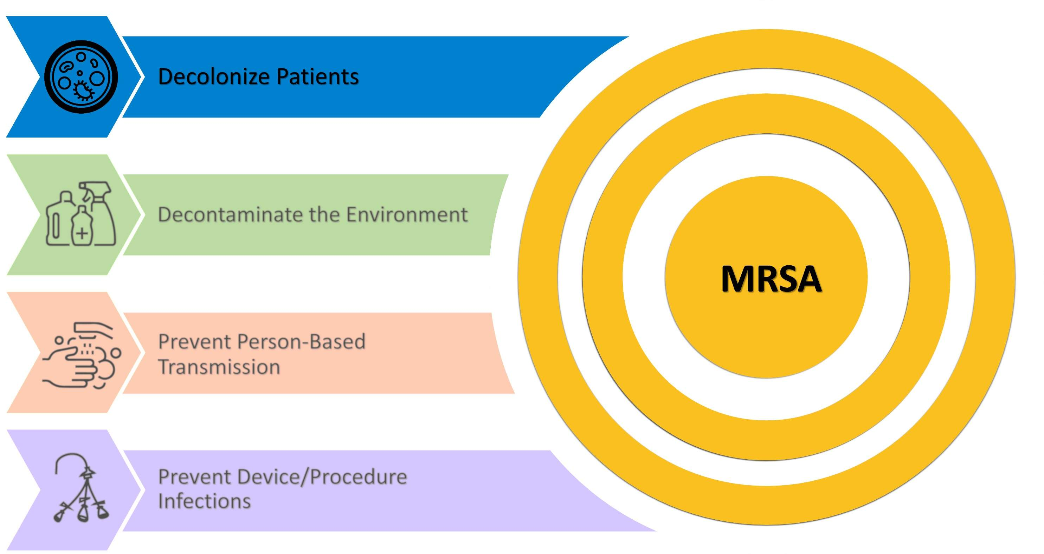
Four Key Strategies to Prevent MRSA

Slide 4

Decolonizing Patients
Colonization is defined as carriage of bacteria on or in the body without any current signs or symptoms of infection.
  About 1 in 3 of the general population is colonized with S. aureus.¹
Hospitalized patients are more vulnerable to infection and transmission.
Decolonization refers to the process of reducing or suppressing the number of bacteria from the body.
  Decolonization reduces risk of colonization progressing to infection and being transmitted to other patients.

Slide 5
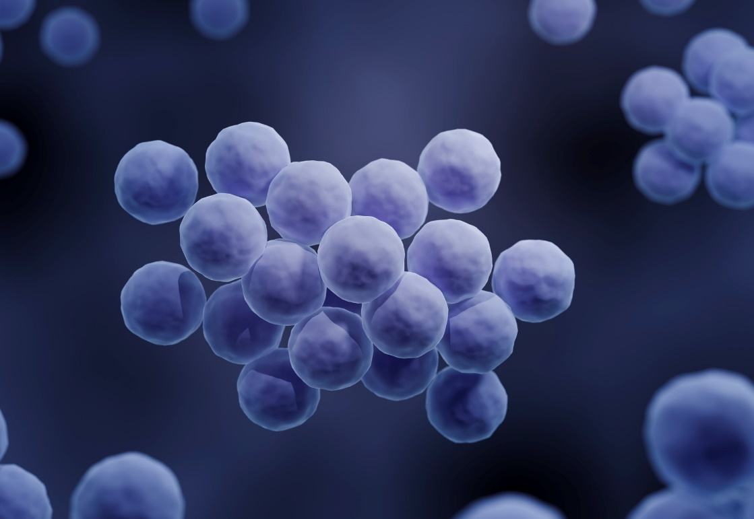
Prevalence of S. aureus^{2,3}
S. aureus causes 120,000 bloodstream infections (BSI) per year.²
Causes 20,000 associated deaths per year.²
S. aureus is the second most common causative pathogen (11.3 percent) among all healthcare-associated infections (HAIs).³
  Central line-associated bloodstream infections (CLABSI):
  Most common pathogen in non-ICUs;
  5th most common in ICUs³
  Ventilator-associated pneumonia (VAP):
  Most common pathogen in ICUs (29.6 percent); 2nd most common in non-ICUs³
  Surgical site infections (SSIs):
  Most common pathogen (15.4 percent)³

Slide 6
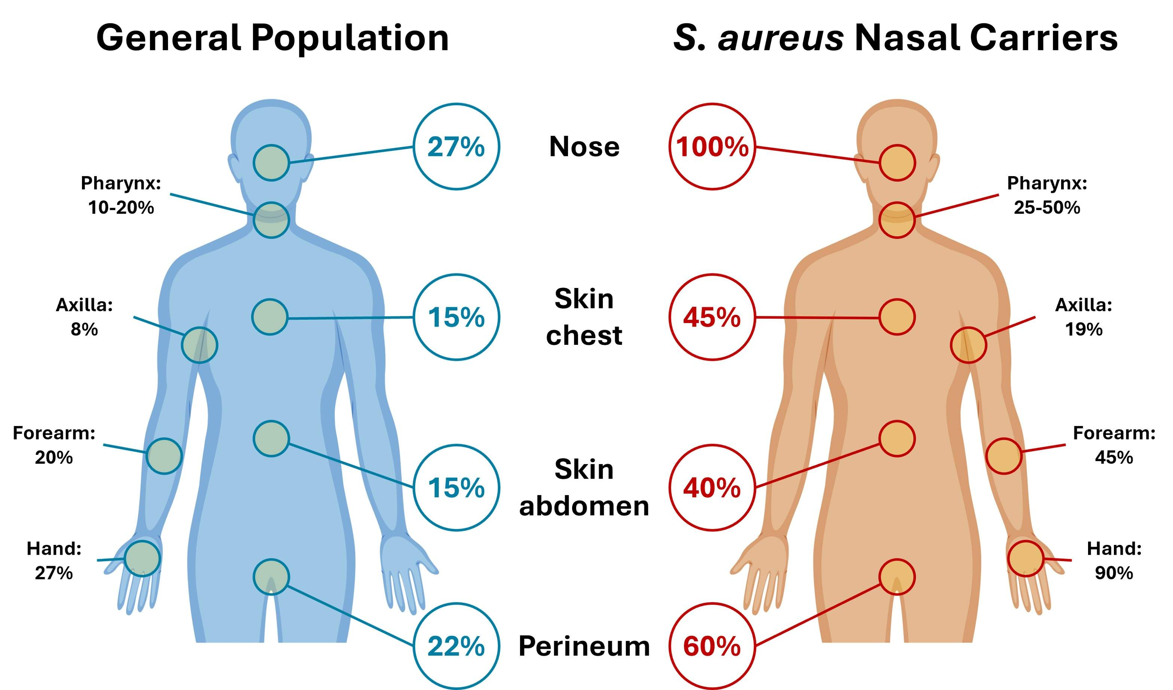
S. aureus Colonization Patterns⁴

Slide 7
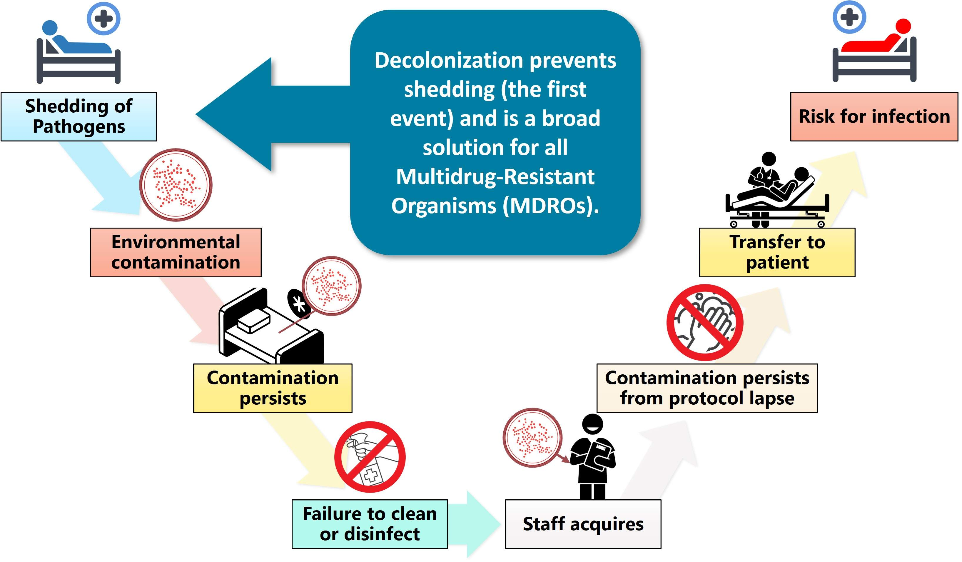
Decolonization Prevents a Cascade of Unfortunate Events

Slide 8
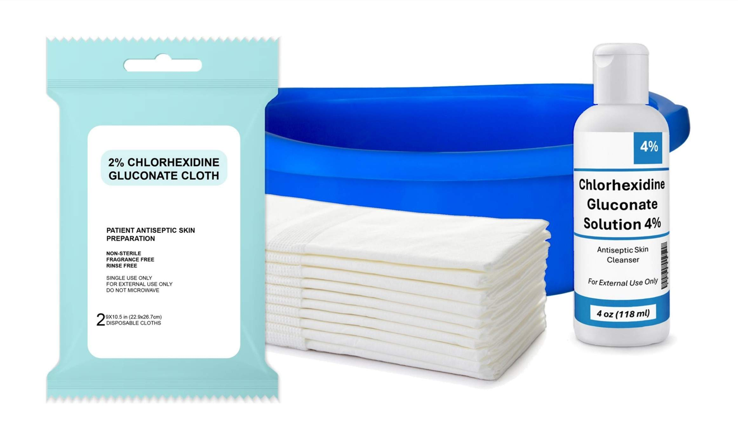
The Evidence for Decolonization
The Effect of Chlorhexidine Gluconate (CHG) Bathing

Slide 9
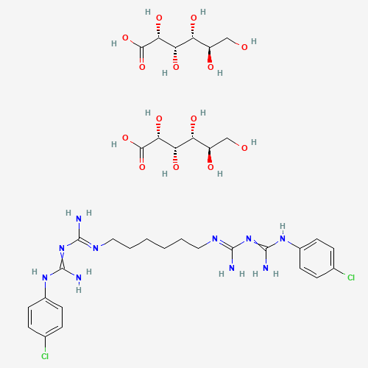
Chlorhexidine Gluconate (CHG)⁵
Discovered in the early 1950s by a UK chemical company
Cationic antiseptic that disrupts cell membranes
Properties
Binds to skin proteins, broadly active
Provides germicidal kill for up to 24 hours
Safe as mouth rinse, soap, shampoo
Common preparations
  0.12 percent mouthwash
  2 percent no-rinse skin antiseptic
  4 percent rinse-off skin antiseptic
Chlorhexidine Gluconate
PubChem Identifier: CID 29089
URL: https://pubchem.ncbi.nlm.nih.gov/compound/29089#section=2D-Structure

Slide 10
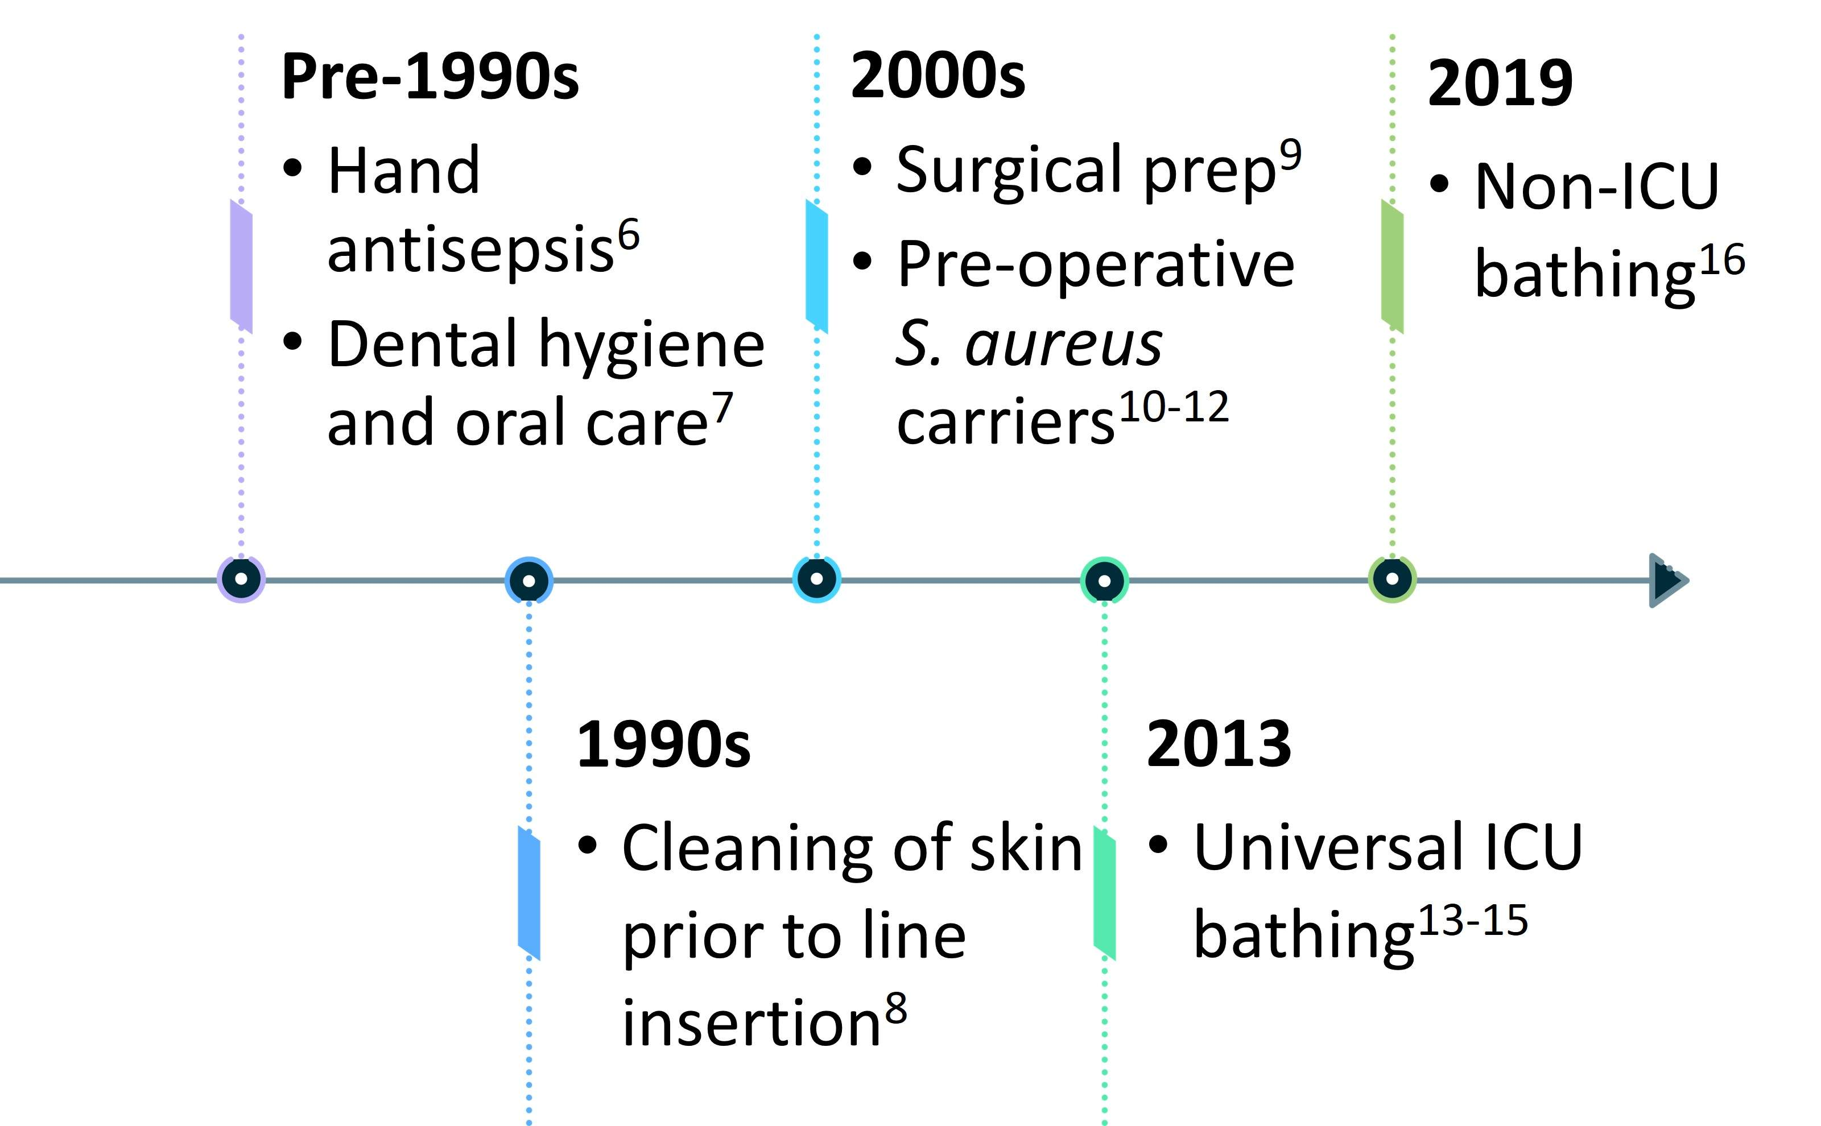
Uses for CHG in Healthcare

Slide 11
Decolonization Trials
Targeted Prevention
  Recurrent S. aureus infections¹⁷
  Pre-operative S. aureus carriers^{10,12,18}
  Post-discharge¹⁹
Universal Prevention
  ICU^{13-15,20}
  Non-ICU¹⁶
  Nursing homes²¹

Slide 12
Decolonization Evidence Summary
Author | Study Year | Study Type | Hospitals (#) | Units (#) | N | Findings | Publication
Vernon²² | 10/2002-12/2003 | Obs | 1 | 1 (ICU) | 1,787 | 65 percent less Vancomycin-resistant enterococci (VRE) acquisition 40-70 percent less VRE on skin, healthcare worker’s hands, environment | Arch Int Med 2006;166:306-12
Climo²³ | 12/2004-1/2006 | Obs | 4 | 6 (ICU) | 5,293 | 66 percent less VRE BSI 32 percent less MRSA acquisition 50 percent less VRE acquisition | Crit Care Med 2009, 37:1858-65
Bleasdale²⁴ | 12/2005-6/2006 | Obs | 1 | 2 (ICU) | 836 | 61 percent less primary BSI | Arch Int Med 2007; 167(19):2073-9
Popovich²⁵ | 9/2004-10/2006 | Obs | 1 | 1 (ICU) | 3,816 | 87 percent less CLABSI 41 percent less blood contaminants | ICHE 2009; 30(10):959-63
Climo¹³ | 8/2007-2/2009 | Cluster RCT | 6 | 9 (ICU) | 7,727 | 23 percent less MRSA/VRE acquisition | N Engl J Med 2013; 368:533-42
Milstone¹⁵ | 2/2008-9/2010 | Cluster RCT | 5 | 10 (ICU) | 4,947 | 36 percent total BSI (as treated) | Lancet 2013; 381(9872):1099-106
Huang¹⁴ | 1/2009-9/2011 | Cluster RCT | 43 | 74 (ICU) | 122,646 | 37 percent less MRSA clinical cultures 44 percent less all-cause BSI | N Engl J Med 2013; 368:2255-65
Huang¹⁶ | 3/2013-2/2016 | Cluster RCT | 53 | 194 (Non-ICU) | 528,983 | General population – no difference. Patients w/medical devices – 31 percent reduction in all-cause bacteremia and 37 percent reduction in MRSA or VRE clinical cultures when compared to control | Lancet 2019; 393(10177):1205-15
*Obs: Observation
Cluster RCT: Cluster Randomized Controlled Trial

Slide 13
Vernon et al., 2006: CHG Bathing in the ICU²²
Single center 3-phase study in a MICU, 2002-2003
  First phase: 5 months bathing with soap and water
  Second phase: 5 months bathing with 2 percent CHG cloths
  Third phase: 5 months bathing with non-medicated cloths
Data gathered via cultures of patient rectal and skin sites, hands of healthcare workers, patient environment
Primary outcome: Acquisition of VRE
Results: Compared with soap and water, bathing with CHG led to decrease in VRE on patient skin, healthcare personnel’s hands, and in the environment.

Slide 14
Popovich et al., 2009 and 2012:
Bioburden on Skin By Cleansing Method^{25,26}
Popovich 2009:
  Pre-post study in an ICU (2004 to 2006)
  Compared daily bathing with soap and water with daily 2 percent CHG cloths
  Results: 87 percent reduction in CLABSI and 41 percent decrease in blood culture contamination
Popovich 2012:
  Study conducted in same ICU as previous study (2007)
  Compared three methods of daily bathing: Soap and water, 2 percent CHG cloths, and non-medicated cloths
  Results: CHG cloths had significantly reduced concentrations of VRE, gram-positive and -negative bacteria, and yeast on the skin, compared to the other methods.

Slide 15
Bleasdale et al., 2007: CHG and CLABSI²⁴
Single center, 52-week, 2-arm crossover clinical trial in two ICUs
  Compared 2 percent CHG cloths versus soap and water for daily bathing
Main outcome: Incidence of BSI and clinical sepsis
Results:
  Reduction in CLABSI with CHG bathing
  Bacterial colonization on skin reduced

Slide 16
Three Decolonization Trials in 2013
Three major decolonization trials published results in 2013.
  Climo et al. (2007 to 2009)¹³: 9 adult ICUs in 6 academic medical centers
  Huang et al. (2009 to 2011)¹⁴: 74 adult ICUs in 43 hospitals, including community hospitals
  Milstone et al. (2008 to 2010)¹⁵: 10 pediatric ICUs in 5 hospitals

Slide 17
Climo et al., 2013: Effect of Daily CHG Bathing on Hospital-Acquired Infection¹³
August 2007 to February 2009
Cluster randomized cross-over trial in 9 adult ICUs at 6 hospitals
Evaluated daily baths with CHG cloths (intervention) versus daily baths with non-antimicrobial washcloths (control)
  Each ICU received 6 months of each protocol
Outcomes:
  Composite outcome of MRSA and VRE acquisition
  All-cause bloodstream infections (BSI)

Slide 18
Climo et al., 2013: Results¹³
7,735 patients
Overall MDRO acquisition rate reduced by 21 percent
MRSA or VRE acquisition rate reduced by 23 percent
All-cause BSI rate reduced by 31 percent
  CLABSI rate reduced by 53 percent
No evidence of CHG resistance

Slide 19
Huang et al., 2013: REDUCE MRSA Trial¹⁴
Cluster randomized 43 hospitals (74 adult ICUS)
  74,256 patients and 282,803 ICU patient-days
Arm 1: Routine Care
  All patients screened
  Contact precautions for known MRSA-positive patients
Arm 2: Targeted Decolonization
  All patients screened
  Contact precautions for known MRSA-positive patients
  MRSA-positive patients decolonized (5 days CHG, 5 days mupirocin)
Arm 3: Universal Decolonization
  No screening
  Contact precautions for known MRSA-positive patients
  All patients decolonized (CHG for duration of stay, 5 days mupirocin)

Slide 20
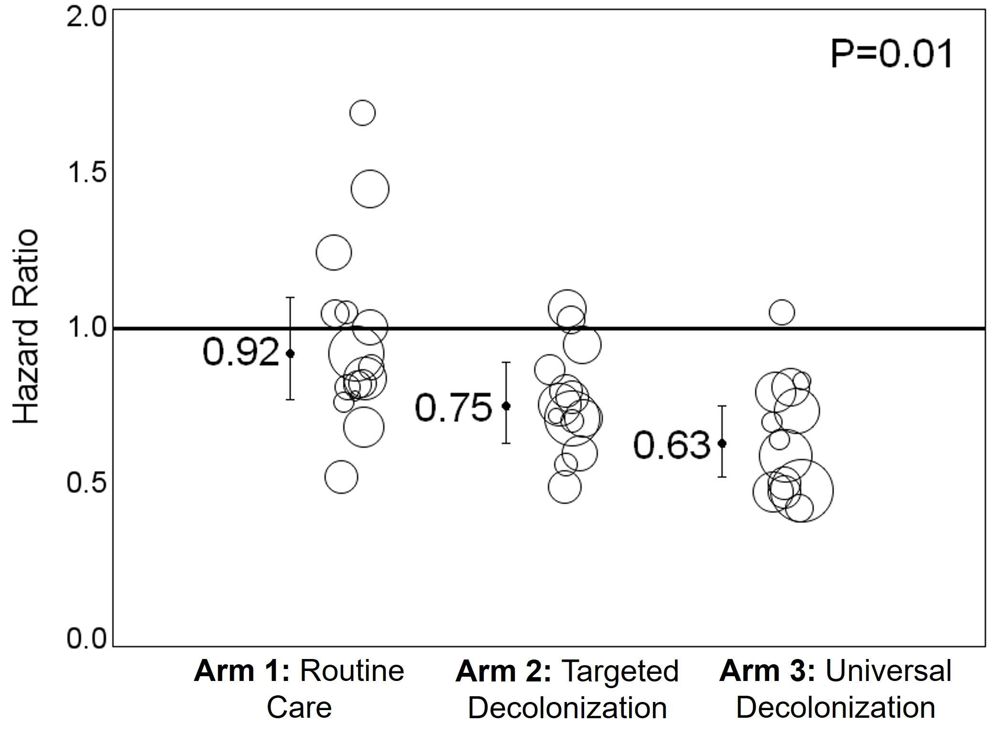
REDUCE MRSA Results: MRSA Cultures¹⁴
Primary outcome: MRSA-positive clinical cultures
Hazard Ratio: Ratio of a hospital’s intervention to their own baseline
  Hazard ratio < 1: Reduced risk compared to baseline
Arm 3: 37 percent reduction in MRSA cultures
Overall: P=0.01
Arm 2 vs. 1: P=0.09
Arm 3 vs. 2: P=0.16
Arm 3 vs. 1: P<0.003
From The New England Journal of Medicine, Huang SS, Septimus E, Kleinman K et al., Targeted versus universal decolonization to prevent ICU infection, Volume 368, Issue 24, Page 2255-65. Copyright © 2013 Massachusetts Medical Society. Reprinted with permission from Massachusetts Medical Society.

Slide 21
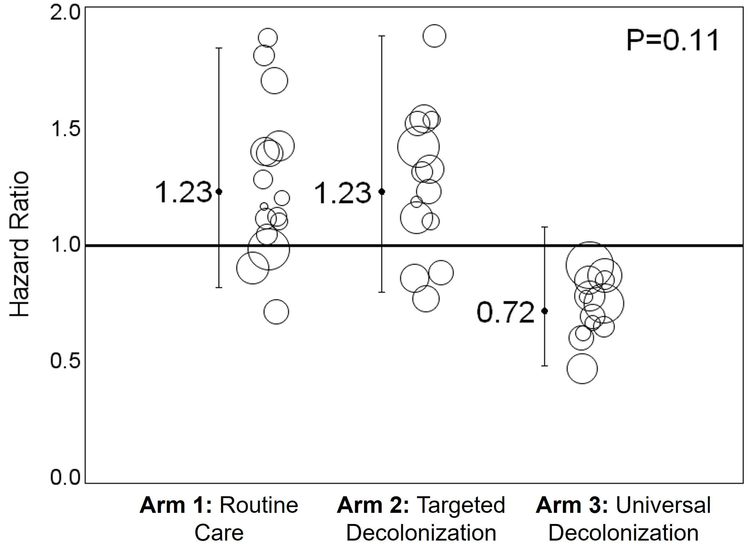
REDUCE MRSA Results: MRSA BSI¹⁴
Outcome: MRSA bloodstream infections
Arm 3 showed a reduction that was not statistically significant compared with Arms 1 and 2.
Only Arm 3 showed any improvement.
Results were similar for Arm 1 and Arm 2, indicating a limitation of targeted decolonization.
Suggests nasal screening may be insufficient to detect all MRSA carriers.
From The New England Journal of Medicine, Huang SS, Septimus E, Kleinman K et al., Targeted versus universal decolonization to prevent ICU infection, Volume 368, Issue 24, Page 2255-65. Copyright © 2013 Massachusetts Medical Society. Reprinted with permission from Massachusetts Medical Society.

Slide 22
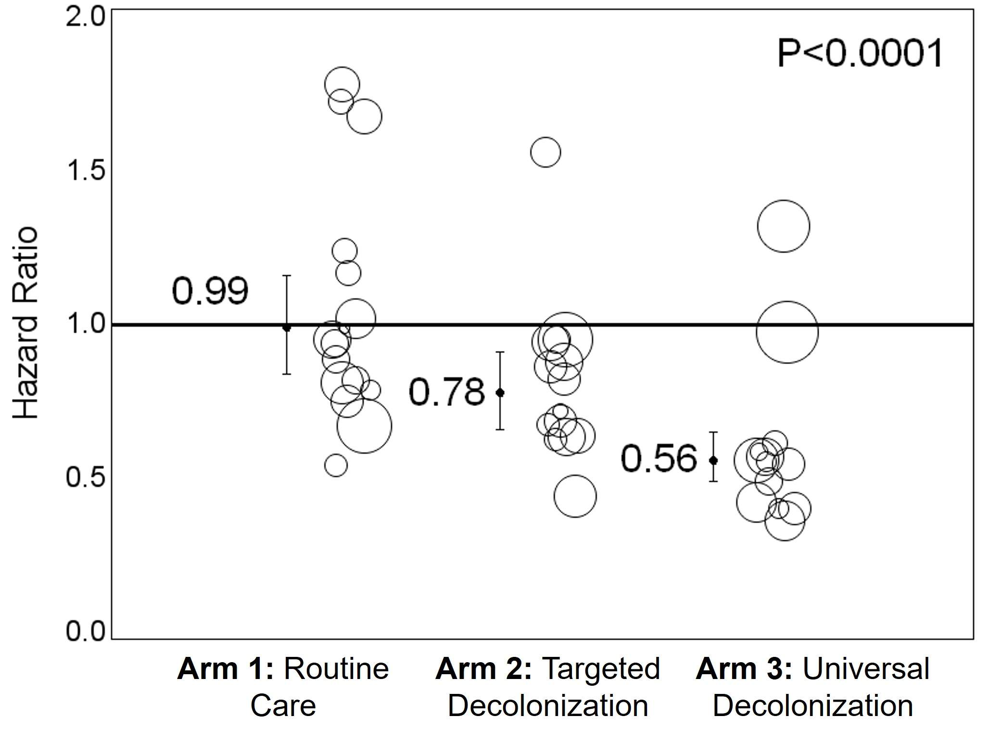
REDUCE MRSA Results: All-Pathogen BSI¹⁴
Outcome: All-pathogen bloodstream infections
Arm 3 had a 44 percent reduction in all-pathogen BSI compared to Arm 1.
Overall: P<0.0001
Arm 2 vs. 1: P=0.04
Arm 3 vs. 2: P=0.003
Arm 3 vs. 1: P<0.0001
From The New England Journal of Medicine, Huang SS, Septimus E, Kleinman K et al., Targeted versus universal decolonization to prevent ICU infection, Volume 368, Issue 24, Page 2255-65. Copyright © 2013 Massachusetts Medical Society. Reprinted with permission from Massachusetts Medical Society.

Slide 23
REDUCE MRSA Results:
Cost Savings of Universal ICU Decolonization¹⁴
Universal ICU decolonization is the most cost-effective of the three strategies.
Lower intervention costs due to not screening
  Decolonization costs more than offset by savings from not screening
  $17K lower than screening and precautions (per 1,000 ICU admissions)
  $21K lower than targeted decolonization
Lower overall costs when accounting for infections prevented
  Reduction of 5 MRSA clinical cultures and 9 bloodstream infections (per 1,000 ICU admissions)
  $171K lower than screening and precautions
  $100K lower than targeted decolonization

Slide 24
REDUCE MRSA Results:
Additional Decolonization Impact
Additional benefits from subsequent analysis:
  Reduction of blood culture contamination²⁷
  Reduction of bacteriuria and candiduria in men²⁸
  No emergence of CHG or mupirocin resistance in trial²⁹
  CLABSI benefit seen with rapid adoption in 95 other hospitals³⁰
Per a 2021 survey, 63 percent of US hospitals have now adopted universal CHG bathing in the ICU.²⁰

Slide 25
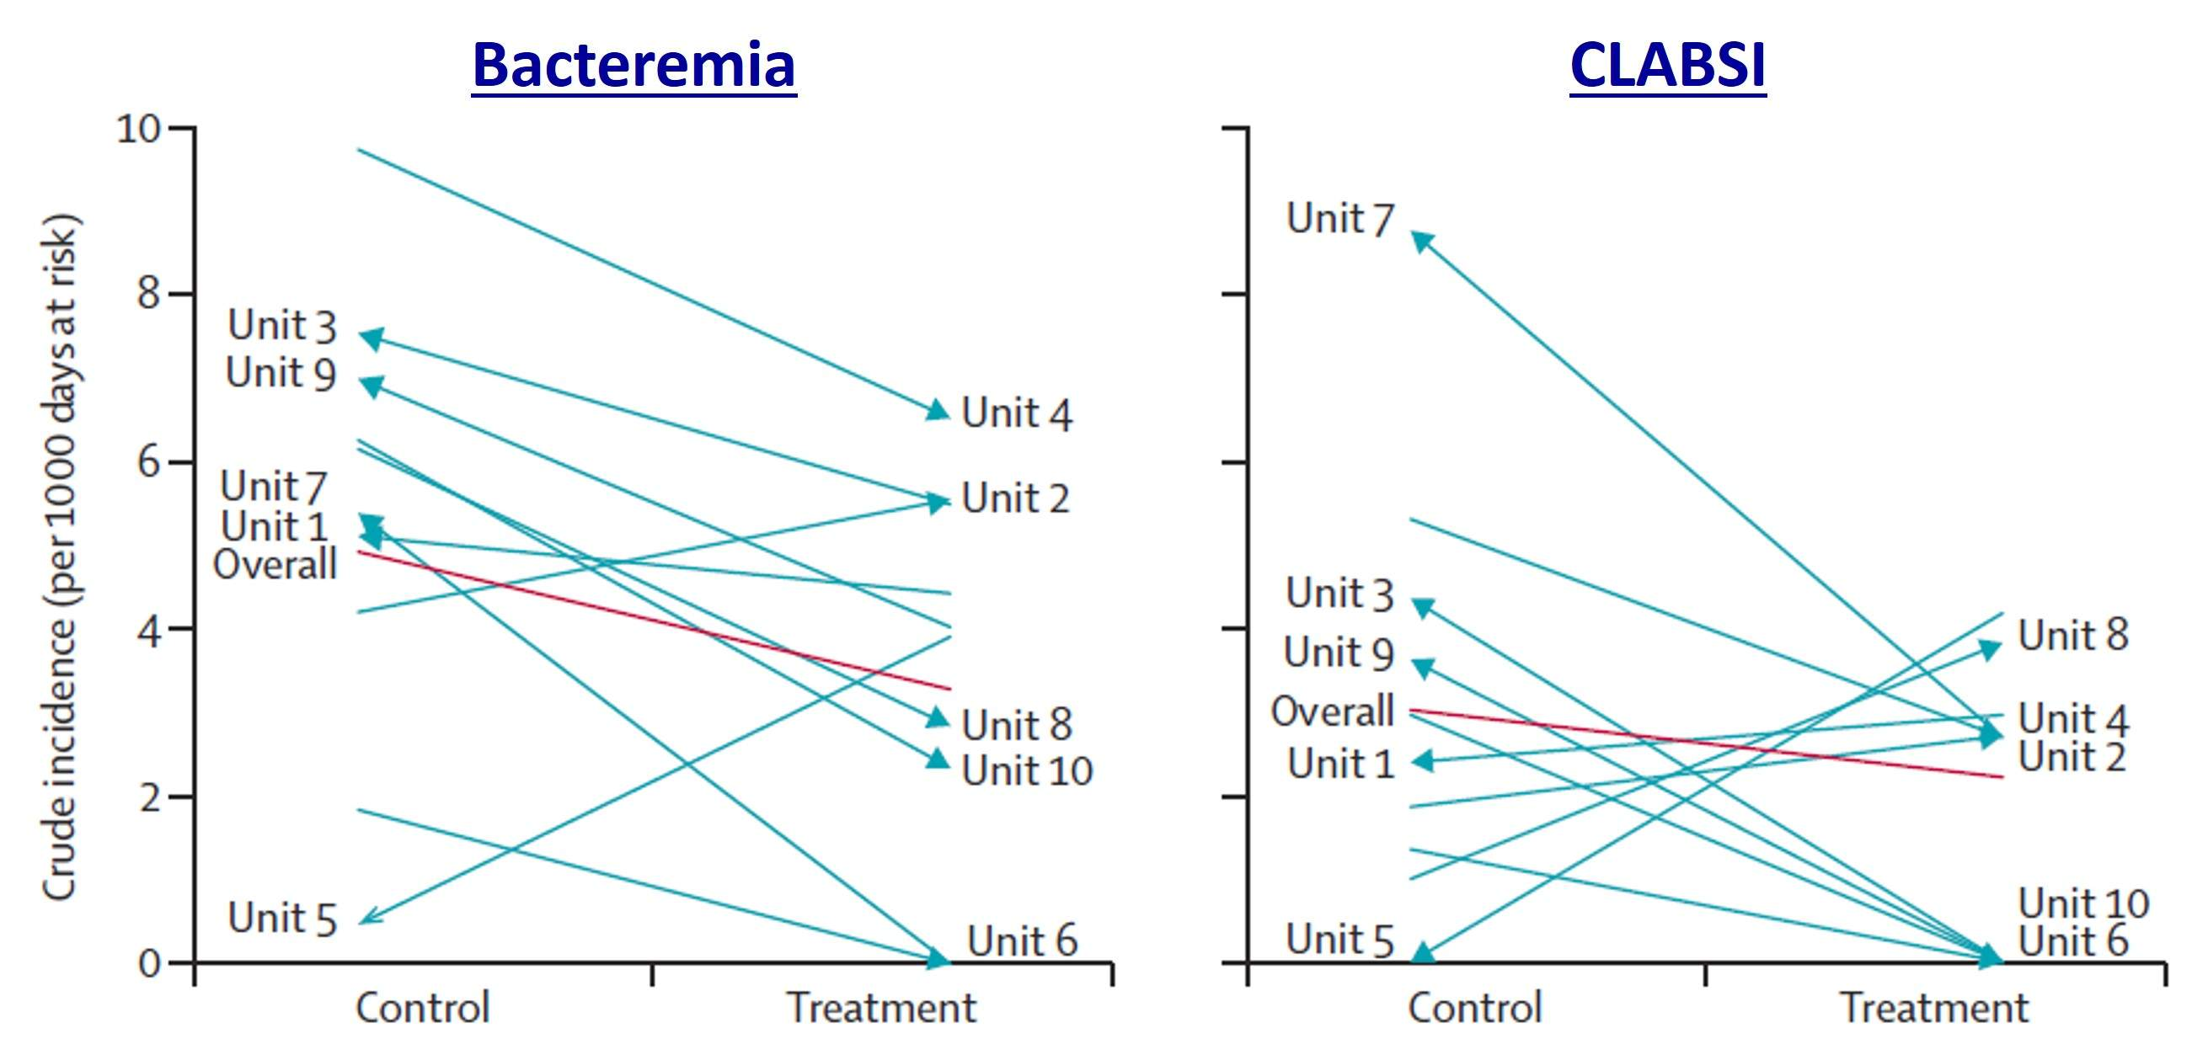
Milstone et al., 2013: Pediatric SCRUB Trial¹⁵
Randomized cross-over trial of universal CHG in 10 pediatric ICUs
  Over 4,900 patients
36 percent reduction in bacteremia compared to normal bathing
  Did not evaluate MRSA specifically
Used with permission of Elsevier Science & Technology Journals, from “Daily chlorhexidine bathing to reduce bacteraemia in critically ill children: a multicentre, cluster-randomised, crossover trial” by Milstone AM, Elward A, Song X et al. in The Lancet, Volume 381, Issue 9872, 2013; permission conveyed through Copyright Clearance Center, Inc.

Slide 26
Decolonization in the Non-ICU Setting:
ABATE Infection Trial¹⁶
Cluster-randomized trial of 53 hospitals and 194 adult non-ICUs
  Included adult medical/surgical, step down, oncology units
  Nearly 340,000 patients and over 1.3 million patient-days in intervention
Arm 1: Routine Care
  Routine policy for showering and bathing with standard soap
Arm 2: Decolonization
  Daily 4 percent rinse-off CHG shower or 2 percent leave-on CHG bed bath
  Twice-daily mupirocin for 5 days for patients who are MRSA-positive by history, culture, or screening
Study Outcomes
  Primary: Combined MRSA or VRE clinical cultures attributable to unit
  Secondary: All-pathogen bloodstream infections

Slide 27
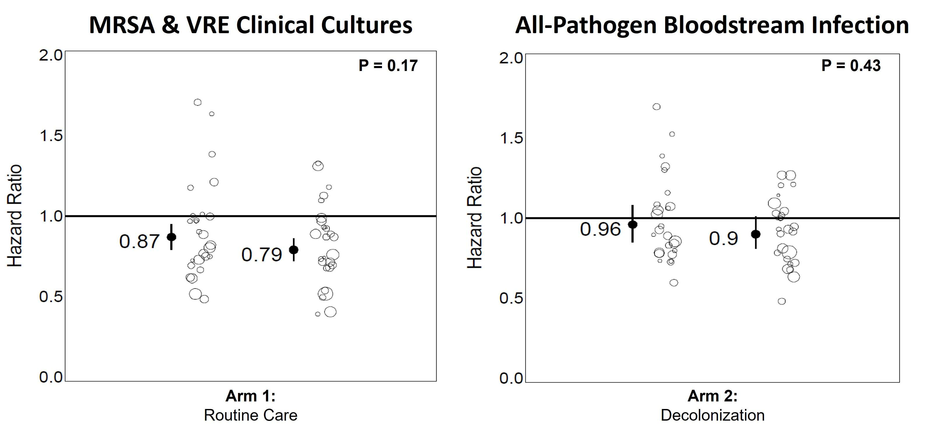
ABATE Trial: Results¹⁶
No significant difference between arms
Used with permission of Elsevier Science & Technology Journals, from “Chlorhexidine versus routine bathing to prevent multidrug-resistant organisms and all-cause bloodstream infections in general medical and surgical units (ABATE Infection trial): a cluster-randomised trial” by Huang SS, Septimus E, Kleinman K et al., in The Lancet, Volume 393, Issue 10177, 2019]; permission conveyed through Copyright Clearance Center, Inc.

Slide 28
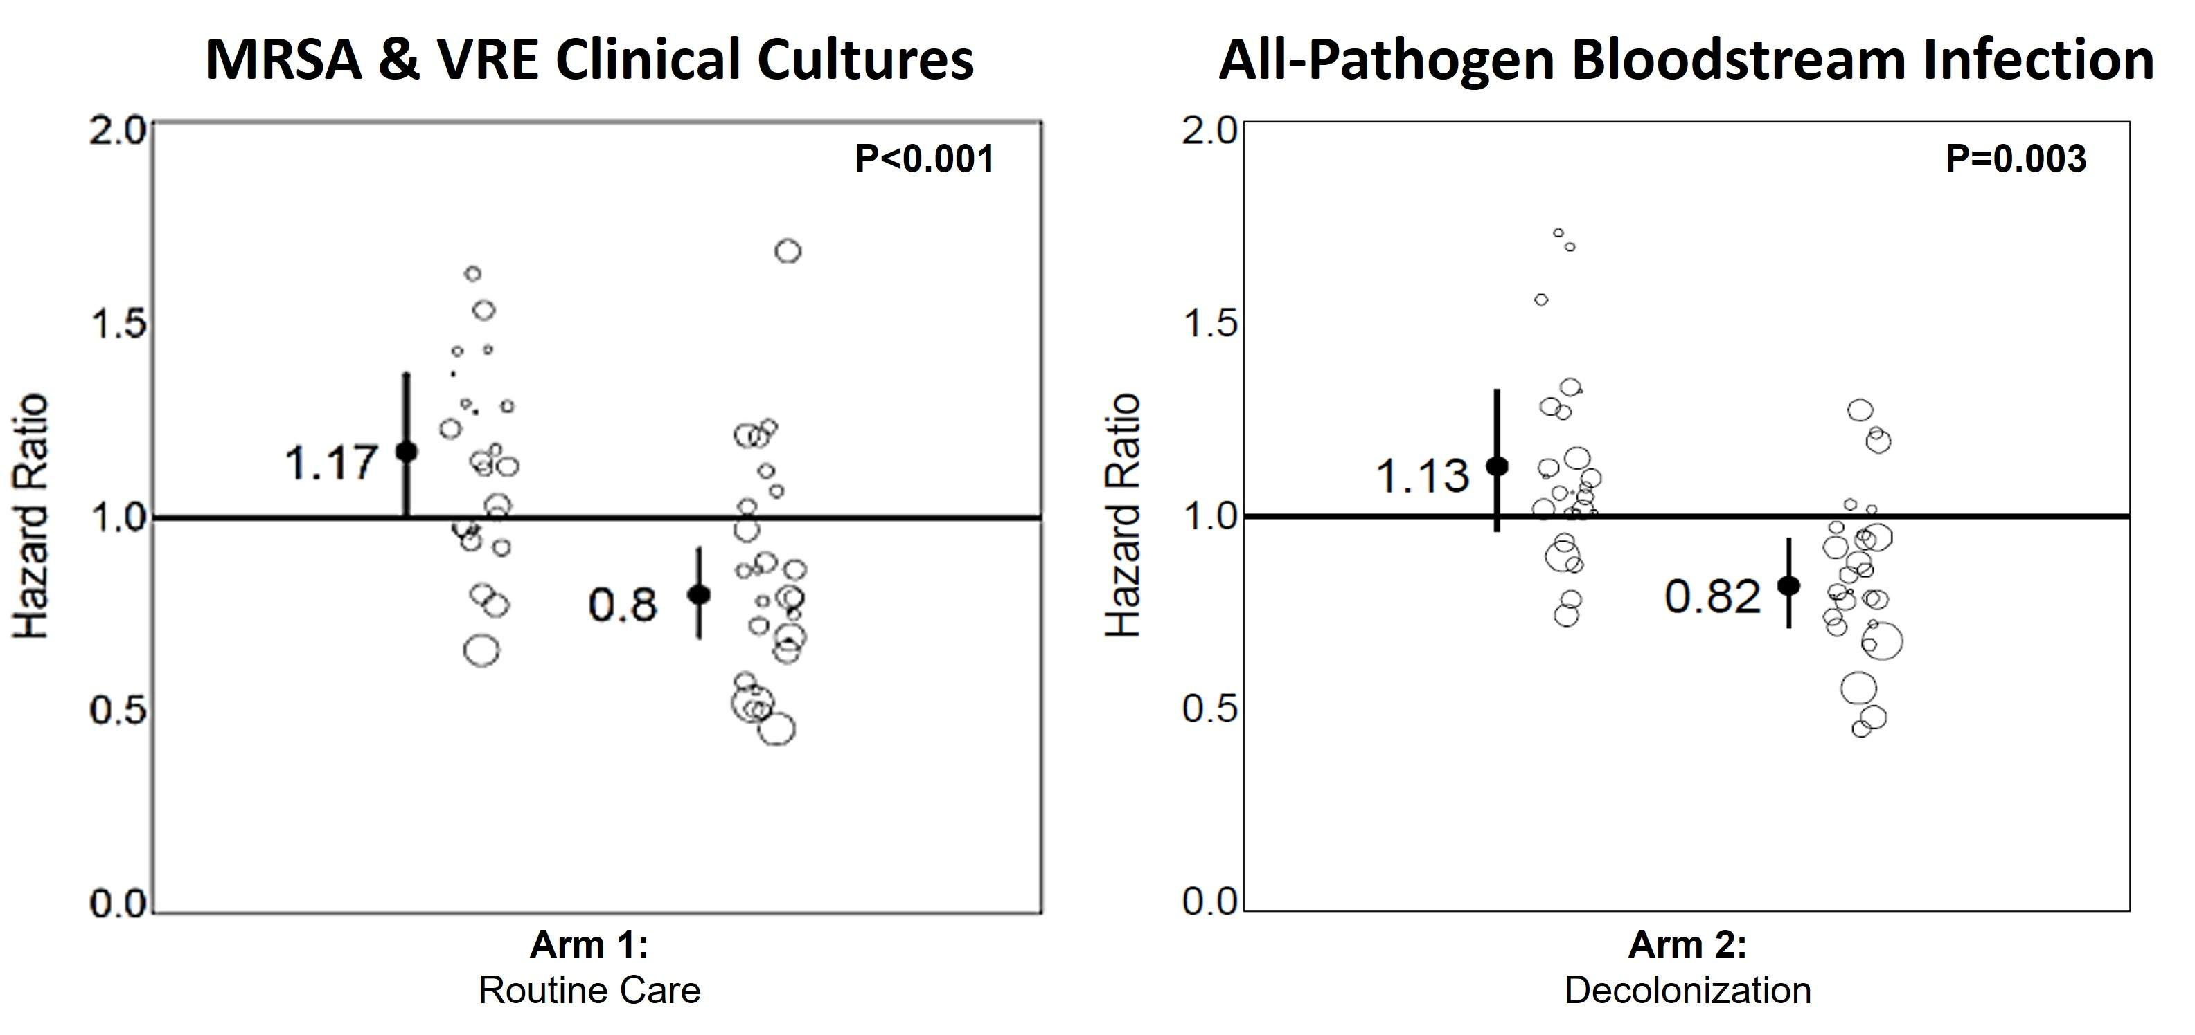
ABATE Trial: Patients With Devices¹⁶
Subpopulation analysis of patients with central lines, midlines, and lumbar drains
  37 percent reduction in MRSA and VRE cultures
  31 percent reduction in bloodstream infections
Used with permission of Elsevier Science & Technology Journals, from “Chlorhexidine versus routine bathing to prevent multidrug-resistant organisms and all-cause bloodstream infections in general medical and surgical units (ABATE Infection trial): a cluster-randomised trial” by Huang SS, Septimus E, Kleinman K et al., in The Lancet, Volume 393, Issue 10177, 2019]; permission conveyed through Copyright Clearance Center, Inc.

Slide 29
Decolonization in Non-ICUs¹⁶
No benefit in overall non-ICU population
  Lower infection risk and smaller effect size than ICUs
Significant benefit in patients with lines and devices
  37 percent reduction in MRSA and VRE clinical cultures
  32 percent reduction in all-cause bloodstream infections
Represents a higher risk population
  Patients with devices were 10 percent of population
  Accounted for 37 percent of all MRSA and VRE cultures and 57 percent of bloodstream infections

Slide 30

The Evidence for Nasal Decolonization
Importance and Impact of Nasal Decolonization

Slide 31
S. aureus Nasal Carriage Confers Disease Risk
Most S. aureus infections are from endogenous strains.
80 percent of infecting strains match nasal strains.³¹
  84.6 percent of surgical site infections¹⁰
  82 percent of bactermia³²
Repeat discrete S. aureus infections³³
  76 percent identical strains (additional 12 percent highly related)
  74 percent match nasal strains

Slide 32
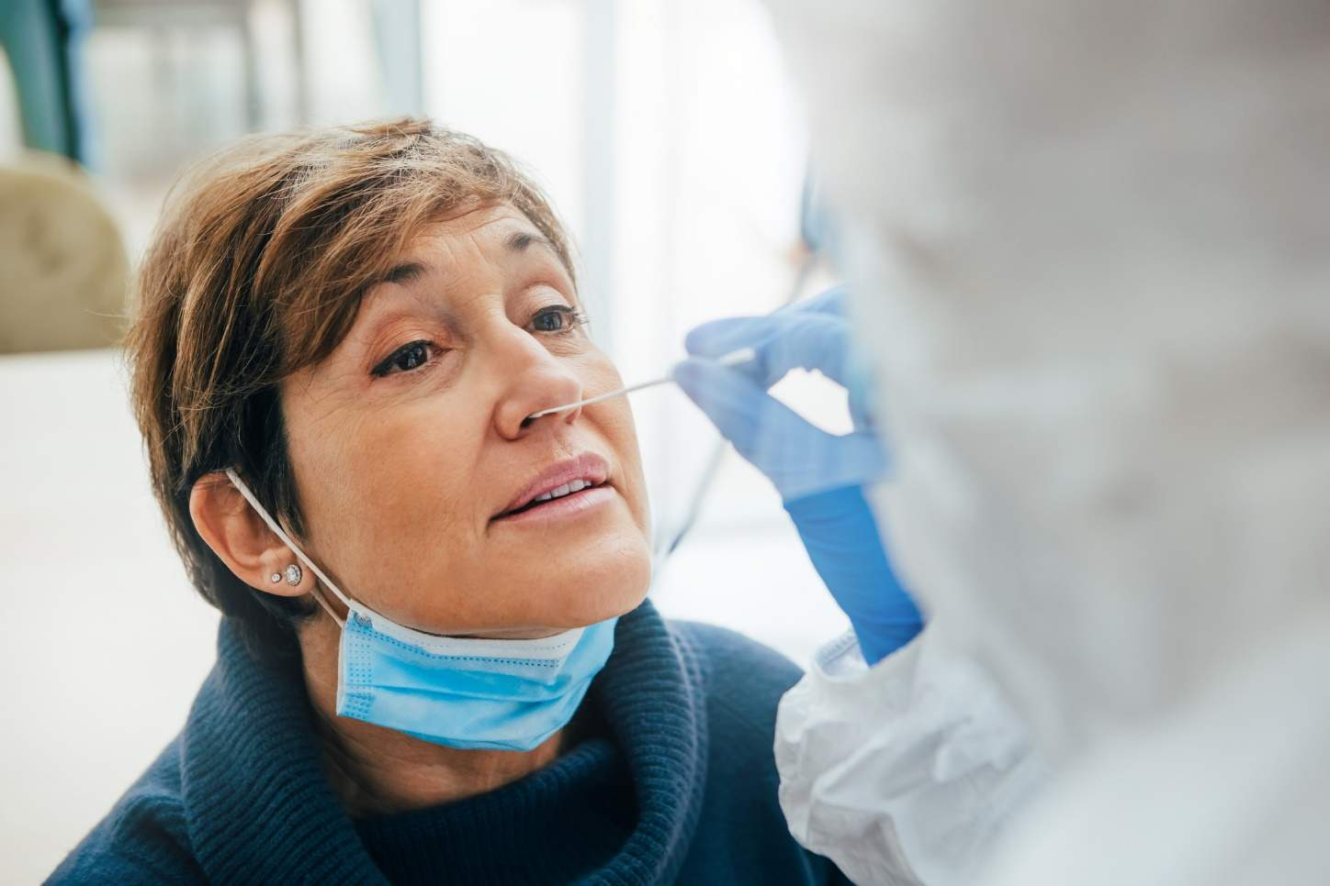
Mupirocin Alone Reduces Infection
Cochrane Review by van Rijen et al., 2008 showed 45 percent decrease in healthcare-acquired MRSA infection among treated carriers³⁴
Confirmed by separate systematic review by Ammerlaan et al., 2009³⁵

Slide 33
Harbarth et al., 1999:
CHG With and Without Mupirocin³⁶
98 MRSA-colonized inpatients received daily CHG bathing
Randomized to also receive 5 days of mupirocin or 5 days of placebo
Cultured at 12, 19, and 26 days after start of therapy
Study was too small to be sufficiently powered
 | CHG + Mupirocin | CHG + Placebo | P-value
Nares cleared | 44 percent | 25 percent | 0.06
All body sites cleared | 25 percent | 18 percent | 0.4
MRSA infection | 6 percent | 14 percent | 0.32

Slide 34
Fritz et al., 2011:
Mupirocin for Eradicating S. aureus Carriage³⁷
Compared decolonization methods in clearing S. aureus carriage among outpatients
300 children (64 percent) and adults (36 percent)
Randomly assigned to four different arms:
  Education only
  Mupirocin (twice daily for 5 days) only
  Mupirocin and 4 percent CHG body rinse for 5 days
  Mupirocin and dilute bleach baths for 5 days
Outcomes included eradication of S. aureus at 1 month and at 4 months

Slide 35
Fritz et al., 2011: Results³⁷
Mupirocin is the workhorse, not CHG.
Mupirocin + bleach is effective.
Arm | Clearance from all sites at 1 month | Nasal carriage at 4 months | Axilla carriage at 4 months | Inguinal carriage at 4 months | Clearance from all sites at 4 months
Education | 38 percent | 50 percent | 21 percent | 26 percent | 48 percent
Mupirocin | 56 percent | 23 percent | 15 percent | 24 percent | 56 percent
Mupirocin & CHG | 55 percent | 24 percent | 14 percent | 30 percent | 54 percent
Mupirocin & Bleach | 63 percent | 15 percent | 9 percent | 16 percent | 71 percent

Slide 36
Importance of Mupirocin²⁰
Mupirocin has been shown to be critical when targeting S. aureus reduction and decolonizing MRSA carriers.
Because the nose is the primary reservoir of S. aureus, clearing the nose is crucial.
CHG is effective at preventing MRSA transmission, but because it does not target the nose, its preventive benefit for colonized patients is limited.
Mupirocin is the most well-studied and most common nasal decolonization agent.

Slide 37
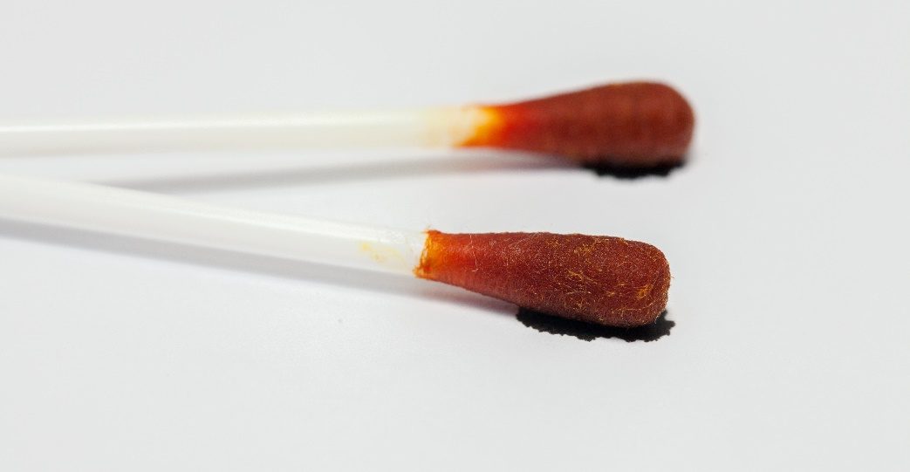
Nasal Iodophor
Trials have examined effectiveness of mupirocin versus iodophor.²⁰
Iodophor may be relevant as mupirocin-resistance rises.³⁸⁻⁴¹
  Iodophor is an antiseptic rather than antibiotic.
Does not require a prescription
Evidence that iodophor is better tolerated than mupirocin⁴²
However, iodophor does not have sustained effect on MRSA cultures⁴³
  Iodophor suppresses MRSA growth but does not eliminate organisms.

Slide 38
Huang et al., 2023: Mupirocin-Iodophor ICU Decolonization Swap Out Trial²⁰
Non-inferiority trial to assess effectiveness of iodophor versus mupirocin at universal decolonization
Cluster-randomized noninferiority trial with two arms:
  Mupirocin Arm: daily CHG + 5 days twice daily mupirocin
  Iodophor Arm: daily CHG + 5 days twice daily iodophor
137 hospitals, 233 adult ICUs
Study outcomes:
  S. aureus ICU-attributable clinical cultures (primary)
  MRSA clinical cultures
  All-cause bacteremia
  Emergence of resistance to mupirocin or iodophor

Slide 39
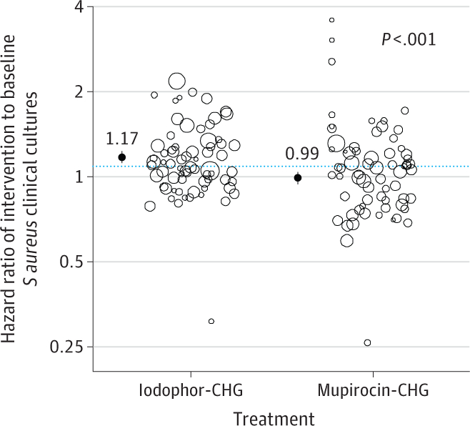
Swap Out Trial Results: S. aureus Cultures²⁰
As-Randomized Analysis:
Mupirocin superior to iodophor
18 percent fewer S. aureus cultures
P< 0.001
Reproduced with permission from JAMA. 2023. 330(14): 1337-1347. DOI: 10.1001/jama.2023.17219. Copyright © 2023 American Medical Association. All rights reserved, including those for text and data mining, AI training, and similar technologies. Link to original article.

Slide 40
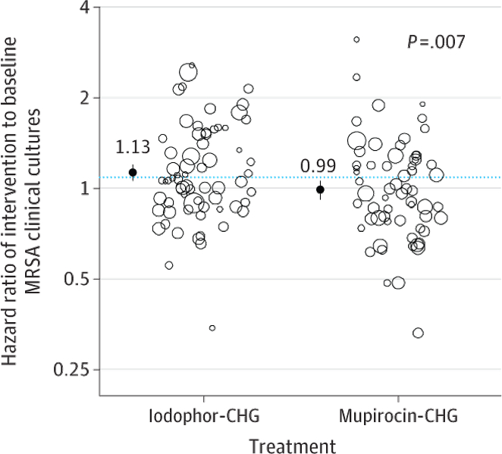
Swap Out Trial Results: MRSA Cultures²⁰
As-Randomized Analysis:
Mupirocin superior to iodophor
14 percent fewer MRSA cultures
P< 0.001
Reproduced with permission from JAMA. 2023. 330(14): 1337-1347. DOI: 10.1001/jama.2023.17219. Copyright © 2023 American Medical Association. All rights reserved, including those for text and data mining, AI training, and similar technologies. Link to original article.

Slide 41
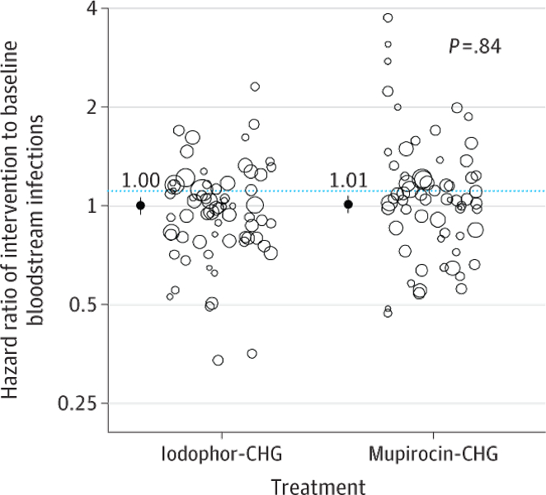
Swap Out Trial Results: All-Cause BSI²⁰
As-Randomized Analysis:
Iodophor non-inferior to mupirocin
P=0.7
Reproduced with permission from JAMA. 2023. 330(14): 1337-1347. DOI: 10.1001/jama.2023.17219. Copyright © 2023 American Medical Association. All rights reserved, including those for text and data mining, AI training, and similar technologies. Link to original article.

Slide 42
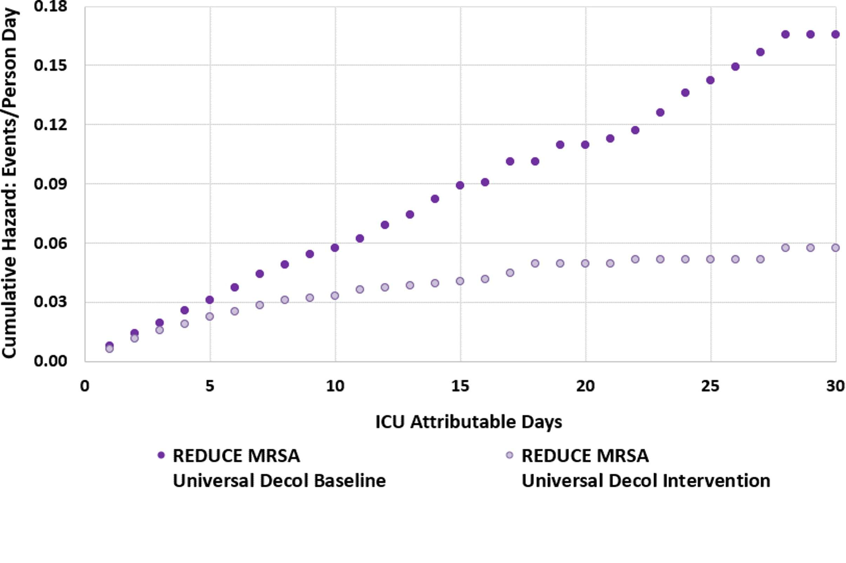
Examining Long-Term Resistance¹⁴
REDUCE MRSA Trial
Cumulative Hazard of S. aureus Clinical Cultures
Reproduced with permission from JAMA. 2023. 330(14): 1337-1347. DOI: 10.1001/jama.2023.17219. Copyright © 2023 American Medical Association. All rights reserved, including those for text and data mining, AI training, and similar technologies. Link to original article.

Slide 43
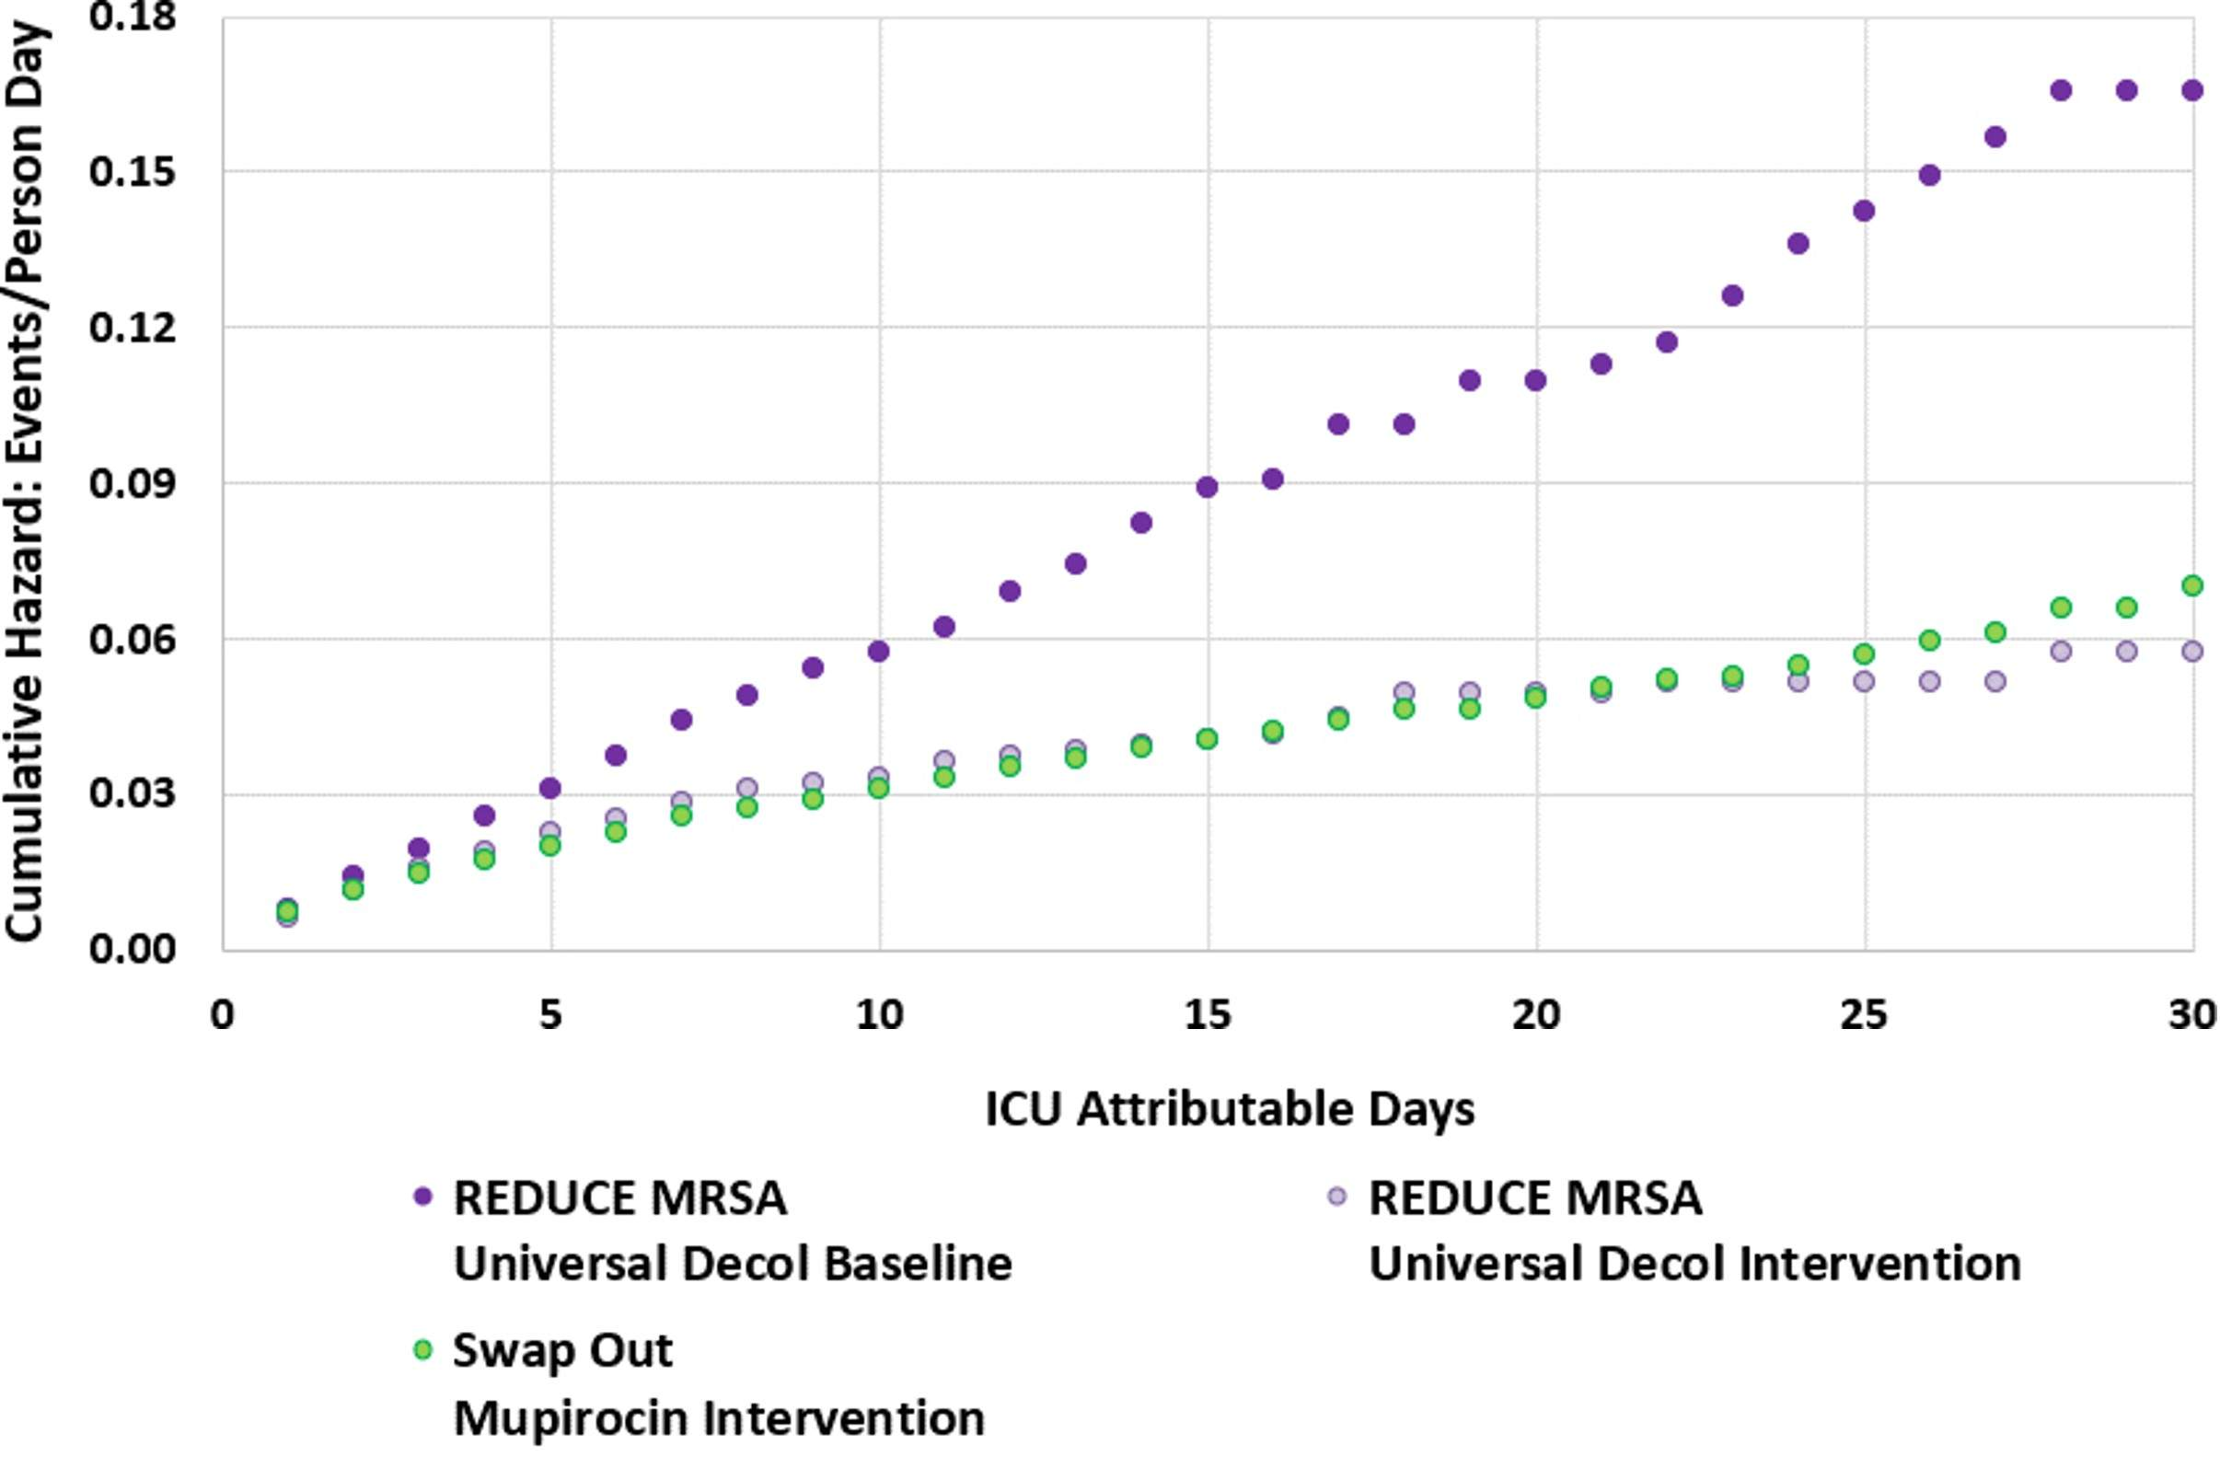
Long-Term Resistance: Comparing Results^{14,20}
REDUCE MRSA & Swap Out Trials
Cumulative Hazard of S. aureus Clinical Cultures
Reproduced with permission from JAMA. 2023. 330(14): 1337-1347. DOI: 10.1001/jama.2023.17219. Copyright © 2023 American Medical Association. All rights reserved, including those for text and data mining, AI training, and similar technologies. Link to original article.

Slide 44
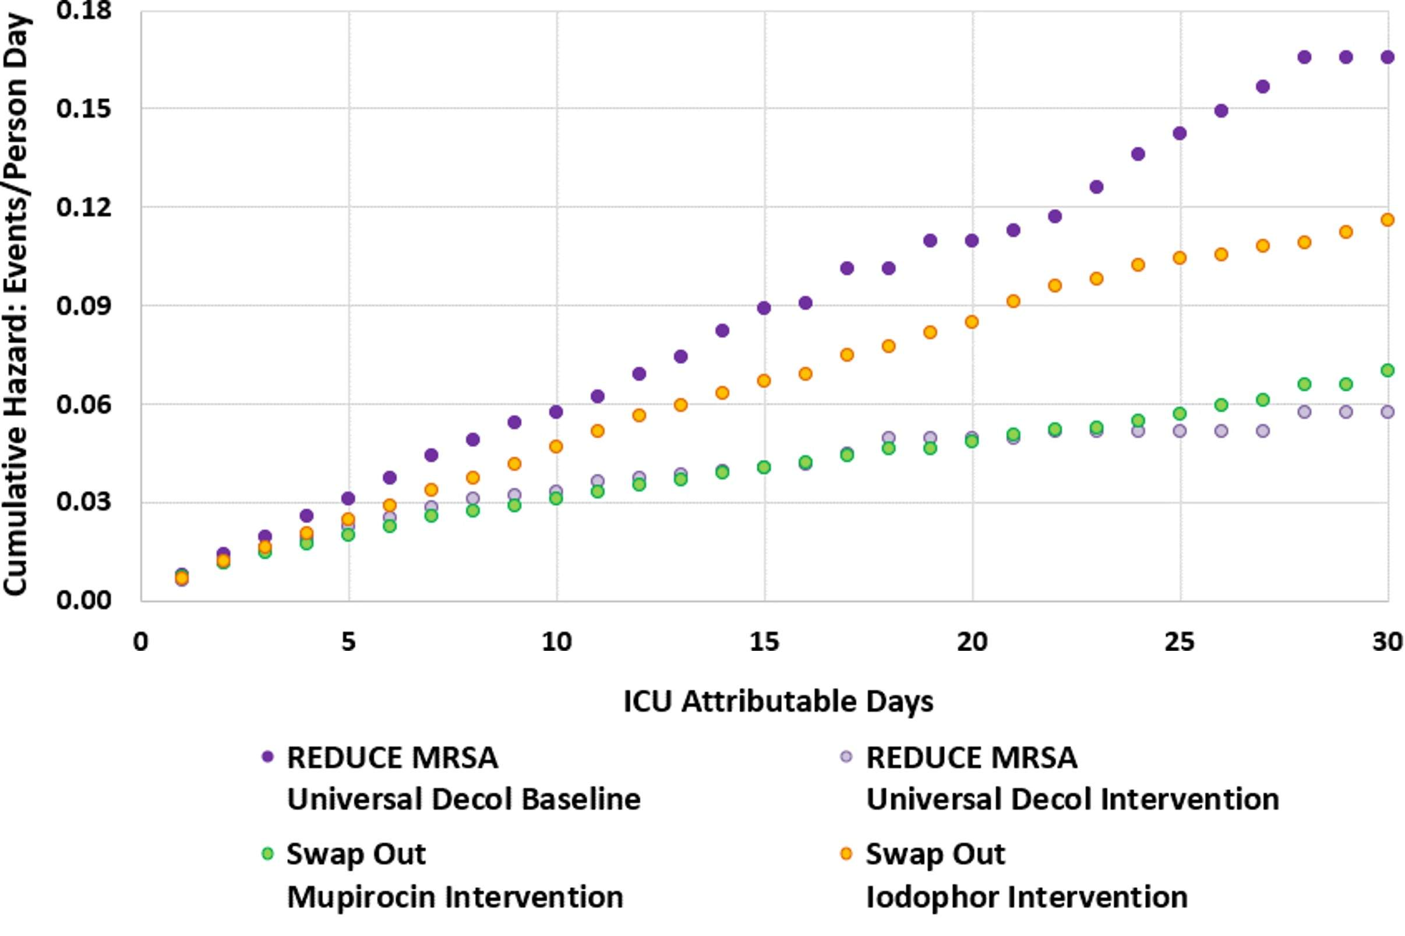
Comparing Results: Iodophor^{14,20}
REDUCE MRSA & Swap Out Trials
Cumulative Hazard of S. aureus Clinical Cultures
Reproduced with permission from JAMA. 2023. 330(14): 1337-1347. DOI: 10.1001/jama.2023.17219. Copyright © 2023 American Medical Association. All rights reserved, including those for text and data mining, AI training, and similar technologies. Link to original article.

Slide 45
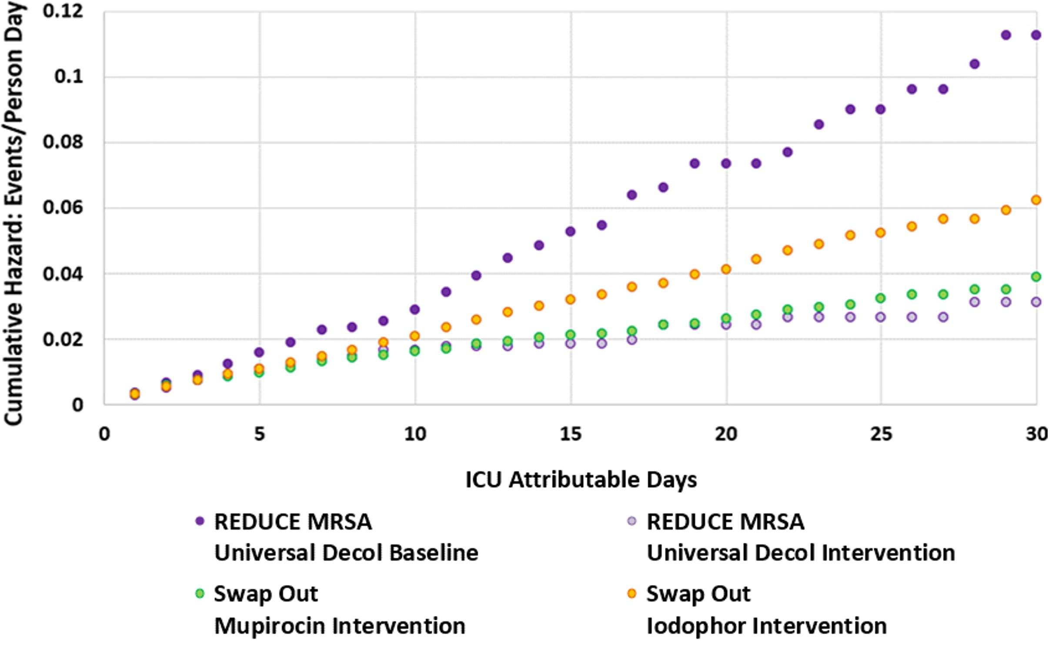
Comparing Results: MRSA Clinical Cultures^{14,20}
REDUCE MRSA & Swap Out Trials
Cumulative Hazard of MRSA Clinical Cultures
Reproduced with permission from JAMA. 2023. 330(14): 1337-1347. DOI: 10.1001/jama.2023.17219. Copyright © 2023 American Medical Association. All rights reserved, including those for text and data mining, AI training, and similar technologies. Link to original article.

Slide 46
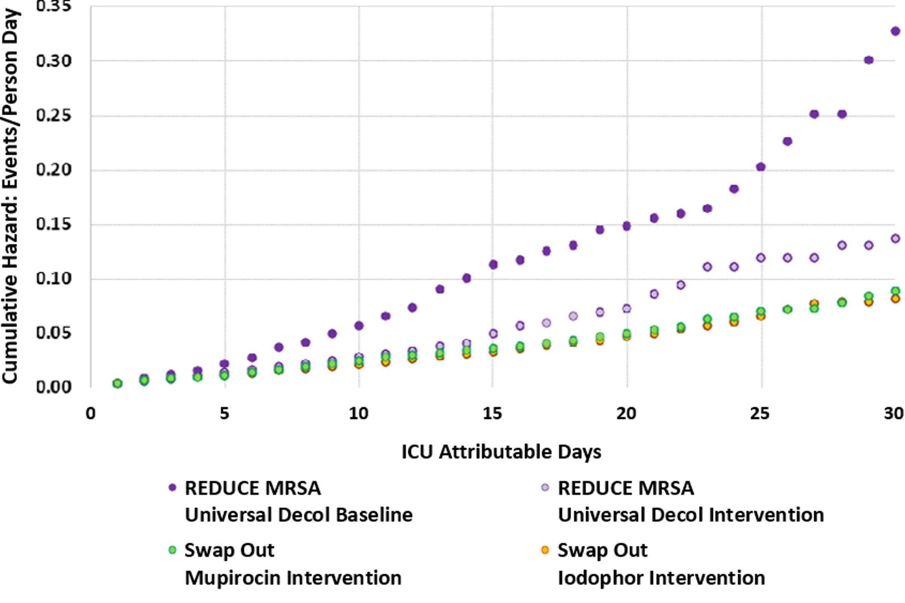
Comparing Results: All-Cause BSI^{14,20}
REDUCE MRSA & Swap Out Trials
Cumulative Hazard of All-Cause Bloodstream Infection
Reproduced with permission from JAMA. 2023. 330(14): 1337-1347. DOI: 10.1001/jama.2023.17219. Copyright © 2023 American Medical Association. All rights reserved, including those for text and data mining, AI training, and similar technologies. Link to original article.

Slide 47

Getting Started With Decolonization
Key Considerations and Questions

Slide 48
Which Type of MRSA Decolonization Will Work Best in Your Unit?
A key early decision is to determine whether a Universal or Targeted strategy is best for your unit.
Universal Decolonization: All patients in the unit receive decolonization throughout their stay.
Targeted Decolonization: Only patients who meet high-risk criteria are treated.
Which Type of Decolonization Will Work Best in My Unit? (.docx)
Key Evidence for Decolonization One-Pager (.docx)

Slide 49
Universal Decolonization^{13-16,20,21}
Universal is strongly recommended for all ICUs.
  Universal has consistently proven effective in ICU trials.
    Both adult and pediatric ICUs
For non-ICUs, universal should be considered if:
  Unit is for high-acuity patients (e.g., Oncology).
  Unit has a high percentage of patients with devices.
    Central lines, midline catheters, PICC lines, lumbar drains
Also appropriate for units currently experiencing high MRSA acquisition rates.

Slide 50
Targeted Decolonization^{10,12,17-19}
Targeted is recommended for non-ICUs where typically some but not all patients have devices.
  Central lines, midline catheters, PICC lines, lumbar drains
  Patients with devices are higher-risk.
Targeted is appropriate to decolonize patients identified as being colonized or infected with MRSA when using active or passive MRSA surveillance.
Targeted Decolonization is not recommended for ICUs or other units that care for mostly high-risk patients.

Slide 51
MRSA Surveillance for Decolonization
About 30 percent of humans carry nasal S. aureus at any time.⁴⁴
Single MRSA nasal swab PCR only around 60 percent sensitive.⁴⁵
For high-risk patients, it is not recommended to use targeted decolonization based on surveillance.

Slide 52




For More on Implementation
For a deeper dive into implementation, please access the presentation “Implementation of CHG Bathing and Nasal Decolonization” on the Decolonization section of the Toolkit website.
This Toolkit also provides Tools and Resources for Decolonization to assist the implementation of your decolonization program:
  First Steps, Readiness, and Pre-Launch
Guides to walk you through key early decisions and the preparatory steps for launch of decolonization.
Sample Protocols
Sample unit and nursing protocols for CHG and nasal decolonization. Choose and adapt the protocols that best fit your unit’s needs.
Staff Training Materials
Training materials for staff education, including training documents, FAQs, and talking points.
Patient Educational Resources
Resources and instructions to educate patients about decolonization.

Slide 53
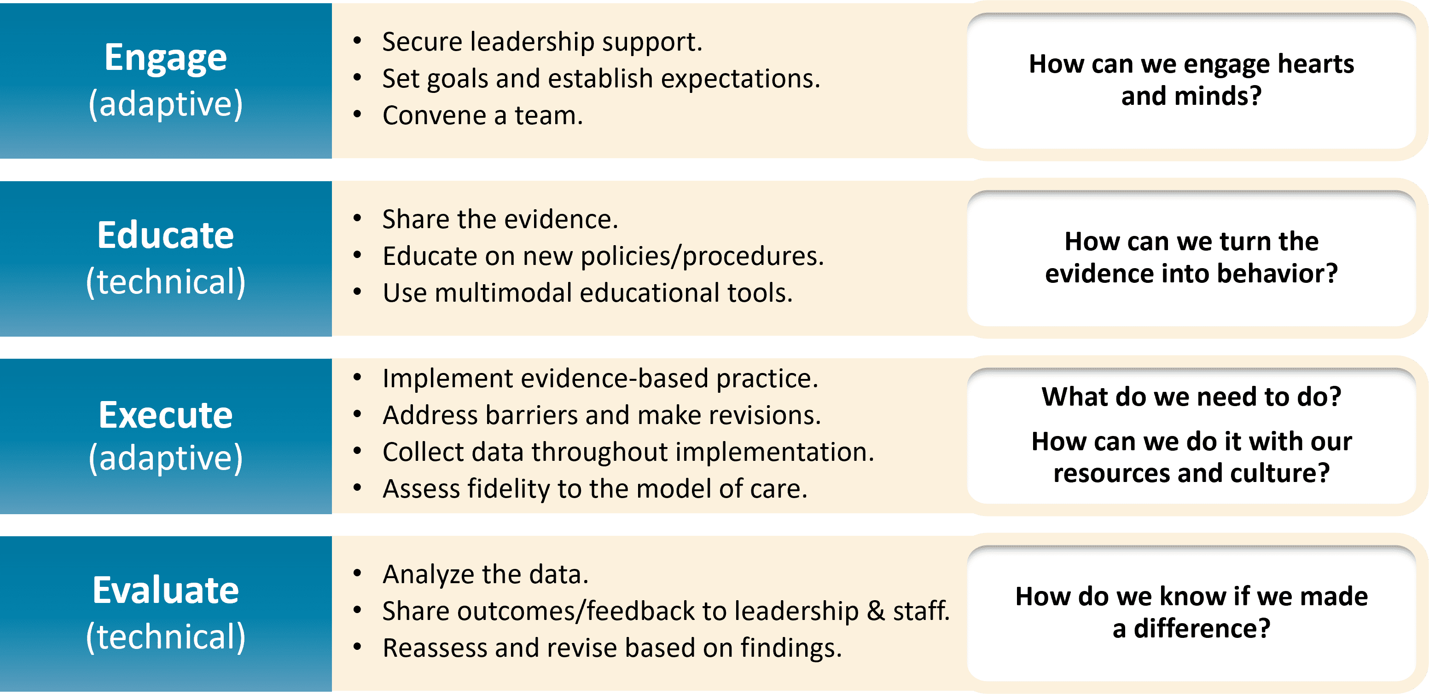
Using the 4 Es⁴⁶⁻⁵¹
Learn more on What Are The 4 Es? from the Toolkit website.
Access the one-pager on the 4 Es here.

Slide 54

Case Example: Engaging the ICU CUSP Team
The hospital’s ICU was experiencing rising MRSA rates.
  Implemented decolonization several years ago
  Unit’s rates recently rose above hospital average.
The CUSP team reviews the data and recognizes the problem.
  Data shows that rates have been rising every quarter.
CUSP team engages with staff and leaders to learn more about current practices.

Slide 55
Case Example: Assessing Current Practice
Staff had been using soap and water bathing instead of CHG.
  Patients complained about feeling “sticky” and staff felt patients were cleaner with soap.
  Some leaders considered soap-and-water to be a less costly option.
Decolonization was not being documented in the electronic health records (EHR).
  Staff did not receive training on how to document decolonization in the new EHR system.
CUSP Team conducts a literature search and review of national guidelines.

Slide 56

Case Example: Educating the Staff
The CUSP Team shared evidence on decolonization practices with the unit staff and leaders.
  Information on CHG’s effect and protection
Staff received education on correct procedure and proper documentation in the EHR.
The team employed multiple methods of education and communication.
  Used staff huddles, email distributions, unit team meetings, and visual displays on the unit
The team engaged with staff to collaborate and develop strategies for consistent implementation.

Slide 57
Key Takeaways
Staphylococcus aureus is a common and formidable pathogen in hospital ICUs and non-ICUs
Decolonization procedures protect patients from progressing from colonization to infection
Nasal decolonization is key to clearing MRSA carriage
Universal decolonization with mupirocin and CHG is superior to screening and contact precautions or targeted decolonization for reducing MRSA clinical cultures and all-cause bloodstream infections. Benefit has persisted over 10 years without evidence of emerging resistance.
Mupirocin-CHG is superior to iodophor-CHG for S. aureus and MRSA outcomes
Iodophor still may be preferred if mupirocin resistance is high, or prescription logistics are problematic

Slide 58
Disclaimer
The findings and recommendations in this presentation are those of the authors, who are responsible for its content, and do not necessarily represent the views of AHRQ. No statement in this presentation should be construed as an official position of AHRQ or of the U.S. Department of Health and Human Services.
Any practice described in this presentation must be applied by healthcare practitioners in accordance with professional judgment and standards of care in regard to the unique circumstances that may apply in each situation they encounter. These practices are offered as helpful options for consideration by healthcare practitioners, not as guidelines.

Slide 59
Reference List—1
Clinical Overview of Methicillin-resistant Staphylococcus aureus (MRSA) in Healthcare Setting. https://www.cdc.gov/mrsa/hcp/clinical-overview/index.html. Accessed July 17, 2024.
Kourtis AP, Hatfield K, Baggs J, et al. Vital signs: epidemiology and recent trends in methicillin-resistant and in methicillin-susceptible Staphylococcus aureus bloodstream infections - United States. MMWR Morb Mortal Wkly Rep. 2019 Mar 8;68(9):214-9. PMID: 30845118.
Centers for Disease Control and Prevention. HAI Pathogens and Antimicrobial Resistance Report, 2018 – 2021. https://www.cdc.gov/nhsn/hai-report/index.html. Accessed August 1, 2024.
Wertheim HF, Melles DC, Vos MC, et al. The role of nasal carriage in Staphylococcus aureus infections. Lancet Infect Dis. 2005 Dec;5(12):751-62. PMID: 16310147.
PubChem Identifier: CID 29089
URL: https://pubchem.ncbi.nlm.nih.gov/compound/29089#section=2D-Structur.
Hall R. Povidone-iodine and chlorhexidine gluconate containing detergents for disinfection of hands. J Hosp Infect. 1980 Dec;1(4):367-8. PMID: 6182243.

Slide 60
Reference List—2
Schiott CR, Löe H, Jensen SB, et al. The effect of chlorhexidine mouthrinses on the human oral flora. J Periodontal Res. 1970;5(2):84-9. PMID: 4254173.
Maki DG, Ringer M, Alvarado CJ. Prospective randomised trial of povidone-iodine, alcohol, and chlorhexidine for prevention of infection associated with central venous and arterial catheters. Lancet. 1991 Aug 10;338(8763):339-43. PMID: 1677698.
Darouiche RO, Wall MJ Jr, Itani KM, et al. Chlorhexidine-alcohol versus povidone-iodine for surgical-site antisepsis. N Engl J Med. 2010 Jan 7;362(1):18-26. PMID: 20054046.
Perl TM, Cullen JJ, Wenzel RP, et al. Intranasal mupirocin to prevent postoperative Staphylococcus aureus infections. N Engl J Med. 2002 Jun 13;346(24):1871-7. PMID: 12063371.
Harbarth S, Fankhauser C, Schrenzel J, et al. Universal screening for methicillin-resistant Staphylococcus aureus at hospital admission and nosocomial infection in surgical patients. JAMA 2008 Mar 12;299(10):1149-57. PMID: 18334690.
Bode LG, Kluytmans JA, Wertheim HF, et al. Preventing surgical-site infections in nasal carriers of Staphylococcus aureus. N Engl J Med. 2010 Jan 7;362(1):9-17. PMID: 20054045.

Slide 61
Reference List—3
Climo MW, Yokoe DS, Warren DK, et al. Effect of daily chlorhexidine bathing on hospital-acquired infection. N Engl J Med. 2013 Feb 7;368(6):533-42. PMID: 23388005.
Huang SS, Septimus E, Kleinman K, et al. Targeted versus universal decolonization to prevent ICU infection. N Engl J Med. 2013 Jun 13;368(24):2255-65. PMID: 23718152.
Milstone AM, Elward A, Song X, et al. Daily chlorhexidine bathing to reduce bacteraemia in critically ill children: a multicentre, cluster-randomised, crossover trial. Lancet 2013 Mar 30;381(9872):1099-106. PMID: 23363666.
Huang SS, Septimus E, Kleinman K, et al. Chlorhexidine versus routine bathing to prevent multidrug-resistant organisms and all-cause bloodstream infections in general medical and surgical units (ABATE Infection trial): a cluster-randomised trial. Lancet. 2019 Mar 23;393(10177):1205-15. PMID: 30850112.
Liu C, Bayer A, Cosgrove SE, et al. Clinical practice guidelines by the Infectious Diseases Society of America for the treatment of methicillin-resistant Staphylococcus aureus infections in adults and children: executive summary. Clin Infect Dis. 2011 Feb 1;52(3):285-92. PMID: 21217178.
Lee AS, Cooper BS, Malhotra-Kumar S, et al. Comparison of strategies to reduce meticillin-resistant Staphylococcus aureus rates in surgical patients: a controlled multicentre intervention trial. BMJ Open. 2013 Sep 19;3(9):e003126. PMID: 24056477.

Slide 62
Reference List—4
Huang SS, Singh R, McKinnell JA, et al. Decolonization to reduce postdischarge infection risk among MRSA carriers. N Engl J Med. 2019 Feb 14;380(7):638-50. PMID: 30763195.
Huang SS, Septimus E, Kleinman K, et al. Universal chlorhexidine bathing plus nasal mupirocin versus iodophor to prevent Staphylococcus aureus and bloodstream infections in adult ICUs: a pragmatic cluster-randomized clinical trial. JAMA. 2023; 330(14):1337-47.
Miller LG, McKinnell JA, Singh R, et al. Nursing home decolonization for infection and hospitalization prevention. N Engl J Med. 2023; 389:1766-77.
Vernon MO, Hayden MK, Trick WE, et al. Chlorhexidine gluconate to cleanse patients in a medical intensive care unit: the effectiveness of source control to reduce the bioburden of vancomycin-resistant enterococci. Arch Intern Med. 2006 Feb 13;166(3):306-12. PMID: 16476870.
Climo MW, Sepkowitz KA, Zuccotti G, et al. The effect of daily bathing with chlorhexidine on the acquisition of methicillin-resistant Staphylococcus aureus, vancomycin-resistant Enterococcus, and healthcare-associated bloodstream infections: results of a quasi-experimental multicenter trial. Crit Care Med. 2009 Jun;37(6):1858-65. PMID: 19384220.

Slide 63
Reference List—5
Bleasdale SC, Trick WE, Gonzalez IM, et al. Effectiveness of chlorhexidine bathing to reduce catheter-associated bloodstream infections in medical intensive care unit patients. Arch Intern Med. 2007 Oct 22;167(19):2073-9. PMID: 17954801.
Popovich KJ, Hota B, Hayes R, et al. Effectiveness of routine patient cleansing with chlorhexidine gluconate for infection prevention in the medical intensive care unit. Infect Control Hosp Epidemiol. 2009 Oct;30(10):959-63. PMID: 19712033.
Popovich KJ, Lyles R, Hayes R, et al. Relationship between chlorhexidine gluconate skin concentration and microbial density on the skin of critically ill patients bathed daily with chlorhexidine gluconate. Infect Control Hosp Epidemiol. 2012 Sep;33(9):889-96. PMID: 22869262.
Septimus EJ, Hayden MK, Kleinman K, et al. Does chlorhexidine bathing in adult intensive care units reduce blood culture contamination? a pragmatic cluster-randomized trial. Infect Control Hosp Epidemiol. 2014 Oct;35 Suppl 3:S17-22. PMID: 25222893.
Huang SS, Septimus E, Hayden MK, et al. Effect of body surface decolonisation on bacteriuria and candiduria in intensive care units: an analysis of a cluster-randomised trial. Lancet Infect Dis. 2016 Jan;16(1):70-9. PMID: 26631833

Slide 64
Reference List—6
Hayden MK, Lolans K, Haffenreffer K, et al. Chlorhexidine and mupirocin susceptibility of methicillin-resistant Staphylococcus aureus isolates in the REDUCE-MRSA Trial. J Clin Microbiol. 2016 Nov;54(11):2735-42. PMID: 27558180.
Septimus E, Hickok J, Moody J, et al. Closing the translation gap: toolkit-based implementation of universal decolonization in adult intensive care units reduces central line-associated bloodstream infections in 95 community hospitals. Clin Infect Dis. 2016 Jul 15;63(2):172-7. PMID: 27143669.
Frank DN, Feazel LM, Bessesen MT, et al. The human nasal microbiota and Staphylococcus aureus carriage. PLoS One. 2010 May 17;5(5):e10598. PMID: 20498722.
von Eiff C, Becker K, Machka K, et al. Nasal carriage as a source of Staphylococcus aureus bacteremia. Study group. N Engl J Med. 2001 Jan 4;344(1):11-6. PMID: 11136954.
Huang SS, Diekema DJ, Warren DK, et al. Strain-relatedness of methicillin-resistant Staphylococcus aureus isolates recovered from patients with repeated infection. Clin Infect Dis. 2008 Apr 15;46(8):1241-7. PMID: 18444862.
van Rijen M, Bonten M, Wenzel R, et al. Mupirocin ointment for preventing Staphylococcus aureus infections in nasal carriers. Cochrane Database Syst Rev. 2008 Oct 8;(4):CD006216. PMID: 18843708.

Slide 65
Reference List—7
Ammerlaan HS, Kluytmans JA, Wertheim HF, et al. Eradication of methicillin-resistant Staphylococcus aureus carriage: a systematic review. Clin Infect Dis. 2009 Apr 1;48(7):922-30. PMID: 19231978.
Harbarth S, Dharan S, Liassine N, et al. Randomized, placebo-controlled, double-blind trial to evaluate the efficacy of mupirocin for eradicating carriage of methicillin-resistant Staphylococcus aureus. Antimicrob Agents Chemother. 1999 Jun;43(6):1412-6. PMID: 10348762.
Fritz SA, Camins BC, Eisenstein KA, et al. Effectiveness of measures to eradicate Staphylococcus aureus carriage in patients with community-associated skin and soft-tissue infections: a randomized trial. Infect Control Hosp Epidemiol. 2011 Sep;32(9):872-80. PMID: 21828967.
Williamson DA, Carter GP, Howden BP. Current and Emerging Topical Antibacterials and Antiseptics: Agents, Action, and Resistance Patterns. Clin Microbiol Rev. 2017 Jul;30(3):827-60. PMID: 28592405.
Dadashi M et al. Mupirocin resistance in Staphylococcus aureus: A systematic review and meta-analysis. J Glob Antimicrob Resist. 2020 Mar;20:238-47.PMID: 31442624.
Hetem DJ, Bonten MJ. Clinical relevance of mupirocin resistance in Staphylococcus aureus. J Hosp Infect. 2013 Dec;85(4):249-56. PMID: 24144552.

Slide 66
Reference List—8
Patel JB, Gorwitz RJ, Jernigan JA. Mupirocin resistance. Clin Infect Dis 2009 Sep 15;49(6):935-41. PMID: 19673644.
Smith M, Herwaldt L. Nasal decolonization: What antimicrobials and antiseptics are most effective before surgery and in the ICU. Am J Infect Control 2023 Nov;51(11S):A64-A71. PMID: 37890955.
Ghaddara HA, Kumar JA, Cadnum JL, et al. Efficacy of a povidone iodine preparation in reducing nasal methicillin-resistant Staphylococcus aureus in colonized patients. Am J Infect Control 2020 Apr;48(4):456-459. PMID: 31735591.
Staphylococcus aureus Basics. https://www.cdc.gov/staphylococcus-aureus/about/index.html. Accessed August 1, 2024.
Senn L, Basset P, Nahimana I, et al. Which anatomical sites should be sampled for screening of methicillin-resistant Staphylococcus aureus carriage by culture or by rapid PCR test? Clin Microbiol Infect 2012 Feb;18(2):E31-3. PMID: 22192160.
Ellingson K, Haas JP, Aiello AE, et al. Strategies to prevent healthcare-associated infections through hand hygiene. Infect Control Hosp Epidemiol 2014 Aug;35(8):937-60. PMID: 25026608.

Slide 67
Reference List—9
Romig M, Goeschel C, Pronovost P. Integrating CUSP and TRIP to improve patient safety. Hosp Pract (1995). 2010 Nov;38(4):114-21. PMID: 21068535.
Pronovost PJ, Berenholtz SM, Needham DM. Translating evidence into practice: a model for large scale knowledge translation. BMJ. 2008 Oct 6; 337:a1714. PMID: 18838424.
The 4 E’s. Agency for Healthcare Research and Quality. https://www.ahrq.gov/hai/cusp/videos/02b-the-4e/index.html. Accessed May 24, 2024.
Assemble the Team, Facilitator Notes. Agency for Healthcare Research and Quality. https://www.ahrq.gov/hai/cusp/modules/assemble/team-notes.html#slide12. Accessed May 24, 2024.
Engage the Senior Executive Facilitator Notes. Agency for Healthcare Research and Quality. https://www.ahrq.gov/hai/cusp/modules/engage/exec-notes.html#sl3. Accessed May 24, 2024.

