Slide 1
AHRQ Safety Program for MRSA Prevention
Implementation of Chlorhexidine Gluconate (CHG) Bathing and Nasal Decolonization
ICU & Non-ICU
AHRQ Pub. No. 25-0007
October 2024

Slide 2
Educational Objectives
Discuss methicillin-resistant Staphylococcus aureus (MRSA) decolonization strategies.
Describe key steps leading up to launch of decolonization.
Review procedures for CHG and nasal decolonization.
Identify barriers to implementation of CHG and nasal decolonization.
Discuss helpful tips and advice on implementation.

Slide 3
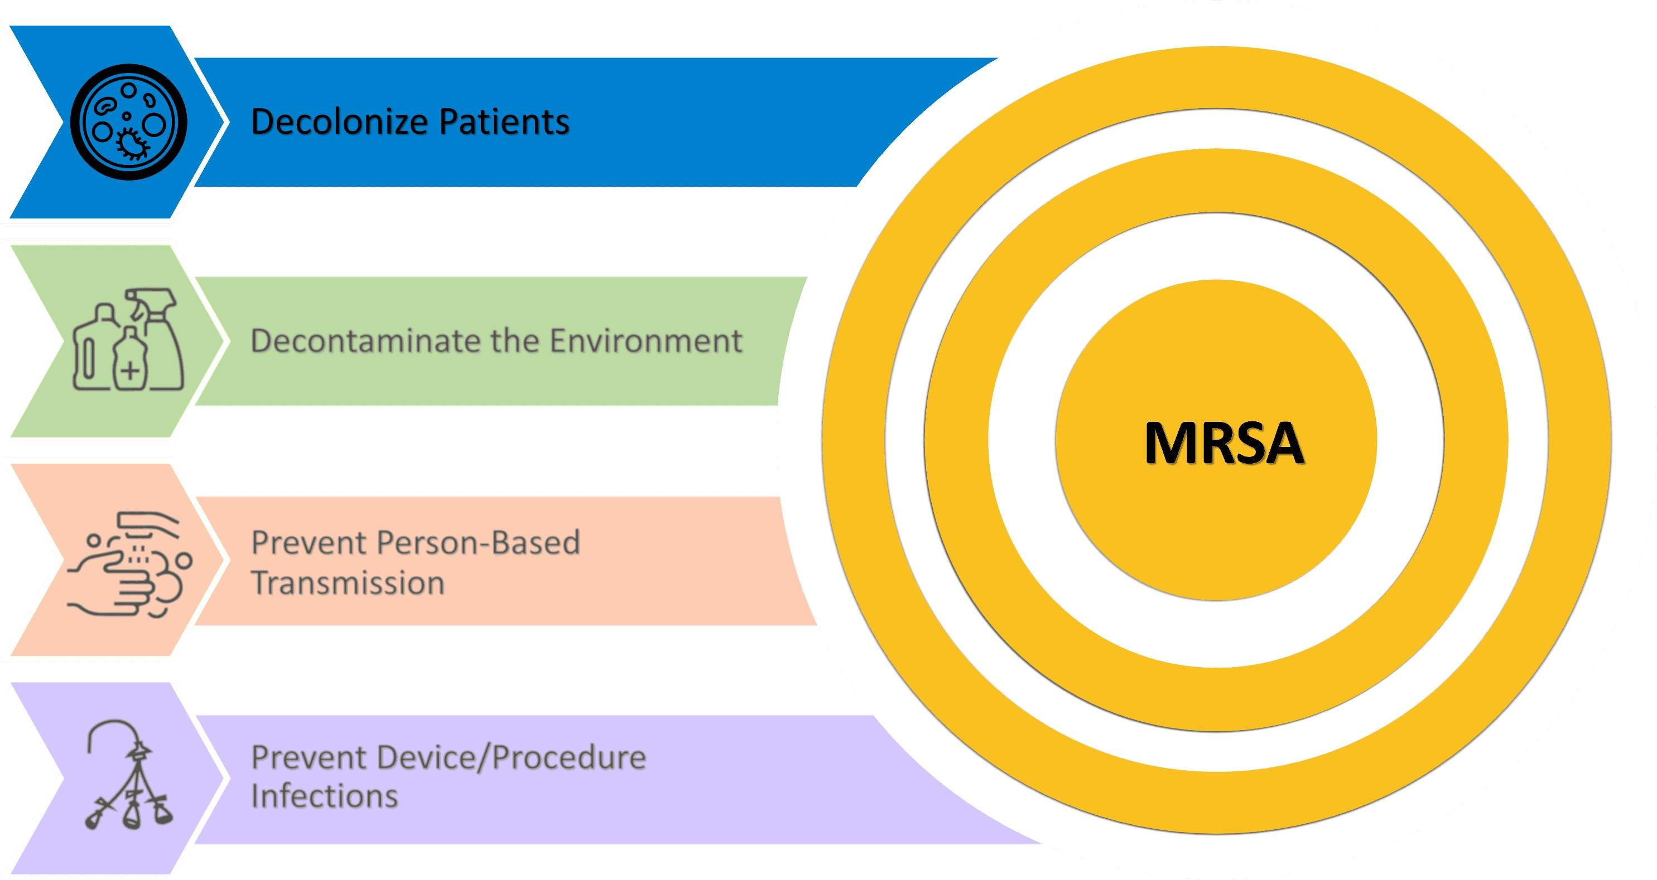
Key Strategies for MRSA Prevention

Slide 4

Decolonizing Patients
Decolonization: Process of reducing or eliminating bacterial burden to prevent infections and transmission.
Decolonization for MRSA typically involves
  Skin decolonization with CHG bathing
  Nasal decolonization with nasal mupirocin or nasal iodophor
Studies show decolonization can significantly lower risk of MRSA infections and transmission in acute care settings.^{1,2}
  For more detail on the evidence, please review the presentation on The Evidence Behind Decolonization Strategies.
Visit the Tools and Resources for Decolonization page of the website.

Slide 5

Decision-Making and Pre-Launch Activities
Planning and Preparation for Decolonization

Slide 6
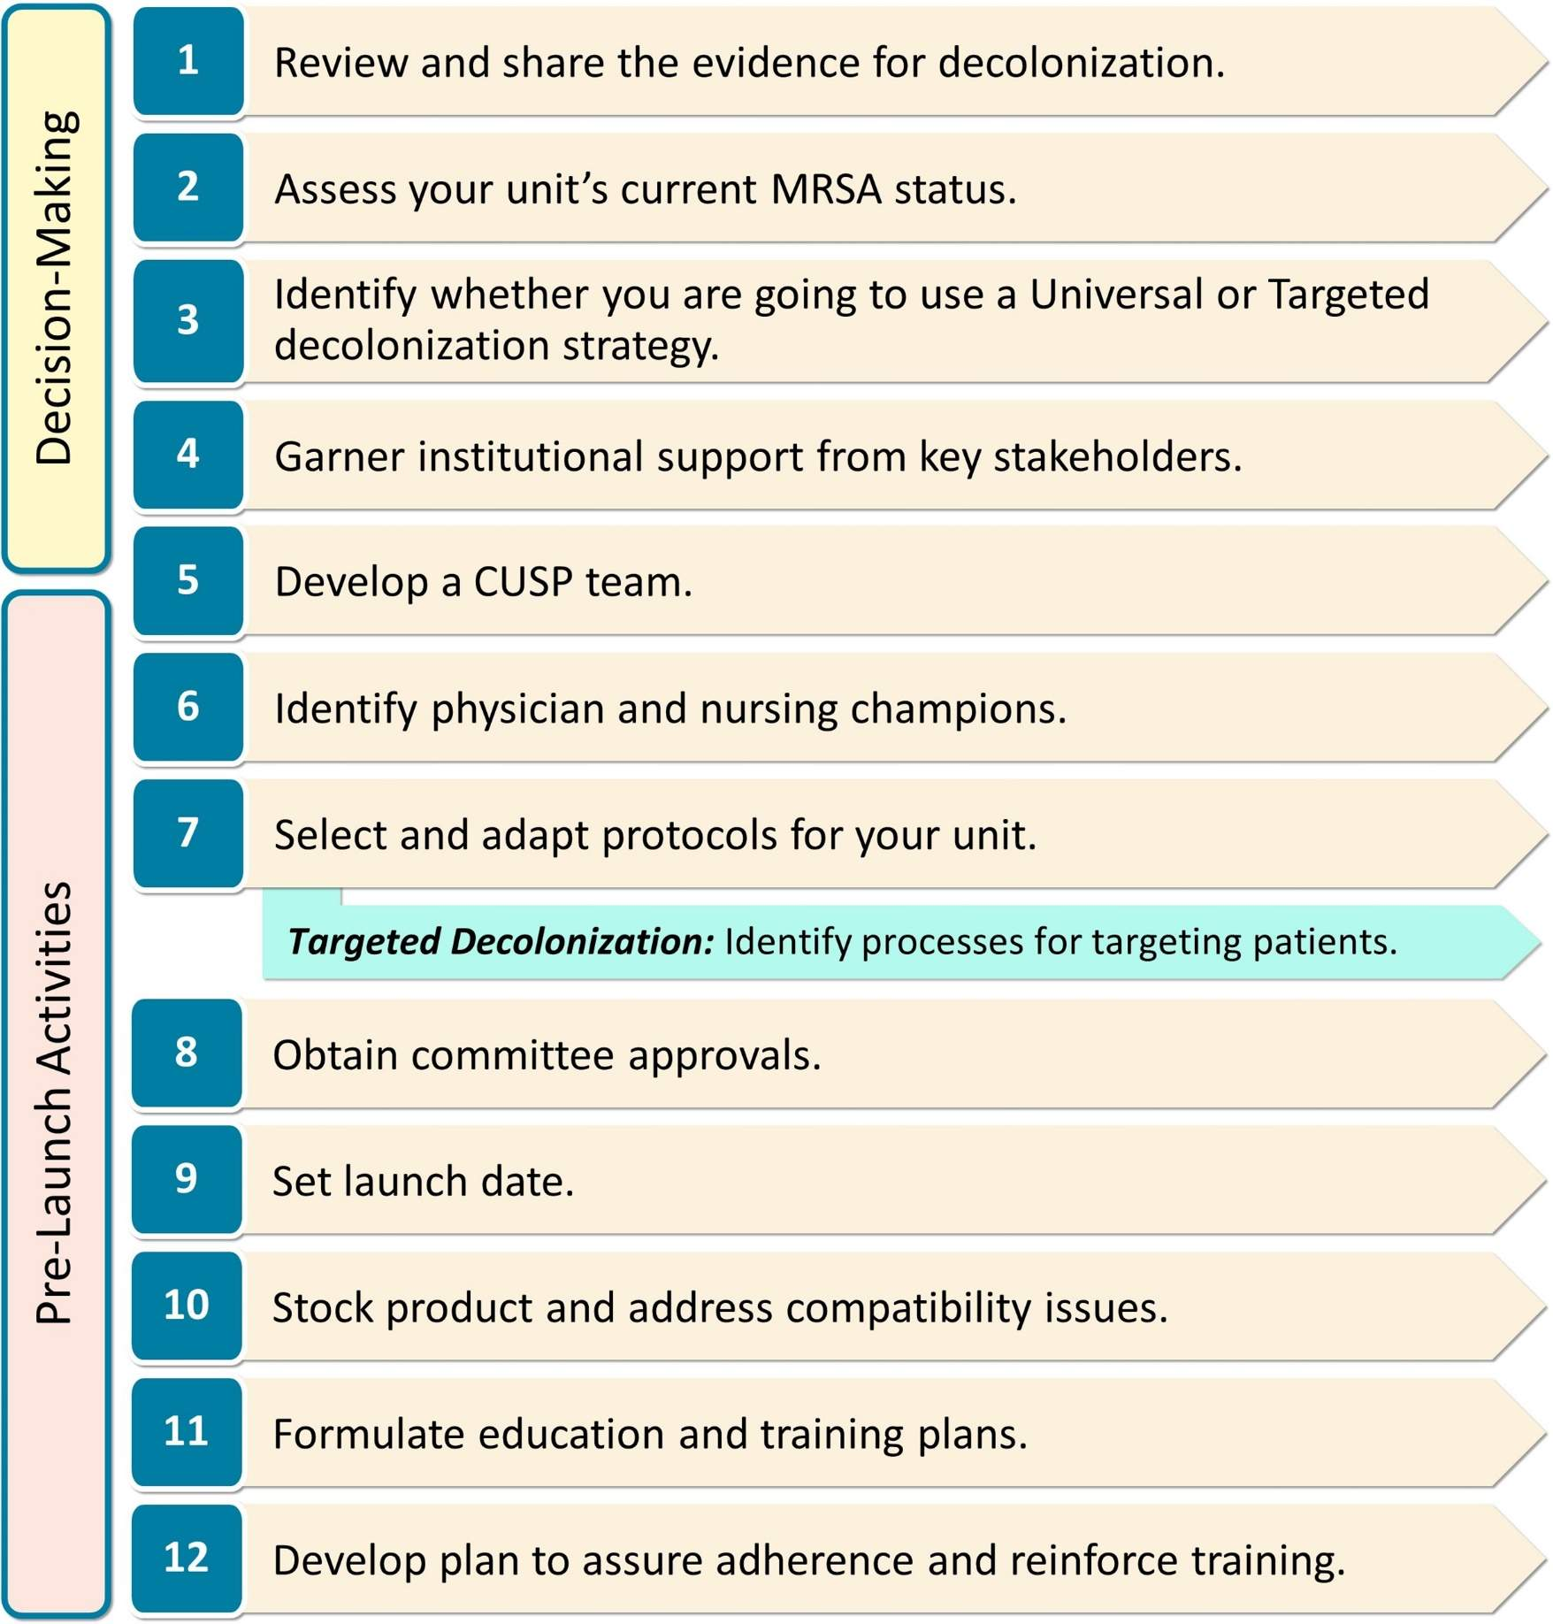
Steps for Implementation
Download this document: Action Chart for Implementing Decolonization

Slide 7
Decision-Making and Readiness
Download the guide: Decision-Making & Readiness for Implementation
Review and share the evidence for decolonization.
  Share the evidence with your team, staff, leadership, and stakeholders.
Assess your unit’s current MRSA status.
  All-cause bloodstream infection (BSI) rate:
  Number of all-cause BSI events per 1,000 patient-days
  MRSA clinical cultures:
  Percentage of patients with any positive MRSA clinical cultures over the past year
Decide between a Universal or Targeted decolonization strategy.
Garner institutional support from key stakeholders.
  Engage stakeholders, present your plan, and address their concerns.
Develop a Comprehensive Unit-based Safety Program (CUSP) team.
  Assemble a Decolonization team to lead implementation.

Slide 8
Decision-Making: Universal Versus Targeted Decolonization
Universal Decolonization: All patients in a specific hospital unit are treated with decolonization.
  Strongly recommended for intensive care units (ICUs)^{3,4}
  Should be considered by non-ICUs where many patients are high risk for infection
Targeted Decolonization: Only patients who meet high-risk criteria in a hospital unit are decolonized.
  Recommended: Target patients with medical devices⁵
    Central lines, midline catheters, peripherally inserted central catheter (PICC) lines, lumbar drains
  Alternative: Target patients with MRSA colonization identified through surveillance or history
Download: Which Type of Decolonization Would Work Best in My Unit?

Slide 9
Pre-Launch Activities
Download the guide: Pre-Launch Activities
Identify physician and nursing champions.
  Champions are individuals in the unit who will take an active leadership role to promote decolonization, support implementation, and engage personnel.
Select and adapt protocols for your unit.
  Develop decolonization protocols to meet your unit’s needs.
  Visit the page on Tools & Resources for Decolonization: Protocols to download editable sample protocols.
  Note that use of mupirocin requires a physician order.
Obtain committee approvals.
  Identify the appropriate committees and navigate your hospital’s approval process.

Slide 10
Pre-Launch: Identifying Patients to Receive Decolonization
Targeted Decolonization: Identification process for high-risk patients.
  Decide how you will identify patients for decolonization.
  Discuss with leaders from nursing, physicians, information technology (IT), pharmacy, and supply chain.
  Manual process: Nurse champion identifies patients with devices during daily rounds, activates the CHG bathing protocol, and contacts the treating physicians to order nasal decolonization.
  Electronic process: Patients with devices are identified by the electronic health record (EHR) software, and an order set automatically activates the CHG bathing protocol and nasal decolonization order set.
  Mixed electronic/manual process: EHR generates a daily report of patients with devices. A nurse champion uses this report to activate the CHG bathing protocol and contacts the treating physicians to order nasal decolonization.
Please refer to the Pre-Launch Activities guide, in the section on Identify process for targeting patients with devices.

Slide 11
Pre-Launch: Putting Plans Into Action
Set launch date.
  Consider time needed to stock product, train personnel, and obtain approvals.
Stock product and address compatibility issues.
  Ensure you have adequate decolonization supplies.
  Verify skin and hair products (soaps, lotions, etc.) are compatible with CHG.
Formulate education and training plans.
  Establish plans to train staff to perform decolonization according to protocol.
  Access staff training resources on the Decolonization Staff Training Materials page of the Toolkit website.
Develop a feedback plan to ensure adherence and reinforce training.
  Establish plans to conduct regular assessments, share data with unit personnel, and reinforce training.
  A Sample Adherence Report is available in the Toolkit.

Slide 12

Resources for Decision-Making and Pre-Launch
Tools & Resources for Decolonization: First Steps, Readiness, and Pre-Launch Webpage
  Action Chart for Implementing Decolonization
  Decision-Making & Readiness for Implementation
  Which Type of Decolonization Would Work Best in My Unit?
  Pre-Launch Activities
  Decolonization Nursing Practice Guide
    Summary chart of key nursing practice processes
Tools & Resources for Decolonization: Protocols Webpage

Slide 13
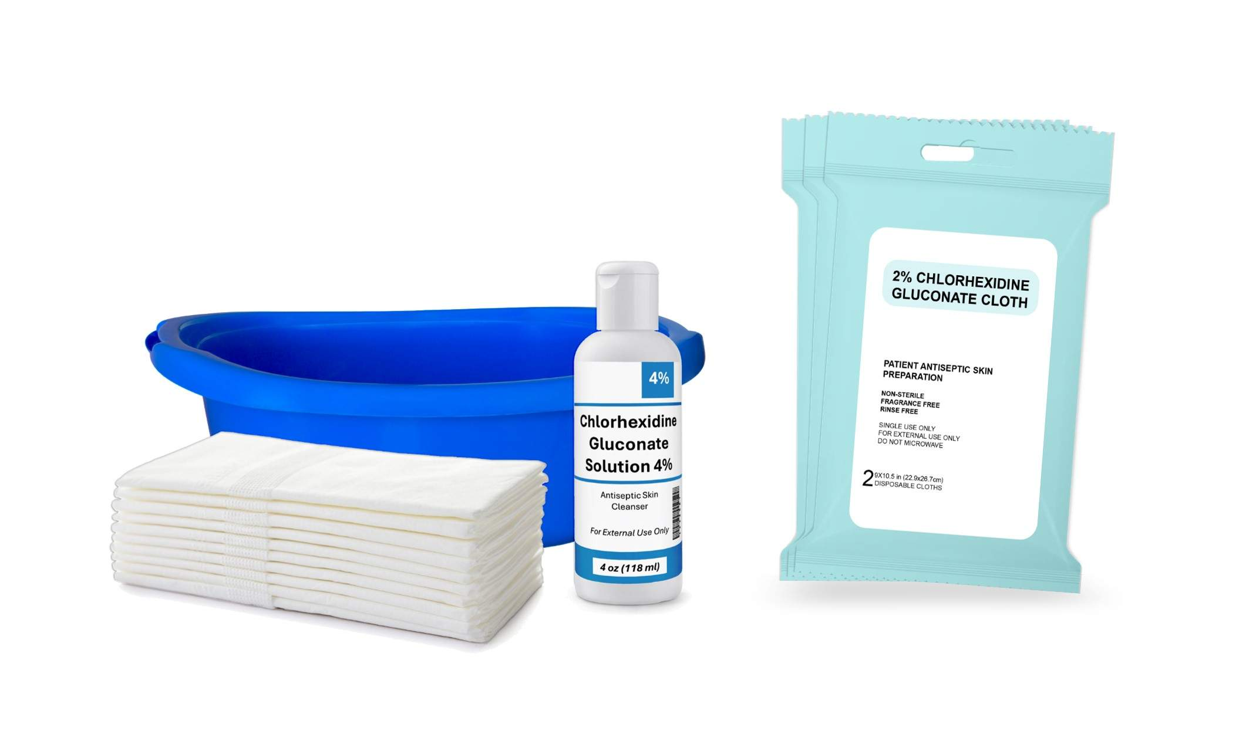
How To Decolonize With CHG
Essential Steps and Procedures for CHG Use

Slide 14
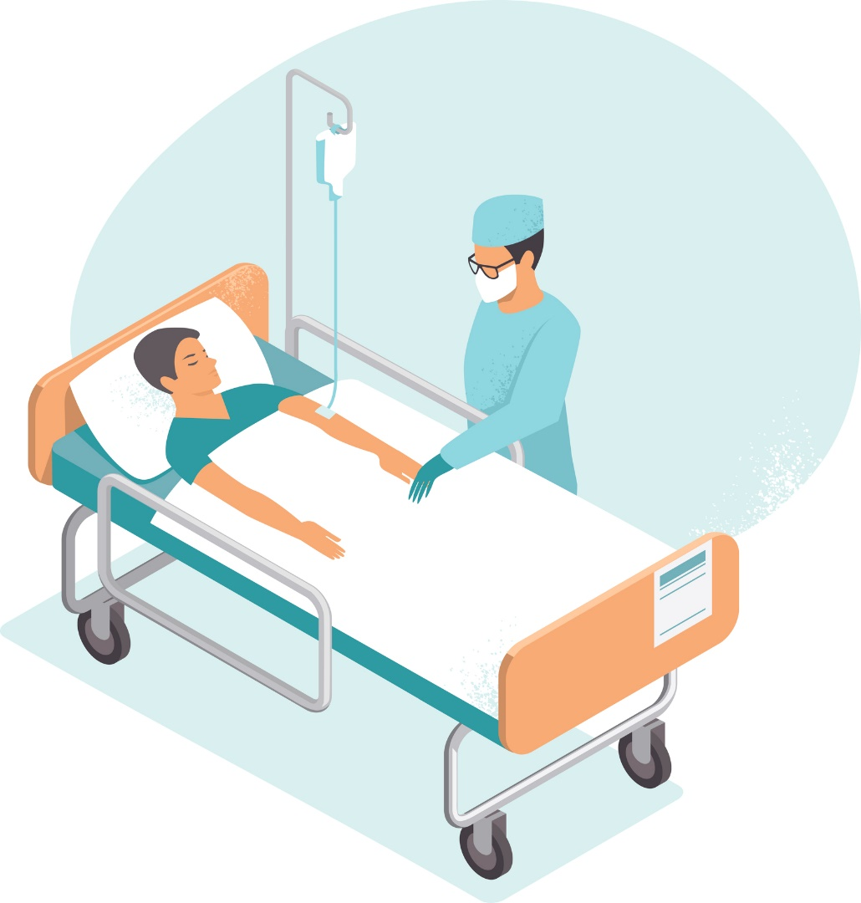
Overview of CHG^{1,2}
Effective at killing bacteria and maintains effect for 24 hours⁶
Safe for use on the face, perineum, and external mucosa
  Avoid eyes and ear canals!
Applied to patient daily for duration of hospital stay
Replaces regular soap for all bathing needs
Please refer to the CHG Decolonization Nursing Protocol Training PowerPoint for more detail.

Slide 15
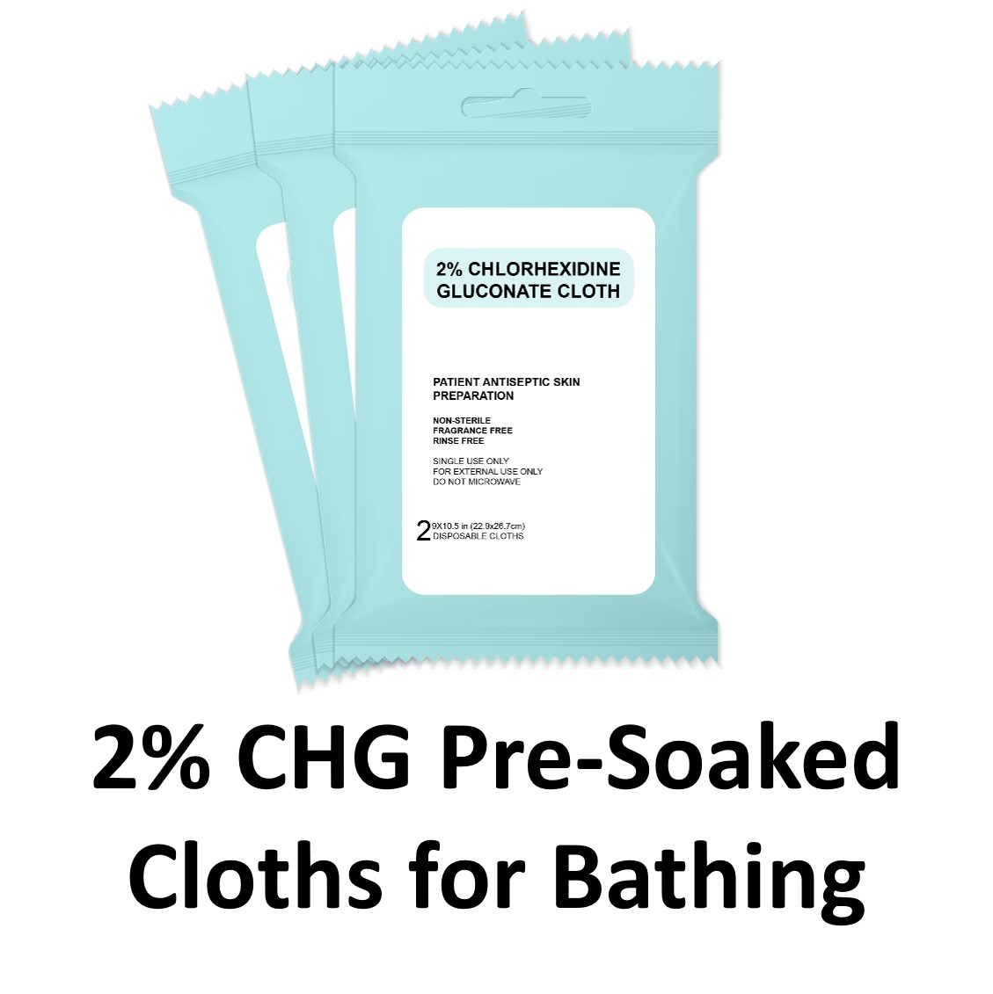

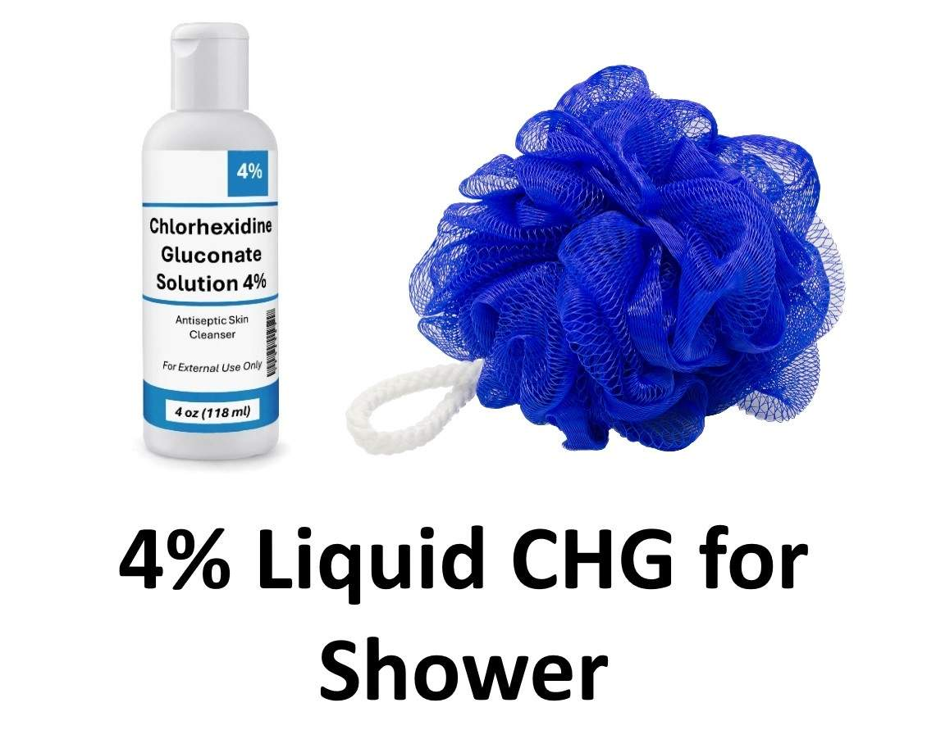
Chlorhexidine Products

Slide 16
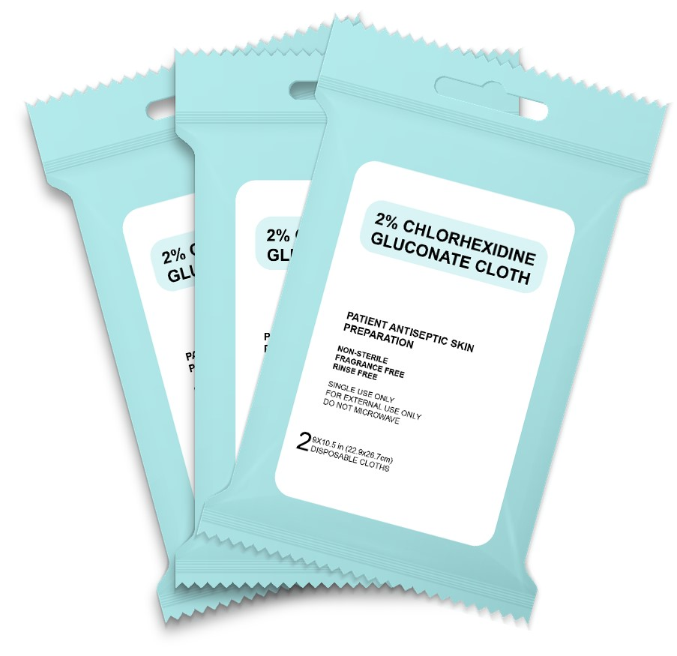
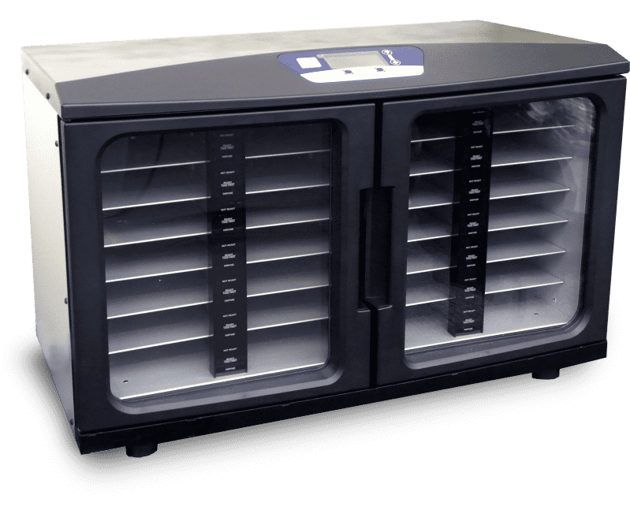
2 Percent CHG Pre-Impregnated Cloths^{1,2}
There are usually 2 or 6 cloths per packet.
Do NOT rinse, wipe off, or dry with another cloth. Let air dry.
CHG cloths have built-in moisturizers. Skin may feel sticky for a few minutes.
Cloths may be warmed for patient comfort; it is not required. Cold cloths are active and can be used.
Source: Stryker Corp. Images used with permission.

Slide 17
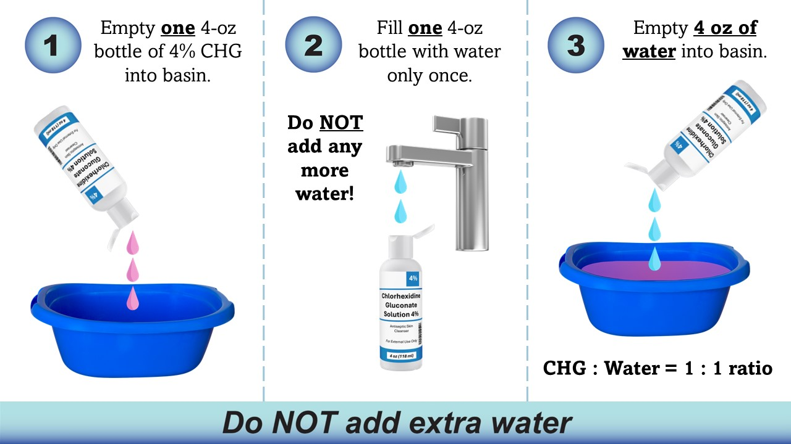
4 Percent CHG Liquid for Basin Bathing⁷
Dilute 4 percent liquid CHG to a 2 percent solution.
Do not over-dilute. Use equal parts CHG and water.

Slide 18
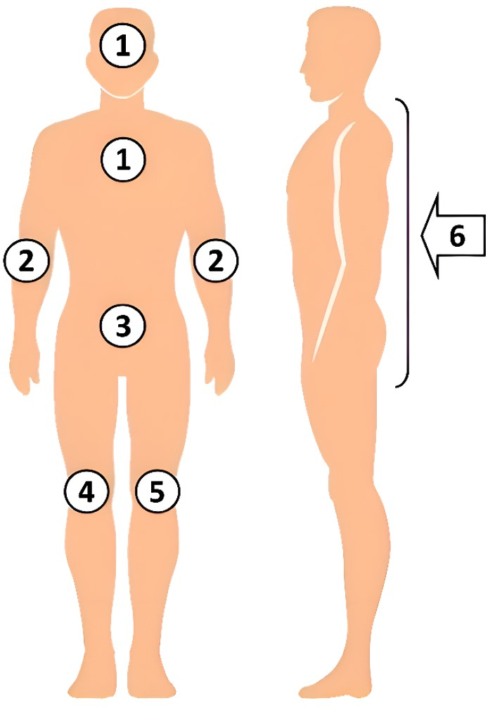
CHG Bed Bathing Procedure⁷
Apply six cloths in the following order:
  Face, neck & chest. Avoid eyes and ear canals.
  Both shoulders, arms and hands
  Abdomen, then groin/perineum
  Right leg and foot
  Left leg and foot
  Back of neck, back, then buttocks
  Massage CHG firmly onto skin.
  Air dry. Do NOT rinse.
  Use all six cloths. Never re-use cloths.
    Use extra cloths if needed.
  Pay extra attention to neck, joints, and skin folds.
    Make sure these areas also fully dry.

Slide 19
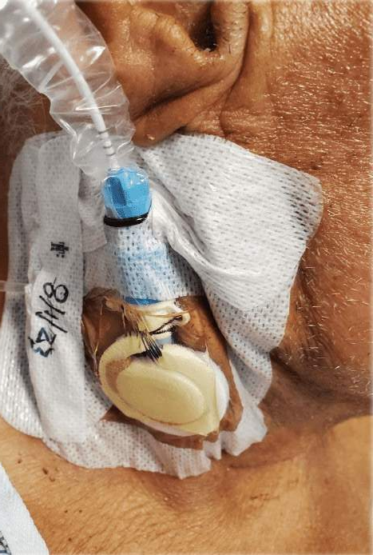
CHG for Medical Devices^{1,2}
CHG must be used to clean all lines, tubes, drains, or other devices.
Clean the skin thoroughly surrounding where the device connects to the body.
Then clean the 6 inches of the device that are nearest to the body.
Clean connections to all devices, including:
  Urinary catheters
  G-tubes, J-tubes
  Chest tubes
  Rectal tubes
  EKG leads and wires

Slide 20
CHG for Wounds and Dressings⁸
Recommended for superficial wounds
  Friable skin/rashes
  Superficial burns
  Pressure injuries (Stage 1 and 2)
Not recommended for large, deep, or packed wounds
Recommended for use over semipermeable or occlusive dressings
  Including vacuum-assisted closures and surgical drains
Should not be used for permeable dressings (e.g., gauze)
  Apply to the edge of but not over the dressing

Slide 21
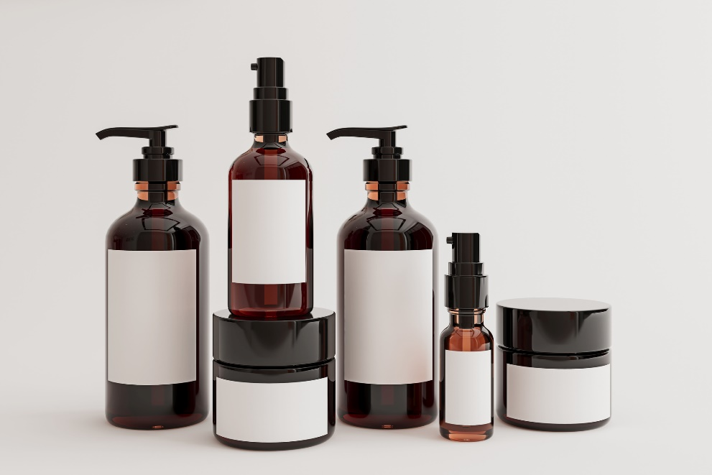
Ensuring Compatibility With CHG^{1,2}
Assess CHG compatibility of all skin and hair products used in the unit.
  Check with manufacturers for CHG compatibility.
  Do not worry about prescribed medicated creams.
CHG should be used for all cleaning and bathing needs.
If patients insist on using their own shampoo or soap, it should be used before applying CHG.
  It should be thoroughly rinsed off before the CHG is applied.

Slide 22
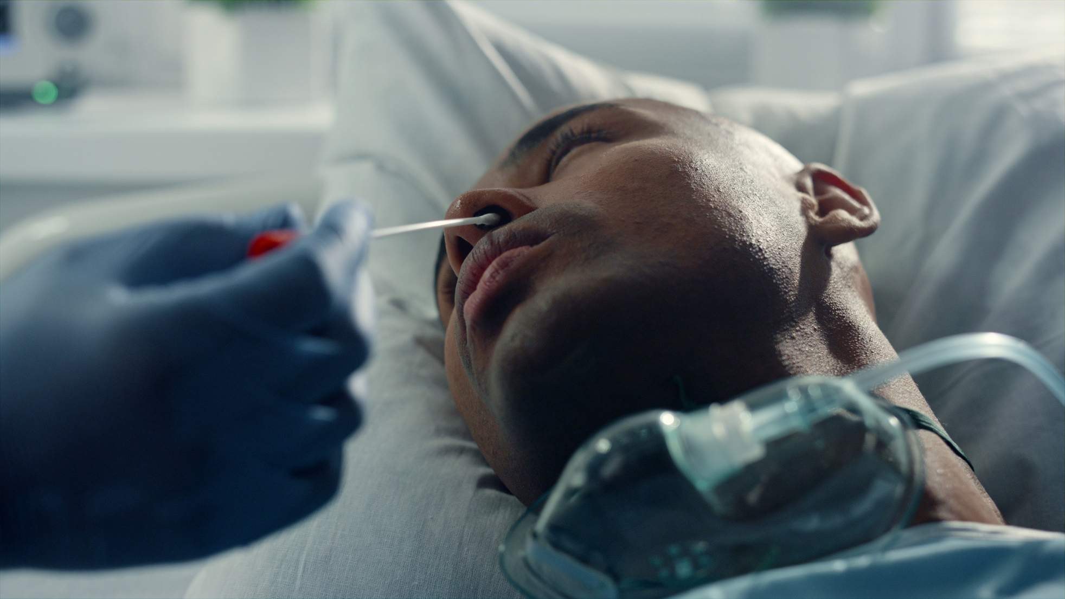
How To Conduct Nasal Decolonization
Essential Steps and Procedures for Nasal Decolonization

Slide 23

Nasal Decolonization Protocol^{1,2}
Given twice a day for 5 days, starting from patient’s first day on the unit.
  Even if they completed nasal decolonization in prior unit.
  If patient was mid-course in previous unit, then the course should be resumed.
  Readmitted patients should restart 5-day course.
If patient is on the unit for 2+ weeks, full 5-day course restarts.
If a dose is missed, resume decolonization according to original schedule.
  Do not double up doses.
  If 2+ doses are missed, 5-day course restarts
Please refer to the Nasal Decolonization Nursing Protocol Training PowerPoint for more detail.

Slide 24
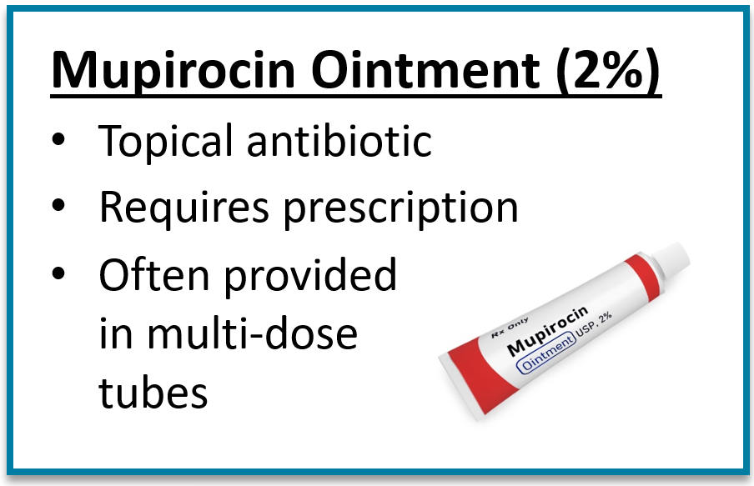
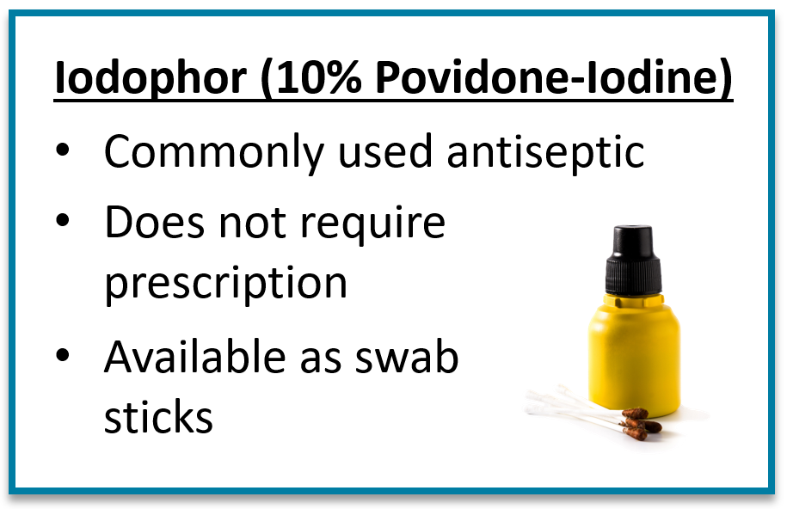
Nasal Decolonization Products^{1,2}
Evidence shows mupirocin is more effective than iodophor.
  Mupirocin Iodophor Swap Out Trial by Huang et al., published 2023⁹
Mupirocin is preferred over iodophor, unless:
  High prevalence of mupirocin resistance
  Logistical concerns about providing prescription

Slide 25
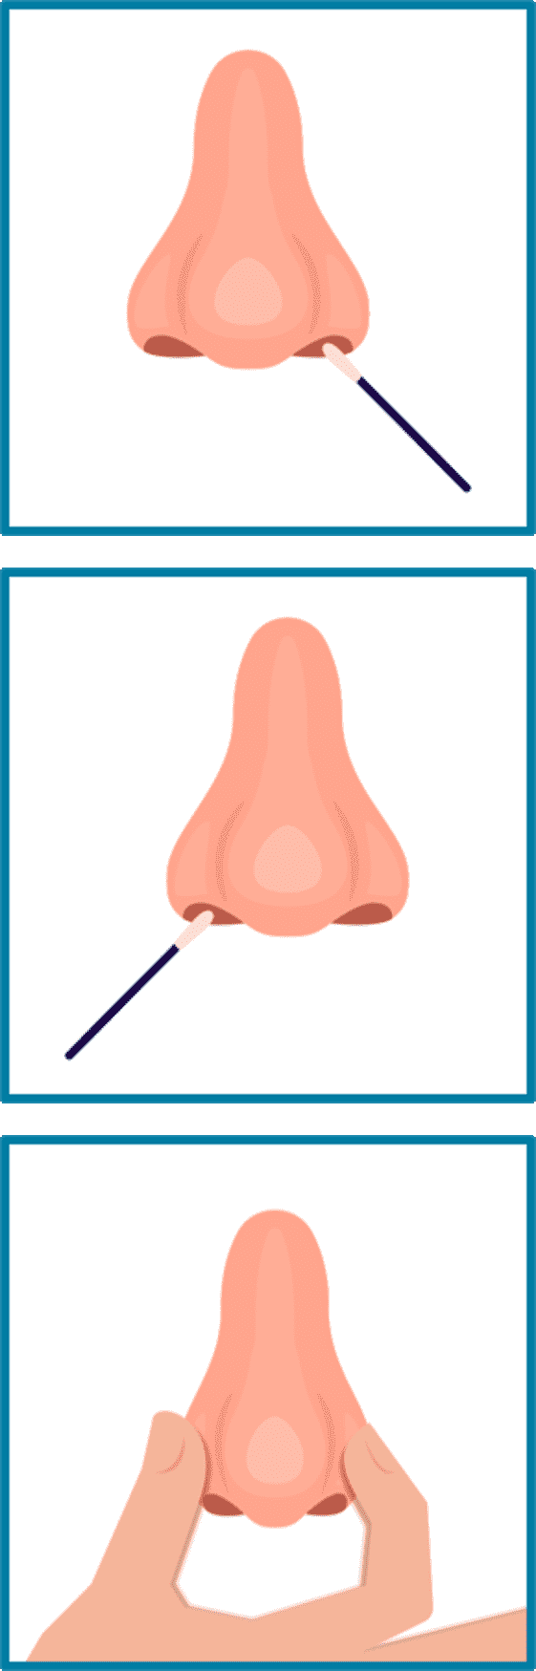
Procedure for Nasal Mupirocin
Protocol:
Dispense 0.5 grams of mupirocin (pea-sized amount) for each nostril onto two new clean swabs before entering patient room.​
Have patient blow their nose into a tissue to clear nostrils.​
Place head of patient’s bed at 30 degrees, if tolerated.​
Apply single dose into each nostril using swab applicator.​
Press patient’s nostrils together and massage gently for 60 seconds.​
  Avoid contact with eyes and other intranasal products. ​
Side effects are uncommon, most often nasal irritation, runny nose, and sneezing.
  Other side effects of burning, stinging, or itching are rare.
Most common patient complaint is that it feels thick or goopy. Having the patient blow their nose before can help.
  Do not allow patient to blow their nose AFTER application.

Slide 26
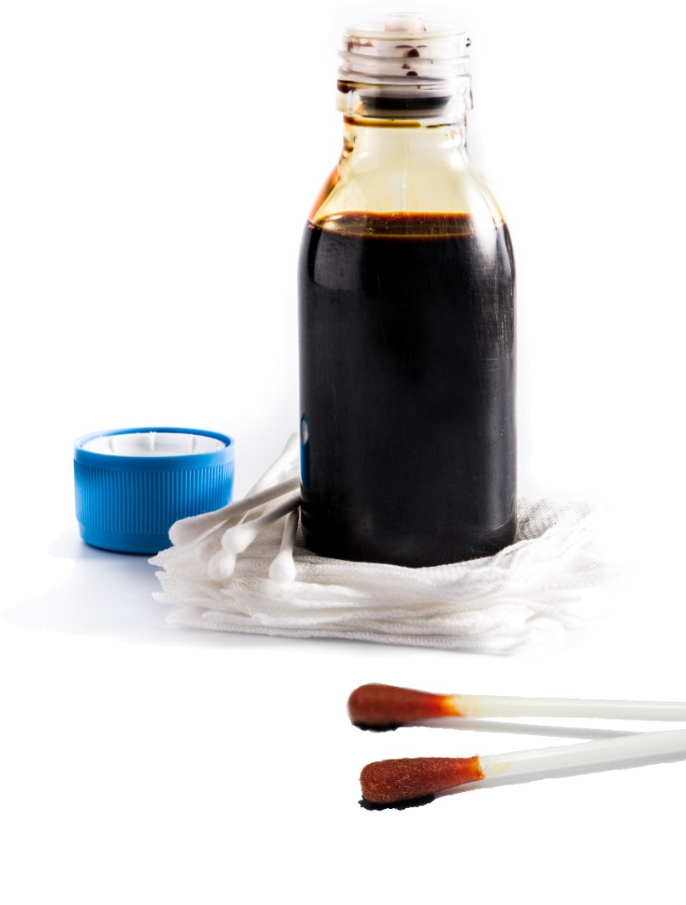
Procedure for Nasal Iodophor
Protocol:
Have patient blow their nose into a tissue to clear nostrils.
Place head of patient’s bed at 30 degrees, if tolerated.
Insert an iodophor swab into one nostril and rotate for 30 seconds, covering all surfaces of the inner nostril.
  Firm contact is needed; nares should bulge when applying.
Discard swab.
Using the second swab, repeat step 2 for the other nostril.
  Avoid contact with eyes and other intranasal products. ​
Side effects are uncommon, most often nasal irritation, runny nose, and sneezing.
  Other side effects of burning, stinging, or itching are rare.
Do not allow the patient to blow their nose AFTER using nasal iodophor. If solution drips, dab with tissue.
Protocol for decolonization with iodophor is different from pre-operative use.
  Ensure these distinctions are addressed in order sets and staff training.

Slide 27
Other Nasal Medicine and Nasal Devices^{1,2}
Patient should continue to use any other nasal medicines as prescribed.
  Prescriptions may not be compatible. Discuss with the patient’s provider.
Removable nasal devices:
  If tolerated, briefly remove nasal prongs, etc.
Nasal endotracheal tube or nasogastric tubes:
  Apply decolonization product to area around the tube.
Recent nasal surgery or trauma:
  Discuss with your hospital’s ENT surgeons to establish guidelines for specific circumstances.

Slide 28
Do’s and Don’ts of Decolonization
DO
  DO use CHG for all bathing needs.
  DO massage CHG firmly onto skin.
  DO pay special attention to neck, joints, and skin folds.
  DO clean 6 inches closest to the body of any lines, tubes, or drains.
  DO use CHG over superficial wounds, sutures, and semipermeable dressings.
  DO only use CHG-compatible skin products.
DON’T
  DO NOT get CHG into eyes or ear canals.
  DO NOT rinse or wipe off CHG. Let air dry.
  DO NOT use on deep or large wounds.
  DO NOT flush CHG cloths.
  DO NOT save open packs for later use.
  DO NOT use on patient if allergic.
Download as a one-pager here: Decolonization Do’s and Don’ts (.docx)

Slide 29

Resources for Staff Training
Tools & Resources for Decolonization: Staff Training Materials Webpage
  Nursing Protocol Training PowerPoint: Decolonization With CHG (.pptx)
  Nursing Protocol Training PowerPoint: Nasal Decolonization (.pptx)
  Staff FAQs: CHG, Nasal & Wound Care
    Frequently asked questions from staff on the topic of decolonization
  Staff FAQs: Safety & Side Effects
    Frequently asked questions on safety and side effects
  Decolonization Do’s and Don’ts
    Reminder sheet of important Do’s and Don’ts
  Talking Points for Patients: CHG Bathing
    Common questions and key talking points from patients on CHG bathing
  Talking Points for Patients: Nasal Decolonization
    Common questions and key talking points from patients on nasal decolonization

Slide 30
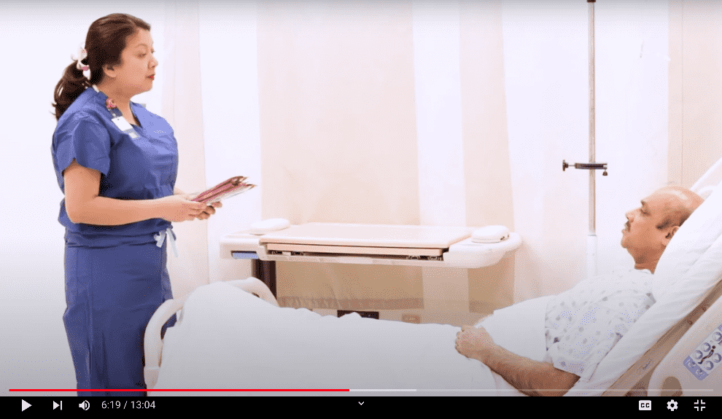
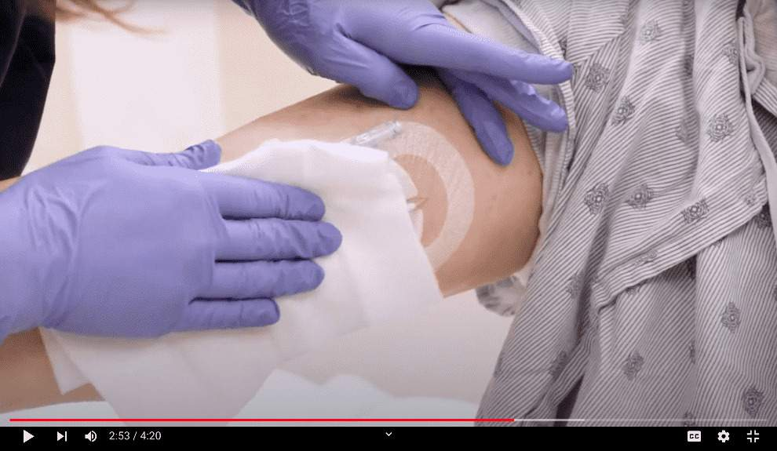
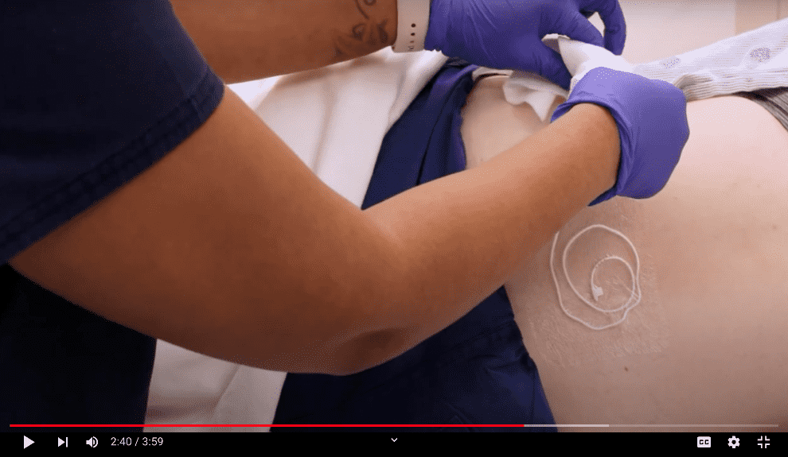
Training Videos for Decolonization
ABATE Toolkit for Decolonization of Hospital Non-ICU Patients With Indwelling Devices: Overview¹⁰
ABATE Toolkit: Cleaning Central and Midline Catheters With CHG¹¹
Below is a list of topics presented in this video, along with corresponding timepoints and direct links.
ABATE Toolkit: Cleaning Lumbar Drains With CHG¹²
Topics | Timepoint
Instructions for Bed Bath Using CHG Cloths | 2:38 – 4:26
Instructions for Bed Bath Using Diluted CHG | 4:27 – 5:38
Instructions for Patient Showering with CHG | 9:00 – 10:23
Scenario: Talking to a Patient about CHG | 5:38 - 7:37
Scenario: Teaching a Patient to Shower with CHG | 7:38 – 8:59
Scenario: Talking to a Patient about Mupirocin | 10:24 – 11:54
From the “ABATE Toolkit for Decolonization of Non-ICU Patients With Devices”.
While these were created with non-ICU in mind, they are suitable for all acute care settings.

Slide 31
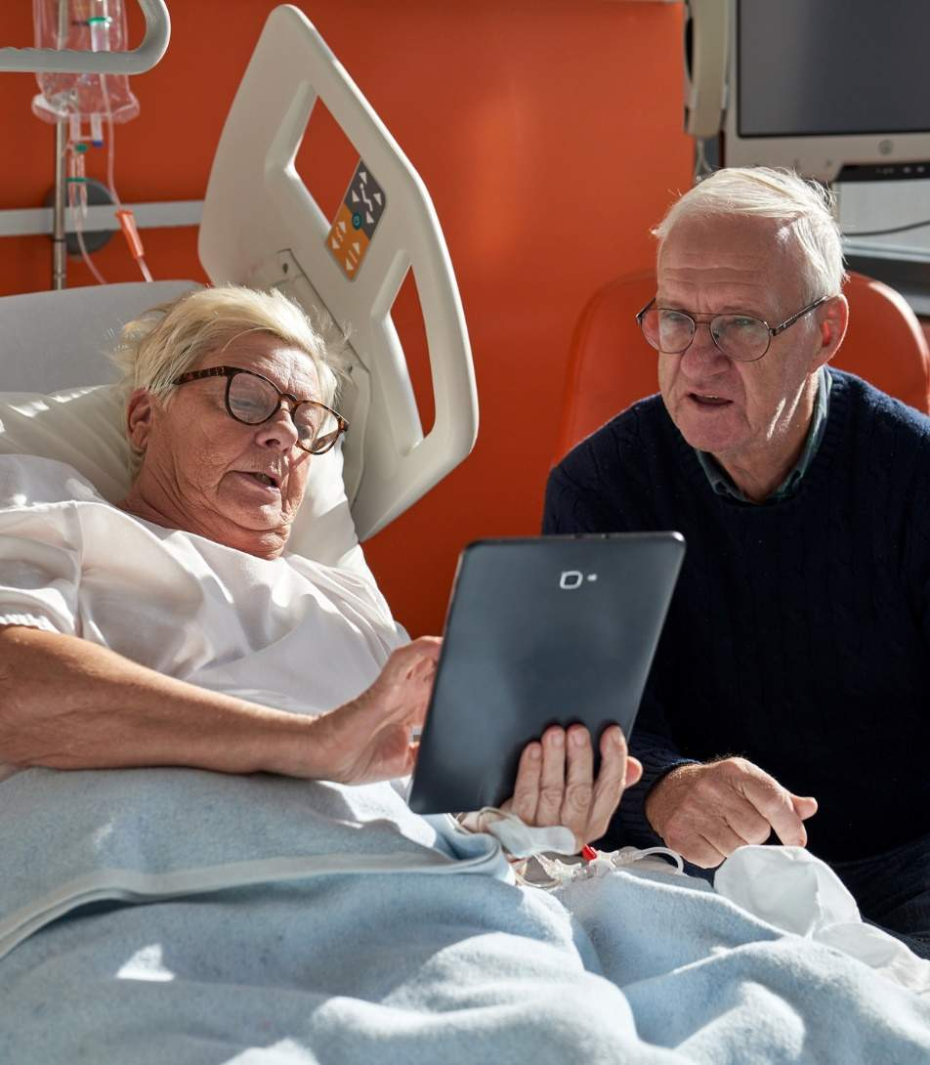
Resources for Patient Education
Tools & Resources for Decolonization: Patient Educational Resources Webpage
  Info Sheet for Patient & Family: Daily Bathing With CHG
    Information sheet on the importance of CHG bathing
  Patient Instruction Sheet: Bathing With CHG Cloths
    Patient instructions for bathing using CHG cloths
  Patient Instruction Sheet: Showering With CHG
    Patient instructions for showering with CHG
  Wall Poster: CHG Bathing Reminder
    Reminder poster designed for placement in visible areas
  Talking Points for Patients: CHG Bathing
    Key talking points for patients on CHG decolonization
  Talking Points for Patients: Nasal Decolonization
    Key talking points for patients on nasal decolonization

Slide 32

Top 10 Pearls for Success
Tips and Tricks for Successful Implementation

Slide 33
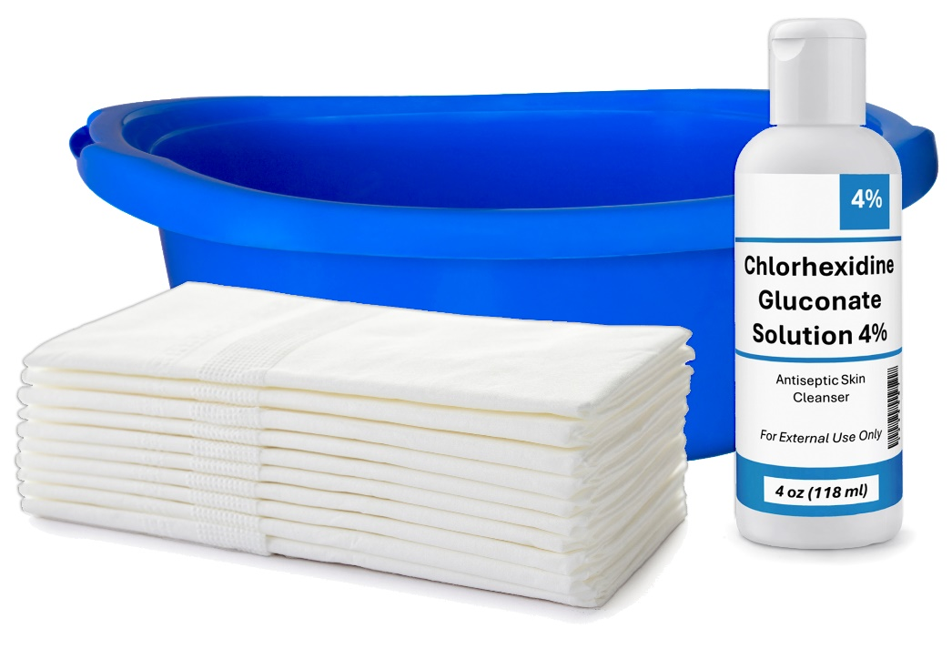
#1: CHG Is the Bath, Not a Topcoat^{1,2}
CHG is not a “topcoat” to be used after regular soap.
Apply firmly to remove grime and massage into skin.
CHG works better than regular soap and water:
  Binds to skin and continues to kill germs for 24 hours
  Removes germs and all multidrug-resistant organisms
  Improves skin health and reduces infection

Slide 34
#2: Cleaning Face and Hair Is Important
CHG is safe to use on face and hair.
Face and nose area harbor substantial germs.
Like all soap, avoid eyes and ear canals.
  Primary concern is that CHG may come into direct contact with nervous tissue, e.g., due to ruptured ear drum.
CHG can be used to clean hair.
  Shampoo can inactivate the CHG.

Slide 35
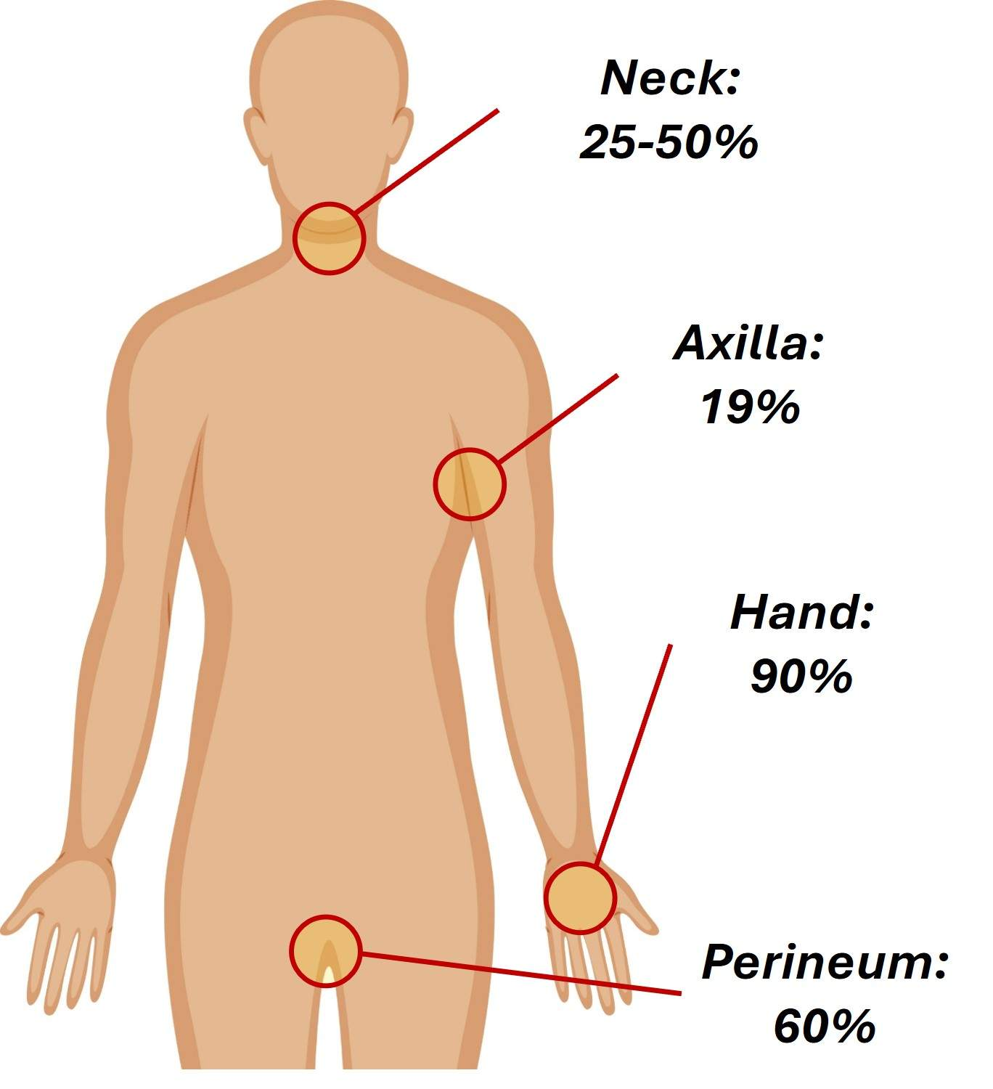
#3: Be Attentive to Commonly Missed Areas
Remind staff about commonly missed, high-risk areas:
  Neck
  Armpits
  Between skin folds
  Back of knee
  Between fingers
Neck often has more bacteria than the groin because staff regularly clean the groin, but often forget about the neck.
Be sure to fully air dry any CHG.
Data on this diagram is from Wertheim et al., 2005.¹³

Slide 36
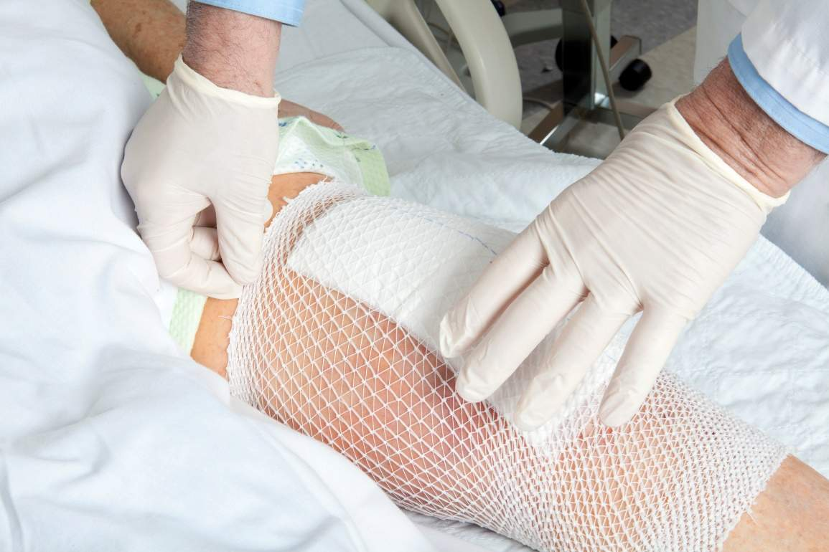
#4: Clean Wounds and Rashes With CHG
Infection risk is highest with breaks in skin.
CHG is safe on rashes, friable skin, abrasions, superficial burns, and wounds that are not packed or deep.
CHG is approved as a wound cleanser.
Encourage wound care nurses to provide support to staff who are uncomfortable.

Slide 37
#5: Clean All Medical Devices
All lines, tubes, and drains provide an opportunity for germs.
CHG is safe on devices.
  Central lines, drains, tubes, and catheters.
Clean the skin around each device to remove bacteria.
  Clean over semipermeable dressings.
Clean 6 inches of connections and devices closest to body.
  Staff should make sure devices are cleaned.

Slide 38
#6: Allow CHG to Dry
Do NOT wipe off CHG or towel dry after application.
CHG binds to skin proteins and continues to kill germs.
Works for up to 24 hours.
CHG residual on skin helps protect. Do not rinse or wipe off.
CHG is effective against Candida species.
  Allow skin folds to dry – fan dry or prop with rolled towels.
  Improves Candida/yeast rashes.
  If moisture stays within skin folds, it can make a Candida rash worse.

Slide 39
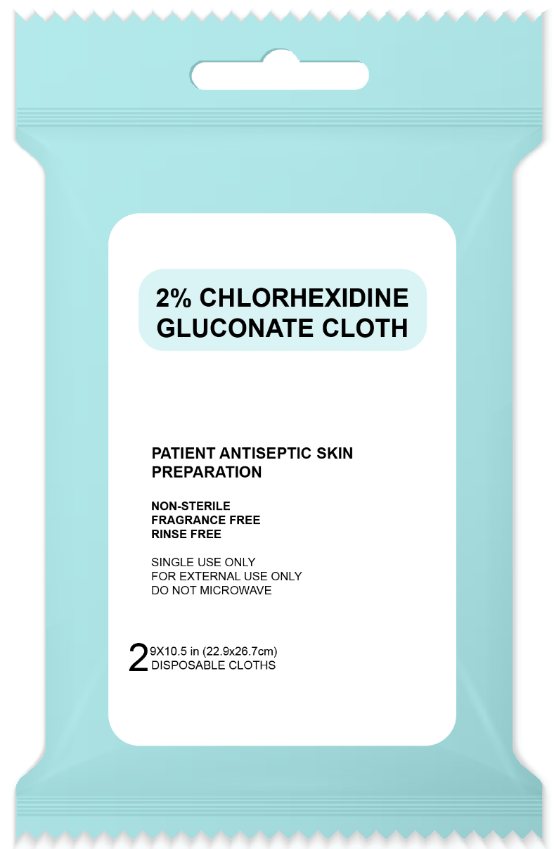
#7: Apply CHG Closest to the Skin
CHG should be applied closest to the skin, to bind skin proteins and kill germs.
CHG-compatible lotions or creams should be applied after the CHG.
For incontinence clean up:
  Clean soilage with water and wipes or disposable cloths.
  Reapply CHG if skin breaks or wounds are present in area.
  Apply CHG-compatible barrier protection, if needed.
Do not use products that are not compatible with CHG.

Slide 40

#8: How CHG Is Applied Matters
Bathing is not intuitive.
  Leads to incorrect assumptions among staff
If not done correctly, there is no benefit.^{14,15}
Training is imperative for success.
  High turnover of staff
  Multiple competing knowledge priorities

Slide 41

#9: Nasal Decolonization Is Important¹⁶⁻¹⁹
MRSA carriage is the most common risk factor for infection.
The nose is the primary reservoir for MRSA.
From the nose, MRSA spreads to other body areas.
  Majority of infecting strains match nasal strain
Nasal decolonization is critical to protecting patients from MRSA.
  Safe and easy to do
  Decreases infections in MRSA carriers

Slide 42
#10: Try, Try Again
Create a plan for how staff can re-approach refusers.
Determine why patient is refusing
(e.g., in pain, uncomfortable, too tired, cold, hungry).
  Ask if a later time would be better.
  The number one reason for refusing nasal decolonization or CHG is not understanding its importance.
  Re-approach patient to confirm understanding.
  Inform nurse manager for another effort to explain its value.

Slide 43

Implementation Considerations
Important Steps for Implementation

Slide 44
Admission Bath Is Critically Important
  Unit admission is one of the most important times to get rid of germs being brought into the hospital and unit.
  Patients don’t feel well when they arrive and may not have bathed in days. They bring in germs, including multidrug-resistant organisms.
  Bathing upon unit admission not only protects the patient, but also other patients on the unit.

Slide 45

Order Set—Pearls^{1,2}
Develop order sets for each unit.
Admission bath is important.
Nasal decolonization:
  Twice daily, for 5 days
  If two or more doses missed, restart.
  If readmitted, restart.
  For ICUs, nasal product ends on ICU discharge, although some hospitals choose to finish 5-day course while inpatient.
  For non-ICUs, nasal product ends after the course or upon discharge.

Slide 46
Pre-Launch One-Time Skin Check
When staff are unfamiliar with CHG, it can help to check for and document skin lesions, wounds, or rashes before the very first day of the program.
  Do a one-time check for Candida rashes, heat rashes, drug eruptions, vesicles, etc.
Staff who have concerns about adopting CHG bathing may be more attentive to patients’ skin after starting to use CHG and may misattribute skin issues that already existed to CHG.
This can also help reassure patients.

Slide 47
Value of Checking Adherence
Monitoring adherence is crucial to the success of any decolonization program.
  How will you know that the decolonization is being done? How will you monitor this?
  EHR is essential for this purpose.
Can a report be generated?
  Has a CHG bath been given?
  Has admission bathing been done?
  Are the reasons for lapses reasonable?
  Are certain staff, units, or shifts doing better than others?
If adherence is low, provide support/use huddle documents.
Encourage order sets and documentation.

Slide 48
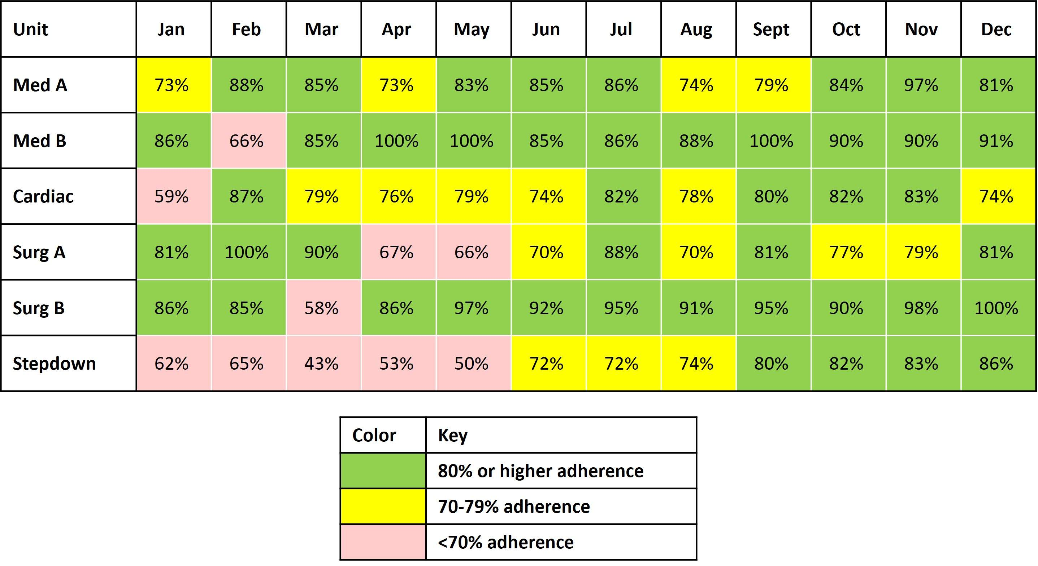
Sample CHG Bathing Adherence Report
Download a Sample Adherence Report template here.

Slide 49

Implementing Decolonization: A Case Example
An Example of Decolonization in Action

Slide 50
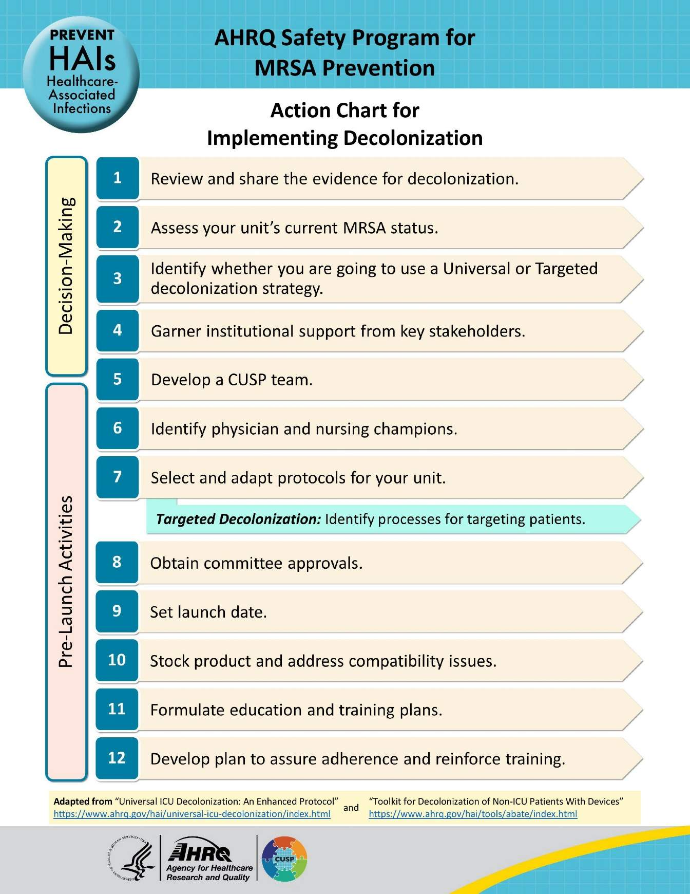
The 4 Es and Implementation
The 4 Es ensure the intervention is implemented across all appropriate patients.
Engage: How can we engage hearts and minds?
Educate: How can we turn the evidence into behavior?
Execute: What do we need to do? How can we do it?
Evaluate: How do we know if we made a difference?
More can be accessed in the section on the 4 Es on the Toolkit website.
Download: Action Chart for Implementing Decolonization

Slide 51


Case Example: Reviewing Evidence, Assessing Current Status, Garnering Support
MediocreCare Hospital
Had a significant MRSA outbreak this year
Had a significant MRSA outbreak last year
Currently at risk of losing accreditation due to deficiencies in infection prevention
For more on these steps, refer to Decision-Making and Readiness for Implementation.
Three units, an ICU and two non-ICUs, decide to set up a decolonization program.
The team first reviews the evidence on decolonization.
The team assesses their current status. They gather baseline data on MRSA cultures and bloodstream infection rates for each unit.
The team garners institutional support by engaging with leadership and staff, making connections and sharing their findings.
  Communicate the problem: Bring the MRSA issue to their attention.
  Propose solution: Explain the process of decolonization and its benefits.
  Communicate project goals: Establish targets of the decolonization program.

Slide 52

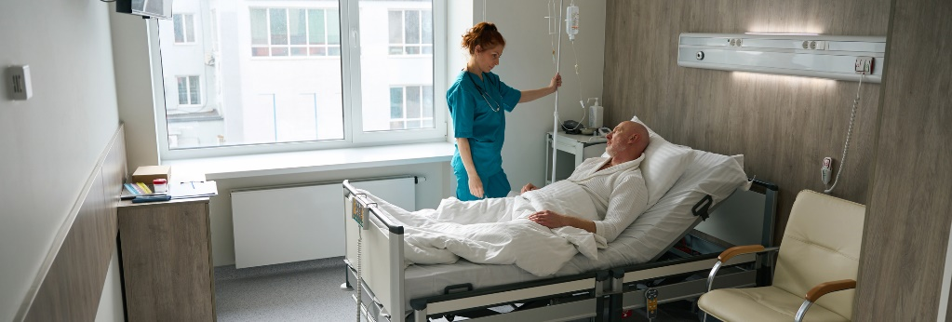

Case Example: Deciding on Universal Versus Targeted
Team will decide on universal or targeted strategies unit-by-unit.
  Cardio ICU: Implements a universal protocol
    Strongly supported for ICU^{3,4}
  General Med: Adopts a targeted protocol
    Targets patients with central lines, midline catheters, PICC lines, or lumbar drains⁵
  Progressive Care Unit: Adopts universal protocol due to patient vulnerability
    High percentage of patients with invasive devices
For a detailed algorithm, refer to Which Type of Decolonization Would Work Best in My Unit?

Slide 53

Case Example: Developing a CUSP Team, Identifying Champions, Developing Protocols
For more detail on these steps, refer to the guide on Pre-Launch Activities.
The CUSP team organizes into a more formal working group.
  Regular meetings are scheduled.
  Roles and responsibilities are assigned.
Decolonization champions are identified among physicians and nurses.
  More resources on How To Integrate a CUSP Approach on the Toolkit website.
The team collaborates with other departments to finalize protocols and develop order sets.
For the targeted protocol, the team sets up process to identify patients with devices.

Slide 54


Case Example: Obtaining Approvals, Setting Launch Date, Stocking Product, Addressing Compatibility
The team is careful to navigate the necessary committee approvals.
The launch date is set.
The team ensures all necessary products are in stock.
  Collaborates with supply chain department for CHG
  Collaborates with pharmacy for mupirocin
Team conducts a thorough compatibility review and makes changes to products when necessary.

Slide 55
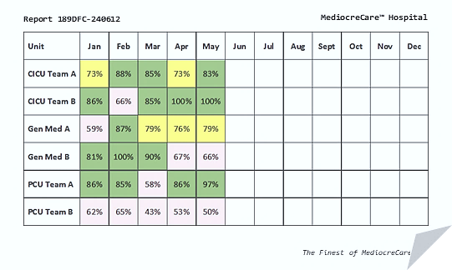
Case Example: Formulating Education and Training Plan, Developing a Feedback Plan
Team develops their education plan to match the needs and knowledge gaps.
  Facilitated by strong staff engagement
Training emphasizes hands-on demonstrations, effective for teaching complex techniques.
Decolonization is documented in EHR to generate regular adherence reports.
  Effective data monitors compliance, reinforces training, and identifies issues
Regular audits conducted by direct observation allows the team to monitor correct technique, especially at program start.
Download this Sample Adherence Report template.
Visit the Staff Training Materials section on the Toolkit website.

Slide 56



Case Example: Launch, Monitoring, Adjustment
Data monitoring and feedback used to identify issues and make adjustments, including:
  Staff are uncertain about CHG use on wounds.
    Appoint champions to guide staff on wound care
  Self-bathing patients are not provided sufficient instruction.
    Suspend self-bathing option
    Develop staff training to improve patient education
  Brown stains on laundry, caused by reaction of CHG residue and chlorine bleach.
    Recommend a switch to peroxide bleach
    Advise staff to avoid used CHG cloth contact with bed
    Remind staff not to flush CHG cloths

Slide 57



Case Example: Results
After 6 months, data show significant reductions in MRSA and bloodstream infections.
The success is shared widely, including in the hospital newsletter.
  Celebrating staff success boosts motivation and commitment.
Leadership decides to expand decolonization to all of MediocreCare Hospital.
The original CUSP team is happy to support broader rollout and share their lessons learned.
  “Learn Locally, Share Globally”

Slide 58
Key Takeaways
Successful implementation of decolonization requires engagement, preparation, and coordination.
  The Toolkit for MRSA Prevention offers tools and resources, including guides for planning, sample protocols, training materials, and patient resources.
There are various strategies and methods of decolonization, with advantages and disadvantages.
  Select protocols based on suitability and appropriateness to your unit’s needs.
Implement robust data and feedback mechanisms to monitor compliance, track progress, and identify areas for improvement.
Make sure staff are well trained in decolonization procedures and understand the importance of their efforts.
After launch, keep regularly reviewing the data, and make adjustments to ensure effective implementation.

Slide 59
Disclaimer
The findings and recommendations in this presentation are those of the authors, who are responsible for its content, and do not necessarily represent the views of AHRQ. No statement in this presentation should be construed as an official position of AHRQ or of the U.S. Department of Health and Human Services.
Any practice described in this presentation must be applied by healthcare practitioners in accordance with professional judgment and standards of care in regard to the unique circumstances that may apply in each situation they encounter. These practices are offered as helpful options for consideration by healthcare practitioners, not as guidelines.

Slide 60
Reference List—1
Universal ICU Decolonization: An Enhanced Protocol. Agency for Healthcare Research and Quality. https://www.ahrq.gov/hai/universal-icu-decolonization/index.html. Accessed June 9, 2022.
Toolkit for Decolonization of Non-ICU Patients with Devices. Agency for Healthcare Research and Quality. https://www.ahrq.gov/hai/tools/abate/index.html. Accessed June 9, 2022.
Huang SS, Septimus E, Kleinman K, et al. Targeted versus universal decolonization to prevent ICU infection. N Engl J Med. 2013 Jun 13;368(24):2255-65. PMID: 23718152.
Huang SS, Septimus E, Avery TR, et al. Cost savings of universal decolonization to prevent intensive care unit infection: implications of the REDUCE MRSA trial. Infect Control Hosp Epidemiol. 2014 Oct;35 (Suppl 3):S23-31. PMID: 25222894.
Huang SS, Septimus E, Kleinman K, et al. Chlorhexidine versus routine bathing to prevent multidrug-resistant organisms and all-cause bloodstream infections in general medical and surgical units (ABATE Infection trial): a cluster-randomised trial. Lancet. 2019 Mar 23;393(10177):1205-15. PMID: 30850112.

Slide 61
Reference List—2
Popovich KJ, Lyles R, Hayes R, et al. Relationship between chlorhexidine gluconate skin concentration and microbial density on the skin of critically ill patients bathed daily with chlorhexidine gluconate. Infect Control Hosp Epidemiol. 2012;33(9):889-96. PMID: 22869262.
Patients with Devices: Prevent Infections During the Hospital Stay- Basin Bed Bathing with Chlorhexidine (CHG) Liquid. Agency for Healthcare Research and Quality. https://www.ahrq.gov/hai/tools/abate/handouts.html. Accessed June 9, 2022.
SHIELD: Eliminating Multidrug-Resistant Organisms; FAQ: Wound Care. UCI Health. https://www.ucihealth.org/shield/hospital-decolonization-toolkit. Accessed August 16, 2024.
Huang SS, Septimus E, Kleinman K, et al. Universal chlorhexidine bathing plus nasal mupirocin versus iodophor to prevent Staphylococcus aureus and bloodstream infections in adult ICUs: a pragmatic cluster-randomized clinical trial. JAMA. 2023 Oct 10;330(14):1337-47. PMID: 37815567.
ABATE Toolkit for Decolonization of Hospital Non-ICU Patients with Indwelling Devices: Overview. Agency for Healthcare Research and Quality. https://www.youtube.com/watch?v=bQ9MP4dOOhg&feature=youtu.be. Accessed August 16, 2024.

Slide 62
Reference List—3
ABATE Toolkit: Cleaning Central and Midline Catheters with CHG. Agency for Healthcare Research and Quality. https://www.youtube.com/watch?v=Id2OhR0Sx5c. Accessed August 16, 2024.
ABATE Toolkit: Cleaning Lumbar Drains with CHG. Agency for Healthcare Research and Quality. https://www.youtube.com/watch?v=jXdbSNcv6oY. Accessed August 16, 2024.
Wertheim HF, Melles DC, Vos MC, et al. The role of nasal carriage in Staphylococcus aureus infections. Lancet Infect Dis. 2005 Dec;5(12):751-62. PMID: 16310147.
Popovich KJ, Hota B, Hayes R, et al. Daily skin cleansing with chlorhexidine did not reduce the rate of central-line associated bloodstream infection in a surgical intensive care unit. Intensive Care Med. 2010 May;36(5):854-8. PMID: 20213074.
Supple L, Kumaraswami M, Kundrapu S, et al. Chlorhexidine only works if applied correctly: use of a simple colorimetric assay to provide monitoring and feedback on effectiveness of chlorhexidine application. Infect Control Hosp Epidemiol. 2015 Sep;36(9):1095-7. PMID: 26074153.

Slide 63
Reference List—4
Frank DN, Feazel LM, Bessesen MT, et al. The human nasal microbiota and Staphylococcus aureus carriage. PLoS One. 2010 May 17;5(5):e10598. PMID: 20498722.
von Eiff C, Becker K, Machka K, et al. Nasal carriage as a source of Staphylococcus aureus bacteremia. study group. N Engl J Med. 2001 Jan 4;344(1):11-6. PMID: 11136954.
Huang SS, Diekema DJ, Warren DK, et al. Strain-relatedness of methicillin-resistant Staphylococcus aureus isolates recovered from patients with repeated infection. Clin Infect Dis. 2008 Apr 15;46(8):1241-7. PMID: 18444862.
Perl TM, Cullen JJ, Wenzel RP, et al. Intranasal mupirocin to prevent postoperative Staphylococcus aureus infections. N Engl J Med. 2002 Jun 13;346(24):1871-7. PMID: 12063371.

