Slide 1
AHRQ Safety Program for MRSA Prevention
Decolonization With Chlorhexidine Gluconate (CHG) Nursing Protocol Training
ICU & Non-ICU
AHRQ Pub. No. 25-0007
October 2024

Slide 2
Educational Objectives
This PowerPoint is intended to assist training of healthcare personnel in skin decolonization with chlorhexidine gluconate (CHG).
Multiple methods of CHG bathing are discussed in these slides, including:
Bed bathing with 2% CHG impregnated cloths
Bed bathing with basin and 2% CHG solution
Patient self-bathing with CHG cloths
Patient showering with 4% CHG liquid
You should edit and customize these training slides to match your unit’s chosen methods and protocols.

Slide 3
Training Objectives
From this training you will learn:
How to use chlorhexidine gluconate (CHG) for skin decolonization
How to address special circumstances related to CHG bathing
This training module will take approximately 15 minutes to complete.

Slide 4
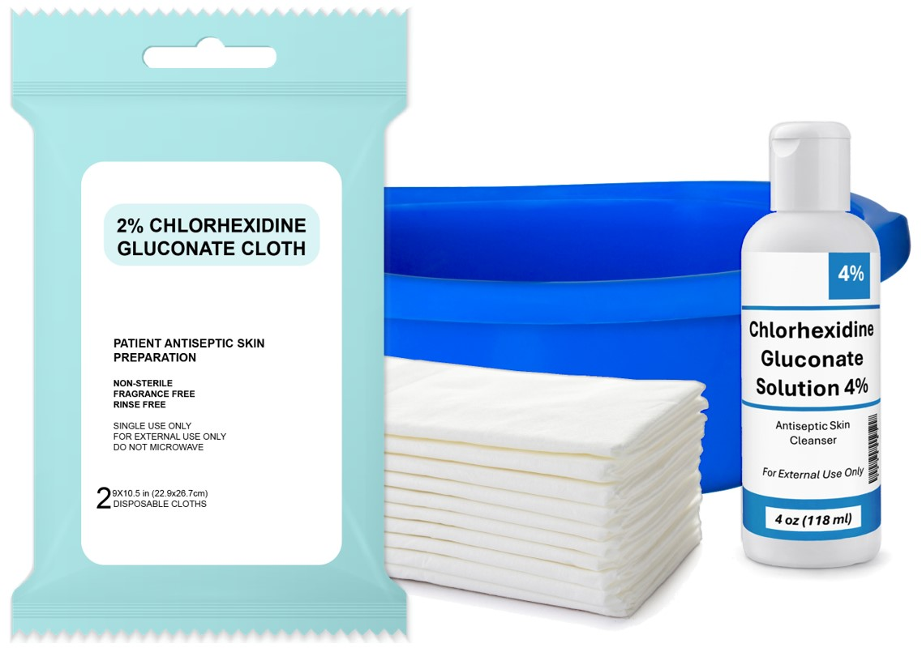
What Is Decolonization?
Decolonization is the use of topical antiseptic soaps and nasal products to reduce bacteria from the body surface.
Decolonization is proven in hospital settings to reduce the occurrence of antibiotic-resistant bacteria and bloodstream infections.

Slide 5
Why Are We Using CHG Decolonization?
Bacteria on a patient’s skin can progress to severe infection during hospital stays due to the heightened risk from wounds, medical devices, and poor health of the patient.
Decolonization has been shown to prevent infections:
Among patients with multidrug-resistant organisms
In hospital intensive care units (ICUs)
Among hospitalized patients with medical devices
In long-term acute care hospitals

Slide 6
What Is Chlorhexidine Gluconate (CHG)?
Chlorhexidine gluconate (CHG) is a topical antiseptic that is effective at killing bacteria.
Once applied, CHG will continue to work to keep germs off the skin for 24 hours.
CHG works better than regular soap and water to remove bacteria and is also less drying.
CHG is safe for use on the face, perineum, and external mucosa.
Avoid eyes and ear canals.

Slide 7
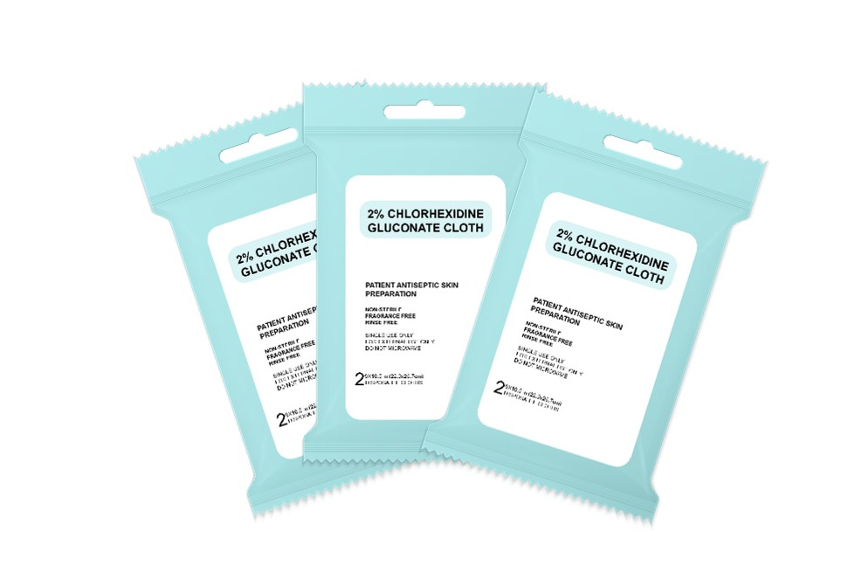
How Do I Perform Decolonization?
Daily CHG baths are given to a patient.
Use CHG instead of regular soap for all bathing needs for the patient’s entire unit stay.
Do NOT use regular soap. Other soaps can inactivate CHG.
Massage CHG firmly onto all areas of patient’s body.
Pay special attention to skin folds, neck, and joints.
If patients have any devices (lines, tubes, drains, etc.), then the devices must be cleaned with CHG as well.

Slide 8
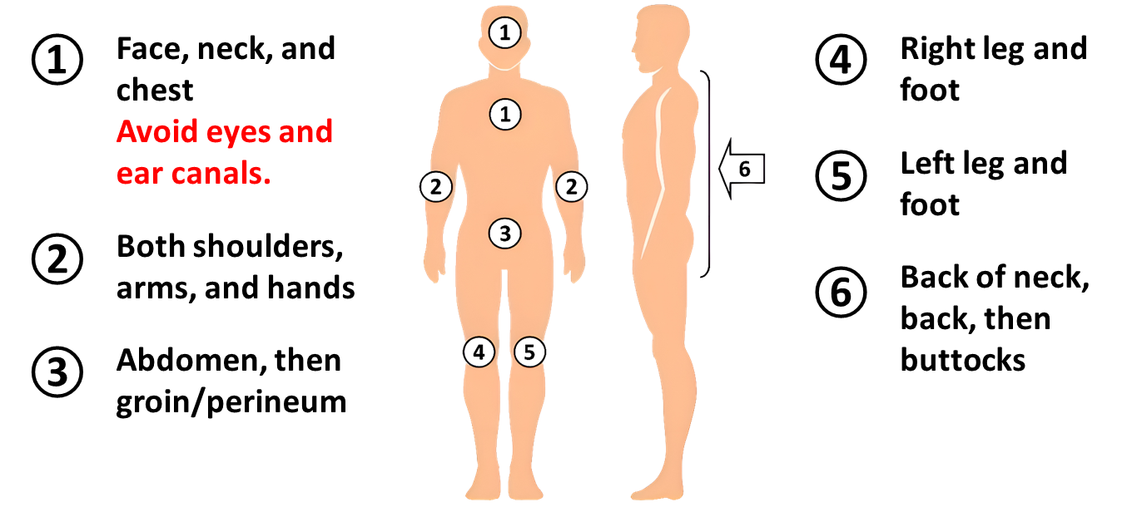
CHG Bathing Procedure
Use one cloth for each section – 6 cloths in total.
Air dry. Do NOT rinse.
Apply CHG to the body in the following order, from ① to ⑥:

Slide 9
CHG Bathing Procedure: Notes
Do not rinse or wipe off CHG. CHG must be allowed to fully dry to be effective.
Patients may complain about a sticky feeling. This will go away when the CHG fully dries in a few minutes.
Patients should only use skin and hair products (e.g., lotions, powders) that are provided by the unit.
Skin and hair products often contain ingredients that can inactivate CHG.
Dispose used cloths in the trash.
Do NOT flush cloths in the toilet.
The cloths WILL CLOG toilets.

Slide 10
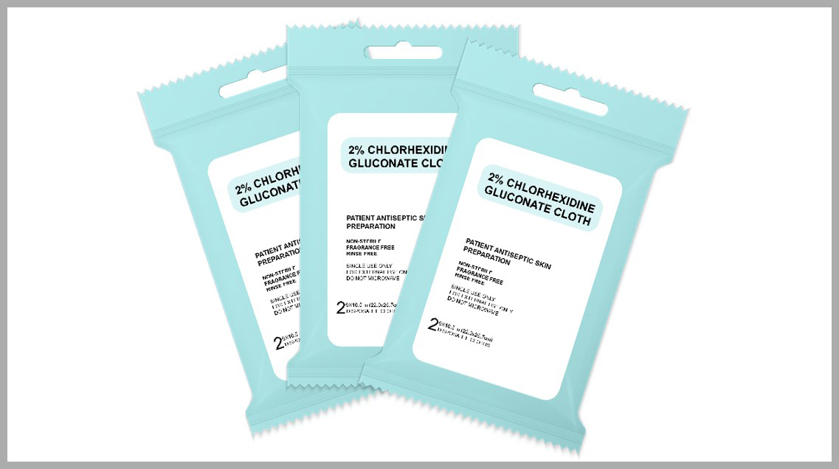
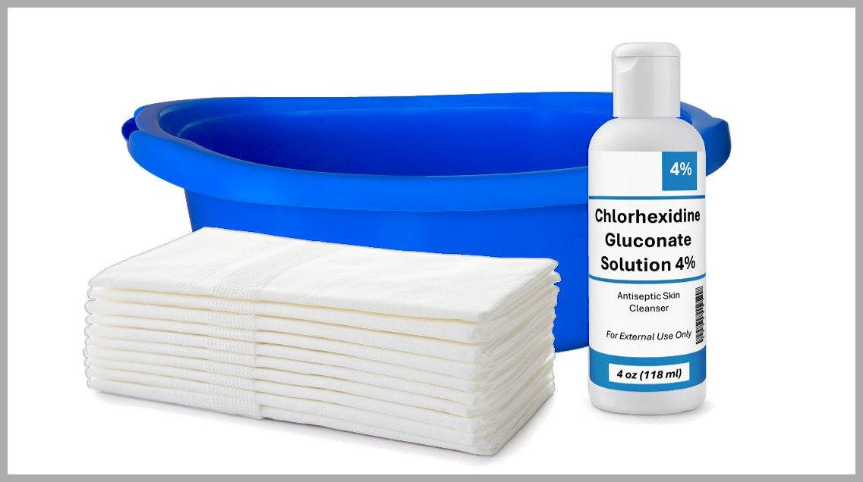
Methods for Applying CHG
Bath with 2% CHG pre-impregnated cloths:
Use 6 cloths/wipes per bath.
No rinse – air dry only.
Bath with 2% CHG solution:
Dilute a bottle of 4% CHG to 2%.
Requires basin and disposable cloths.
No rinse – air dry only.
Showering with 4% liquid CHG:
Patient conducts own shower.
Not diluted for showering.
Rinse off after 2 minutes.

Slide 11
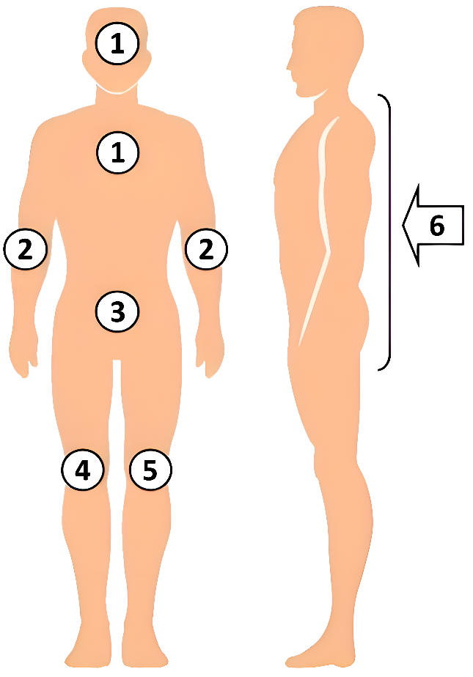
CHG Cloths: Bathing With 2% CHG Cloths
Use 6 CHG cloths or wipes per patient.
Use 1 cloth per body area.
Typically, there are 2 or 6 cloths per packet.
If extra cloths are needed, 6-cloth packets can be separated into 2-cloth “singles.”
Do NOT reuse cloths.
Bathe patients with CHG cloths for entirety of unit stay.
Use CHG cloths for all patient bathing needs.

Slide 12
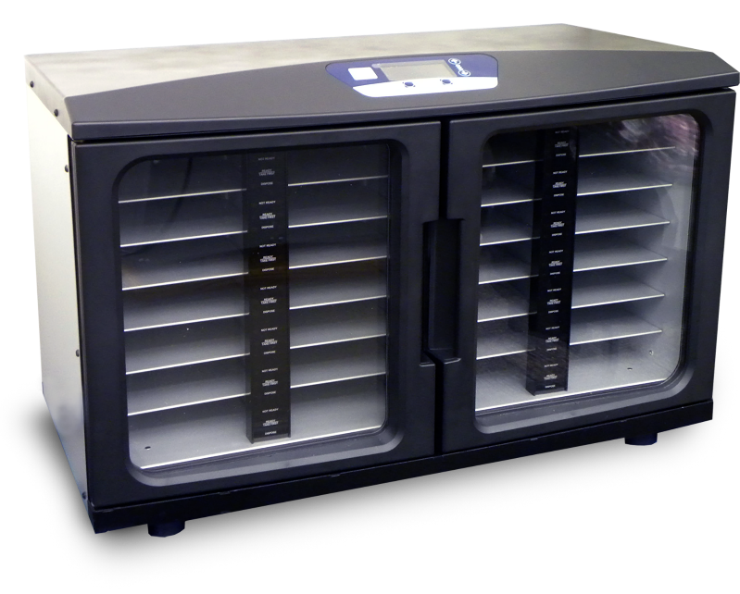
CHG Cloths: Using a Cloth Warmer
Warmers keep CHG packets heated for patient comfort.
Warming is for comfort only. CHG will still work at room temperature.
Packets are usually ready for use after about 2 hours.
Replace packets you remove with a new one in the warmer.
If a packet has been in the warmer too long, it will need to be disposed.
Do NOT rewarm cloths.
Source: Stryker Corp. Image used with permission.
Refer to manufacturer guidance for detailed instructions.
Caution: Check temperature of cloths with bare hand prior to use. Gloves can diminish sense of heat.
Place any separated 2-cloth singles back into an individual slot.

Slide 13
CHG Cloths: Patient Self-Bathing
Some patients may ask to apply their own CHG. They may do so using the CHG impregnated cloths.
Provide the patient with the patient instruction sheet and the packet of CHG cloths.
Demonstrate and explain how to use the CHG correctly.
Instruction sheet is not a substitute for your demonstration.
Make sure patient understands they should let the CHG air dry, and not to rinse or wipe it off.
Remind patients to avoid getting the CHG in their eyes or ear canals.
Cleaning of wounds, dressings, and devices should be done by you.
You should also assist with any hard-to-reach areas the patient has missed.

Slide 14
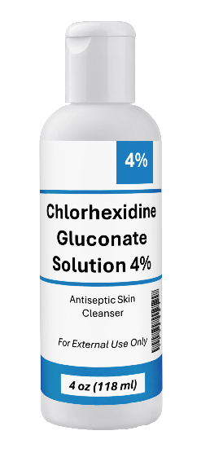
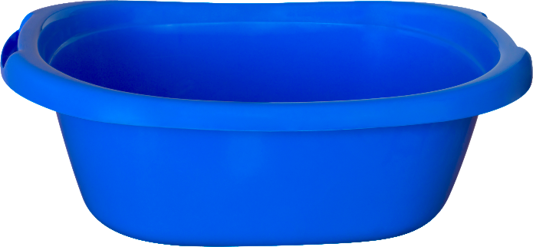
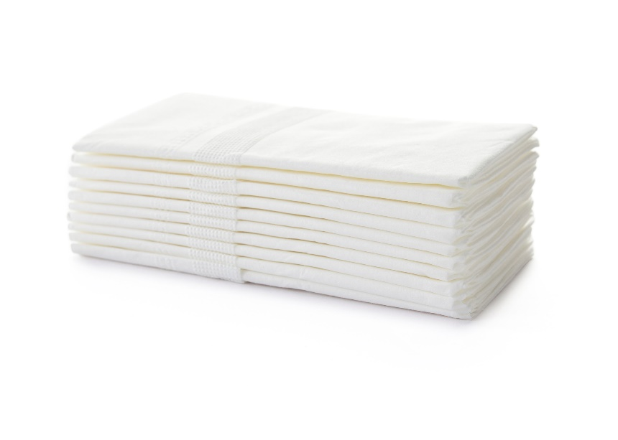
CHG Basin Bath: Bathing With 2% CHG Solution
What you will need:
One 4 oz. bottle of 4% liquid CHG
Bath basin
Six disposable non-cotton cloths

Slide 15
CHG Basin Bath: Procedure
Empty one 4 oz. bottle of 4% CHG liquid into a basin.
Fill the 4 oz. bottle with water and empty it into the basin.
Do NOT over-dilute. Use only equal parts of water and CHG.
Soak disposable cloths in basin. Wring out cloth prior to applying.
Only soak and wring out each cloth once. Do NOT re-soak or place used cloths back in basin.

Slide 16
Patients Showering With 4% CHG Liquid
Some patients may ask to apply their own CHG. If they prefer, they may apply their own CHG in the shower.
Provide the patient with the patient instruction sheet.
Demonstrate and explain how to use the CHG correctly.
Instruction sheet is not a substitute for your demonstration.
Make sure the patient understands they should allow the CHG to dry for at least 2 minutes before rinsing it off.
Patients will need:
4 oz. bottle of 4% CHG liquid (should not be diluted)
Mesh sponge or non-cotton washcloth
Remind patients to avoid getting the CHG in their eyes or ear canals.
Cleaning of wounds, dressings, and devices should be done by you.
Wrap all the patient’s devices to protect from water in the shower.
You should also assist the patient with any hard-to-reach areas.

Slide 17
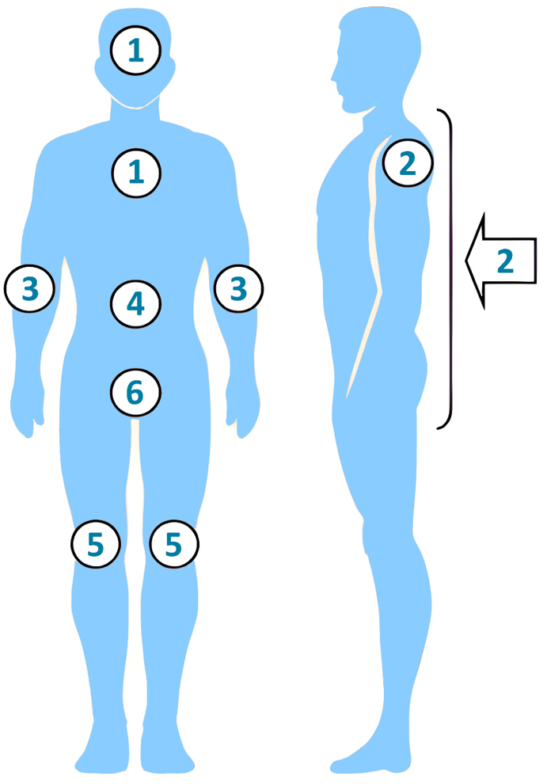
Showering: Giving the Patient Instructions
Clean face with a small amount of CHG. Avoid eyes and ear canals. Rinse well.
Wet your skin with water. Turn water off.
Apply CHG soap to the sponge/cloth.
Clean by massaging your skin firmly, from the head down. Use the diagram as a guide.
Clean your groin and buttocks last.
Allow the CHG to dry on your skin for at least 2 minutes.
Turn water back on and rinse thoroughly.
Note: The order of body parts when showering is different than when using cloths or a basin.
Generally, the goal is to apply CHG from cleanest to dirtiest areas.

Slide 18
If a Patient Asks to Use Own Soap or Shampoo
A possible scenario is that a patient asks to use their own personal facial soap or shampoo.
Encourage patients to use CHG for all soap/shampoo needs while they are in the unit.
Most soaps and shampoos have ingredients that will inactivate CHG.
CHG is safe for use on the face and hair (avoiding the eyes and ear canals).
If a patient insists on using their personal facial soap or shampoo, then have them use it BEFORE applying the CHG.
Advise them to avoid getting the soap/shampoo on other skin areas.
Make sure they rinse off the soap/shampoo thoroughly afterwards.
Patients should NOT use a different soap/shampoo AFTER using CHG.

Slide 19
Should I Use CHG on Lines/Tubes/Drains?
Yes! It is very important to clean all lines, tubes, drains, or other devices with CHG.
Clean the skin around the device thoroughly.
Then clean at least 6 inches nearest to the body of any lines, tubes, drains, or other devices.
Use a clean CHG cloth or an unused section of a CHG cloth.
Clean all connections to devices including:
Urinary catheters
G-tubes, J-tubes
Chest tubes
Rectal tubes
EKG leads and wires

Slide 20
Should I Use CHG on Wounds?
Yes. CHG should be applied to any superficial wounds, including:
Friable skin and rashes
Superficial burns
Superficial pressure injuries (stages 1 and 2)
CHG should also be applied over sutured or stapled wounds.
CHG is not recommended for packed, large, or deep wounds.
CHG does not contain alcohol and should not sting.
Clean wound carefully with CHG.
Apply CHG with firm pressure, unless the wound is over a bony prominence.
If the wound is in the location of a bony prominence, use a gentle massaging motion.

Slide 21
Should I Use CHG on Dressings?
Sometimes. CHG can be applied over semipermeable and occlusive dressings, including vacuum-assisted closures (VACs) and surgical drains.
Clean all tubing within 6 inches of the body.
If the dressing is permeable (e.g., gauze), then use CHG up to the edge of the dressing but not on its surface.
You may have trouble reapplying a bandage before the CHG fully dries.
CHG should dry in less than 5 minutes.
Do NOT wipe off the CHG. It must be allowed to air dry.

Slide 22
CHG for Obese Patients
For larger patients (>300 lbs.), you may need more than the usual 6 cloths. Use as many cloths as necessary.
Pay extra attention to neck, joints, and all skin folds.
Lift skin folds to clean with CHG.
Make sure that after the CHG is applied, all areas are exposed to air and allowed to dry. Do NOT wipe off.
Using rolled towels to prop open the skin folds may help.
For all patients, you may need extra cloths if additional bathing is required (e.g., incontinence, sweating, or other reasons).

Slide 23
CHG and Incontinence
Do NOT use regular soap to clean incontinent patients.
Regular soap will inactivate the CHG.
Remove urine and stool with non-medicated disposable wipes/cloths and water. Do NOT use soap.
After removing soilage, if there is evidence of skin breakdown or wounds in the area, clean skin again with CHG and air dry.
Apply CHG-compatible barrier protection, if needed.
Use only barrier products compatible with CHG.
If additional bathing is required during the day, clean with CHG, and reapply CHG-compatible barrier protection as needed.

Slide 24
Talking to Patients About CHG
Patients may need encouragement to receive their daily bath.
Most patients agree to CHG once they understand its purpose.
Your enthusiasm is critical.
Some talking points for your patients:
“The bath will only take about 10 minutes.”
“CHG serves as your protection to prevent infection.”
“CHG reduces germs on your skin better than soap and water.”
If your patient declines, try again later in the day.
For tips on addressing some common reasons for patient refusals, refer to Talking Points for Patients: Chlorhexidine Bathing.

Slide 25
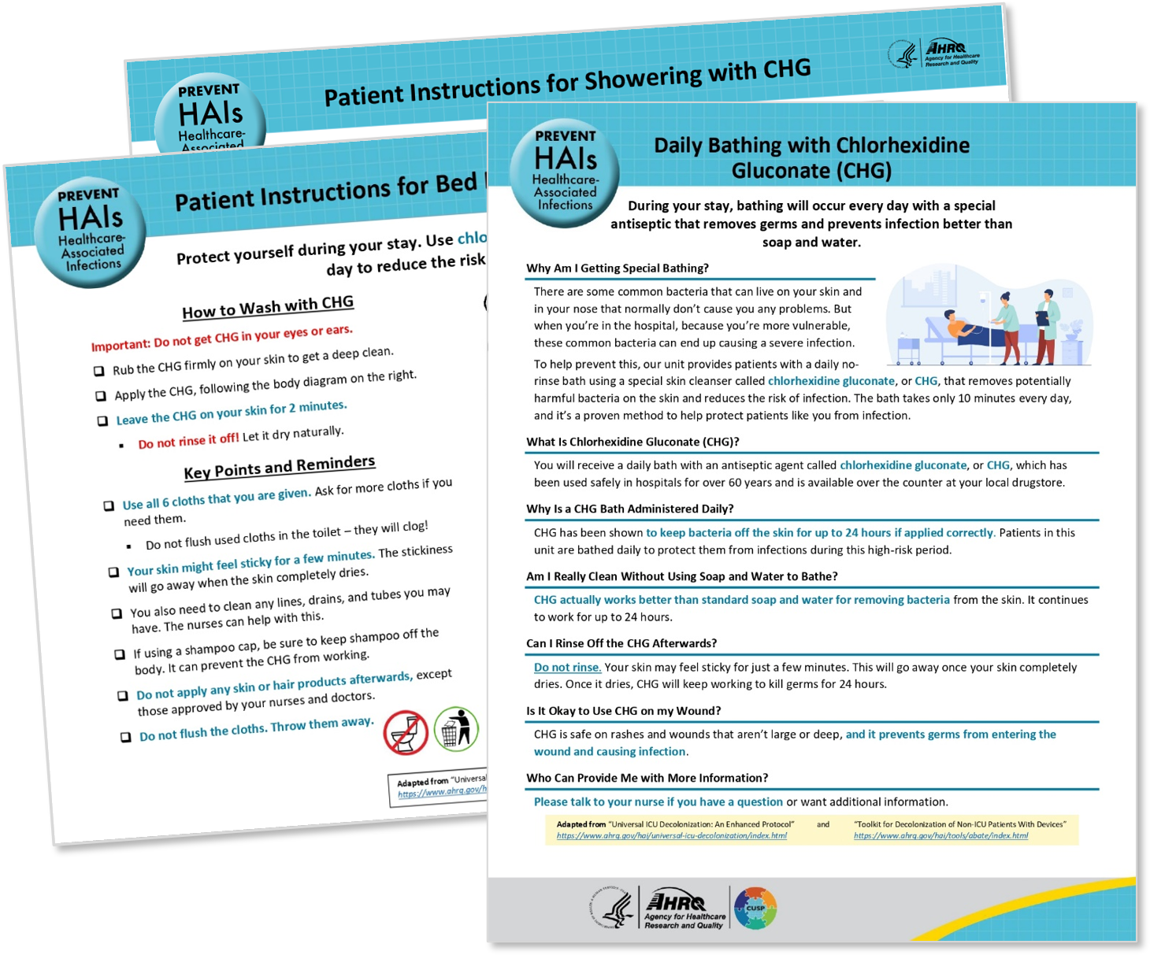
Patient Information Sheets
Informational sheets (like the ones shown here) are available for distribution to patients and families.
Providing patients with these sheets prior to bathing will save time but is not a substitute for your verbal teaching.
Links to patient resources:
Daily Bathing With CHG (Patient Info Sheet)
Patient Instructions for Bed Bath With CHG Cloths
Patient Instructions for Showering With CHG

Slide 26
Additional Notes on CHG
Avoid placing CHG-soaked cloths or spilling CHG liquid directly on bedsheets.
CHG can produce a brown-colored stain if it contacts bleach during the laundry cycle.
Once applied to skin, CHG binds to skin proteins and will not stain sheets.
Decolonization protocol doesn’t impact other protocols that your unit already has in place. Maintain your existing protocols for:
Surgical skin prep
Pre-operative bathing with CHG
Hand hygiene
Contact or isolation precautions

Slide 27
Commonly Missed Bathing Practices
Cleaning the 6 inches of any lines, drains, and tubes closest to the body, as well as cleaning over non-absorbable dressings.
After the body is finished, always remember to clean all devices and dressings, too.
Ensuring that CHG is applied to skin with a firm massage.
A light touch might not get enough CHG onto the skin. You need to get full coverage of the patient’s whole body.
Using the CHG on superficial wounds, and stage 1 and 2 pressure injuries.
CHG should be used on all superficial wounds, to help prevent infections. Refer to the slides on Wound Care.

Slide 28
Do’s and Don’ts of Decolonization
DO
DO use CHG for all bathing needs.
DO massage CHG firmly onto skin.
DO pay special attention to neck, joints, and skin folds.
DO clean 6 inches closest to the body of any lines, tubes, or drains.
DO use CHG over superficial wounds, sutures, and semipermeable dressings.
DO only use CHG-compatible skin products.
DON’T
DO NOT get CHG into eyes or ear canals.
DO NOT rinse or wipe off CHG. Let air dry.
DO NOT use on deep or large wounds.
DO NOT flush CHG cloths.
DO NOT save open packs for later use.
DO NOT use on patient if allergic.
Download as a one-pager here: Decolonization Do’s and Don’ts (.docx)

