Slide 1
AHRQ Safety Program for MRSA Prevention
Nasal Decolonization Nursing Protocol Training
ICU & Non-ICU
AHRQ Pub. No. 25-0007
October 2024

Slide 2
Educational Objectives
This PowerPoint is intended to assist training of healthcare personnel in nasal decolonization.
Different nasal decolonization agents are discussed in these slides, including:
  Nasal mupirocin ointment
  Nasal iodophor (10% povidone-iodine)
You should edit and customize these training slides to match your unit’s chosen methods and protocols.

Slide 3
Training Objectives
From this training you will learn:
  What nasal decolonization is
  How to implement nasal decolonization with mupirocin and nasal iodophor (10% povidone-iodine)
  How to address special circumstances related to nasal decolonization
This training module will take approximately
5 minutes to complete.

Slide 4
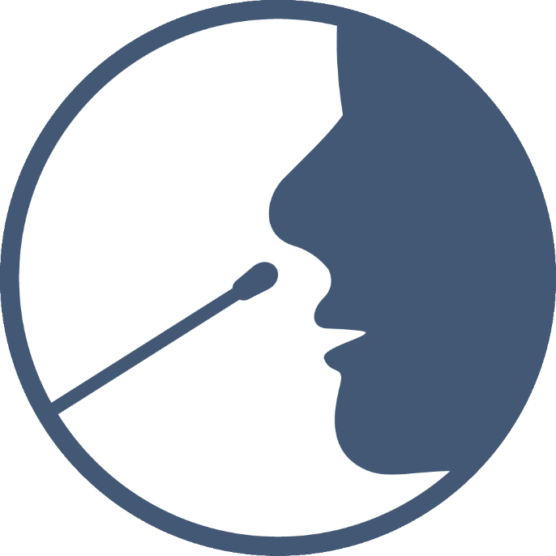
Why Are We Using Nasal Decolonization for Patients?
Nasal decolonization has been shown to prevent infections:
  For patients with multidrug-resistant organisms
  In hospital ICUs
  In long-term acute care hospitals
  In hospital non-ICU patients with devices
Methicillin-resistant Staphylococcus aureus (MRSA), in particular, is known to reside inside the nose.
Risk of severe MRSA infection is elevated during hospital stays.

Slide 5
How Do I Perform Nasal Decolonization?
Initial Course
Administer nasal decolonization 2x a day for a total of 5 days, starting on the day of admission to the unit.
Duration and Restarting Protocol
If a patient is admitted for longer than 2 weeks, restart the 5-day course from Day 1.
For new patient transfers or readmissions, start a new 5-day course, regardless of previous decolonization in another unit.
If unable to track administration for current patients, start a new 5-day course.

Slide 6
Managing Nasal Decolonization
Missed Doses
Resume nasal decolonization as soon as possible on the original schedule if a dose is missed.
Do not double up doses.
Restart the 5-day course from the beginning if more than 2 doses are missed.
Temporary Transfers
Maintain the nasal decolonization protocol for patients temporarily transferred for radiology or surgical procedures.

Slide 7
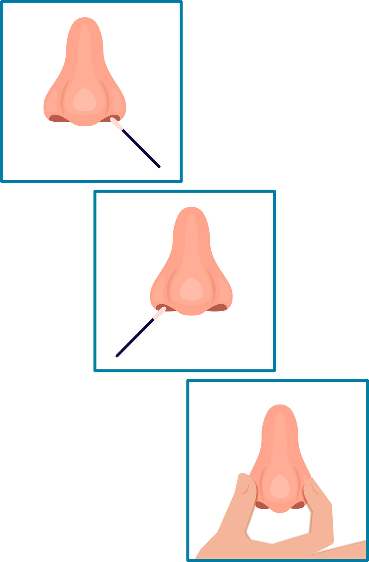
How To Apply Nasal Mupirocin Ointment
Wash hands and don gloves.
Dispense 0.5 grams of mupirocin (pea-sized amount) for each nostril onto two new clean swabs before entering patient room.
Have patient blow their nose into a tissue to clear nostrils.
Place patient’s bed at 30 degrees, if tolerated.
Apply single dose into each nostril using swab applicator.
Press patient’s nostrils together and massage gently for 60 seconds.
Avoid contact with eyes and other intranasal products.

Slide 8
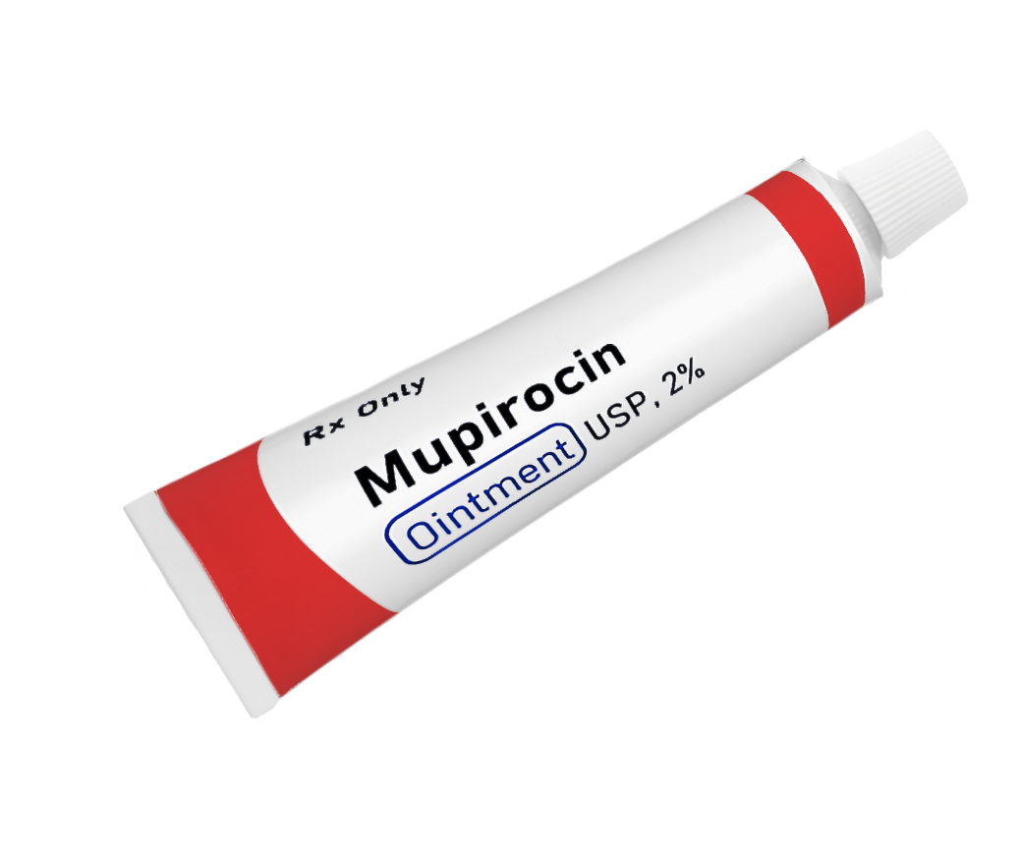
Notes on Nasal Mupirocin
Do not allow patient to blow their nose AFTER mupirocin is applied.
Mupirocin requires a physician order. Contact treating physicians to place the order if necessary.
Side effects include nasal irritation, runny nose, and sneezing. These are uncommon and resolve with discontinuation.
  Other side effects involving burning, stinging, or itching are rare.
The most common complaint is that the ointment feels thick or goopy.
  Having the patient blow their nose before can help.
  Massaging the patient’s nose also helps to alleviate the goopiness.
  You can have the patients perform the massaging themselves if they are able.

Slide 9
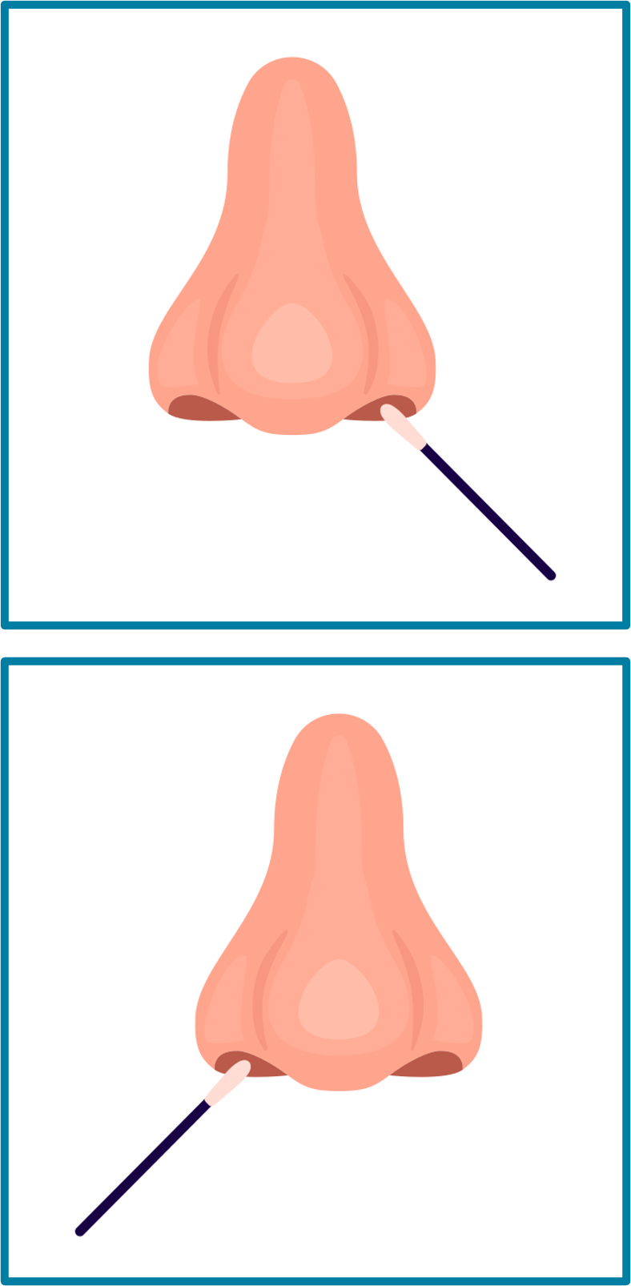
How To Apply Nasal Iodophor
Wash hands and don gloves.
Have patient blow their nose into a tissue to clear nostrils.
Place patient’s bed at 30 degrees, if tolerated.
Insert swab into nostril and rotate for 30 seconds, covering all surfaces.
  Apply in a circular manner to coat entire surface of inner nostril.
  Firm contact is needed, and a bulge should be seen as the swab is applied.
Discard swab.
Using the second swab, repeat step 2 in the other nostril (swab 2).
Avoid contact with eyes and other intranasal products.

Slide 10
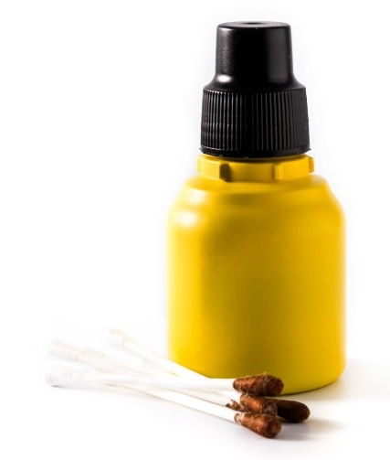
Notes on Nasal Iodophor
Advise the patient not to blow their nose AFTER nasal decolonization.
  If solution drips, dab the patient’s nose with tissue.
Nasal iodophor does not require a prescription and can be used for nasal decolonization under a standardized nursing protocol.
Side effects include nasal irritation, runny nose, and sneezing. These are uncommon and resolve with discontinuation.
  Other side effects involving burning, stinging, or itching are rare.

Slide 11
Other Nasal Medicine / Nasal Devices
Patient should continue to use any other nasal medicines as prescribed.
  Some nasal products may not be compatible with the decolonization agent. Check with their provider.
  If possible, separate the provision of those medications from nasal decolonization application by several hours.
Removable nasal devices:
  If tolerated, briefly remove nasal prongs, etc., before applying any agent for nasal decolonization.
Nasal endotracheal tube/nasogastric tubes:
  Apply decolonization agent to area around the tube.
Nasal trauma:
  If the patient has had a recent nasal surgery or trauma, work with your hospital’s ENT surgeons to establish some general guidelines for specific circumstances.

Slide 12
Talking Points for Patients
Patients may refuse the protocol, but your enthusiasm and encouragement can often help them understand the value of nasal decolonization.
Talking points might include:
  “Some bacteria live in the nose and can increase your risk of infection.”
  “We routinely use this special product in the nose to get rid of bacteria to reduce the risk of infection during your stay.”
If your patient declines a bath, try again later in the day.
For tips on addressing some common reasons for patient refusals, please review Talking Points for Patients: Nasal Decolonization.

