Slide 1
AHRQ Safety Program for MRSA Prevention
Why Choose a CUSP Approach?
ICU & Non-ICU
AHRQ Pub. No. 25-0007
October 2024

Slide 2
Educational Objectives
Describe the Comprehensive Unit-based Safety Program (CUSP)
Explain the cultural influence CUSP can have on safety and teamwork
Define the core roles that compose a successful CUSP team

Slide 3
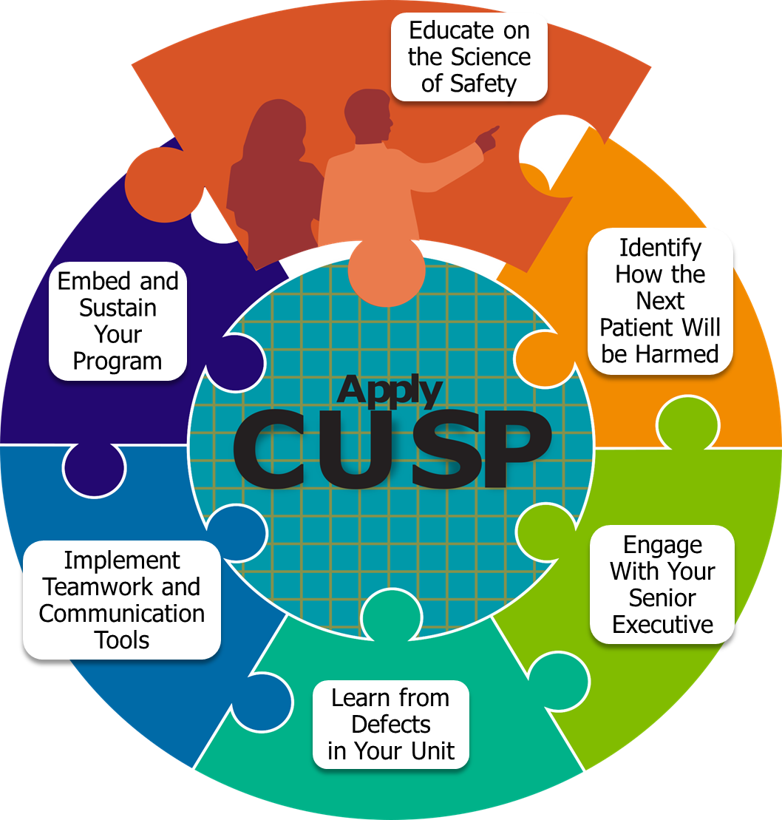
Comprehensive Unit-based Safety Program (CUSP)
Comprehensive Unit-based Safety Program (CUSP) is designed to improve patient safety culture and reduce preventable harm in healthcare settings.¹
Proven, consistent success in patient safety and quality improvement efforts since 2002.
Demonstrated improvements in patient safety outcomes.
Emphasizes interdisciplinary action, instilling safety culture, and fostering collaboration and accountability.

Slide 4
CUSP Resources
AHRQ CUSP Core Toolkit
Main CUSP toolkit on the AHRQ website
MRSA Prevention Team Checkup Tool
A progress tool to collect information on staff actions and adherence to guidelines
CUSP Roles and Responsibilities Tool
Identifies team members and describes team roles and responsibilities
Staff Safety Assessment
Gathers staff insight on safety issues and areas for improvement
Learning From Defects Tool
Guides teams through the Learning From Defects process
LFD Investigating a Defect Worksheet
Summary worksheet of the Learning From Defects

Slide 5
Background³
CUSP acknowledges that healthcare can be complicated, and sometimes unsafe.
Developed as a method for multidisciplinary teams to identify safety issues, a.k.a. “defects.”
Defect: Any clinical or operational event or situation that you do not want to have happen again.⁴
Emphasizes engaging with frontline staff and empowering them to speak up and lead safety efforts, with the active support of leadership.

Slide 6
How Can Healthcare Be Unsafe?
Healthcare at every level is made up of many microsystems which are not perfect.
Healthcare workers are fallible.
Every system is perfectly designed to achieve the results it gets.

Slide 7
CUSP
Comprehensive:
Includes all people
Unit-based:
Focused on local culture and issues
Safety:
Specific to safety concerns
Program:
Infrastructure that supports an evidence-based methodology to address issues

Slide 8
The Goal of CUSP
Improving safety and quality through multi-disciplinary partnerships and local ownership.
CUSP is done with a team, not to a team.
What is learned by one CUSP team should be shared broadly so that others can benefit.

Slide 9
CUSP Vision
CUSP aims to eliminate preventable harm.
The CUSP culture empowers teams to achieve excellence in patient safety and quality.
CUSP enables all to speak up when they have safety concerns, without fear.
CUSP keeps an eye on systems, rather than blaming people.
CUSP enables teams to see defects as opportunities for continuous learning.

Slide 10
CUSP Promotes a Culture of Safety⁵
Adaptive work changes the attitudes, values, and beliefs of people taking part in technical work: a focus on culture.
Example: An evidence-based protocol (technical work) will only affect outcomes if staff understand, value, and prioritize (adaptive work) use of the protocol.⁶

Slide 11
Why Does Culture Matter?
Culture influences how people feel about their work setting, teamwork, communication, and outcomes.
Culture can enhance or inhibit effects of other interventions.
Perceptions of safety culture can change through intervention.

Slide 12
Safety Culture Is Related to Outcomes⁷
Patient outcomes⁸⁻¹¹
Patient care experience
Infection rates, sepsis
Post-op hemorrhage
Respiratory failure or puncture/laceration
Treatment errors
Healthcare worker outcomes^{12,13}
Incident reporting
Burnout and turnover

Slide 13
Statewide Michigan CUSP ICU Results^{14,15}
Pre-CUSP: Statewide average in 2004: 42.5 percent to 46.5 percent
With CUSP: Average increase of 4 percent to 10 percent in 2007

Slide 14
CUSP Implementation Has Been Associated With:
A 66 percent reduction in catheter-related bloodstream infections among 103 ICUs.^{17,18}
A 71 percent reduction in ventilator-associated pneumonia infections among 112 ICUs.¹⁹
A 10 percent reduction in Michigan hospital mortality compared to 350 hospitals in surrounding states.²⁰
A 40 percent reduction in central-line associated bloodstream infections among more than 1,000 hospitals.²¹
A $1.1 million annual savings for the average hospital.²²
A 33 percent reduction in surgical site infections.²³
Significant improvements in safety climate, teamwork climate, and nurse turnover rates.^{14,24}

Slide 15
Successful CUSP Teams: Members
Composed of engaged frontline clinicians who take ownership of patient safety
Include staff members who have different levels of experience and perspectives
Represent all stakeholders by bringing multiple disciplines together

Slide 16
Successful CUSP Teams: Meetings
Meet regularly.
Have adequate resources, including protected time (2 to 4 hours/week).
Share leadership.
Work together to make decisions.
Avoid preconceived notions.
Break down silos within unit/work area and between units/work areas.

Slide 17
Science of Safety
The Science of Safety focuses on principles of safe system designs and provides new lenses for staff to recognize that every system is designed to achieve the results it gets. ​
Members of the CUSP team are encouraged to watch the AHRQ Science of Safety video.²⁵
Please visit the Understanding the Science of Safety module of the Core CUSP Toolkit²⁶ for more information.

Slide 18
For More On CUSP
Core CUSP Toolkit²
Modules:
Learn About CUSP²⁷
Assemble the Team²⁸
Engage the Senior Executive²⁹
Understand the Science of Safety³⁰
Identify Defects Through Sensemaking³¹
Implement Teamwork and Communication³²
Apply CUSP³³
The Role of the Nurse Manager³⁴
Spread³⁵
Patient and Family Engagement³⁶

Slide 19
Key Takeaways
CUSP acknowledges that healthcare can be complicated and errors can occur.
CUSP enables all to speak up when they have safety concerns, without fear.
CUSP enables teams to see defects as opportunities for continuous learning.
CUSP teams are composed of frontline clinicians and staff members from multiple disciplines.

Slide 20
Disclaimer
The findings and recommendations in this presentation are those of the authors, who are responsible for its content, and do not necessarily represent the views of AHRQ. No statement in this presentation should be construed as an official position of AHRQ or of the U.S. Department of Health and Human Services.
Any practice described in this presentation must be applied by healthcare practitioners in accordance with professional judgment and standards of care in regard to the unique circumstances that may apply in each situation they encounter. These practices are offered as helpful options for consideration by healthcare practitioners, not as guidelines.

Slide 21
Reference List—1
Pronovost PJ, Weast B, Rosenstein B, et al. Implementing and validating a comprehensive unit-based safety program. Journal of Patient Safety 2005;1(1):33–40.
Core CUSP Toolkit. Agency for Healthcare Research and Quality. https://www.ahrq.gov/hai/cusp/modules/index.html. Accessed June 4, 2024.
Stefl ME. To err is human: building a safer health system in 1999. Front Health Serv Manage 2001;18(1):1-2. PMID: 11589119.
Learn from Defects Tool. Agency for Healthcare Research and Quality. https://www.ahrq.gov/hai/cusp/toolkit/learn-defects.html. Accessed June 13, 2024.
Heifetz RA, Heifetz R, Grashow A, et al. The practice of adaptive leadership: Tools and tactics for changing your organization and the world. Harvard Business Press. 2009.
Sexton JB, Berenholtz SM, Goeschel CA, et al. Assessing and improving safety climate in a large cohort of intensive care units. Crit Care Med 2011 May;39(5):934-9. PMID: 21297460.

Slide 22
Reference List—2
The Joint Commission. Safety culture assessment: Improving the survey process. The Joint Commission Perspectives 2018 Jun;38(6). https://www.jointcommission.org/-/media/tjc/documents/accred-and-cert/safety_culture_assessment_improving_the_survey_process.pdf. Accessed June 6, 2024.
Huang D, Clermont G, Kong L, et al. Intensive care unit safety culture and outcomes: a US multicenter study. International Journal for Quality in Health Care 2010;22(3):151-61. PMID: 20382662.
Mardon R, Khanna K, Sorra J, et al. Exploring relationships between hospital patient safety culture and adverse events. J Patient Saf 2010 Dec;6(4):226-32. PMID: 21099551.
Sorra J, Khanna K, Dyer N, et al. Exploring relationships between patient safety culture and patients’ assessments of hospital care. J Patient Saf 2012 Sep;8(3):131-9. PMID: 22785344.
Weaver SJ. A Configural Approach to Patient Safety Climate: The Relationship Between Climate Profile Characteristics and Patient Outcomes [dissertation]. University of Central Florida. 2011.

Slide 23
Reference List—3
MacDavitt K, Chou SS, Stone P. Organizational climate and health care outcomes. Jt Comm J Qual Patient Saf 2007 Nov;33(11 Suppl):45-6. PMID: 18173165.
Singer S, Falwell A, Gaba D, et al. Identifying organizational cultures that promote patient safety. Health Care Manage Rev 2009 Oct-Dec:34(4):300-11. PMID: 19858915.
Sexton JB, Berenholtz S, Goeschel C, et al. Assessing and improving safety climate in a large cohort of intensive care units. Crit Care Med 2011;39(5):934-9. PMID: 21297460
Sexton J, Helmreich R, Neilands T, et al. The Safety Attitudes Questionnaire: psychometric properties, benchmarking data, and emerging research. BMC Health Services Research 2006;6(44). PMID: 16584553
Pronovost P, Berenholtz S, Goeschel C, et al. Improving patient safety in intensive care units in Michigan. J Crit Care 2008;23(2):207-21. PMID: 18538214.
Pronovost PJ, Needham D, Berenholtz S, et al. An intervention to decrease catheter-related bloodstream infections in the ICU. N Engl J Med 2006 Dec 28;355(26):2725-32. PMID: 17192537.

Slide 24
Reference List—4
Pronovost PJ, Goeschel CA, Colantuoni E, et al. Sustaining reductions in catheter-related bloodstream infections in Michigan intensive care units: an observational study. BMJ 2010;340:c309. PMID: 20133365.
Berenholtz SM, Pham JC, Thompson DA, et al. Collaborative cohort study of an intervention to reduce ventilator-associated pneumonia in the intensive care unit. Infect Control Hosp Epidemiol 2011 Apr;32(4):305-14. PMID: 21460481.
Lipitz-Snyderman A, Steinwachs D, Needham DM, et al. Impact of a statewide intensive care unit quality improvement initiative on hospital mortality and length of stay: retrospective comparative analysis. BMJ 2011 Jan 28;342:d219. PMID: 21282262.
Schmidt B. AHRQ patient safety project reduces bloodstream infections by 40%. Patient Saf Qual Hcare Sep 2012. https://www.psqh.com/news/ahrq-patient-safety-project-reduces-bloodstream-infections-by-40/. Accessed June 5, 2024.
Waters HR, Korn R Jr, Colantuoni E, et al. The business case for quality: economic analysis of the Michigan Keystone Patient Safety Program in ICUs. Am J Med Qual 2011 Sep-Oct;26(5):333-9. PMID: 21856956.

Slide 25
Reference List—5
Wick EC, Hobson DB, Bennett JL, et al. Implementation of a surgical comprehensive unit-based safety program to reduce surgical site infections. J Am Coll Surg 2012 Aug;215(2):193-200. PMID: 22632912.
Timmel J, Kent PS, Holzmueller CG, et al. Impact of the Comprehensive Unit-based Safety Program (CUSP) on safety culture in a surgical inpatient unit. Jt Comm J Qual Patient Saf 2010 Jun;36(6):252-60. PMID: 20564886.
CUSP: Understand the Science of Safety. Agency for Healthcare Research and Quality. https://youtu.be/87zaudxubmA. Accessed June 4, 2024.
Understand the Science of Safety. Agency for Healthcare Research and Quality. https://www.ahrq.gov/hai/cusp/modules/understand/index.html. Accessed June 4, 2024.
Learn About CUSP. Agency for Healthcare Research and Quality. https://www.ahrq.gov/hai/cusp/modules/learn/index.html. Accessed June 4, 2024.
Assemble the Team. Agency for Healthcare Research and Quality. https://www.ahrq.gov/hai/cusp/modules/assemble/index.html. Accessed June 4, 2024.

Slide 26
Reference List—6
Engage the Senior Executive. Agency for Healthcare Research and Quality. https://www.ahrq.gov/hai/cusp/modules/engage/index.html. Accessed June 4, 2024.
Understand the Science of Safety. Agency for Healthcare Research and Quality. https://www.ahrq.gov/hai/cusp/modules/understand/index.html. Accessed June 4, 2024.
Identify Defects Through Sensemaking. Agency for Healthcare Research and Quality. https://www.ahrq.gov/hai/cusp/modules/identify/index.html. Accessed June 4, 2024.
Implement Teamwork and Communication. Agency for Healthcare Research and Quality. https://www.ahrq.gov/hai/cusp/modules/implement/index.html. Accessed June 4, 2024.
Apply CUSP. Agency for Healthcare Research and Quality. https://www.ahrq.gov/hai/cusp/modules/apply/index.html. Accessed June 4, 2024.

Slide 27
Reference List—7
The Role of the Nurse Manager. Agency for Healthcare Research and Quality. https://www.ahrq.gov/hai/cusp/modules/nursing/index.html. Accessed June 4, 2024.
Spread. Agency for Healthcare Research and Quality. https://www.ahrq.gov/hai/cusp/modules/spread/index.html. Accessed June 4, 2024.
Patient and Family Engagement. Agency for Healthcare Research and Quality. https://www.ahrq.gov/hai/cusp/modules/patient-family-engagement/index.html. Accessed June 4, 2024.

