Slide 1
AHRQ Safety Program for MRSA Prevention
How to Integrate a CUSP Approach
ICU & Non-ICU

Slide 2
Educational Objectives
List the key steps to integrating a CUSP approach
Explain the role of the core CUSP team
Define the core roles that compose a successful CUSP team
Review CUSP tools that can enhance the work of your team

Slide 3
Assembling the CUSP Team

Slide 4
Key Steps to Using the CUSP Approach¹⁻⁴
Identify multidisciplinary team members who are interested and willing to participate.
Define the roles of the core team.
The Roles and Responsibilities Tool can guide this process.
Introduce the approach to the entire team.
Establish meeting dates and times.
Include a kick-off date.
Engage staff by asking them to share their concerns specifically related to MRSA, or just in general.
Use the Staff Safety Assessment Tool to facilitate conversations.

Slide 5
Core Team and Team Meetings
The Core Team is responsible for scheduling and running meetings and setting the agenda.
Each meeting should include a review of assigned tasks and previous action items.
Use these resources to assist with meeting prep.
CUSP Monthly Meeting Pre-Work
CUSP Monthly Meeting Agenda Template
Be open and considerate of all thoughts and suggestions.
Provide an open floor to bring up new issues and ideas.

Slide 6
Core CUSP Team Roles
Frontline Staff
The focus of a CUSP team is always centered on patient care.
Each of these roles plays a key part in the CUSP team.
CUSP/Unit Champion
Manager/ Director
Patient & Family
Physician Champion
Senior Hospital Executive
CUSP Facilitator

Slide 7
Patient and Family
Receiver of care
Provides unique perspective
Voices concerns

Slide 8
Manager/Director
Leads local team
Supports champions and CUSP team
Provides resources as needed

Slide 9
Senior Hospital Executive
Provides resources and addresses barriers to implementation
Collaborates with team to problem-solve
Shares team’s success with hospital leadership

Slide 10
CUSP Facilitator
Safety expert
Familiar with CUSP
Coaches the champions
Ensures CUSP is being utilized appropriately

Slide 11
Provider Champion
Serves the patients
Familiar with unit operations
Respected among peers and can act as a liaison

Slide 12
CUSP/Unit Champion
Leads CUSP
Familiar with unit operations
Respected, encourages teamwork and communication

Slide 13
Frontline Staff
Most familiar with defects in service line
Drives the CUSP team with desire for change
Collaborates with other members of CUSP team

Slide 14
Putting CUSP Into Practice

Slide 15
The Purpose of the CUSP Approach
CUSP is led by frontline staff.
CUSP happens WITH others, not BY others.
Improvements that are learned locally should be shared broadly.

Slide 16
Align With Principles of High Reliability
Preoccupation with failure
Reluctance to simplify
Deference to expertise
Sensitivity to operations
Commitment to resilience

Slide 17
Have a Kick-Off!
Introduce the “Science of Safety” to the team.
Emphasize empowerment and engagement
Your voice matters.
You are the expert.
Make it fun!
Consider providing incentives.

Slide 18
Powerful Questions
How will the next patient be harmed?
What can we do to minimize or mitigate that harm?
Gather staff responses and organize by themes to identify trends.
Prioritize issues based on the trends that emerge.

Slide 19
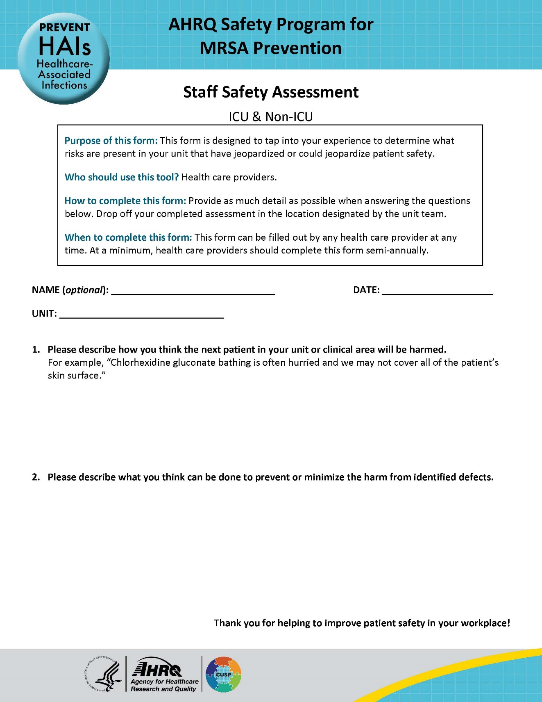
Staff Safety Assessment
The Staff Safety Assessment (SSA) is a survey tool that asks staff to answer these questions.
SSA should be conducted regularly to track progress and identify new issues.
Remember to share findings with staff and keep them engaged.

Slide 20
Learn From These Defects
Prioritize defects for maximum effect: start with ones easy to operationalize interventions for, that have the greatest outcomes on patient safety and quality.
Consider attacking one defect per quarter, or more, depending on your local practices. Set a goal and aim to meet it.
Don’t forget other methods of obtaining data from staff.
Event Reporting
CUSP Meeting Discussions
Briefing/Debriefing

Slide 21
Key Takeaways
A CUSP approach can be used even if you don’t have a formal CUSP team or training
A multidisciplinary core team that understands the operations of the unit is essential and aligns with principles of high reliability
CUSP tools can be accessed via AHRQ and can be used to integrate a CUSP approach

Slide 22
Disclaimer
The findings and recommendations in this presentation are those of the authors, who are responsible for its content, and do not necessarily represent the views of AHRQ. No statement in this presentation should be construed as an official position of AHRQ or of the U.S. Department of Health and Human Services.
Any practice described in this presentation must be applied by healthcare practitioners in accordance with professional judgment and standards of care in regard to the unique circumstances that may apply in each situation they encounter. These practices are offered as helpful options for consideration by healthcare practitioners, not as guidelines.

Slide 23
Reference List
Berenholtz SM, Pham JC, Thompson DA, et al. Collaborative cohort study of an intervention to reduce ventilator-associated pneumonia in the intensive care unit. Infect Control Hosp Epidemiol 2011;32(4): 305-14. PMID: 21460481.
Lipitz-Snyderman A, Steinwachs D, Needham DM, et al. Impact of a statewide intensive care unit quality improvement initiative on hospital mortality and length of stay: retrospective comparative analysis. BMJ 2011;342:d219. PMID: 21282262.
Timmel J, Kent PS, Holzmueller CG, et al. Impact of the Comprehensive Unit-based Safety Program (CUSP) on safety culture in a surgical inpatient unit. Jt Comm J Qual Patient Saf 2010 Jun;36(6):252-60. PMID: 20564886.
Sexton JB, Berenholtz SM, Goeschel CA, et al. Assessing and improving safety climate in a large cohort of intensive care units. Crit Care Med 2011 May;39(5):934-9. PMID: 21297460.
High reliability. Agency for Healthcare Research and Quality. https://psnet.ahrq.gov/primer/high-reliability. Accessed June 26, 2024.
Understand the Science of Safety. Agency for Healthcare Research and Quality. https://www.ahrq.gov/hai/cusp/modules/understand/index.html. Accessed June 26, 2024.

