Slide 1
AHRQ Safety Program for MRSA Prevention
CUSP Program: Sustainability
ICU & Non-ICU
AHRQ Pub. No. 25-0007
October 2024

Slide 2
Educational Objectives
Define sustainability for quality improvement success
Identify key components of sustainability
Identify challenges and successes in sustainability
Describe steps to create and implement a sustainability plan
Define a core Comprehensive Unit-based Safety Program (CUSP) team, roles, and responsibilities
Identify tools to help maintain success

Slide 3
Sustainability Defined¹
Sustainability
…ensures that gains are maintained beyond the life of the project.
…embeds a successful improvement process into the culture and norms of a facility.

Slide 4
Keys to Sustainability²⁻⁴
Initiatives
Align with the mission and vision of the institution
Improve patient care delivery
Manageable impact on staff workload
CUSP Team
Leadership commitment
Psychological safety
Accountability and communication
Enduring processes
Resources and processes remain
Ongoing leadership and staff engagement
Ongoing evaluation of processes

Slide 5
Identify Challenges and Successes^{1,4}
Identify Potential Challenges
Organizational structure
CUSP Team
Buy-in
Workload
Turnover
Engagement
Identify Possible Goals and Outcomes
Improvements met
Improvements not met
Next steps
Ongoing evaluation
Culture change

Slide 6
Challenges and Successes: Personnel⁴
Organizational infrastructure and the CUSP team
Staffing patterns and team members
Psychological safety
Turnover and/or lack of engagement
Project implementation and workload burden
Skill-building
Communication and teamwork

Slide 7
Challenges and Successes: Reaching Goals^{1,4}
What is going on?
Are staff still adherent to MRSA decolonization practices?
Are patient rooms still being disinfected appropriately?
Has antibiotic stewardship changed?
Are central lines removed ASAP?
Are resources still available?
Is data capture accurate and timely?
Check your data!

Slide 8
Steps to Create and Implement a Sustainability Plan²⁻⁴
Start at the beginning of the project.
Identify and maintain the program CUSP team.
Identify champions.
Empower staff to contribute.
Perform a gap analysis.
Ongoing evaluation of the program and plan.
Identify barriers and successes.
Open communication and listening.
Recognize staff and celebrate results.

Slide 9
Maintaining Sustainability²⁻⁴
Provide opportunities for continued education on safety culture
Leadership support
Create data collection processes
Review and display data for continuous improvement
Frontline personnel input and participation
Scheduled review of processes and workload
Dedicated time and resources to sustain the program

Slide 10
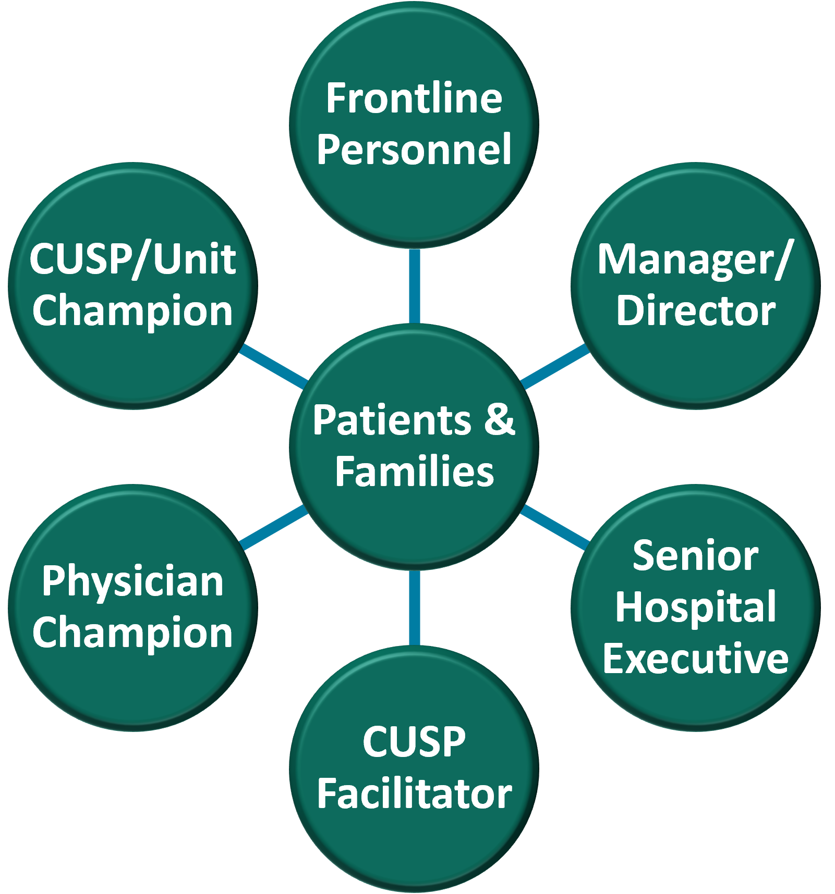
Key Members of the CUSP Team
The CUSP team has a vital role in the delivery of the patient safety initiatives and in transforming the culture of the unit.
The CUSP Team Model diagram depicts the roles included in a CUSP team and emphasizes that patients and families are at the heart of the QI project.
View the CUSP Roles and Responsibilities document for further information on the CUSP team positions.

Slide 11
The Importance of the CUSP Team
Re-evaluate your team.
Are all the roles filled?
Do we have co-champions?
Do members attend meetings?
Are we missing key stakeholders?
The team is the breath that gives life to problem identification, learning from defects, and ongoing success with any or all interventions.

Slide 12
Where, When, and How?
Revisit your meeting schedule.
Consider hybrid meetings.
Consider a revision to the format.
Agenda
Meeting summary
Methodology (Learning From Defects)
Dashboard to measure impact
| 12

Slide 13
Create a 12-Month CUSP Meeting Schedule
Having a schedule allows core team members and frontline personnel to plan the meeting into their calendars.

Slide 14
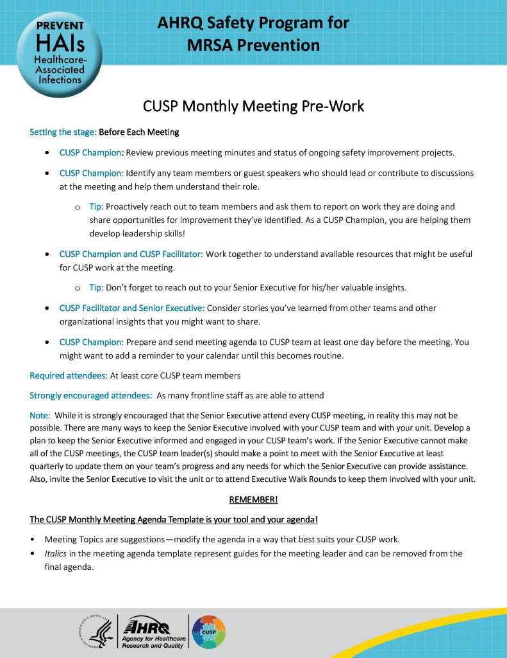
CUSP Meeting Agenda
Helps members anticipate and prepare for topics
Don’t fill meeting with speakers and topics
Allow time for discussion
For examples, please review the CUSP Monthly Meeting Pre-Work and CUSP Monthly Meeting Agenda Template documents.

Slide 15
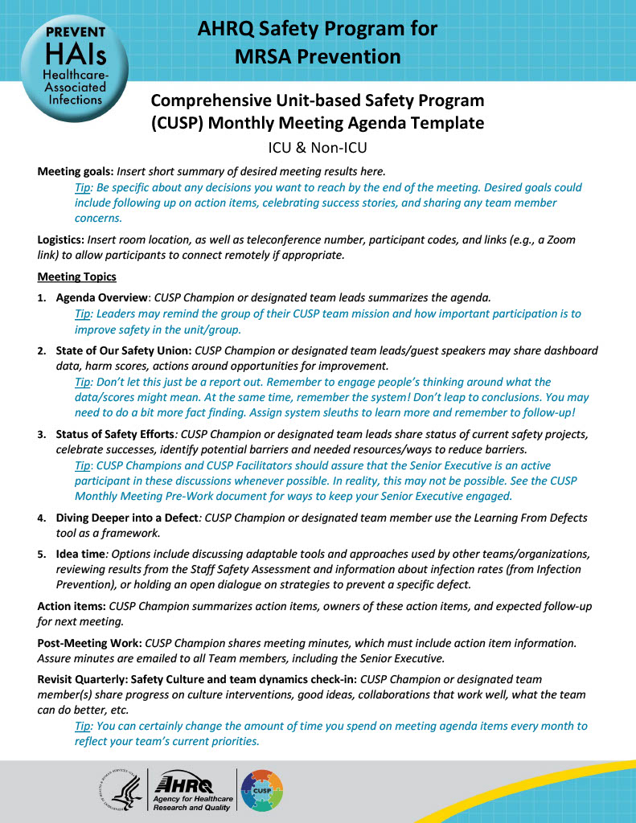
A Sample Agenda
CUSP Monthly Meeting Agenda
Welcome – new guests
Announcements/Recognition
Follow up from previous meeting
Project updates
HEIC report – MRSA rates/dashboard review
Event reports
Project discussion
Open discussion
Closure and next steps
For examples, please review the CUSP Monthly Meeting Pre-Work and CUSP Monthly Meeting Agenda Template documents.

Slide 16
Data Sources and CUSP Tools
Collecting data from a variety of sources can help inform the team of the QI project’s progress.
It is important to use metrics that are pertinent to the QI initiative and not outside the scope of the project.
Common data sources:
Audits
Huddles
Hospital/Unit Reports
Adverse events
For more information on data sources for monitoring QI initiative progress, please see the following documents:
Staff Safety Assessment
Learning From Defects Tool
LFD Investigating a Defect Worksheet
Example of Completed LFD

Slide 17
Share the Data and Celebrate Success!
Disseminate results.
Infographics, charts, and tables help visibly communicate the impact of the project.
Open forums provide opportunity to discuss outcomes and next steps.
Celebrate success to sustain impact and to motivate future participation.

Slide 18
Key Takeaways
Plan for sustainability early in the process.
Establish and maintain CUSP team participation.
Co-champions are helpful for sustainability.
Identify challenges and successes along the way and after the goals are reached.
Utilize data and tools to help measure success.
Create a culture of safety that aligns with mission and vision of the organization.

Slide 19
Disclaimer
The findings and recommendations in this presentation are those of the authors, who are responsible for its content, and do not necessarily represent the views of AHRQ. No statement in this presentation should be construed as an official position of AHRQ or of the U.S. Department of Health and Human Services.
Any practice described in this presentation must be applied by healthcare practitioners in accordance with professional judgment and standards of care in regard to the unique circumstances that may apply in each situation they encounter. These practices are offered as helpful options for consideration by healthcare practitioners, not as guidelines.

Slide 20
Reference List
Enhancing Project Spread and Sustainability – A Companion to the “Easy Guide to Clinical Practice Improvement.” Clinical Excellence Commission. August 2008. https://www.med.unc.edu/ihqi/wp-content/uploads/sites/463/2020/07/Enhancing-Project-Spread-and-Sustainability.pdf. Accessed July 17, 2024.
Scoville R, Little K, Rakover J, et al. Sustaining Improvement. Institute for Healthcare. https://www.ihi.org/resources/white-papers/sustaining-improvement. Accessed July 17, 2024.
Lawson T, Weekes L, Hill M. Ensuring success and sustainability of a quality improvement project. BJA Education. 2018 May 1;18(5):147-52. PMID: 33456825.
Hayes CW, Goldmann D. Highly adoptable improvement: a practical model and toolkit to address adoptability and sustainability of quality improvement initiatives. Jt Comm J Qual Patient Saf 2018 Mar;44(3):155-63. PMID: 29499812.

