Slide 1
AHRQ Safety Program for MRSA Prevention
Mini Presentation: Performing a Premortem Project Assessment
ICU & Non-ICU
AHRQ Pub. No. 25-0007
October 2024

Slide 2
Educational Objectives
At the end of this presentation, participants will be able to:
Understand the purpose of the premortem project assessment process
Understand how to use the Premortem Project Assessment Tool
Ensure the results from their premortem project assessment are actionable

Slide 3
Failure in Quality Improvement Programs¹⁻⁴
As many as 50 to 70 percent of programs involving organizational change are not sustained.
Performing a Premortem Project Assessment can give you an extra push to success.

Slide 4
What Is a Premortem Project Assessment?^{5,6}
Look into the future.
Imagine your QI program has failed!
What could have happened?
What could have gone wrong?
And, since you are at the beginning of the program, what can you do to prevent it from actually failing?

Slide 5
What Are the Benefits of a Premortem Project Assessment?⁶
Gain prospective hindsight⁵
Reduce overconfidence
Involve cross-functional teams
Align team on project risks
Take action to increase the probability of success

Slide 6
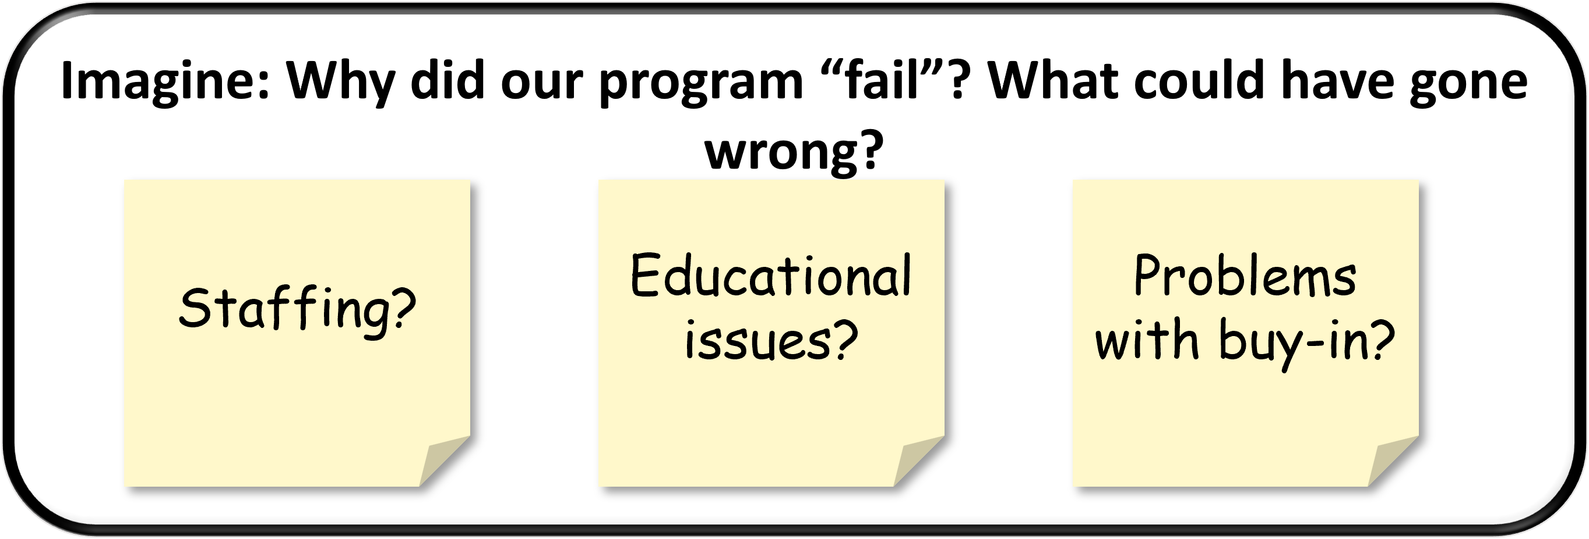
Your Premortem Project Assessment
Set up a meeting and invite key stakeholders.
Schedule plenty of time.
Set up easels, use Post-its, or use the whiteboard on Zoom.
Brainstorm!

Slide 7
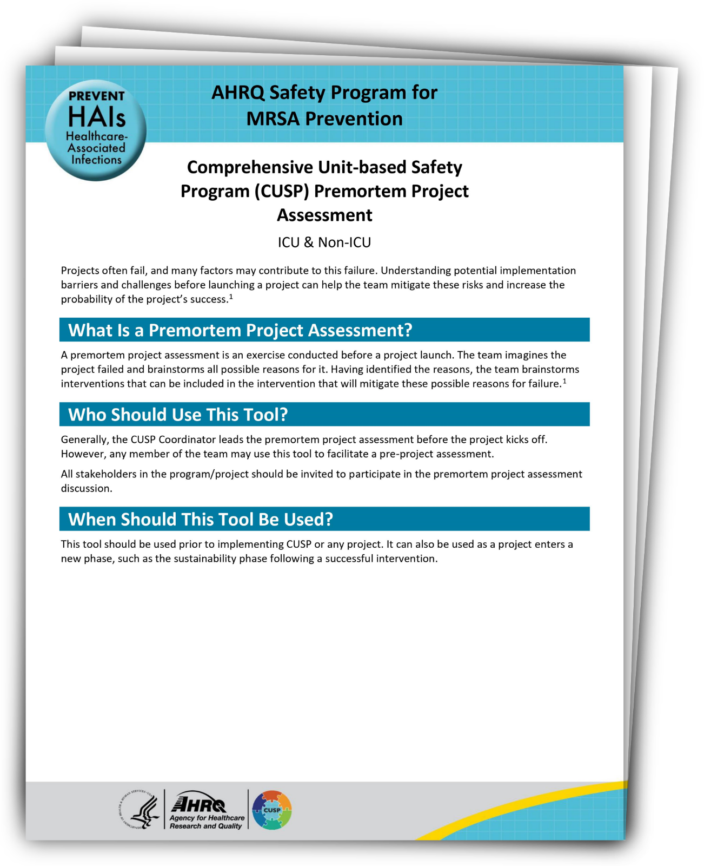
Comprehensive Unit-based Safety Program (CUSP) Premortem Project Assessment
Write down potential reasons for failure.
Rate the reasons by level of concern from 1 to 5, where 1 is lowest.
Choose reasons with high levels of concern to discuss and develop action plans.
Download the CUSP Premortem Project Assessment Tool here.

Slide 8
Now What?
Integrate the action plans into your implementation.
Assign the tasks.
Report out on possible signs and progress in your mitigation at CUSP meetings.

Slide 9
Repeat the Process
To keep your program going strong, meet again and continue to “look forward” and mitigate risks.
Once a year, as a regular event
When your program reaches the sustainability phase
When things feel “hardwired,” and everything is “skating along”
When key members of staff leave
When products you’re relying on go out of production or prices increase
When executive support dwindles

Slide 10
Key Takeaways
Perform a Premortem Project Assessment before you begin your QI program.
Use it to imagine a time your program is failing.
Determine the most likely reasons for failure.
Develop plans, strategies, and assign tasks to prevent those foreseen potential failures.
Implement your new plans and strategies together with your program to ensure your program is a success.

Slide 11
Disclaimer
The findings and recommendations in this presentation are those of the authors, who are responsible for its content, and do not necessarily represent the views of AHRQ. No statement in this presentation should be construed as an official position of AHRQ or of the U.S. Department of Health and Human Services.
Any practice described in this presentation must be applied by healthcare practitioners in accordance with professional judgment and standards of care in regard to the unique circumstances that may apply in each situation they encounter. These practices are offered as helpful options for consideration by healthcare practitioners, not as guidelines.

Slide 12
Reference List—1
Silver SA, McQuillan R, Harel Z, et al. How to sustain change and support continuous quality improvement. Clin J Am Soc Nephrol. 2016 May 6;11(5):916-24. PMID: 27016498.
Beer M, Nohria N. Cracking the code of change. Har Bus Rev. 2000 May-Jun;78(3):133-41. PMID: 11183975.
Creasy T. Why do improvement projects in healthcare fail? Becker’s Hospital Review. Leadership and Management. 2014 Oct 3. https://www.beckershospitalreview.com/hospital-management-administration/why-do-improvement-projects-in-healthcare-fail.html. Accessed July 18, 2024.
Chakravorty SS. Where process-improvement projects go wrong. Wall Street Journal. 2010 Jan 24. https://www.wsj.com/articles/SB10001424052748703298004574457471313938130. Accessed July 18, 2024.

Slide 13
Reference List—2
Mitchell DJ, Russo JE, Pennington N. Back to the future: temporal perspective in the explanation of events. Journal of Behavioral Decision Making. 1989 Jan;2(1):1-67.
Martins J. ASANA. How to conduct a project premortem. 2024 Jan 21. https://asana.com/resources/premortem. Accessed July 18, 2024.

