Slide 1
AHRQ Safety Program for MRSA Prevention
What Are the 4 Es?
ICU/Non-ICU
AHRQ Pub. No. 25-0007
October 2024

Slide 2
Educational Objectives
Define the 4 Es framework—Engage, Educate, Execute, Evaluate—and explain its significance in implementing effective interventions.
Identify common implementation barriers within systems and how each component of the 4 Es can address these barriers.
Implement and prioritize interventions based on the 4 Es framework to address identified issues.
Disseminate findings and results to stakeholders using the 4 Es framework to ensure widespread understanding and adherence to best practices.

Slide 3
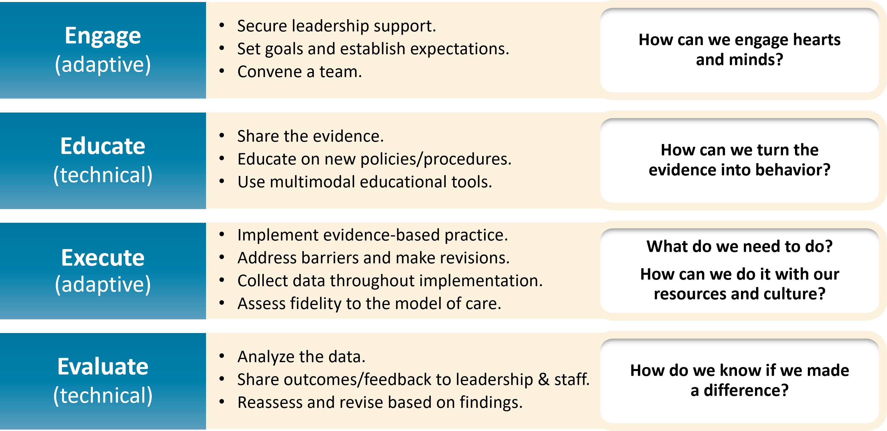
Using the 4 Es Framework¹⁻⁶
Access the one-pager on the 4 Es .

Slide 4
Case Example: St. Misfortune’s Hospital
St. Misfortune’s Hospital is a small community hospital with limited resources.
MRSA rates have been well above the regional average for a long time.
MRSA rates are as high as 15 infections per 1,000 patient-days in some units.
Decision:
Hospital personnel decide to assemble a MRSA Prevention Team.

Slide 5
Engage
Engagement: Actively involve individuals in identifying and addressing safety issues.
Changing attitudes and behaviors
Foster open communication channels.
Encourage collaboration.
Empower and encourage contributions.

Slide 6
Engage: Convene Your Team
Convene your team.
Include people from every role relevant to the process.
Providers
Nursing
Microbiology
Infection Prevention
Phlebotomy
Products/Value Analysis
Environmental Services
Executive Leadership
A senior executive team member can be a key resource.
For more resources on assembling and engaging your team, visit these links:
AHRQ Core CUSP Toolkit: Assemble the Team⁷
AHRQ Core CUSP Toolkit: Engage the Senior Executive⁸

Slide 7
Engage: Secure Leadership Support
Engaging leadership is essential for success.
Obtain leadership involvement and support.
Leadership can provide access to resources and help address barriers.
Articulate the concern. Communicate the importance of the problem.
Use baseline data to demonstrate the magnitude of the problem.
Don’t underestimate the impact of storytelling.
Set goals & establish expectations.
Align goals with organizational priorities.
Establish a shared vision of what success will look like.
For more resources on how to engage senior leadership, visit these links:
AHRQ Core CUSP Toolkit: Engage the Senior Executive⁸
CUSP Toolkit: Engage the Senior Executive (Video)⁹
CUSP Tip Sheet on Engaging Senior Leaders in MRSA Prevention (.docx)

Slide 8
Engage: Set and Communicate Goals
Set the scope of your implementation.
Choose your metrics and benchmarks and determine how your intervention will affect them.
Make sure that the reporting capabilities exist.
Review existing policies to ensure they have clear procedures that are consistent with your intervention.
Consider including unit-based action plans to ensure local engagement and accountability.

Slide 9
Case Example: Convening the Team and Engaging Leadership
The new MRSA Prevention Team recruits people from all relevant roles and departments.
They meet with leaders and staff to communicate the severity of the MRSA problem and how they plan to address it.
The team uses baseline data, published literature, national guidelines, and storytelling as methods for engagement.
The team invites a member of St. Misfortune’s leadership to join as an active and involved senior executive.

Slide 10
Engage: Frontline Personnel
Share the need.
Healthcare workers may not be aware that the problem exists.
Share the data with the staff.
Ensure they understand the implications and risk.
Use educational tools and policy updates.
Involve staff and invite them to contribute.
Benefit from their direct experience.
Engage them to participate in the program.
For more resources on how to engage frontline staff, visit these links:
AHRQ Core CUSP Toolkit: Implement Teamwork and Communication¹⁰
CUSP Tip Sheet: Engaging Unit Staff in MRSA Prevention (.docx)
CUSP Tip Sheet: Engaging Physicians in MRSA Prevention (.docx)

Slide 11
Engage: Assess Current Practice
Don’t assume you know what is actually happening.
Go to the GEMBA!
gemba = “the place where work happens”
Observe workflows in person.
Engage and talk directly with frontline personnel.
Gain knowledge firsthand.
Practice can diverge greatly from policy.
Temporary workarounds may become accepted practice.

Slide 12
Case Example: Engaging Staff and Assessing Practice
The MRSA Prevention Team engages directly with staff, speaking at rounds, talking with healthcare workers one-on-one.
Most staff were unaware of the severity of MRSA problem because the data were not widely shared at the hospital.
The team conducts regular observations in every unit to assess current practices.
The team’s assessment reveals that actual practices differ greatly between units and from hospital policy.
A review of policies shows that they are confusing, inconsistent, out-of-date, and not standardized.

Slide 13
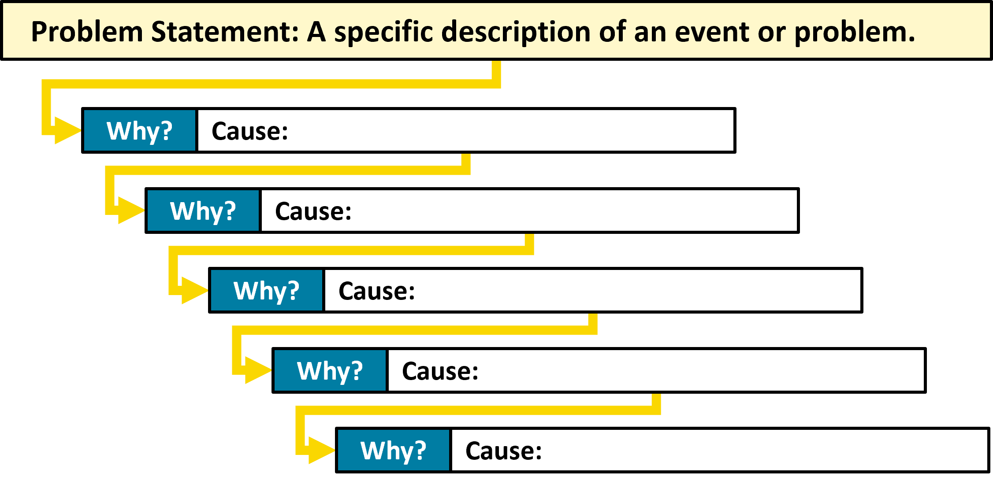
Engage: Identify Causes
Determine the root causes of the failures in care.
One method is “the 5 Whys.”
Follow these links for more detailed information on the 5 Whys and Root Cause Analysis:
CMS: Five Whys Tool for Root Cause Analysis¹²
CMS: Guidance for Performing Root Cause Analysis (RCA) with Performance Improvement Projects (PIPs)¹³

Slide 14
Case Example: Identifying Causes
The MRSA team discovers several critical issues impacting patient care and safety:
Contact precautions criteria vary by unit, causing confusion.
No system is in place to optimize antibiotic prescribing.
Hand hygiene compliance is not monitored.
Environmental cleaning quality is inconsistent.
The CLABSI prevention bundle is not up to date.
Training for blood culture collection is inadequate.
A VAP prevention bundle implemented 4 years earlier had been dropped.

Slide 15
Engage: Prioritize Interventions^{14,15}
Strength of Intervention | Interventions
Strong Actions | Forcing Functions Simplify Process Standardize the Process Devices
Intermediate Actions | Improve Staffing Reduce Distractions High-quality Education Checklists
Weak Actions | Policy Re-education Audits Signage/Reminders

Slide 16
Case Example: Prioritizing Interventions
The team prioritizes interventions based on the Action Hierarchy:
Immediate actions (strong, high-impact interventions):
Implement a clinical decision support system that supports:
Antibiotic prescribing
Mandatory Electronic Health Records checklists
Automated alerts to reinforce CLABSI prevention
Short-term improvements:
Implement a hand hygiene monitoring program.
Standardize contact isolation precaution criteria across units.
Long-term improvements:
Conduct quarterly training workshops on blood culture collection.
Establish consistent environmental cleaning protocols with standardized checklists and regular audits.

Slide 17
Educate^{16,17,19-21}
Include education as part of a multi-modal performance improvement plan.
Education alone is considered a weak action item.
Simulation-based education is more effective to teach complex skills.¹⁸
Consider requiring completion of a competency.
Require refresher training annually, or more often in units that do not perform the intended intervention frequently.

Slide 18
Case Example: Education Plan
The MRSA Prevention Team develops a new education plan with four key components:
Develop training resources such as engaging videos, hands-on guides, and evidence summaries for MRSA prevention.
Conduct interactive training with live demonstrations and simulations for hands-on practice.
Integrate MRSA training and assessments into annual recertification to ensure staff proficiency.
Distribute policies by making them accessible, require staff to sign off on understanding, and provide reference factsheets and checklists.

Slide 19
Execute^{16,17,20,22}
Follow principles of safe system design:
Simplify the system.
Create redundancy.
Learn from mistakes.
Maintain open lines of communication.
Track performance and metrics and adjust your approach.
Embed new practices into daily routines and enable staff to consistently follow them.
Make it easy for staff to make the right decision and do the right thing.

Slide 20
Case Example: Executing the Plan
The team schedules their first hands-on training session for the end of the month as part of staff annual recertification.
MRSA prevention policies are uploaded to the St. Miz Hospital’s internal website, and quick reference sheets distributed. Staff must now electronically sign off their understanding.
Random audits will begin next month to observe and verify adherence to MRSA prevention practices.
The team will hold a weekly review meeting to assess performance metrics, gather and review staff feedback, and make adjustments as needed.

Slide 21
Evaluate: Surveillance and Feedback^{16,17,19,20,23-25}
Surveillance data should be shared widely and transparently.
Data sharing should also be timely.
Feedback reports should be disseminated broadly to:
CUSP teams
Providers
Unit leadership
Infection prevention
Frontline staff
Relevant committees (e.g., QAPI, infection prevention, or antimicrobial stewardship committee)
Use data to learn from defects and adjust interventions and approaches as needed.

Slide 22
Disseminate Findings

Slide 23
Case Example: Evaluating
Real-time data on MRSA and HAI rates are shared via an accessible dashboard.
Usage of the computerized decision support system is tracked as a key process measure.
Data on compliance is regularly shared with individual units to promote accountability and help address problems.
Completion rates and attendance at training sessions are tracked.
To evaluate overall safety culture, an anonymous survey is administered, asking staff to assess patient safety.

Slide 24
Sustain and Celebrate!
The 4 Es are ongoing processes.
Continue Engaging, Educating, Executing, and Evaluating
Vital for initial and sustained progress
Celebrate success!
Reward efforts
Reinforce engagement
Sustain improvements

Slide 25
Case Example: Plan Progress
In the first 2 months, only 75% of staff completed training. Based on feedback, more emphasis is placed on hands-on training. After 12 months, rates have increase to 93%.
Implementation of the computerized clinical decision support system goes smoothly and has an immediate impact.
Initial audits show units struggling to adhere to MRSA prevention standards. The team designates unit champions to promote best practices and reinforce training. At 12 months, 80% of units are consistently adhering to best practices.
After 12 months, MRSA rates have significantly decreased. The hospital celebrates the success.

Slide 26
Key Takeaways
The 4 Es Framework stands for Engage, Educate, Execute, and Evaluate.
This approach addresses both technical and adaptive challenges.
Engage: Actively involve both leadership and personnel in safety initiatives to foster open communication and empower everyone to contribute effectively.
Educate: Provide ongoing education and training to keep the team informed and skilled in best practices for managing safety concerns.
Execute: Implement interventions based on identified needs and use the Action Hierarchy model to prioritize actions by their impact level.
Strong
Intermediate
Weak
Evaluate: Continuously assess the effectiveness of interventions, refine approaches based on feedback, and share data broadly and transparently to drive improvements and progress.

Slide 27
Disclaimer
The findings and recommendations in this presentation are those of the authors, who are responsible for its content, and do not necessarily represent the views of AHRQ. No statement in this presentation should be construed as an official position of AHRQ or of the U.S. Department of Health and Human Services.
Any practice described in this presentation must be applied by healthcare practitioners in accordance with professional judgment and standards of care in regard to the unique circumstances that may apply in each situation they encounter. These practices are offered as helpful options for consideration by healthcare practitioners, not as guidelines.

Slide 28
Reference List—1
Ellingson K, Haas JP, Aiello AE, et al. Strategies to prevent healthcare-associated infections through hand hygiene. Infect Control Hosp Epidemiol. 2014 Aug;35(8):937-60. PMID: 25026608.
Romig M, Goeschel C, Pronovost P. Integrating CUSP and TRIP to improve patient safety. Hosp Pract (1995). 2010 Nov;38(4):114-21. PMID: 21068535.
Pronovost PJ, Berenholtz SM, Needham DM. Translating evidence into practice: a model for large scale knowledge translation. BMJ. 2008 Oct 6; 337:a1714. PMID: 18838424.
The 4 E’s. Agency for Healthcare Research and Quality. https://www.ahrq.gov/hai/cusp/videos/02b-the-4e/index.html. Accessed May 24, 2024.
Assemble the Team, Facilitator Notes. Agency for Healthcare Research and Quality. https://www.ahrq.gov/hai/cusp/modules/assemble/team-notes.html#slide12. Accessed May 24, 2024.
Engage the Senior Executive Facilitator Notes. Agency for Healthcare Research and Quality. https://www.ahrq.gov/hai/cusp/modules/engage/exec-notes.html#sl3. Accessed May 24, 2024.

Slide 29
Reference List—2
Assemble the Team. Agency for Healthcare Research and Quality. https://www.ahrq.gov/hai/cusp/modules/assemble/index.html. Accessed August 09, 2024.
Engage the Senior Executive. Agency for Healthcare Research and Quality. https://www.ahrq.gov/hai/cusp/modules/engage/index.html. Accessed August 09, 2024
Engage the Senior Executive. Agency for Healthcare Research and Quality. https://www.ahrq.gov/hai/cusp/modules/engage/exec-slides.html. Accessed May 24, 2024.
Implement Teamwork and Communication. Agency for Healthcare Research and Quality. https://www.ahrq.gov/hai/cusp/modules/implement/index.html. Accessed August 09, 2024.
Five Whys Tool for Root Cause Analysis. Centers for Medicare and Medicaid Services. https://www.cms.gov/medicare/provider-enrollment-and-certification/qapi/downloads/fivewhys.pdf. Accessed May 24, 2024.
Guidance for Performing Root Cause Analysis (RCA) with Performance Improvement Projects (PIPs). Centers for Medicare and Medicaid Services. https://www.cms.gov/medicare/provider-enrollment-and-certification/qapi/downloads/guidanceforrca.pdf. Accessed May 24, 2024.

Slide 30
Reference List—3
Patient Safety Essentials Toolkit: Action Hierarchy (part of RCA2). Institute for Healthcare Improvement. https://www.ihi.org/sites/default/files/SafetyToolkit_ActionHierarchy.pdf. Accessed May 24, 2024.
Root Cause Analysis Tools. VA National Center for Patient Safety. 2014. https://www.patientsafety.va.gov/docs/joe/2014%20RCA%20Tools%20FINAL%20Formatted%20REV10%202016.pdf. Accessed May 24, 2024.
Root Cause Analysis Tools. VA National Center for Patient Safety. 2014. https://www.patientsafety.va.gov/docs/joe/2014%20RCA%20Tools%20FINAL%20Formatted%20REV10%202016.pdf. Accessed May 24, 2024.
Doern GV, Carroll KC, Diekema DJ, et al. Practical guidance for clinical microbiology laboratories: a comprehensive update on the problem of blood culture contamination and a discussion of methods for addressing the problem. Clin Microbiol Rev. 2019 Oct 30;33(1):e00009-19. PMID: 31666280.
Centers for Disease Control and Prevention. Blood Culture Contamination: An Overview For Infection Control And Antibiotic Stewardship Programs Working With The Clinical Laboratory. CS 331454-B. Atlanta, GA: Centers for Disease Control & Prevention; July 2022. https://stacks.cdc.gov/view/cdc/123257/cdc_123257_DS1.pdf. Accessed May 3, 2024.

Slide 31
Reference List—4
Chernikova O, Heitzmann N, Stadler M, et al. Simulation-based learning in higher education: A meta-analysis. Rev Ed Res. 2020;90(4):499-541.
Preventing Adult Blood Culture Contamination: A Quality Tool For Clinical Laboratory Professionals. Centers for Disease Control and Prevention. https://www.cdc.gov/labquality/blood-culture-contamination-prevention.html. Accessed May 24, 2024.
Principles and Procedures for Blood Cultures, 2nd Edition. CLSI guideline M47. Clinical and Laboratory Standards Institute. 2022.
Specimen Collection: Blood Cultures (Ambulatory)- CE/NCPD. Elsevier. https://elsevier.health/en-US/preview/blood-collection-blood-cultures-ambulatory. Accessed May 24, 2024.
Bool M, Barton MJ, Zimmerman PA. Blood culture contamination in the emergency department: an integrative review of strategies to prevent blood culture contamination. Australas Emerg Care. 2020 Sep;23(3):157-65. PMID: 32253130.
Hopkins K, Huynh S, McNary C, et al. Reducing blood culture contamination rates: a systematic approach to improving quality of care. Am J Infect Control. 2013 Dec;41(12):1272-4. PMID: 23747025.

Slide 32
Reference List—5
Harding AD, Bollinger S. Reducing blood culture contamination rates in the emergency department. J Emerg Nurs. 2013 Jan;39(1):e1-6. PMID: 23295096.
Gibb AP, Hill B, Chorel B, et al. Reduction in blood culture contamination rate by feedback to phlebotomists. Arch Pathol Lab Med. 1997 May;121(5):503-7. PMID: 9167605.

