Slide 1
AHRQ Safety Program for MRSA Prevention
The Science of Safety:
Principles in Practice
ICU & Non-ICU
AHRQ Pub. No. 25-0007
October 2024

Slide 2
Educational Objectives
Describe the patient safety risks that patients face in healthcare environments.
Explain the four principles of the science of safety and how they inform teams who seek to strengthen their organization's safety culture.
Describe the characteristics of safe systems and outline the main strategies used to create them.
Explain how diverse teams foster a safety culture and protect patients from safety defects.

Slide 3

Patient Safety and Preventable Harm
When it comes to patient safety, the numbers are startling.
1 in 10 patients are harmed during a hospital stay.¹
Preventable patient error is among the leading causes of death in the U.S.²

Slide 4
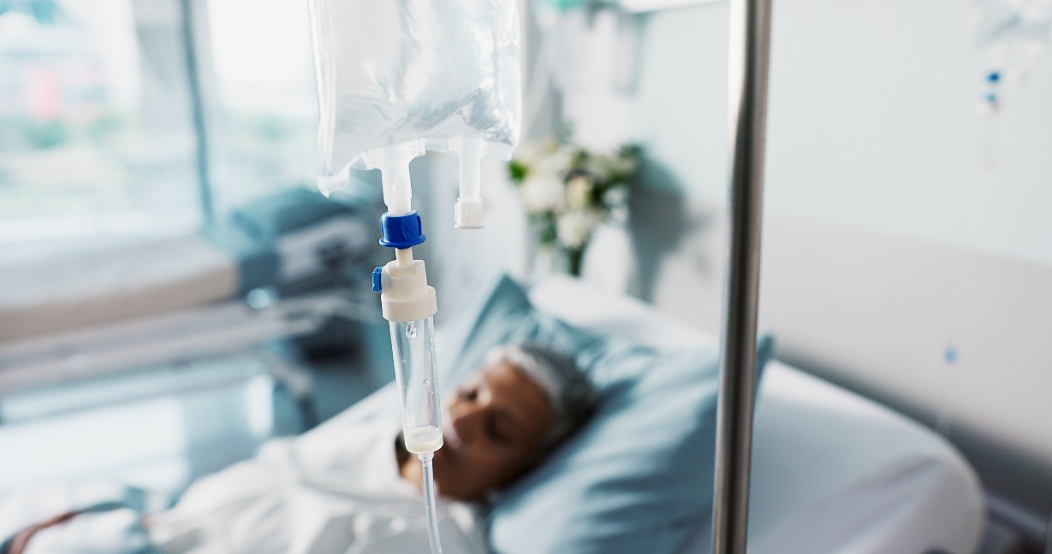
Risks of Healthcare-Associated Infection (HAI)
In the U.S., 5 percent of hospitalized patients contract an HAI.³
30 percent of ICU patients develop an HAI.²
2 million people per year develop an HAI during their hospital stay.²
More than 99,000 people die annually from HAIs.²
HAIs represent $28–$33 billion per year in healthcare costs.⁴

Slide 5
How Can Safety Be Such a Big Problem?
We are human and errors happen.
Our system is not perfect, and it is increasingly complex.
Time and resources are limited.
Healthcare teams, patients, and their caregivers are all stressed.
We must deliberately incorporate the science of safety into healthcare to protect patients.

Slide 6
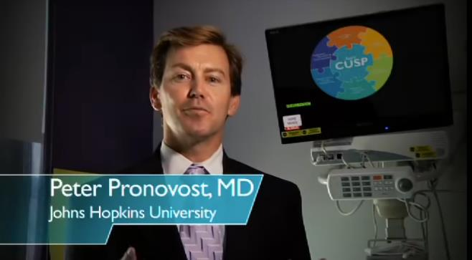
The Science of Safety⁵
The Science of Safety seeks to understand the causes and consequences of accidents and incidents and develop effective solutions to prevent them and mitigate the risks.
Watch the AHRQ Science of Safety video.

Slide 7
The Four Principles of the Science of Safety
Safety is a property of the system.
Safe systems can be designed by applying human factors and other approaches to address technical problems.
Safe teamwork can be fostered by applying sociology and other approaches to address cultural problems.
Teams make wiser decisions when there is diverse input from stakeholders.

Slide 8
Principle 1 of the Science of Safety
Safety is a property of the system.
  Systems are designed to obtain the results they get.
  Characteristics of patients, providers, care team, and the environment impact safety.
  Communication errors are common.
  Hospitals face pressures, including balancing safety risks with costs.
  Environmental factors such as staffing, workflows, equipment, and the flow of people through the space impact safety.
  Careful and honest review of these factors improves patient safety; the CUSP framework is helpful.
Blaming individual healthcare workers rarely solves safety problems.

Slide 9
Principle 2 of the Science of Safety
Safe systems can be designed by applying human factors and other approaches to address technical problems.
  Standardize whenever possible.
  Create independent double-checks for important things.
  Learn, don’t just recover, when things go wrong.
  Ask how staff think the next patient will be harmed and what we can do to prevent that harm from happening.

Slide 10
Principle 3 of the Science of Safety
Safe teamwork can be fostered by applying sociology and other approaches to address cultural problems.
  Healthcare is noisy and chaotic; communication errors are common.
  Use safe design principles to guard against communication mistakes (e.g., misinterpreting ambiguous language).
    Standardize important communications (SBAR, briefings, daily goals)
    Independent checks (repeat back to confirm correct understanding)
    Learn from mistakes (analyze communication errors and take steps to guard against the same future mistake)

Slide 11
Principle 4 of the Science of Safety
Teams make wiser decisions when there is diverse input from stakeholders.
  Provides different perspectives
  Fosters creativity and innovation
  Allows access to "ground truth"
  As teams alternate between divergent and convergent thinking, they incorporate new data and adjust their plans and actions accordingly

Slide 12
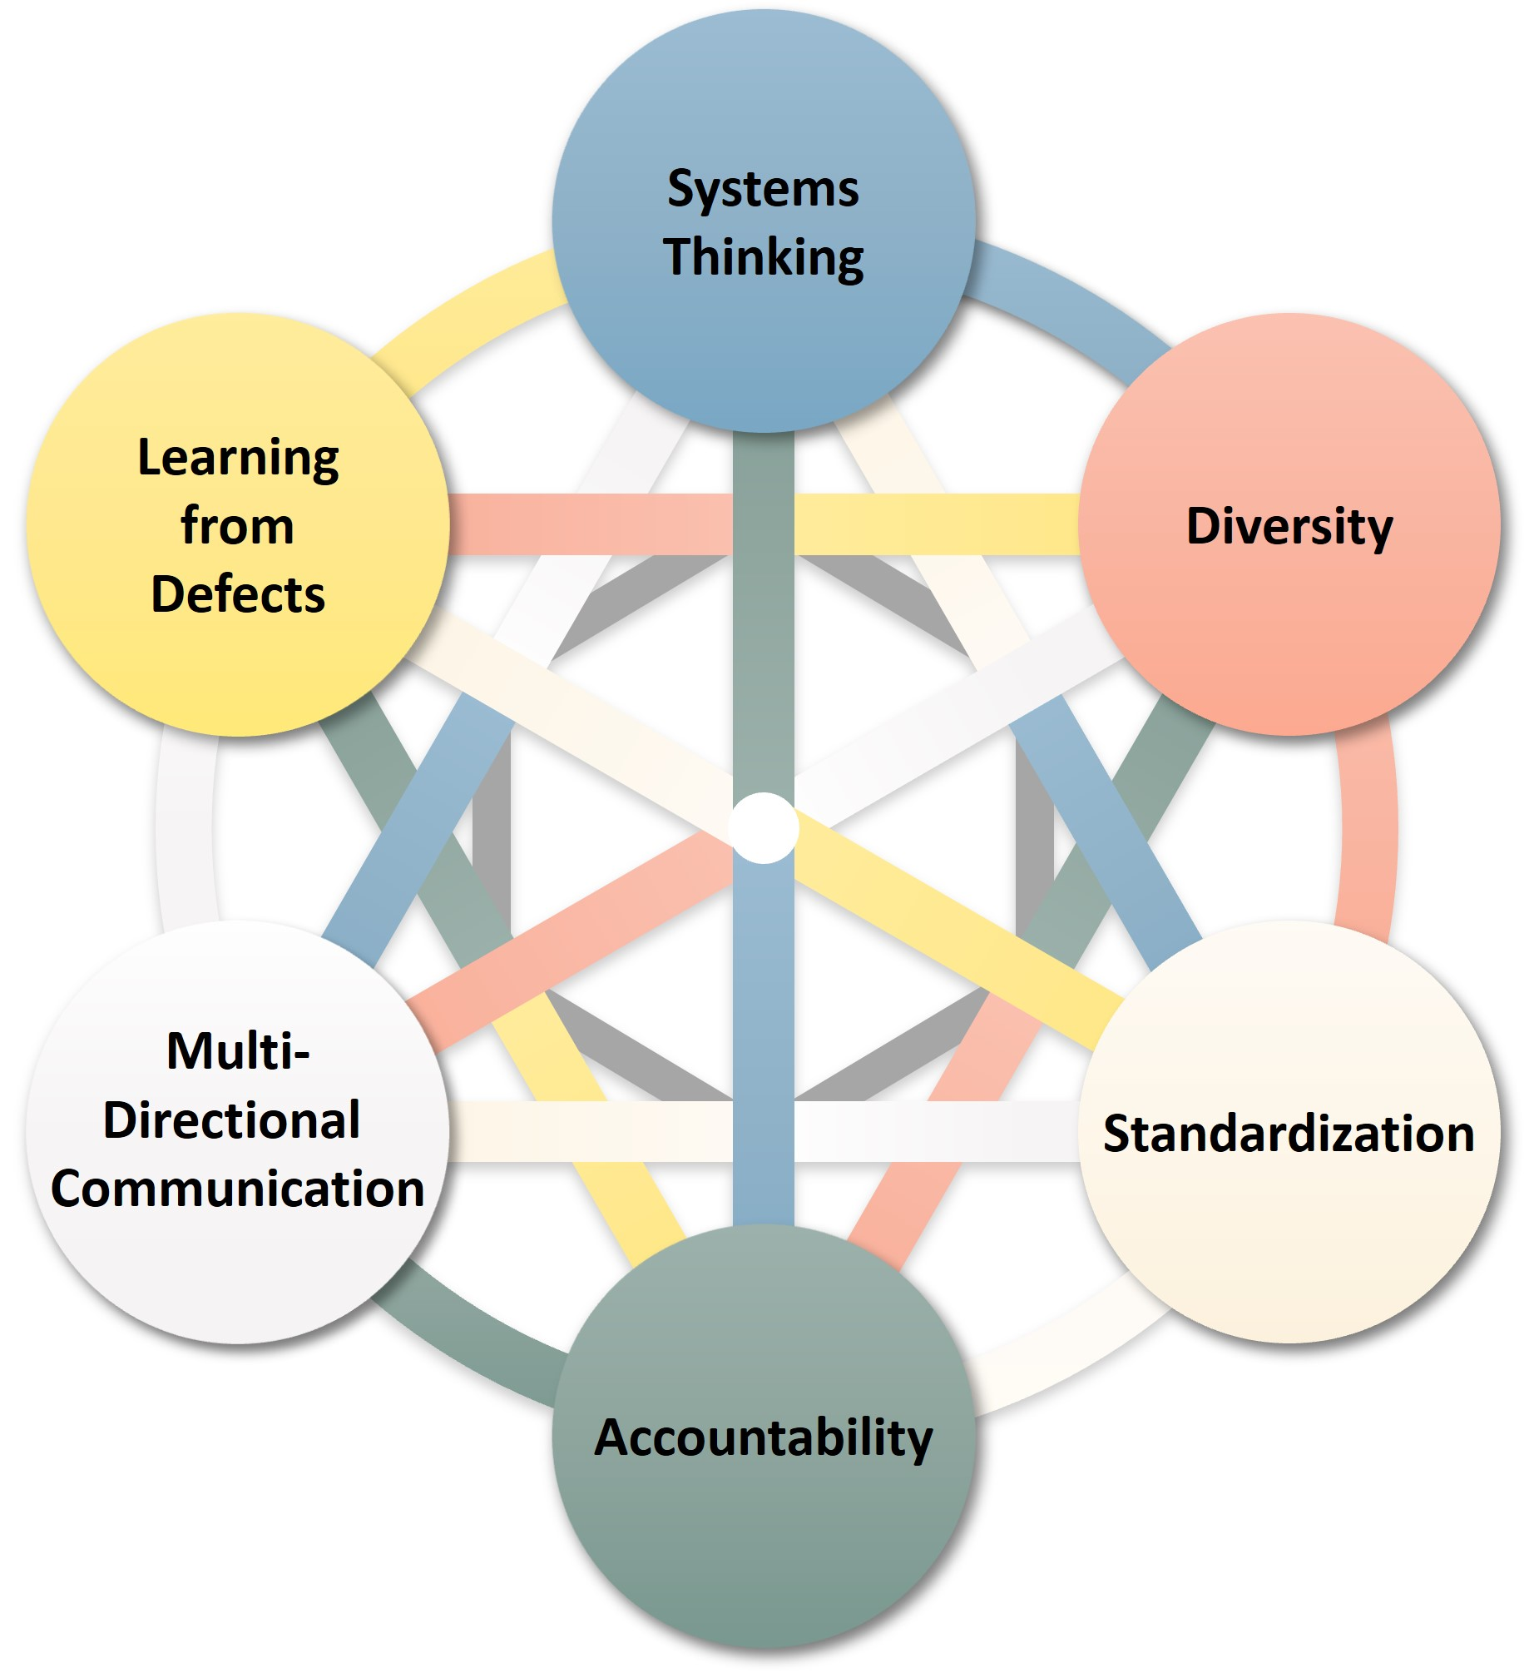
CUSP and the Science of Safety

Slide 13
So… What is a Safety Culture?
“Patient safety culture is the extent to which an organization's culture supports and promotes patient safety. It refers to the values, beliefs, and norms that are shared by healthcare practitioners and other staff throughout the organization that influence their actions and behaviors. Patient safety culture can be measured by determining the values, beliefs, norms, and behaviors related to patient safety that are rewarded, supported, expected, and accepted in an organization. It is also important to note that culture exists at multiple levels, from the unit level to the department, organization, and system levels.”
- Agency for Healthcare Research and Quality⁶
Key elements to a strong safety culture:
People are encouraged, even rewarded, for providing essential safety-related information, but clear lines are drawn between human error and at-risk or reckless behaviors.
Due to psychological safety, there is no risk when people report their errors and near-misses.
There is a willingness to learn and the competence to draw the right conclusions from safety information systems, and the will to implement major reforms when their need is indicated.
  -Joint Commission Sentinel Event Alert⁷

Slide 14
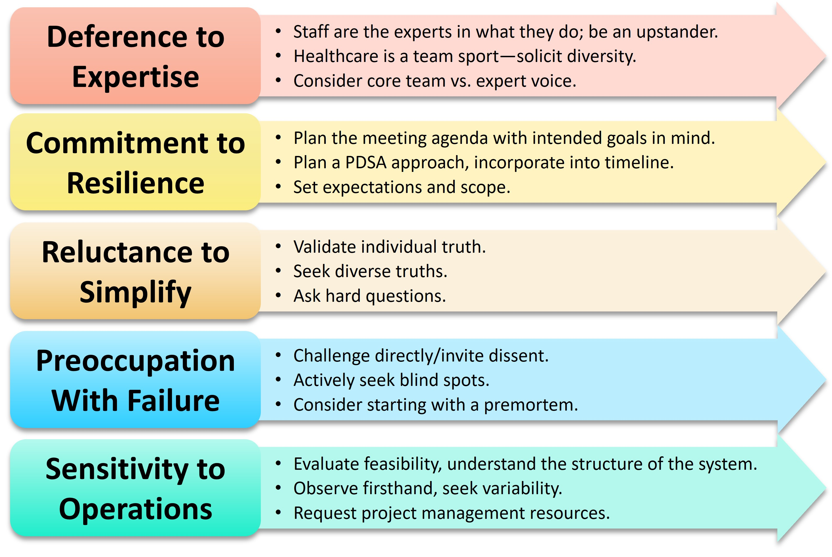
Principles of High Reliability Organizations (HRO) Align With Safety Culture⁸

Slide 15
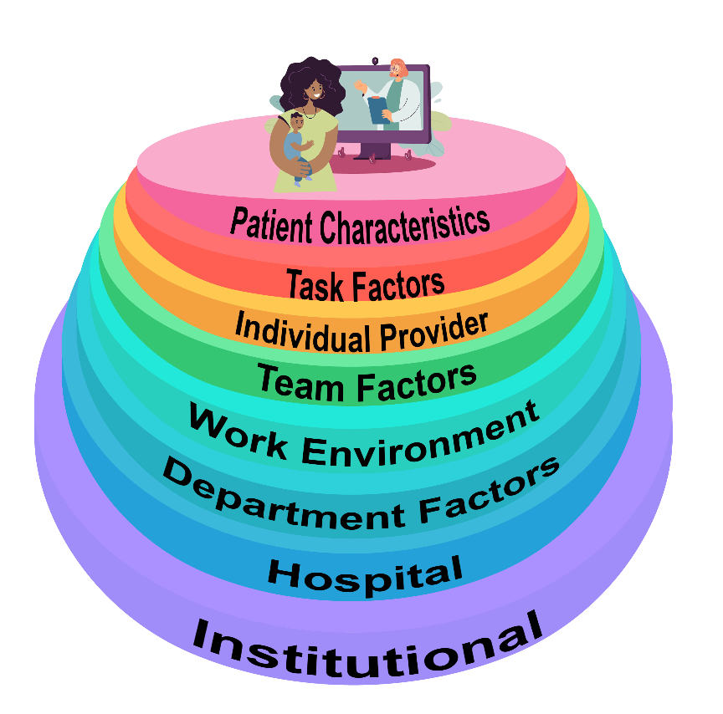
System Factors Impact Safety⁹

Slide 16

Beyond Personal Responsibility
“Rather than being the main instigators of an accident, operators tend to be the inheritors of system defects … Their part is that of adding the final garnish to a lethal brew that has been long in the cooking.”
- James Reason, Human Error¹⁰
The CUSP approach is to understand the system behind the defect, not to identify blame.
Personal responsibility is just one factor.
Focus on systems, not individuals.
Engagement and psychological safety is necessary for team members to speak up.

Slide 17
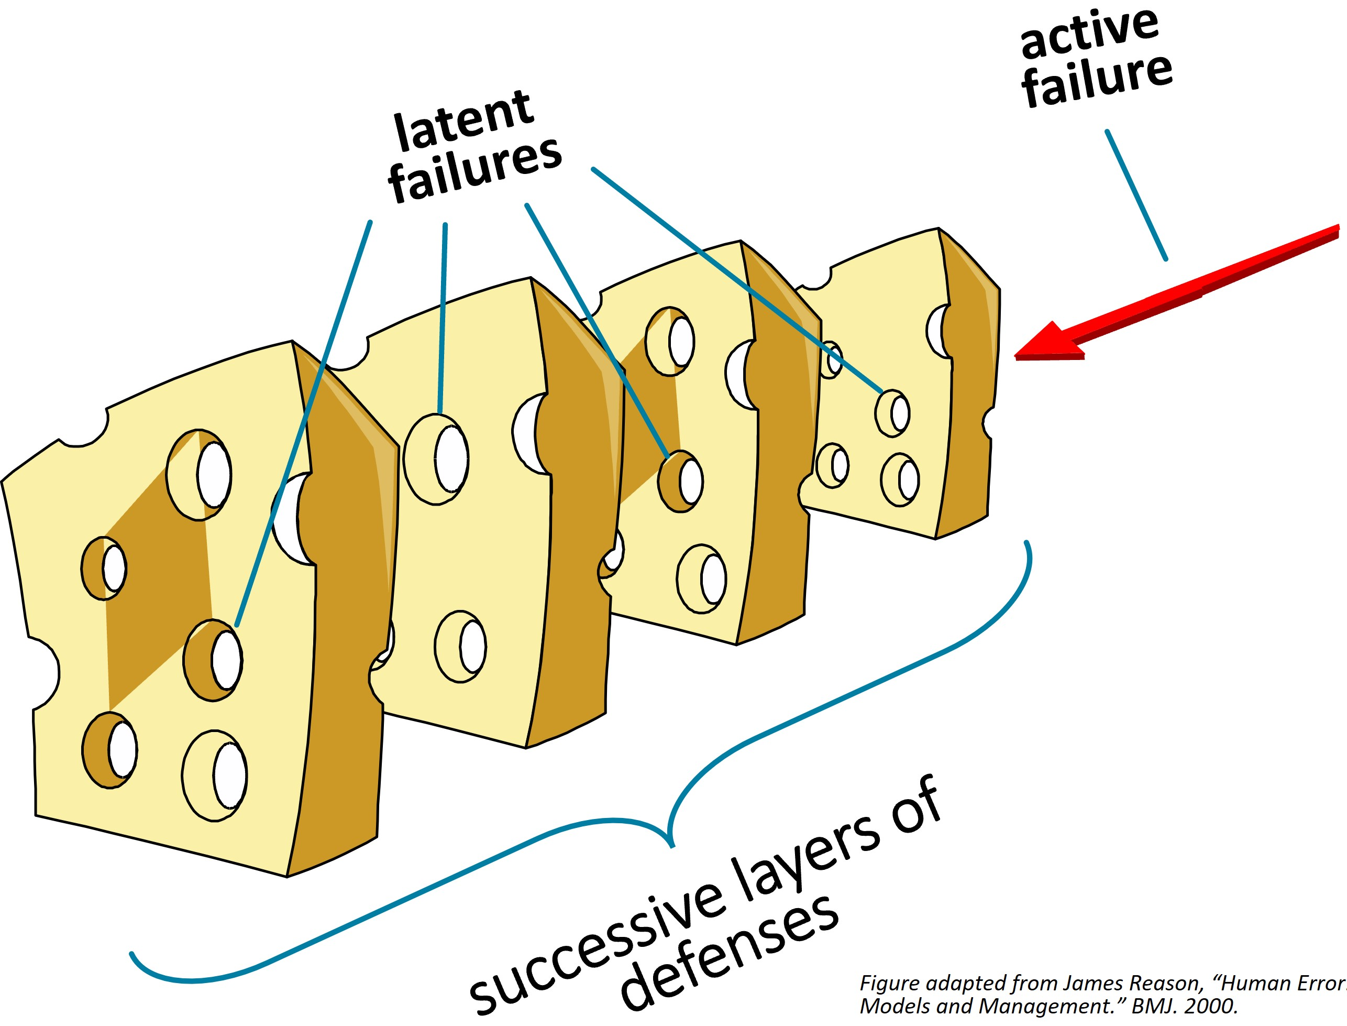
Swiss Cheese Model¹⁰

Slide 18
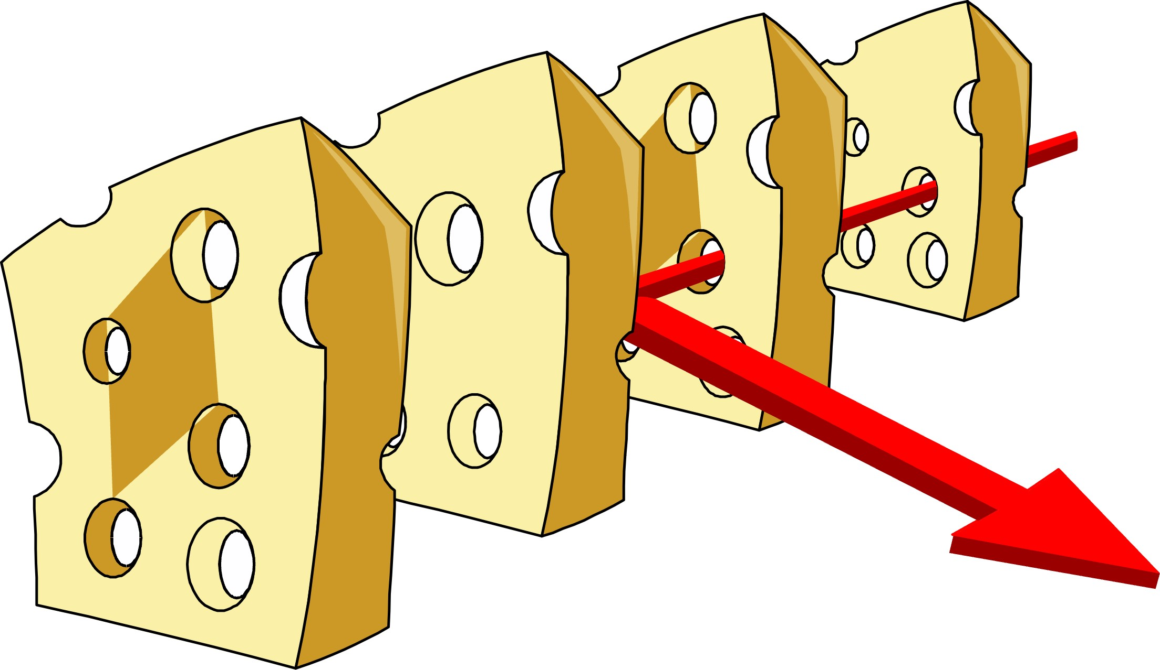
Swiss Cheese Model: Layers of Defense¹⁰
Layers of defenses prevent or mitigate errors.

Slide 19
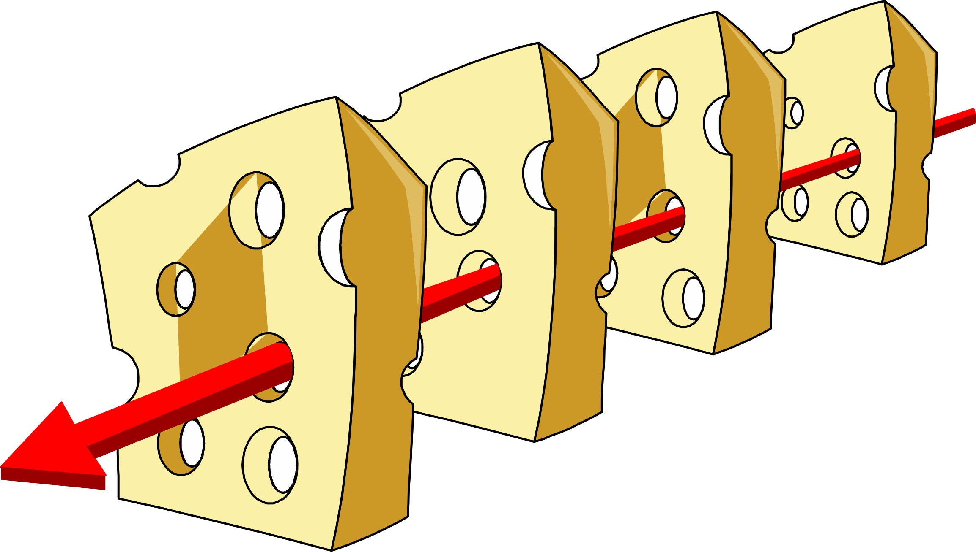
Swiss Cheese Model: How Errors Happen¹⁰
But sometimes holes (i.e., failures) line up, allowing for a catastrophic outcome.

Slide 20
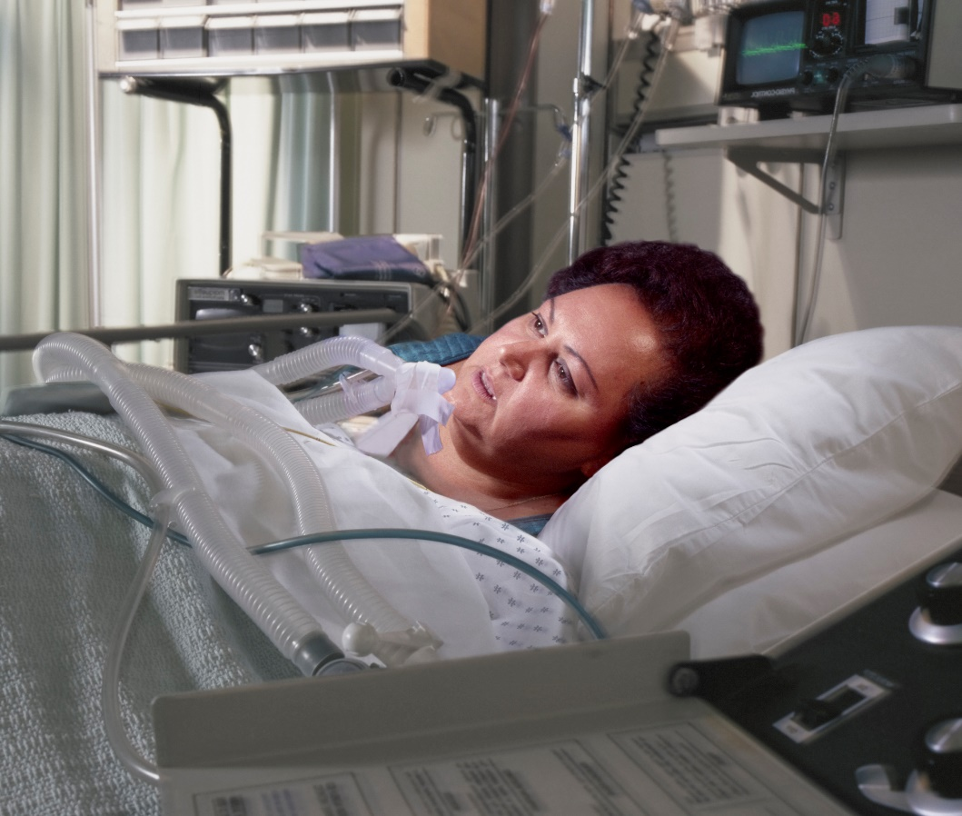
Susan’s Story – Part 1
Susan comes to the hospital after a car accident.
ED nurse fails to record Susan’s hormone therapy in her chart.
Surgeon asks Susan if she has family history of venous thromboembolism (VTE). The hospital does not have a standard VTE risk assessment protocol.
Unaware of what VTE is, Susan answers that she has no family history of VTE.
Susan’s electronic hospital records are incomplete.
Surgeon proceeds with surgery to repair Susan’s hip fracture.

Slide 21
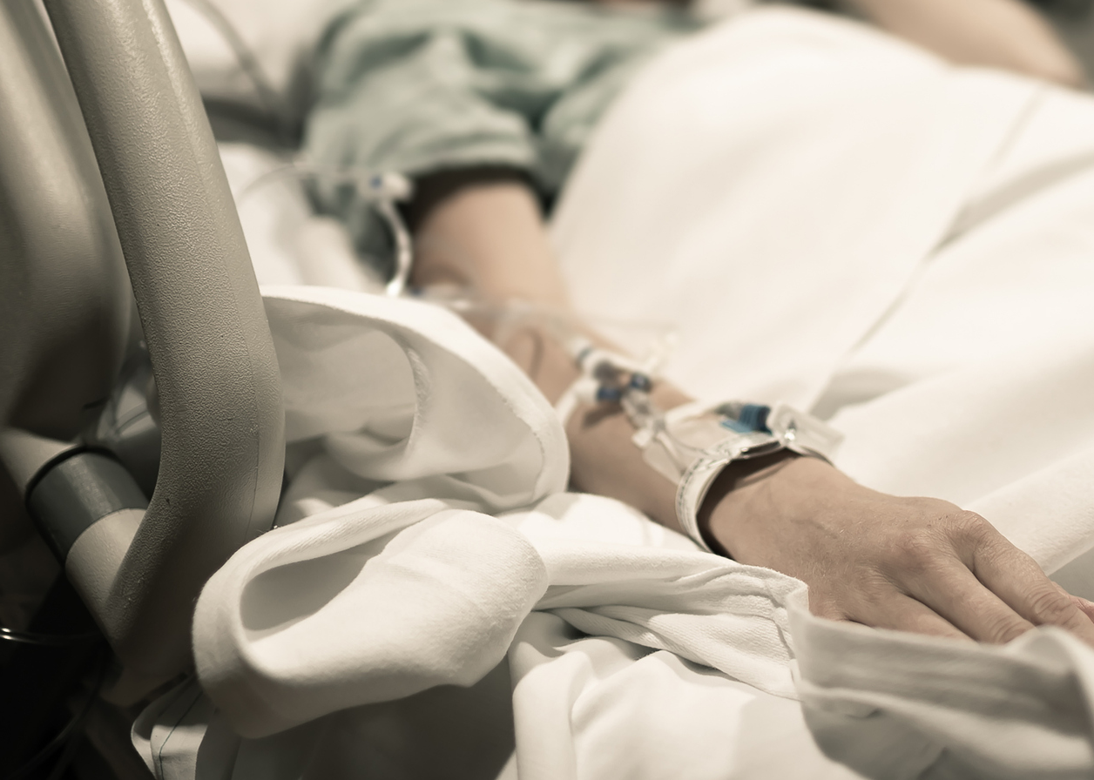
Susan’s Story – Part 2
On post-operative day 6, Susan complains of pain in her leg.
Surgeon attributes this to postoperative discomfort, and orders pain medication.
Susan’s condition worsens, but the nurses are hesitant to contradict the surgeon and delay before escalating the issue.
Eventually a hospitalist is called and a rapid assessment performed.
Assessment indicates pulmonary embolism.
Susan is already in acute distress. She passes away soon after.

Slide 22
What System Factors Did You Identify?
What are some of the system factors that contributed to Susan’s death?
Consider all factors, or holes in the system, that led to this outcome.

Slide 23
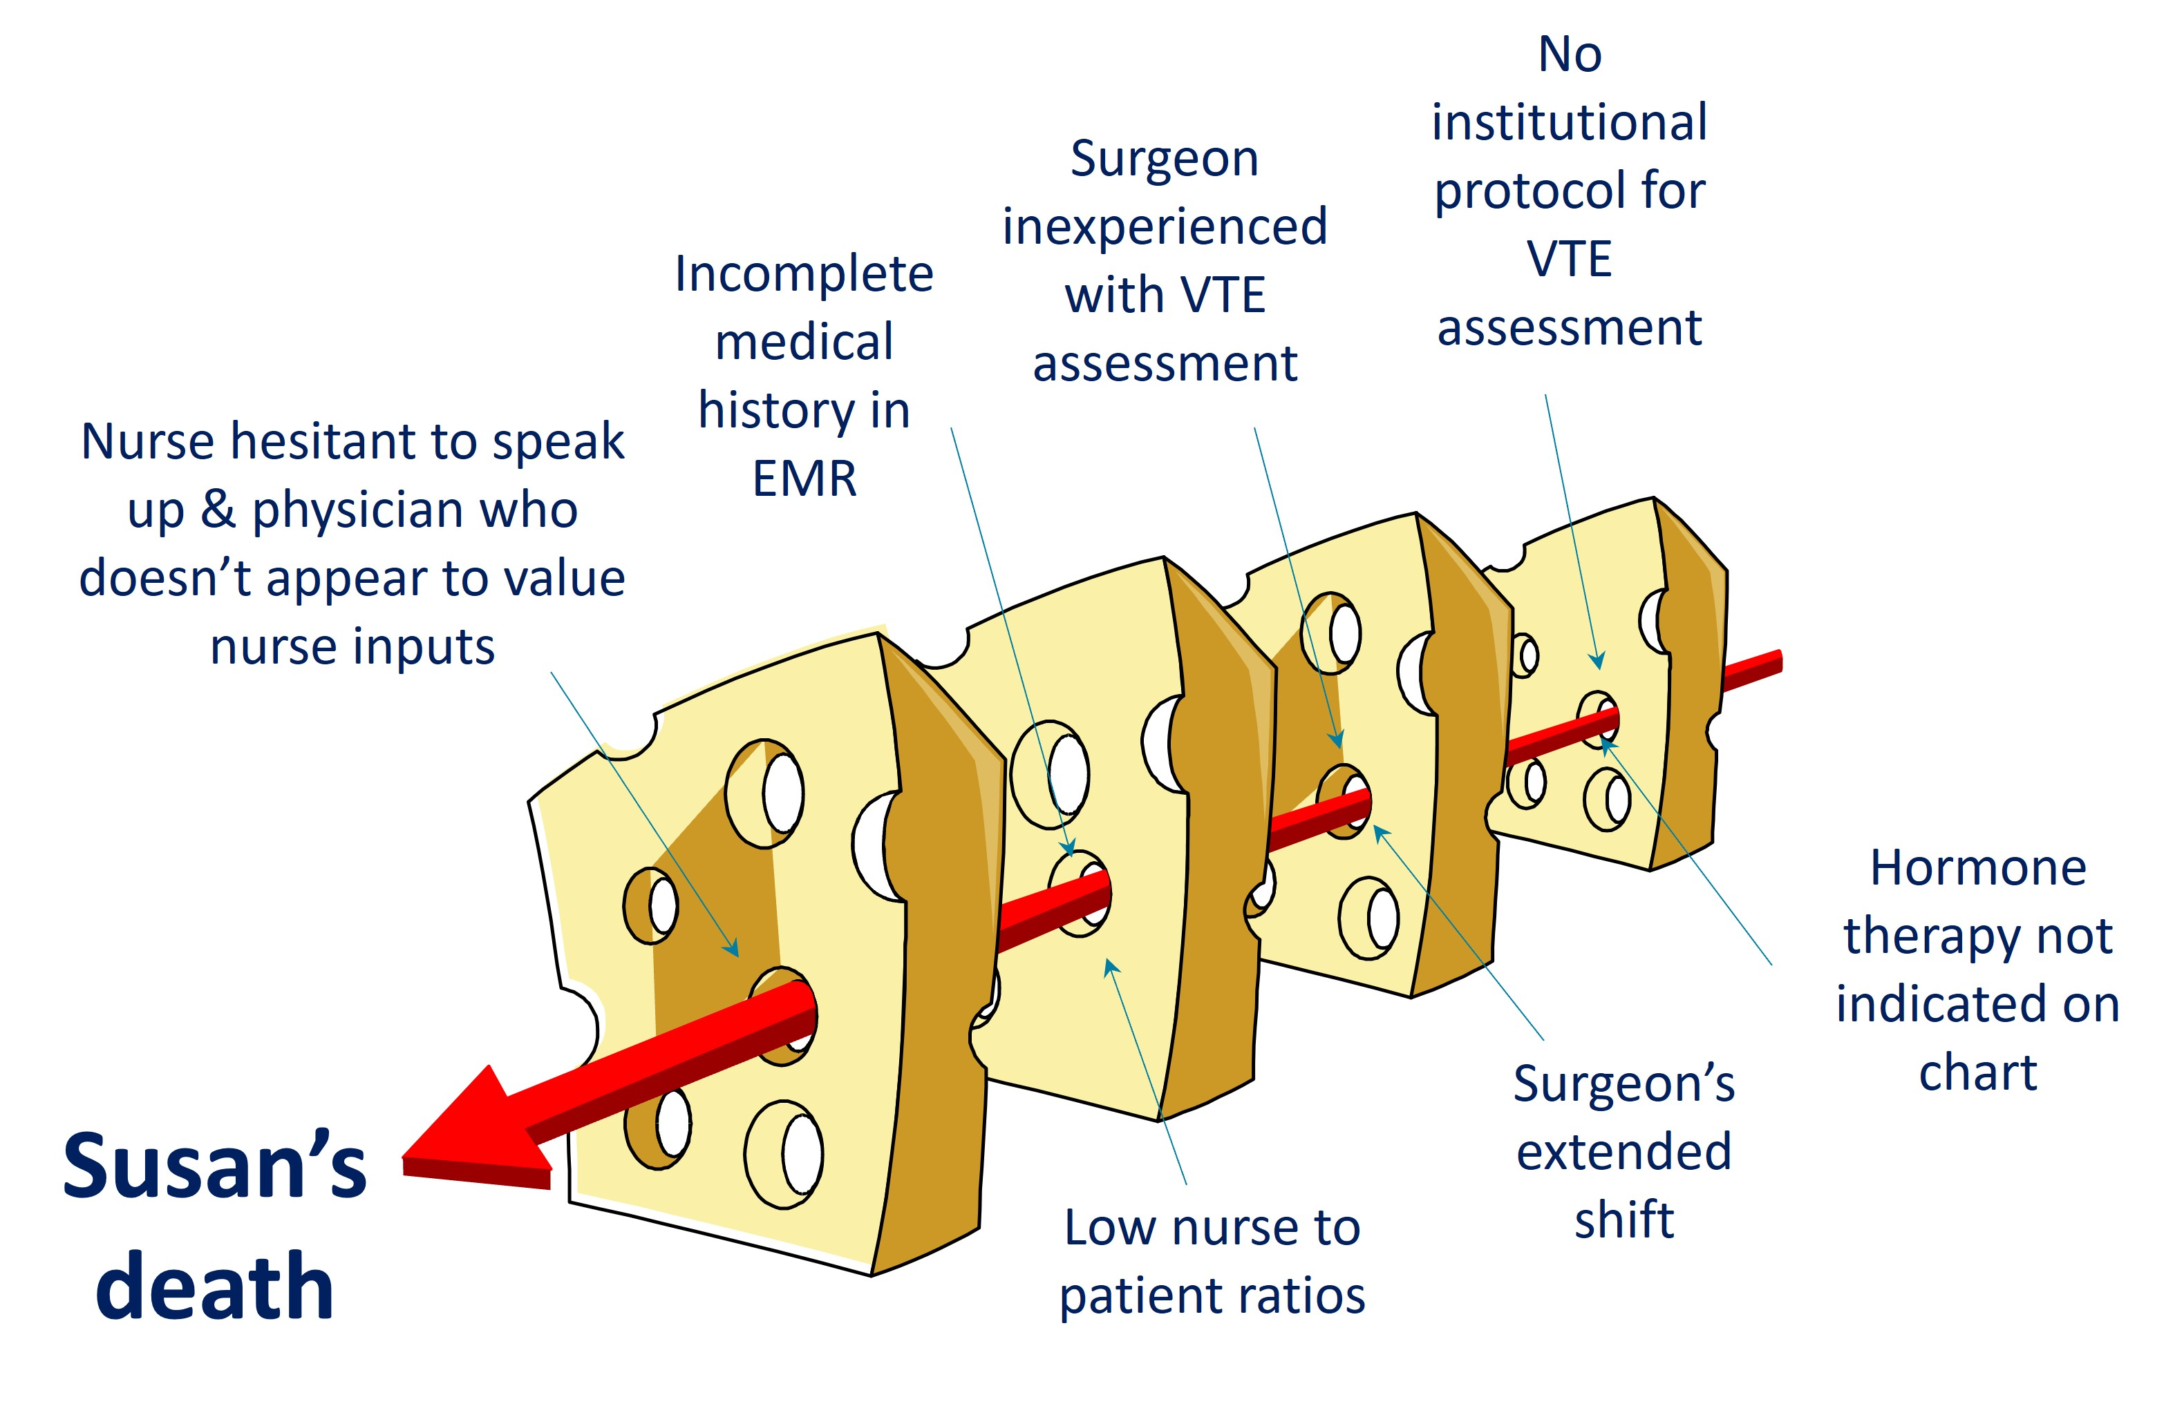
Susan’s Swiss Cheese Model

Slide 24


What’s Wrong With This Picture?
You must….

Slide 25

Leading Change
“One of most common leadership mistakes is expecting technical solutions to solve adaptive problems….”
- Heifetz, Leadership Without Easy Answers¹¹

Slide 26

Diverse Voices, Wiser Decisions

Slide 27
Power of CUSP
Do not be intimidated.
CUSP teams are powerful when they utilize the principles of the science of safety.
“Never doubt that a small group of thoughtful, committed citizens can change the world; indeed, it’s the only thing that ever has.”
- Margaret Mead

Slide 28
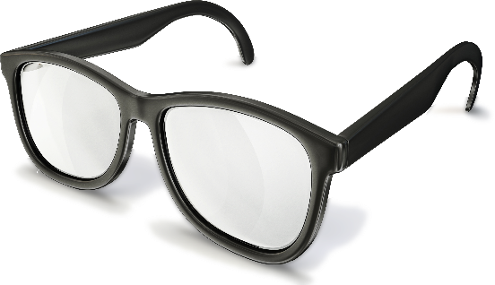



Important Messages To Share With Your Teams
See the system, see the risks.
Speak up and speak out for safety.
Value each other.
Learn and share.

Slide 29
Key Takeaways
Patient harm is largely preventable.
Change efforts often require a focus on systems, not individuals.
The science of safety allows us to create safe systems and safe teams by standardizing processes, incorporating independent double-checks for important things, and learning from defects.
Patient safety efforts require adaptive work, technical work, and diverse team members' input to succeed.

Slide 30
Disclaimer
The findings and recommendations in this presentation are those of the authors, who are responsible for its content, and do not necessarily represent the views of AHRQ. No statement in this presentation should be construed as an official position of AHRQ or of the U.S. Department of Health and Human Services.
Any practice described in this presentation must be applied by healthcare practitioners in accordance with professional judgment and standards of care in regard to the unique circumstances that may apply in each situation they encounter. These practices are offered as helpful options for consideration by healthcare practitioners, not as guidelines.

Slide 31
Reference List—1
World Health Organization. 10 facts on Patient Safety. https://www.who.int/news-room/photo-story/photo-story-detail/10-facts-on-patient-safety. Accessed August 28, 2024.
Klevens RM, Edwards JR, Richards CL, et al. Estimating health care-associated infections and deaths in U.S. hospitals, 2002. Public Health Rep. 2007;122(2):160-6. PMID: 17357358.
Magill S, Edwards J, Bamberg W, et al. Multistate point-prevalence survey of health care-associated infections. N Engl J Med. 2014;370(13):1198-208. PMID: 24670166.
Scott D. The direct medical costs of healthcare-associated infections in U.S. hospitals and the benefits of prevention. National Center for Preparedness, Detection, and Control of Infectious Diseases (U.S.) 2009. https://stacks.cdc.gov/view/cdc/11550. Accessed August 28, 2024.
CUSP: Understand the Science of Safety. Agency for Healthcare Research and Quality. https://www.youtube.com/watch?v=o5hg_VU7MiY. Accessed August 28, 2024.
What Is Patient Safety Culture? Agency for Healthcare Research and Quality. https://www.ahrq.gov/sops/about/patient-safety-culture.html. Accessed August 28, 2024.

Slide 32
Reference List—2
The Essential Role of Leadership in Developing a Safety Culture. The Joint Commission. https://www.jointcommission.org/-/media/tjc/newsletters/sea-57-safety-culture-and-leadership-final3.pdf. Accessed August 28, 2024.
High Reliability Organization Toolkit. Missouri Hospital Association. https://web.mhanet.com/media-library/high-reliability-organization-toolkit/. Accessed August 28, 2024.
Vincent C, Taylor-Adams S, Stanhope N. Framework for analyzing risk and safety in clinical medicine. BMJ. 1998;316(7138):1154-7. PMID: 9552960.
Reason J. Human error: models and management. BMJ. 2000;320(7237):768-70. PMID: 10720363.
Heifetz R. Leadership Without Easy Answers. Harvard University Press; 1994.

