Slide 1

Mutual Support
Obstetric Hemorrhage
SPPC-II
Toolkit
Module 5 of 8
AHRQ Pub. No. 23-0046
July 2023
Notes:
SCRIPT
Welcome to Module 5 of the SPPC-II Teamwork Toolkit. In this module, we will discuss the different facets of mutual support and strategies for supporting each.

Slide 2
Mutual Support
Mutual support involves members:
  Assisting each other
  Asserting and advocating for safety
  Providing and receiving feedback
  Managing conflict
Notes:
SCRIPT
Mutual support involves the willingness and preparedness to assist other team members during operations. In addition to task assistance, mutual support also encompasses feedback, conflict management, and advocacy and assertion. These supportive behaviors are facilitated by continuous situation monitoring, which keeps teammates aware of team member and patient needs.

Slide 3
Task Assistance
Team members foster a climate in which it is expected that assistance will be actively sought and offered.
  Don’t view the need for help as a weakness
Effective teams place all offers and requests for assistance in the context of patient safety
Team members protect each other from work overload situations
  You can set limits
Notes:
SCRIPT
Team members foster a climate in which it is expected that assistance will be actively sought and offered as a method for reducing the occurrence of error.
Ask: Which is easier? Asking for help or offering it?
Yes, offering help is generally easier than asking for it. I encourage you to make it a habit to do both.
It’s important not to view help as a weakness. Medicine is getting ever more demanding and complex. We are reaching the point where it’s unreasonable to expect any one individual to be able to do it all. That’s why there are so many professions and specialties. Asking for help is just a normal part of getting the job done, and once you and your teams see it that way, you’ll find the stigmas are no longer a barrier.
Whether you’re asking for help or offering it, placing the request or offer in the context of patient safety is going to make it more compelling for whomever you’re addressing.
Of course, you can protect yourself from overload by setting limits. For instance, you can say “sure, I have 5 minutes” to set a parameter before you begin.

Slide 4
Asserting Your Position
Stating your opinion to other team members,
particularly when that opinion differs from the plan.
Best done respectfully but firmly
Firmly assert your concerns and suggestions for doing it differently
Include key vitals
Tip! Assert your position using a Call-Out (see Module 3).
Tip! Use DESCR script as a way to structure your assertion.
Notes:
SCRIPT
Assertion is a key element in being a good team member, even when it’s sometimes difficult to do because the culture is unsupportive of speaking up or you’re worried you’ll be wrong. Still, it’s your responsibility to state your opinion honestly to other team members, especially if you aren’t agreeing with them or the care plan. Remembering that you’re simply trying to start a constructive conversation that will help the team and your patients.
Your team members will be more likely to listen to you when you’re respectful but back up your concerns with data, such as vital signs, and suggestions for what to do differently. Begin by opening the discussion, sharing your concern, describing the problem, offering a solution, and obtaining team agreement with how to proceed.
You can integrate your assertions under a call-out, if the opportunity is appropriate, and use the DESCR script as a way to structure dissent from the group. We have already learned about call-outs in Module 3 and will be learning about the DESCR script later in this module.
Next, we’ll introduce two tools in this module to help you assert your position respectfully yet firmly. These include the Two-Challenge Rule and Power Words.

Slide 5
Two-Challenge Rule
Helpful for escalating a concern
Asserting your position at least twice,
especially when ignored or unheard the first time.
Form the first challenge as a question.
Provide support for your concern in the second challenge.
Tip! Challenged team members MUST acknowledge the assertion,
otherwise escalate!
Notes:
SCRIPT
The Two-Challenge Rule is a strategy that will help you escalate a concern you have to the team. The aptly named Two-Challenge Rule is a challenge to yourself to assert your position at least twice, if initially ignored. The goal is to have the team member or team members you have challenged acknowledge your observation. Your strategy in the Two-Challenge Rule should be to form your first challenge as a question. This will naturally bring attention to your concern and encourage the teammate you've challenged to think about the situation and provide a rationale for their choices. If your question is ignored, you can frame your second challenge as a statement and provide support for your concern. The idea at this point is to explicitly explain what you're observing and why it's bothering you once again with the intent to engage your teammates in a constructive discussion.
As you have likely realized, the Two-Challenge Rule does not have to be enacted by a single individual. It is totally possible for a team member to back you up by following your challenge question with supporting concern or vice versa. If anything, providing this sort of support to a teammate will help escalate the concern more effectively, as there is often power in numbers.
Remember this is about advocating for the patient, yourself, and your team members. The Two-Challenge Rule ensures that an expressed concern has been heard, understood, and acknowledged.
There may be times when an initial assertion is ignored. If after two attempts the concern is still disregarded, but the member believes patient or staff safety is or may be severely compromised, the Two-Challenge Rule mandates taking a stronger course of action or using a supervisor or chain of command. This overcomes our natural tendency to believe the team leader must always know what he or she is doing, even when the actions taken depart from established guidelines. When invoking this rule and moving up the chain, it is essential to communicate to the entire medical team that additional input has been solicited.
It is important to have an agreed-upon approach of delivering the Two-Challenge Rule within your institution and to obtain buy-in from all involved (e.g., nurses, physicians, and administration). As with any of the tools and strategies in the SPPC-II Teamwork Toolkit, having a standardized method of delivery is critical for effectiveness. The chosen approach must be made known to all team members (i.e., everyone must be on the same page and speaking the same language).

Slide 6

Escalating the Concern
If the outcome is not acceptable
  Take a stronger course of action
  Use supervisor or chain of command
Empower any team member to “stop the line” if he or she senses or discovers a breach of safety
This is an action never to be taken lightly, but it requires immediate cessation of the process and resolution of the safety concern
Notes:
SCRIPT
There may be times when an initial assertion is ignored. If after two attempts the concern is still disregarded, but the team member believes patient or staff safety may be severely compromised, the Two-Challenge Rule mandates taking a stronger course of action or using a supervisor or chain of command. This overcomes our natural tendency to believe the team leader must always know what he or she is doing, even when the actions taken depart from established guidelines. When invoking this rule and moving up the chain, it is essential to communicate to the entire medical team that additional input has been solicited.
If you personally are challenged by a team member, it is your responsibility to acknowledge the concerns instead of ignoring the person. Any team member should be empowered to “stop the line” if he or she senses or discovers an essential safety breach. This is an action that should never be taken lightly but requires immediate cessation of the process to resolve the safety issue.

Slide 7

Power Words aka, ”CUS” Words
I am Concerned
I am Uncomfortable
This is a Safety Issue
Notes:
SCRIPT
Power Words provide another tool for advocacy, assertion, and mutual support. If you are familiar with AHRQ’s TeamSTEPPS materials, you may know these as CUS words. Signal words, such as "danger," "warning," and "caution" are common in the medical arena. They catch the reader's attention. In verbal communication, Power Words and other signal phrases have a similar effect. If all team members have a shared mental model and are on the same page, when these words are spoken, all team members will clearly understand the issue and its magnitude.
To use Power Words:
First, state your Concern.
Then state why you are Uncomfortable.
If the conflict is not resolved, state that there is a Safety issue. Discuss in what way the concern is related to safety. If the safety issue is not acknowledged, a supervisor should be notified.
If these words feel too strong for the present situation or are becoming a bit overused in your work setting, other phrases you could consider incorporating into your lexicon include:
I would like some clarity about... [state the issue], and
Would you like some assistance?
Of course, you can always find other ways to draw attention to your observations, but these Power Words are nice options for your toolkit and pair well with the second challenge when you're leveraging the Two-Challenge Rule.

Slide 8
Empower the Patient and Family
Give the patient explicit permission to participate in care discussions
  “If you hear us say something that sounds wrong or if you think we missed something that is important to you, please say something.”
Patient Power Words
  I am concerned, I am uncomfortable, I am worried about my safety
Escalating the concern:
  I would like it noted in my chart…
Notes:
SCRIPT
You should also consider giving each patient and family member you care for explicit permission to participate in discussions of her care. Many patients and family members may feel deference to the experience and expertise of their care team. While you certainly have more clinical knowledge in most cases, the patient and family members will typically have a greater understanding and knowledge of their own health history and what feels normal for them. In other words, they are the experts about themselves and may know important information relevant to their case.
Patients might be instructed to use the same power words we just described. That is, you might suggest they state when they are feeling concerned, uncomfortable, or worried about their safety. Additionally, you can instruct your patients that if they are feeling unheard, they can say, “I would like it noted in my chart that…” Often, this request will get the attention of providers when other mechanisms fail.

Slide 9
Application to 4 Rs:
Power Words & Two-Challenge Rule
4 Rs
Readiness Every Unit | Recognition Every Patient | Response Every Case | Reporting Every Unit
Ask what parameters your organization has set in the escalation plan for what to do when the Two-Challenge Rule has been used and ignored more than once | Be assertive when there is a concern for unanticipated hemorrhage or risk of deterioration Follow-up an ignored assertion using Two-Challenge Rule Employ Power Words to strengthen your assertion | Assert using the Two-Challenge Rule and Power Words to clarify the care plan when a provider believes patient is at risk of clinical worsening Can use together with a Call-Out (Module 3) | Use Power Words and the Two-Challenge Rule during problem-solving discussions when you have a differing opinion
Notes:
SCRIPT
The Two-Challenge Rule and Power Words can be considered and/or leveraged at every stage in the 4 Rs framework. When working on Readiness, ask what parameter your organization has set in the escalation plan for what to do when the Two-Challenge Rule has been used and ignored more than once. If no such plans currently exist, ask what would seem appropriate in the case of obstetric hemorrhage.
At the Recognition stage, during assessment of hemorrhage risk, use an assertive statement, possibly in conjunction with a call-out, which we discussed in Module 3, when there is a concern for hemorrhage risk. Follow-up using Two-Challenge Rule if initial assertion is ignored or brushed off and incorporate Power Words to strengthen your assertion.
In the Response stage, you might find that the Two-Challenge Rule, Power Words, and Call-Outs may also be useful when actively managing the third stage of labor to clarify the care plan when a provider believes the patient is at risk of clinical worsening. Key vital signs need to be included, along with protocol.
Finally, in the Reporting stage these strategies and tools may be useful during problem-solving discussions, such as debriefs, which we covered in Module 4, to communicate and resolve differing opinions.

Slide 10
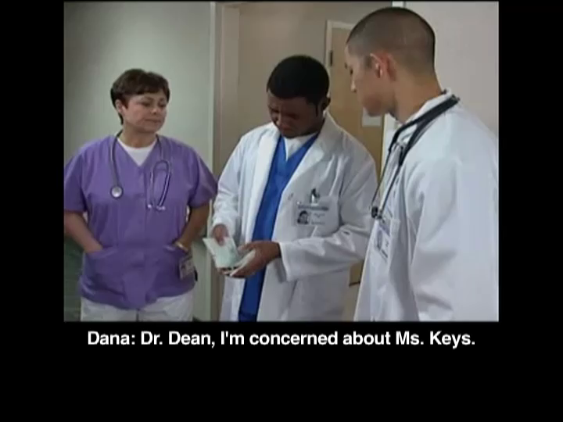
Demonstrating Power Words
Click video to watch
Notes:
SCRIPT
Before we start, please note that this is not an obstetric hemorrhage scenario. Look out for the power words used in this example.
How was the “challenge” presented?
In the form of a statement, “I am concerned…,” and then followed up with additional patient vitals.
How did she leverage Power Words?
The nurse was uncomfortable with the late decelerations.
She became concerned and uncomfortable that the patient’s safety could be at risk.

Slide 11
Practice Two-Challenge Rule
~8 minutes
Break into groups of two or three individuals
Brainstorm (5 minutes)
  Imagine you are Dana from the previous video and Dr. Dean has just brushed off your assertion about Ms. Keys.
  What would you do or say next?
Report out (2–3 minutes)
  Share your strategy to the group.
  Why you think it would be (in)effective?
Notes:
SCRIPT
Break into groups of two or three individuals.
Take no more than 5 minutes to imagine you are Dana from the previous video and Dr. Dean has just brushed off your assertion about Ms. Keys. What would you do or say next?
Would one or two teams like to share their strategy to the group? Why do you think that approach would be effective (or ineffective)?

Slide 12
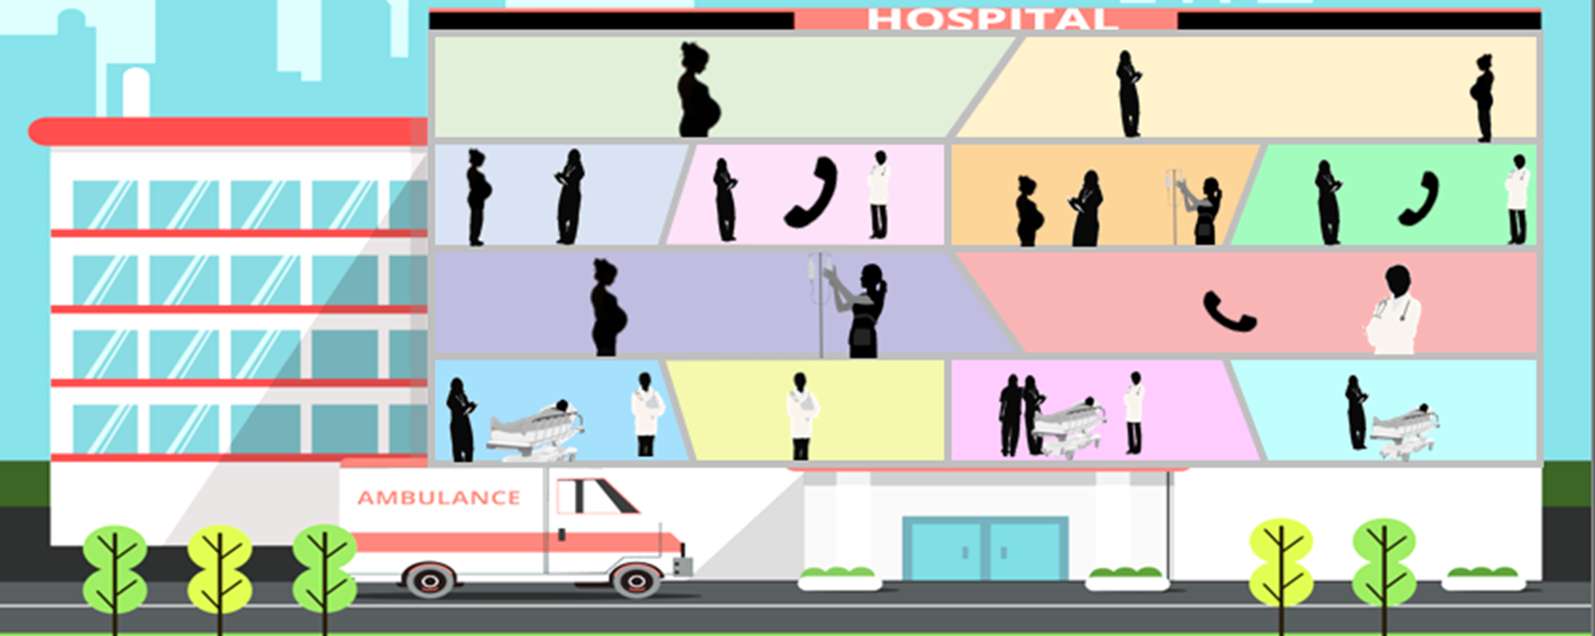

Obstetric Hemorrhage
Power Words & Two-Challenge Rule
Tanya is notifying Dr. Sonentag that Ms. Williams is bleeding.
Observe how Tanya pairs power words with the Two-Challenge rule to assert her concerns.
Notes:
SCRIPT
Here, we will delve into a clinical scene relating back to our original postpartum hemorrhage master scenario. We enter into the scenario just as Allison, the bedside nurse, has asked the charge nurse, Tanya, to notify the obstetrician, Dr. Sonentag that their patient, Ms. Williams, is bleeding. We enter the scene just as Tanya has reached Dr. Sonentag. Observe how Tanya pair power words with the Two-Challenge Rule to assert her position and concerns.

Slide 13



Obstetric Hemorrhage
Power Words & Two-Challenges
Hi Dr. Sonentag, this is Tanya, the charge nurse on L&D.
I was just informed that Ms. Williams is feeling lightheaded and dizzy, and on most recent fundal massage and perineal exam, she was noted to have a large gush of blood and clots totaling 250 cc.
Dr. Sonentag, obstetrician
Tanya, charge nurse
Notes:
SCRIPT
Once Dr. Sonentag is on the phone, Tanya says, “Hi Dr. Sonentag, this is Tanya, the charge nurse on L&D. I was just informed that Ms. Williams is feeling lightheaded and dizzy, and on most recent fundal massage and perineal exam, she was noted to have a large gush of blood and clots totaling 250 cc.”

Slide 14
Obstetric Hemorrhage
Power Words & Two-Challenges
Thank you, Tanya, for notifying me. I am sure Ms. Williams is just having normal postpartum lochia and blood loss.
I think she should be OK. We can continue monitoring her for now.
Obstetric Hemorrhage
Power Words & Two-Challenges
Dr. Sonentag, obstetrician
Tanya, charge nurse
Notes:
SCRIPT
Dr. Sonentag replies, “Thank you, Tanya, for notifying me. I am sure Ms. Williams is just having normal postpartum lochia and blood loss. I think she should be OK. We can continue monitoring her for now.”

Slide 15
Obstetric Hemorrhage
Power Words & Two-Challenges
Hi Dr. Sonentag, this is Tanya, the charge nurse on L&D.
I was just informed that Ms. Williams is feeling lightheaded and dizzy, and on most recent fundal massage and perineal exam, she was noted to have a large gush of blood and clots totaling 250 cc.
Dr. Sonentag, obstetrician
Tanya, charge nurse
Notes:
SCRIPT
Once Dr. Sonentag is on the phone, Tanya says, “Hi Dr. Sonentag, this is Tanya, the charge nurse on L&D. I was just informed that Ms. Williams is feeling lightheaded and dizzy, and on most recent fundal massage and perineal exam, she was noted to have a large gush of blood and clots totaling 250 cc.”

Slide 16
Obstetric Hemorrhage
Power Words & Two-Challenges
Hi Dr. Sonentag, this is Tanya, the charge nurse on L&D.
I was just informed that Ms. Williams is feeling lightheaded and dizzy, and on most recent fundal massage and perineal exam, she was noted to have a large gush of blood and clots totaling 250 cc.
Dr. Sonentag, obstetrician
Tanya, charge nurse
Notes:
SCRIPT
Once Dr. Sonentag is on the phone, Tanya says, “Hi Dr. Sonentag, this is Tanya, the charge nurse on L&D. I was just informed that Ms. Williams is feeling lightheaded and dizzy, and on most recent fundal massage and perineal exam, she was noted to have a large gush of blood and clots totaling 250 cc.”

Slide 17
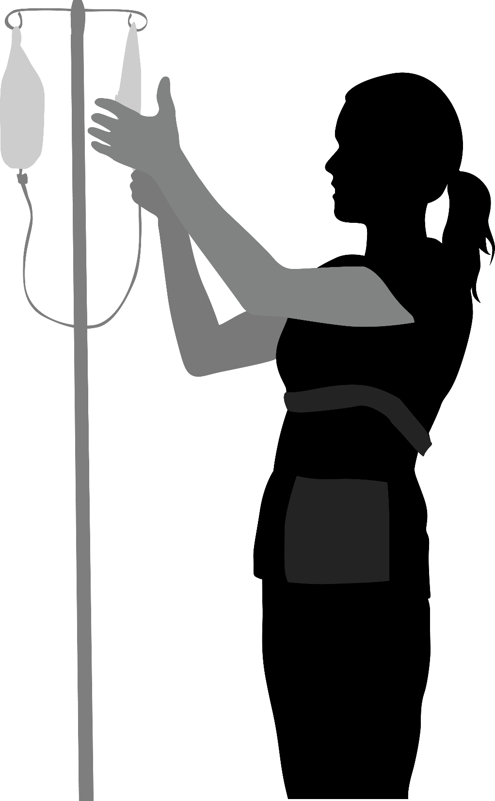
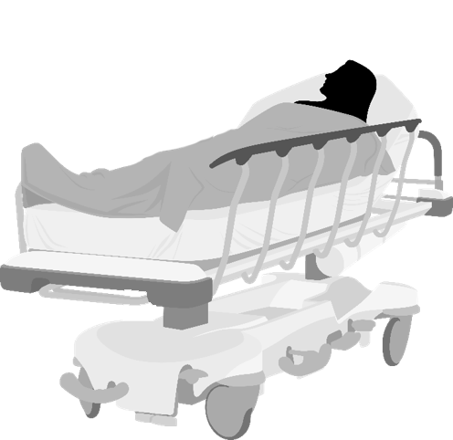
Obstetric Hemorrhage
Power Words & Two-Challenges
Allison repeats a set of vitals, showing a heart rate of 126 and blood pressure of 102/56. She relays to Tanya the new set of vitals and to make sure that Dr. Sonentag is on his way.
Obstetric Hemorrhage
Power Words & Two-Challenges
Allison, L&D nurse
Danielle Williams, the patient
Tanya, charge nurse
Notes:
SCRIPT
In the meantime, Allison repeats a set of vitals, showing Ms. Williams has a heart rate of 126 and blood pressure of 102/56. She relays to Tanya the new set of vitals and to make sure that Dr. Sonentag is on his way.

Slide 18
Obstetric Hemorrhage
Power Words & Two-Challenges
Hi Dr. Sonentag, this is Tanya, the charge nurse on L&D.
I was just informed that Ms. Williams is feeling lightheaded and dizzy, and on most recent fundal massage and perineal exam, she was noted to have a large gush of blood and clots totaling 250 cc.
Dr. Sonentag, obstetrician
Tanya, charge nurse
Notes:
SCRIPT
Once Dr. Sonentag is on the phone, Tanya says, “Hi Dr. Sonentag, this is Tanya, the charge nurse on L&D. I was just informed that Ms. Williams is feeling lightheaded and dizzy, and on most recent fundal massage and perineal exam, she was noted to have a large gush of blood and clots totaling 250 cc.”

Slide 19
Obstetric Hemorrhage
Power Words & Two-Challenges
Hi Dr. Sonentag, this is Tanya, the charge nurse on L&D.
I was just informed that Ms. Williams is feeling lightheaded and dizzy, and on most recent fundal massage and perineal exam, she was noted to have a large gush of blood and clots totaling 250 cc.
Dr. Sonentag, obstetrician
Tanya, charge nurse
Notes:
SCRIPT
Once Dr. Sonentag is on the phone, Tanya says, “Hi Dr. Sonentag, this is Tanya, the charge nurse on L&D. I was just informed that Ms. Williams is feeling lightheaded and dizzy, and on most recent fundal massage and perineal exam, she was noted to have a large gush of blood and clots totaling 250 cc.”

Slide 20
Obstetric Hemorrhage
Power Words & Two-Challenges
Tanya calls Dr. Sonentag back.
Dr. Sonentag, this is Tanya again. Ms. Williams is still having vaginal bleeding, her blood pressure has dropped to 102/56, and she is tachycardic to 126.
Do you think this is consistent with postpartum hemorrhage needing immediate evaluation and possible treatment?
Obstetric Hemorrhage
Power Words & Two-Challenges
Dr. Sonentag, obstetrician
Challenge #1!
Tanya, charge nurse
Notes:
SCRIPT
Tanya calls Dr. Sonentag back. She tells him, “Ms. Williams is still having vaginal bleeding, her blood pressure has now dropped to 102/56, and she is tachycardic to 126. Do you think this is consistent with postpartum hemorrhage needing immediate evaluation and possible treatment?”
Notice how Tanya posed her first challenge to Dr. Sonentag as a question.

Slide 21
Obstetric Hemorrhage
Power Words & Two-Challenges
I am concerned because Ms. Williams is now becoming symptomatic from her ongoing blood loss, which seems to be challenging her safety.
I am uncomfortable not having you present to evaluate her in person.
Challenge #2!
Use of Power Words
Dr. Sonentag, obstetrician
Tanya, charge nurse
Notes:
SCRIPT
Dr. Sonentag does not immediately acknowledge Tanya’s question, so she persists with a second challenge that she supplements with Power Words. She says, “I am concerned because Ms. Williams is now becoming symptomatic from her blood loss, which seems to be challenging her safety. I am uncomfortable not having you present to evaluate her in person.”

Slide 22
Obstetric Hemorrhage
Power Words & Two-Challenges
My apologies, Tanya, I was distracted for a moment. You’re absolutely right to be concerned. I will be there right away to see Ms. Williams in person.
Dr. Sonentag, obstetrician
Tanya, charge nurse
Notes:
SCRIPT
Finally, Dr. Sonentag responds, “My apologies, Tanya, I was distracted for a moment. You’re absolutely right to be concerned, and I’ll be there right away to see Ms. Williams in person.”

Slide 23
What Is Feedback?
Information provided for the purpose
of improving team or individual performance.
Professional development through—
  Reinforcing desired performance or
  Correcting undesirable performance
Notes:
SCRIPT
Another strategy to foster mutual support is feedback. Feedback is information provided for the purpose of improving individual and/or team performance. The ability to communicate self-improvement information in a useful way is an important skill in the team improvement process.
Feedback can either be given to reinforce desired performance or correct undesirable performance. Both types are helpful. Feedback can be given by any team member at any time. It is not limited to leadership roles or formal evaluation mechanisms. Effective feedback benefits the team in several ways, including:
• Fostering improvement in work performance,
• Meeting the team’s and individuals’ need for growth,
• Promoting better working relationships, and
• Helping the team set goals for ongoing improvement.
Can you describe a situation in which you had to give feedback to another team member? What was the situation? What was the result?

Slide 24
Good Feedback
Considerate and respectful
  Everyone is human, and feedback can be uncomfortable for both parties
Directed toward improvement
  Growth, not goading
Behavior-oriented
  Do not make it about personality traits
Specific
  Concrete examples
Timely
  Sooner is better
Notes:
SCRIPT
Think about how it feels to receive feedback. How does good feedback feel? What about “bad” or “constructive” feedback? Not as good, right? We are all trying our best on a daily basis and many of us are already our own worst critics. Often we are already aware of our limitations, shortcomings, and mistakes. Having someone be unkind can be salt in the wound. Alternatively, if we are blissfully unaware it can be disarming to learn we have fallen short. If you find yourself in the position of giving feedback, you should take care to do so with respect and consideration for the person to whom you are providing feedback. On the other hand, if you are the one receiving feedback it’s good to remember that the person who is giving you the feedback might be struggling to find the right words. It can be just as difficult to give as it is to receive feedback. Being as gentle with each other as possible, despite the discomfort of feedback, is sound advice for everyone who is part of the conversation.
Secondly, feedback should provide advice and information that is directed toward improvements that will help someone develop professionally and/or personally. As such, the topic of conversation should be about identifying ways to enhance someone’s performance so that they continue to grow as professionals and team members. To that end, feedback should focus on behavior rather than general personality traits. Doing so will not only help individuals channel their own improvement efforts to actionable changes but it will also keep the conversation constructive and help prevent hurt feelings if not embarrassment.
Furthermore, the more specific you can make feedback the better it is for the recipient. Offer up specific examples of things that drew your attention. Doing so gives you greater credibility, helps the recipient better understand how they are being perceived and what exactly it is they need to work on, and helps again to keep the message from sounding too personal. Having feedback conversations in a timely manner is going to help you provide these concrete examples. It’s not always possible or appropriate to provide feedback in the moment or on the fly, but the more recent the incident the better chance you have of offering valuable insight.

Slide 25
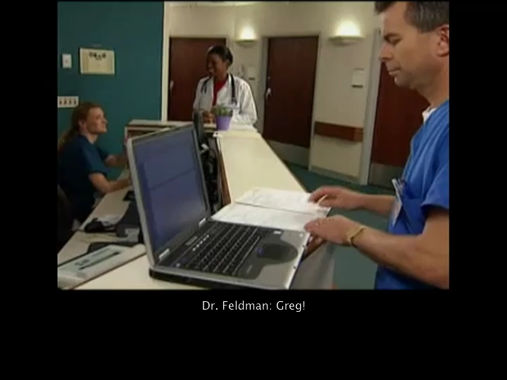
Effective Feedback Demonstration
Click video to watch
Notes:
SCRIPT
This video will provide an example of a doctor providing feedback to a medical tech. Although this video doesn’t showcase feedback within the context of an obstetric hemorrhage event, think about the guidelines for giving effective feedback as you watch the video.

Slide 26
Feedback Video Discussion
What did you like about this demonstration?
How would you have given feedback in this instance?
How might feedback be different when it’s of a negative or developmental nature?
Notes:
SCRIPT
What did you like about how the feedback was delivered?
Some possible answers:
Positive
Specific
Opportunity to share the experience
Appears to be timely
Directed and considerate – respectful and related to behavior
What didn’t you like about how feedback was delivered?
Some possible answers:
Was public. Maybe not a bad thing with it being reinforcing feedback, but this could be touchy.
Hard to replicate exactly what he did for next time.
Why would it be a good practice to share the experience with other team members?
Sharing the effective communication technique with others will promote continuous learning.

Slide 27
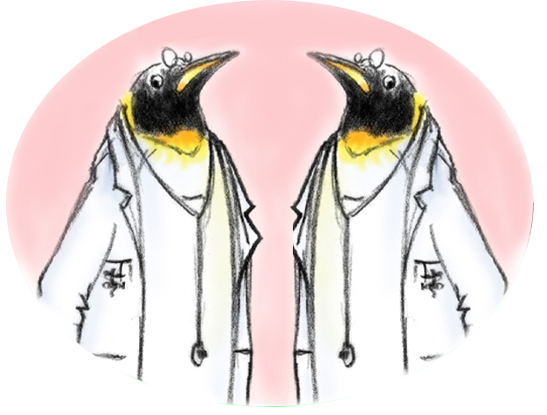
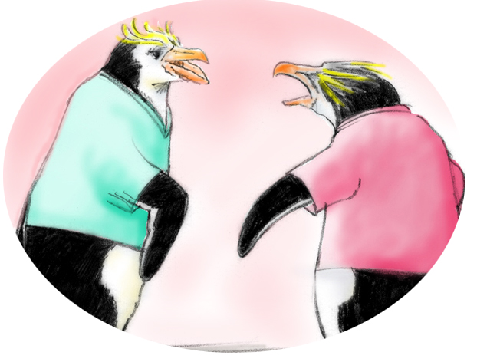
Conflict in Teams
Informational Conflict
(We have different information!)
Interpersonal Conflict
(Hostile and harassing behavior)
Two-Challenge Rule
DESCR Script
Notes:
SCRIPT
Conflict can occur in teams, and it is important to know how to handle such situations when they occur. The two types of conflict we will address are informational and interpersonal.
Informational conflict involves differing views, ideas, and opinions related to information. This is task-related and could involve disagreement about the best method to proceed with the plan of care.
Interpersonal conflict stems from interpersonal compatibility and is not usually task related. This type of conflict tends to revolve around the team members themselves, not the actions or information. Tension, annoyance, and animosity are common, and interactions can become very argumentative.
Attempts should be made to resolve both types of conflict before they interfere with work and undermine quality and patient safety. Informational conflicts left unresolved may evolve into interpersonal conflicts in the long run and severely weaken teamwork. Disruptive behavior among staff should be actively discouraged. Organizations should develop guidelines for acceptable behaviors to assist staff in better identifying, reporting, and managing behaviors that cause disruption to patient safety. Types of disruptive behavior include condescending language or voice intonation, impatience with questions, reluctance or refusal to answer questions or telephone calls, strong verbal abuse or threatening body language, and physical abuse.
Interpersonal conflict is best handled with the DESCR script, but informational conflict might be managed by using either the Two-Challenge Rule or the DESCR script.

Slide 28
DESCR’ibe It
A constructive approach for delivering
feedback and managing conflict.
Describe the specific situation
Express your concerns about the action
Suggest alternatives
Consequences should be stated
Reach consensus and agreement
Notes:
SCRIPT
The DESCR script is a useful tool for framing all sorts of different difficult communications. It is especially helpful for communicating feedback constructively and effectively managing and resolving both task and interpersonal conflicts. It can be used in minor disagreements as well as in situations involving greater conflict or consequences, such as when hostile or harassing behaviors are ongoing.
DESCR is a mnemonic for:
D – Describing the specific situation
E – Expressing your concerns about the action
S – Suggesting other alternatives
C – stating Consequences if the behavior remains unchanged, and, finally,
R – Reaching a consensus with your teammate about how to move forward and finding agreement and compromise with a solution you both feel comfortable with.

Slide 29

Tips for Constructive Conversations
Be prepared and have a timely discussion in a private
location
Frame the problems in terms of your experience
  Use ”I” statements; don’t play the blame game
Remain behavior-based and specific
Keep solution-focused and directed toward improvement
Recognize and listen to the other’s perspective
  Approach the conversation with empathy and compassion
Work on finding the win–win
Follow up
Notes:
SCRIPT
To make your conversations with the DESCR script more effective, you might want to consider:
Having a timely discussion in a private location. If you wait too long to have the hard conversation, you will forget details and may not be as effective at conveying your stance. You might also find yourself less likely to address the underlying issue, as more time goes by. Failing to do so can have severe consequences for you, your teammates, and the patient. In cases where you fail to give constructive feedback, patients might suffer as your teammate continues to replicate the unwanted behaviors. In instances of interpersonal conflict, your relationship with your teammate may continue to degrade, making work a miserable place for you and your teammate, and again contributing to diminished patient care if your relationship deteriorates to the point that you cannot work well together.
You will likely want privacy when you’re having a conversation about your working relationship and when delivering constructive feedback that involves telling your teammate that what they are doing isn’t correct or ideal. People can feel targeted and embarrassed when their mistakes are pointed out in public, and they may be less likely to listen to you and may react poorly due to feelings of humiliation. The only time where public feedback might be OK is when it’s positive reinforcement for a job well done. Not only does public commendation make the individual feel good, but it also signals to other team members what behaviors are rewarded.
When you’re dealing with interpersonal conflict or even constructive feedback, your team member will be more receptive if you frame the problems in terms of your experience and feelings to it. That reduces their defensive reactions and helps them to empathize with you better, enabling them to see the situation slightly more objectively, or at least through another person’s perspective. Using “I” statements will help you underscore the point that you are simply explaining things from your perspective and want to have a productive conversation.
Similarly, avoid blaming your team member, especially when the mistake wasn’t intentional. Recognize that we are all trying to do the best we can and making mistakes is hard on us.
Importantly, you’ll want to listen to your team member’s perspective and reactions just as much as you hope to be listened to. Approach the conversation with empathy and compassion for the other as much as you can. It’s very difficult to receive corrective feedback or learn that a team member has a problem with your relationship. If you realize that from your end, it will help to keep the conversation in a calmer place than when negative emotions escalate.
Relatedly, focus on what is right, not who is right. Whether you’re giving feedback or managing interpersonal conflict this point stands. If you focus on what behavior is best, it doesn’t matter who is right. It’s possible for both parties to be right, but if you can back your position up with clear best practice it’s hard to argue. Admittedly, this point might be a bit harder to follow if the premise of the conversation is personal. In those instances, try to focus on your teammate’s behavior as much as possible, avoiding criticisms of his or her character and personality.
Work to find a win–win solution. This is where the “reaching consensus” point comes into play. I’m sure you’ll have an idea of what you want to change but be open to listening to the other and coming to a place where you are both OK with the solution. This might involve your having to make changes in your own behavior for the conflict to resolve completely.

Slide 30

Receiving Feedback or Managing Conflict
Control your emotions as much as possible
  Even when you’re justified not to
Actively listen
Clarify the feedback you’re receiving
  Tip! Use the check-back technique (see Module 3)
Demonstrate gratitude
Sort feedback for relevancy
Notes:
SCRIPT
It’s never easy being on the receiving end, but if you find yourself the recipient of feedback or a conflict resolution conversation, there are a few tips you might want to consider to help the conversation go as painlessly and productively as possible. Try to control your emotions as much as possible. Sometimes the feedback giver will not be especially tactful or astute and might even say something that you may feel justified reacting to, but this will only escalate the situation. Instead, actively listen to what the giver is saying and clarify the message. If the giver is feeling particularly uncomfortable with the conversation, their points might be somewhat obscure. You can always draw on what you’ve learned about using the check-back technique for good communication to make sure you are understanding the point. If you aren’t familiar with that technique, it involves restating the message you are given in the way you are understanding it and giving your teammate the opportunity to confirm or clarify your understanding as correct. You can learn more about it in Module 3.
After hearing what your team member has to say, either about your performance or their perspective on your interpersonal relationship, thank them for their honesty and bringing it to your attention. Once you’ve listened with an open mind, you can determine for yourself the relevancy and merit of the feedback you’ve received. This isn’t a free pass to ignore all feedback you’re given, but sometimes you may find yourself receiving feedback that is biased, skewed, or misinformed, and in those cases it might make sense to select applicable nuggets from the feedback and ignore other pieces.

Slide 31
Application to 4 Rs: DESCR Script
4 Rs
Readiness Every Unit | Recognition Every Patient | Response Every Case | Reporting Every Unit
N/A | N/A | Apply DESCR: To unit-standard, stage-based, OB hemorrhage emergency management plans during the care process To address conflict and offer real-time feedback. If not possible to address it in the moment, wait until after the case is completed | Use DESCR: To provide team-based feedback during debriefs or individual-level feedback during one-on-one interactions Post-case or event to manage fallout from unresolved conflicts
Notes:
SCRIPT
Although you will likely find the DESCR script useful in many situations, it is especially applicable to the Response and Reporting & Systems Learning stages of AIM’s 4 Rs. For hemorrhage events, these tools are particularly useful for including as checklists in unit-standard, stage-based, obstetric hemorrhage emergency management plans to help resolve any task or interpersonal conflict that may arise during care. It is notable to suggest that, if conflict and feedback cannot be proffered real-time in the moment, it’s best to wait until after the case is completed. Just use common sense and remember our tips for holding constructive conversations.
Finally, DESCR is a great tool to help reinforce and establish a culture of huddles for high-risk patients and post-event debriefs. Use DESC to provide feedback during debriefs or in one-on-one interactions between providers post-event and manage fallout from unresolved conflicts.

Slide 32
Obstetric Hemorrhage
DESCR Script
Dr. Sonentag was called twice before presenting in person.
Observe how the L&D director uses the DESCR Script to provide feedback.
Notes:
SCRIPT
Building from the obstetric hemorrhage master case scenario presented in Module 1, let’s observe what the use of the DESCR script in action might look like. If you recall, Dr. Sonentag was called twice by the charge nurse before coming in person to attend to the hemorrhage event.
Observe how the L&D director uses the DESCR script to give Dr. Sonentag feedback about this event.

Slide 33
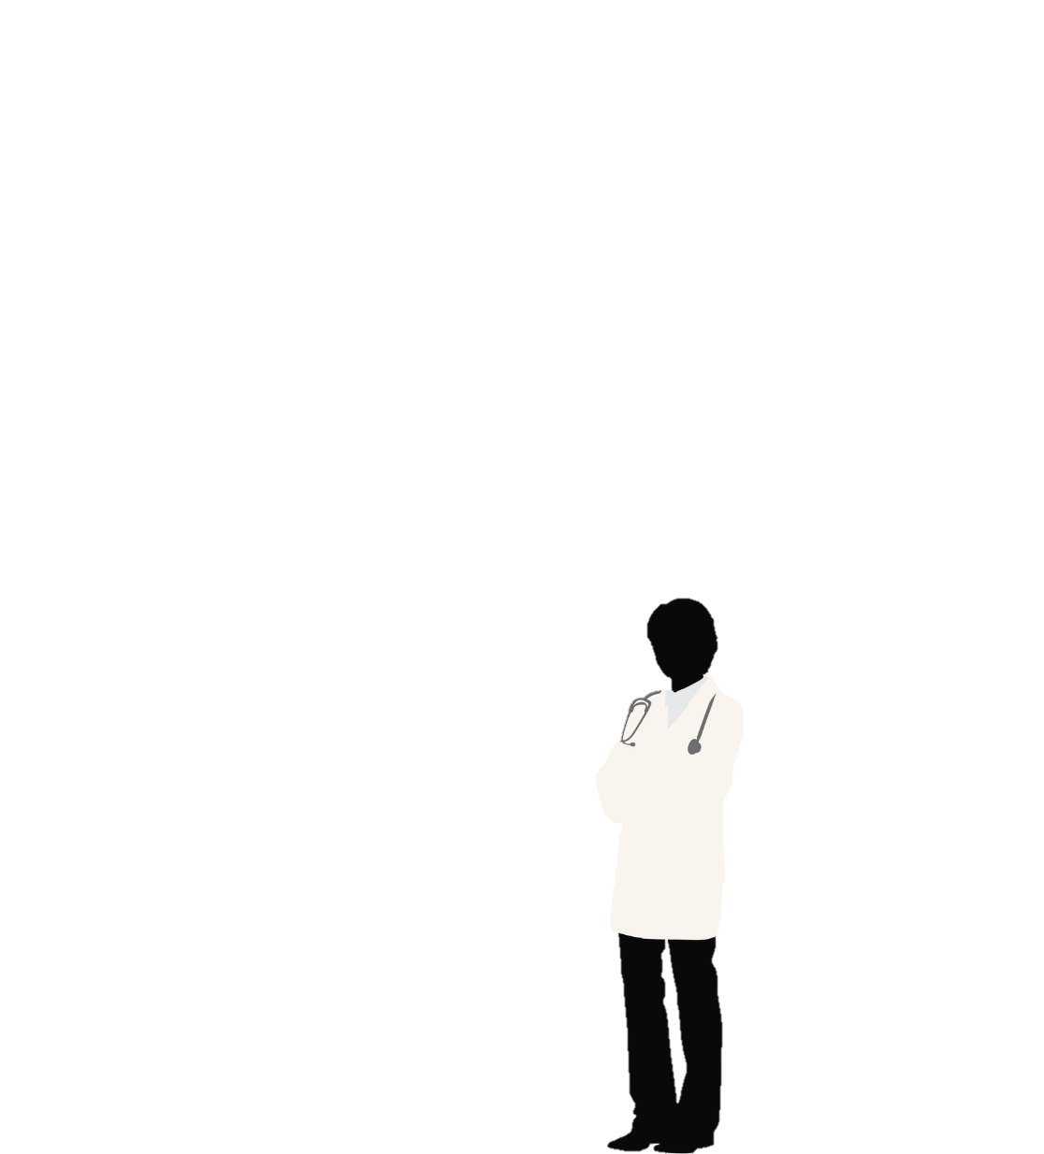

Obstetric Hemorrhage
DESCR Script
The L&D director approaches Dr. Sonentag to offer feedback on the most recent hemorrhage event.
Dr. Sonentag, do you have a few minutes? I would like to discuss a situation that occurred with your patient, Ms. Danielle Williams, yesterday.
L&D Director
Dr. Sonentag, obstetrician
Notes:
SCRIPT
Let’s see how the L&D director gives Dr. Sonentag feedback using the DESCR script. She opens the conversation by saying, “Dr. Sonentag, do you have a few minutes? I would like to discuss a situation that occurred with your patient, Ms. Danielle Williams, yesterday.”

Slide 34
Obstetric Hemorrhage
DESCR Script
Yes, I participated in her care and recall most of the details of her case.
What would you like to discuss?
L&D Director
Dr. Sonentag, obstetrician
Notes:
SCRIPT
Dr. Sonentag replies, “Yes, I participated in her care and recall most of the details of her case. What would you like to discuss?”

Slide 35
Obstetric Hemorrhage
DESCR Script
Upon review of the case, it appears that Allison identified Ms. Williams’ symptoms of postpartum hemorrhage and ongoing bleeding rather quickly.
It’s my understanding that the charge nurse, Tanya, called you immediately and you presented in person after the second call.
Do I have that right?
L&D Director
Dr. Sonentag, obstetrician
Notes:
SCRIPT
The L&D director begins with a description of what happened, as she understood it: “Upon review of the case, it appears that Allison identified Ms. Williams’ symptoms of postpartum hemorrhage and ongoing bleeding rather quickly. It’s my understanding that the charge nurse, Tanya, called you immediately and you presented in person after the second call. Do I have that right?”

Slide 36
Obstetric Hemorrhage
DESCR Script
Yes, that is my recollection as well.
The first time Tanya called me, I requested the nursing staff continue to monitor Ms. Williams.
I immediately went to see her when her blood pressure began dropping.
L&D Director
Dr. Sonentag, obstetrician
36
Notes:
SCRIPT
Dr. Sonentag confirms the events and adds to them his perspective: “Yes, that is my recollection as well. The first time Tanya called me, I requested the nursing staff continue to monitor Ms. Williams. I immediately went to see her when her blood pressure began dropping.”

Slide 37
Obstetric Hemorrhage
DESCR Script
OK, thank you for your honesty. This is concerning to me because our unit standard and goal is to treat and manage any uterine atony immediately, especially if it advances to the point of the patient becoming symptomatic and developing a postpartum hemorrhage.
Next time, please evaluate the patient immediately to determine whether vaginal bleeding is actually concerning for a postpartum hemorrhage or if it is physiologic and likely benign.
L&D Director
Dr. Sonentag, obstetrician
Notes:
SCRIPT
The L&D director explains that Dr. Sonentag’s decision to wait before seeing the patient in person is concerning to her, “because our unit standard and goal is to treat and manage any uterine atony immediately, especially if it advances to the point of the patient becoming symptomatic and developing a postpartum hemorrhage.”
Crucially, the director suggests that Dr. Sonentag should “evaluate the patient immediately, possibly determining if indeed the vaginal bleeding was actually concerning for a postpartum hemorrhage or if it was actually physiologic and likely benign.”

Slide 38
Obstetric Hemorrhage
DESCR Script
You are a valued employee, so I want to have this coaching conversation before it becomes habit. I understand that there is always the potential for extenuating circumstances, but failing to examine Ms. Williams promptly put her at unnecessary risk.
Next time a similar incident occurs, I will require you to retake the SPPC-II Teamwork modules. Staff who don’t work in accordance with those principles may not be eligible for good performance-based recognition and incentives.
L&D Director
Dr. Sonentag, obstetrician
Notes:
SCRIPT
The L&D director reinforces her belief that Dr. Sonentag is a valued employee, so she wanted to take the time to have this coaching conversation before it becomes a habit because delaying a prompt in-person examination of Ms. Williams put her at unnecessary risk. The consequence, should Dr. Sonentag’s behavior repeat barring extenuating circumstances, will be required participation in the SPPC-II Teamwork Toolkit modules to reinforce the unit standards and that she could lose eligibility for performance-based recognition.

Slide 39
Obstetric Hemorrhage
DESCR Script
I completely agree. I should have come to evaluate the patient at that time and identified the developing postpartum hemorrhage sooner.
I will be sure to respond to immediate requests for patient evaluation promptly in the future.
Thank you for bringing this to my attention.
L&D Director
Dr. Sonentag, obstetrician
Notes:
SCRIPT
At the end, Dr. Sonentag reaches consensus with the director. She tells her, “I completely agree. I should have come to evaluate the patient at that time and identified the developing postpartum hemorrhage sooner. I will be sure to respond to immediate requests for patient evaluation promptly in the future. Thank you for bringing this to my attention.”

Slide 40
Obstetric Hemorrhage
DESCR Script
You’re welcome. The remainder of Ms. Williams’ care and your response to her postpartum hemorrhage were commendable.
Great job!
L&D Director
Dr. Sonentag, obstetrician
Notes:
SCRIPT
The Director choses to end the feedback session on a positive note: “You’re welcome. The remainder of Ms. Williams’ care and your response to her postpartum hemorrhage were commendable. Great job!”

Slide 41
Practice DESCR
~10 minutes
Find a partner.
Imagine again that you are Dana, and Dr. Dean has ignored your assertion about Ms. Keys and you were forced to escalate the concern.
Imagine your partner is Dr. Dean.
Use the DESCR script to frame what you would like to say to Dr. Dean.
Your partner can use DESCR to give you feedback on your approach.
Alternatively:
Think of a recent conflict you’ve experienced and
use the DESCR script to address it with your partner.
Notes:
SCRIPT
For this exercise, find a partner. One of you act as Dana and the other as Dr. Dean.
Imagine that you are Dana from the video, and Dr. Dean has ignored your assertion about Ms. Keys and you were forced to escalate your concern.
The partner playing Dana should use the DESCR script to frame what you would say to Dr. Dean. The partner playing Dr. Dean might provide feedback on partner Dana’s use of DESCR.
If you’re feeling open enough, you can alternatively think of a recent conflict you’ve had with somebody. It doesn’t have to be work-related, but it can be. It can also be as serious or minor or personal as you are comfortable sharing. Imagine your partner is that person, be it your teenage child, spouse, or coworker.
Take no more than 10 minutes to complete this activity.

Slide 42
Summary
There are a number of ways to show team members support:
  Task assistance
  Feedback
  Respectful conflict management
  Asserting and advocating for teammates, patients, and yourself
Strategies:
  Two-Challenge Rule
  Power Words
  DESCR script
38
Notes:
SCRIPT
Mutual support is the heart of teamwork. It goes beyond simple task assistance to include giving constructive feedback, resolving conflict respectfully, and asserting and advocating for your patients, teammates, and yourself.
To help you navigate these interactions, you can adopt the Two-Challenge Rule in your home institutions to empower staff to speak up. Pair this with Power Words for extra effect. Finally, the DESCR script is a great tool for framing difficult conversations, especially those involving delivering constructive feedback or managing disagreements.

