Slide 1

Coaching
SPPC-II
Toolkit
Module 6 of 8
AHRQ Pub. No. 23-0046
July 2023
Notes:
SCRIPT
Welcome to Module 6 of the SPPC-II Teamwork Toolkit. In this module, we’ll learn some tactics for coaching your frontline providers on using the teamwork tools.

Slide 2
Coaching
Involves providing instruction, direction, and prompting
Includes demonstrating, reinforcing, motivating, and providing feedback
Requires monitoring and ongoing performance assessment
Continues even after skills are mastered to ensure sustainment
Notes:
SCRIPT
"Coaching" is defined as instructing, directing, or prompting as a coach. The term "coaching" describes specific actions that include demonstrating, reinforcing, motivating, and providing feedback. These actions share the purpose of improving performance or achieving a specified goal for the individuals or team being coached.
Coaching is an active and typically ongoing process that can be used in structured and unstructured activities. It requires routine monitoring and ongoing assessment of performance.
Coaching is different from traditional instruction. With traditional instruction, teaching typically ends when the new content or skill is mastered. Coaching, however, continues even after content or skill mastery to ensure sustainment.
In this module, we will provide some general information about coaching, as well as provide specific information about the role and implementation of coaching as you work on your AIM clinical bundles and promote teamwork.

Slide 3
Why Is Coaching Important?
To help improve the adoption of AIM clinical bundles by frontline staff
Effective coaching helps to achieve:
  Clearly defined goals
  Alignment of expectations between AIM Team Leads and frontline staff
  Increased understanding of teamwork concepts
  Increased teamwork competence among staff
  Successful integration of teamwork behaviors into daily practice
  Improved team performance and safer patient care
  Sustainment of improved performance over time
Notes:
SCRIPT
Coaching is an effective way to influence and improve performance. The effective use of coaching can achieve several positive outcomes.
In general, the results of effective coaching include:
Goals that are defined and understood.
Alignment of expectations between the AIM Team and frontline staff.
Transfer of knowledge on a "just-in-time" basis.
Increased understanding of teamwork concepts.
Increased teamwork competence among staff.
Successful integration of teamwork behaviors into daily practice,
Improved team performance and safer patient care.
Sustainment of improved performance over time.
In the context of adopting the AIM clinical bundles, the key to integrating teamwork behaviors into daily practice is through frontline coaching. Coaches will help ensure that teamwork concepts are understood by team members and that the teamwork tools and strategies you implement are used accurately and appropriately. If you help staff become proficient and comfortable with the new behaviors, they will integrate them into daily practice.
Over the longer term of your implementation, coaches will continue to monitor teamwork behaviors to ensure continued use of implemented tools and strategies, as well as to identify new areas for improvement. As such, coaches play a critical role in both Technical (i.e., clinical practice) and Adaptive (e.g., teamwork) implementation and sustainment efforts.

Slide 4
Your Role as a Teamwork Coach
Motivate team members
Encourage frontline participation in SPPC-II Teamwork Toolkit training modules and facilitation sessions
Provide opportunities to practice and improve
  Host facilitation sessions with frontline staff to debrief training modules and practice with the teamwork tools and strategies
Role model behavior
Observe performance and provide feedback
Notes:
SCRIPT
In order to achieve the important outcomes of coaching, the Hospital Aim Team Lead’s role includes several activities. These include:
Encouraging participation in the SPPC-II Teamwork Toolkit training modules and facilitation sessions,
Providing opportunities to practice and refine performance,
Role-modeling behavior,
Observing performance and providing feedback, and
Motivating team members.
Let's review each of these and discuss their application to the implementation of SPPC-II Teamwork Toolkit and training material.

Slide 5
The Coach as a Role Model and Motivator
Demonstrates effective use of teamwork behaviors, tools, or strategies
As a respected member of the team, reinforces acceptance of behavior through performance
Helps team members see the bridge between new behaviors and patient safety and outcomes
Encourages belief in team members’ abilities to succeed, and offers support, assistance, and empathy
Communicates and recognizes positive results/outcomes, validates current accomplishments
Identifies potential challenges, pitfalls, and unforeseen consequences
Notes:
SCRIPT
Effective coaches must role model the behavior they intend to reinforce. Modeling the teamwork behaviors being trained and reinforced will not only provide a demonstration of performance of the behavior to the team members, but also highlight the acceptance of the behavior in the environment. This may include general teamwork skills or the use of a specific teamwork tool or strategy, depending on your implementation plans.
Coaches should be individuals who are well-respected and supported in their work area. As such, coaches will send an important message by demonstrating the behaviors they are working to improve and then reinforce in your organization. The most effective skill coaches are members of the team in which the teamwork tools are being implemented.
In addition to role modeling behaviors and providing feedback, an effective coach motivates team members. In this role, a coach:
Helps team members see the bridge between new behaviors and patient safety and outcomes.
Encourages belief in team members' ability to succeed. This includes asking powerful questions to identify the source of team members' perceived expertise, knowledge, or experience and aligning their level of confidence with their abilities.
Expresses enthusiasm among and commitment in team members.
Validates current levels of accomplishment while advocating greater achievement.
Recognizes and reassures team members when they are successful, such as using a tool or strategy effectively.
Identifies potential challenges, pitfalls, barriers, and unforeseen consequences.
Helps navigate team members to think through barriers to successful implementation.
Offers support and assistance, and displays empathy toward perceived challenges the team member is facing.
Communicates positive results and outcomes with the team; for example, highlights for the team a potential error that was avoided with the effective use of teamwork behaviors.

Slide 6
Exercise: Brainstorm
As a group, brainstorm the qualities/characteristics of your most influential coaches, and then do the same for your most ineffective coaches.
Good Coach Qualities vs. Bad Coach Qualities
Notes:
SCRIPT
Have groups of four or five people brainstorm and record what they have experienced with past coaches. What has made a good coach or a bad coach to them?

Slide 7
Coaching Criteria
Communication
Communicating instructions
Performance Improvement
Relationships
Building rapport and trust
Execution
Responding to requests
Providing feedback
Listening for understanding
Setting performance goals
Rewarding improvement
Dealing with failure
Assessing strengths and weaknesses
Motivating others
Working with personal issues
Confronting difficult situations
Following through
Notes:
SCRIPT
Knowing the role of a coach is not sufficient to understanding what it takes to be an effective coach. Effective coaches exhibit specific competencies. The American Society for Training and Development, or ASTD, identified 13 competencies that coaches should exhibit. These can be organized into four clusters:
Communication.
Performance improvement.
Relationship building.
Execution.
We'll discuss each of these clusters. We'll also be distributing a handout that defines the competencies.
Communication
Skill in communicating is clearly critical for coaching effectively. There are three specific areas of coaching competency related to communication:
Communicating Instructions―Demonstrating to the person you are coaching how to accomplish the task and clarifying when, where, how much, and to what standard it should be done.
The role of coach often involves teaching a skill or procedure to another person. The ability to break down a task into easy-to-understand steps that you can articulate to another is vital to being an effective coach.
Providing Feedback―As we have discussed, this involves carefully observing performance and sharing these observations in a non-threatening manner.
Listening for Understanding―Demonstrating attention to and conveying understanding of others.
Listening is an indicator of respect. It requires being open minded to what others say, focusing on both the content of what is said and the feelings others may be expressing.
Performance Improvement
A coach cannot be successful without skill in improving the performance of others. There are four areas of coaching competency related to performance improvement:
Setting Performance Goals―Collaborating with others to establish short- and long-term goals for performance on particular tasks.
Effective coaching sometimes starts with pointing someone in the right direction. First, you work with the person to set broad goals; then you become very specific in agreeing on desired outcomes and how they will be measured.
Rewarding Improvement―Using a variety of means to provide positive reinforcement to others for making progress on the accomplishment of important tasks.
Timing of rewards is important. Don't wait until you see either perfection or failure on the task. Look for growth in task accomplishment, and reward that soon after you observe it. Although coaches don't always control formal rewards, such as pay, perks, or promotions, they can make frequent and effective use of informal rewards.
Dealing With Failure―Working with others to encourage them when they do not meet expectations.
When an individual demonstrates an inability or unwillingness to perform a task according to expectations and standards, you need to be able to deal with the result. This can mean encouraging, redirecting, retraining, or otherwise affecting his or her ability to willingly change. Patience can be a virtue or an enabler of more failure, so use it wisely.
Assessing Strengths and Weaknesses―Identifying root causes of performance through keen observation and effective definition and articulation of performance issues.
Properly identifying the skills, abilities, and interests of the person you are coaching directs your coaching efforts to the most critical areas. This involves distinguishing between symptoms and root causes of problems. Without accurate assessment, coaching efforts might be spent addressing the wrong problem or a nonexistent one.
Relationship Building
Effective coaches must be able to build relationships with those they coach. There are four areas of coaching competencies related to relationship building:
Building Rapport and Trust―Showing respect for others. Acting with integrity and honesty. Easily forming bonds with others.
Rapport and trust are the cornerstones of an effective coaching relationship. The person you are coaching needs to trust that you have his or her best interests at heart, so he or she can be honest with you regarding shortcomings. There also needs to be a bond of mutual respect, so the advice, teaching, and counseling of the coach will be more readily accepted.
Motivating Others―As we have discussed, coaches must encourage others to achieve desired results.
The right button to push to help motivate another person differs widely across people, so there are no hard and fast rules for motivating others. It is best to ask each person what is important to him or her and how the task at hand relates.
Working with Personal Issues―Listening empathically and without judgment, and offering emotional support for personal difficulties.
In general, coaches are not expected to function as counselors. Few are qualified to carry out such responsibilities, and the context of the organizational relationship might preclude this type of interaction. Faced with an individual whose personal situation is interfering with his or her performance, however, you need to be able to intervene. A good rule of thumb is that whenever you feel "in over your head," you are. Be prepared to refer the person to appropriate sources of professional assistance and adjust the coaching process to support getting through the personal situation.
Confronting Difficult Situations―Raising uncomfortable topics that are affecting task accomplishment.
Coaching often involves situations in which performance has not met expectations. Unmet expectations often lead to finger pointing, denial of personal responsibility, and other dysfunctional behaviors. Talking about these issues can make people uncomfortable. Good coaching requires the ability and willingness to confront difficult and uncomfortable situations head on, but with tact and diplomacy. When the best interests of all concerned are at heart, the honesty and courage to confront difficult situations are welcomed.
Execution
The final cluster relates to coaches' skill in executing their role as a coach. There are two areas of coaching competency related to execution:
Responding to Requests―Consulting with others on an as-needed basis. Responding to requests in a timely manner.
Timely response to requests is a tangible indicator of respect. To build and maintain a healthy coaching relationship, make sure your responsiveness reflects a high level of priority.
Following Through―Keeping your commitments. Monitoring outcomes of the coaching process and providing additional assistance when necessary.
Trust is a critical component of any coaching relationship. Keeping your commitments helps build and maintain trust. Showing an ongoing commitment to the long-term success of the person you are coaching also builds a strong relationship.

Slide 8
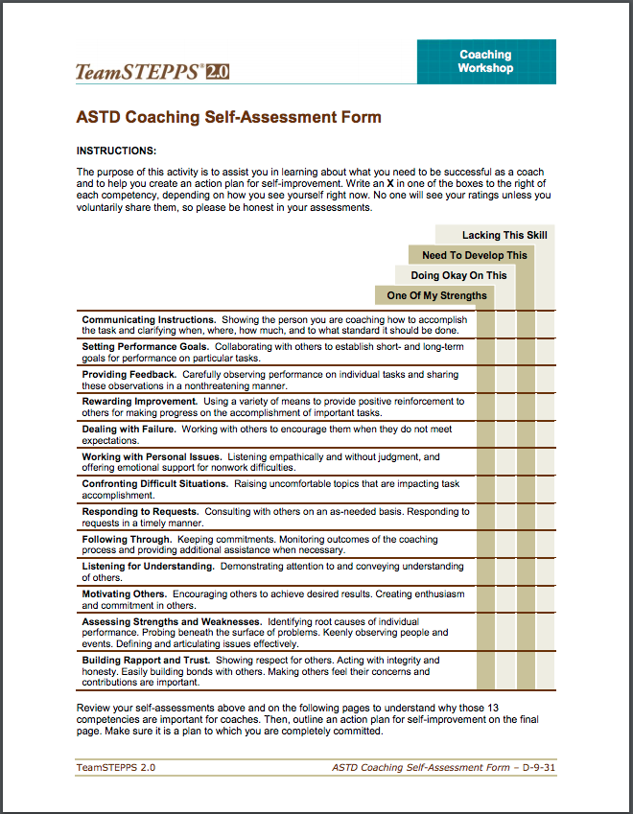
Exercise:
Coaching Self-Assessment
Independently:
  Complete the TeamSTEPPS Coaching Self-Assessment (page 1)
Group Discussion:
  How can each competency be improved?
Independently:
  Strategize a plan for personal self-improvement (page 4)
Notes:
SCRIPT
Let’s do a coaching self-assessment. Independently complete the self-assessment.
Why These Competencies Are Important
The 13 competencies that make up this assessment are of particular importance for those with a coaching role. They represent areas in which you need to excel in order to fulfill your coaching role successfully.
Communicating Instructions. Showing the person you are coaching how to accomplish the task and clarifying when, where, how much, and to what standard it should be done. The role of coach often involves teaching a skill or procedure to another person. The ability to break down a task into easy-to-understand steps that you can articulate to another is vital to being an effective coach.
Setting Performance Goals. Collaborating with others to establish short- and long-term goals for performance on particular tasks. Effective coaching sometimes starts with pointing someone in the right direction. First, you work with the person to set broad goals; then you become very specific in agreeing on desired outcomes and how they will be measured.
Providing Feedback. Carefully observing performance on individual tasks and sharing these observations in a nonthreatening manner. Giving others feedback on their task performance is critical to improving their performance. In order to do this effectively, you have to observe the person performing the task, noting what the person is doing well and what can be improved. Then you work with the individual to ensure that he or she understands your feedback and uses it developmentally.
Rewarding Improvement. Using a variety of means to provide positive reinforcement to others for making progress on the accomplishment of important tasks. Timing of rewards is important. Don’t wait until you see either perfection or failure on the task. Look for growth in task accomplishment and reward that soon after you observe it. Although coaches don’t always control formal rewards (pay, perks, or promotions), they can make frequent and effective use of informal (“pat on the back” or other nonmonetary recognition) ones.
Dealing with Failure. Working with others to encourage them when they do not meet expectations. When an individual demonstrates an inability or unwillingness to perform a task according to expectations and standards, you need to be able to deal with the result. This can mean encouraging, reprimanding, redirecting, retraining, or otherwise affecting his or her ability or willingness. Patience can be a virtue or an enabler of more failure. Use it wisely.
Working with Personal Issues. Listening empathically and without judgment and offering emotional support for nonwork difficulties. In general, coaches are not expected to function as counselors or psychotherapists. Few are qualified to carry out such responsibilities, and the context of the organizational relationship might preclude this type of interaction. Faced with an individual whose personal situation is interfering with his or her performance, however, you need to be able to intervene. A good rule of thumb is that whenever you feel “in over your head,” you are. Be prepared to refer the person to appropriate sources of professional assistance and adjust the coaching process to support getting through the situation humanely.
Confronting Difficult Situations. Raising uncomfortable topics that are affecting task accomplishment. Coaching often involves situations in which performance has not met expectations. Unmet expectations often lead to finger pointing, denial of personal responsibility, and other dysfunctional behaviors. Talking about these issues can make people uncomfortable. Good coaching requires the ability and willingness to confront difficult and uncomfortable situations head on, but with tact and diplomacy. When the best interests of all concerned are at heart, the honesty and courage to confront difficult situations are welcomed.
Responding to Requests. Consulting with others on an as-needed basis. Responding to requests in a timely manner. Timely response to requests is a tangible indicator of respect. To build and maintain a healthy coaching relationship, make sure your responsiveness reflects a high level of priority.
Following Through. Keeping your commitments. Monitoring outcomes of the coaching process and providing additional assistance when necessary. Trust is a critical component of any coaching relationship. Keeping your commitments helps build and maintain trust. Showing an ongoing commitment to the long-term success of the person you are coaching also builds a strong relationship.
Listening for Understanding. Demonstrating attention to and conveying understanding of others. Listening is another indicator of respect. It requires keeping your mind open to what others say, attending well to both the content of what they say and the feelings they may be expressing (sometimes unconsciously). Listening effectively almost invariably involves checking your understanding of others’ messages by reflecting what you hear, using such phrases as, “What I hear you saying is...” and, “You seem to be concerned about....”
Motivating Others. Encouraging others to achieve desired results. Creating enthusiasm and commitment in others. The right button to push to help motivate another person differs widely. There are no hard-and-fast rules to what motivates anyone. You can be effective by knowing what motivates the person you are coaching and tying his or her desires and goals to the task at hand. This requires continual assessment and reassessment of the person and situation. “Reading” the person can be inaccurate. It’s better to ask what is important to him or her and how the task at hand relates.
Assessing Strengths and Weaknesses. Identifying root causes of individual performance. Probing beneath the surface of problems. Keenly observing people and events. Defining and articulating issues effectively. Properly identifying the abilities and interests of the person you are coaching directs your coaching efforts to the most critical areas. This involves keen observation and attention to detail. It also means distinguishing between symptoms and root causes of problems. Without accurate assessment, your coaching efforts might all be spent on addressing the wrong problem or a nonexistent one.
Building Rapport and Trust. Showing respect for others. Acting with integrity and honesty. Easily building bonds with others. Making others feel their concerns and contributions are important. Rapport and trust are the cornerstones of an effective coaching relationship. The person you are coaching needs to trust that you have his or her best interests at heart so he or she can be honest with you regarding shortcomings. There also needs to be a bond of mutual respect so the advice, teaching, and counseling of the coach will be more readily accepted.
Turn to page 4 and take 15 minutes to work through your personal self-improvement plan.
REQUIRED MATERIALS
Note: Need to provide participants with the coaching self-assessment handout: https://www.ahrq.gov/sites/default/files/wysiwyg/professionals/education/curriculum-tools/teamstepps/instructor/fundamentals/module9/coachselfasfm.pdf

Slide 9
Coaches Provide Opportunities To Practice
Can be formal/structured or informal
Examples include:
  Ask team members how they might have approached a situation differently by using a teamwork tool or strategy
  Use scenarios during staff or team meetings to discuss or simulate the effective use of a teamwork tool or strategy
  Develop tools that facilitate use of tool or strategy, such as notepads that outline the SBAR components
  Provide staff with a teamwork “tip of the week”
Notes:
SCRIPT
Your most important role as a coach will be providing practice opportunities to your team members and offering valuable feedback on their use of teamwork skills. These can be formal opportunities, such as those you might provide during debriefing sessions, or informal, such as those you might provide on the job.
A few ideas for practice opportunities include:
Ask team members how they might have approached a situation differently by using a teamwork tool or strategy.
Use scenarios during staff or team meetings to discuss or simulate the effective use of a teamwork tool or strategy.
Develop tools that facilitate use of tool or strategy, such as notepads that outline the SBAR components.
Provide staff with a teamwork “tip of the week.”
Do you have any other suggestions for additional ways to provide practice?
Note: See Module 3 for information on SBAR.

Slide 10
Exercise: Coaching
Divide into groups of three
Review the scenarios, Facilitator Guide, and Coaching Feedback Form
  Pick either the hypertension or hemorrhage scenario
  Choose an aspect of the scenario on which you’ll provide coaching
Each participant takes a turn playing the coach, team member, and observer
  The coach provides feedback to the team member in the scenario
  The team member acts out the scenario
  The observer completes the Coaching Feedback Form and shares feedback
Notes:
SCRIPT
You should each be in a group of three and have copies of the Coaching Feedback Forms and some coaching scenarios.
To practice your coaching skills, you will each take turns playing the role of the coach, the team member being coached, and the observer. The coach works through the designated issue with the team member; the team member acts out the particular scenario; and the observer watches the interaction and notes on the Coaching Feedback Form which competencies the coach exhibits and does not exhibit.
Within your group, read the first scenario and assume your designated roles of coach and team member. You'll have about 2 minutes to act out the scenario while the third person observes and completes the Coaching Feedback Form. At the end of the scenario, the observer provides feedback based on comments noted on the Coaching Feedback Form. You'll then rotate roles and use a new scenario.
You may wish to reference the coaching competencies and definitions on the ASTD Coaching Self-Assessment Form you completed earlier as you provide feedback to your team members.
Do:
Help keep time to ensure that each participant has an opportunity to play multiple roles.
Observe the coaching sessions. Identify a well-demonstrated coaching scenario and ask if the group would demonstrate their scenario in front of the class.
After about 10–12 minutes, reconvene the group and have the identified group demonstrate their scenario.
Discussion:
Which of the competencies of an effective coach were demonstrated in this exercise?
How did you choose which team member(s) to coach? Is there an alternative approach?
What did the team member do well in interacting with the coach?
Were there opportunities for improvement?

Slide 11
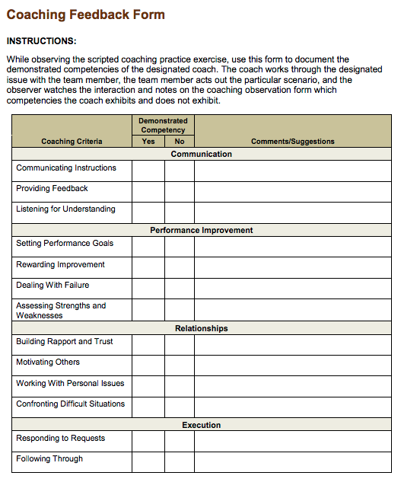
Coaching Feedback Form
Used to provide feedback on a coaching interaction
Observer scores whether each competency has been demonstrated
Discuss comments and suggestions following the coaching interaction
Notes:
SCRIPT
While observing coaching interactions, use this form to document the demonstrated competencies of the designated coach.

Slide 12
When You Provide Feedback, Make Sure It Is…
Timely
Respectful
Specific
Directed toward improvement
Two-way
Considerate
Remember: The DESCR script (Module 5) is a great tool for framing feedback.
Notes:
SCRIPT
Effective coaches also observe and provide feedback about team members' performance. To do so, coaches must conduct ongoing observations of performance and identify what is being done well and what can be improved. Coaches will focus their observations and feedback on the use of teamwork tools and strategies that align with the implementation plan.
Strengths and weaknesses in performance must be conveyed to team members through feedback. Effective feedback is:
Timely. Coaches should provide feedback when the behavior is still fresh in the team member's mind.
Respectful. Feedback from coaches should be about behavior, not about an individual. Coaches should not attribute a team member's performance to internal factors. If negative feedback is specific to an individual team member, the feedback should not be delivered in front of others.
Specific. Coaches should describe behavior in a specific, objective way and not be judgmental. Feedback should clearly describe what was good about the performance or what was incorrect or demonstrated need for improvement.
Directed toward improvement. Coaches should provide information aimed at improving skills. When a behavior is performed correctly, it is critical for coaches to identify what was good about the performance and reinforce it for continued use. When behavior is not performed correctly, or demonstrates room for improvement, coaches must not only point out what should be improved, but also how it should be improved. Feedback should include goals related to improvement.
Two way. As part of providing feedback, coaches should allow team members the opportunity to ask questions. This requires active listening by the coach. Similarly, coaches should ask questions to try to understand team members' point of view and to ensure they understand the feedback provided.
Considerate. Coaches should provide feedback with the goal of correcting or improving behavior while leaving self-esteem intact.
You may want to provide coaches with a specific structure or model for providing feedback. For example, the SMART model stands for "specific, measurable, attainable, realistic, and timely." If your organization already has a feedback model in place for use in performance management, teach coaches to use the same model.

Slide 13
Exercise:
How Can You Empower Others To Be Helpers?
Independently: think about your local institution…
  Who might be a good candidate for helping to reinforce teamwork behavior?
    Shouldn’t be current AIM team members
    Should be someone who is open or already bought in to the importance of teamwork
    Frontline who have influence and respect among their peers
  How will you get these people to help you reinforce teamwork?
  What information will you provide to them to help them coach teamwork?
Share independent thoughts with the whole group/class.
Notes:
Now that you have gone through the modules and this one-day training, think about how you can make sure to utilize and promote the tools you learned about?

Slide 14
Coaching Tips
Do…
  Actively monitor and assess team performance
  Establish performance goals and expectations
  Acknowledge desired teamwork behaviors and skills through feedback
  Coach by example—be a good mentor
Do not…
  Coach from a distance
  Coach only to problem solve
  Lecture instead of coach
Notes:
SCRIPT
This module has provided you with information to serve as a teamwork coach, as well as prepare others for this role. Here are a few coaching tips:
Do…
Actively monitor and assess team performance.
Establish performance goals and expectations.
Acknowledge desired teamwork behaviors and skills through feedback.
Coach by example—be a good mentor.
Do not…
Coach from a distance.
Coach only to problem solve.
Lecture instead of coach.

Slide 15
Summary
Coaching facilitates adoption and proper use of the teamwork tools and strategies presented in the SPPC-II Teamwork Toolkit
Hospital AIM Team Leads are responsible for providing initial coaching to frontline
  Facilitation sessions
  Real-time feedback
In time, frontline staff may begin to coach each other
Notes:
TALKING POINTS
In conclusion:
Coaching helps facilitate adoption and proper use of the teamwork tools and strategies presented in the SPPC-II Teamwork Toolkit.
Its primary purpose is to reinforce desired behaviors and modify undesired behavior.
Hospital AIM Team Leads are primarily responsible for providing initial coaching to the frontline. They will do so primarily through facilitation sessions but also through the provision of real-time feedback.
In time, frontline staff may begin to coach each other on tool use and reinforce new teamwork norms.

Slide 16
Acknowledgments
This project is funded and implemented by the Agency for Healthcare Research and Quality and the Johns Hopkins University Contract Number HHSP233201500020I in collaboration with the Health Resources and Services Administration and the Alliance for Innovation on Maternal Health.

