Slide 1

Introduction to the SPPC-II Teamwork Toolkit for Severe Hypertension
SPPC-II
Toolkit
Module 1 of 8
AHRQ Pub. No. 23-0046
July 2023
Notes:
SCRIPT
Thank you for participating in the Safety Program for Perinatal Care II (also known as SPPC-II) presented by the Johns Hopkins University, Agency for Healthcare Research and Quality, and the Alliance for Innovation on Maternal Health (AIM). This module will introduce you to the SPPC-II program and the Teamwork Toolkit for the Severe Hypertension bundle. It will serve as the foundation to the remaining training modules, which will cover a suite of useful teamwork tools and their application to managing severe hypertension in accordance with the AIM framework.

Slide 2
Overview
Mision and Vision
Care Components: Technical and Adaptive
SPPC-II Teamwork Toolkit
The 4 Rs of AIM Patient Safety Bundles
The Master Clinical Scenario: Maternal Severe Hypertension
2
Notes:
SCRIPT
A brief outline of this session is:
To provide an overview of AIM’s mission and vision
Explain the technical and adaptive sides of patient care improvement work
Situate the SPPC-II Teamwork Toolkit within this framework and mission
Provide an overview of the 4 Rs of AIM’s Severe Hypertension patient safety bundle
Introduce the clinical scenario of severe hypertension, which will serve as the basic scenario in which we will demonstrate all of the tools covered in this workshop

Slide 3
Vision and Mission
Vision
Safe healthcare for every woman.
Mission
Continually improve patient safety in women’s healthcare through multidisciplinary collaboration that drives culture change.
Notes:
SCRIPT​
Guided by the vision to achieve safe healthcare for every woman, the AIM program is working toward elimination of all preventable maternal mortality and severe morbidity across the United States. We will share maternal mortality and severe maternal morbidity statistics later in the day during the Evaluation Module (Module 8).
The mission of AIM is to continually improve patient safety in women's healthcare through multidisciplinary collaboration that drives culture change. To this end, AIM has created multiple patient safety bundles designed to address specific concerns within obstetric care, such as severe hypertension. Working toward the improvement of overall maternal health outcomes, AIM partners with state teams and health systems to align national-, State-, and hospital-level quality improvement efforts and implementation of the patient safety bundles.

Slide 4
Two Sides of Patient Care
Technical Elements
Clinical knowledge
Clinical expertise
Evidence-based best practices
Adaptive Elements
Culture
Teamwork
Engagement
AIM Patient Safety Bundle
Teamwork Toolkit
Notes:
SCRIPT
We know you are working hard to align yourself with the AIM mission and vision statements by committing all you can to your clinical practice. You may be surprised to learn that patient safety isn’t simply about the application of clinical knowledge and expertise. While these technical elements are essential, there is a second side to care that complements clinical skills. Termed “adaptive” because they enable translation of technical competence into practice, these components include the cultural and socio-emotional elements that deeply affect the way technical elements of care are delivered. Consider for a moment how your ability to do your job is enhanced or hindered by your working relationships. Imagine how the care you provide might be or feel different when you’re completely in sync with your teammates versus what it might look like if you had completely dysfunctional team dynamics. Totally different, right?
Hopefully, what you take away from this simple mind exercise is the understanding that, when we have the goal to provide safe care to every woman, we have to consider both whether we are caring for her with the best clinical knowledge available and within the most effective adaptive setting. The AIM patient safety bundles that your organization is implementing satisfy the technical side. This teamwork toolkit aligns with those bundles to help improve the adaptive side of patient care. The SPPC-II Teamwork Toolkit will do so by providing you with specific tools and strategies you can use when working with your colleagues to provide team-based care to your patients.

Slide 5
SPPC-II Teamwork Toolkit Purpose
Connects to AIM Patient Safety Bundle concepts via the 4 Rs
  Also available for Obstetric Hemorrhage
Provides common language, skills, and tools as resources to better support your clinical team
  Calling-out critical information and checking-back for clarity and correctness (Module 3)
  SBAR and I PASS the BATON for framing information exchange (Module 3)
  Briefs, huddles, and debriefs to facilitate shared understanding (Module 4)
  Power Words and the two-challenge rule to assert for safety (Module 5)
  DESCR script for delivering feedback and managing conflict (Module 5)
Notes:
SCRIPT
This toolkit has been designed to connect established teamwork concepts within the context of AIM’s Patient Safety Bundle for Severe Hypertension in Pregnancy using AIM’s 4R’s framework. A similar toolkit is available for AIM’s Obstetric Hemorrhage Patient Safety Bundle. The SPPC-II Teamwork Toolkit is comprehensive in its ability to teach language, skills, tools, and strategies you can utilize with your team daily and presents a case scenario that demonstrates how these strategies may be used while caring for a severely hypertensive mother. Not only does the SPPC-II Teamwork Toolkit provide instruction on the adaptive skills that allow you to best engage in teamwork that keeps your patients’ safety and quality of care at the forefront of everything, but it also discusses how to have difficult conversations and interactions with coworkers/colleagues that come when working in a stressful and busy environment.
We will discuss the terms and concepts on this slide as we proceed throughout today’s workshop. Your frontline providers and staff will also be expected to complete online modules covering each of these topics, though their numbering will be different from that presented here.

Slide 6
SPPC-II Teamwork Toolkit Structure
Hospital AIM Team Leads
Frontline Providers & Staff
In-person all-day workshop
  Teamwork basics
  Teamwork tool specifics
  Implementation guidance
Organize frontline participation
Lead the facilitation sessions
Resource: Facilitator Guide
Eight online, tool-focused modules per Patient Safety Bundle
Maximum time commitment of 12 minutes per online module
  Self-directed and self-paced
Mandatory in-person team facilitation sessions
  Reinforce online module lessons
  Practice with tools in person
6
Notes:
SCRIPT
There are two audiences for this toolkit: Hospital (or OB) AIM Team Leads and the frontline providers and staff. All of you here today are part of your Hospital AIM Team and responsible for leading the efforts for rolling out both the AIM clinical bundles and this SPPC-II Teamwork Toolkit to your frontline staff at your home institutions.
As our Tier 2 audience, you’ll participate in this in-person workshop during which you will learn teamwork basics, teamwork tool specifics, and implementation necessities. We will help you organize frontline participation and teach you how to lead the facilitation sessions.
Your frontline providers and staff are what we call our Tier 1 audience as they will really only learn about teamwork tool specifics that are the foundation to everything else you will learn. The training developed for the frontline include eight online tool-focused modules that have been tailored to each patient safety bundle. We have kept each of these modules purposefully short—under 12 minutes each. However, to supplement this information and demonstration-based training, we expect you to schedule in-person team facilitation sessions so lessons from the training are reinforced through demonstrated commitment to their use and practice. See the Facilitator Guide for more explicit guidance on how to mange the rollout of these materials.

Slide 7
The 4 Rs of AIM Patient Safety Bundles
Alliance for Innovation on Maternal Health
4 Rs
Readiness (unit level)
Recognition and Prevention (patient level)
Response (incident level)
Reporting and Systems Learning (unit/department/institution level)
Notes:
SCRIPT
AIM is a national data-driven maternal safety and quality improvement initiative based on proven implementation approaches to improving maternal safety and outcomes in the United States. AIM provides evidence-based frontline resources for birth facilities and provider/public health teams to adapt and implement a series of action steps (patient safety bundles) on high-risk maternal conditions. These patient safety bundles are standardized evidence-informed processes to reduce variation in response to maternal care. They are developed by multidisciplinary work groups of experts in the field representing each of our AIM partners and specialty organizations.
Each patient safety bundle consists of four domains, known as the 4 Rs. These include readiness, recognition and prevention, response, and reporting. Specifics of each domain is tailored to each patient safety bundle.
This module will focus on the 4 Rs associated with the Severe Hypertension bundle.

Slide 8
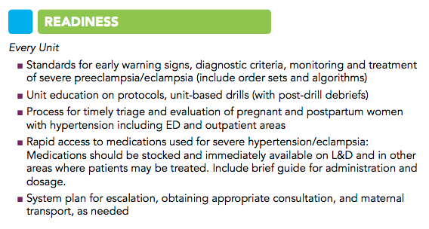
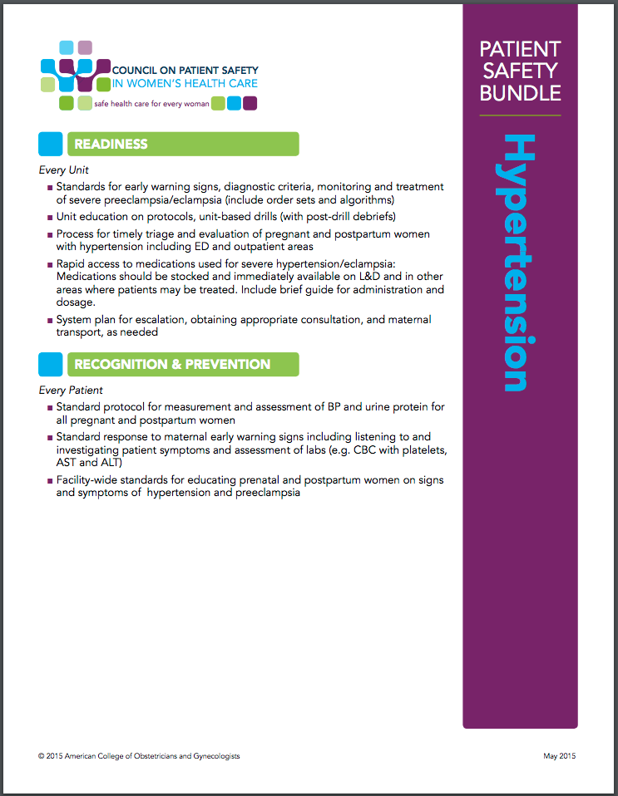
Severe Hypertension: Readiness
8
Notes:
SCRIPT
Every birth unit and outpatient triage area needs to prepare for the emergency situation of maternal hypertension—developing protocols, educating staff, and creating quick access to medications. Drills and other staff education in responding to severe maternal hypertension are critical as well as creating the systems to assure timely and adequate treatment centering on patient needs.

Slide 9
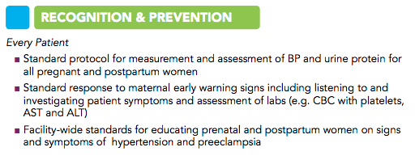
Severe Hypertension: Recognition
9
Notes:
SCRIPT
Early recognition of severe maternal hypertension is lifesaving. Staff must note that the hemodynamics of pregnancy require action even when the pregnant woman has lived with chronic hypertension. Every unit working with pregnant and postpartum women should review correct blood pressure measurement with cuffs that are appropriate for the size and requirement of the woman. Staff should respond to early-warning signs, especially unremitting headaches.

Slide 10
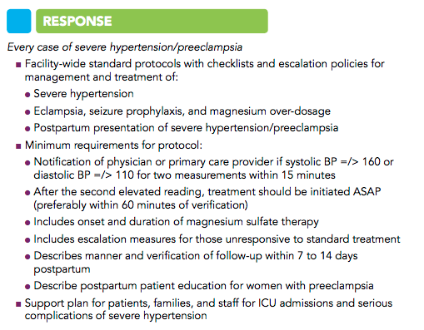
Severe Hypertension: Response
10
Notes:
SCRIPT
Every unit engaged with pregnant or postpartum women should have a single protocol for response and treatment and an escalation protocol when the protocol cannot be followed.

Slide 11
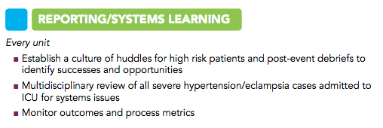
Severe Hypertension: Reporting and Systems Learning
11
Notes:
SCRIPT
We learn from every instance of severe hypertension through post-event debriefs and multidisciplinary case reviews. These should take place as soon after the incident as possible.

Slide 12
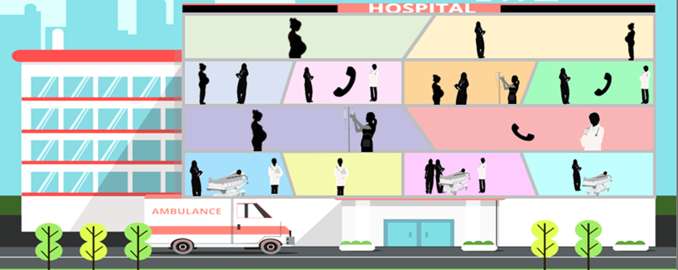

Severe Hypertension
Master Case
Read the master case scenario on the following slides.
Notice where clinician interactions are crucial to keeping patients safe.
We will use this scenario to demonstrate the use of the teamwork tools described in later modules.
Notes:
SCRIPT
We conclude the introduction module with the master case scenario related to a severe hypertension case. Read through the case, which has been positioned in a comic strip layout, to see the scenario which will be used and referenced throughout the entire SPPC-II teamwork toolkit training. At certain points in this case, you may see places where clinicians could provide more and better interactions to keep their patients safer, but these instances will be explored during the other online modules in which the teamwork tools are individually introduced.

Slide 13

Severe Hypertension
Master Case
Patient name: Alice Smith
Age: 31 BMI: 24
Current Vitals:
BP is 178/112
Headache
Gravida 1, para 0
Past Medical History:
Uncomplicated pregnancy with limited prenatal care
Alice Smith, the patient
Notes:
SCRIPT
Alice Smith is a 31-year-old primiparous female who is 36-weeks and 2-days pregnant when she presents to L&D triage with complaints of a headache. She has no pertinent medical history, and her pregnancy has thus far been uncomplicated except for limited prenatal care.

Slide 14

Severe Hypertension
Master Case
2:35 p.m.
Hi, Ms. Smith, I’m Kim. I’m going to take your vitals. How are you feeling?
Frankly, I’m ready to have this baby. He’s already giving me headaches!
I know that feeling! He’ll be here before you know it. Any other unusual sensations with belly, chest, breathing, or eyes?
Kim, triage nurse
Alice Smith, the patient
Notes:
SCRIPT
Kim, the triage nurse, greets Ms. Smith at 2:35 p.m. and checks her vitals. As she does so, they casually joke about Ms. Smith’s headache and readiness to greet her son. Kim tactfully follows up, asking Ms. Smith to tell her about any other symptoms such as chest pain, belly pain, nausea, breathing difficulty, or vision spots that would be consistent with hypertension.

Slide 15
Severe Hypertension
Master Case
2:35 p.m.
Well, now that you mention it, the lights are a bit bright in here. Maybe it’s a migraine? I wouldn’t know. I’ve never had one.
Ah, you’re having some light sensitivity. Thanks for telling me; I’ll make a note so your nurse knows to keep the lights low.
Your blood pressure is 178/112. That’s much higher than we like to see, so I want us to watch that, OK? I’ll take your vitals again in ten minutes to see where we stand.
Kim, triage nurse
Alice Smith, the patient
Notes:
SCRIPT
Ms. Smith tells Kim that she’s experiencing some light sensitivity, which is abnormal for her as she’s not prone to migraines. Kim adds the note to Ms. Smith’s chart.
Kim also notes that Ms. Smith’s blood pressure is 178/112, which is significantly higher than her baseline. Kim informs Ms. Smith and tells her that she would like to take her vitals again in a few minutes to see where they stand.

Slide 16
Severe Hypertension
Master Case
10 minutes later, 2:45 p.m.
OK, Ms. Smith, your blood pressure is now 182/114.
I don’t want to worry you but that’s very high, so I’m going to let Dr. Johnson, the obstetrician, know.
Kim, triage nurse
Alice Smith, the patient
Notes:
SCRIPT
In the meantime, Kim initiates routine admission paperwork and begins to obtain consent from Ms. Smith for admission to triage. Ten minutes later, Ms. Smith’s blood pressure has increased to 182/114. Kim is concerned so at this point she informs Ms. Smith and notifies the covering obstetrician, Dr. Johnson.

Slide 17


Severe Hypertension
Master Case
Kim notifies Dr. Johnson about Ms. Smith’s increasing blood pressure.
Great, thank you for letting me know, Kim.
I’ll request an IV and labs. Go ahead and give her immediate acting antihypertensives.
Kim, triage nurse
Dr. Johnson, obstetrician
Notes:
SCRIPT
Kim calls Dr. Johnson, who listens intently to Kim’s concerns about Ms. Smith’s rising blood pressure. Following Kim’s briefing, Dr. Johnson requests an IV and labs, and orders immediate acting antihypertensives to treat Ms. Smith’s severe-range blood pressure.

Slide 18
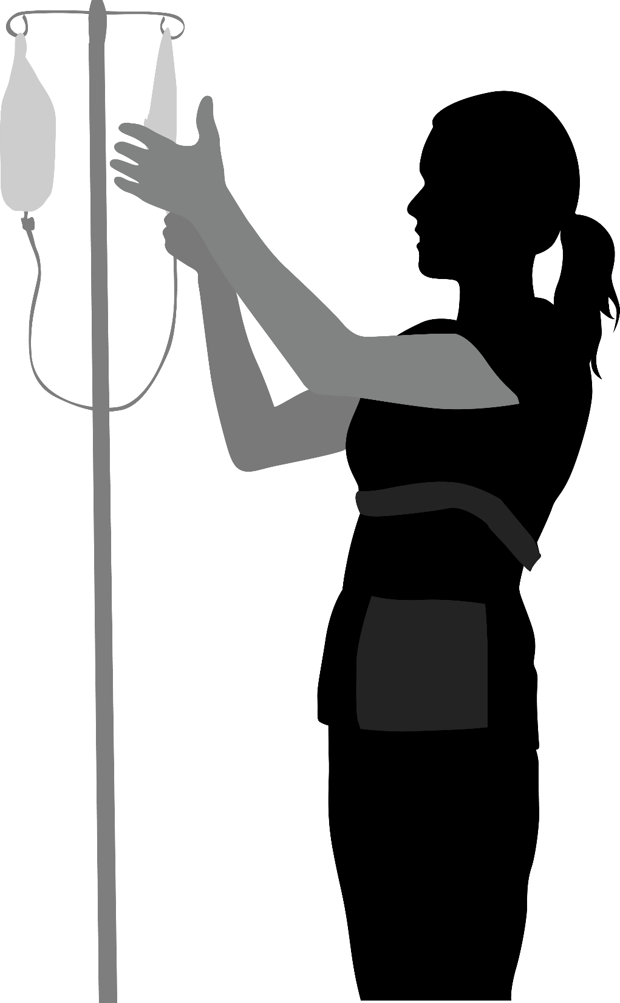
Severe Hypertension
Master Case
After hanging up with Dr. Johnson, Kim attempts IV access.
She has difficulty establishing access, so she calls out for assistance.
Alice Smith, the patient
Kim, triage nurse
Notes:
SCRIPT
After hanging up with Dr. Johnson, Kim attempts IV access in order to obtain labs and administer IV antihypertensives. She has difficulty establishing access, so she calls out for assistance.

Slide 19
Severe Hypertension
Master Case
3 p.m.
Another nurse, Beth, responds to Kim’s request for assistance.
3:15 p.m.
Together, they obtain IV access and draw labs.
Kim immediately rechecks Ms. Smith’s blood pressure, which is now 202/120.
Alice Smith, the patient
Kim, triage nurse
Beth, L&D nurse
Notes:
SCRIPT
At 3 p.m., another nurse, Beth, comes to attempt additional IV placement and blood draw.
At 3:10 p.m., with Beth’s help they successfully obtain IV access and draw labs. Kim immediately rechecks Ms. Smith’s blood pressure, which is now 202/120.

Slide 20
Severe Hypertension
Master Case
3:15 p.m.
Kim calls Dr. Johnson.
Hi Dr. Johnson, it’s Kim again. I had difficulty obtaining IV access, so labs were delayed. Ms. Smith is set up now and her blood pressure is still severely elevated at 202/120. What do you think are next steps?
Please treat with 5 mg of IV hydralazine* immediately. Then continue taking blood pressure every 5 minutes.
Kim, triage nurse
*Apresoline®
Dr. Johnson, obstetrician
Notes:
SCRIPT
Kim calls Dr. Johnson again to deliver an update on Ms. Smith’s severe-range blood pressure, explaining that the difficulty in obtaining IV access led to a delay in treatment.
Dr. Johnson emphasizes immediate treatment with 5 mg of IV hydralazine (Apresoline®) and instructs Kim to continue taking blood pressure measurements every 5 minutes.

Slide 21
Severe Hypertension
Master Case
3:18 p.m.
OK, Ms. Smith, I’m giving you a medication called hydralazine* to reduce your blood pressure. You’re doing great. Let me know if you have questions or need anything.
*Apresoline
Ms. Smith’s blood pressure drops to 198/110, 186/100, 186/96, and 172/92 over the next 20 minutes.
Alice Smith, the patient
Kim, triage nurse
Notes:
SCRIPT
Ms. Smith receives IV hydralazine (Apresoline) at 3:18 p.m. Her blood pressure drops to 198/110, 186/100, 186/96, and 172/92 over the next 20 minutes.

Slide 22

Severe Hypertension
Master Case
3:40 p.m.
OK, that’s still worrisome.
Give her another 10 mg of IV hydralazine* immediately, please.
*Apresoline
Kim, triage nurse
Dr. Johnson, obstetrician
Notes:
SCRIPT
Kim calls Dr. Johnson to deliver an update at 3:40. Still not satisfied with the improvement, Dr. Johnson orders an additional 10 mg of IV hydralazine (Apresoline).

Slide 23
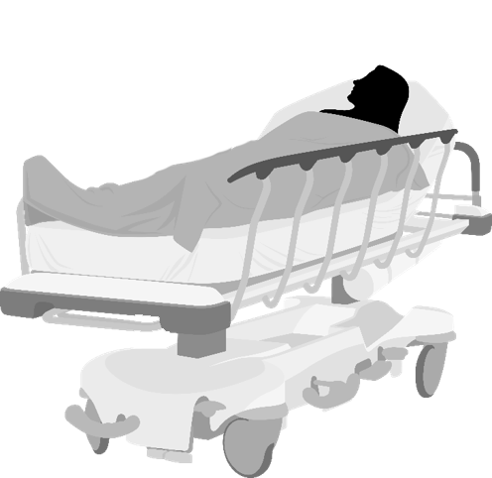
Severe Hypertension
Master Case
4:10 p.m.
Fetal monitoring remains reassuring with a fetal heart rate in the 150s, consistent with a category 1 tracing.
20 minutes later, Ms. Smith’s blood pressure is 158/84. She is transferred to L&D.
Alice Smith, the patient
Notes:
SCRIPT
In the meantime, fetal monitoring remains reassuring with a fetal heart rate in the 150s, consistent with a category 1 tracing. However, 20 minutes following the second hydralazine (Apresoline) administration, Ms. Smith’s blood pressure is 158/84 so she is transferred to L&D given her persistent severe-range blood pressure.

Slide 24
Severe Hypertension
Master Case
Ms. Smith’s lab results demonstrate a protein/creatinine ratio of 0.46 with 3+ protein on a catheterized urine sample, elevated transaminases with AST of 107 U/L and ALT of 98 U/L, a Hgb of 10 g/dl, and a normal platelet count.
Hey, team, let’s quickly huddle to discuss Ms. Smith’s plan of care.
Kim, triage nurse
Alice Smith, the patient
Dr. Johnson, obstetrician
Notes:
SCRIPT
Ms. Smith’s lab results return shortly after her arrival to L&D and demonstrate a protein/creatinine ratio of 0.46 with 3+ protein on a catheterized urine sample, elevated transaminases with AST of 107 U/L and ALT of 98 U/L, a Hgb of 10 g/dl, and a normal platelet count.
Dr. Johnson reviews Ms. Smith’s vital signs and laboratory values, and calls a huddle with the L&D treatment team to discuss the plan of care moving forward.

Slide 25
Severe Hypertension
Master Case
Ms. Smith, you have a condition called severe preeclampsia.
We have your blood pressure under control with medication, but it’s still high.
You are close enough to your due date for me to suggest we to go ahead and deliver your baby today. I believe it is the safest option for you both.
Do you have any questions or concerns?
Alice Smith, the patient
Dr. Johnson, obstetrician
Notes:
SCRIPT
Ms. Smith is diagnosed with severe preeclampsia and recommended to undergo an induction of labor. Her blood pressure will continue to be monitored closely, and severe-range pressure will be treated when encountered.

Slide 26
Severe Hypertension
Master Case
I’ll do whatever you think is best.
Is it possible for me to still have a vaginal delivery?
Yes, a vaginal delivery is completely possible so long as we don’t experience any additional complications, which I don’t expect.
Kim, triage nurse
OK, then. Let’s deliver this baby.
Support Staff
Alice Smith, the patient
Dr. Johnson, obstetrician
Notes:
SCRIPT
Ms. Smith agrees with the plan of care, asking about whether she is still able to deliver vaginally. Dr. Johnson assures her that a vaginal delivery is still possible unless additional complications arise.

Slide 27
Severe Hypertension
Master Case
Magnesium sulfate is initiated with a 6-g bolus, followed by 2 g/hr thereafter for seizure prophylaxis based on doctor's orders.
Ms. Smith’s initial cervical exam is 2 cm, 50% effacement, and a station of -3, with the fetus in the vertex position.
Her blood pressure is rechecked and noted to be 135/86.
Ms. Smith, your blood pressure remains under control.
Kim, triage nurse
Alice Smith, the patient
Notes:
SCRIPT
Dr. Johnson and the team agree to initiate magnesium sulfate with a 6 g/hr bolus, followed by 2 g/hr thereafter for seizure prophylaxis. Dr. Johnson orders for start of the magnesium sulfate. Her initial cervical exam is 2 cm, 50% effacement, and a station of -3, with the fetus in the vertex position. Her blood pressure is rechecked and noted to be 135/86.

Slide 28
Summary
Revisit this introduction module anytime throughout training
Encourage your frontline providers and staff to complete training
Coordinate in-person practice sessions
Motivate your frontline providers and staff to use the SPPC-II teamwork tools in their patient care activities
Be accessible to your frontline providers and staff
Resource: Facilitator Guide
Notes:
SCRIPT
In conclusion, this introduction module sets the foundation for the SPPC-II Teamwork Toolkit. The remaining modules will draw from and build on the case scenario that we just walked through in order to demonstrate each of the teamwork tools and strategies within an example of a severe hypertension case. It is the same scenario your frontline providers and staff will see in their introduction modules.
Ultimately, it is your responsibility as a Hospital AIM Team Lead to enable and encourage your frontline providers and staff to participate in the eight online modules associated with your clinical patient safety bundle and coordinate practice sessions that will reinforce the use of these tools within your organization.
To do so, be accessible to your frontline and feel free to adopt a training approach that works best for your local needs and check out the Facilitator Guide for more explicit guidance on how to mange the rollout of these materials.

Slide 29
Resources
Severe Hypertension in Pregnancy Patient Safety Bundle link:
https://saferbirth.org/wp-content/uploads/U1-FINAL_AIM_Bundle_SHP2022.pdf
Notes:
SCRIPT
Complete information about the severe hypertension in pregnancy patient safety bundle, including the 4 Rs, can be found at:
https://saferbirth.org/wp-content/uploads/U1-FINAL_AIM_Bundle_SHP2022.pdf

Slide 30
Acknowledgments
This project is funded and implemented by the Agency for Healthcare Research and Quality and the Johns Hopkins University Contract Number HHSP233201500020I in collaboration with the Health Resources and Services Administration and the Alliance for Innovation on Maternal Health.

