Slide 1

Communication
Severe Hypertension
SPPC-II
Toolkit
Module 3 of 8
AHRQ Pub. No. 23-0046
July 2023
Notes:
SCRIPT
Welcome to Module 3 of the SPPC-II Teamwork Toolkit. In this module we will talk about communication and the various tools in the SPPC-II Toolkit for improving communication. We’ll begin with a brief conceptual overview.

Slide 2
Communication is…
The process by which information is exchanged
between individuals, departments, or organizations.
Verbal or nonverbal
The foundation of teamwork
Effective communication skills are vital for patient safety
Notes:
SCRIPT
Communication is the lifeline of a well-functioning team and serves as a coordinating mechanism for teamwork. Effective communication skills are vital for patient safety and interplay directly with other teamwork components, such as mutual support, and situational awareness, because it is the vehicle by which most teamwork tools and strategies are executed. Therefore, this module serves as the foundation to the other teamwork skills we present.
Communication is defined as the transfer or exchange of information from a sender to a receiver. More specifically, communication is a process whereby information is clearly and accurately conveyed to another person using a method that is known and recognized by all involved. It includes the ability to ask questions, seek clarification, and acknowledge the message was received and understood. One critical result of effective communication is a shared understanding between the sender and receiver(s) of the information conveyed.
Two considerations in communication are with whom and how you are communicating information.
With whom you are communicating, that is to say, the audience, will influence how information is conveyed. For example, an information exchange with a lab technician may differ from an exchange with a physician.
In terms of how you communicate, there are two major modes of communication: verbal and nonverbal.
We will cover standards of effective communication shortly. These relate primarily to verbal communication.
Nonverbal communication can take several forms. Written communication is common in healthcare. This form of nonverbal communication should adhere to many of the same standards we will discuss shortly. In addition, one should be mindful of standards associated with written communication, such as the Joint Commission's "Do Not Use" list of abbreviations.
More information about the "Do Not Use" List of Abbreviations can be found on the Joint Commission website at https://www.jointcommission.org/resources/news-and-multimedia/fact-sheets/facts-about-do-not-use-list/.
Another form of nonverbal communication is body language. The way you make eye contact and the way you hold your body during a conversation are signals that can be picked up by the person with whom you are communicating. Body language plays a significant role in communication. In a face-to-face communication, words account for 7 percent of the meaning, tone of voice accounts for 38 percent of the meaning, and body language accounts for the remaining 55 percent. Although powerful, nonverbal communication does not provide an acceptable mode to verify, validate, or acknowledge the information exchanged.
A third form of nonverbal communication is visual cues. For example, the use of color coding for assignments, charts, scrubs, orders, and so on can help team members identify the information they need quickly.
To avoid making assumptions that can lead to error, you should verify in writing or orally any nonverbal communication, such as body language or visual cues, to ensure patient safety. The simple rule is, "When in doubt, check it out, offer information, or ask a question."
Ask: Can you provide examples from your work setting when nonverbal communication produced a breakdown in teamwork? Did you know the actual intent of the person?
Instructor Note: If responses to the questions above do not provide sufficient examples, the one below may be read aloud to participants.
Examples: The nonverbal cues an emergency department doctor gives when looking at an electrocardiogram would quickly tell the nurse the severity of the situation and might lead to proactive action. Likewise, the nonverbal cues from the nurse's face might communicate the urgency of the situation and need for interruption to a doctor who is with a patient's family members.

Slide 3
Maternal and Perinatal Deaths and Injuries 2004-2015^{1,2}
Top 5 Root Causes | Maternal Events (N = 131) | Perinatal Events (N = 348) | Op/Post-op Complication Events (N = 924)
Human Factors | 97% | 100% | 88%
Communication | 95% | 100% | 87%
Assessment | 66% | 100% | 69%
Leadership | 50% | 77% | 54%
Information Management | 21% | 20% | 19%
Note: The majority of events have multiple root causes, so percentages may be greater than 100%.
Notes:
SCRIPT
Human factors and communication breakdowns are identified as the primary root cause of maternal and perinatal deaths and injuries. According to the Joint Commission, these errors are reported over 80 percent of the time and represent the majority of repairable defects within the L&D unit.
Human factors refer generally to employee competency and staffing concerns. They specifically include staffing levels, staffing skill mix, staff orientation, in-service education, competency assessment, staff supervision, resident supervision, medical staff credentialing/privileging, medical staff peer review, other (e.g., rushing, fatigue, distraction, complacency, bias).
Communication causes capture breakdowns in oral, written, or electronic exchanges among staff, with and among physicians, with administration, and/or with patient or family members.
Other root causes for maternal and perinatal deaths and injuries are—
Assessment (i.e., the adequacy, timing, or scope of assessment; pediatric, psychiatric, alcohol/drug, and/or abuse/neglect assessments; patient observation; clinical laboratory testing; and care decisions),
Leadership (i.e., organizational planning, organizational culture, community relations, service availability, priority setting, resource allocation, complaint resolution, leadership collaboration, standardization [e.g., clinical practice guidelines], directing department/services, integration of services, inadequate policies and procedures, non-compliance with policies and procedures, performance improvement, medical staff organization, nursing leadership),
Information management (i.e., information management needs assessment, confidentiality, security of information, data definitions, availability of information, technical systems, patient identification, medical records, aggregation of data),
Physical environment (i.e., general safety, fire safety, security systems, hazardous materials, emergency management, smoking management, equipment management, utilities management),
Continuum of care (i.e., access to care, care setting, continuity of care, transfer of patient, and/or patient discharge)
Care planning (i.e., planning and/or collaboration), and
Medication use (i.e., formulary, storage/control, labeling, ordering, preparing/distributing, administering, and/or patient monitoring).

Slide 4
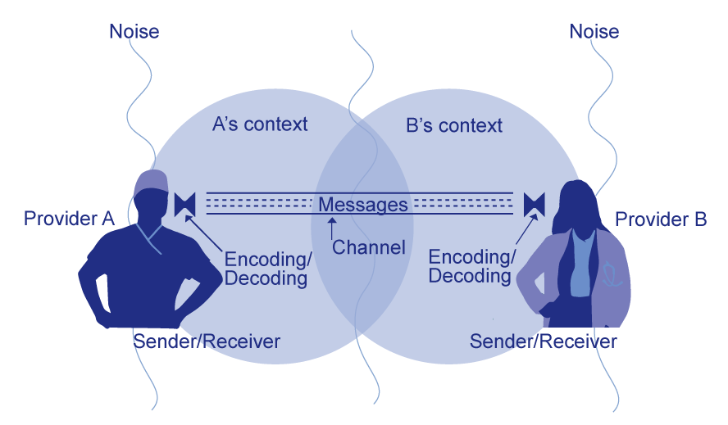
Basic Components and Process of Communication³
Adapted from Dayton E, Henriksen K. Communication failure: basic components, contributing factors, and the call for structure. Joint Commission Journal of Quality and Patient Safety. 2007 Jan;33(1):34-47. Adapted with permission.
Notes:
SCRIPT
Communication, both verbal and nonverbal, is complex and subject to distortion or misinterpretation as it is encoded and decoded between communicators. In verbal communication, ideas are first encoded, or created, when the sender speaks to the receiver. The receiver then decodes, or interprets, the message. The interpretation is affected by the context, auditory distractions, and the individual makeup of the participants involved in the conversation.
These seemingly insignificant elements comprise the overall communication system in which providers share information, ideas, and needs within the healthcare setting. Each aspect is interconnected and dependent on the influences and composition of the others, meaning a distraction or malfunction in the encoding process or any other component in the model impairs decoding and understanding.
The background and physical environment of the communicators influences the distribution and receipt of messages. Individuals are unique, and their experiences dictate how messages are created, shared, and understood. Knowing this, individuals in healthcare settings can affect the outcome of their interaction with colleagues by realizing how to effectively share ideas and comprehend those of others.

Slide 5
Standards of Effective Communication
Complete
  Communicate all relevant information
Clear
  Convey information that is plainly understood
Brief
  Communicate the information in a concise manner
Timely
  Offer and request information in an appropriate time frame
  Verify authenticity
  Validate or acknowledge information
Notes:
SCRIPT
Effective communication is complete.
It communicates all relevant information while avoiding unnecessary details that may cause confusion.
It allows time for patients and staff to ask and answer questions completely.
Effective communication is clear.
It uses plain language, such as layman’s terms, that patients and their families can easily understand.
It uses common or standard terminology when communicating with team members.
Effective communication is brief and concise.
Provide information that is brief, yet as complete as possible. Do not overexplain the situation; be concise.
Effective communication is timely. Consider ramifications of delayed communication.
It offers and requests information.
It avoids compromising a patient’s situation by promptly relaying information.
It notes times of observations and interventions in the patient’s record.
It updates patients and families frequently.
It verifies the recipient received the intended message.
It validates or acknowledges information received.
Ask (Time Permitting): What could affect communication among team members?
Tip: You may wish to create a list of answers to the question on a flip chart and then compare those to the challenges listed on the next slide.
Example 1: applying the four elements of effective communication to a recommendation to proceed with a cesarean section for a laboring patient:
Complete—it includes the medical reason for recommending a cesarean section and risks associated with not proceeding to a section;
Clear—It is conveyed using plain language and avoiding medical jargon;
Brief—It contains only the necessary information; and
Timely—It is communicated to the patient as soon as possible after the decision has been made by the attending physician.
Example 2: A well-written discharge prescription is:
Complete—It includes medication, dosage, and frequency.
Clear—It is clearly written and legible.
Brief—It contains only the necessary information.
Concise—It is written before discharge and filled when the patient is ready to leave the hospital.

Slide 6
Information Exchange Strategies
Call-Out
Check-Back
SBAR
  Situation–Background–Assessment–Recommendation
I PASS the BATON
  Introduction-Patient-Assessment-Situation-Safety-Background-Actions-Timing-Ownership-Next
Notes:
SCRIPT
In this module, we will discuss the following four information exchange strategies:
Check-Backs
Call-Outs
SBAR: Situation—Background—Assessment—Recommendation
I PASS the BATON.
Each of these communication strategies are simple to integrate into daily practice yet have been shown to improve team performance. They do so by helping to reduce errors associated with miscommunication and failure to share relevant and critical information.

Slide 7
Call-Out
Doctor, I’m concerned because the patient’s blood pressure is 160/110.
Loudly announcing critical information during emergent situations.
Informs all team members simultaneously
Helps team members anticipate next steps
Especially helpful when directed at a specific individual
OK, let’s huddle and strategize.
Notes:
SCRIPT
A call-out is a tactic used to convey critical information during an emergency. Critical information audibly announced in these situations helps the team anticipate and prepare for vital next steps in patient care. To assist with follow-through and attention to information shared in a callout, direct the information to a specific individual.
For example, a nurse may say to an obstetrician, “Doctor, I’m concerned because the patient’s blood pressure is 160/110.” This is an example of a call-out. To close the loop, as you'll learn next, the doctor may reply, “Okay, let’s huddle and strategize.”
On your unit, what information would you want called out?

Slide 8

When To Use a Call-Out
Whenever information needs to be urgently communicated
As an emergent event unfolds
  E.g., when there are signs of severe hypertension
Updates during emergent events
  E.g., call-out when systolic BP ≥ 160 and/or diastolic BP ≥ 110
Tip! Pair call-outs with assertive statements, power words,
and the two-challenge rule to really drive home your message (see Module 5)
Notes:
SCRIPT
Call-outs aren’t a tool that you’ll necessarily be using on a daily basis, but they are ones that are useful under certain circumstances. Because the nature of the call-out is to relay critical information immediately, call-outs are most helpful during emergent events, such as a hemorrhage, and when team members are co-located. Even if team members aren’t co-located, the spirit of a call-out is maintained when you immediately relay your observations to your team members as directly and quickly as soon as you notice something awry.
Call-outs will continue to be useful as events unfold, particularly once a rapid response team is present or the primary care team members are all co-located and attending to the patient together. In these moments, call-outs ensure that the entire team hears the same information simultaneously and are able to adapt quickly.
In the event of hypertension, it’s recommended to always call-out when systolic or diastolic blood pressure reach or exceeds 160 or 110, respectively.

Slide 9
Calling-Out With Patients and Family Present
Mitigation Suggestions
Use established code words in call-outs for common events
  Tip! Determine what code words to use as an organization; include these in the Readiness materials
  Tip! Set expectations during briefs or huddles (Module 4)
Speak pointedly but calmly
Involve the patient and family in a frank discussion
Think empathetically
Call-outs could unnecessarily alarm conscious patients or family members who are present in the room.
Notes:
SCRIPT
One critical point to discuss is the appropriateness of using a call-out when family is present. While patient safety will always take precedence, you can run the risk of unnecessarily alarming the patient or the patient’s family if you use a call-out in their presence, while they are awake and conscious. Aside from spiking their fears, it’s possible that the resulting worry might add to the confusion and noise of what is going on in the room, especially if there is an emergency.
Therefore, we highly encourage you to consider the use of code words. Your organization may already have certain codes you use for common events. Definitely continue to use these. If you don’t, consider suggesting to your department that they decide on uniform code words and include them in the Readiness materials of the 4 Rs package. If you choose to use code words, it is critical that they are used consistently and that all staff understand what they mean.
In cases where no standard codes already exist, consider discussing with your colleagues how to appropriately communicate information to each other when a family member or patient is present. Huddles and briefs are a great opportunity for having these conversations. We will talk about Huddles and Briefs in Module 4.
Although the traditional model is to immediately send the family out when an emergency is unfolding, many places are moving to allowing the family to stay. In these cases, it is essential to have a clinician communicate with them honestly and transparently. A physician or nurse should speak with them as the call-out is occurring, explaining the situation, what the risks are, and what is being done about the problem, so that they know what to expect and how to behave. Of course, there may be situations in which it is more appropriate to ask family to leave the room. However, even in these cases it’s important to keep the worried family in the loop as events unfold, whether they are in the room or not.
In the end, thinking and acting empathetically towards the patient and her family are essential. If you find yourself having to use a call-out in front of a patient, always prioritize her care. It may involve speaking assertively but calmly so that, even if there is a concern, the patient and the family also remain calm as they will be looking to you for clues regarding the severity of the situation.

Slide 10

Call-Out Demonstration
Click video to watch
Notes:
SCRIPT
In this short clip, you will see the nurse, Dana, demonstrate a call-out during labor. Notice how Dana communicates critical information to the physician as she becomes aware of it. Please note the technique is the focus, as the event is not a hypertensive event.

Slide 11

Assessing the Team’s Call-Outs
Team members verbally confirmed critical information
The team was anticipating future actions
Information was directed by name for response and feedback
Sense of urgency but professionalism
What else did you see?
Notes:
SCRIPT
How did the call-outs made by the nurse and intern aid the team during this emergent labor and delivery event?
Team members verbally confirmed critical information about the presence and duration of decelerations.
The team was anticipating future actions, including a possible C-section and call to attending.
Information was directed by name to Dr. Dean for response and feedback.
Team members communicated a sense of urgency but also calmness and professionalism.
Did you notice anything else?

Slide 12
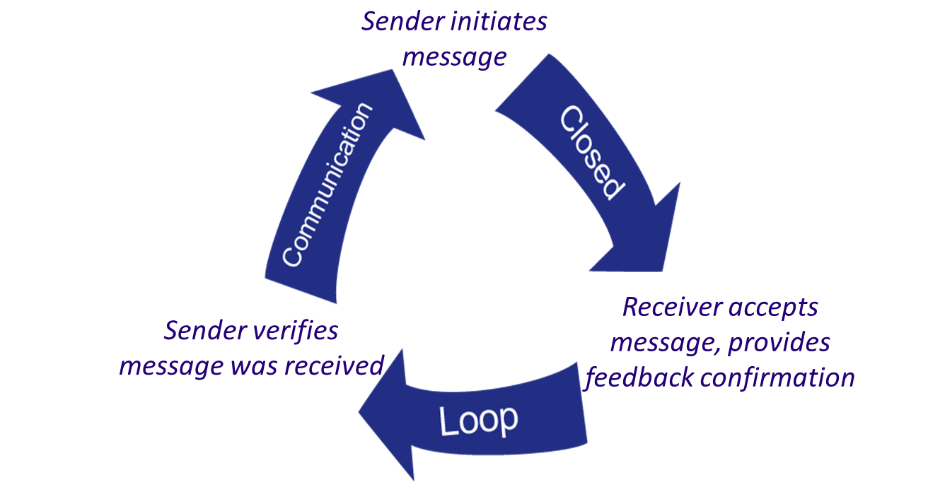
Check-Back
It’s been 15 minutes, and the patient’s BP hasn’t changed.
OK, BP is still 160/110.
That’s correct.
Notes:
SCRIPT
A check-back is a closed-loop communication strategy to verify and validate information exchanged between two people. The strategy entails the sender initiating a message, the receiver accepting the message and confirming what was communicated, and the sender verifying the correct message was received.
As an example, the message sender calls-out information about the patient’s status by saying, “it's been 15 minutes and the patient's BP hasn't changed.” The receiver acknowledges receipt of this message and indicates understanding by saying, “Okay, BP is still 160/110.” The sender can now verify the correct message was received or otherwise clarify the original message further. By the end of this cycle, the sender and receiver both know information was communicated correctly.
A check-back is an effective tool for all members of the team, including patients and their family members. For example, patients and families can use the check-back to verify the receipt of care instructions or confirm understanding of which symptoms to monitor.
Check-backs create a critical opportunity to confirm that everyone involved in the conversation is on the same page. If they are not on the same page, check-backs give the sender a chance to clarify the message until everyone has a similar understanding.

Slide 13
Opportunities To Check-Back
During handoffs and care transitions
In response to a call-out
  Especially about blood loss during hemorrhage
During briefs, huddles, and debriefs (see Module 4)
When receiving verbal orders
In short:
Whenever information is shared between two or more people!
Notes:
SCRIPT
Unlike call-outs, check-backs have a wide range of applications and are a handy tool that you will likely use constantly both in your daily clinical practice as well as personal life. You may even already be doing this naturally on your own, as it’s a fairly simple strategy for confirming that you understood what someone has told you.
When talking about patient care and clinical practice, you will find check-backs are particularly helpful:
During handoffs and care transitions. Use a structured communication strategy like SBAR during these transitions and confirm that you have understood the information using a check-back. You may also use the check-back as an opportunity to clarify points of confusion.
It’s also essential to use a check-back as a response to a call-out so that everyone knows that the message was heard and understood. During a hemorrhage events, it’s especially important to acknowledge and confirm you have heard the blood pressure measurement correctly.
Briefs, huddles, and debriefs are other rich opportunities to employ a check-back as a lot of information and planning occur during these team meetings. Check-backs will ensure that you and the entire team have a shared cognitive map and similar understanding about how to proceed by the end of these meetings. You will learn more about briefs, huddles, and debriefs later today when we reach Module 4.
Confirming verbal orders is essential, especially to make sure that you didn’t mishear or misspeak the orders. It’s a simple and quick means to prevent a medication error.
In short, use a check-back whenever information is shared between yourself and another team member. Get in the habit of feeling comfortable repeating information to your teammates and prompting them to use check-backs with you. If possible, it’s helpful to restate the information slightly differently, in the way you understood it, so your teammate can confirm the information was received as intended.
Note:
SBAR is covered later in this module.
Briefs, Huddles, and Debriefs are covered in Module 4.

Slide 14

Check-Back Demonstration
Click video to watch
Notes:
SCRIPT
This video will demonstrate what a check-back might look like in practice. Please be aware that the scenario is unrelated to a case involving maternal severe hypertension. Focus on the technique rather than the context. As you watch, observe who the team members are, how they completed the check-back, and what communication errors they avoided.

Slide 15

Check-Back Video Discussion
Who were the team members involved?
How did they complete the check-back?
What communication errors were avoided?
Notes:
Discussion:
Who was the sender? Who was the receiver?
Pharmacist was the sender.
Resident was the receiver.
How did the sender and receiver "close the loop"?
The pharmacist says, “correct."
What communication errors were avoided?
Pharmacist did not rely on memory to give correct dosing information.
Resident wrote the exact dosing instructions to avoid depending on memory and could check back using notes since the dosing was more complicated by dilution.
Errors caused by misunderstood dosage amounts or drugs with similar-sounding names were avoided.

Slide 16
Check-Back Discussion Answers
Who were the team members involved?
  Sender = pharmacist
  Receiver = resident
How did they complete the check-back?
  Resident repeated the order; pharmacist confirmed
What communication errors were avoided?
  Did not rely on memory
  Avoided misunderstandings and miscommunications
Notes:
SCRIPT
In the demonstration, the pharmacist was the sender who initiated the conversation. The resident was the receiver. In order to ensure that the information the pharmacist communicated was understood as intended, the resident repeated the orders back to the pharmacist, who closed the loop with a verbal assurance that the order had been understood. Had the resident misunderstood the order, the pharmacist would have offered correction until he could confirm the resident had the same understanding.
Communication errors were further avoided in that neither the pharmacist nor the resident relied on memory. The pharmacist used notes to give correct dosing information and the resident wrote down the exact dosing instructions. The use of notes was especially helpful as dosing was more complicated by dilution. Furthermore, errors caused by misunderstood dosage amounts or drugs with similar-sounding names were avoided.

Slide 17
Application to the 4 Rs: Call-Outs & Check-Backs
4 Rs
Readiness Every Unit | Recognition Every Patient | Response Every Case | Reporting Every Unit
Check-back To confirm information learned in drills is understood Medications for severe hypertension and eclampsia Requests for escalation, consultation, or transport | Call-out early warning signs E.g., when systolic BP ≥ 160 or diastolic BP ≥ 110 Check-back to ensure: Warning signs are heard and understood Patients understand education information Medications are correct | Call-out patient status updates Changes in status No changes for 15 minutes Check-back when moving through the facilitywide protocol and escalation policies | N/A
Notes:
SCRIPT
Because there are many opportunities to use call-outs and check-backs across numerous situations, these two tools are useful at nearly every point in the 4 Rs framework. Check-backs are especially useful at every step because we can always benefit by restating the information we receive in a way that signals to our teammates that we have understood and provides them with an opportunity to correct us if and when we’ve misunderstood or confirm that we are all on the same page. This strategy applies from planning, preparing, responding, and learning.
Call-outs may be a little bit more limited in their direct applicability within the 4 Rs framework. While it’s always important to share critical information in a timely manner, call-outs will be especially helpful in the recognition and response to an unfolding event. They are most effective when all or the majority of team members are in the same space and able to hear a team member’s call-out.
At the readiness stage:
Use check-backs to confirm providers have understood new information learned during drills and education opportunities
Use check-back when ordering, dispensing, and administering medications for severe hypertension and eclampsia
Integrate check-backs into any requests for escalation, consultation, or transport
During recognition of a hypertensive patient:
Use check-backs to ensure that warning signs are correctly communicated to team members
As part of education standards, use check-backs as a method for ensuring patients understand information about prenatal and postpartum signs and symptoms of hypertension and preeclampsia
Call-out when early warning signs are observed (e.g., when systolic or diastolic blood pressure reach or exceeds 160 or 110, respectively)
When responding to a severely hypertensive case:
Check-back with the team when moving through the facility-wide protocol and escalation policies to ensure that information has been properly and fully relayed to everyone
Call-out during the incident response to keep the team updated on patient status and relevant information enhancing the ability of the team as a whole to clearly recognize and register the incident as well as progress/action to be taken

Slide 18


Severe Hypertension
Call-Out & Check-Back
Observe how the nurse, Kim, calls-out assertively.
Notice the confirmation during the check-back.
Notes:
SCRIPT
The next few slides are a deeper dive into a section from the severe maternal hypertension master scenario that you saw in the introduction module (Module 1). At this point, there is an opportunity for the team to use some of the tools you just learned about. Observe how the nurse, Kim, calls-out assertively. Then notice the confirmation during the check-back.

Slide 19

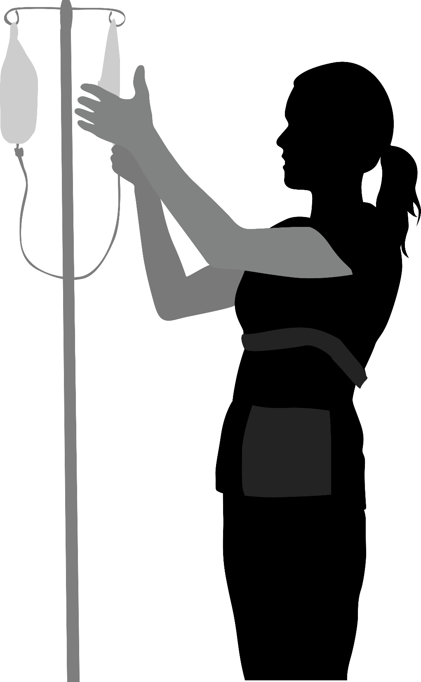


Severe Hypertension
Call-Out & Check-Back
The triage nurse, Kim, is having difficulty establishing IV access in Ms. Smith, so she CALLS OUT to the charge nurse, Melanie, to ask for assistance with establishing an IV…
Hey, Melanie, could you come to triage room 2? I need some help with an IV.
Sorry about this, Ms. Smith. You’re a trooper. I am going to get a little help so we can start this IV and get your blood pressure under control and figure out next steps. How are you doing?
Alice Smith, the patient
Kim, triage nurse
Notes:
SCRIPT
As you recall from the severe hypertension scenario that we covered in Module 1, the patient, Ms. Alice Smith, is noted to have two severe-range pressure readings in triage. Dr. Johnson, the labor and delivery attending, appropriately orders IV access, labs, and administration of IV antihypertensives, but Kim is having difficulty establishing IV access. So she calls out to the charge nurse, Melanie, to ask for assistance with establishing an IV:
“Hey, Melanie, could you come to triage room 2? I need some help with an IV."
In order to keep the patient apprised of what is going on and help her remain calm, Kim says, "Sorry about this, Ms. Smith; you’re a trooper. I am going to get a little help so we can start this IV and get your blood pressure under control and figure out next steps.” Kim also checks-in with the patient by asking, ”How are you doing?"

Slide 20

Severe Hypertension
Call-Out & Check-Back
Melanie comes into triage room 2.
What’s going on, Kim?
Ms. Smith has had two severe-range blood pressure readings 10 minutes apart. She needs IV antihypertensives, and Dr. Johnson has requested labs as well, but I am having a lot of difficulty obtaining IV access. Can you help?
Melanie, charge nurse
Kim, triage nurse
Notes:
SCRIPT
Melanie comes into the triage room and asks Kim what’s going on. Kim tells her that since arrival to L&D triage, Ms. Smith has had two severe-range blood pressure readings 10 minutes apart. Her blood pressure need to be treated with IV antihypertensives, and Dr. Johnson, her physician, has requested labs as well but she’s having a lot of difficulty obtaining IV access.

Slide 21
Severe Hypertension
Call-Out & Check-Back
Check-Back
OK, Kim. I’ll send someone to assist you with establishing an IV in Ms. Smith so you can treat her severe blood pressure and draw labs.
Great, thank you!
Melanie, charge nurse
Kim, triage nurse
Notes:
SCRIPT
Melanie confirms understanding of Kim's request by repeating back her interpretation of the situation and saying she will send help. Kim closes the interaction by thanking her.

Slide 22
Activity: Call-Out & Check-Back
Partner in groups of three to four people
Recall a time when information had to be quickly communicated to others on your unit
  Can be real or make-believe
Take 5 minutes to write a quick sketch using a call-out and check-back
Bravely perform your sketch for the class
Have fun!
Approximate time: 10 min
Notes:
SCRIPT
Let’s do an activity. I’d like you to partner in groups of three to four people and think of a recent event on your unit where information had to be quickly communicated. Maybe it’s a request for help, sharing emergent information, or routine communications. The event can be real, loosely based on real events, or totally made up. However, you only have 5 minutes to sketch together a script that integrates a call-out and check-back.
Have fun with this. Silliness for this activity is encouraged, even if that’s not your typical unit culture. I’ll be asking at least one brave group to perform their sketch for the class.

Slide 23
SBAR Provides…
A framework for team members to effectively communicate information to one another.
Communicate the following information:
  Situation―What is going on with the patient?
  Background―What is the clinical background or context?
  Assessment―What do I think the problem is?
  Recommendation―What would I recommend?
Tip! Use a check-back after SBAR
Notes:
SCRIPT
The SBAR technique provides a standardized framework for members of the healthcare team to communicate about a patient's condition. It can be used to structure a general conversation or patient care transitions.
In phrasing a conversation with another member of the team, consider the following:
Situation—What is happening with the patient?
Background—What is the clinical background?
Assessment—What do I think the problem is?
Recommendation—What would I recommend?
You may also refer to this as the ISBAR, where "I" stands for "Introductions.”
Introduction—What is your name and role on the team?
Think about whether or not you have used SBAR in your institution. If so, how was it used? What was the result of its use? What were the challenges to implementing the use of SBAR and how were these challenges overcome?
Although SBAR is typically used as a communication tool between clinical staff, it can also be modified for use by the patient to communicate with the care team. For example, your facility could instruct patients to use SBAR to enable them to share information about their own situation, background, assessment, and recommendations, or to ask the care team about their care.
Of course, as with most of the tools in this toolkit, you can integrate several at once. Consider including a check-back at the end of an SBAR exchange to ensure information has been reliably and completely communicated.

Slide 24

When Is SBAR Useful?
Care transitions and handoffs (e.g., during shift changes)
Requesting a response during emergent events
Providing updates about a patient or emergent event
Problem solving and suggesting solutions
Notes:
SCRIPT
You may find SBAR is useful in a variety of situations including care transitions such as shift changes and other handoffs; requesting a response during emergent events; while providing updates to other team members or the patient and family members; and when problem solving or suggesting solutions.

Slide 25
Application of the 4 Rs: SBAR
4 Rs
Readiness Every Unit | Recognition Every Patient | Response Every Case | Reporting Every Unit
Use SBAR to: Frame triage recommendations Communicate need for escalation, consultation, or transport | Use SBAR to: Communicate hypertension-specific and general patient information across care transitions to ensure continuity of care Frame changes in status, especially those related to early-warning signs | Use SBAR to: Structure communications, care transitions, and recommend changes to the established care plan | Use SBAR to: Frame event reports Structure case scenarios for sharing lessons learned (either positive or negative) to other staff Summarize a particularly effective or ineffective event
Notes:
SCRIPT
From response to reporting, SBAR is an excellent way to structure conversations at every stage in the 4 Rs framework. It can be used in the Readiness stage of managing severe hypertension as a tool for framing triage recommendations and communicating the need for escalation, consultation, or transport. At the Recognition point of severe hypertension, SBAR can be used to communicate patient information across care transitions to ensure continuity of care and frame changes in patient status, especially those related to early-warning signs. When responding to severe hypertension, SBAR might be used to structure communications again during care transitions of a hypertensive patient, particularly to recommend continued adherence or changes to an established care plan. Finally, SBAR might be useful at the Reporting stage to frame event reports, structure case scenarios for sharing lessons learned, or summarizing a particularly effective or ineffective event for posterity and continuous learning.

Slide 26
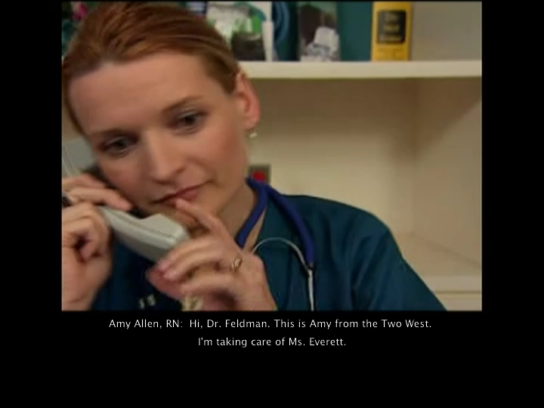
SBAR Video
Click video to watch
How did the SBAR technique improve communication between the nurse and physician?
Notes:
SCRIPT
Let's review how to properly use the SBAR technique. In this video, the patient's condition has worsened, resulting in a call to the physician on call. Please be aware that the scenario is unrelated to a case involving severe maternal hypertension. Focus on the use of the SBAR technique for structuring information rather than the context.
While you watch, think about how the SBAR technique improves communication between the nurse and physician.
Instructor Note:
Play the video by clicking on it.

Slide 27
SBAR Video Debrief
How did the SBAR technique improve
communication between the nurse and
physician?
  I—The nurse identified herself and the reason she was calling
  S—The physician was quickly made aware of Mrs. Everett's deteriorating situation
  B—The nurse provided the background of the DVT diagnosis and all current labs
  A—The recent assessment of the patient has led the nurse to call the physician with her concerns
  R—The recommendation was initiated by the nurse for additional labs and a plan was discussed for future care
Notes:
SCRIPT
How did the SBAR technique improve communication between the nurse and physician?
The nurse identified herself and the reason she was calling.
The physician was quickly made aware of Mrs. Everett's deteriorating Situation.
The nurse provided the Background of the DVT diagnosis and all current labs.
The recent Assessment of the patient has led to the nurse to call the physician with her concerns.
The Recommendation was initiated by the nurse for additional labs and a plan was discussed for future care.
*Some find Recommendation difficult as they attempt not to diagnose but give broader indirect suggestions that may not provide clear or concise patient information.

Slide 28
Severe Hypertension
SBAR
Ms. Smith has persistent severe-range blood pressure with no IV access.
How does the nurse, Kim, use SBAR to structure her communication with Dr. Johnson, the obstetrician?
If you were the nurse, what would you say to Dr. Johnson?
Notes:
SCRIPT
The next few slides are from the severe hypertension master scenario, particularly relating to the fact that the patient in triage has persistent severe-range blood pressure with no IV access. In this scenario, we demonstrate an opportunity to use the SBAR communication tool.
As you read through this expanded section from our scenario, think about how the nurse uses SBAR to communicate with the obstetrician. If you were the nurse, what would you say to the obstetrician when she enters the room?
Remember that Kim should still use good communication standards (which include complete, clear, brief, and timely dialogue), but she should also Identify herself, explain the Situation with the patient, provide clinical Background, Assess the current problem, and Recommend a plan.

Slide 29
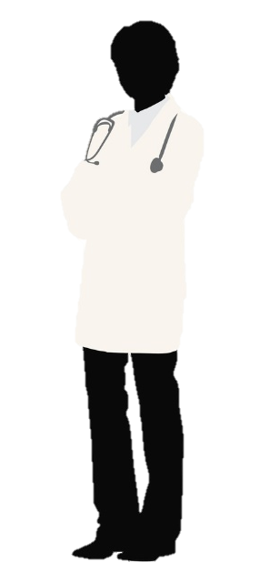
Severe Hypertension
SBAR
Situation
Hi, Dr. Johnson, it’s Kim. I’m caring for Ms. Alice Smith, who recently presented to L&D triage complaining of a headache.
Since her arrival, she has had two severe-range blood pressure readings separated by 10 minutes.
Kim, triage nurse
Dr. Johnson, obstetrician
Notes:
SCRIPT
Kim, the triage nurse, calls Dr. Johnson, the obstetrician. Kim begins by introducing herself and her role. She then describes the current clinical situation regarding Alice Smith, who recently presented to L&D triage complaining of a headache and since her arrival has had two severe-range blood pressure readings separated by 10 minutes.

Slide 30
Severe Hypertension
SBAR
Background
Ms. Smith is a 31-year-old primiparous female at 36 weeks and 2 days with overall uncomplicated prenatal care.
She presented to L&D triage today reporting worsening daily headaches. On arrival, she was noted to have an initial severe blood pressure of 178/112.
We initiated routine admission paperwork and the consent process while letting her relax a bit; however, her repeat blood pressure 10 minutes later was 182/114.
Dr. Johnson, obstetrician
Kim, triage nurse
Notes:
SCRIPT
Kim then proceeds to provide Dr. Johnson with some clinical background that can be used to make informed care decisions. She tells Dr. Johnson, “Ms. Smith is a 31-year-old primiparous female at 36 weeks and 2 days with overall uncomplicated prenatal care. She presented to L&D triage today reporting worsening daily headaches. On arrival, she was noted to have an initial severe blood pressure of 178/112. We initiated routine admission paperwork and the consent process while letting her relax a bit; however, her repeat blood pressure 10 minutes later was 182/114.”

Slide 31
Severe Hypertension
SBAR
Assessment
I am concerned she could have pre-eclampsia.
Dr. Johnson, obstetrician
Kim, triage nurse
Notes:
SCRIPT
Kim tells Dr. Johnson she is concerned that Ms. Smith could have pre-eclampsia. This assessment is based on Kim’s synthesis of all the information she has gathered and relayed to Dr. Johnson, opening the opportunity for discussion of next steps.

Slide 32
Severe Hypertension
SBAR
Recommendation
I think we should treat her blood pressure immediately and assess her for pre-eclampsia.
Would you order IV access, IV antihypertensives, and additional labs?
Kim, triage nurse
Dr. Johnson, obstetrician
Notes:
SCRIPT
Ending on a recommendation for next steps helps direct the plan of care. Kim knows that Ms. Smith should immediately receive antihypertensives to treat her severe range blood pressure and will need additional work-up, so requests Dr. Johnson order IV access, IV antihypertensives, and additional labs to assess Ms. Smith for pre-eclampsia.
At this point, the providers could engage in a constructive conversation about whether Kim’s assessments and recommendations are appropriate from the perspective of the other team members, such as Dr. Johnson. Whatever the ultimate decision, Kim and Dr. Johnson should end their discussion with a check-back, which is described in Module 2.

Slide 33
Handoffs
The transfer of the responsibility of patient care to a different provider or healthcare professional.
Reasons for Handoffs:
  Shift changes
    E.g., nurse to nurse
  Severe hypertension and other emergent events
    E.g., primary care to rapid response team
  Location transfer
    E.g., triage (antenatal) to inpatient (L&D)
    E.g., L&D to postpartum room
Notes:
SCRIPT
Handoffs involve the transfer of the responsibility of patient care to a different provider or healthcare professional. Handoffs occur across the entire healthcare continuum in all types of settings and for various reasons. Some reasons for handoffs include shift changes wherein one provider is being temporarily relieved of duty by another provider; during hemorrhage and other emergent events when specialized responders may take over care responsibilities for a patient; or location transfers wherein patient care is transferring between providers as part of normal care such as from triage to the inpatient labor and delivery unit to the postpartum room.
It’s estimated that a typical teaching hospital may experience more than 4,000 handoffs every day. However, sometimes handoffs are conducted too casually, when they should be structured and focused to ensure continuity of care. In these cases, there is increased risk that necessary information about the patient might not be communicated.
Ask:
When do you typically use handoffs in your unit?
What do you think makes an effective handoff?

Slide 34
Ensure Continuity of Care
Use a structured communication tool, like SBAR or I PASS THE BATON
Verbally communicate as much as possible
Discuss the patient problem list
  Address all elements of patient care, especially the most critical
Develop a shared understanding between team members
  Give team members the opportunity to respond and ask questions
  Use check-backs to clarify accurate and complete understanding
Include the patient in the discussion
Notes:
SCRIPT
The primary objective of a good handoff is to provide accurate information about a patient’s health history, treatment and services, current condition, and any recent or anticipated changes to the patient’s status or plan of care, including contingency plans. Handoff discussions should include knowledge about the degree of certainty and uncertainty regarding a patient, such as whether a diagnosis has been confirmed or the patient’s response to treatment. This is why a structured communication tool, such as SBAR or I PASS the BATON, which you’ll learn about in a few minutes, are helpful. When used properly, these tools help providers communicate completely by providing reminders about what information needs to be shared and communicated clearly and by providing a known structure for sharing information.
During a handoff, you cannot assume that the person accepting responsibility for a patient will read or understand written or nonverbal communications, so it’s important to verbally communicate as much information as possible. Handoffs are an opportunity to develop a shared understanding between team members so it’s important that all information communicated is acknowledged by the recipient. Until your teammate has provided a verbal confirmation of understanding, you should not relinquish your responsibility. Give your team member the opportunity to respond to and ask questions. Handoffs are a good time to review and have fresh eyes evaluate the situation for both safety and quality. If you yourself are the one taking over patient responsibilities, use check-backs to repeat what you have understood and clarify any concerns or information gaps.
When appropriate, you should include the patient or family in the handoff discussion. Doing so not only keeps patients apprised of their own care but can also help you maintain continuity of care. Patients can sometimes provide details that providers may not have access to.

Slide 35
Application to the 4 Rs: Handoff
4 Rs
Readiness Every Unit | Recognition Every Patient | Response Every Case | Reporting Every Unit
During Handoffs: Restate the plan for escalation, obtaining appropriate consultation, and transport, as needed | During Handoffs: Review patient problem list and communicate risk for severe HT, citing early warning signs Throughout care (predelivery → delivery → postpartum) During shift changes | During Handoffs: Review response protocol during handoffs overlapping with the emergence or existence of severe hypertension between staff and with husband or other accompanying family member | N/A
Notes:
SCRIPT
As we’ve discussed, handoffs are foundational to care and so they are especially relevant to the recognition and response stages of the 4 Rs framework. At the Readiness stage, use handoffs as an opportunity to restate the plan for escalation, obtaining appropriate consultation, and transport in the event of severe hypertension. During Recognition of severe hypertension, you should review the patient problem list and communicate the risks or realities of hemorrhage whether the care transition is occurring during shift changes or as a natural progression of the patient’s care continuum. At the Response stage of managing severe hypertension, review the unit-standard response protocol during handoffs.

Slide 36

“I PASS THE BATON”
Introduction: Introduce yourself and your role/job (include patient)
Patient: Identifiers, age, sex, location
Assessment: Present chief complaint, vital signs, symptoms, and diagnosis
Situation: Current status/circumstances, including code status, level of uncertainty, recent changes, and response to treatment
Safety: Critical lab values/reports, socioeconomic factors, allergies, and alerts (falls, isolation, etc.)
THE
Background: Comorbidities, previous episodes, current medications, and family history
Actions: What actions were taken or are required? Provide brief rationale
Timing: Level of urgency and explicit timing and prioritization of actions
Ownership: Who is responsible (nurse/doctor/team)? Include patient/family responsibilities
Next: What will happen next? Anticipated changes? What is the plan? Are there contingency plans?
Notes:
SCRIPT
I PASS the BATON is another mnemonic for remembering information to be shared during a patient handoff. As you may notice from our discussion about SBAR, there are some familiar features such as the situation, background, and next steps. However, the advantage of I PASS the BATON is it is more nuanced, so when referenced you may be less likely to omit critical information during a handoff.
I PASS the BATON begins with an introduction of yourself and your job role, assuming this information isn’t already known by the person to whom you’re handing off responsibility. Next is an introduction to the patient and their basic characteristics such as name, age, and sex. The first "A" stands for assessment, which involves articulating the chief complaint, current vital signs, symptoms, and diagnosis. The first “S” reminds you to share information pertaining to the current situation, including present status, level of uncertainty, recent changes, and any response to treatment. The second "S" stands for safety and prompts you to share any details that might compromise or affect patient safety such as critical lab values, cultural or socioeconomic factors that might make the patient vulnerable, allergies, and alerts.
"B" stands for background and reminds you to share patient and family history. "A" refers to actions that have been taken or are required for the patient along with a rationale for why these were undertaken or needed. The "T" in baton reminds you to think about timing, such as level of urgency or the prioritization of actions, while "O" refers to ownership and requires you to explain specifically who is responsible for each action. Finally, "N" stands for next and reminds you to end the handoff with what the care plan dictates is the next step in care, whether any changes are anticipated, what the rest of the current care plan articulates, and whether there are any contingency plans in place.

Slide 37
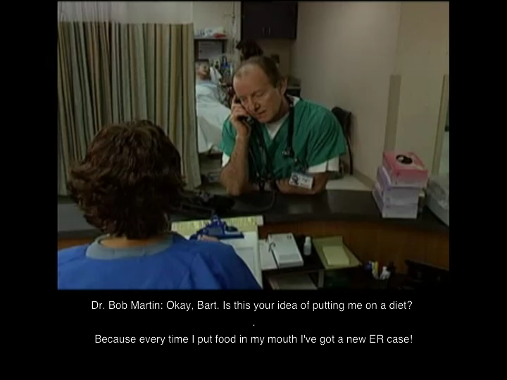
I PASS THE BATON Video
Click video to watch
What was effective or ineffective in this handoff?
Notes:
SCRIPT
As you watch this short video, see how many elements of the I PASS the BATON mnemonic you observe. Please note that the scenario does not relate to a severe hypertensive event. We encourage you to focus on the technique, rather than the context. What made this an effective or ineffective handoff?

Slide 38
Handoff Video Discussion
What elements were covered by Dr. Smith?
  Overlap in some of the elements
What might have been improved?
  Greater details about timing the chest squirting
  Detailing next steps and a contingency plan
  Opportunity for questions and discussion from Dr. Martin
What was good about this handoff?
  Short but communicated critical information
  Dr. Martin used a check-back
Notes:
SCRIPT
What elements of I PASS the BATON did you see represented in the previous video?
You might have observed that Dr. Smith did not provide his name or role but that Dr. Martin knew exactly to whom he was speaking, so the introduction might have been unnecessary. However, Dr. Smith began the handoff by sharing a bit about the patient, including his sex, age, and name, which he quickly followed with the assessment that the patient has viral cardiomyopathy, frequent episodes of congestive heart failure, presenting with acute anterior MI and early cardiogenic shock. Dr. Smith described the situation as the patient reporting sensations of ripping pain and that he already has access to past and present electrocardiograms with labs drawn and pending. Dr. Smith reiterated that the patient’s background is one of viral cardiomyopathy, and clarified it’s not coronary artery disease. As part of the patient’s background and safety concerns, Dr. Smith reported that the patient has had aspirin and heparin, and was starting integrilin, and was not receiving beta-blockers or nitroglycerin due to his hypotension. He suggested the next action would be squirting the chest to rule out dissection. He transferred ownership to both Dr. Martin and Hal.
You might notice that there is sometimes overlap in the different I PASS the BATON elements or that they might be presented out of order of the mnemonic. That’s OK. I PASS the BATON is simply another tool you can draw on to help you ensure that you have communicated fully and completely all the critical information about the patient. As you become accustomed to using the strategy during handoffs, it will start to feel more natural to you.
Now, what about this particular handoff do you think could have been improved? Dr. Smith did not appear to provide details regarding the timing of actions or clear next steps, so he might have given more detail about when the chest squirting would and should take place as well as for any other explicit next steps in the care plan. He might even have asked Dr. Martin if he had anything additional to add or questions. Dr. Smith also might have summarized the results of the EKGs rather than leaving Dr. Martin to read them for himself.
Overall, this was a good handoff that touched on nearly all the aspects of the I PASS the BATON mnemonic. Importantly, it was fairly concise, even with the banter between the two doctors, and critical information was shared. Dr. Martin even used a check-back, wherein he repeated the information that Dr. Martin communicated to him in his own words.

Slide 39
Severe Hypertension
I PASS the BATON
I PASS the BATON can be used during a nursing handoff at shift change.
Notes:
SCRIPT
Now we will see how the I PASS THE BATON can be used in a case where the patient has developed severe hypertension.

Slide 40

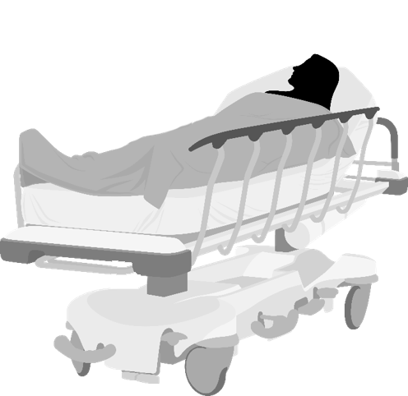
Severe Hypertension
I PASS the BATON
Introduction
Hi, Beth. I’m Kim, from triage. I have been taking care of Ms. Smith here, and she is now being admitted to L&D.
Are you ready for handoff?
Hi, Kim. I’m ready. Are you ready, Ms. Smith?
I guess so. I didn’t think I’d be doing this today.
Alice Smith, the patient
Beth, L&D Nurse
I know it’s a surprise, but I’m Beth and I’ll be taking care of you. Kim is going to tell me what’s going on. If you have anything to add or if you have any questions, please let us know.
Kim, triage nurse
Notes:
SCRIPT
Here you see the triage nurse, Kim, preparing to hand off Ms. Smith’s care to the receiving L&D nurse, Beth. Ms. Smith is present and included in the conversation so she is fully aware that now there will be a different person and team taking care of her. She is given an opportunity to respond with whether she is ready before the handoff dialogue starts. Note how Beth takes particular care to make Ms. Smith feel like a team member.
You will note that all aspects of ”I” are covered. Assuming that Beth and Kim already know each other and are conducting the handoff in person, they may not have introduced themselves in quite this same way. However, it is helpful to start the handoff by making sure everyone involved knows each other’s roles and responsibilities.

Slide 41
Severe Hypertension
I PASS the BATON
Ms. Smith is a 31-year-old primip female at 36 weeks and 2 days with overall uncomplicated prenatal care.
She presented to L&D triage with complaints of a headache and was noted to have severe-range blood pressure. I believe it is likely she has preeclampsia with severe features.
I’ve taken her blood pressure several times since her arrival and seen them as high as 202/120. Severe-range blood pressure was sustained for nearly an hour.
Ms. Smith now has a peripheral IV in place.
Thank you so much for your help with that,
by the way.
-Patient-
-Background-
-Assessment-
-Situation-
Alice Smith, the patient
Kim, triage nurse
Beth, L&D Nurse
Notes:
SCRIPT
Kim explains Ms. Smith's history, offering her own assessment of the situation, and recap of the recent process.
"Ms. Smith is a 31-year-old primip female at 36 weeks and 2 days with overall uncomplicated prenatal care. She presented to L&D triage with complaints of a headache and was noted to have severe-range blood pressure. I believe it is likely she has preeclampsia with severe features. I’ve taken her blood pressure several times since her arrival and seen them as high as 202/120. Severe-range blood pressure was sustained for nearly an hour. Ms. Smith now has a peripheral IV in place. Thank you so much for your help with that, by the way.”

Slide 42
Severe Hypertension
I PASS the BATON
Admission and preeclampsia labs were collected and sent but have not yet returned.
Ms. Smith has received a total of 15 mg of hydralazine,* and as of 10 minutes ago her blood pressure is no longer in the severe range.
Safety concerns include potential stroke and seizures if she’s diagnosed with preeclampsia.
You will need to repeat her vital signs in 5 minutes.
*Apresoline®
-Safety-
-Action-
-Timing-
-Ownership-
-Next-
Beth, L&D Nurse
Alice Smith, the patient
Kim, triage nurse
Notes:
SCRIPT
Kim continues with the handoff, moving toward the next steps that need to be taken by the receiving L&D nurse. She tells Beth, “Admission and preeclampsia labs were collected and sent but have not yet returned. Ms. Smith has received a total of 15 mg of hydralazine (Apresoline), and as of 10 minutes ago her blood pressure is no longer in the severe range. Safety concerns include potential stroke if her very high blood pressure is not treated acutely. She is also likely at high risk for seizures if diagnosed with preeclampsia with severe features. You will need to repeat her vital signs in 5 minutes.”
Note that Kim touches on all aspects of I PASS BATON throughout her handoff.

Slide 43
Severe Hypertension
I PASS the BATON
Do either of you have questions or anything else to add?
No, thank you.
Ms. Smith, you do not have severe-range blood pressure at this time. I’ll take your vitals again in 5 minutes. If you think of any questions or need anything, please let me know.
I’ve got it from here, Kim.
Beth, L&D Nurse
Alice Smith, the patient
Kim, triage nurse
Notes:
SCRIPT
Kim concludes by giving Beth an opportunity to clarify anything or ask questions. Beth briefly summarizes the main points of what she’s heard, while keeping Ms. Smith engaged in the handoff.

Slide 44
Discussion
Which communication tools do you think your staff will easily adopt?
  Call-out | Check-back | SBAR | I PASS the BATON
What do you think will be hurdles to using these tools in your facilities?
What ideas can you share to potentially overcome some of the hurdles?
How would you modify the tools so that your staff might use them?
Notes:
SCRIPT
Now that you’ve learned about the communication tools and strategies we have for improving teamwork let’s talk about their feasibility, any barriers you expect to have with adopting them, concerns you have with their utility, applicability, or friendliness, and ideas you might have to improve upon them or encourage their use.
I want you to feel open to sharing your thoughts, ideas, and concerns. And remember: these tools can always be modified in order to be made more useful, if that’s what you need. It’s not so much about the exact structure of the tool (e.g., SBAR or I PASS the BATON) as it is in having a unit-recognized procedure for organizing your communications and ensuring information has been correctly and similarly understood by everyone involved..

Slide 45
Summary
Communication is the foundation to effective teamwork
  Clear, Complete, Brief, & Timely
Four simple strategies to improve communication:
  Call-out
  Check-back
  SBAR
  I PASS THE BATON
Use these strategies together!
Notes:
SCRIPT
Communication is the foundation to effective teamwork. To be effective, it should be clear, brief yet complete, and timely. In this module, we reviewed four simple strategies that you can immediately begin using and promoting at your home organizations to improve teamwork. These include call-outs, check-backs, SBAR, and I PASS the BATON.
Encourage the use of multiple strategies together. Check-backs can and should be used to confirm information shared during call-outs and communicated with the SBAR and I PASS the BATON mnemonics.

Slide 46
References
Joint Commission on Accreditation of Healthcare Organizations. Sentinel Events Statistics: Root causes of sentinel events. 2015. http://www.jointcommission.org/sentinel_event.aspx.
Joint Commission on Accreditation of Healthcare Organizations. Sentinel Event Data: Root Causes by Event Type, 2004-2015. 2016. https://hcupdate.files.wordpress.com/2016/02/2016-02-se-root-causes-by-event-type-2004-2015.pdf.
Dayton E, Henriksen K. Communication failure: basic components, contributing factors, and the call for structure. Joint Commission Journal of Quality and Patient Safety. 2007 Jan;33(1):34-47. PMID: 17283940.

Slide 47
Acknowledgments
This project is funded and implemented by the Agency for Healthcare Research and Quality and the Johns Hopkins University Contract Number HHSP233201500020I in collaboration with the Health Resources and Services Administration and the Alliance for Innovation on Maternal Health.

