Slide 1

Program Evaluation
SPPC-II
Toolkit
JHU & AHRQ for
AIM
Module 8 of 8
AHRQ Pub. No. 23-0046
July 2023
Notes:
SCRIPT
Welcome to Module 8 of the SPPC-II Teamwork Toolkit. In this module we will discuss aspects related to the evaluation of the program.

Slide 2
Overview
Background information for the SPPC-II/Demonstration Project
Key program evaluation concepts
SPPC-II/Demonstration Project evaluation approach
Notes:
SCRIPT
We will start by looking at some national maternal health outcome data that demonstrate the need for the SPPC-II Program, then briefly review key program evaluation concepts, and then last we will discuss the proposed evaluation approach for the SPPC–II Demonstration Project.

Slide 3
Background Information for the SPPC-II/Demonstration Project
3
Notes:
SCRIPT
Now that we have built some background in program evaluation, let’s discuss some of the relevant background data that justify the need for our program and its evaluation.

Slide 4
As a Reminder…
The Safety Program in Perinatal Care version II (SPPC-II) aims to integrate teamwork and provider communication tools and strategies with the Alliance for Innovation on Maternal Health (AIM) patient safety bundles for hemorrhage and severe hypertension
Funded by the Agency for Healthcare Research and Quality (AHRQ) and implemented by a team of clinicians and scientists at the Johns Hopkins University in close collaboration with the national AIM program
  SPPC-II Demonstration Project in Oklahoma & Texas
Notes:
SCRIPT
First, as a reminder:
The Safety Program in Perinatal Care version II or SPPC-II aims to integrate teamwork and provider communication aspects with the AIM patient safety bundles for hemorrhage and severe hypertension.
The SPPC-II program is funded by AHRQ and implemented by Johns Hopkins University in close collaboration with the AIM program. The Demonstration Project will implement obstetric provider trainings using the SPPC-II toolkit in birthing hospitals throughout Oklahoma and Texas.

Slide 5
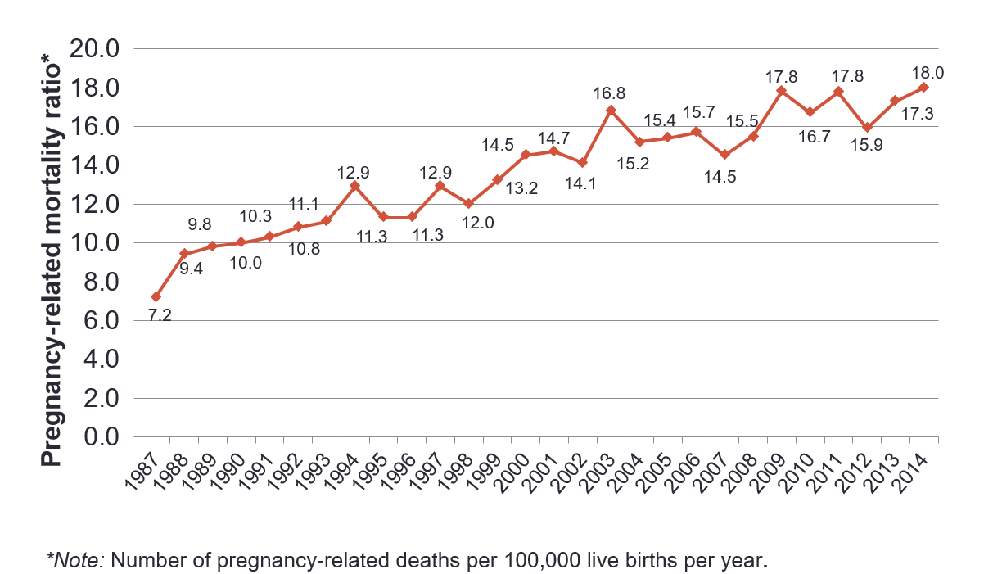
Pregnancy-Related Mortality: United States, 1987–2014
Source: https://www.cdc.gov/reproductivehealth/maternalinfanthealth/pregnancy-mortality-surveillance-system.htm
Notes:
SCRIPT
You may ask, why are AIM and SPPC programs needed?
The most recent pregnancy-related mortality data from the Centers for Disease Control and Prevention’s (CDC) pregnancy-related mortality surveillance are shown on this slide.
As you see, mortality has been increasing over time, and in 2014, there were 18 pregnancy-related deaths per 100,000 live births in the United States.

Slide 6
Cause-Specific Proportionate Pregnancy-Related Mortality: United States, 1987–2013
Source: Creanga A, Syverson C, Seed K, et al. Pregnancy-related mortality in the United States, 2011-2013. Obstet Gynecol. 2017 Aug;130(2):366-73. doi: 10.1097/AOG.0000000000002114. PMID: 28697109; PMCID: PMC5744583. Used with permission.
Notes:
SCRIPT
The most common causes of maternal mortality in the United States are shown here for the period between 1987 and 2013.
Over time, the contribution of traditional causes of maternal mortality represented by hemorrhage, hypertensive disorders of pregnancy, infection has been declining, while that of chronic medical conditions, especially cardiovascular conditions, separated here by the orange line, has been rising. However, it has been shown that preventable deaths are those contributed by conditions like hemorrhage and severe hypertension, and this why the AIM program has developed patient safety bundles for these specific conditions.

Slide 7

Growing interest in Severe Maternal Morbidity (SMM)
Calls by professional organizations to review SMM
  to better understand adverse maternal events
  to implement clinical audits and improve quality of care
  to increase awareness/knowledge of SMM recognition and management
Development and validation of SMM measures
Increase in SMM rates over the last decade due to—
  delays in childbearing and more women entering pregnancy with burden of chronic conditions
  medical advances that allow for successful high-risk pregnancies
  changes in clinical practice
Notes:
SCRIPT
There is growing interest in measuring and addressing severe maternal morbidity—or SMM–the key impact measure for AIM and most quality improvement initiatives in the United States.
Interest in SMM has been driven by:
Calls by professional organizations to review SMM
to better understand adverse maternal events
to implement clinical audits and improve quality of care
to increase awareness/knowledge of SMM recognition and management
The development and validation of SMM measures so that we know what we are interested in and how to follow it (CLICK TO SHOW NEXT BULLET)
The increase in SMM rates over the last decade due to
delays in childbearing and more women entering pregnancy with burden of chronic conditions
medical advances that allow sick(er) women to become pregnant and carry a pregnancy to term
changes in clinical practice

Slide 8
How Do We Account for SMM?
CDC measure
  original list of 25 SMM indicators based on ICD-9 codes was published in 2012
  updated list of 21 indicators (as of 2023) and corresponding ICD-10 codes used to identify delivery hospitalizations with SMM available on CDC website
For more information on SMM, go to https://www.cdc.gov/reproductivehealth/maternalinfanthealth/severematernalmorbidity.html
Notes:
SCRIPT
Now, how do we account for severe maternal morbidity in the United States?
Most commonly used is the measure developed by CDC using ICD codes
an original list of 25 SMM indicators based on ICD-9 codes was published in 2012, and
an updated list of 21 indicators and corresponding ICD-10 codes used to identify delivery hospitalizations with SMM available on CDC website
The CDC measure is further described on the CDC website. A link is also present on the AIM website for easy reference.
Links:
https://www.cdc.gov/reproductivehealth/maternalinfanthealth/smm/severe-morbidity-ICD.htm
https://www.cdc.gov/reproductivehealth/maternalinfanthealth/severematernalmorbidity.html
https://saferbirth.org/wp-content/uploads/AIMData_SMMGuide_5CR_042922.pdf

Slide 9
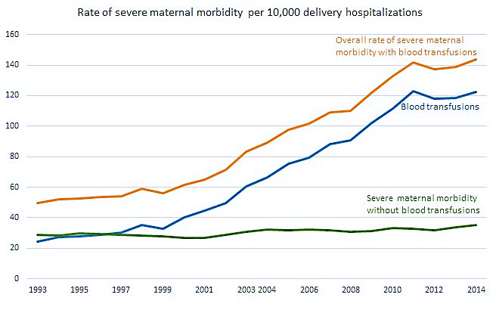
Trends in Severe Maternal Morbidity During Delivery Hospitalizations: United States,1993-2014
Severe morbidity during delivery hospitalizations more than doubled during 1993-2014, with increase driven by blood transfusions
If excluding blood transfusions, rate of SMM increased by about 20% during 1993-2014
Source: https://www.cdc.gov/reproductivehealth/maternalinfanthealth/severematernalmorbidity.html
Notes:
SCRIPT
Here, we see the most recent national trends in SMM from the CDC.
Severe morbidity during delivery hospitalizations more than doubled during 1993-2014, with the increase being driven mostly by blood transfusions.
If we exclude blood transfusions, the rate of SMM increased by about 20% during the same time period 1993-2014
Overall, this shows the important contribution of obstetric hemorrhage to SMM in the US.

Slide 10
Key Program Evaluation Concepts
Notes:
No script needed

Slide 11
What Is Program Evaluation?
Using evidence to—
  Determine how well a program is being implemented
  Indicate whether it is achieving results
  Guide decision making (i.e., should it be modified, cut, continued, or expanded)
Notes:
SCRIPT
So, to start, what is program evaluation?
(PAUSE TO ALLOW PARTICIPANTS TO RAISE THEIR HANDS AND ANSWER THIS QUESTIONS. AFTER TWO OR THREE PEOPLE RESPOND, GUIDE THEM BACK TO THE PRESENTATION AND SHARE THE FOLLOWING INFORMATION.)
Program evaluation is the process of using evidence to:
Determine how well a program is being implemented
Indicate whether it is achieving results
Help guide decision-making about programs – for example, should it be modified, cut, continued, or expanded.

Slide 12
Considerations for Designing Evaluations
Utility: Who needs the evaluation results? Will the evaluation provide relevant information in a timely manner?
Feasibility: Are the planned evaluation activities realistic given the time, resources, and expertise available?
Propriety: Does the evaluation protect the rights of individuals and protect the welfare of those involved?
Accuracy: Will the evaluation produce findings that are valid and reliable given the needs of those who will use the results?
Notes:
SCRIPT
Now, what are some key considerations for designing evaluations?
You should keep in mind the following:
Utility: Who needs the evaluation results? Will the evaluation provide relevant information in a timely manner? (CLICK TO SHOW NEXT BULLET)
Feasibility: Are the planned evaluation activities realistic given the time, resources, and expertise available? (CLICK TO SHOW NEXT BULLET)
Propriety: Does the evaluation protect the rights of individuals and protect the welfare of those involved? (CLICK TO SHOW NEXT BULLET)
Accuracy: Will the evaluation produce findings that are valid and reliable given the needs of those who will use the results? (CLICK TO SHOW NEXT BULLET)

Slide 13
All Evaluations Need an Impact Model
A [framework, schema, diagram, set of tables]
  That describes the [steps, milestones, intermediate achievements]
    And the [assumptions, intended processes, pathways]
      Between program [startup, inputs]
        And expected [impact, changes]
Notes:
SCRIPT
As discussed when we identified the steps to designing an evaluation, all evaluations need an impact model to guide their development.
Impact models begin with:
A framework, schema, diagram or set of tables, which
Describe the steps, milestones, or intermediate achievements of the evaluation
And the assumptions, intended processes and pathways
Between the program start-up and inputs
And the expected impact or changes – in our case, impact or changes in maternal health status

Slide 14
Why Are Impact Models Important for
Program Evaluation?
To clarify expectations of program planners/developers
To define the evaluation questions and measurements
To guide analysis and attribution of results
To track changes in assumptions as they evolve in response to evaluation findings
To stay honest about what was expected
Notes:
SCRIPT
Impact models are important for program evaluation for multiple reasons.
They can help:
To clarify expectations of program planners/developers
To define the evaluation questions and measurements
To guide analysis and attribution of results
To track changes in assumptions as they evolve in response to evaluation findings
To stay honest about what was expected

Slide 15
SPPC-II/Demonstration Project
Evaluation Approach
15
Notes:
SCRIPT
Now, moving into the final section of this presentation, let’s shift our focus to the proposed SPPC-II Program Evaluation approach.

Slide 16
Evaluation Plan for
SPPC-II/Demonstration Project
Implementation evaluation to understand the extent to which the program is delivered as intended
Impact evaluation to ascertain the impact of the program on
  provider teamwork and communication
  safety culture
  maternal outcomes
We will employ a mixed-methods approach consisting of
  surveys (i.e., quantitative)
  interviews (i.e., qualitative)
Notes:
SCRIPT
The evaluation plan for SPPC II Demonstration Project includes—
an implementation evaluation to understand the extent to which the program is delivered as intended, and
an impact evaluation to ascertain the impact of the program on provider teamwork and communication, unit safety culture, and maternal outcomes.
To do this, we will employ a mixed-methods (quantitative and qualitative) approach consisting of surveys as well as qualitative interviews and focus group discussions.

Slide 17
Impact Model
Note: T&C = teamwork and communication
Notes:
SCRIPT
Here, we have the impact model for the SPPC II evaluation showing all inputs, processes, outputs, outcomes, and impact.
You can see in the far left column, the inputs include the:
SPPC II training toolkit, staff time, and use of technology
the AIM clinical bundle with its resources, staff time, and equipment, and
contextual factors, such as project funding, leadership and stakeholder involvement
Moving to the next column showing processes, we find corresponding activities such as:
the process of assembling a site team, engaging site leadership, conducting the teamwork and communication trainings
in relation to the AIM clinical bundles, we have activities such as reviewing the bundle resources and implementing selected bundles
establishing a regular meeting schedule and sites’ submitting data for monitoring and evaluation
The middle column of outputs shows us that, for example,
site teams should be formed, site leadership should be supportive, site staff should be using the teamwork and communication tools and strategies they were trained to use
staff should be ready to act and recognize bundle-specific conditions
regularly scheduled meetings should be conducted by staff and program stakeholders, and
feedback should be provided on data sent by sites
Next, in the outcomes column, expected positive outcomes are shown – for example:
improved provider teamwork and communications
more defects being identified and addressed, and
patient safety culture becoming better established and improving over time
Collectively, these will lead lead to reductions in adverse events – as shown in the impact column.

Slide 18
Evaluation Data Collection
Baseline assessment survey at baseline
  Survey with AIM team leads in all sites
Implementation surveys at baseline, 6, 18, and 30 months after implementation
  Surveys with randomly selected staff in all sites
Qualitative interviews 3–4 months after start of implementation
  In-depth interviews with AIM team leads
Notes:
SCRIPT
Data collection processes for the SPPC-II program evaluation will include:
Baseline assessment surveys at baseline with AIM team leaders in all sites
Implementation surveys at baseline, 6 months, 18 months and 30 months after implementation, which will be completed by randomly selected staff from in all sites
Qualitative interviews with AIM team leads 3-4 months after the start of project implementation to assess whether the project needs to be modified in any way.

Slide 19
Current Data Reporting to AIM
Each AIM State or hospital system works on one or two bundles at a time, and focuses on corresponding structure, process, and outcome metrics
Several outcome measures (e.g., SMM) are considered key and included in all bundles
  No patient-level data collected by AIM
  Only numerators/denominators for hospital and state rates are shared with AIM
Maternal deaths are rare events, and thus maternal mortality is not reported at the hospital level
Notes:
SCRIPT
We will use the information collected regularly by the AIM program for the evaluation.
Each State or hospital system participant works on one or two bundles at a time, and focuses on corresponding structure, process and outcome metrics as we will show on the next slide
Several measures (such as SMM) are considered key and included in all bundles -- of note, no patient level data are collected and only numerators/denominators for hospital and state rates are shared with AIM
Maternal deaths are rare events, and thus maternal mortality is not reported at the hospital level -- AIM depends on State health departments, maternal mortality review committees, and the National Center for Health Statistics to provide data on maternal deaths

Slide 20
AIM Data Measures Overview
Key Measure Examples | Data Source & Frequency of Data Collection
Structure measures Existence of debriefs process Performance of multidisciplinary case reviews | Hospital-generated data Reported at time of AIM enrollment
Process measures Number of unit drills % providers trained on AIM bundle topic | Hospital-generated data Reported quarterly
Outcome measure SMM (overall and bundle-specific, i.e., women with hemorrhage or preeclampsia) | Hospital discharge data Reported quarterly
Notes:
SCRIPT
This slides provide a couple of key examples of the data metrics collected by AIM.
Key structure measures include:
existence of a debriefs process, and
performance of multidisciplinary case reviews
These data are generated by the hospitals and reported only once at the time of enrollment in AIM.
Key process measures include:
the number of unit drills, and
The percent of providers trained on AIM bundle topic
These data are also available generated by hospitals and collected quarterly.
The SMM metric, overall and bundle-specific, for example SMM among women with hemorrhage or SMM women with preeclampsia is made available from the state hospital discharge data on a quarterly basis.

Slide 21
Teamwork and Communications Measures
Some already required by AIM (see previous slide)
Others collected through implementation surveys and covering three domains:
  LEARNING: assess knowledge, attitudes, and behaviors
  TRANSFER: assess application of learned competencies
  RESULTS: assess organizational learning and safety culture
Notes:
SCRIPT
Some of the teamwork and communication measures are required for reporting by AIM, such as the examples provided on the previous slide, and some will be collected through our implementation surveys.
We will aim to capture indicators in three specific domains, including:
LEARNING domain to assess provider knowledge, attitudes, and behaviors
TRANSFER domain to assess application of learned competencies
RESULTS domain to assess organizational learning and safety culture

Slide 22
Key Considerations for the Analysis Plan
Absolute and relative changes in process and outcome measures at 4 time points (baseline, 6, 18, and 30 months after implementation)
Qualitative data coded and thematically analyzed to study organizational elements of successful program implementation
Reports and publications will be generated to disseminate the lessons learned
Notes:
SCRIPT
And finally, we want to share some key consideration for the analysis plan.
We will be looking at absolute and relative changes in process and outcome measures over time. These will be measured at 4 separate time points, specifically at baseline and 6, 18, and 30 months after implementation
All qualitative data will be deidentified, coded, pooled, and thematically analyzed to study overall organizational elements of successful program implementation
Reports and publications will be generated to disseminate the lessons learned

Slide 23
Thank you!
Notes:
This concludes the presentation for the Evaluation Module. Thank you for your attention and participation!

Slide 24
Acknowledgements
This project is funded and implemented by the Agency for Healthcare Research and Quality and the Johns Hopkins University Contract Number HHSP233201500020I in collaboration with the Health Resources and Services Administration and the Alliance for Innovation on Maternal Health.

