Slide 1

Severe Hypertension Scenarios
SPPC-II
Toolkit
Safety Program for Perinatal Care II Teamwork Toolkit
AHRQ Pub. No. 23-0046
July 2023
Notes:
SCRIPT
In this handout we have compiled all of the case scenarios presented in the SPPC-II Teamwork Toolkit for AIM’s Severe Hypertension Clinical Bundle.

Slide 2


Severe Hypertension
Master Case
Read the master case scenario on the following slides.
Notice where clinician interactions are crucial to keeping patients safe.
We will use this scenario to demonstrate the use of the teamwork tools described in later modules.
Notes:
SCRIPT
We conclude the introduction module with the master case scenario related to a severe hypertension case. Read through the case, which has been positioned in a comic strip layout, to see the scenario that will be used and referenced throughout the entire SPPC-II teamwork toolkit training. At certain points in this case, you may see places where clinicians could provide more and better interactions to keep their patients safer, but these instances will be explored during the other online modules in which the teamwork tools are individually introduced.

Slide 3
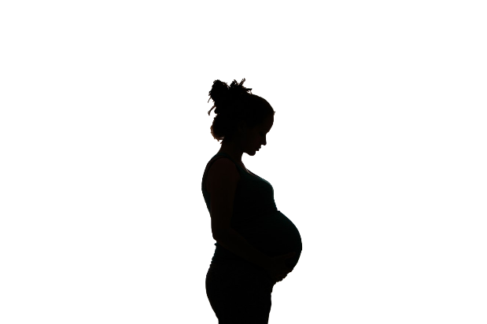
Severe Hypertension
Master Case
Patient name: Alice Smith
Age: 31 BMI: 24
Current Vitals:
BP is 178/112
Headache
Gravida 1, para 0
Past Medical History:
Uncomplicated pregnancy with limited prenatal care
Alice Smith, the patient
Notes:
SCRIPT
Alice Smith is a 31-year-old primiparous female who is 36 weeks and 2 days pregnant when she presents to Labor & Delivery triage with complaints of a headache. She has no pertinent medical history, and her pregnancy has thus far been uncomplicated except for limited prenatal care.

Slide 4

Severe Hypertension
Master Case
2:35 p.m.
Hi, Ms. Smith, I’m Kim. I’m going to take your vitals. How are you feeling?
Frankly, I’m ready to have this baby. He’s already giving me headaches!
I know that feeling! He’ll be here before you know it. Any other unusual sensations with belly, chest, breathing, or eyes?
Kim, triage nurse
Alice Smith, the patient
Notes:
SCRIPT
Kim, the triage nurse, greets Ms. Smith at 2:35 p.m. and checks her vitals. As she does so, they casually joke about Ms. Smith’s headache and readiness to greet her son. Kim tactfully follows up, asking Ms. Smith to tell her about any other symptoms such as chest pain, belly pain, nausea, breathing difficulty, or vision spots that would be consistent with hypertension.

Slide 5
Severe Hypertension
Master Case
2:35 p.m.
Well, now that you mention it, the lights are a bit bright in here. Maybe it’s a migraine? I wouldn’t know. I’ve never had one.
Ah, you’re having some light sensitivity. Thanks for telling me; I’ll make a note so your nurse knows to keep the lights low.
Your blood pressure is 178/112. That’s much higher than we like to see, so I want us to watch that, OK? I’ll take your vitals again in 10 minutes to see where we stand.
Kim, triage nurse
Alice Smith, the patient
Notes:
SCRIPT
Ms. Smith tells Kim that she’s experiencing some light sensitivity, which is abnormal for her as she’s not prone to migraines. Kim adds the note to Ms. Smith’s chart.
Kim also notes that Ms. Smith’s blood pressure is 178/112, which is significantly higher than her baseline. Kim informs Ms. Smith and tells her that she would like to take her vitals again in a few minutes to see where they stand.

Slide 6
Severe Hypertension
Master Case
10 minutes later, 2:45 p.m.
OK, Ms. Smith, your blood pressure is now 182/114.
I don’t want to worry you but that’s very high, so I’m going to let Dr. Johnson, the obstetrician, know.
Kim, triage nurse
Alice Smith, the patient
Notes:
SCRIPT
In the meantime, Kim initiates routine admission paperwork and begins to obtain consent from Ms. Smith for admission to triage. Ten minutes later, Ms. Smith’s blood pressure has increased to 182/114. Kim is concerned so at this point she informs Ms. Smith and notifies the covering obstetrician, Dr. Johnson.

Slide 7

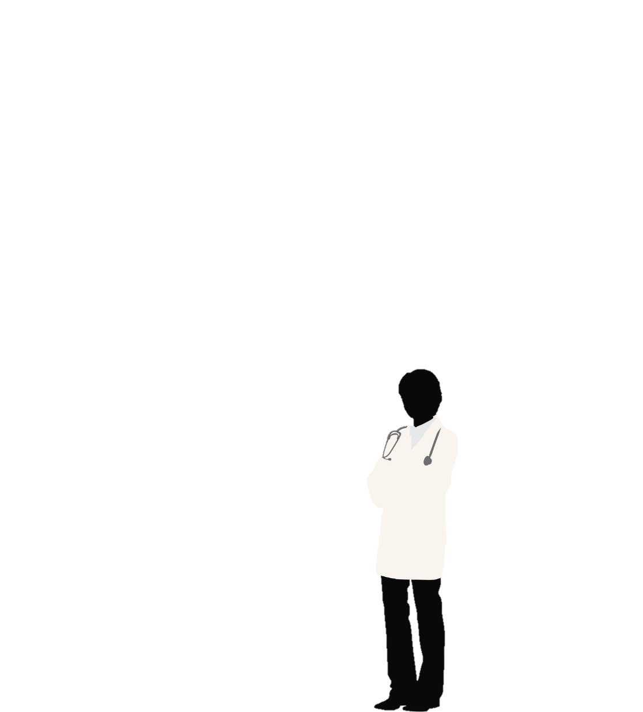
Severe Hypertension
Master Case
Kim notifies Dr. Johnson about Ms. Smith’s increasing blood pressure.
Great, thank you for letting me know, Kim.
I’ll request an IV and labs. Go ahead and give her immediate-acting antihypertensives.
Kim, triage nurse
Dr. Johnson, obstetrician
Notes:
SCRIPT
Kim calls Dr. Johnson, who listens intently to Kim’s concerns about Ms. Smith’s rising blood pressure. Following Kim’s briefing, Dr. Johnson requests an IV and labs, and orders immediate acting antihypertensives to treat Ms. Smith’s severe-range blood pressure.

Slide 8
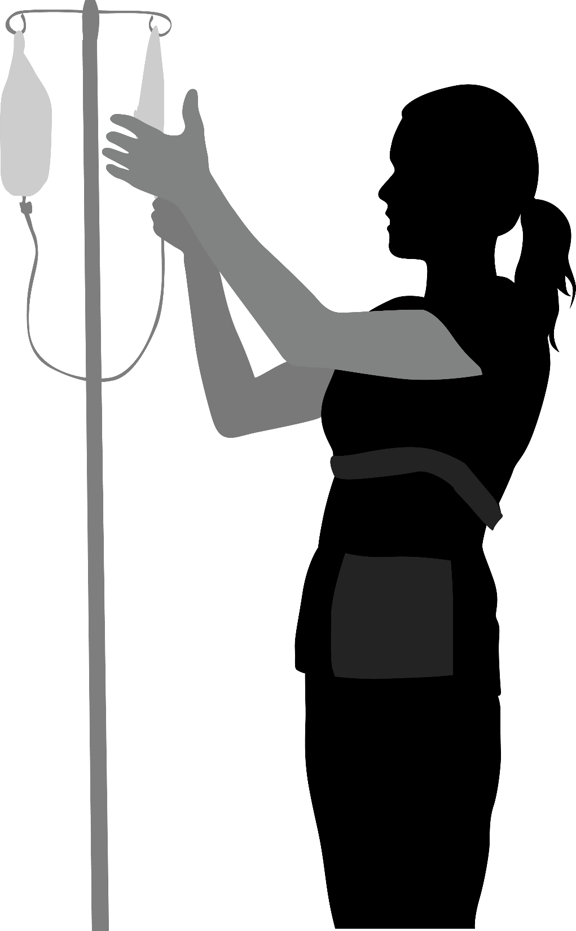
Severe Hypertension
Master Case
After hanging up with Dr. Johnson, Kim attempts IV access.
She has difficulty establishing access, so she calls out for assistance.
Alice Smith, the patient
Kim, triage nurse
Notes:
SCRIPT
After hanging up with Dr. Johnson, Kim attempts IV access in order to obtain labs and administer IV antihypertensives. She has difficulty establishing access, so she calls out for assistance.

Slide 9
Severe Hypertension
Master Case
3 p.m.
Another nurse, Beth, responds to Kim’s request for assistance.
3:15 p.m.
Together, they obtain IV access and draw labs.
Kim immediately rechecks Ms. Smith’s blood pressure, which is now 202/120.
Alice Smith, the patient
Kim, triage nurse
Beth, L&D nurse
Notes:
SCRIPT
At 3 p.m., another nurse, Beth, comes to attempt additional IV placement and blood draw.
At 3:10 p.m., with Beth’s help they successfully obtain IV access and draw labs. Kim immediately rechecks Ms. Smith’s blood pressure, which is now 202/120.

Slide 10
Severe Hypertension
Master Case
3:15 p.m.
Kim calls Dr. Johnson.
Hi, Dr. Johnson, it’s Kim again. I had difficulty obtaining IV access, so labs were delayed. Ms. Smith is set up now and her blood pressure is still severely elevated at 202/120. What do you think are next steps?
Please treat with 5 mg of IV hydralazine immediately. Then continue taking blood pressure every 5 minutes.
Kim, triage nurse
*Apresoline®
Dr. Johnson, obstetrician
Notes:
SCRIPT
Kim calls Dr. Johnson again to deliver an update on Ms. Smith’s severe-range blood pressure, explaining that the difficulty in obtaining IV access led to a delay in treatment.
Dr. Johnson emphasizes immediate treatment with 5 mg of IV hydralazine (Apresoline) and instructs Kim to continue taking blood pressure measurements every 5 minutes.

Slide 11
Severe Hypertension
Master Case
3:18 p.m.
ddddd
OK, Ms. Smith, I’m giving you a medication called hydralazine* to reduce your blood pressure. You’re doing great; let me know if you have questions or need anything.
*Apresoline
Ms. Smith’s blood pressure drops to 198/110, 186/100, 186/96, and 172/92 over the next 20 minutes.
Alice Smith, the patient
Kim, triage nurse
Notes:
SCRIPT
Ms. Smith receives IV hydralazine (Apresoline) at 3:18 p.m. Her blood pressure drops to 198/110, 186/100, 186/96, and 172/92 over the next 20 minutes.

Slide 12

Severe Hypertension
Master Case
3:40 p.m.
OK, that’s still worrisome.
Give her another 10 mg of IV hydralazine* immediately, please.
*Apresoline
Kim, triage nurse
Dr. Johnson, obstetrician
Notes:
SCRIPT
Kim calls Dr. Johnson to deliver an update at 3:40. Still not satisfied with the improvement, Dr. Johnson orders an additional 10 mg of IV hydralazine (Apresoline).

Slide 13
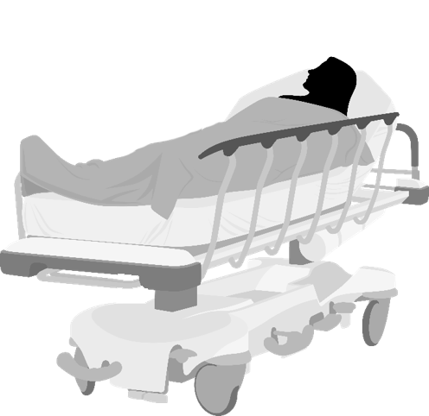
Severe Hypertension
Master Case
4:10 p.m.
Fetal monitoring remains reassuring with a fetal heart rate in the 150s, consistent with a category 1 tracing.
Twenty minutes later, Ms. Smith’s blood pressure is 158/84. She is transferred to L&D.
Alice Smith, the patient
Notes:
SCRIPT
In the meantime, fetal monitoring remains reassuring with a fetal heart rate in the 150s, consistent with a category 1 tracing. However, 20 minutes after the second hydralazine (Apresoline) administration, Ms. Smith’s blood pressure is 158/84 so she is transferred to L&D given her persistent severe-range blood pressure.

Slide 14
Severe Hypertension
Master Case
Ms. Smith’s lab results demonstrate a protein/creatinine ratio of 0.46 with 3+ protein on a catheterized urine sample, elevated transaminases with AST of 107 U/L and ALT of 98 U/L, a Hgb of 10 g/dl, and a normal platelet count.
Hey, team, let’s quickly huddle to discuss Ms. Smith’s plan of care.
Kim, triage nurse
Alice Smith, the patient
Dr. Johnson, obstetrician
Notes:
SCRIPT
Ms. Smith’s lab results return shortly after her arrival to L&D and demonstrate a protein/creatinine ratio of 0.46 with 3+ protein on a catheterized urine sample, elevated transaminases with AST of 107 U/L and ALT of 98 U/L, a Hgb of 10 g/dl, and a normal platelet count.
Dr. Johnson reviews Ms. Smith’s vital signs and laboratory values, and calls a huddle with the L&D treatment team to discuss the plan of care moving forward.

Slide 15
Severe Hypertension
Master Case
Ms. Smith, you have a condition called severe preeclampsia.
We have your blood pressure under control with medication but it’s still high.
You are close enough to your due date for me to suggest we go ahead and deliver your baby today. I believe it is the safest option for you both.
Do you have any questions or concerns?
Alice Smith, the patient
Dr. Johnson, obstetrician
Notes:
SCRIPT
Ms. Smith is diagnosed with severe preeclampsia and recommended to undergo an induction of labor. Her blood pressure will continue to be monitored closely, and severe-range pressure will be treated when encountered.

Slide 16
Severe Hypertension
Master Case
I’ll do whatever you think is best.
Is it possible for me to still have a vaginal delivery?
Yes, a vaginal delivery is completely possible so long as we don’t experience any additional complications, which I don’t expect.
Kim, triage nurse
OK, then. Let’s deliver this baby.
Support Staff
Alice Smith, the patient
Dr. Johnson, obstetrician
Notes:
SCRIPT
Ms. Smith agrees with the plan of care, asking about whether she is still able to deliver vaginally. Dr. Johnson assures her that a vaginal delivery is still possible unless additional complications arise.

Slide 17
Severe Hypertension
Master Case
Magnesium sulfate is initiated with a 6-g bolus, followed by 2 g/hr thereafter for seizure prophylaxis based on Doctor's orders.
Ms. Smith’s initial cervical exam is 2 cm, 50% effacement, and a station of -3, with the fetus in the vertex position.
Her blood pressure is rechecked and noted to be 135/86.
Ms. Smith, your blood pressure remains under control.
Kim, triage nurse
Alice Smith, the patient
Notes:
SCRIPT
Dr. Johnson and the team agree to initiate magnesium sulfate with a 6 g/hr bolus, followed by 2 g/hr thereafter for seizure prophylaxis. Dr. Johnson orders for start of the Magnesium Sulfate. Her initial cervical exam is 2 cm, 50% effacement, and a station of -3, with the fetus in the vertex position. Her blood pressure is rechecked and noted to be 135/86.

Slide 18
Severe Hypertension
Call-Out & Check-Back
Observe how the nurse, Kim, calls-out assertively.
Notice the confirmation during the check-back.
Notes:
SCRIPT
The next few slides are a deeper dive into a section from the severe maternal hypertension master scenario that you saw in the introduction module (Module 1). At this point, there is an opportunity for the team to use some of the tools you just learned about. Observe how the nurse, Kim, calls-out assertively. Then notice the confirmation during the check-back.

Slide 19
Severe Hypertension
Call-Out & Check-Back
The triage nurse, Kim, is having difficulty establishing IV access in Ms. Smith, so she CALLS OUT to the charge nurse, Melanie, to ask for assistance with establishing an IV…
Hey, Melanie, could you come to triage room 2? I need some help with an IV.
Sorry about this, Ms. Smith; you’re a trooper. I am going to get a little help so we can start this IV and get your blood pressure under control and figure out next steps. How are you doing?
Alice Smith, the patient
Kim, triage nurse
Notes:
SCRIPT
As you recall from the severe hypertension scenario that we covered in Module 1, the patient, Ms. Alice Smith, is noted to have two severe-range pressure readings in triage. Dr. Johnson, the labor and delivery attending, appropriately orders IV access, labs, and administration of IV antihypertensives, but Kim is having difficulty establishing IV access. So, she calls out to the charge nurse, Melanie, to ask for assistance with establishing an IV:
“Hey, Melanie, could you come to triage room 2? I need some help with an IV."
In order to keep the patient apprised of what is going on and help her remain calm, Kim says, "Sorry about this, Ms. Smith; you’re a trooper. I am going to get a little help so we can start this IV and get your blood pressure under control and figure out next steps.” Kim also checks in with the patient by asking, ”How are you doing?"

Slide 20

Severe Hypertension
Call-Out & Check-Back
Melanie comes into triage room 2.
What’s going on, Kim?
Ms. Smith has had two severe-range blood pressure readings 10 minutes apart. She needs IV antihypertensives, and Dr. Johnson has requested labs as well, but I am having a lot of difficulty obtaining IV access. Can you help?
Melanie, charge nurse
Kim, triage nurse
Notes:
SCRIPT
Melanie comes into the triage room and asks Kim what’s going on. Kim tells her that since arrival to L&D triage, Ms. Smith has had two severe-range blood pressure readings 10 minutes apart. Her blood pressure need to be treated with IV antihypertensives, and Dr. Johnson, her physician, has requested labs as well but she’s having a lot of difficulty obtaining IV access.

Slide 21
Severe Hypertension
Call-Out & Check-Back
Check-Back
OK, Kim. I’ll send someone to assist you with establishing an IV in Ms. Smith so you can treat her severe blood pressure and draw labs.
Great, thank you!
Melanie, charge nurse
Kim, triage nurse
Notes:
SCRIPT
Melanie confirms understanding of Kim's request by repeating back her interpretation of the situation and saying she will send help. Kim closes the interaction by thanking her.

Slide 22
Severe Hypertension
SBAR
Ms. Smith has persistent severe-range blood pressure with no IV access.
How does the nurse, Kim, use SBAR to structure her communication with Dr. Johnson, the obstetrician?
If you were the nurse, what would you say to Dr. Johnson?
Notes:
SCRIPT
The next few slides are from the severe hypertension master scenario, particularly relating to the fact that the patient in triage has persistent severe-range blood pressure with no IV access. In this scenario, we demonstrate an opportunity to use the SBAR communication tool.
As you read through this expanded section from our scenario, think about how the nurse uses SBAR to communicate with the obstetrician. If you were the nurse, what would you say to the obstetrician when she enters the room?
Remember that Kim should still use good communication standards (which include complete, clear, brief, and timely dialogue), but she should also Identify herself, explain the Situation with the patient, provide clinical Background, Assess the current problem, and Recommend a plan.

Slide 23
Severe Hypertension
SBAR
Situation
Hi, Dr. Johnson, it’s Kim. I’m caring for Ms. Alice Smith, who recently presented to L&D triage complaining of a headache.
Since her arrival, she has had two severe-range blood pressure readings separated by 10 minutes.
Kim, triage nurse
Dr. Johnson, obstetrician
Notes:
SCRIPT
Kim, the triage nurse, calls Dr. Johnson, the obstetrician. Kim begins by introducing herself and her role. She then describes the current clinical situation regarding Alice Smith, who recently presented to L&D triage complaining of a headache and since her arrival has had two severe-range blood pressure readings separated by 10 minutes.

Slide 24
Severe Hypertension
SBAR
Background
Ms. Smith is a 31-year-old primiparous female at 36 weeks and 2 days with overall uncomplicated prenatal care.
She presented to L&D triage today reporting worsening daily headaches. On arrival, she was noted to have an initial severe blood pressure of 178/112.
We initiated routine admission paperwork and the consent process while letting her relax a bit; however, her repeat blood pressure 10 minutes later was 182/114.
Dr. Johnson, obstetrician
Kim, triage nurse
Notes:
SCRIPT
Kim then proceeds to provide Dr. Johnson with some clinical background that can be used to make informed care decisions. She tells Dr. Johnson, “Ms. Smith is a 31-year-old primiparous female at 36 weeks and 2 days with overall uncomplicated prenatal care. She presented to L&D triage today reporting worsening daily headaches. On arrival, she was noted to have an initial severe blood pressure of 178/112. We initiated routine admission paperwork and the consent process while letting her relax a bit; however, her repeat blood pressure 10 minutes later was 182/114.”

Slide 25
Severe Hypertension
SBAR
Assessment
I am concerned she could have pre-eclampsia.
Dr. Johnson, obstetrician
Kim, triage nurse
Notes:
SCRIPT
Kim tells Dr. Johnson she is concerned that Ms. Smith could have pre-eclampsia. This assessment is based on Kim’s synthesis of all the information she has gathered and relayed to Dr. Johnson, opening the opportunity for discussion of next steps.

Slide 26
Severe Hypertension
SBAR
Recommendation
I think we should treat her blood pressure immediately and assess her for pre-eclampsia.
Would you order IV access, IV antihypertensives, and additional labs?
Kim, triage nurse
Dr. Johnson, obstetrician
Notes:
SCRIPT
Ending on a recommendation for next steps helps direct the plan of care. Kim knows that Ms. Smith should immediately receive antihypertensives to treat her severe-range blood pressure and will need additional workup, so requests Dr. Johnson order IV access, IV antihypertensives, and additional labs to assess Ms. Smith for pre-eclampsia.
At this point, the providers could engage in a constructive conversation about whether Kim’s assessments and recommendations are appropriate from the perspective of the other team members, such as Dr. Johnson. Whatever the ultimate decision, Kim and Dr. Johnson should end their discussion with a check-back, which is described in Module 2.

Slide 27
Severe Hypertension
I PASS the BATON
I PASS the BATON can be used during a nursing handoff at shift change.
Notes:
SCRIPT
Now we will see how the I PASS THE BATON can be used in a case where the patient has developed severe hypertension.

Slide 28

Severe Hypertension
I PASS the BATON
Introduction
Hi, Beth. I’m Kim, from triage. I have been taking care of Ms. Smith here, and she is now being admitted to L&D.
Are you ready for handoff?
Hi, Kim. I’m ready. Are you ready, Ms. Smith?
I guess so. I didn’t think I’d be doing this today.
Alice Smith, the patient
Beth, L&D Nurse
I know it’s a surprise, but I’m Beth and I’ll be taking care of you. Kim is going to tell me what’s going on. If you have anything to add or if you have any questions, please let us know.
Kim, triage nurse
Notes:
SCRIPT
Here you see the triage nurse, Kim, preparing to hand off Ms. Smith’s care to the receiving L&D nurse, Beth. Ms. Smith is present and included in the conversation so she is fully aware that now there will be a different person and team taking care of her. She is given an opportunity to respond with whether she is ready before the handoff dialogue starts. Note how Beth takes particular care to make Ms. Smith feel like a team member.
You will note that all aspects of ”I” are covered. Assuming that Beth and Kim already know each other and are conducting the handoff in person, they may not have introduced themselves in quite this same way. However, it is helpful to start the handoff by making sure everyone involved knows each other’s roles and responsibilities.

Slide 29
Severe Hypertension
I PASS the BATON
Ms. Smith is a 31-year-old primip female at 36 weeks and 2 days with overall uncomplicated prenatal care.
She presented to L&D triage with complaints of a headache and was noted to have severe-range blood pressure. I believe it is likely she has preeclampsia with severe features.
I’ve taken her blood pressure several times since her arrival and seen them as high as 202/120. Severe-range blood pressure was sustained for nearly an hour.
Ms. Smith now has a peripheral IV in place.
Thank you so much for your help with that,
by the way.
-Patient-
-Background-
-Assessment-
-Situation-
Alice Smith, the patient
Kim, triage nurse
Beth, L&D Nurse
Notes:
SCRIPT
Kim explains Ms. Smith's history, offering her own assessment of the situation, and recap of the recent process.
"Ms. Smith is a 31-year-old primip female at 36 weeks and 2 days with overall uncomplicated prenatal care. She presented to L&D triage with complaints of a headache and was noted to have severe-range blood pressure. I believe it is likely she has preeclampsia with severe features. I’ve taken her blood pressure several times since her arrival and seen them as high as 202/120. Severe-range blood pressure was sustained for nearly an hour. Ms. Smith now has a peripheral IV in place. Thank you so much for your help with that, by the way.”

Slide 30
Severe Hypertension
I PASS the BATON
Admission and preeclampsia labs were collected and sent but have not yet returned.
Ms. Smith has received a total of 15 mg of hydralazine,* and as of 10 minutes ago her blood pressure is no longer in the severe range.
Safety concerns include potential stroke and seizures if she’s diagnosed with preeclampsia.
You will need to repeat her vital signs in 5 minutes.
*Apresoline
-Safety-
-Action-
-Timing-
-Ownership-
-Next-
Beth, L&D Nurse
Alice Smith, the patient
Kim, triage nurse
Notes:
SCRIPT
Kim continues with the handoff, moving toward the next steps that need to be taken by the receiving L&D nurse. She tells Beth, “Admission and preeclampsia labs were collected and sent but have not yet returned. Ms. Smith has received a total of 15 mg of hydralazine (Apresoline), and as of 10 minutes ago her blood pressure is no longer in the severe range. Safety concerns include potential stroke if her very high blood pressure is not treated acutely. She is also likely at high risk for seizures if diagnosed with preeclampsia with severe features. You will need to repeat her vital signs in 5 minutes.”
Note that Kim touches on all aspects of I PASS BATON throughout her handoff.

Slide 31
Severe Hypertension
I PASS the BATON
Do either of you have questions or anything else to add?
No, thank you.
Ms. Smith, you do not have severe-range blood pressure at this time. I’ll take your vitals again in 5 minutes. If you think of any questions or need anything, please let me know.
I’ve got it from here, Kim.
Beth, L&D Nurse
Alice Smith, the patient
Kim, triage nurse
Notes:
SCRIPT
Kim concludes by giving Beth an opportunity to clarify anything or ask questions. Beth briefly summarizes the main points of what she’s heard, while keeping Ms. Smith engaged in the handoff.

Slide 32
Severe Hypertension
Power Words & Two-Challenge Rule
Analyze how the nurse, Kim, uses the Two-Challenge Rule to assert her position and concerns in a clinical scenario.
Notes:
SCRIPT
Here, we will delve into a clinical scene relating back to the severe maternal hypertension master scenario presented in the introduction module (Module 1).
In this scene, we will analyze how to use the Two-Challenge Rule to assert a position and concerns in a clinical scenario.

Slide 33
Severe Hypertension
Power Words & Two-Challenges
Nurse Kim calls the charge nurse, Melanie, to ask for assistance with establishing an IV…
Hi, Melanie.
Ms. Smith recently presented to L&D triage and was noted to have severe-range blood pressure.
Since arrival, she has had sustained severe-range blood pressure and I have been attempting to obtain IV access. However, I am having difficulty.
Would you be able to send someone to assist me?
Kim, triage nurse
Melanie, charge nurse
Notes:
SCRIPT
Remember from the master scenario presented in the introduction module that Kim was having difficulty with IV placement. She calls out to the charge nurse, Melanie, for assistance: “Hi, Melanie. Ms. Smith recently presented to L&D triage and was noted to have severe-range blood pressure. Since arrival, she has had sustained severe range blood pressure, and I have been attempting to obtain IV access. However, I am having difficulty. Would you be able to send someone to assist me?”

Slide 34
Severe Hypertension
Power Words & Two-Challenges
Sorry, Kim, I am short on nursing staff, and I am getting ready to go on a coffee break. I really cannot spare someone right now.
Challenge #1!
Are you sure you can’t send someone now?
Just try a few more times…I am sure you will get it.
Kim, triage nurse
Melanie, charge nurse
Notes:
SCRIPT
Melanie responds, telling Kim she is short on nursing staff and getting ready to go on break, which is not the response Kim was expecting nor what she feels is clinically appropriate, so she challenges Melanie to send someone immediately. Yet, even after reasserting herself, Kim's request is not honored, which sometimes happens.

Slide 35
Severe Hypertension
Power Words & Two-Challenges
I am concerned because Ms. Smith has severe-range blood pressure, and I don’t have IV access in order to administer the magnesium sulfate for seizure prophylaxis.
I am uncomfortable with how long it has taken, and I really need assistance in obtaining an IV.
Challenge #2!
Power Words
OK, Kim. I can see this is a safety issue. I will help you before I go on break.
Kim, triage nurse
Melanie, charge nurse
Notes:
SCRIPT
Rather than taking Melanie’s advice and trying a few more times, Kim employs power Power Words to assert her feelings and position in a second challenge to Melanie.
This time, it works, and Melanie agrees to stay and help.

Slide 36
Severe Hypertension
Huddle
Observe how a huddle can be used to quickly and efficiently convey pertinent and timely clinical information.
Notes:
SCRIPT
We will now revisit a scene from the severe hypertension master scenario presented in Module 1. In this scene, we will demonstrate how a huddle can be used to quickly and efficiently convey pertinent and timely clinical information to appropriately inform the team and advance patient care.

Slide 37

Severe Hypertension
Huddle
Dr. Johnson reviews Ms. Smith’s vital signs and laboratory values and calls a huddle with the L&D treatment team to discuss the plan for care.
Dr. Larsen, anesthesiologist
Alice Smith, the patient
Beth, L&D Nurse
Dr. Johnson, obstetrician
Notes:
SCRIPT
As you recall from our master scenario, the patient first presented with severe-range blood pressure to triage. Ms. Smith’s lab results return shortly after her arrival on L&D and demonstrate a protein/creatinine ratio of 0.46 with 3+ protein on a catheterized urine sample, elevated transaminases with AST of 107 U/L and ALT of 98 U/L, a Hgb of 10 g/dl, and a normal platelet count. Labs were collected and sent. Our current scene picks up with those labs returning and Dr. Johnson wanting to inform the team about the care plan moving forward.

Slide 38
Severe Hypertension
Huddle
Good afternoon, Ms. Smith.
I called a huddle of your clinical team to give us an opportunity to review your clinical course, and make sure everyone is on the same page moving forward!
I hope it is OK that I will be talking about your situation for a few moments...
Dr. Larsen, anesthesiologist
Of course, Dr. Johnson.
Alice Smith, the patient
Beth, L&D Nurse
Dr. Johnson, obstetrician
Notes:
SCRIPT
Dr. Johnson convenes a huddle with the team in the patient's room. When appropriate, it is a great opportunity to involve the patient in her own care.

Slide 39
Severe Hypertension
Huddle
Great! Beth, can you start us off?
Certainly, Dr. Johnson.
Ms. Smith is a 31-year-old primip at 36 weeks and 2 days with overall uncomplicated prenatal care who presented to L&D triage with a headache.
Dr. Larsen, anesthesiologist
Alice Smith, the patient
Beth, L&D Nurse
Dr. Johnson, obstetrician
Notes:
SCRIPT
Dr. Johnson asks Beth, the L&D bedside nurse, to start off the huddle. Beth begins with a summary of the patient’s situation, “Ms. Smith is a 31-year-old primip at 36 weeks and 2 days with overall uncomplicated prenatal care who presented to L&D triage with a headache.”

Slide 40
Severe Hypertension
Huddle
On arrival to L&D triage, Ms. Smith was noted to have multiple severe-range blood pressure readings, reaching as high as 202/120.
Due to initial issues obtaining an IV, she was given 10 mg immediate-release oral nifedipine.
Her blood pressure is now improved after receiving the IR nifedipine and currently remains in the mild range.
Dr. Larsen, anesthesiologist
Alice Smith, the patient
Beth, L&D Nurse
Dr. Johnson, obstetrician
Notes:
SCRIPT
Beth continues with some background about Ms. Smith: “On arrival to L&D triage, Ms. Smith was noted to have multiple severe-range blood pressure readings, reaching as high as 202/120. Due to initial issues obtaining an IV, she was given 10 mg immediate-release oral nifedipine. Her blood pressure is now improved after receiving the IR nifedipine and currently remain in the mild range.”

Slide 41
Severe Hypertension
Huddle
Excellent. Thank you, Beth.
Ms. Smith, your labs just returned and are notable for an elevated protein/creatinine ratio and elevated liver enzymes but normal platelets, creatinine, and hemoglobin.
Dr. Larsen, anesthesiologist
What does that mean?
Alice Smith, the patient
Beth, L&D Nurse
Dr. Johnson, obstetrician
Notes:
Script:
Dr. Johnson now pivots to inform not only the patient but the team about the new lab results and the patient's diagnosis of severe preeclampsia.

Slide 42
Severe Hypertension
Huddle
Well, these results indicate that you have severe preeclampsia. If we don’t treat it, it can lead to seizures and become life threatening.
I think our best course of action will be to induce labor and deliver your baby today.
Team, can we please initiate magnesium sulfate for seizure prophylaxis with a 6-gram bolus followed by a 2 g/hr continuous rate?
We will also proceed with induction of labor.
Dr. Larsen, anesthesiologist
Alice Smith, the patient
Beth, L&D Nurse
Dr. Johnson, obstetrician
Notes:
Script:
In answer to Ms. Smith’s question, Dr. Johnson lays out the plan moving forward: “Well, these results mean that you have severe preeclampsia. If we don’t treat it, it can lead to seizures and become life threatening. I think our best course of action will be to induce labor and deliver your baby today. Team, can we please initiate magnesium sulfate for seizure prophylaxis with a 6-gram bolus followed by a 2 g/hr continuous rate? We will also proceed with induction of labor.”

Slide 43
Severe Hypertension
Huddle
Understood, Dr. Johnson.
Ms. Smith, I’ll be back to do your anesthesia evaluation and discuss pain control.
Thank you, all.
Ms. Smith, would you like to call anyone to come be with you?
I’ll administer the bolus.
Dr. Larsen, anesthesiologist
Alice Smith, the patient
Beth, L&D Nurse
Dr. Johnson, obstetrician
Notes:
Script:
The anesthesiologist and nurse both agree to the plan and explicitly acknowledge their respective responsibilities. Dr. Johnson thanks them and turns her attention to Ms. Smith, concerning herself with her comfort and emotional needs by asking if she’d like to make any phone calls to friends or family.

Slide 44
Severe Hypertension
Debrief
Ms. Smith presented with severe blood pressure.
There was trouble obtaining IV access; she was treated with IR nifedipine.
IV access eventually obtained; Ms. Smith was admitted to L&D and started on magnesium sulfate.
Observe the care team debrief this case.
Notes:
SCRIPT
Let’s revisit our maternal severe hypertension scenario presented in the introduction module (Module 1) and explore what a short debrief of that case might look like.
To recap the scenario, Ms. Smith was a 31-year-old primip at 36 weeks and 2 days who presented to L&D triage with complaints of a headache. While in L&D triage, she was noted to have multiple severe-range blood pressure readings, reaching as high as 202/120. IV antihypertensives were ordered, as well as labs; however, there was initial difficulty obtaining IV access, so her severe-range blood pressure was appropriately treated with IR nifedipine. IV access was eventually obtained, and Ms. Smith had a good response of her blood pressure profile. She was admitted to L&D and started on magnesium sulfate for seizure prophylaxis.

Slide 45

Severe Hypertension
Debrief
If we could, I’d like to take about 5 minutes to share our observations about how we handled Ms. Smith’s case.
What do you think we did well?
Dr. Johnson, obstetrician
Dr. Larsen, anesthesiologist
Beth, L&D Nurse
Notes:
SCRIPT
To begin, the obstetrician, Dr. Johnson, says: “If we could, I’d like to take about 5 minutes to share our observations about how we handled Ms. Smith’s case."
Dr. Johnson invites the team members to provide their thoughts about the event and specifically asks for examples of what the team did well to get the conversation started.

Slide 46
Severe Hypertension
Debrief
In review of Ms. Smith’s initial presentation to L&D triage, I thought Beth did well by identifying her severe-range blood pressure quickly and notifying you immediately.
Dr. Johnson, obstetrician
Dr. Larsen, anesthesiologist
Beth, L&D Nurse
Notes:
SCRIPT
Dr. Larsen, the anesthesiologist on the team, commends the L&D bedside nurse, Beth, for identifying Ms. Smith’s severe-range blood pressure early and immediately notifying Dr. Johnson.
Consciously crowd-sourcing team members encourages them to share. All team members should be encouraged to participate and contribute their thoughts and feelings about their experiences. Each team member has a unique perspective, and everyone can learn from one another.

Slide 47
Severe Hypertension
Debrief
That’s a great assessment, Dr. Larsen. Kim, anything to add?
Well, I do have some ideas about what we could have done better in terms of treating Ms. Smith, but I thought everyone did a great job and Ms. Smith received overall excellent care.
Dr. Johnson, obstetrician
Dr. Larsen, anesthesiologist
Beth, L&D Nurse
Notes:
SCRIPT
Dr. Johnson welcomes and encourages the input of each team member. She actively invites thoughts from Ms. Smith’s bedside nurse, Beth, a quieter teammate, who hasn’t yet contributed her thoughts. Beth indicates that, while everyone did a great job and Ms. Smith received excellent care overall, she did observe some opportunities for improvement.

Slide 48
Severe Hypertension
Debrief
Thanks for the kudos. What do you see as our best opportunity for improvement?
Although we upheld the standard of care by treating Ms. Smith’s severe-range blood pressure within 1 hour using IR nifedipine, I still think there was an opportunity for improvement by recognizing our difficulty in obtaining IV access.
Dr. Johnson, obstetrician
Dr. Larsen, anesthesiologist
Beth, L&D Nurse
Notes:
SCRIPT
Noting Beth’s hesitancy to share her thoughts more fully, Dr. Johnson encourages her to talk about what she sees as their best opportunity for improvement.
Beth explains, “Although we upheld the standard of care by treating Ms. Smith’s severe-range blood pressure within 1 hour using IR nifedipine, I still think there was an opportunity for improvement by recognizing our difficulty in obtaining IV access.”

Slide 49
Severe Hypertension
Debrief
I agree. Any ideas on what we can do differently moving forward?
The treatment team can consider other options for obtaining IV access in difficult patients.
I like those ideas and think we should add them to our huddle topics cheat-sheet so that it becomes consistent practice.
Dr. Johnson, obstetrician
Dr. Larsen, anesthesiologist
Beth, L&D Nurse
Notes:
SCRIPT
Dr. Johnson agrees and asks the team for ideas about how they can do things differently next time.
Dr. Larsen suggests that moving forward treatment teams can consider other options for obtaining IV access in difficult patients. Beth seconds those ideas and provides additional suggestions for adding them to the huddles topics cheat-sheet in an effort to make it consistent practice.
Notice how the team lead adopted the role of debrief facilitator rather than sole expert. The conversation was a dialogue among colleagues, not one person’s diatribe. Importantly, Dr. Johnson encouraged independent thought and inclusion, and prompted discussion of both opportunities for improvement and viable methods for making those improvements in addition to observations about the behaviors they would like to reinforce during future cases.
The team members served as good listeners to feedback and ideas for improvement. This is important as once this opportunity is lost, there may be very little learning that gets applied for future improvement due to reduced recall as time passes.

Slide 50
Severe Hypertension
Debrief
I’d like to make sure we also get Ms. Smith’s impressions. While we managed her case in a way that makes clinical sense, I imagine she may have a very different impression of her care, and I’d like to hear her concerns and observations. I’m on my way to talk with her now, if either of you have time to join me.
Thank you for your great work and honest, constructive comments.
Dr. Johnson, obstetrician
Dr. Larsen, anesthesiologist
Beth, L&D Nurse
Notes:
SCRIPT
Debriefs should occur after all clinical events. It enables a full-circle communication and provides an opportunity for feedback from the team for future improvement.
To wrap up the debrief, Dr. Johnson thanks her teammates for their good work and honest, constructive comments. She offers her own insights last, suggesting that next time they might try to include the patient or family members in the debrief, reinforcing the idea of the patient as a team member. She acknowledges Ms. Smith may have a different impression of her care. Although it may not be entirely appropriate to include the patient in formal team debriefs so that staff can feel that they can speak freely, it is wise to talk with your patients about how they perceived their care. They may provide novel insights or at least a different but important perspective.
Related, though beyond the scope of this module and toolkit, is the important issue of providing support and resources to patients and clinicians after a traumatic event. Additional information about partnering with patients and families can be found on the resources page at the end of this module.

Slide 51
Severe Hypertension
DESCR Script
Kim, the triage nurse, struggled to obtain IV access to Ms. Smith.
Observe how Dr. Johnson uses the DESCR script to provide Kim with feedback.
Notes:
SCRIPT
We will now build from the severe hypertension case scenario presented in Module 1. If you recall, Ms. Alice Smith presented with severe hypertension and her nurse, Kim, struggled to obtain IV access.
Observe how Dr. Johnson uses the DESCR script to give Kim feedback.

Slide 52
Severe Hypertension
DESCR Script
Kim, do you have a few minutes? I would like to discuss some of the events surrounding Ms. Smith’s delivery yesterday.
Do you recall participating in her care?
Yes, I participated in her care and recall most of the details of her case.
What would you like to discuss?
Kim, triage nurse
Dr. Johnson, obstetrician
Notes:
SCRIPT
Dr. Johnson, the obstetrician, opens the conversation by saying, “Kim, do you have a few minutes? I would like to discuss some of the events surrounding Ms. Smith’s delivery yesterday. Do you recall participating in her care?”
Kim confirms her participation and asks what Dr. Johnson would like to discuss.

Slide 53
Severe Hypertension
DESCR Script
I recall that we spoke yesterday at 2:45 p.m., when you first notified me of Ms. Smith’s elevated blood pressure. We spoke again around 3:15 p.m., when you notified me that you had established an IV and that the patient’s blood pressure remained in the severe range.
From what I understand, it was difficult to obtain IV access, which frequently occurs in some of our patients.
Describe
Kim, triage nurse
Dr. Johnson, obstetrician
Notes:
SCRIPT
Dr. Johnson begins by describing the situation as she remembers it. She says, “I recall that we spoke yesterday at 2:45 p.m. when you first notified me of Ms. Smith’s elevated blood pressure. We spoke again around 3:15 p.m. when you notified me that you had established an IV and that the patient’s blood pressure remained in the severe range. From what I understand, it was difficult to obtain IV access, which frequently occurs in some of our patients.”

Slide 54
Severe Hypertension
DESCR Script
I appreciate you notified me in both instances about Ms. Smith’s severe-range blood pressure; however, I would have liked to have been informed about the difficulty in obtaining IV access.
While we were able to control her blood pressure initially with IR nifedipine, it was important to have the second IV in place in case we needed to use IV antihypertensive medications.
Express
Kim, triage nurse
Dr. Johnson, obstetrician
Notes:
SCRIPT
Dr. Johnson expresses her appreciation that Kim kept her informed about Ms. Smith’s severe-range blood pressure but admits she would like to have also known about the difficulty in obtaining IV access. Dr. Johnson’s reasoning is that although “we were able to control Ms. Smith’s blood pressure initially with IR nifedipine, it was important to have the second IV in place in case we needed to use IV antihypertensive medications.”

Slide 55
Severe Hypertension
DESCR Script
Perhaps next time you can let me know when you run into difficulties obtaining IV access in a hypertensive patient.
My concern is that Ms. Smith had dangerously elevated blood pressure, which could have led to stroke or seizures. I need to know what treatment options are available to prevent such outcomes from happening.
Suggest
Consequences
Kim, triage nurse
Dr. Johnson, obstetrician
Notes:
SCRIPT
Dr. Johnson suggests that next time Kim should let her know when she runs into difficulties obtaining IV access in a hypertensive patient. She reasons that because dangerously elevated blood pressure can lead to stroke or seizures, she needs to know what treatment options are available to prevent such adverse consequences.

Slide 56
Severe Hypertension
DESCR Script
I completely agree. I should have notified you about our difficulty with the IV as soon as we noticed Ms. Smith’s sustained severe-range blood pressure.
I will be sure to notify sooner in the future. No one wants a patient to stroke out under our care.
Thank you for taking the time to speak with me about this.
Reach Agreement
Kim, triage nurse
Dr. Johnson, obstetrician
Notes:
SCRIPT
Kim agrees with everything Dr. Johnson has shared. She says, “I should have notified you about our difficulty with the IV as soon as we noticed Ms. Smith’s sustained severe-range blood pressure. I will be sure to notify sooner in the future. No one wants a patient to stroke out under our care. Thank you for taking the time to speak with me about this.”

Slide 57
Severe Hypertension
DESCR Script
You’re welcome. Thank you for your dedication. I know our work is not always easy.
Your response to Ms. Smith’s severe preeclampsia was commendable. Great job!
Kim, triage nurse
Dr. Johnson, obstetrician
Notes:
SCRIPT
Dr. Johnson thanks Kim for her care and provides some additional reinforcing feedback.

Slide 58
Acknowledgments
This project was funded and implemented by the Agency for Healthcare Research and Quality and the Johns Hopkins University Contract Number HHSP233201500020I in collaboration with the Health Resources and Services Administration and the Alliance for Innovation on Maternal Health.

