Slide 1
Identifying Stakeholders
AHRQ Safety Program for Improving
Surgical Care and Recovery
How To Do a Stakeholder Analysis for Your Improving Surgical Care and Recovery Program
AHRQ Pub. No. 23-0052
June 2023

Slide 2
Introduction to ISCR
The AHRQ Safety Program for Improving Surgical Care and Recovery (ISCR) incorporates AHRQ’s Comprehensive Unit-based Safety Program, or CUSP, to help you introduce, embed, and sustain an enhanced recovery program at your hospital.

Slide 3
How Do We Know Who To Engage in This Work?

Slide 4
Timing for Stakeholder Analysis

Slide 5
What Is the Purpose of a Stakeholder Analysis?
Gathering qualitative information about project’s impact on stakeholders
Ensuring broad input
Understanding complexity of change effort
Notes:
4

Slide 6
Creating the Right Temperature for Change

Slide 7
Stakeholder Analysis Buy-in
Stakeholder analysis helps identify support needed for program implementation

Slide 8
Asking Questions To Facilitate Understanding
“What puzzles you about how we take care of our surgical patients?”
“How might your patients benefit from an enhanced recovery program?”
“When do you find yourself wasting time while taking care of our surgical patients?”
“What ideas do you have to make this effort successful?”
“What might be our blind spot?”
“If we were to help make your work easier in this next year, what might that be?”
“Tell me about a surgical patient who made you smile.”

Slide 9
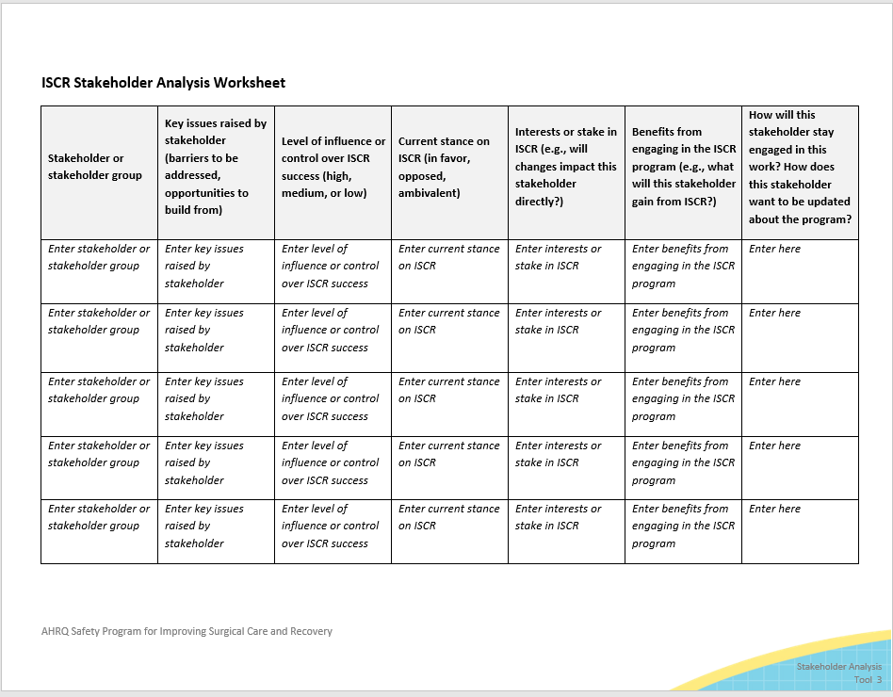
The Stakeholder Analysis Worksheet
The Stakeholder Analysis Worksheet is in the Toolkit on the AHRQ ISCR website.

Slide 10
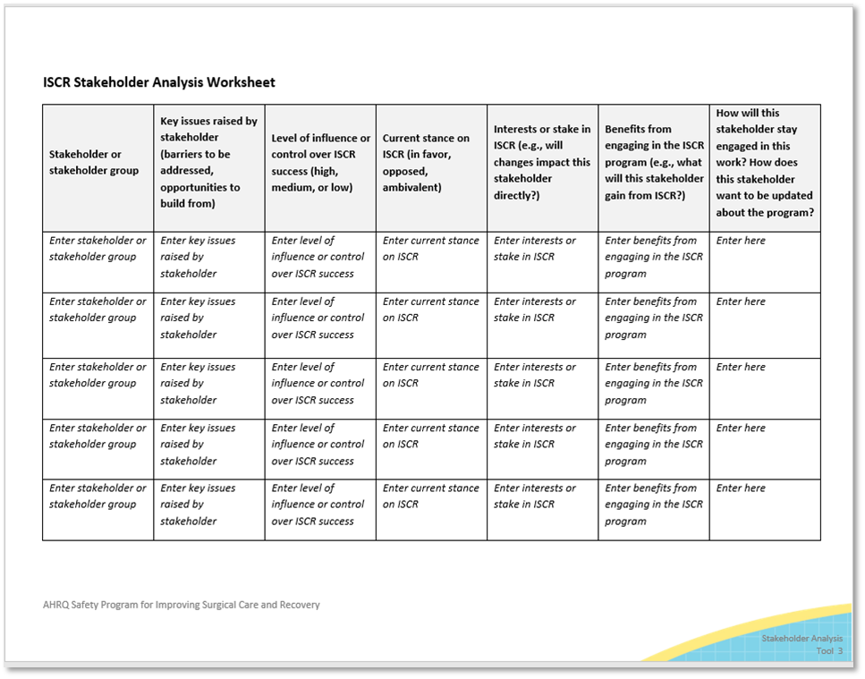
Questions To Consider
How much will this work impact this stakeholder?
How much influence does this stakeholder have in the success of this work?
What matters to this stakeholder?
How might this stakeholder contribute to this work?
How might this stakeholder block this work?

Slide 11
Additional Considerations
Remember, there are both internal and external stakeholders.
Finally, remember that one of the information columns when conducting the stakeholder analysis is how to keep this stakeholder engaged.

Slide 12
Available Resources
Next, check out the resources on creating a vision (PowerPoint presentation and facilitator guide) and an elevator pitch to engage your stakeholders.

Slide 13
Thank You!
Please contact [enter point of contact name, email address, and telephone number] with questions.

