Slide 1
AHRQ Safety Program for Improving Surgical Care and Recovery
Engaging Stakeholders
Developing a Vision for Your Improving Surgical Care and Recovery Program
AHRQ Pub. No. 23-0052
June 2023

Slide 2
Multidisciplinary Approach
Visit AHRQ’s Comprehensive Unit-Based Safety Program (CUSP) website to learn more about the CUSP method.

Slide 3
What Can We Learn From Bill Gates?
“ … A computer running Microsoft software on every desk, and in every home..."
Bill Gates, 1980
Set a clear, bold vision statement for the future, even if it seems impossible today.

Slide 4
Vision Statements
A vision statement provides a clear picture of what we want for the future of healthcare.
A vision is not a plan.

Slide 5
Imagine…
…surgical care where we eliminate confusion, rework, waste, and harm.
…surgical care on the unit where nurses spend more time with patients.
…surgical care where patients are discharged from the hospital opiate-free or near opiate-free.
…surgical care where quality is improved, costs are lowered, patient experience is improved, and staff work/life experience is improved.
…where we build teams to foster resilience in how we work together.
……surgical care for our elderly patients where frailty is not a barrier to recovery and a goal is building strength.
Engaging Stakeholders 5

Slide 6
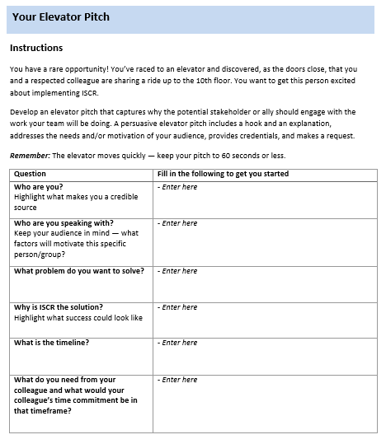
Developing an Elevator Pitch
Once you create your vision for this work, use the Developing an Elevator Pitch tool to effectively and concisely communicate that vision to your stakeholders.
The Developing an Elevator Pitch tool can be found in the Toolkit on the ISCR Program website.
Engaging Stakeholders 6

Slide 7
Follow Up With a Commitment
May I attend your department meeting next week to share some of how and what we are going to do to achieve this?
May I email you the most recent technical review and ask you to give us some feedback?
Would you come to the floor and visit some of our Improving Surgical Care and Recovery patients postoperatively with me next week for 30 minutes?
Engaging Stakeholders 7

Slide 8
ISCR as a Framework for Improvement
Define clear protocols
Develop reliable implementation
Connect for seamless care
Communicate expectations to continually improve the experience of the patient and the clinicians caring for our surgical patients
Engaging Stakeholders 8

Slide 9
Thank You!
Please contact [enter point of contact name, email address, and telephone number] with questions.
Disclaimer: The mention of manufacturer or brand names in this presentation is for illustration purposes only and does not imply endorsement by the Agency for Healthcare Research and Quality or U.S. Department of Health and Human Services.
Engaging Stakeholders 9

