Slide 1
AHRQ Safety Program for Improving Surgical Care and Recovery
Program Overview
AHRQ Pub. No. 23-0052
June 2023

Slide 2

Introduction
What is The Agency for Healthcare Research and Quality Safety Program for Improving Surgical Care and Recovery (ISCR)?

Slide 3

A Balanced Approach is Key to Success
  Adaptive
  CUSP method to improve buy in, teamwork, and change management
Technical
Clinical elements to reduce surgical site infections (SSI), venous thromboembolism (VTE), and urinary tract infections (UTI)

Slide 4
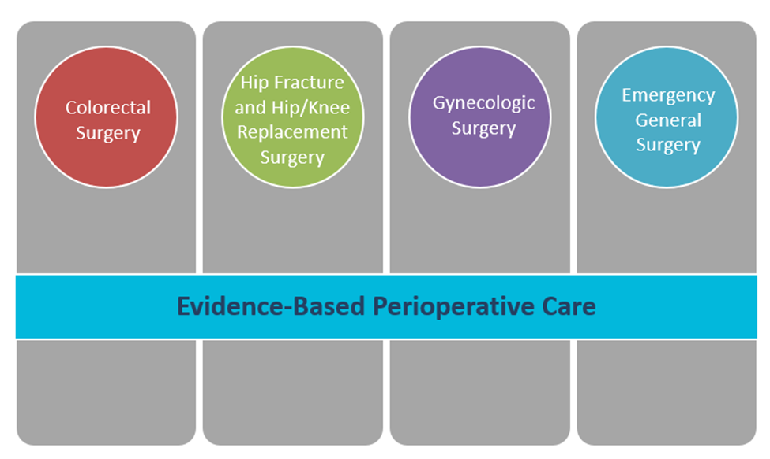
Why Use the AHRQ Safety Program for Improving Surgical Care and Recovery?
Hip Fracture
and Hip/Knee Replacement Surgery
Emergency General Surgery
Colorectal Surgery
Gynecologic Surgery

Slide 5
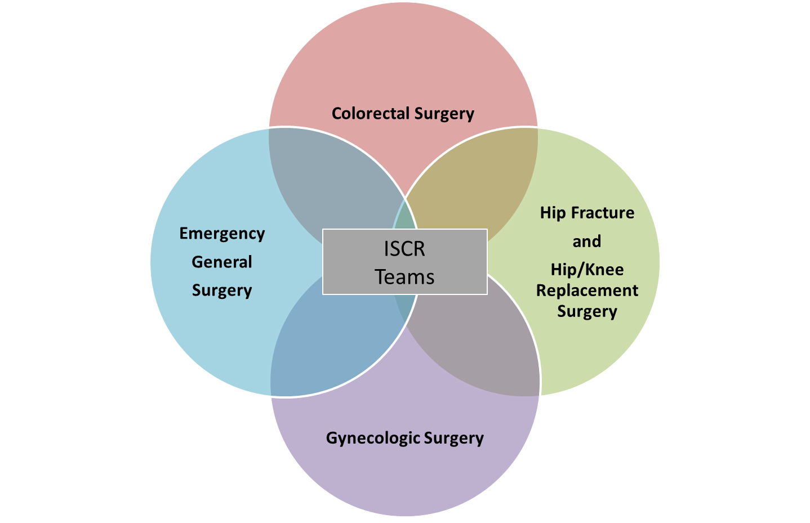
Who Should Use This Toolkit?
Perioperative staff
Surgical quality improvement specialists
Hospital leaders

Slide 6
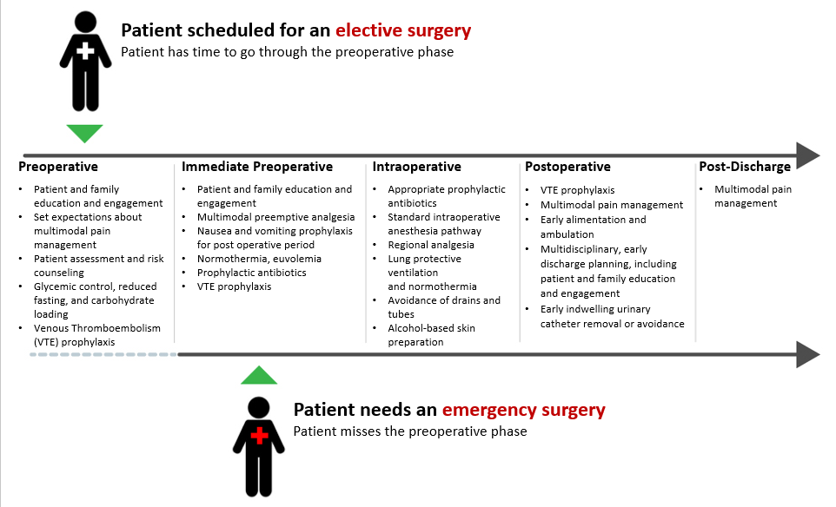
The AHRQ Safety Program for ISCR Pathway Roadmap

Slide 7
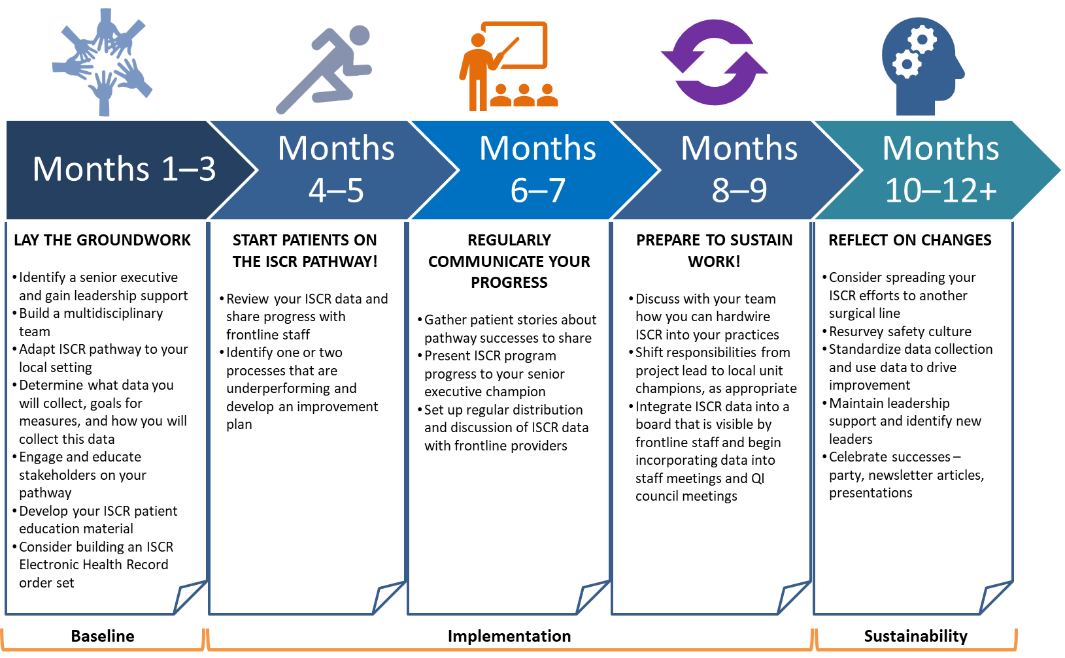
The ISCR Implementation Phaseline

Slide 8
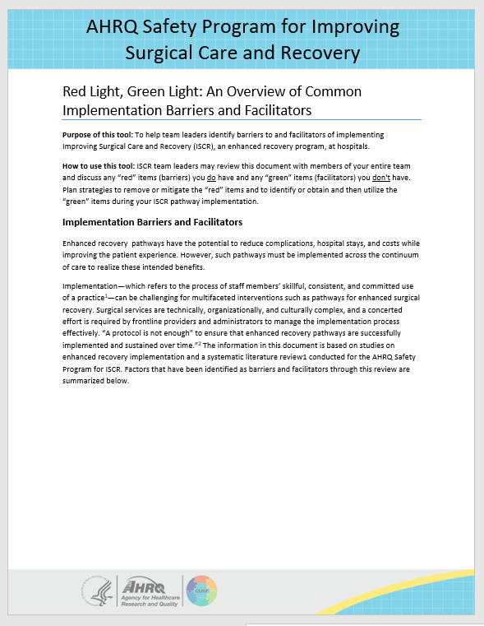
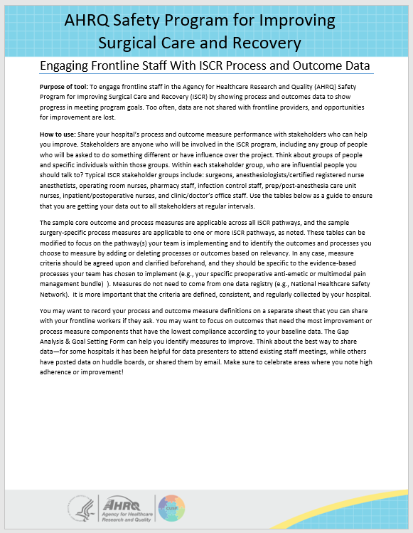
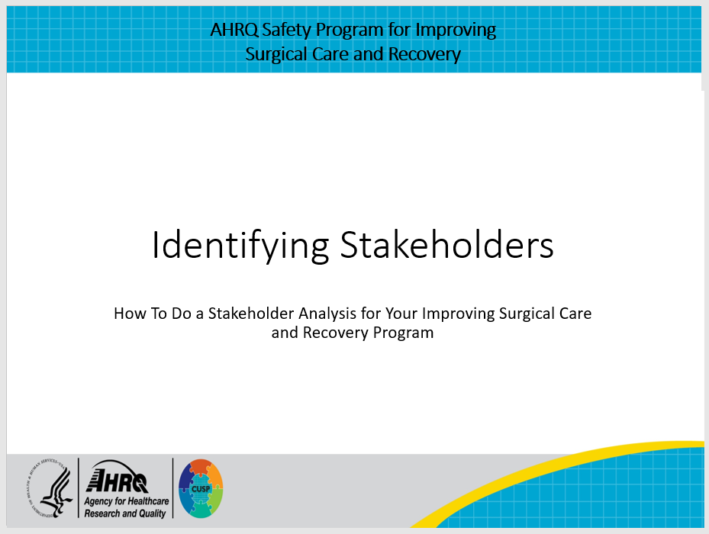
How To Use This Toolkit and What Is Included
Choosing a Service Line
Implementing an ISCR Pathway
Measuring the Impact of Your Pathway
Sustaining and Spreading

Slide 9
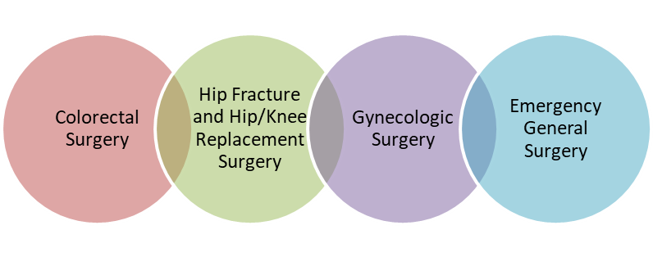
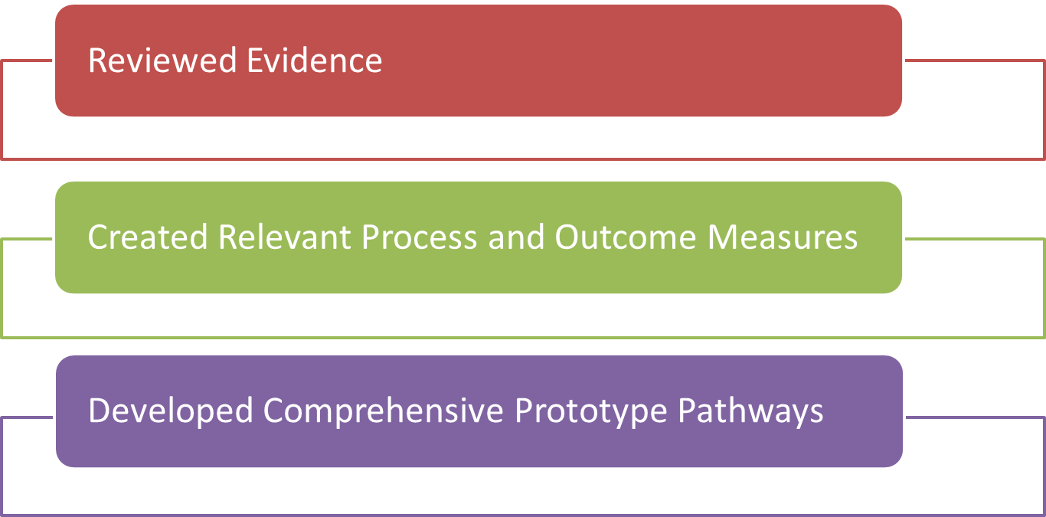
Toolkit and Pathway Development

Slide 10
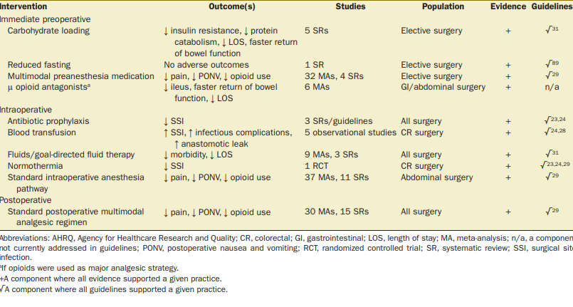
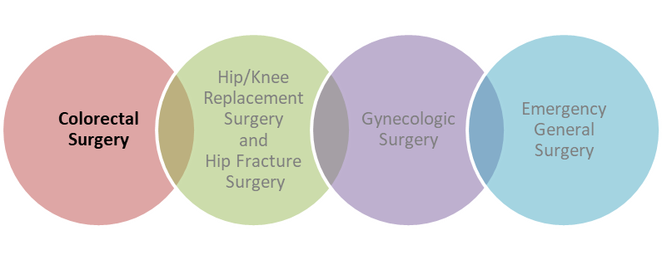
Evidence Reviews: Colorectal Surgery Snapshot
Immediate preoperative components resulted in:
  Faster return of bowel function, ↓ ileus, ↓ length of stay (LOS), ↓ opioid use, ↓ pain, ↓ postoperative nausea and vomiting (PONV)
Intraoperative components resulted in:
  Decreased LOS, ↓ morbidity, ↓ opioid use, ↓ pain, ↓ PONV, ↓ SSI
Postoperative components resulted in:
  Decreased pain, ↓ PONV, ↓ opioid use
Ban et al. J Am Coll Surg. 2017; Ban et al. Anesth Analg. 2019

Slide 11
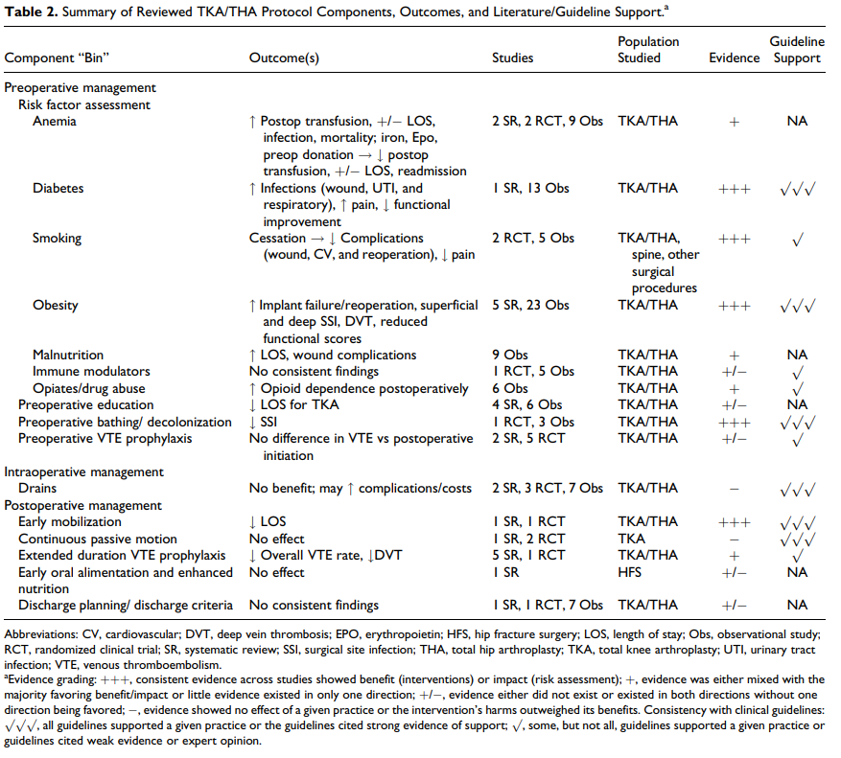
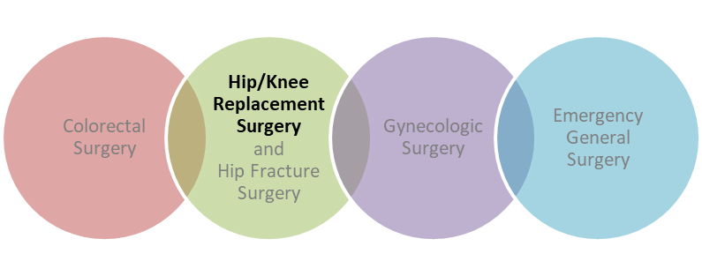
Evidence Reviews: Hip/Knee Replacement
Surgery Snapshot
Preoperative components resulted in:
  Decreased complications, ↓ LOS, ↓ pain, ↓ SSI
Postoperative components resulted in:
  Decreased LOS, ↓ VTE rate, ↓ deep vein thrombosis
Childers et al. Geriatr Orthop Surg Rehabil. 2018; Soffin et al. Anesth Analg. 2019

Slide 12
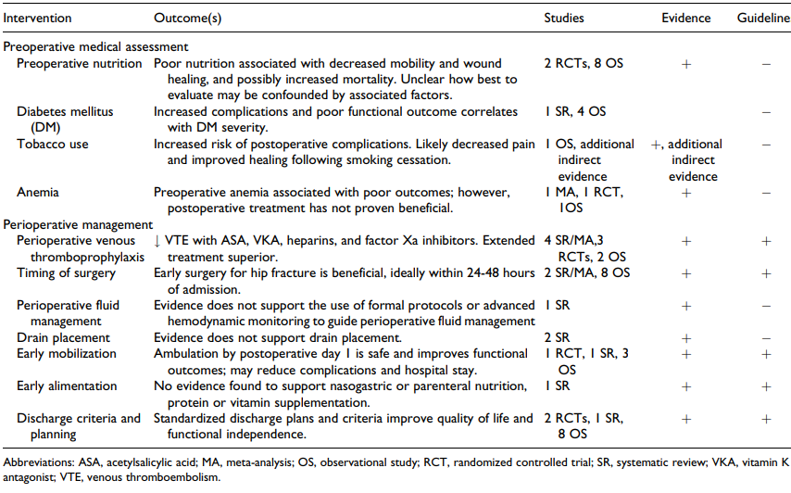
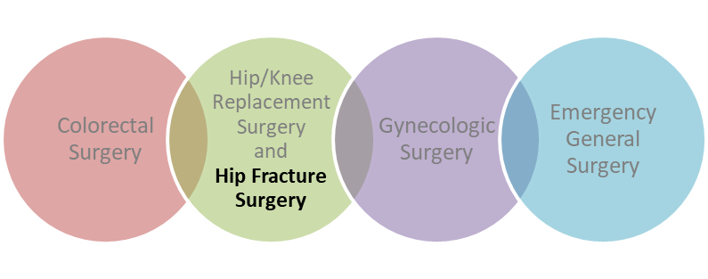
Evidence Reviews: Hip Fracture Surgery Snapshot
Preoperative components resulted in:
  Likely ↓ pain and improve healing (medical assessment and counseling on smoking cessation, weight loss, etc.)
Perioperative components resulted in:
  Early surgery (within 24–48 hours of admission) beneficial
  Resulted in ↓ VTE, improved functional outcomes, quality of life, and functional independence
  May ↓ complications and ↓ LOS
Siletz A et al. Geriatr Orthop Surg Rehabil. 2018; Soffin et al. Anesth Analg. 2019

Slide 13
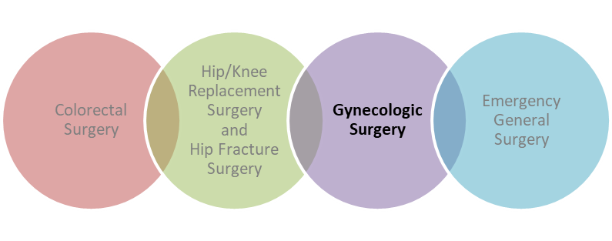
Evidence Reviews: Gynecologic Surgery Snapshot
Immediate preoperative components resulted in:
  Faster return of bowel function, ↓ LOS
  Decreased pain, ↓ PONV, ↓ opioid use
Intraoperative components resulted in:
  Decreased pain, ↓ PONV, ↓ opioid use
  Decreased pulmonary complications
  Decreased morbidity, ↓ LOS
Postoperative component resulted in:
  Decreased pain, ↓ PONV, ↓ opioid use
Kalogera et al. Am J Obstet Gynecol. 2018; Grant MC et al. Reg Anesth Pain Med. 2019

Slide 14
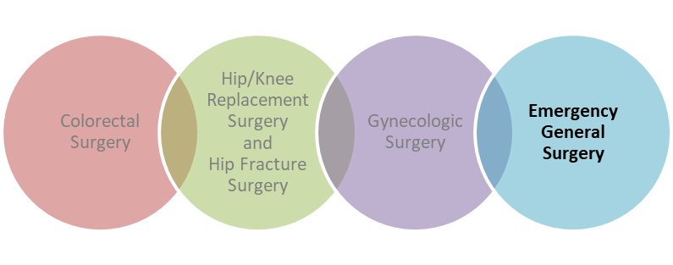
Evidence Reviews: Appendectomy Snapshot
Immediate preoperative components resulted in:
  Decreased infectious complications, ↓ postoperative morbidity
Intraoperative component (Laparoscopic surgical technique) resulted in:
  Decreased SSI, ↓ postoperative pain, ↓ LOS
Postoperative components resulted in:
  Decreased infectious complications; may ↑ gastrointestinal function and ↓ LOS
Hornor MA et al. J Am Coll Surg. 2018.

Slide 15
Final Thoughts
The ISCR program integrates both technical and adaptive methodologies into a holistic, team-focused approach to improve patient outcomes
The toolkit includes step-by-step instructions and turnkey materials to implement colorectal surgery, hip fracture surgery, hip/knee replacement surgery, gynecologic surgery, and emergency general surgery ISCR pathways
This toolkit can be used by perioperative staff, surgical quality improvement specialists, and hospital leadership
Every tool is intended to be adapted to suit each hospital
Tools to support implementation are available in the Toolkit for Improving Surgical Care and Recovery, and all materials are publicly available and downloadable online
The toolkit is available at https://www.ahrq.gov/hai/tools/enhanced-recovery/index.html

Slide 16
Thank You!
Please contact [enter point of contact name, email address, and telephone number] with questions.

Slide 17
References
Ban KA, Gibbons MM, Ko CY, et al. Surgical technical evidence review for colorectal surgery conducted for the AHRQ Safety Program for Improving Surgical Care and Recovery. J Am Coll Surg. 2017 Oct;225(4):548-557.e3. doi: 10.1016/j.jamcollsurg.2017.06.017. Epub 2017 Aug 7. PMID: 28797562; PMCID: PMC9275829. http://dx.doi.org/10.1016/j.jamcollsurg.2017.06.017.
Ban KA, Gibbons MM, Ko CY, et al. Evidence Review Conducted for the Agency for Healthcare Research and Quality Safety Program for Improving Surgical Care and Recovery: Focus on Anesthesiology for Colorectal Surgery. Anesth Analg. 2019;128(5):879-889. doi:10.1213/ANE.0000000000003366.
Childers CP, Siletz AE, Singer ES, et al. Surgical Technical Evidence Review for Elective Total Joint Replacement Conducted for the AHRQ Safety Program for Improving Surgical Care and Recovery. Geriatr Orthop Surg Rehabil. 2018. doi:10.1177/2151458518754451.
Grant MC, Gibbons MM, Ko CY, et al. Evidence Review Conducted for the AHRQ Safety Program for Improving Surgical Care and Recovery: Focus on Anesthesiology for Gynecologic Surgery. Reg Anesth Pain Med. 2019. doi:10.1136/rapm-2018-100071.
Hornor MA, Liu JY, Hu QL, Ko CY, Wick E, Maggard-Gibbons M. Surgical Technical Evidence Review for Acute Appendectomy Conducted for the Agency for Healthcare Research and Quality Safety Program for Improving Surgical Care and Recovery. J Am Coll Surg. 2018;227(6):605-617.e2. doi:10.1016/j.jamcollsurg.2018.09.024.
Kalogera E, Nelson G, Liu J, et al. Surgical technical evidence review for gynecologic surgery conducted for the Agency for Healthcare Research and Quality Safety Program for Improving Surgical Care and Recovery. Am J Obstet Gynecol. 2018 Dec;219(6):563.e1-563.e19. doi: 10.1016/j.ajog.2018.07.014. Epub 2018 Jul 19. PMID: 30031749. https://doi.org/10.1016/j.ajog.2018.07.014.
Notes:
This slide lists references for the evidence reviews mentioned in this presentation.

Slide 18
References
Siletz A, Childers CP, Faltermeier C, et al. Surgical Technical Evidence Review of Hip Fracture Surgery Conducted for the AHRQ Safety Program for Improving Surgical Care and Recovery. Geriatr Orthop Surg Rehabil. 2018. doi:10.1177/2151459318769215.
Soffin EM, Gibbons MM, Ko CY, et al. Evidence review conducted for the Agency for Healthcare Research and Quality Safety Program for Improving Surgical Care and Recovery: focus on anesthesiology for total knee arthroplasty. Anesth Analg. 2019 Mar;128(3):441-453. doi: 10.1213/ANE.0000000000003564. PMID: 29889710. https://doi.org/10.1213/ANE.0000000000003564.
Soffin EM, Gibbons MM, Ko CY, et al. Evidence review conducted for the Agency for Healthcare Research and Quality Safety Program for Improving Surgical Care and Recovery: focus on anesthesiology for total hip arthroplasty. Anesth Analg. 2019 Mar;128(3):454-465. doi: 10.1213/ANE.0000000000003663. PMID: 30044289. https://doi.org/10.1213/ANE.0000000000003663.
Soffin EM, Gibbons MM, Wick EC, et al. Evidence review conducted for the Agency for Healthcare Research and Quality Safety Program for Improving Surgical Care and Recovery: focus on anesthesiology for hip fracture surgery. Anesth Analg. 2019 Jun;128(6):1107-1117. doi: 10.1213/ANE.0000000000003925. PMID: 31094775. https://doi.org/10.1213/ANE.0000000000003925.
Notes:
This slide lists references for the evidence reviews mentioned in this presentation.

