Slide 1
Regional Analgesia for
Total Hip Arthroplasty and Total Knee Arthroplasty
AHRQ Safety Program for Improving
Surgical Care and Recovery
AHRQ Pub. No. 23-0052
June 2023

Slide 2

Why Use Regional Analgesia?
Regional analgesia
  Optimize pain control
  Reduce reliance upon opioids
  Ideal for orthopedic procedures
  Appropriate for elective or nonelective procedures

Slide 3
Types of Regional Techniques
Neuraxial nerve blocks
    Epidural
    Spinal/intrathecal
Peripheral nerve blocks
    Femoral distribution: femoral, adductor canal, lumbar plexus blocks
    Sciatic distribution: sciatic, popliteal blocks

Slide 4

What Block To Use? (Part 1)
The type of block to use may depend on—
  Match of the anatomical nerve distribution of the block to the surgical site
  Side effect profile from each block
  Local expertise and resources

Slide 5
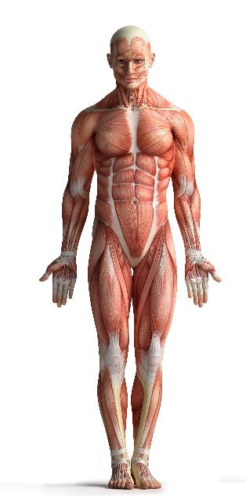
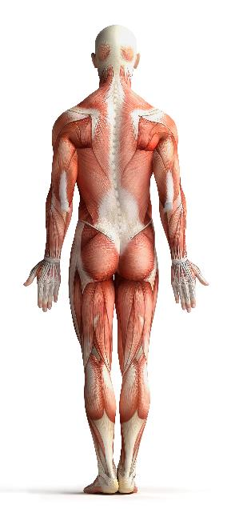
  What Block To Use? (Part 2)
Match the anatomical distribution of the block to the surgical site
  Hip (total hip arthroplasty [THA]) – femoral nerve distribution
  Knee (total knee arthroplasty [TKA]) – need both sciatic and femoral nerve distributions
Neuraxial (epidural/spinal) block: will cover both THA and TKA
Sciatic nerve block: sciatic nerve distribution
Femoral nerve block: lumbar plexus, femoral nerve distribution, adductor canal

Slide 6

Side Effect Profile
Side effects typically related to drug used
  Local anesthetic: hypotension, motor block
  Opioid: nausea/vomiting, itching, (rarely) respiratory depression
  Side effects dependent on location of block
Neuraxial blocks: decrease in blood pressure, motor block
Peripheral nerve block: technically may be more difficult to perform

Slide 7
Local Expertise and Resources
Not every clinician will be comfortable doing all of the regional techniques listed in the pathways
Not every institution will have the resources to allow every regional technique (e.g., regional catheters, intrathecal opioids)
Tailor the choice to your local expertise and available resources

Slide 8

Anticoagulation
THA/TKA are at high risk for deep vein thrombosis (DVT)/pulmonary embolism (PE)
  Should expect perioperative anticoagulation
Concurrent administration of anticoagulation and regional analgesia should be used with caution
Different anticoagulants have different risk profiles
Access the American Society of Regional Anesthesia and Pain Medicine Guidelines: https://www.asra.com/guidelines-articles/guidelines

Slide 9
Final Thoughts
Regional techniques are recommended for THA/TKA
What type of regional techniques will depend on the site of surgery, side effect profile, and local expertise/resources
Additional agents are available and described in detail in the various evidence reviews conducted for the AHRQ Safety Program for Improving Surgical Care and Recovery, listed on slide 11
Tools to support implementation are available in the Toolkit for Improving Surgical Care and Recovery

Slide 10
Thank You!
Please contact [enter point of contact name, email address, and telephone number] with questions.

Slide 11
References
Soffin EM, Gibbons MM, Wick EC, et al. Evidence review conducted for the Agency for Healthcare Research and Quality Safety Program for Improving Surgical Care and Recovery: focus on anesthesiology for hip fracture surgery. Anesth Analg. 2019 Jun;128(6):1107-17. doi: 10.1213/ANE.0000000000003925. PMID: 31094775.
Memtsoudis SG, Cozowicz C, Bekeris J, et al. Peripheral nerve block anesthesia/analgesia for patients undergoing primary hip and knee arthroplasty: recommendations from the International Consensus on Anesthesia-Related Outcomes after Surgery (ICAROS) group based on a systematic review and meta-analysis of current literature. Reg Anesth Pain Med. 2021 Nov;46(11):971-85. doi: 10.1136/rapm-2021-102750. Epub 2021 Aug 25. PMID: 34433647.
Soffin EM, Gibbons MM, Ko CY, et al. Evidence review conducted for the Agency for Healthcare Research and Quality Safety Program for Improving Surgical Care and Recovery: focus on anesthesiology for total hip arthroplasty. Anesth Analg. 2019 Mar;128(3):454-65. doi: 10.1213/ANE.0000000000003663. PMID: 30044289.
Soffin EM, Gibbons MM, Ko CY, et al. Evidence review conducted for the Agency for Healthcare Research and Quality Safety Program for Improving Surgical Care and Recovery: focus on anesthesiology for total knee arthroplasty. Anesth Analg. 2019 Mar;128(3):441-53. doi: 10.1213/ANE.0000000000003564. PMID: 29889710.

