Slide 1

National Center for Excellence in Primary Care

Slide 2
National Center for Excellence in Primary Care Research
Presents
Approaches to Address Health Risks for Older Adults
January 16, 2025
Presented by:
Lisa Kern, MD, MPH
Alberta K. Tran, Ph.D., RN, CCRN
Yu-Jung Wei, PhD
Moderated by:
Arlene Bierman, MD, MS, AHRQ

Slide 3
Disclaimer
The views expressed in this webinar do not represent official views of the U.S. Department of Health and Human Services or the Agency for Healthcare Research and Quality.

Slide 4

Welcome
Aimee R. Eden, PhD, MPH
Director, National Center for Excellence in Primary Care Research (NCEPCR), AHRQ

Slide 5
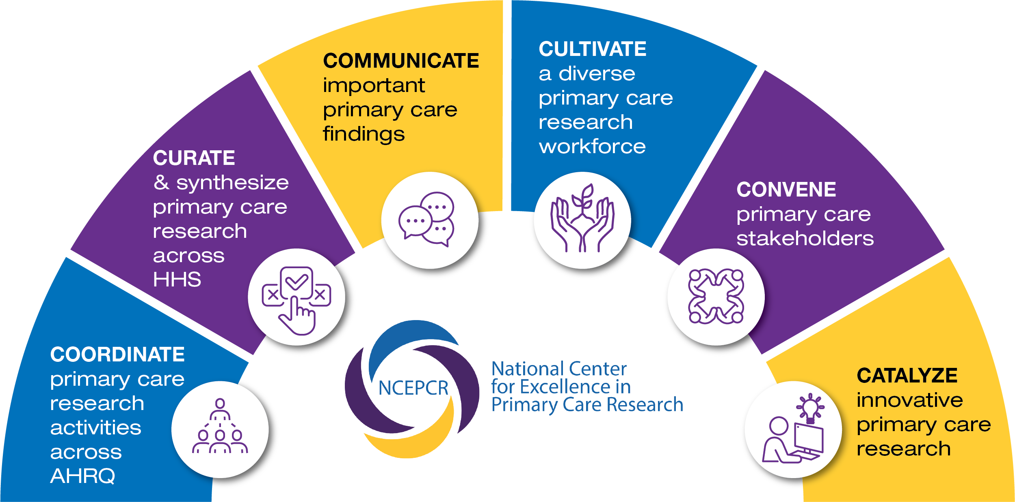


NCEPCR’s Activities

Slide 6
Special Emphasis Notice
Research to Improve Care Delivery, Access, Quality, Equity, and Health Outcomes for Older Adults
  Research that will address questions related to the development, implementation, evaluation, and scale of person-centered models of care to optimize physical and mental health, functional status, and well-being among older adults.
  https://grants.nih.gov/grants/guide/notice-files/NOT-HS-24-013.html

Slide 7
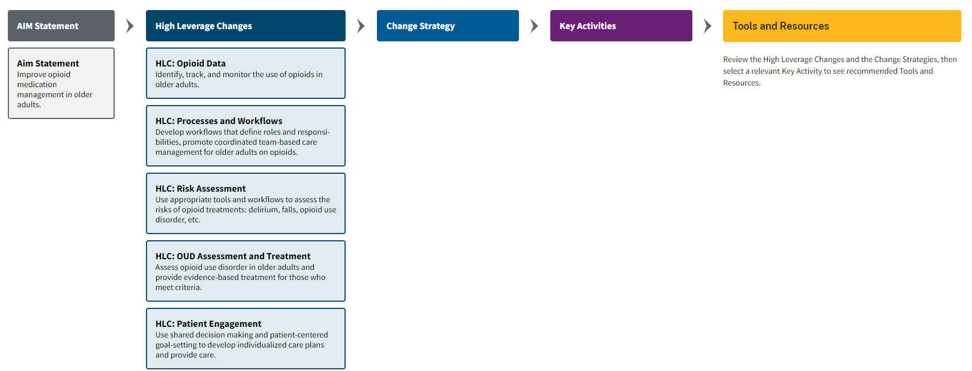
Opioids in Older Adults Compendium
Notes:
Opioids in Older Adults Compendium | Agency for Healthcare Research and Quality
The purpose of this change package, known as the Compendium, is to support efforts by primary care practices and healthcare systems to improve opioid medication management and prevent opioid misuse and opioid use disorder in older adults in primary care. The Compendium offers key activities with tools and resources that practices and systems can use in their improvement efforts.
Some items in the compendium include links to commercial sites, and inclusion of these items does not imply endorsement of any commercial websites by AHRQ, HHS, or the federal government.

Slide 8
Request for Information Regarding the Impact of Ageism in Healthcare
Definition
  Ageism: stereotypes, prejudice, and discrimination directed towards other people or oneself based on age.
Information Sought
  What is the impact of ageism in healthcare?
  What methods and strategies can address/mitigate ageism in healthcare delivery?
Comments must be submitted on or before March 15, 2025
https://www.federalregister.gov/documents/2024/12/27/2024-31074/request-for-information-regarding-the-impact-of-ageism-in-healthcare

Slide 9
Today’s Webinar Objectives
Objective 1: To learn about the comparative effectiveness of two approaches for assigning care coordinators to patients: 1) to patients who are aware they need better coordination and 2) to patients post-hospitalization.
Objective 2: To learn the state of the science around the diagnostic process in older adults, including unique challenges and recommendations for practice improvement, research, and policy to reduce the risk of diagnostic error.
Objective 3: To learn about the associations of pain with risk for OUD/OD outcomes in older adults with prescribed opioids.

Slide 10

Moderator
Arlene Bierman, MD, MS
Chief Strategy Officer,
AHRQ

Slide 11
Today’s Webinar Presenters
Lisa Kern, MD, MPH (Weill Medical College of Cornell University) Care Fragmentation, Care Continuity, and Care Coordination: How They Differ and Why It Matters for Older Adults
Alberta K. Tran, Ph.D., RN, CCRN (MedStar Institute for Quality and Safety) State of the Science and Future Directions To Improve Diagnostic Safety in Older Adults
Yu-Jung Wei, PhD (Ohio State University) Pain, Multimorbidity, Opioid-Drug Interactions and Risk for Opioid Use Disorder or Overdose in Older Adults

Slide 12

Presentation 1
Care Fragmentation, Care Continuity, and Care Coordination:
How They Differ and Why It Matters for Older Adults
Lisa Kern, MD, MPH
Weill Medical College of Cornell University

Slide 13
Case (hypothetical but typical)
65-year-old woman with diabetes and coronary artery disease comes to establish care with me, as her primary care physician.
She says she is switching primary care physicians because she recently retired and lost her employer-based insurance; she now has Medicare.
Her cardiologist, who is in a different health system with a different electronic health record, recently started new medication, drew blood, and did an echo, but the patient does not have the details.
The patient also has an endocrinologist and ophthalmologist, who are in separate outside practices.
And the patient went to urgent care last night for foot pain.

Slide 14
Outline
Explain why fragmentation of care for older adults warrants more attention
  Define fragmentation and distinguish it from care continuity and care coordination
  Illustrate how a focus on fragmentation can lead to novel ideas for interventions that would not necessarily be identified through the lenses of continuity or coordination
Highlight key features of an ongoing AHRQ-funded trial that leverages these distinctions

Slide 15


Continuity
Care continuity = the use of the same ambulatory physician repeatedly over time, such that the usual physician (who can be a primary care or specialist physician) accounts for a substantial proportion of visits

Slide 16

Coordination
Care coordination = the extent to which physicians are collectively operating in a team-like manner to develop and implement an overall care plan to meet the patient’s goals
We agree
We agree
We agree
Primary care physician
Specialist
Patient

Slide 17
Two Problems
Continuity and coordination have been topics of discussion for decades, but:
Evaluations of previous care coordination interventions have shown that many of them have not been effective.
This may be because efforts to promote continuity and coordination have typically focused on a small number of providers, potentially omitting many others who may be involved.

Slide 18
Ambulatory Utilization in the U.S.
Landmark papers by Pham et al. in the NEJM in 2007 and in Annals of Intern Med in 2009 found that in the years 2000-2002:
  The median Medicare beneficiary saw 7 ambulatory physicians each year (interquartile range [IQR] 4, 11).
  Because different beneficiaries see different specialists (i.e., Mr. Jones and Mr. Brown may see different cardiologists), the typical primary care physician has 229 (IQR 125, 340) other physicians with whom care must be coordinated, equivalent to an additional 99 physicians for every 100 Medicare beneficiaries managed by the primary care physician.
Barnett et al. found that this problem has gotten worse over time (Ann Intern Med 2021).
  The proportion of Medicare beneficiaries seeing 5 or more physicians annually increased from 19.1% in 2000 to 35.1% in 2019.

Slide 19
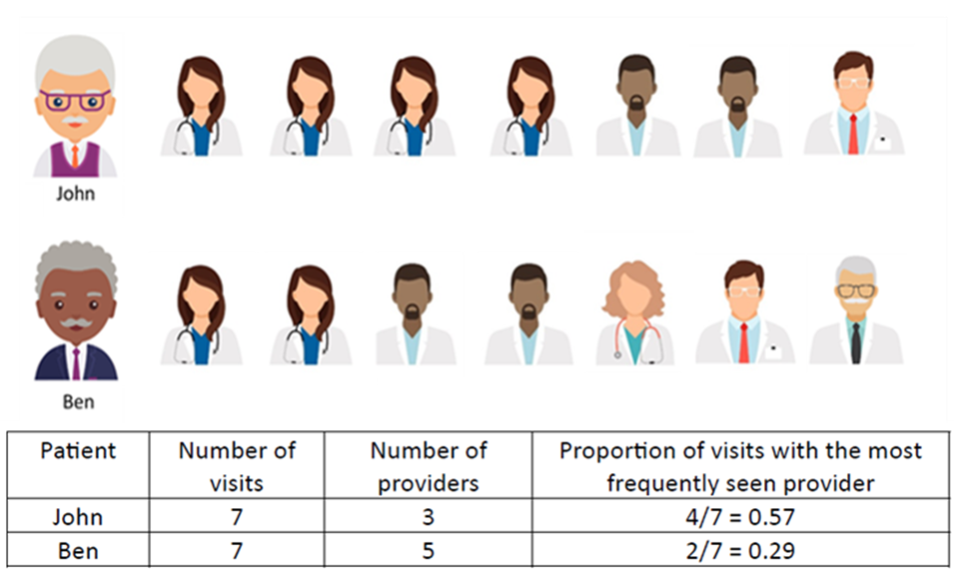
Fragmentation
Care fragmentation = ambulatory care that is diffusely spread across many providers such that no single provider accounts for a substantial proportion of visits
Who has more fragmented care?
Ben – and there are millions of Medicare beneficiaries like him (likely ~25% of beneficiaries)!

Slide 20
Concepts
Continuity and fragmentation are measures of utilization.
Coordination is a measure of communication.
Fragmentation may be clinically appropriate, but it creates challenges for physicians and can cause harm without communication.
Even in the era of electronic health records, gaps in communication persist (Timmins, Kern, et al. Ann Fam Med 2022).
  Data from a 2019 survey found that approximately one-third of primary care physicians nationally do not always or most of the time receive information back from a specialist after a consultation.

Slide 21
Previous Work
I have now published >30 articles on fragmentation of care.
Some key findings from this work include:
  There are more than 40 (!) causes of fragmentation, according to patients and primary care physicians.
  There are also at least 24 consequences of fragmentation, with 3 consequences desirable and 21 undesirable, including provider burnout.
  Quantitative studies have found that more fragmentation is independently associated with more radiology tests, more emergency department visits, more hospitalizations, higher costs, and for some subsets of the population more incident heart attacks and strokes.

Slide 22
Need for Novel Interventions
Despite how common it is for patients to see multiple physicians, there have been relatively few studies of fragmentation and few interventions explicitly designed to address it.
Because fragmentation is caused by many factors, no single intervention will fix the problem.
However, a new framework published in JAMA Internal Medicine may guide the development of novel interventions (Kern, Bynum, Pincus. JAMA Intern Med 2024;184(3):236-237).

Slide 23
6P Framework*
Level of action (6P) | Contribution to fragmentation | Potential intervention
Patients (and caregivers) | Assumption that providers are communicating with each other | Patient-facing educational intervention about fragmentation
Providers (physicians and others) | Lack of communication with each other | With financial incentives from payers, improve communication across all providers
Practice settings | Lack of notification when a provider sees a patient with highly fragmented care | Plans can identify patients with highly fragmented care in real time and work with patients and physicians to address it
Plans (public and private payers) | Undervalue cognitive work of communication among providers | Increase compensation for cognitive work of coordinating care across all providers
Purchasers (employers) | Lack of identification of fragmentation as an opportunity for improvement | Put pressure on public and private payers to hold them accountable for addressing fragmentation
Populations (communities) | Lack of consistent communication between primary care and urgent care | Improve communication between primary care and urgent care centers
*This table, adapted from our JAMA IM 2024 paper, is not comprehensive; it is illustrative. Also, a cause at one level of action could lead to an intervention at another level.

Slide 24
6P Framework*
Level of action (6P) | Contribution to fragmentation | Potential intervention
Patients (and caregivers) | Assumption that providers are communicating with each other | Patient-facing educational intervention about fragmentation
Providers (physicians and others) | Lack of communication with each other | With financial incentives from payers, improve communication across all providers
Practice settings | Lack of notification when a provider sees a patient with highly fragmented care | Plans can identify patients with highly fragmented care in real time and work with patients and physicians to address it
Plans (public and private payers) | Undervalue cognitive work of communication among providers | Increase compensation for cognitive work
Purchasers (employers) | Lack of identification of fragmentation as an opportunity for improvement | Put pressure on public and private payers to hold them accountable for addressing fragmentation
Populations (communities) | Lack of consistent communication between primary care and urgent care | Improve communication between primary care and urgent care centers
*Current trial is one of many versions of this.

Slide 25
Key Features of Current Trial (Improving How Older Adults at Risk for CVD Are Selected for Care Coordination)
Set inside a Medicare accountable care organization (ACO), which has financial incentives from Medicare to improve care coordination.
Targets people with or at risk for cardiovascular disease (as that population often sees multiple specialists of different types)
Uses highly fragmented care (measured in claims) as an inclusion criterion – the first of two trials to do so (the other is also mine)
Proactively asks patients if they think their care is well coordinated (which has not previously been used as actionable information)
Offers the assistance of care managers (who are already employed by the ACO) to address any perceived gaps in communication
Results are not yet available

Slide 26
Discussion
There is no consensus yet on whether interventions should decrease fragmentation or ameliorate its potentially harmful effects.
However, the problem of fragmented care requires urgent attention.
Primary care has a huge role to play in the solution, but primary care cannot do this alone, because this is a “systems” problem.
National discussions and health services research are needed to develop, test, and implement new strategies to address fragmentation.

Slide 27
Acknowledgements
Agency for Healthcare Research & Quality (K18HS029255)
National Institute on Aging’s IMPACT Collaboratory (5U54AG063546-05, subaward 00002102)
Julie Bynum, MD, MPH and Harold Pincus, MD
Weill Cornell Medicine and NewYork Quality Care

Slide 28

Presentation 2
State of the Science and Future Directions To Improve Diagnostic Safety in Older Adults
Alberta K. Tran, Ph.D., RN, CCRN MedStar Institute for Quality and Safety

Slide 29

Background
Mis- and delayed diagnoses are estimated to affect at least 1 in 20 U.S. adults (NASEM, 2015)
    Associated with serious preventable harm and death (Gunderson et al., 2020; Newman-Toker et al., 2024)
In primary care, 79% of diagnostic errors are related to the patient-provider encounter (Singh et al., 2013)
Older adult population over age of 65 rapidly increasing
  In the U.S., 55.8 million (16.8% of population) in 2020
  Projected to nearly double by 2060
Older adults are a high risk of diagnostic errors

Slide 30

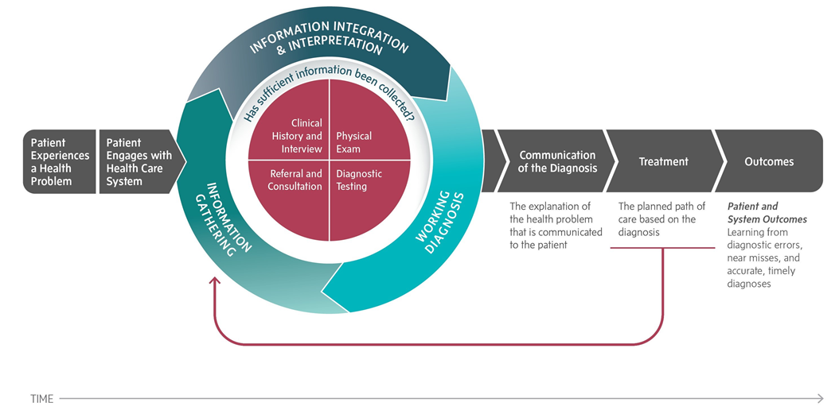
Diagnostic error definitions
- Delayed diagnosis
- Missed or wrong diagnosis
- Diagnosis not communicated
“…the failure to establish an accurate and timely explanation of the patient’s health problem(s) or communicate that explanation to the patient”

Slide 31

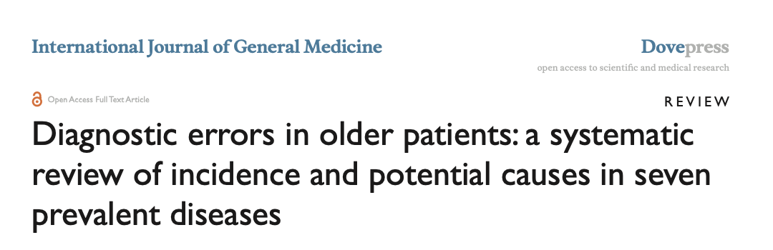
Objective
To summarize existing literature focused on understanding and addressing diagnostic errors in older adult populations
  To identify opportunities for practice improvement, research, and policy to reduce this risk

Slide 32
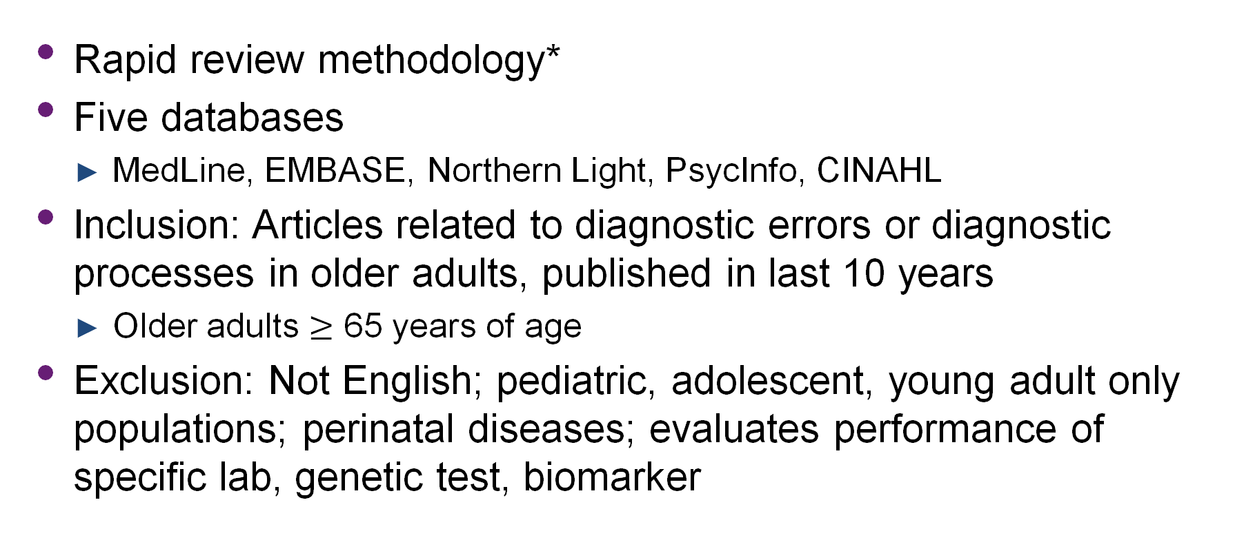
Methods
Rapid review methodology*
Five databases
  MedLine, EMBASE, Northern Light, PsycInfo, CINAHL
Inclusion: Articles related to diagnostic errors or diagnostic processes in older adults, published in last 10 years
  Older adults $≥$ 65 years of age
Exclusion: Not English; pediatric, adolescent, young adult only populations; perinatal diseases; evaluates performance of specific lab, genetic test, biomarker

Slide 33
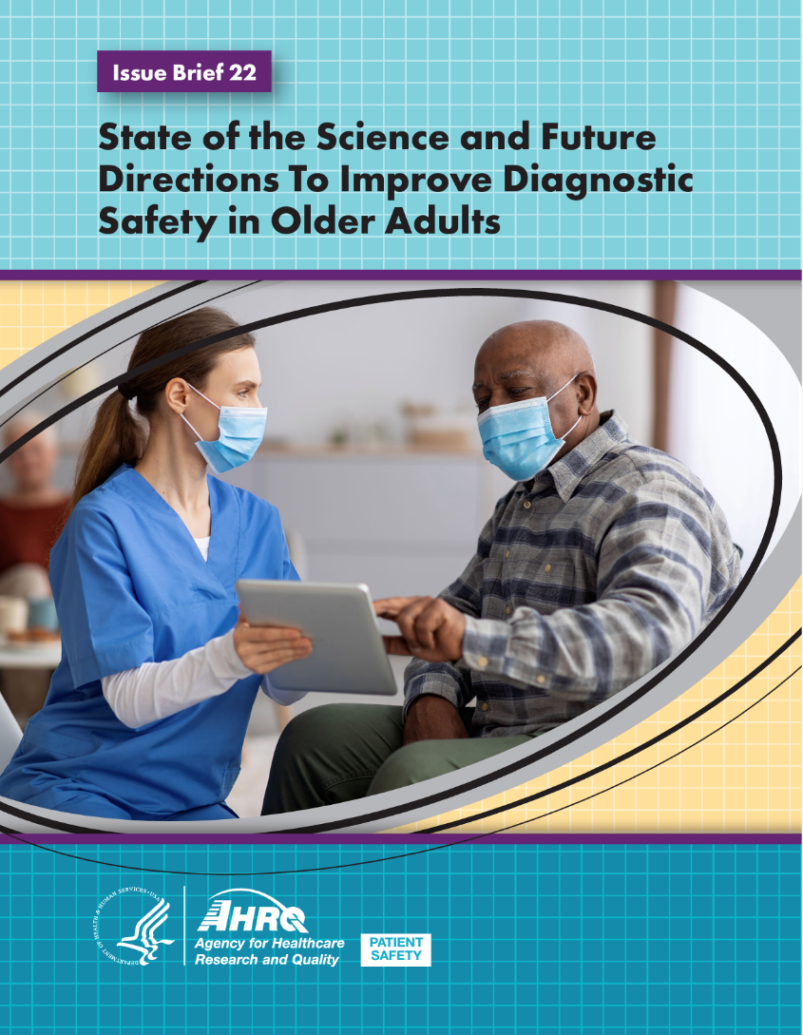
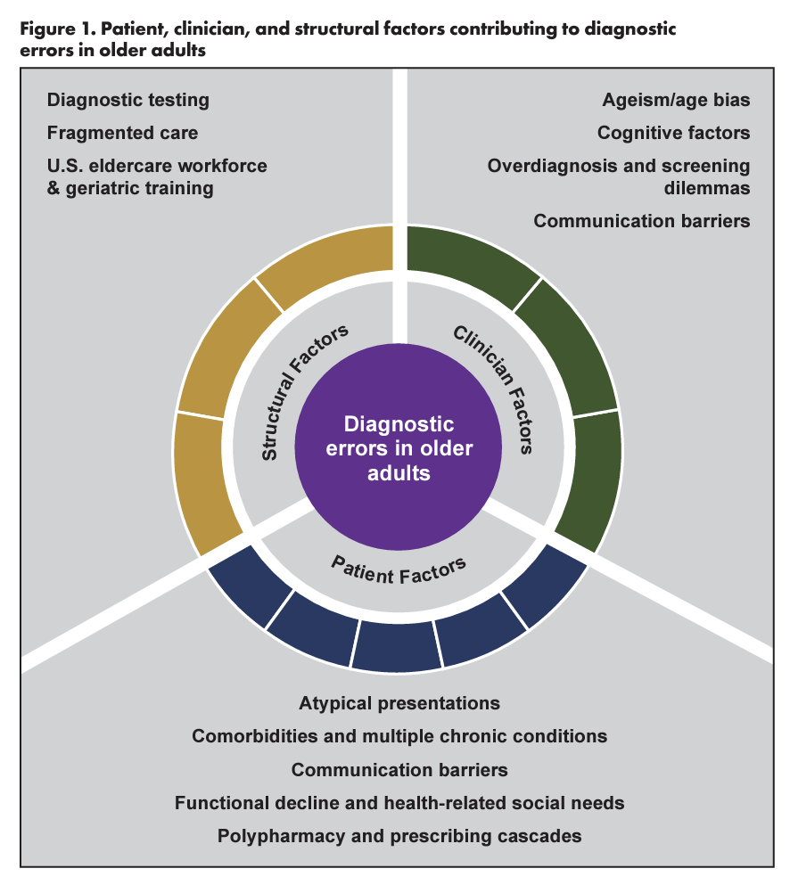
Findings

Slide 34

Findings summary
Patient factors
Clinician factors
Structural factors
  Atypical, non-specific presentations
  Comorbidities and multiple chronic conditions
  Communication barriers
  Functional decline and health-related social needs
  Polypharmacy and prescribing cascades
  Ageism/age biases
  Cognitive factors
  Overdiagnosis and screening dilemmas
  Communication barriers
  Diagnostic testing
  Care fragmentation
  Insufficient workforce and geriatrics training

Slide 35

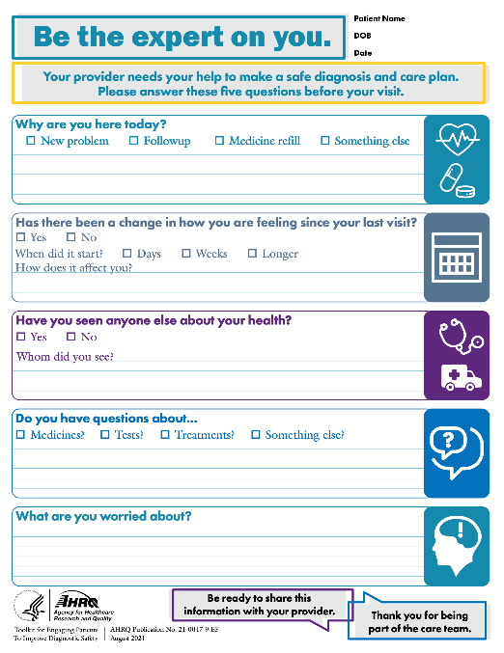
Primary care recommendations
Meaningfully involve other diagnostic team members
  Implement team-based and patient, family, and caregiver communication interventions
  Consider environmental modifications and social needs
  Address care fragmentation
Deploy health IT and other interventions to enhance information sharing and decision-making
  Improve EHR interoperability and integration of medication data
  Design decision-support tools and improve diagnostic processes
Establish practice-level policy and initiatives aimed at improving care for older adults across the diagnostic continuum
  Develop safety surveillance capacity and encourage voluntary reporting of diagnostic errors and near-misses
  Deliver 4Ms of Age-Friendly care
  Expand geriatric education and training efforts to include diagnostic excellence

Slide 36

Presentation 3
Unrelieved Pain and Risk of Opioid Use Disorder or Overdose in Older Adults Prescribed Opioids
Yu-Jung Wei, PhD
Ohio State University

Slide 37
Background
Opioid use disorder (OUD) and overdose (OD) in older adults (≥65 yr)
  OUD prevalence: 16 per 1000 older adults in 2018¹
  OD (fatal & nonfatal) incidence: 1 per 1000 older adults in 2016 ²
  98% of OUD/OD involve prescription opioids³
Increased trends in OUD or OD from 2006-2020
  34% increase in hospitalizations due to OUD/OD, 2010-2015⁴
  74% increase in emergency department visits due to OUD/OD, 2010-2015⁴
  14.2-fold increase in incident diagnosis of OUD/OD, 2006-2016²
  Upward trends continue despite efforts to curb prescription opioids^{1,5}
1 Trends in Opioid Use Disorder Among Older Adults: Analyzing Medicare Data, 2013–2018, Am J Prev Med, 2022
2. Trends in prior receipt of prescription opioid or adjuvant analgesics among patients with incident opioid use disorder or opioid-related overdose from 2006 to 2016. Drug Alcohol Depend, 2019
3. The Substance Abuse and Mental Health Services Administration. Opioid misuse increases among older adults. Accessed August 1, 2021.
4. Opioid-Related Inpatient Stays and Emergency Department Visits Among Patients Aged 65 Years and Older, 2010 and 2015. AHRQ, 2018
5. New AHRQ reports highlight seniors’ struggles with opioids. 2018.

Slide 38
Background
Risk Factors of OUD or OD in Older Adults with Prescribed Opioids
. 2017
Known factors¹
  Mental health disorders (e.g., depression)
  History of substance use disorders
  High-risk obtainment of prescription opioids (e.g., doctor or pharmacy shopping)
  Unsafe prescription opioid use (e.g.,high-dose ≥50 MME/daily, duration >90 days, co-use with benzodiazepines)
Unrelieved pain after prescribed opioids is assumed but not proven
  4 of 5 (85%) older adults engaged in prescription opioid misuse to relieve pain, compared with 66% of their younger counterparts²
  a common pathway to OUD³
1. Opioids in Older Adults: Adverse Event Red Flags. https://www.ahrq.gov/sites/default/files/opioids_compendium/2024-02/opioids-adverse-event-red-flags.pdf. AHRQ, December 2023
2. Prescription opioid use, misuse, and use disorders in U.S. adults: 2015 National Survey on Drug Use and Health. Ann Intern Med, 2017
3. Patient-reported pathways to opioid use disorders and pain-related barriers to treatment engagement. J Subst Abuse Treat, 2017

Slide 39
Specific Research Aim
To examine the associations of pain status with risk of OUD or OD among older adults prescribed opioids
Older Patients (study pop.)
Key exposures
Outcome
Prescription opioids
for chronic pain
Pain status
Uncontrolled pain
High-impact pain
Risk for incident OUD or OD
Note: The figure illustrates the hypothesis that uncontrolled or high-impact pain after prescription opioid use may cause prescription opioid misuse (use without a prescription or for reasons or in ways other than as prescribed), leading to incident diagnosis of OUD or OD.

Slide 40






HRS survey
Methods—Study Source
Health and Retirement Study (HRS), a national longitudinal survey of US community older adults, conducted biennially since 1992 (~17,000 participants /wave)
HRS linked to Medicare claims (19,626 participants), 2006-2021
Medicare claims
Pain status
OUD/OD diagnosis
8-CESD depression
Opioids
Adjuvant analgesics
Physical functioning
Note: The figure illustrates that HRS participants have information on pain status, depression, physical functioning (activities of daily living [ADL] and Instrumental ADL) from surveys and information on OUD/OD diagnosis and use of prescription opioids and adjuvant analgesics from Medicare claims.

Slide 41
Methods— Pain Status
HRS participants responded to pain-related questions
  Are you troubled with pain?
  How bad is the pain most of the time? Mild, moderate, or severe
  Had pain affected any of your daily activities (e.g. household chores)?
Primary pain exposure
  uncontrolled (moderate or severe) pain or controlled ( no or mild) pain
Secondary pain exposure: high-impact pain
  having uncontrolled pain plus the pain affecting daily activities; otherwise, having no high-impact pain

Slide 42
Methods—OUD/OD Outcomes
OD (fatal and non-fatal) ^{1,2}
  Inpatient, outpatient, or ED claim with any of the codes (965.0x, T40.0xx-T40.4xx, T40.601, T40.604, T40,691, T40, 694, E850.0-E850.2)
OUD ^{3,4}
  Inpatient claim with an opioid dependence code (304.0x, 304.7x, F11.2, F11.9), or
  ≥2 outpatient claims with an opioid dependence code*, or
  A claim with opioid misuse code (305.x, F11.x) or opioid dependence code along with an inpatient or ED visit with injection drug use-related infection*, or
  A claim with opioid misuse or opioid dependence along with an inpatient or residential rehabilitation or detoxification care*
* requiring 2 claims within 3 months of each other, with the 1st claim indicating the presence of an OUD event
1. Behavioral Health Services, and Medications for Opioid Use Disorder After a Nonfatal Overdose. JAMA Intern Med 2024.
2. Trajectories of prescription opioid dose and risk of opioid-related adverse events among older Medicare beneficiaries in the United States: A nested case-control study. Plos Med, 2022
3. Comparative Effectiveness of Different Treatment Pathways for Opioid Use Disorder. JAMA Netw Open, 2022
4. Racial Inequality in Receipt of Medications for Opioid Use Disorder. N Engl J Med, 2023

Slide 43
Methods—Study Design Framework
Cohort Entry Date
(1st HRS pain report)
Y0, 2008-2020
Eligibility Window Y(-2, 0] )
Age ≥65 y
Medicare A, B, and D
Chronic pain diagnosis
≥ 1 prescription opioid
No OUD or OD
No treatment for OUD
No substance use disorder
Pain
(Y0)
Pain
(Y2)
Pain
(Y4)
Follow-up Window
Days(0, Censor * )
Other Covariate┼ Assessment Window
HRS-Medicare
Cohort
*OUD or OD event (separate cohort), Medicare disenrollment, death, or study end (12/31/2021)
┼ Time-fixed variables: age, sex, race/ethnicity, region, dual eligibility status, education, year of cohort entry
Time-varying variables: marital status, household income, health indicator (self-rated health status, BMI, ever smoking, ever drinking, ADL, IADL), clinical conditions, pain management (receipt of physical therapy, prescription nonopioids, adjuvant analgesics, opioid duration, and opioid dose), polypharmacy, and use of CNS drugs.
Time

Slide 44
Findings
3,104 older HRS-Medicare participants with chronic pain and≥1 opioid prescription at cohort entry (mean [SD] age=76.2 [7.9] years; female=66.4%)
43.8% of the sample had uncontrolled pain and 33.6% had high-impact pain at cohort entry
Uncontrolled pain and high-impact pain increased from 43.8% to 47.3% and from 33.6% to 36.3% over time during F/U
Mean (SD) length of F/U=6.4 (4.1) years in both the OUD and OD cohorts

Slide 45
Findings—
Uncontrolled (vs Controlled) Pain and OUD/OD Risk
Figure A illustrates probability of remaining OUD event-free was lower in patients with uncontrolled (vs controlled) pain over time.
Figure B illustrates probability of remaining OD event-free was lower in patients with uncontrolled (vs controlled) pain over time.
Adjusted┼ HR = 9.70 (4.56-20.63)
Adjusted┼ HR*= 9.75 (4.48-21.20)
Adjusted┼ HR = 2.46 (1.30-4.66)
Adjusted┼ HR*= 2.68 (1.40-5.13)
┼ Time-fixed variables: age, sex, race/ethnicity, region, dual eligibility status, education, year of cohort entry. Time-varying variables: marital status, household income, health indicator (self-rated health status, BMI, ever smoking, ever drinking, ADL, IADL), clinical conditions, pain management (receipt of physical therapy, prescription nonopioids, adjuvant analgesics, opioid duration, and opioid dose), polypharmacy, and use of CNS drugs.
*Sensitive analysis for adjusting for censoring due to death

Slide 46
Findings—
Having vs Having No High Impact-Pain and OUD/OD Risk
Figure C illustrates probability of remaining OUD event-free was lower in patients with vs without high-impact pain over time.
Figure D illustrates probability of remaining OD event-free was lower in patients with vs without high-impact pain over time.
Adjusted┼ HR = 6.74 (3.76-12.08)
Adjusted┼ HR*= 5.63 (2.94-10.77)
Adjusted┼ HR = 1.96 (1.07-3.60)
Adjusted┼ HR*= 2.12 (1.12-4.03)
┼ Time-fixed variables: age, sex, race/ethnicity, region, dual eligibility status, education, year of cohort entry. Time-varying variables: marital status, household income, health indicator (self-rated health status, BMI, ever smoking, ever drinking, ADL, IADL), clinical conditions, pain management (receipt of physical therapy, prescription nonopioids, adjuvant analgesics, opioid duration, and opioid dose), polypharmacy, and use of CNS drugs.
*Sensitive analysis for adjusting for censoring due to death

Slide 47
Value and Impact
High prevalence of unrelieved pain in older adults prescribed opioids
  2 in 5 (44%) experienced uncontrolled pain
  1 in 3 (34%) experienced high-impact pain
Unrelieved pain has a great impact on OUD/OD
  9.7- & 2.5-fold higher risk for OUD & OD for uncontrolled (vs controlled) pain
  6.7- & 2.0-fold higher risk for OUD & OD for high-impact pain (vs no)
Mechanism
  Persistent pain after prescription opioids → increase opioid use/dependence → OUD or OD

Slide 48
Clinical Implication
Regularly monitor pain intensity after prescribing opioids
Include unrelieved pain as one of the key components to assess the need for continuing prescription opioids
Consider non-opioid therapies for older individuals whose pain remains unrelieved after receiving prescription opioids

Slide 49
Questions
Please post your questions in the chat!

Slide 50
Next Webinar
Factors that Impact Perinatal Care Experience and Outcomes
March 6, 2 PM ET

Slide 51
Thank you
We value your feedback.
Please complete the short evaluation poll after this webinar!

