Slide 1
National Center for Excellence in Primary Care Research
Presents
Research on the Integration of Behavioral Health in Primary Care
March 7, 2024
Presented by:
Nathalie Moise, MD, MS, FAHA
Andrea K. Graham, PhD
Garrett E. Moran, PhD
Neil Korsen, MD, MSc
Moderated by:
Garrett E. Moran, PhD

Slide 2
NCEPCR Webinar Series
The views expressed in this webinar do not represent official views of the U.S. Department of Health and Human Services or the Agency for Healthcare Research and Quality.
Notes:
AHRQ is hosting a new webinar series, Strengthening Primary Care Research. Today’s webinar is the first in the series. Webinar two will be focused on Getting your qualitative Study Funded at AHRQ. Stay tuned to the AHRQ channels for the date and registration.

Slide 3

Welcome
Matthew Simpson, MD
Physician, Division of Practice Improvement, Center for Evidence and Practice Improvement
AHRQ
Notes:
Good day, everyone. My name is Matthew Simpson. I am a physician in the Division of Practice Improvement, Center for Evidence and Practice Improvement here at AHRQ.

Slide 4
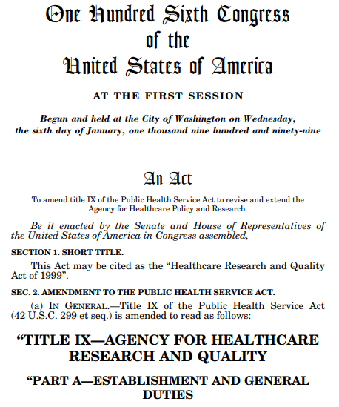
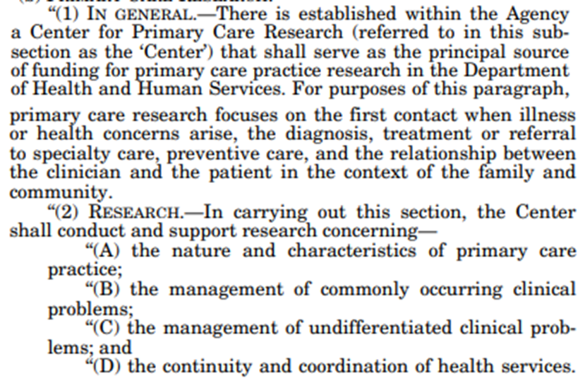
AHRQ’s 1999 authorization
Notes:
AHRQ’s 1999 authorization

Slide 5
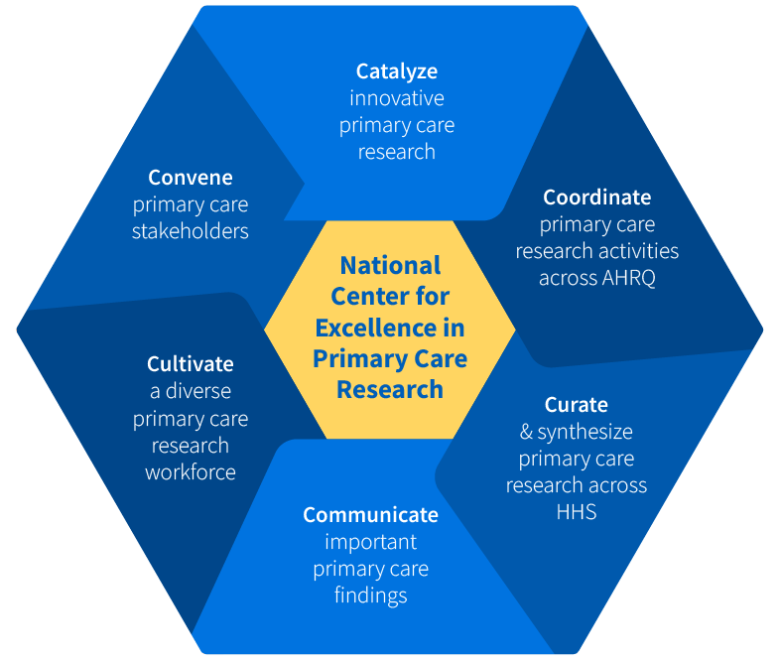
National Center for Excellence
Working to:
Develop a more coordinated primary care research portfolio & agenda
Create more targeted primary care research funding opportunities
Support & expand a diverse primary care research workforce
Build a more robust & systematic dissemination strategy

Slide 6
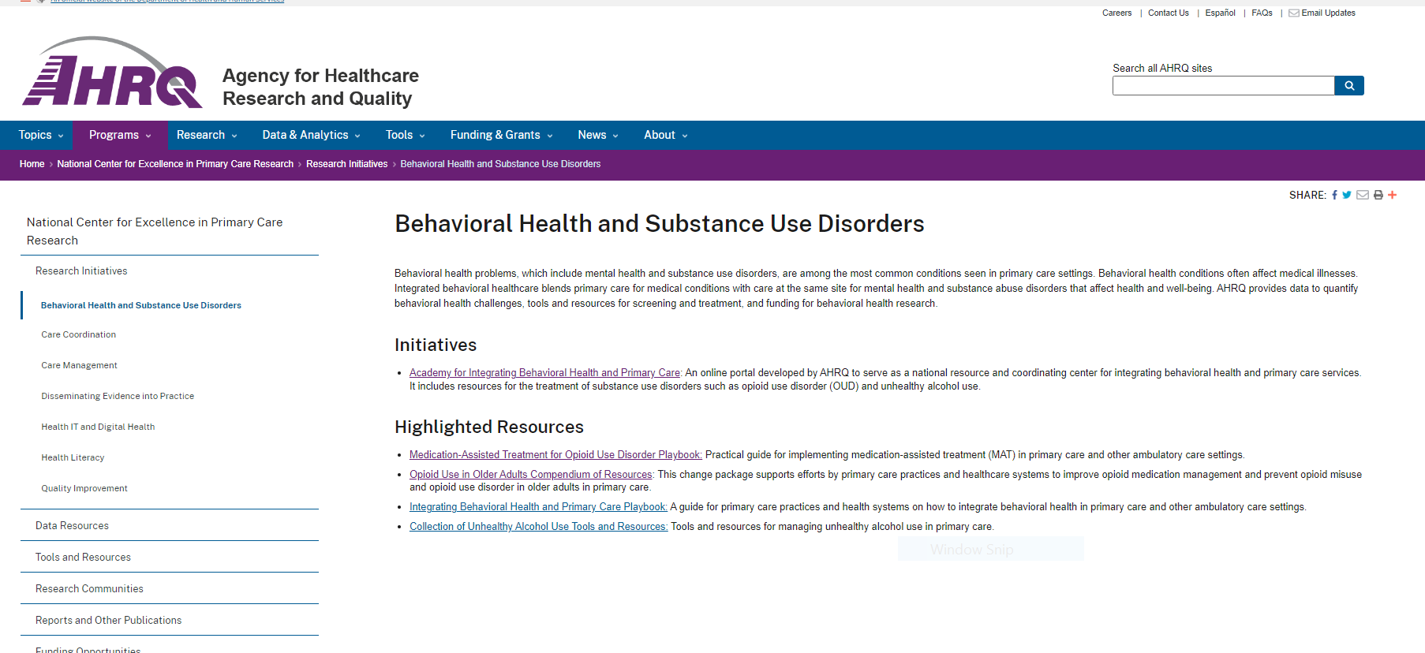
National Center for Excellence in Primary Care Research’s webpage

Slide 7
Strengthening Primary Care Research Webinar Series
Webinar Series
    Research on the Integration
    of Behavioral Health in Primary Care
Notes:
AHRQ is hosting a new webinar series, Strengthening Primary Care Research. Today’s webinar is the third in the series. Stay tuned to the AHRQ channels for announcements of future webinars.

Slide 8
Today’s Webinar Objectives
Research on the Integration of Behavioral Health in Primary Care
Highlight examples of primary care research on integration of behavioral health
Introduce AHRQ resources that support behavioral health integration
Notes:
The goal of today’s webinar is to 1. Highlight examples of primary care research on integration of behavioral health and
2. Introduce AHRQ resources that support behavioral health integration.

Slide 9

Moderator
Garret E. Moran, PhD
The AHRQ Academy
Notes:
Now I’d like to introduce the moderator for today’s webinar, Dr. Garret Moran, from The AHRQ Academy.
Dr. Moran will facilitate the Q&A and discussion, which will take place after all of the presentations are finished. Welcome, Garrett!

Slide 10
Today’s Webinar Presenters
Andrea K. Graham, PhD (Northwestern University Feinberg School of Medicine), Implementation of Digital Mental Health Tools in Ambulatory Care Coordination
Nathalie Moise, MD, MS, FAHA (Columbia University Irving Medical Center), TRANSFORM DEPCARE: A Theoretical Approach to Improving Patient Engagement and Shared Decision Making for Minorities in Collaborative Depression Care
Garrett E. Moran, PhD (The AHRQ Academy)
Neil Korsen, MD, MSc (MaineHealth Institute for Research), The AHRQ Academy
Notes:
Hello everyone. We have four primary care researchers here today. The first two presenters will discuss their research on the integration of behavioral health in primary care. Join me in welcoming:
Andrea K. Graham, PhD (Northwestern University Feinberg School of Medicine), who will present on her research study Implementation of Digital Mental Health Tools in Ambulatory Care Coordination
Nathalie Moise, MD, MS, FAHA (Columbia University Irving Medical Center), who will present on her research study TRANSFORM DEPCARE: A Theoretical Approach to Improving Patient Engagement and Shared Decision Making for Minorities in Collaborative Depression Care
Myself and and Neil Korsen, MD, MSc (MaineHealth Institute for Research), - together we will present on The AHRQ Academy.
Be sure to save your questions – we’ll have the Q&A session after all the presentations are over. You can also pop your questions into the chat for later.

Slide 11

Presentation 1
Implementation of Digital Mental Health Tools in Ambulatory Care Coordination
Andrea K. Graham, PhD Northwestern University Feinberg School of Medicine
Notes:
Now I’d like to introduce our first presenter, Dr. Andrea K. Graham from Northwestern University, Feinberg School of Medicine. Welcome Dr. Graham.

Slide 12
Background
Care coordination services have been developed to provide safer and more effective care for patients who have difficulty managing their healthcare
A large portion of patients in care coordination have mental health conditions, however, care coordination has traditionally focused on primarily physical health problems
The role of care managers is to take a holistic view of patients and to improve healthcare system efficiency, yet there remain several gaps in the efficiency of this work

Slide 13
Background
Digital mental health interventions (DMHIs) can provide patient-facing apps that promote self-management strategies for common mental health problems such as depression
  And are effective when delivered with guidance by a coach
Therefore, a DMHI for depression could improve access to and coordination of mental health services in Ambulatory Care Coordination (ACC)

Slide 14
Intervention: IntelliCare Plus
Guided (with coaching) DMHI for depression and anxiety
Demonstrated effectiveness among primary care patients
High, sustained engaging
Now hosted by Adaptive Health, LLC

Slide 15
Intervention: IntelliCare Plus
Guided (with coaching) DMHI for depression and anxiety
Demonstrated effectiveness among primary care patients
High, sustained engaging
Now hosted by Adaptive Health, LLC
Effect sizes of 0.78 and 0.64 for depression and anxiety
Graham, et al., 2020, Coached mobile app platform for the treatment of depression and anxiety among primary care patients: A randomized clinical trial, JAMA Psychiatry

Slide 16
Specific Research Aims
Aim 1: Adapt a DMHI, IntelliCare Plus, to address implementation barriers within care coordination
Aim 2: Develop and subsequently optimize a multicomponent implementation strategy
Aim 3: Conduct a randomized rollout effectiveness-implementation trial of the IntelliCare Plus platform with optimization and a sustainment pilot period in the 4 regional teams of Ambulatory Care Coordination
  Primary implementation outcome: reach
  Primary effectiveness outcome: depression severity using the PHQ-9

Slide 17
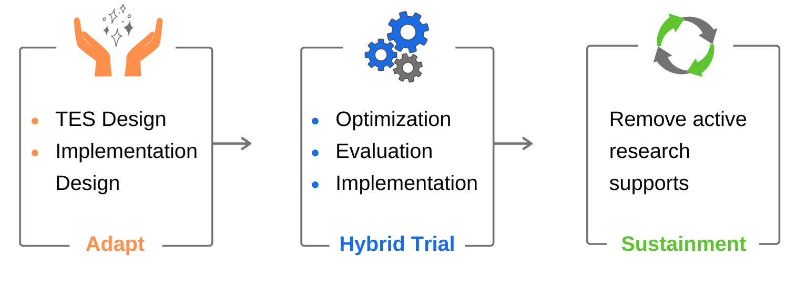
Methods: Solution-Focused Research Framework
Technology-enabled Service (TES):
- Technology
- Service
- Implementation plan
Conduct a hybrid trial while actively and intentionally optimizing implementation strategies
Mohr DC, Riper H, Schueller SM. A Solution-Focused Research Approach to Achieve an Implementable Revolution in Digital Mental Health. JAMA Psychiatry. 2018;75(2):113-114.
Mohr DC, Lyon AR, Lattie EG, Reddy M, Schueller SM. Accelerating Digital Mental Health Research From Early Design and Creation to Successful Implementation and Sustainment. J Med Internet Res. 2017;19(5):e153.

Slide 18
Methods (as Planned)
TES- Technology:
  Expand patient management tools (e.g., medication adherence, decision support, other contact media)
  Integrate IntelliCare’s care management dashboard into ACC’s EHR
TES- Service Design: Train and supervise care coordinators in delivering IntelliCare Plus (refer + coach)
TES- Implementation Plan:
  Deliver IntelliCare Plus sequentially across the 4 regions using a stepped-wedge design
  Refer patients with PHQ-9 ≥10

Slide 19
Field Test (a “Small Test of Change”)
Small tests of change (here, a field test): an implementation strategy to inform larger-scale implementation
Why Needed? Because technology rarely rolls out as planned
Approach:
  Train and supervise 4 care managers (“internal champions”)
  Target patient enrollment: 5 patients each (N = 20 total)
Powell BJ, Waltz TJ, Chinman MJ, Damschroder LJ, Smith JL, Matthieu MM, Proctor EK, Kirchner JE. A refined compilation of implementation strategies: results from the Expert Recommendations for Implementing Change (ERIC) project. Implement Sci. 2015;10:21.

Slide 20
Findings: Reach
3 of 4 care coordinators (75%) enrolled
8 total patients (40%)

Slide 21

Findings: Reach
3 of 4 care coordinators (75%) enrolled
8 total patients (40%)
https://valohai.com/blog/command-line-for-data-science/

Slide 22
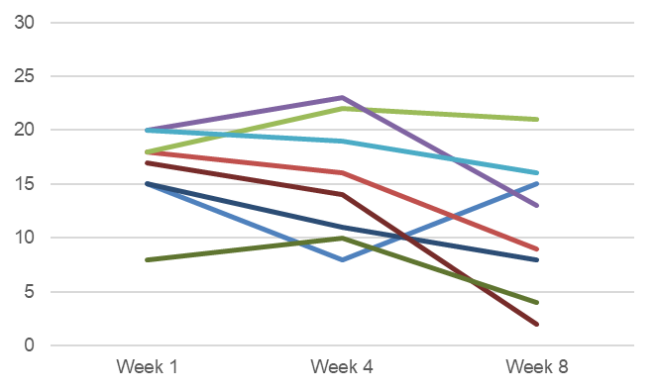
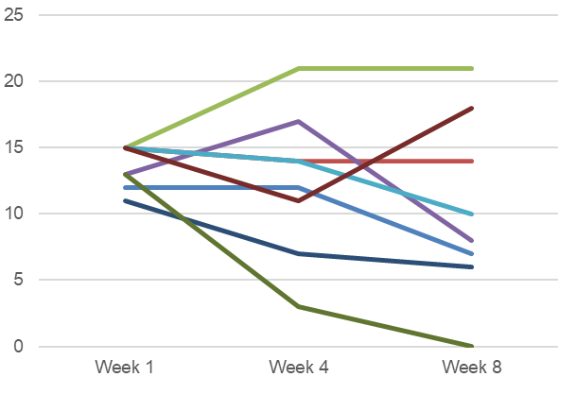
Findings: Effectiveness - 75% Improved
Depression (PHQ-9)
Anxiety (GAD-7)
Week 1 | Week 4 | Week 8 | Outcome
15 | 8 | 15 | -
18 | 16 | 9 | ↓
18 | 22 | 21 | ↑
20 | 23 | 13 | ↓
20 | 19 | 16 | ↓
15 | 11 | 8 | ↓
17 | 14 | 2 | ↓
8 | 10 | 4 | ↓
Week 1 | Week 4 | Week 8 | Outcome
12 | 12 | 7 | ↓
15 | 14 | 14 | ↓
15 | 21 | 21 | ↑
13 | 17 | 8 | ↓
15 | 14 | 10 | ↓
11 | 7 | 6 | ↓
15 | 11 | 18 | ↑
13 | 3 | 0 | ↓

Slide 23
Feedback from Care Coordinators
“My patient really liked the app. She used it when she was alone… She started having negative thoughts and she said it helped her to just redirect herself”
“They really utilized it…. So I looked at it differently after I watched patients experience it – patients that had serious problems”
“Talking with patients about it… seeing how they were using it just solidified that for me that it really is quite a useful tool”
“That was the most surprising one because he really loved it. I would’ve never thought to refer him to it because of the level of his brain injury”
Tack, E., Lakhtakia, T., Beltzer, M., Krause, C., Danielson, E., Lattie, E., Graham, A. (2024). Adapting strategies for digital mental health intervention implementation in ambulatory care coordination. Live Research Spotlight Presentation to be presented at the 45th Annual Meeting & Scientific Sessions of the Society of Behavioral Medicine, Philadelphia.

Slide 24
Lessons Learned
Strengths
  Care coordinators liked the DMHI
  Patients on average improved
Implementation areas for optimization
  Delivering the DMHI with coaching is challenging to fit into the ACC care coordinator’s workflow
  Implementation focus needs to be on identifying and referring patients to uptake into the DMHI
System-level change
  Over the course of COVID, the ACC service was redesigned to remove regional delivery (care coordinators now work across regions)

Slide 25
Future Direction 1:
Adapting the Trial Design to the ACC Service
System-wide deployment using interrupted time series trial design (from stepped-wedge design)
Control phase (3-6 months): 1-time announcement to care coordinators that IntelliCare Plus is available
Intervention phase (~12 months): Monitor reach and deploy data-driven, collaboratively determined implementation strategies (~every 3 months)
Sustainment phase (3-6 months): remove research team involvement
No randomization; available to all

Slide 26
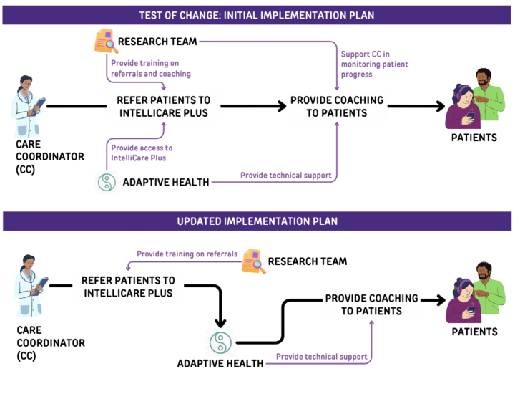
Future Direction 2:
Disentangling DMHI Service Delivery
Care coordinators refer to DMHI
Adaptive Health coaches provide coaching
  Aligns with Adaptive Health’s standard business model
Lakhtakia, T., Beltzer, M., Krause, C., Tack, E., Lattie, E., Graham, A. (2023). Changing course: How a small test of change can inform the implementation of an evidence-based mental health intervention in existing healthcare systems. Poster presented at the 16th Annual Conference on the Science of Dissemination and Implementation, Academy Health, Washington, D.C.

Slide 27
Future Direction 3:
Facilitating DMHI Referrals
Lowering barriers to patient enrollment: PHQ ≥5
Easing referral: Link to IntelliCare Plus “portal” embedded in EHR
Standardizing targets across implementation strategies to match determinants from the field test (“ACC strategy playbook”)
  50% of ACC patients could benefit from depression management
  Fast/immediate access
  Free of cost
  Benefits comorbidities
  Recommended by ACC (standard of care)

Slide 28
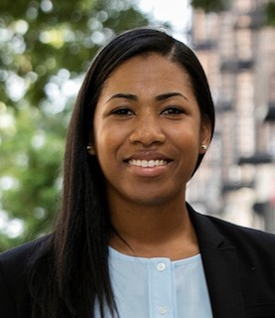
Presentation 2
DEPCARE: A Theoretical Approach to Improving Patient Engagement and Shared Decision Making for Minorities in Collaborative Depression Care
Nathalie Moise, MD, MS, FAHA
Columbia University Irving Medical Center
Notes:
Now I’d like to introduce our third presenter, Dr. Nathalie Moise, MD, MS, FAHA from Columbia University Irving Medical Center. Dr. Moise will present on her study DEPCARE: A Theoretical Approach to Improving Patient Engagement and Shared Decision Making for Minorities in Collaborative Depression Care
Welcome Dr. Moise.

Slide 29
Background
NYS OMH CC Medicaid Program (CCMP)
32 sites (19 academic centers, incl. H+H w/ 1 million patients) (Training, tech assistance, funds, quality monitoring)
611 sites: Expands to depression + anxiety TA/Training + Audit feedback + fee for quality Medicaid reimbursement ($150/member/ month)
Mixed methods Eval
Barriers to sustainability
Develop strategies/ methods
Test sustainability strategies (2020-2022)
2012 (Implement)
2015- (Scale)
2016- (Evaluate)
Notes:
The 32 clinics represented 19 medical centers with academic affiliations (defined as hospital systems where ≥1 residents are trained) caring for approximately 1 million patients. Overall, 11 healthcare systems (17 clinics) were part of New York City Health and Hospital (H+H), the largest public health care system in the US, providing care across 70 locations, a low-cost health insurance plan, and population based-care, while 8 (15 clinics) were non-H+H centers (academic health systems only). Clinic-reported populations ranged in size from 2000 patients/year to 30,000 patients/year.

Slide 30
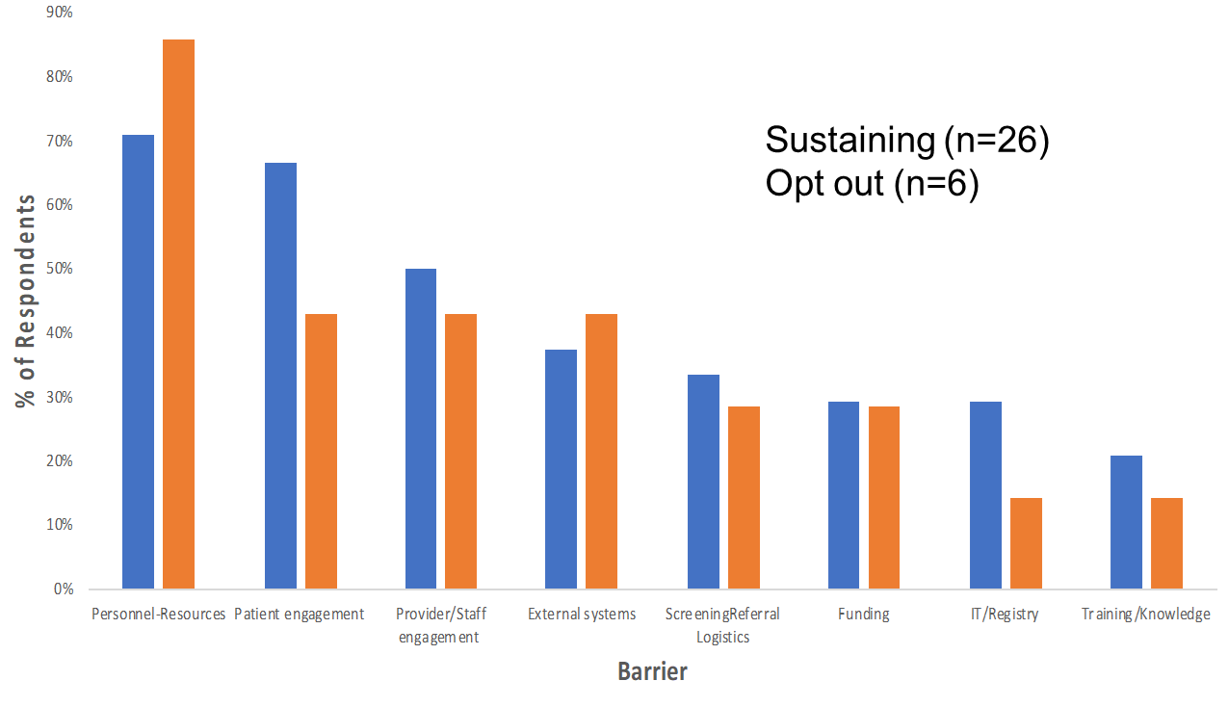
Background (continued)
Determinants/ Mechanisms: Early implementation barriers less prominent in sustainability
(Funding stability, environmental support, communications)
Moise (2018) Implementation Science

Slide 31
Background
Provider Opportunity/ Compatibility
“[Providers] are getting hammered with increased number of items they are supposed to manage in the visit. We have to screen every patient for risk of domestic violence…falls”
– Primary Care Providers
Psychosocial Resources
“At the same time, many patients want and/or need more intensive psychiatric treatment than can be offered in this setting (such as a day program or intensive outpatient treatment).”– Psychiatrist
Patient Stigma/Insight/Fear
“...I didn't want to go because I was thinking only that it was for crazy people...”– Historically marginalized Patient
Reach Improvement
Fidelity
Contacts,
Screening, Psych Consult
Need to address barriers to sustainability & Adapt to changing workflows/contexts
Moise (2018) Implementation Science; Dong [Moise senior] (2020) General Hospital Psychiatry

Slide 32
Specific Research Aims
Refine a strategy centered around an electronic shared decision-making prototype focused on improving treatment optimization
Assess impact on provider optimization behaviors (e.g., referrals, medication intensification)
Assess impact on patient optimization behaviors (CC enrollment, any mental health visits, medication fills)

Slide 33
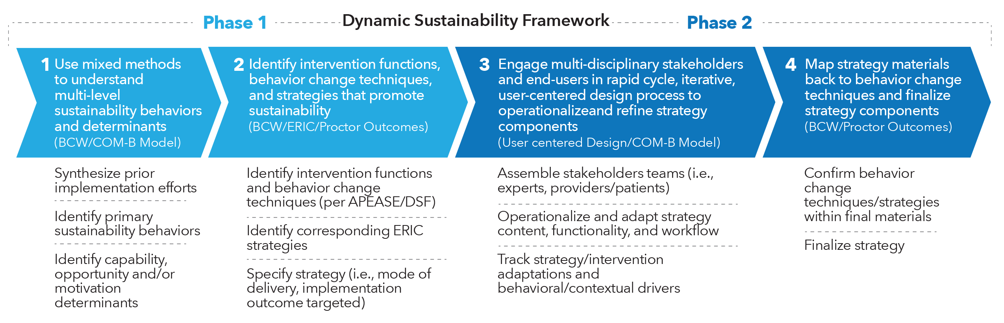
Methods
Notes:
Be it collaborative care or another EBP, what helps a practice implement and sustain, what does sustainability require?

Slide 34
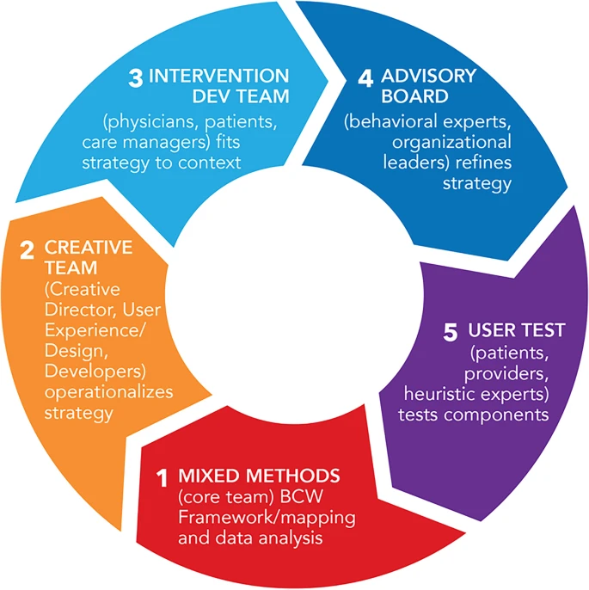
Methods
Stakeholder engagement
ImSci Frameworks/Mapping
Mode of delivery | Strategy | Behavior change technique | DSF tenet | Capability | Opportunity | Motivation
Zoom TA meetings delivered by clinic mental health staff | Systematic Improvement,adapt, pilot | Problem solving, credible source | Continued learning, evaluation, adaptation | X | X | X
Moise (2023) Implementation Science Communications

Slide 35
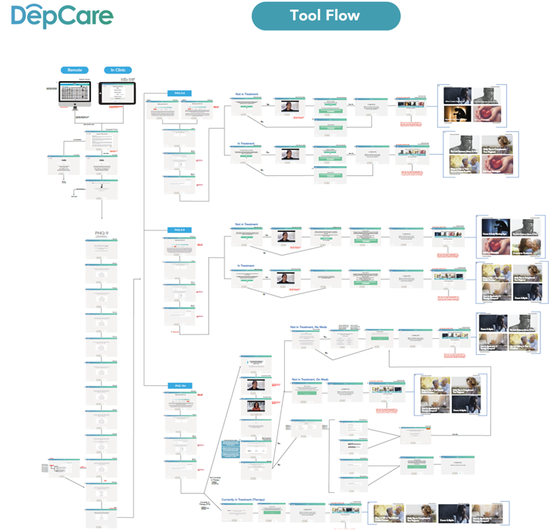

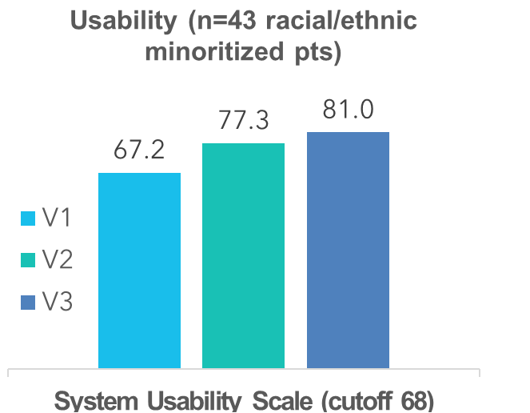
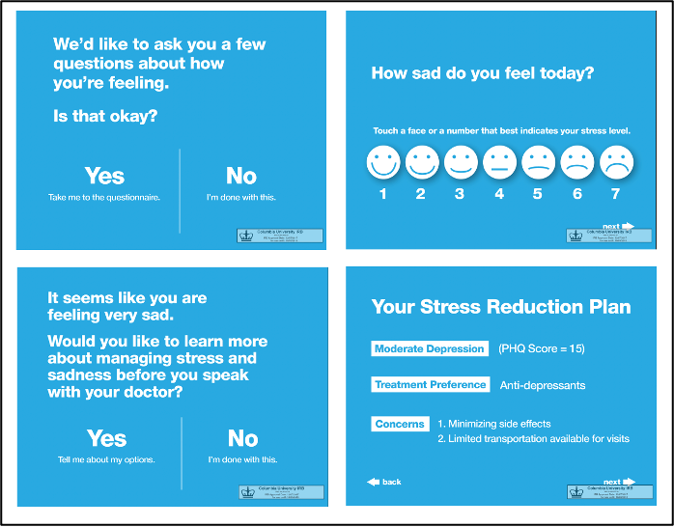
Tool/Intervention
Web App Texted
Bypass PCP Option
Psychoeducation
Activation
Personalized
Access to CBT Apps
Dauber [Moise senior] under review

Slide 36
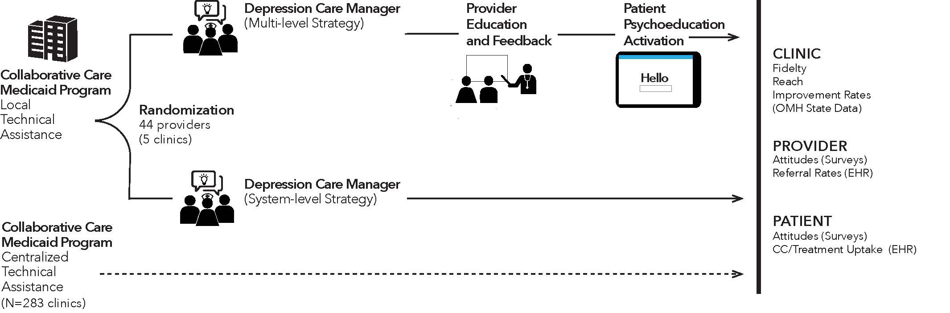
A stakeholder designed multi-level sustainability strategy: DepCare
Fidelity. ≥ 1 champion/clinic attended every TA meeting (n=9, 21 attendees)
2021-2022
Moise et al., 2023, Implementation Science Communications

Slide 37
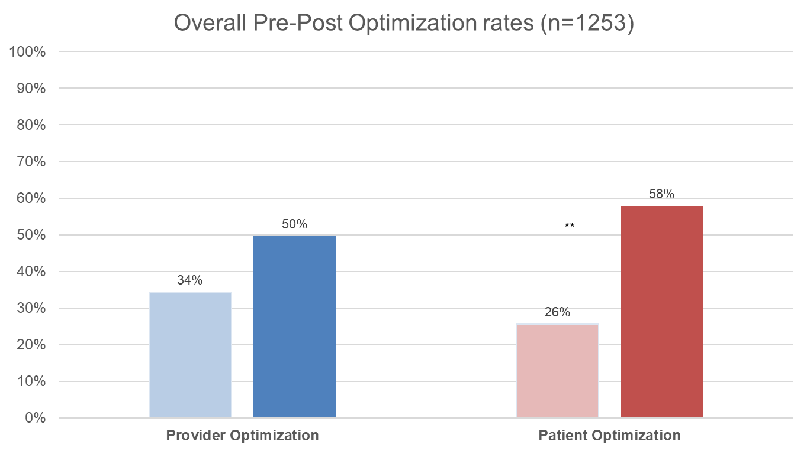
Findings: Pre-Post Optimization Rates
Notes:
Fix Figure

Slide 38
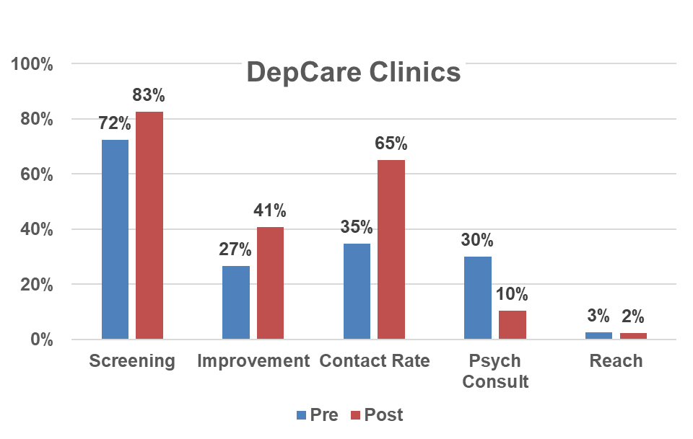
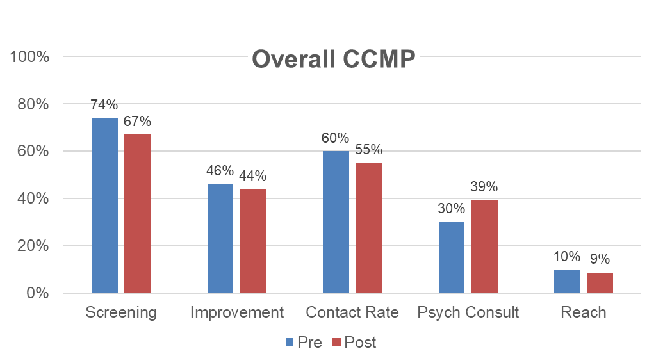
Findings: Pre-Post CC Metrics
* No change in low fidelity CCMP clinics

Slide 39
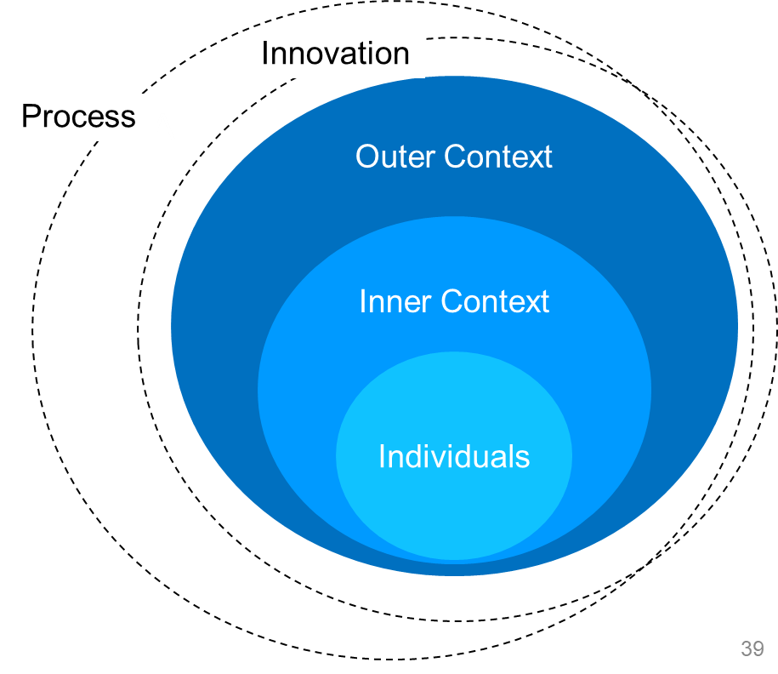
Findings: Context Matters
Contextual Factors
-Psychosocially complex pts ineligible
-Poor Billing infrastructure -Fragmented communication -Compatibility (eligibility)
-Low PCP motivation, burnout, no champion -Psych turnover, + gained more engaged Psy
+Adaptability/Redesign (remote, DBT/CBT, coordination, lower PHQ threshold) + Trialability (Many pilots, screening video) = ⬆ population optimization (e.g., psych/nonCC) & ⬆ CC Fidelity = ⬆ Improvement
Notes:
WE recommended that IS researchers be explicit in including SSDOH in understanding determinants. There are key SSDOH in driving blood pressure disparities for example, like lack of access to healthy foods in neighborhoods, but this may or may not be the same as driving uptake of the EBP (reason why patient is not following hypertension guideline may be lack of access to

Slide 40
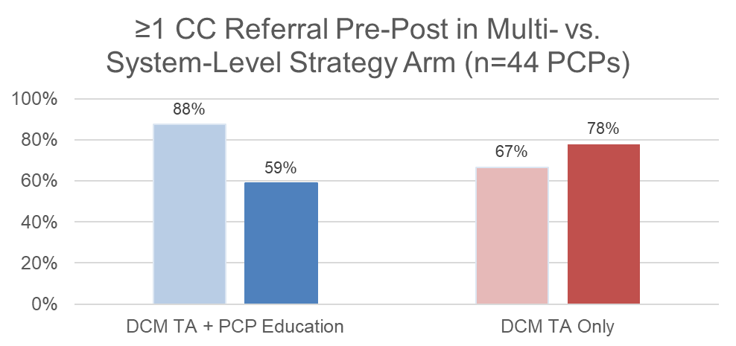
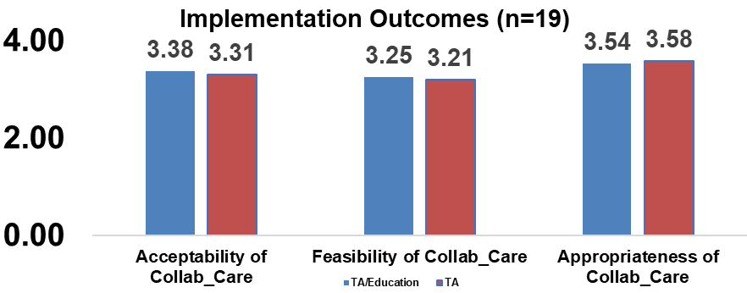
Findings: Adding PCP education may backfire…
30% Burnout/Insomnia, 20% left clinic (Intervention > Control)
Facilitators: high awareness, comfort with meds, ease addressing mental health, CC benefits > costs
Many Barriers: Relative priority, confidence in result of referrals, lack of time, insufficient resources (despite low care managers caseloads)
Notes:
Did engage more care managers not
PCPs opting not to invest in mental health screening/referrals.

Slide 41
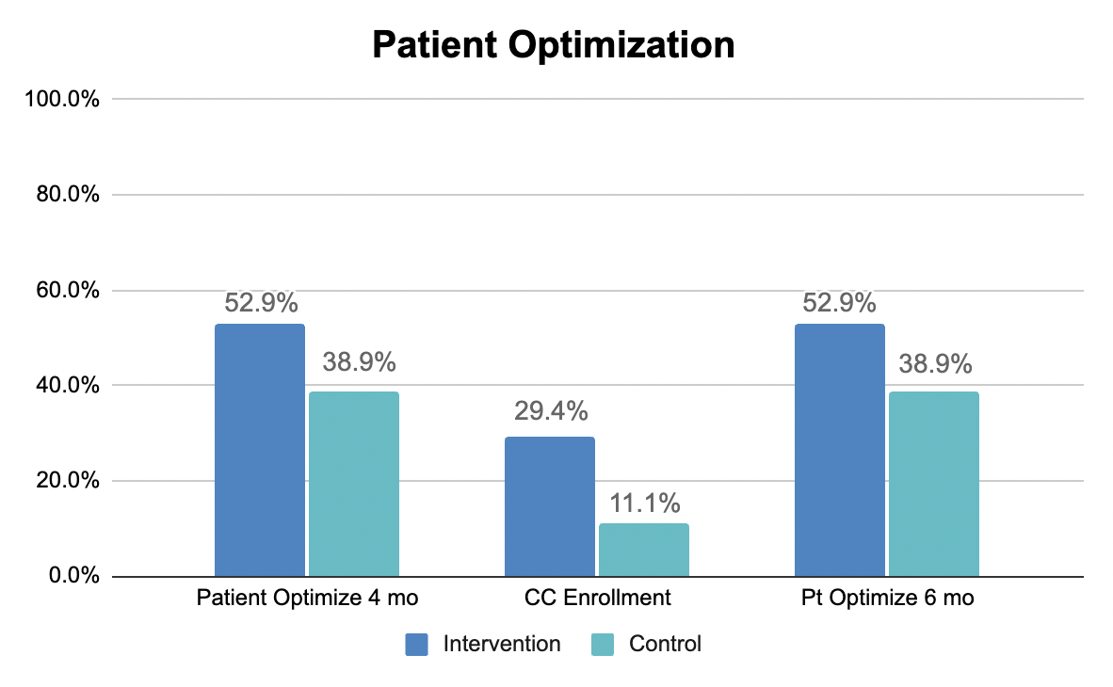
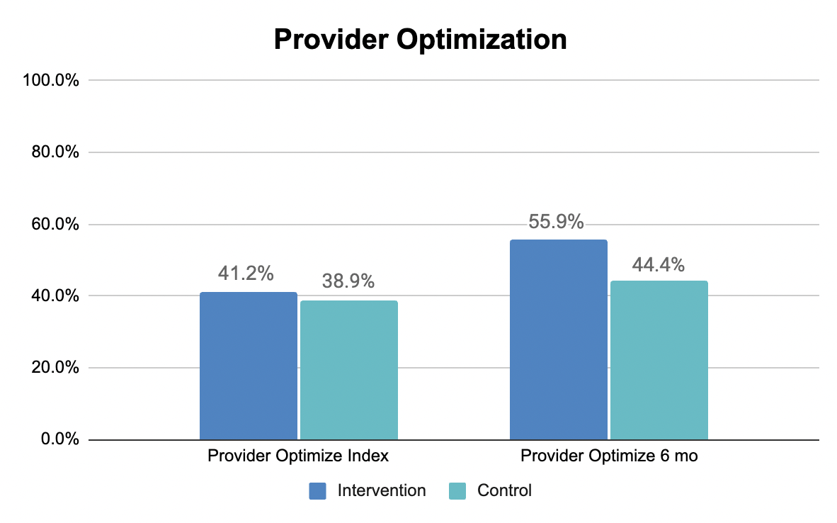
Direct-to-patient activation improves reach
(n=56 CC eligible racial/ethnic minority patients)
Mechanisms
△PHQ: 6 months: -1.7 vs. 0.5; 12 months -2.8 vs. -0.5
Higher Trust in PCP, Higher CC acceptability, Fewer perceived CC barriers (insurance, costs, availability, stigma, trust); PCPs Normalizing Depression/ Resistance to ownership?
Roadblocks: Consent, Cold calls (no in person approach 2/2 COVID19), low eligibility (~2000 screened/year)
Notes:
Efforts that we invested into the PCP, going directly to pateitn got us there.

Slide 42
Lesson Learned
Theory-informed, system level strategies that promote adaptation may be sufficient to improve population wise treatment optimization rates and CC fidelity/outcomes but not CC reach
Well-designed direct-to-consumer approaches may promote reach (disseminate regardless of PHQ score)
Additional research on strategies to promote PCP involvement are needed given PCP burnout (adaptation vs. new model)
Implementation Trial Designs
  Stepped wedge designs in real world settings (ensure rigorous data collection)
  Marginalized populations: tech design, Cold Calls/Remote Consent/ implementation trials

Slide 43
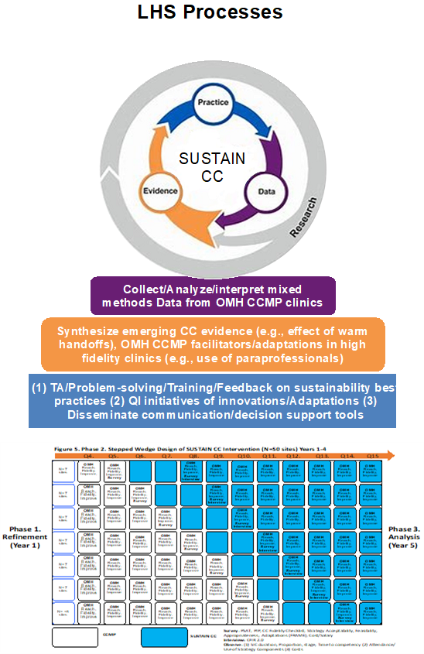
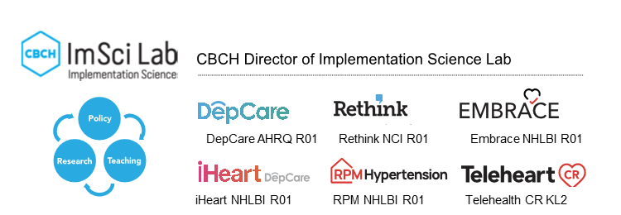
Future Directions

Slide 44

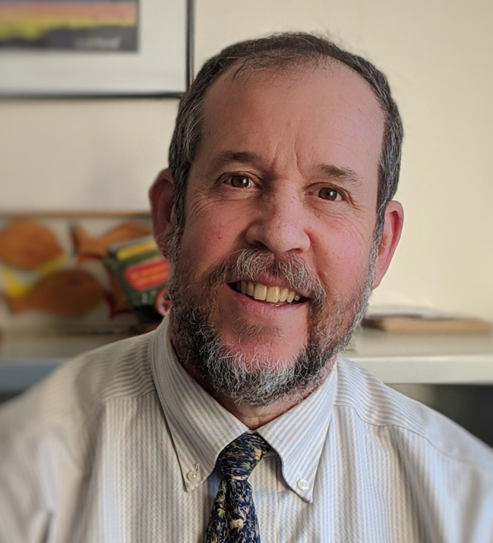
Presentation 3
The AHRQ Academy
Garrett E. Moran, PhD
The AHRQ Academy
Neil Korsen, MD, MSc
MaineHealth
Institute for Research
Notes:
Now I’d like to introduce presenters for the third presentation. You’ve met me, Garret Moran. I’m co-presenting with my colleague Dr. Neil Korsen from MaineHealth Institute for Research. Together we will be presenting on The AHRQ Academy.
Welcome Dr. Korsen.

Slide 45
The Academy for Integrating Behavioral Health and Primary Care
A national resource center for the integration of behavioral health and primary care, including mental health and substance use disorders
Established in 2010 with funding from AHRQ
Developed with guidance from a national expert panel, the National Integration Academy Council (NIAC)
Gathers and disseminates relevant literature and useful tools

Slide 46

https://integrationacademy.ahrq.gov/
Notes:
This is where you can find all the Academy resources, at integrationacademy.ahrq.gov.

Slide 47
Brief Historical Background
Early history of collaborative or integrated care dates to 1970s
Broader awareness came with the President’s New Freedom Commission in the early 2000’s; the Commission’s final report drew attention to the need for integrating behavioral health and primary care
AHRQ awarded a grant to Dr. CJ Peek to develop a common definition so the field could use shared terminology
  Lexicon for Behavioral Health and Primary Care Integration: Concepts and Definitions Developed by Expert Consensus published in 2013, updated in 2023

Slide 48
Lexicon Definition
What is integrated behavioral health? A general definition:
  A practice team of primary care and behavioral health clinicians working together with patients and families, using a systematic and cost-effective approach, to provide patient-centered care for a defined population.
  This care may address mental health and substance use conditions, health behaviors (including their contribution to chronic medical illnesses), life stressors and crises, stress-related physical symptoms, and ineffective patterns of health care utilization.

Slide 49
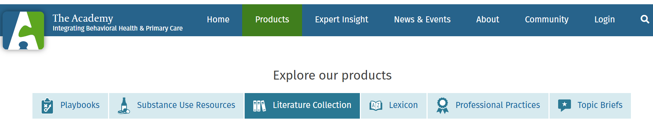
Academy Resources
Products: Literature Collection, Topic Briefs, Tools, Professional Practices, and Playbooks

Slide 50
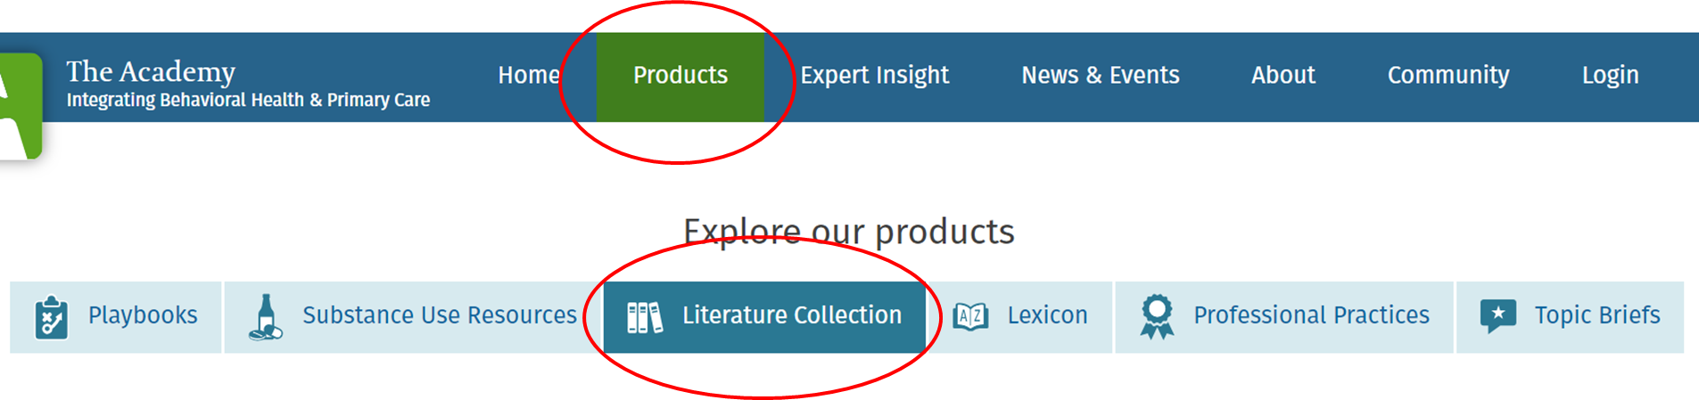
Academy Resources:
Evidence and Best Practices
Curated Literature Collection
  Regularly updated, searchable collection of >9,000 peer-reviewed and grey literature references on the integration of behavioral health and primary care

Slide 51
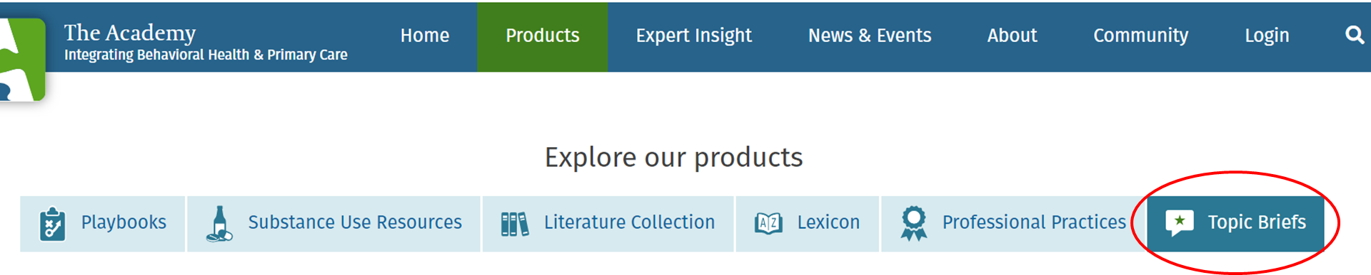
Academy Resources
Evidence and Best Practices
Topic Briefs briefs provide timely information in a succinct format on current issues in integration
    link to additional information and resources
    Topics covered include: Telehealth, COVID-19, stimulant use disorders, polysubstance use, pregnancy and postpartum, health equity, mental health apps, and low threshold treatment for patients with OUD in primary care

Slide 52
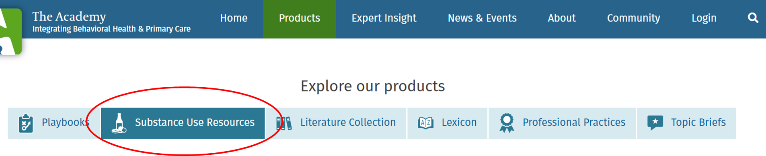
Academy Resources:
Tools
Targeted collections of tools
  Tools and resources for Substance Use and unhealthy alcohol use

Slide 53
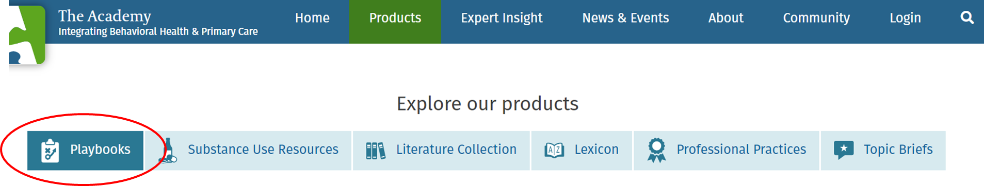
Academy Resources: ‘How To’ Resources
Playbooks: self-guided online manuals to help you imagine, design, and implement a locally tailored behavioral health integration program
    The Integration Playbook walks practices through the steps of integration, with links to tools and resources for every step
    The MAT (MOUD) Playbook offers specific guidance for integrating medications for opioid use disorder into primary care

Slide 54
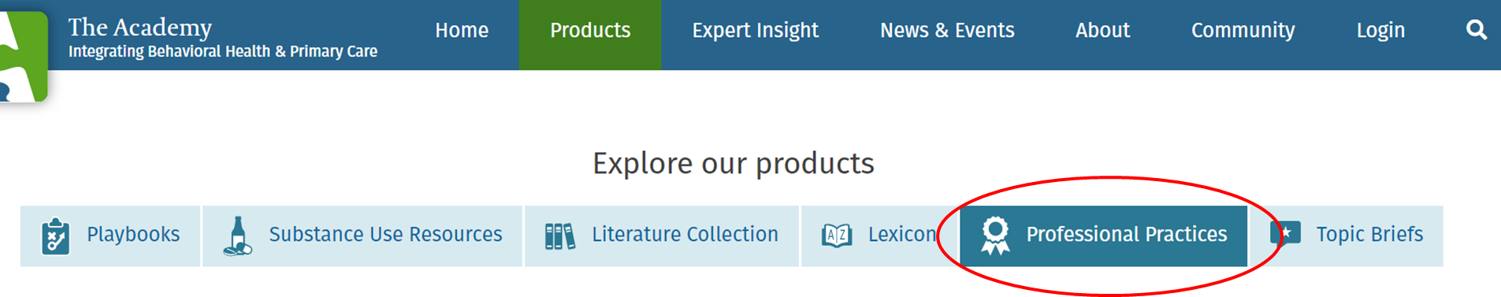
Academy Resources:
Professional Practices and Competencies
Additional resources
  Guidebook of lessons from exemplary practices
  Lit review on clinician and practice competencies

Slide 55
Questions
Please post your questions in the chat!

Slide 56
Thank you
    Check the AHRQ Channels for announcements about the next webinar in the series
Please complete the short evaluation poll after this webinar!
Notes:
Check the AHRQ channels for announcements about the next webinar in the NCECPR webinar series.
Please take the short evaluation poll that will pop up after this webinar. Thank you to our esteemed presenters and to all of you for joining us today!

