Slide 1
National Center for Excellence in Primary Care Research
Presents Using Large Datasets in Primary Care Research
May 24, 2023
Presented by:
Yalda Jabbarpour, MD
Yong-Fang Kuo, PhD
Annie Elizabeth Larson, PhD
Moderated by:
Robin Bloodworth, PhD, MPH
Abt Associates

Slide 2
NCEPCR Webinar Series
The views expressed in this webinar do not represent official views of the U.S. Department of Health and Human Services or the Agency for Healthcare Research and Quality.
Notes:
AHRQ is hosting a new webinar series, Strengthening Primary Care Research. Today’s webinar is the first in the series. Webinar two will be focused on Getting your qualitative Study Funded at AHRQ. Stay tuned to the AHRQ channels for the date and registration.

Slide 3

Welcome
Aimee R. Eden, PhD, MPH
Acting Director,
National Center for Excellence in Primary Care Research (NCEPCR),
AHRQ
Notes:
Good day, everyone. My name is Aimee Eden. I am the acting Director for AHRQ’s National Center for Excellence in Primary Care Research. It is my pleasure to welcome you to today’s webinar, Using Large Datasets in Primary Care Research.
Aimee will talk a bit about NCEPCR and her role and segue to webinar series. Share what NCECPR is doing

Slide 4
NCEPCR Webinar Series
Strengthening Primary Care Research Webinar Series
    Using Large Datasets in Primary Care Research
    Next webinar:
    Tentatively Titled, Primary Care Qualitative Studies Funded by AHRQ
Notes:
AHRQ is hosting a new webinar series, Strengthening Primary Care Research. Today’s webinar is the first in the series. Webinar two will be focused on Getting your qualitative Study Funded at AHRQ. Stay tuned to the AHRQ channels for the date and registration.

Slide 5
Today’s Webinar Objectives
Using Large Datasets in Primary Care Research
    Introduce large datasets being used in primary care research
    Highlight examples of funded grants using large data sets
    Provide guidance on matching primary care research questions with appropriate datasets
Notes:
The goal of today’s webinar is to introduce you to large datasets being used in primary care research, and to provide guidance on matching research questions with appropriate datasets.

Slide 6

Moderator
Robin Bloodworth, PhD, MPH
Associate, Abt Associates
Notes:
Now I’d like to introduce the moderator for today’s webinar, Robin Bloodworth, a health services researcher from Abt Associates. Robin will facilitate the Q&A and discussion, which will take place after all of the presentations are finished. Welcome, Robin!

Slide 7
Today’s Webinar Presenters
Yalda Jabbarpour, MD
Robert Graham Center for Policy Studies, AAFP
The Primary Care Scorecard
Yong-Fang Kuo, PhD
Office of Biostatistics, University of Texas Medical Branch
Use of Medicare Data to Identify Primary Care Teams
Annie Elizabeth Larson, PhD
OCHIN
The effect of rurality and the COVID-19 pandemic on telemedicine and preventive healthcare use
Notes:
Hello everyone. We have three primary care researchers here today. Each one will discuss some of the large datasets and methods they used in a recent study they completed.
Yalda Jabbarpour, MD (Robert Graham Center for Policy Studies, AAFP) will be presenting on The Primary Care Scorecard
Yong-Fang Kuo, PhD (Office of Biostatistics, University of Texas Medical Branch) will be presenting on Use of Medicare Data to Identify Primary Care Teams
Annie Elizabeth Larson, PhD (OCHIN) will be presenting on The effect of rurality and the COVID-19 pandemic on telemedicine and preventive healthcare use
Be sure to save your questions – we’ll have the Q&A session after all the presentations are over.

Slide 8

The Health of US Primary Care: A Baseline Scorecard Tracking Support for High-Quality Primary Care
Presentation 1
Yalda Jabbarpour, MD
Director
Robert Graham Center

Slide 9

Roadmap to Achieve NASEM Vision
Notes:
For each of the measures I will present, we attempted to use publicly available data sets when possible. We also tried to calculate not only national numbers, but state numbers when the data allowed for it. For some metrics, we found that publicly available data was not sufficient for the least populous states so we could not calculate state measures. Year one was truly an iterative process; we tried to calculate the metrics with various data sets and in various ways and really spent a lot of time getting input from our steering committee and other stakeholders around the country who were working in similar areas. Ultimately we arrived at the data that I am presenting here today for this report and as researchers and primary care physicians we really do feel the data in aggregate represent the health of US primary care. And as Lisa said we look forward to feedback from you all as we move into year 2.

Slide 10
Measures
Recommendation 1: Pay for Primary Care Teams to care for people, not doctors to deliver services – Measure 1.1-1.3 Primary Care Spend- Commercial, Medicaid and Medicare
Recommendation 2: Ensure that high quality primary care is available to every individual and family in every Community)- Measure 2.1 and 2.2- Percent of Adults and Children without a usual source of care

Slide 11
Primary Care Spend Data
Medical Expenditure Panel Survey- A national survey that samples civilian and non-institutionalized populations (30,000-35,000 annually).
  Asians and Hispanics oversampled
  Provides nationally representative estimates of insurance coverage, healthcare utilization and expenditures
2010-2020 Consolidated, outpatient and event files
All payers, and each payer type individually

Slide 12
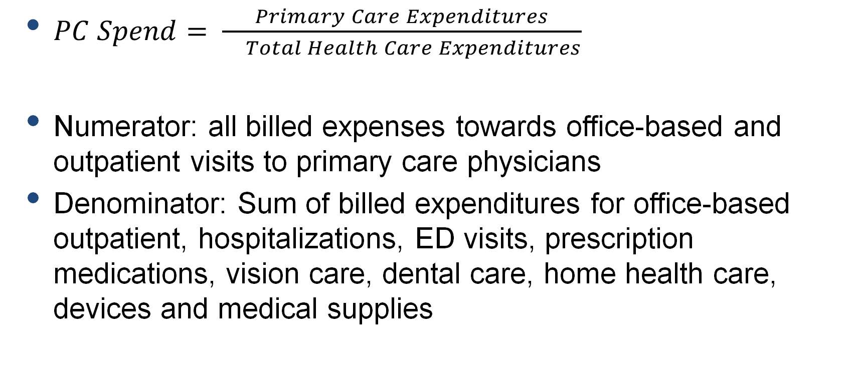
Primary Care Spend Analysis
$PC Spend= \frac{Primary Care Expenditures}{ Total Health Care Expenditures}$
Numerator: all billed expenses towards office-based and outpatient visits to primary care physicians
Denominator: Sum of billed expenditures for office-based outpatient, hospitalizations, ED visits, prescription medications, vision care, dental care, home health care, devices and medical supplies

Slide 13
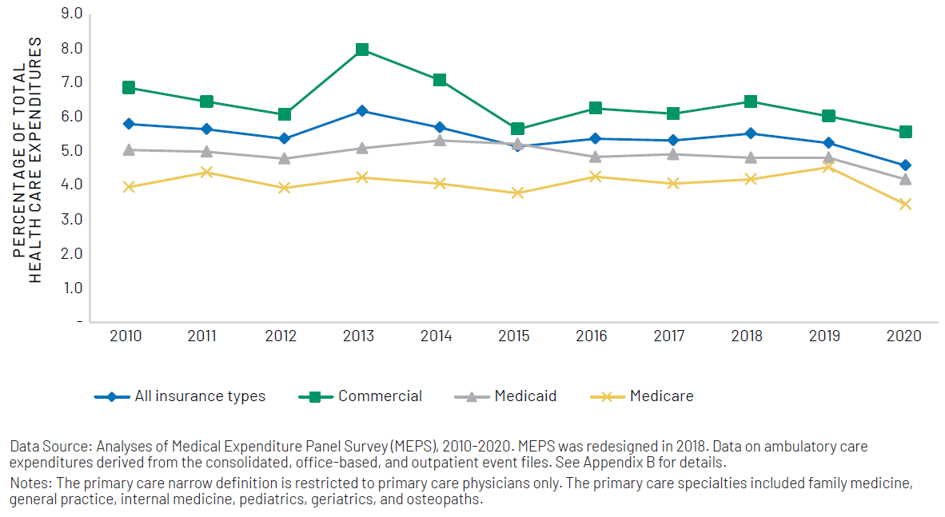
Primary Care Spending (Narrow Definition) from 2010 to 2020
Notes:
The first recommendation from the NASEM committee centered around payment and there were two metrics we were charged with following: how much are we spending or investing in primary care and have we made any progress towards payment models that support primary care teams. So for that first idea of how much are we investing in primary care we examined primary care spend over the last decade. there are multiple definitions of primary care, multiple formulas for calculating primary care spend and different data sets used to calculate this measure. In it’s simplest form primary care spend is just the proportion of total healthcare expenditures that are going towards primary care. Though there is no consensus on definitions, data sources or how this is measured, most estimates of national PC spend using a variety of data sources and definitions land anywhere between 5-7%, some lower or higher depending on the population studied. For our measure of PC spend we used a data set called the Medical Expenditure Panel Survey which is a nationally representative survey of civilians in the United States and gathers data about their healthcare use and expenditures. Our definition of primary care spend we used a provider-based definition and calculated all outpatient office based expenditures associated with those provider. We used both a narrow and broad definition of who primary care providers were. Here I present the results for our narrow definition which included visits to family physicians, general internal medicine physicians, general pediatricians, geriatricians and general practitioners. The blue line is the national primary care spend by year overall for all payer types. The green line is for commercial payers, the gray line is for Medicaid and the yellow for Medicare.
And you can see here how little we ae investing in primary care as a nation—anywhere between 3 and 8% depending on the payer and the year. Probably, as expected given the health of the populations covered, Medicare PC spend is lowest likely reflecting this populations use of specialty services and hospitalizations and commercial PC spend is highest. Spending for all the payers types is lower in 2020 than it was in 2010 with Medicaid showing a continuous drop since 2014. One thing to note here and moving forward is that 2020 was an aberrant year for surveys overall, and it certainly was for MEPS as well given restrictions on how data could be collected at the beginning of the pandemic so this will be interesting to follow to see if the big dip we see in 2020 is real or just a result of data collection changes.

Slide 14
Primary Care Spend Limitations in MEPS
Unable to separate out Medicare and Medicaid HMOs
Specialty for NP/PA and osteopathic providers unavailable
State level estimates are only available for 29 states given relatively small sample sizes

Slide 15
Usual Source of Care Methods
MEPS
2010-2020 data
Consolidated files
Used HAVEUS42 and LOCATN42 to construct a two-category USC measure

Slide 16
Determining whether someone had a USC

Slide 17
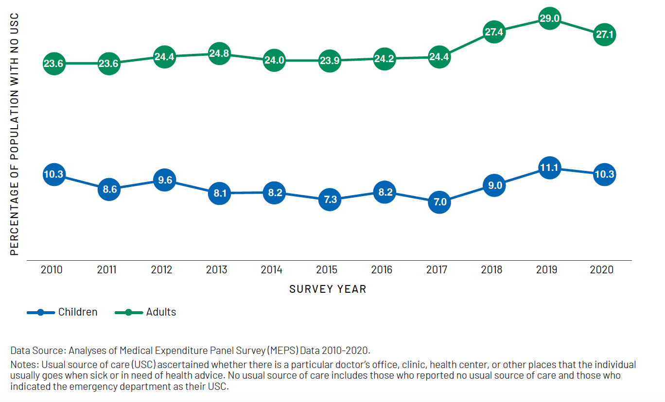
Percentage of US Population Without A Usual Source of Care
Notes:
And finally to examine access to the Primary care workforce we looked at the percentage of US adults and children who report that they do not have a usual source of care. Using the Medical Expenditure Panel Survey from 2010-2020 and found that more than a quarter of adults and 10% of children report no usual source of care in 2020. Once again, 2020 is a little bit of an aberrant year, but that aside, over the last few years we can see that the percentage of US adults and children who report no usual source of care is rising which is concerning for the overall health of the nation given how important primary care is to the health of the population

Slide 18
Usual Source of Care Limitations in MEPS
29 states
  No sub-state measures
Self-report
  Specialty/discipline of provider?
Question changed in 2018

Slide 19
Opportunities in MEPS
Very policy relevant
Nationally representative of coverage, use and expenditures
Individual level
Rich in outpatient data – perfect for primary care
Strong validation methods

Slide 20
Challenges in MEPS
Data only from about 14,000 families
State level estimates can be obtained for only about 29 states
Panel design – 2 year period, half of sample rotates off
Self report
Determinine specialty of practice for non-physicians
Notes:
First, the sample size for MEPS is too small to support many important analyses. MEPS currently collects data from about 14,000 families; a sample size similar to that of the 1977 NMCES. The 1977 survey, however, was designed to evaluate issues such as universal national health insurance and the federalization of Medicaid. NMCES could produce national estimates of the most important demographic groups but there was only moderate demand for state-level data and NMCES was not designed for this purpose. The need for better state estimates was becoming clearer even before the advent of the ACA but now, the ability to compare state experience is of far greater importance. MEPS can now support estimates for 29 states but this refers only to the capability of providing estimates about the total state population, it does not allow researchers to describe specific demographic groups within most states such as the poor or those without coverage.
Third, collection of expenditure data is far more difficult than collecting data on health insurance or use of services. Many respondents are unable to accurately report the payment that went to their provider. MEPS remedies this by obtaining payment data directly from providers that are identified by those in the household survey. There are however insufficient resources to obtain data from all identified providers. Currently attempts are made to obtain validation data from all identified hospitals and pharmacies. Although relatively high response rates are obtained in the provider validation, a substantial amount of data is still missing and must be imputed. Imputed data is not as accurate as validation data.

Slide 21

Presentation 2
Assessing Association Between Team Structure and Health Outcome and Cost by Social Network Analysis
Yong-Fang Kuo, PhD
Office of Biostatistics, University of Texas Medical Branch
Notes:
I’d like to introduce our second presenter, Dr. Yong-Fang Kuo from the University of Texas Medical Branch.

Slide 22
Assessing Association Between Team Structure and Health Outcome and Cost by Social Network Analysis
Nurse practitioners (NPs) and Physician assistants (PAs) have become increasingly important members of the primary care team model.
Compared to physicians only, team-based primary care including advanced practice providers (NPs or PAs) has been linked to:
  better healthcare outcomes
  lower cost of care
However, few studies have examined the degree of team collaboration, team-connectedness, and the dynamics of NP or PA interactions with other providers within the team, and how such interactions affect care outcomes.
Kuo YF, Agrawal A, Chou LN, Jupiter D, Raji MA, J Am Geriatr Soc. 2021;69(4):946-954

Slide 23
Specific Research Aims and Questions
To assess the impact of team structure composition and degree of collaboration among various providers on process and outcomes of primary care.
Social Network Analysis (SNA) is one method that can be used to understand the interaction dynamics and roles of NPs or PAs in a team-based care.
SNA uses graph theory to visualize and quantify a network of participants (such as providers) through mapping information and communication pathways.
SNA measures that have been used to measure healthcare provider networks:
  edge density (degree of collaborative care or connectedness)
  degree centrality (degree to which decision-making process is centralized)
  betweenness centralization (degree to which information sharing is centralized)

Slide 24
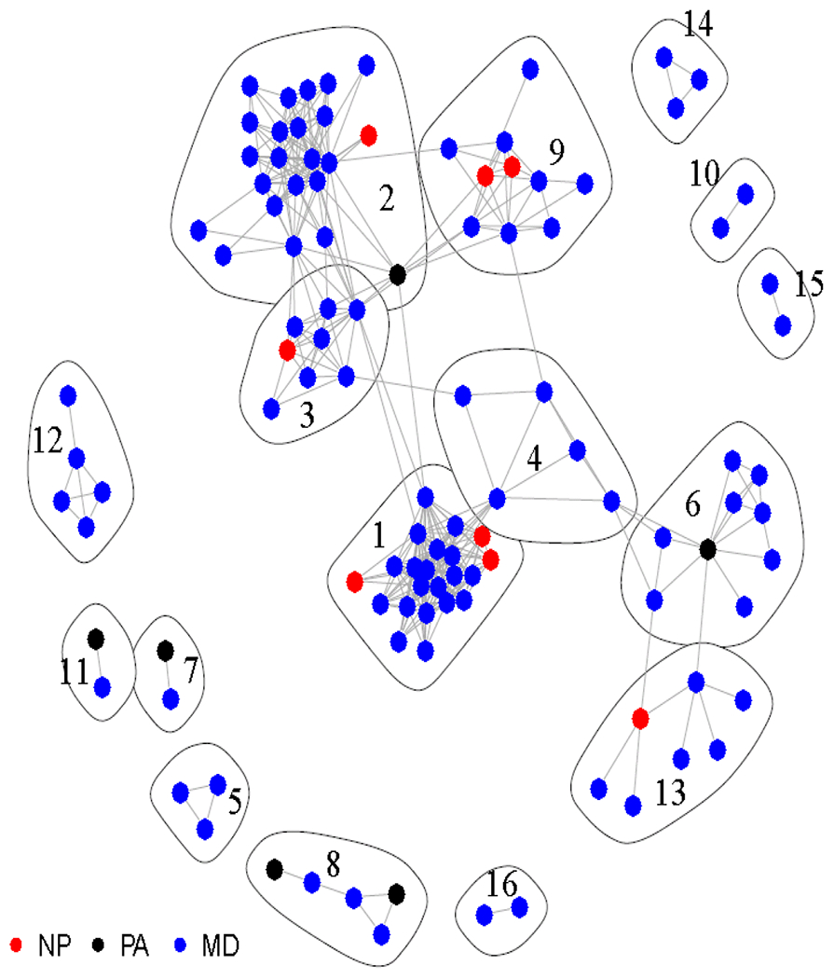
Example on the Visualization of Primary Care Teams Identified through Social Network Analysis. Analysis based on Medicare Data at a county in Texas
Notes:
RB note – I would suggest spending no more than 1 minute on this slide.

Slide 25
Methods: Data Sources
The medical claims and prescription filling record from Medicare beneficiaries
Outpatient visits and preventive medicine services were defined by Current Procedural Terminology (CPT) codes.
PCPs included primary care physicians, NPs, and PAs by specialty code and taxonomy codes .
Measure | Source
Beneficiary characteristics Medicare enrollment status | Master Beneficiary Summary files
Medication Use | Prescription Drug Event files
Outpatient Visits* | Outpatient Statistical Analysis files (OutSAFs) Carrier files
Hospitalizations Emergency Room Visits Cost of Care | Medicare Provider Analysis and Review file OutSAFs Carrier files
Identify primary care NPs and PAs | National Provider Identifier Registry
Notes:
RB notes – I don’t think you need all the specific definitions of which cpt codes were used in your definition. I also suggest putting the measures and their source file in a table like this – but could be reorganized to your preference.

Slide 26
Methods: Social Network Analysis
We first used Medicare outpatient claims from the 20% randomly selected primary care service areas (PCSAs, n=1,400) to identify primary care practices via SNA.
Primary care visits and visits billed by primary care providers were selected to determine the number of shared patients for each provider pair.
Only providers with at least 30 patients shared with another provider were included in SNA.
We identified primary care practices within each PCSA using the Walktrap community finding algorithm:
  four steps as the length of random walk
  weighted by the number of patients shared between primary care providers
Notes:
RB notes - Took out some of the definitions, because you explain them on the previous slide

Slide 27
Methods: Study Cohort and Network Measurements
Well defined modules within the network of PCSAs were selected
  Five hundred fifty-nine PCSAs with a modularity ≥ 0.4²³
Four types of practice:
  MD only, MD-NP, MD-PA, or MD-NP-PA
Patients with chronic conditions in these practices (from 100% Medicare data):
  diabetes, heart failure, or chronic obstructive pulmonary disease
The study cohort included 449,460 patients cared for by 17,185 primary care providers in 4,453 primary care practices in 556 PCSAs.
SNA network measures to show how well each practice was connected:
  edge density: degree of collaborative care or connectedness
  degree centralization: degree to which decision-making process is centralized
  betweenness centralization: degree to which information sharing is centralized
Notes:
RB note – above it says 559, but in the “study cohort included” line, it says 556

Slide 28
Methods: Statistics Analyses
Multi-level generalized linear models were constructed to account for the clustering effect of a practice.
The estimation of the OR of hospitalization, ER admission, and PIM use was performed with binary distribution and logit link function.
The estimation of cost ratio (CR) on Medicare cost was performed with the lognormal distribution.
Notes:
RB note – I think you can just quickly allude to the info in the first bullets, which I am pasting below. Otherwise, I think a high level summary of the methods as I’ve put here on the slide is enough:
For each provider within the practice, both normalized degree centrality and normalized betweenness centrality were calculated to show whether connections and centrality differed between types of provider.
Among practices with NP involvement, the average of provider’s degree centralization and betweenness centralization measures were calculated for NP and MD separately within the practice, and then the provider type specific averages were compared to determine the practice as MD-led (MD average > NP average), NP-led (NP average > MD average), or equal (MD average = NP average).

Slide 29
Results
Notes:
RB note – I would suggest cutting this slide and focusing on the results on the next slide instead. If this slide is deemed too important to cut, I would spend no more than one minute here. Maybe say something about general trends and mention an outlier or two, then go into the the meat of the results on the next slide.

Slide 30
Results
Higher collaboration (edge density) was associated with lower odds of:
  hospitalization (odds ratio (OR) = 0.89, 95% confidence interval (CI) = 0.79-0.99)
  emergency department (ER) admission (OR = 0.80, 95% CI = 0.70-0.92)
  total spending (cost ratio (CR) = 0.86, standard error of the mean (SE) = 0.038)
Higher degree centralization was associated with higher rates of:
  hospitalization (OR = 1.15, 95% CI = 1.03-1.28)
  ER admission (OR = 1.23, 95% CI = 1.08-1.40)
  total spending (CR = 1.14, SE = 0.037)
Higher degree centralization was also associated with lower rates of potentially inappropriate medications (OR = 0.90, 95% CI = 0.81-0.99)
Higher between centralization (highly centralized information sharing) was associated only with increased total spending (CR = 1.10, SE = 0.037)
Team leadership by an NP versus an MD was similar in the rate of ER admissions, hospitalizations, or total spending
Notes:
RB – I would not go too far into the specific results, but give a high level, narrative summary and call out the fact that collaboration and decision centralization had different effects on outcomes
I might also suggest putting a table with numbers off to the side, and pulling the main narrative points out to the side.

Slide 31
Strengths and Limitations: Data
Results may not be generalizable (fee for service Medicare)
  younger patients, those under Medicare Advantage plans, or those with commercial insurance
Possible inaccurate/missing data
  “Incident billing” may result in the care provided by NPs or PAs under the direct supervision of a physician to be billed under the physician
  Diagnoses codes are not always accurate or complete
  Lack of information on patients’ SES and health behaviors
However, strengths include:
  large sample size
  population across US regions
  link to other provider files (ex: Medicare data on provider practice and specialty (MD-PPAS), Shared Savings Program ACO Provider File, Physician Compare (Provider compare)
  multilevel structure of health system
  longitudinal follow-up

Slide 32
Limitations: Study Design and Analysis
Telemedicine not included
Identification of team-care practices by SNA is specific, but with low sensitivity
  Practices that were not tightly connected, or those located in areas with lower population and lower income, were likely under-identified
Cannot distinguish whether NPs or PAs substituted for MDs or contributed their complementary skills to patient care
Cross-sectional study design limits the ability to examine the causal relationship between, and temporal patterns within, team structure and health outcomes
  Further longitudinal study will help to characterize these relationships

Slide 33

Presentation 3
The effect of rurality and the COVID-19 pandemic on telemedicine and preventive healthcare use
Annie Elizabeth Larson, PhD
OCHIN
Notes:
Now I’d like to introduce our third presenter, Dr. Annie Elizabeth Larson from OCHIN.

Slide 34
Acknowledgements
Funding for this research was provided by AHRQ (1K01HS028732-01A1)
Notes:
Nothing to declare

Slide 35
Background
Rural patients have higher rates of chronic disease, infant mortality, ambulatory sensitive hospitalizations, and age-adjusted mortality than more urban patients
Use of primary care among rural patients lags behind that of patients in more urban areas
Telemedicine (TM) is a tool long identified as a means of increasing access to care for people living in rural areas
Notes:
2. Use of primary care services can reduce mortality rates, preventable hospitalizations, and low birth weight, and can improve self-rated health.
3. Telemedicine is a tool long identified as a means of increasing access to care for people living in rural areas, many of whom who face distinct challenges accessing preventive healthcare services

Slide 36
Background
The wide-scale adoption of TM resulting from the COVID-19 pandemic presented an opportunity
  Early evidence suggests rural patients are not utilizing TM at the same rate as more urban patients
Little is known about quality of care or what TM modality patients in rural as compared to more urban areas are using
Notes:
1. … to understand if TM can equitably improve preventive care utilization and quality of care for patients across the urban-rural continuum

Slide 37
Research Aims
Aim 1: Changes in frequency of preventive care visits and method of preventive care received among rural and urban patients
Aim 2: Differences in the use of TM and the type of healthcare for which TM was used among rural and urban patients
Aim 3: Effect of TM use on the quality and equity of care for chronic physical and mental health conditions among rural and urban patients

Slide 38
Research Questions
Who is using which TM modality (video or audio) and for which conditions?
Does quality of care differ by modality?
How do TM modalities provide care in different communities and among different patient populations?
Notes:
Specific to this talk
CMS ruled they will no longer reimburse for audio-only visits after 2024
This decision was made in part because of the limited research on the effectiveness of audio-only visits -> potential to further exacerbate disparities in access to and use of healthcare among patients who are already less likely to assess needed and recommended care

Slide 39
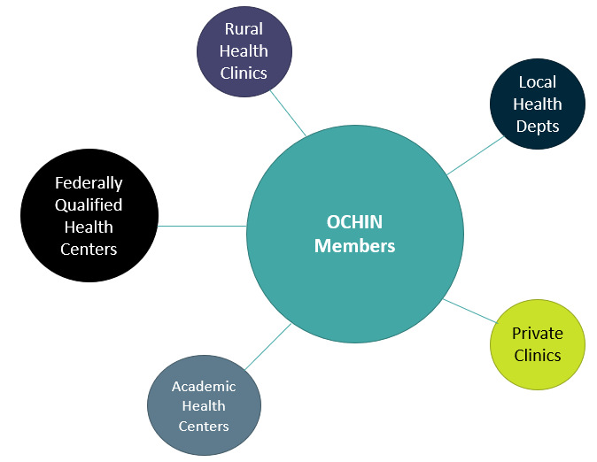
Methods – Data Source
Notes:
EHR from OCHIN’s DWH which has data on community-based health centers that serves safety net clinic patients across the US
primarily FQHCs

Slide 40
Methods – Available Data
DOMAIN | EXAMPLE
Demographics | Sex, age, race, ethnicity, language, FPL, sexual orientation, gender identity
Encounters | Encounter type, level of service, insurance, provider type, date
Diagnoses | From encounters, problem list, patient-reported medical history
Procedures | From encounters and patient-reported medical history
Vitals | BP, BMI, tobacco use, date
Labs | Name, source, values, date
Medications | Rx name, NDC, dose, refills
Patient-reported outcomes | Screening questionnaire responses (PHQ, AUDIT)
Immunizations | Type, dose, date
Social determinants of health | Patient-level social needs screening
Notes:
In addition to what is included in the common data model, I have access to A LOT more information like chart notes

Slide 41
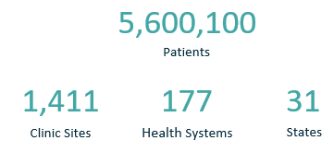
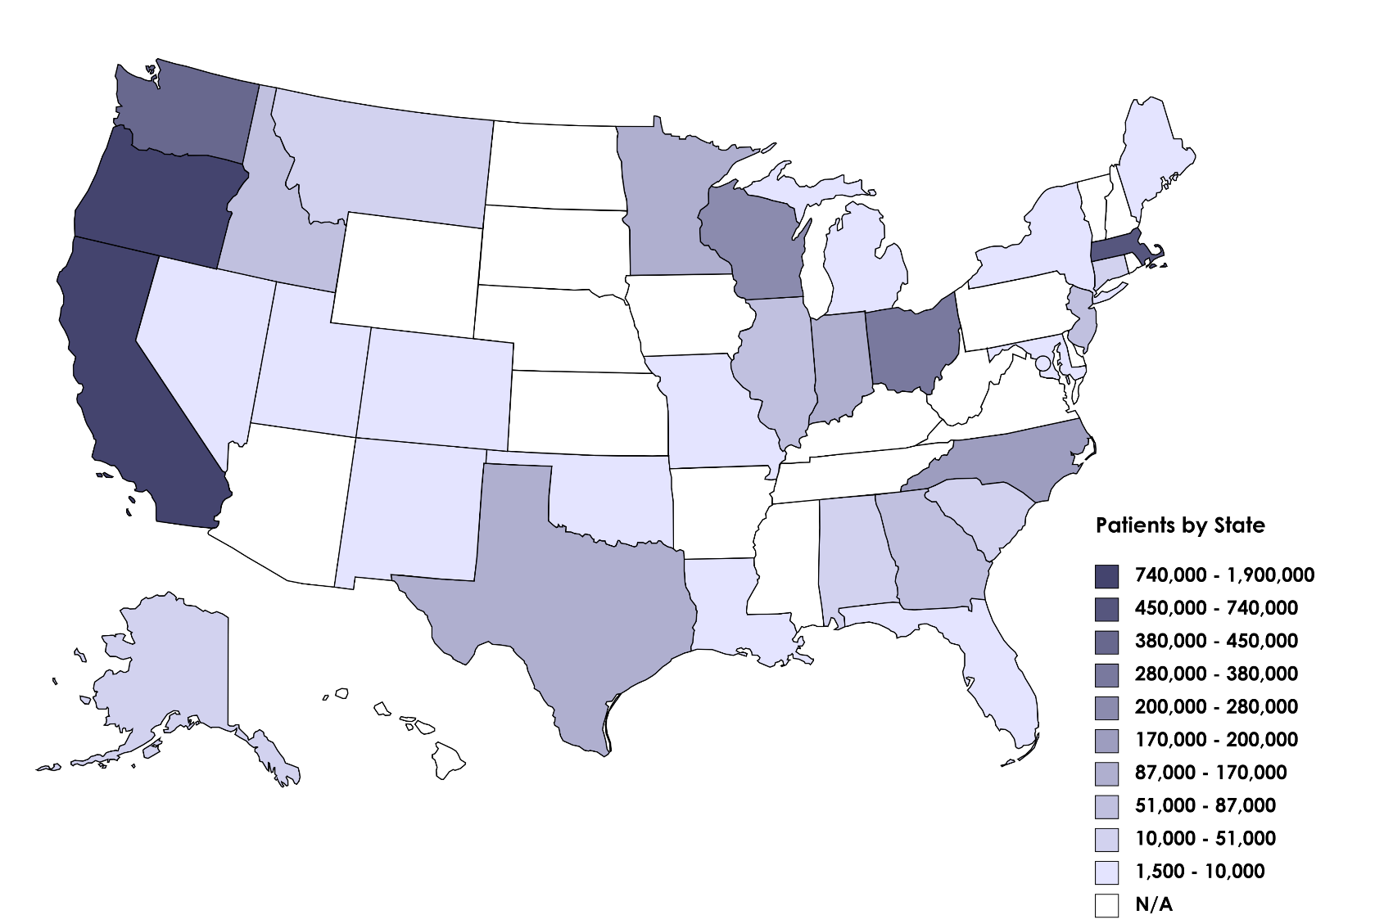
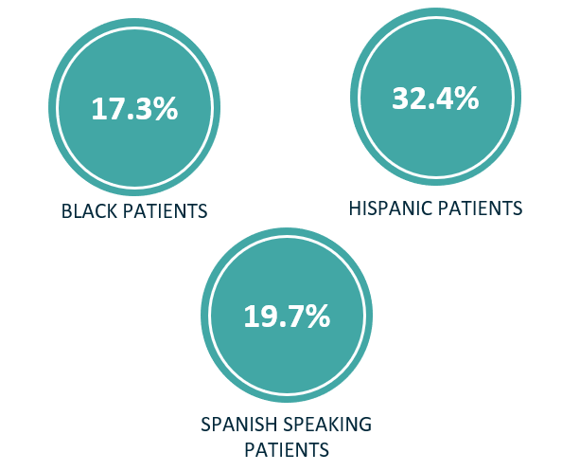
Methods – OCHIN Network
Patient Distribution by Clinic’s State
Notes:
Single instance of Epic, record follows the patient across any OCHIN clinic -> robust longitudinal dataset
Data as of end of 2022
‘active’ patients = visit in the last 3 years

Slide 42
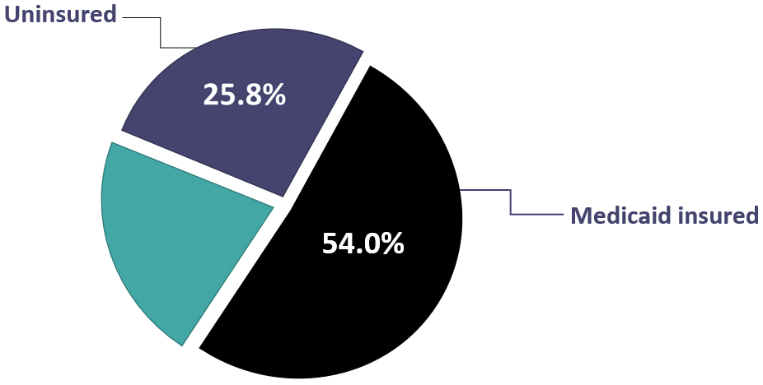
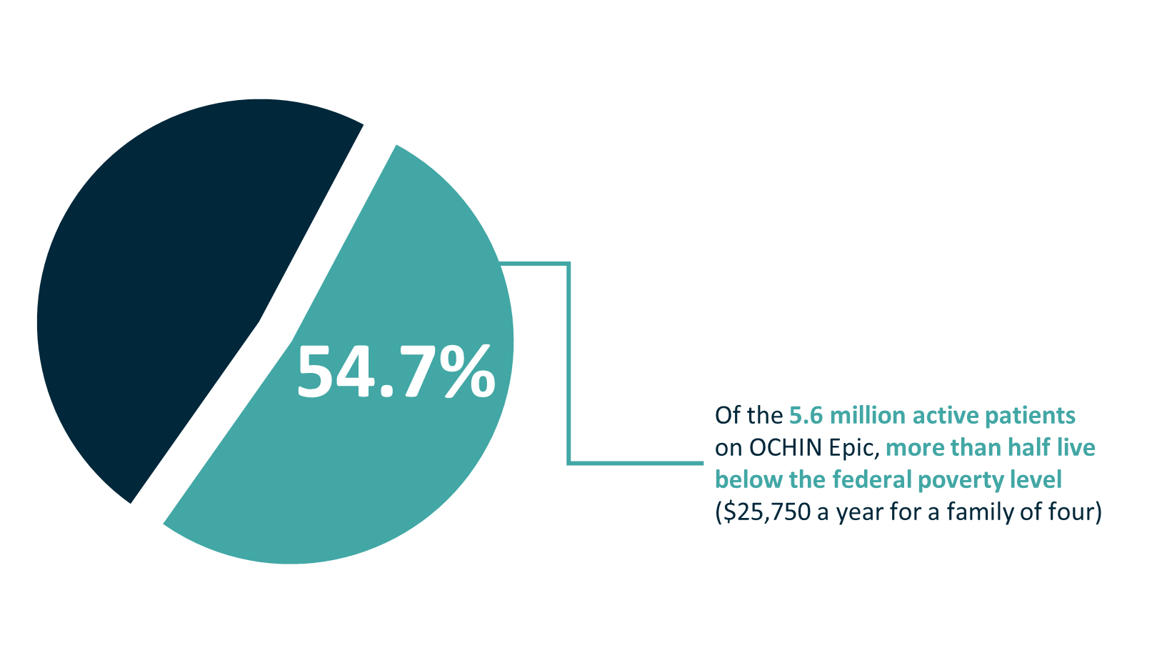
Methods – OCHIN Patient Characteristics
Notes:
-Unique features of this dataset is that it allows us to examine patients who are uninsured, and they care they receive while uninsured

Slide 43
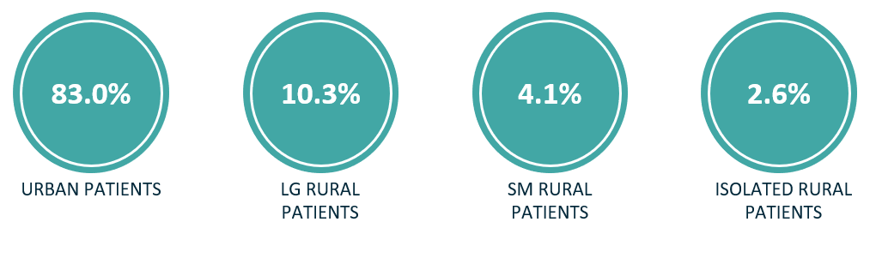
Methods – OCHIN Patient Characteristics
Notes:
Compared to 14% of the 2020 US population based on the USDA Economic Research Center
Because have patient address data the OCHIN data was linked to Rural-Urban Commuting Area data files and American Community Survey data to assign level of rurality of both the patient and the clinic and to utilize contextual / environmental information
Mostly reflects the makeup of clinics

Slide 44
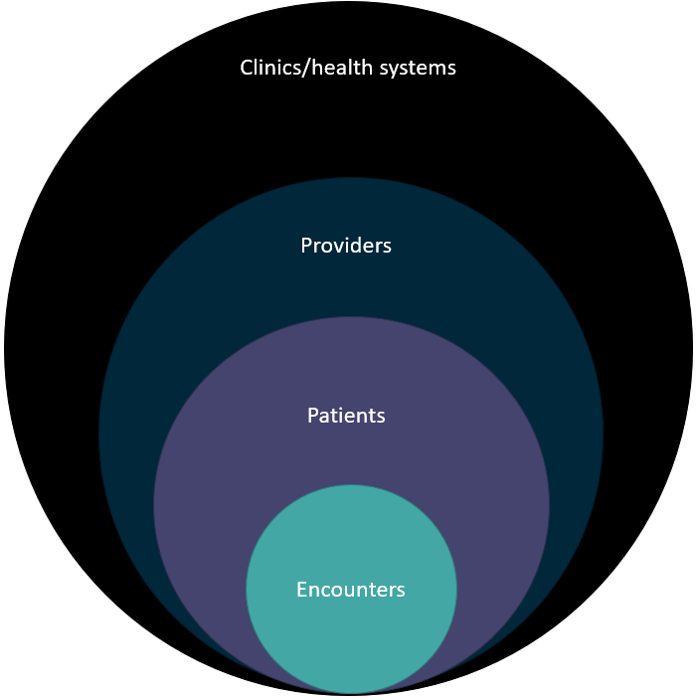
Analytic Methods
Notes:
Linked records across clinics
Because of the nested structure of OCHIN’s data, a lot of the research at OCHIN uses a multilevel modeling approach

Slide 45
Learning Healthcare System
Identifying TM modality (audio and video)
Limited research on this has been a bit mixed depending on the data source (survey, claims, EHR)
Embedded researcher: input from individuals across OCHIN
  clinicians, informaticists, EHR engineers, billers
Information from many different places in the EHR

Slide 46
Strengths
Contains data on patients who are often not captured in other data sources
Single patient record across the system – allows for longitudinal analysis at patient-level
Geocoded data - linkable to external data sources to provide contextual factors (e.g., Rural-Urban Commuting Area codes and ACS data)

Slide 47
Limitations
Only have data available on care received in OCHIN clinics
  Do have the ability to link to external sources for additional detail and information (e.g., Medicaid claims, cancer registries, vitals data)
Different systems & practices -> differential data completeness and quality
Do not know with certainty if TM modality is accurate
  Conversations with other teams within OCHIN to help validate
  Will be completing chart reviews to verify
Notes:
2. New health systems are continually added to the OCHIN network and some leave (a couple of states that are just joining that were not included on the map)
3. Other teams: clinical informaticists, clinicians, evaluation, EHR system developers

Slide 48
Future Directions
Quality of care and identify whether there are certain conditions that are better suited to TM or specific TM modalities than others
Longer term outcomes – hospital data / inpatient claims data

Slide 49
Questions
Yalda Jabbarpour, MD: yjabbarpour@aafp.org
Yong-Fang Kuo, PhD: yokuo@utmb.edu
Annie Elizabeth Larson, PhD: larsona@ochin.org

Slide 50
Thank you
    Stay tuned for the next webinar:
    Tentatively Titled, Primary Care Qualitative Studies Funded by AHRQ
Please complete the short evaluation poll after this webinar!
Notes:
Stay tuned for the next webinar in the series, tentatively titled Primary Care Qualitative Studies Funded by AHRQ. Please take the short evaluation poll that will pop up after this webinar. Thank you to our esteemed presenters and to all of you for joining us today!

