Slide 1
National Center for Excellence in Primary Care Research Presents Research Methods for Studying the Primary Care Workforce
May 2, 2024
Presented by:
Hannah Neprash, PhD
Lawrence P. Casalino, MD, PhD
Sylvia Hysong, PhD
Moderated by:
Yalda Jabbarpour, MD

Slide 2
NCEPCR Webinar Series
The views expressed in this webinar do not represent official views of the U.S. Department of Health and Human Services or the Agency for Healthcare Research and Quality.
Notes:
AHRQ is hosting a webinar series, Strengthening Primary Care Research. Today’s webinar is the fifth in the series. Stay tuned to the AHRQ channels for future webinar dates and registration.

Slide 3
Welcome
Aimee R. Eden, PhD, MPH Acting Director,
National Center for Excellence in Primary Care Research (NCEPCR), AHRQ
Notes:
Good day, everyone. My name is Aimee Eden. I am the acting Director for AHRQ’s National Center for Excellence in Primary Care Research. It is my pleasure to welcome you to today’s webinar.

Slide 4
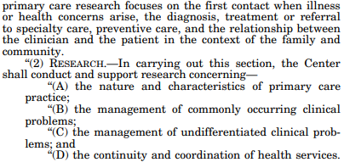
AHRQ’s 1999 Authorization
Notes:
AHRQ’s 1999 authorization

Slide 5
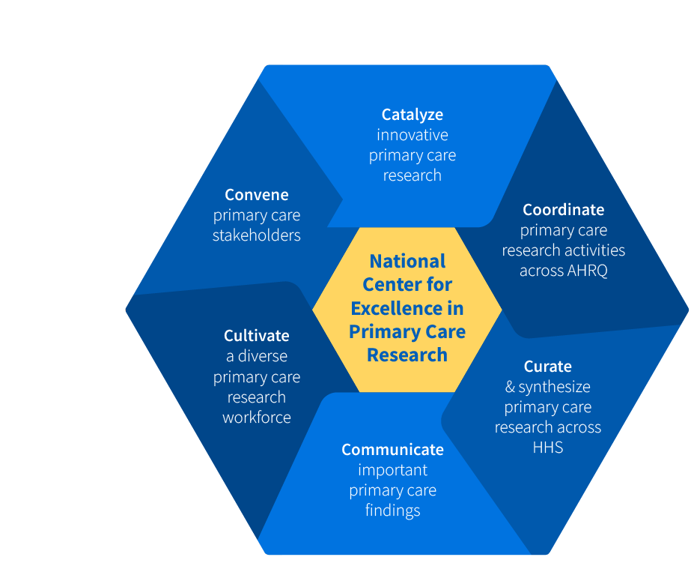
NCEPCR Vision & Mission
VISION:
NCEPCR envisions a future where all patients receive high quality, whole person, evidence-based, affordable primary health care from a healthy primary care workforce.
MISSION:
NCEPCR’s mission is to support transformative primary care research, tools and methods for implementation, and the next generation of primary care researchers to improve the delivery of primary care.

Slide 6
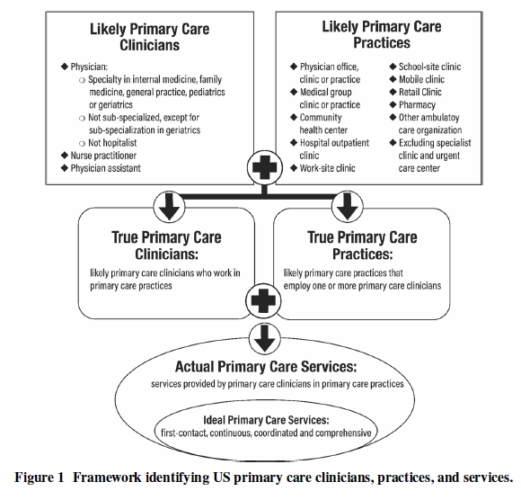
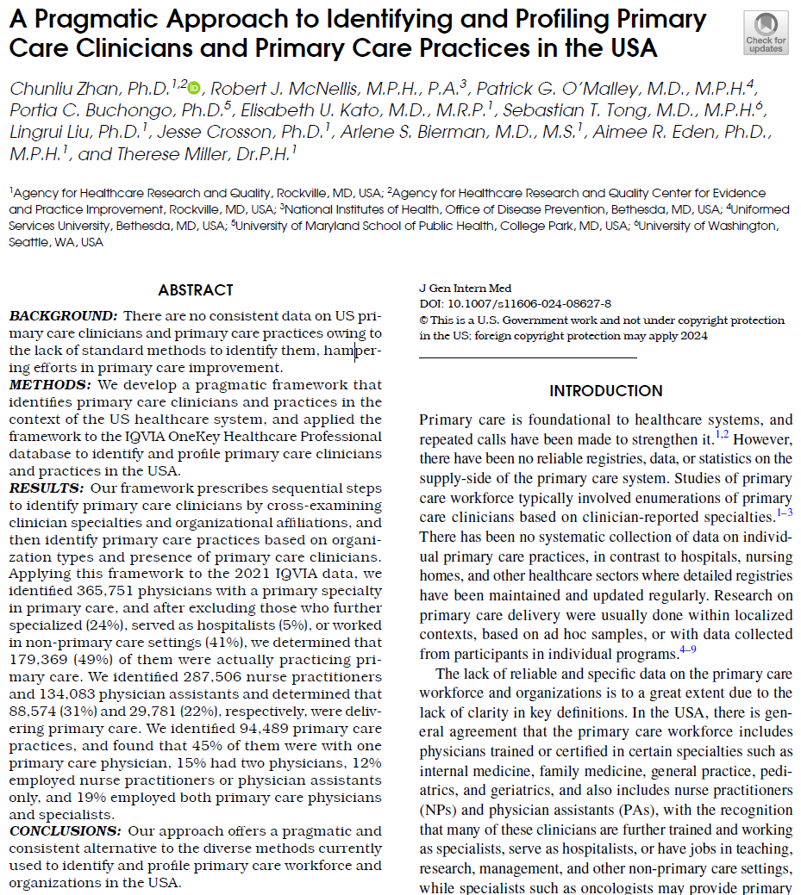
New AHRQ Publication: Identifying the Primary Care Workforce
Zhan C, McNellis RJ, O'Malley PG, Buchongo PC, Kato EU, Tong ST, Liu L, Crosson J, Bierman AS, Eden AR, Miller T. A Pragmatic Approach to Identifying and Profiling Primary Care Clinicians and Primary Care Practices in the USA. J Gen Intern Med. 2024 Jan 25. doi: 10.1007/s11606-024-08627-8. Epub ahead of print. PMID: 38273069.

Slide 7
New R01 Funding Opportunity: Research to Advance the Science of Primary Care
This NOFO prioritizes research projects aiming to improve primary care quality, safety, access, affordability, and equity, which may include attention to the primary care workforce, patient experience or outcomes, social determinants of health, care delivery models, payment, or digital healthcare.
Select sample workforce-related research areas:
Primary care workforce issues, including research that contributes to understanding approaches to support, develop, retain, and grow this workforce and to further understanding and improvement of burnout, moral injury, and well-being.
Time-related issues and concerns in primary healthcare delivery, such as electronic health record burden, patient wait times, how time is spent in a limited primary care patient visit, impact of time pressure on clinician wellbeing and joy in practice, and systems-level structures that impact how clinician and patient time is valued and used.
Interprofessional primary care team composition and configurations and their impact on patient experience of care and health outcomes.
The interface of primary care with pediatric and adult subspecialties, including testing innovative approaches to more effective collaboration, referral, and coordination of care.

Slide 8
Call for Papers: Family Practice Expanding the Primary Care Workforce
Submissions Deadline: August 1, 2024
Seeking papers that address the broad theme of expanding the primary care workforce; especially interested in innovative studies and ideas for recruiting and retaining primary care physicians.
Examples include the following:
Programs designed to encourage medical students and others to pursue primary care careers with clear outcome measures.
Innovative care delivery strategies that expand the reach of primary care without expanding the number of primary care physicians.
Programs designed to promote work-life balance and career satisfaction that promote retention in primary care.
We are also interested in studies which describe current primary care shortages and likely future ones, as well as studies of the consequences of the shortage of primary care physicians.

Slide 9
Today’s Webinar Objectives
Research Methods for Studying the Primary Care Workforce
Highlight examples of research methods used to study the primary care workforce
Notes:
The goal of today’s webinar is to 1. Highlight examples of primary care research on integration of behavioral health and
2. Introduce AHRQ resources that support behavioral health integration.

Slide 10
Moderator
Yalda Jabbarpour, MD Robert Graham Center
Notes:
Now I’d like to introduce the moderator for today’s webinar, Dr. Yalda Jabbarpour, from The Robert Graham Center.
Dr. Jabbarpour will facilitate the Q&A and discussion, which will take place after all of the presentations are finished. Welcome, Yalda!

Slide 11
Today’s Webinar Presenters
Hannah Neprash, PhD (University of Minnesota; School of Public Health; Division of Health Policy & Management), The Role of Nurse Practitioners in Improving Access to Primary Care
Lawrence P. Casalino, MD, PhD (Weill Cornell Medical College, Department of Population Health Sciences), Primary Care Physician-Staff Dyads (“Teamlets”): A Simple, Efficient Means to Improve Healthcare Quality and Decrease Cost
Sylvia Hysong, PhD (Baylor College of Medicine), Impact of Team Configuration and Team Stability on Primary Care Quality
Notes:
Hello everyone. We have three primary care researchers here today. Join me in welcoming:
Hannah Neprash, PhD (University of Minnesota; School of Public Health; Division of Health Policy & Management), The Role of Nurse Practitioners in Improving Access to Primary Care
Lawrence P. Casalino, MD, PhD (Weill Cornell Medical College, Department of Population Health Sciences), Primary Care Physician-Staff Dyads (“Teamlets”): A Simple, Efficient Means to Improve Healthcare Quality and Decrease Cost
Sylvia Hysong, PhD (Baylor College of Medicine), Impact of Team Configuration and Team Stability on Primary Care Quality
.
Be sure to save your questions – we’ll have the Q&A session after all the presentations are over. You can also pop your questions into the chat for later.

Slide 12
Presentation 1
The Role of Nurse Practitioners in Improving Access to Primary Care
Hannah Neprash, PhD University of Minnesota School of Public Health, Division of Health Policy & Management
Notes:
Now I’d like to introduce our first presenter, Hannah Neprash, PhD, University of Minnesota; School of Public Health; Division of Health Policy & Management. Welcome Dr. Neprash.

Slide 13
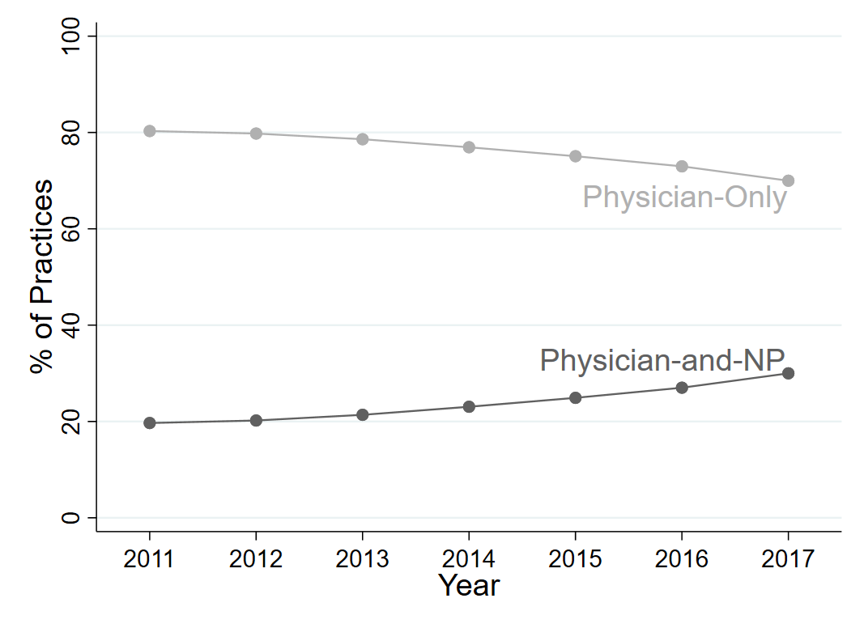
Background
Primary care physicians and nurse practitioners (NPs) increasingly work together.
NPs are more likely than physicians to treat patients of color and uninsured or Medicaid-covered patients.
Interdisciplinary practice staffing may expand access to care for historically underserved patient populations.
Notes:
Figure depicts the share of primary care practices in our data that employed only physicians or physicians and NPs, from 2011 to 2017.

Slide 14
Research Questions
When primary care practices employ NPs for the first time, how does access to care change…
…for new patients (especially new patients of color, uninsured patients, and patients with Medicaid coverage)?
…for established patients?
What this study adds:
Novel and objective measures of access to care
Uses all-payer data to study access for AHRQ’s priority patient populations

Slide 15
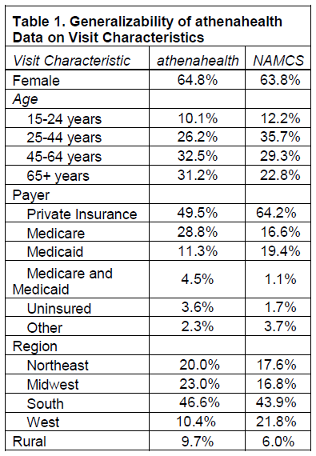
Data from athenahealth, Inc.
Data elements from insurance claims + electronic health records + practice management software
All-payer data from 2011-2017
Distinguishes rendering and billing providers
Includes practice identifiers

Slide 16
Dependent Variables
Access to Care
New patient visits
Visits for patients of color
Visits for uninsured and Medicaid-covered patients
Average visit wait time (in days)
Convenience of Care:
Walk-in visit count (and share)
After-hours visit count (and share)

Slide 17
Empirical Methods: Event Study
Treatment practices: those that hire an NP from 2011-2017
Control practices: those that never employ an NP (or always)
Observations at the practice-month level
Includes practices with at least 12 months of data
$$\begin{aligned}Y_{ist=}β_{0}+{NP_Employed}_{i}×\left[\sum_{y=−4}^{−1}{β_{y}I\left(t−t_{i}^{∗}=y\right)}+\sum_{y=0}^{7}{β_{y}I\left(t−t_{i}^{∗}=y\right)}\right]+X_{it}+γ_{i}+τ_{t}+ε_{ist} \end{aligned}$$
Practice i in state s at time (month) t
Event-time indicators for four months prior and eight months after practices hire NPs
Time-varying practice characteristics include other clinician counts
Practice fixed effects control for time-invariant differences between practices that do and do not hire NPs.
Month and year fixed effects control for seasonal patterns and trends affecting all practices

Slide 18
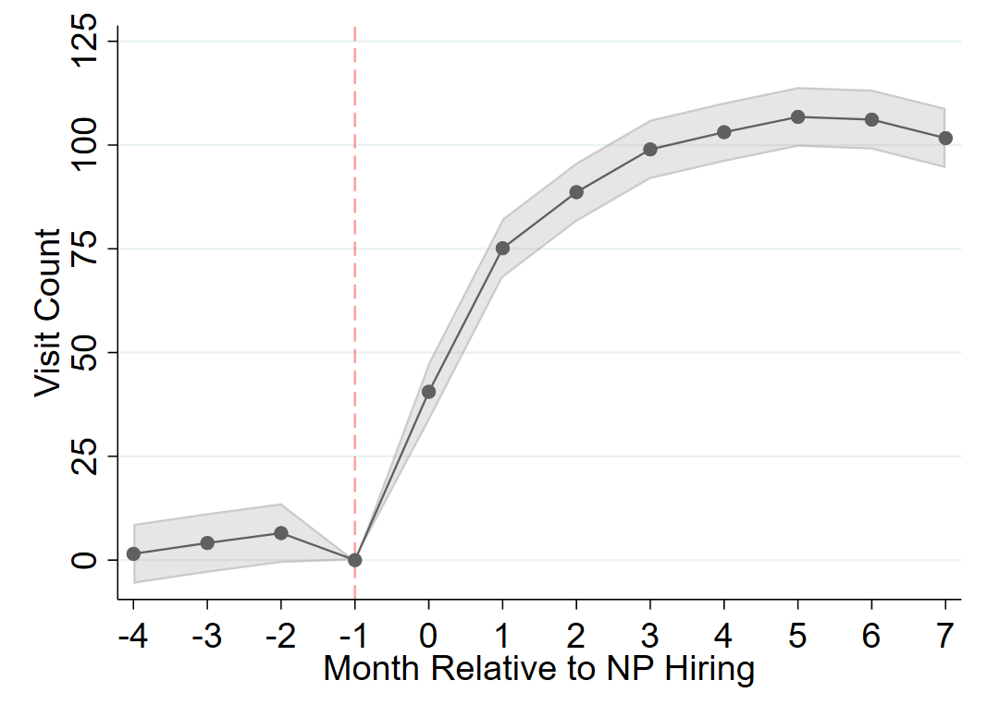
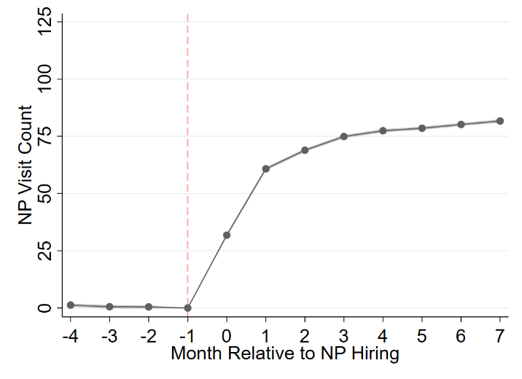
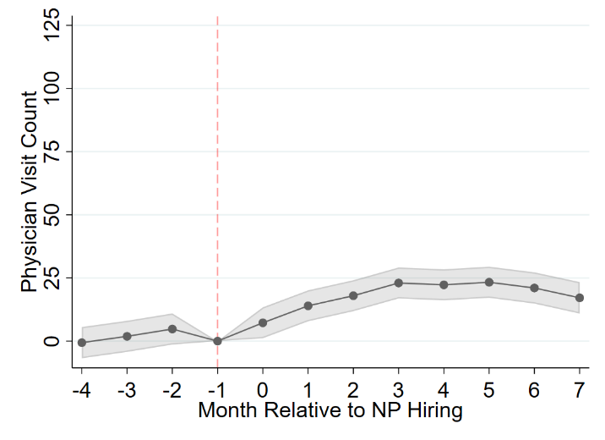
Findings: Visit Count
Practices provide more visits after hiring an NP.
NP and physician visit count increases.
Notes:
The figures show event study estimates of monthly visit count (overall, NP visits and physician visits), relative to the month before practices hired an NP.

Slide 19
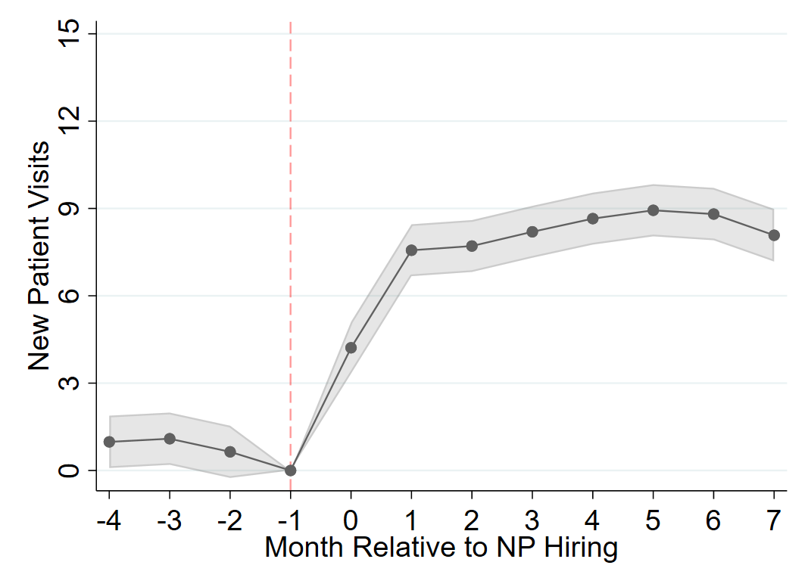
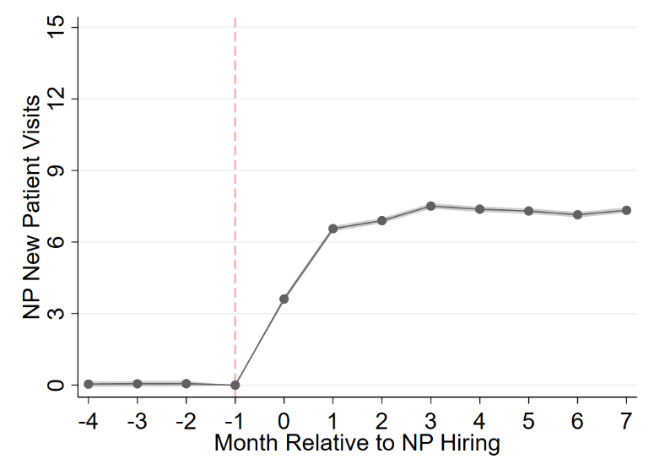
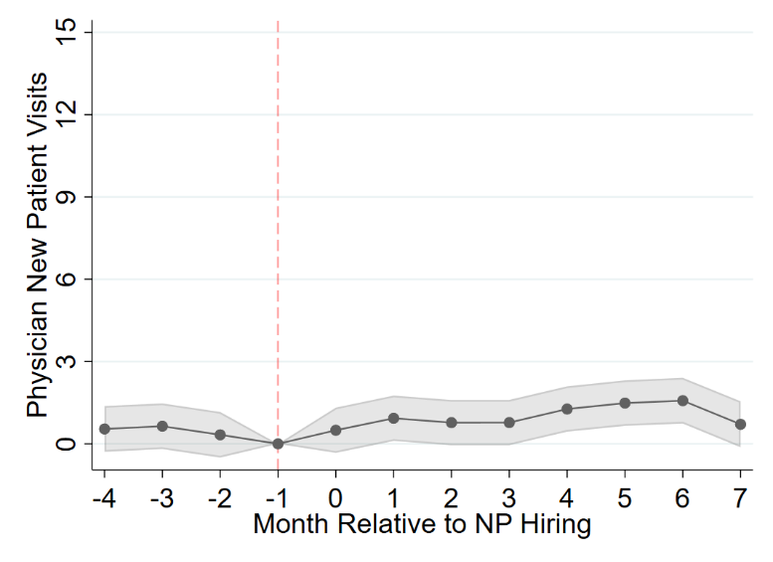
Findings: New-Patient Visits
Practices provide more new-patient visits after hiring an NP.
Most (but not all) of those new-patient visits are with NPs.
Notes:
The figures show event study estimates of monthly new-patient visit count (overall, NP new-patient visits and physician new-patient visits), relative to the month before practices hired an NP.

Slide 20
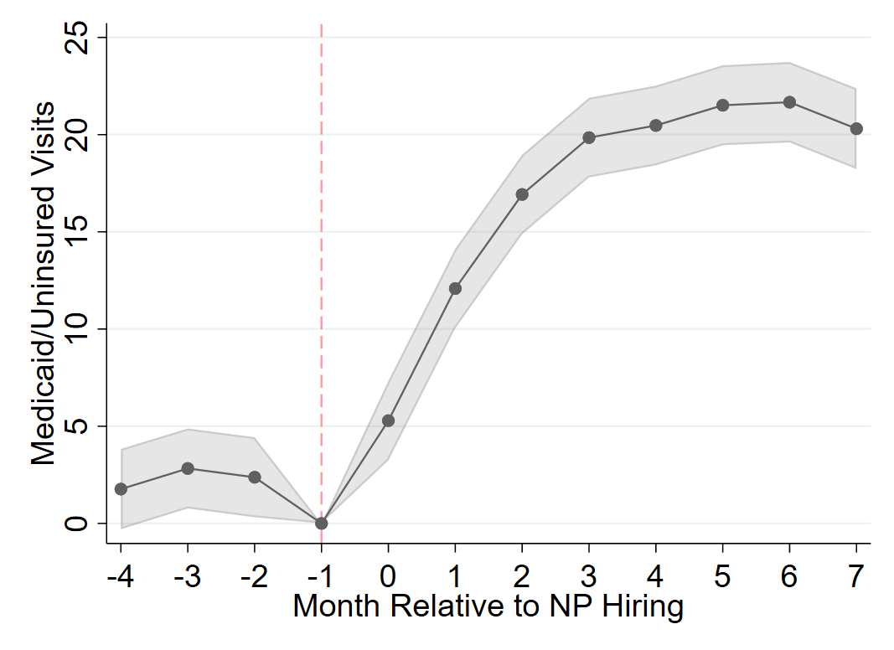
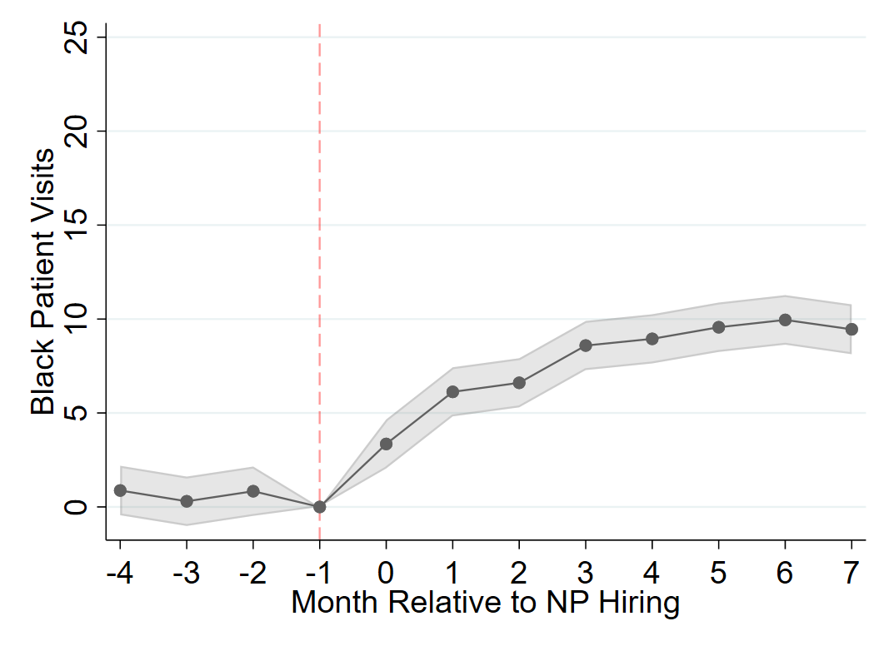
Findings: Priority Patient Population Visits
Practices provide more visits to Medicaid/uninsured and Black patients after hiring an NP.
This access expansion is proportional to the overall visit increase (i.e., the share of visits provided to these patient population does not change).
Notes:
The figures show event study estimates of monthly visit count for uninsured or Medicaid-covered patients (left) and for patients self-identifying as Black (right), relative to the month before practices hired an NP.

Slide 21
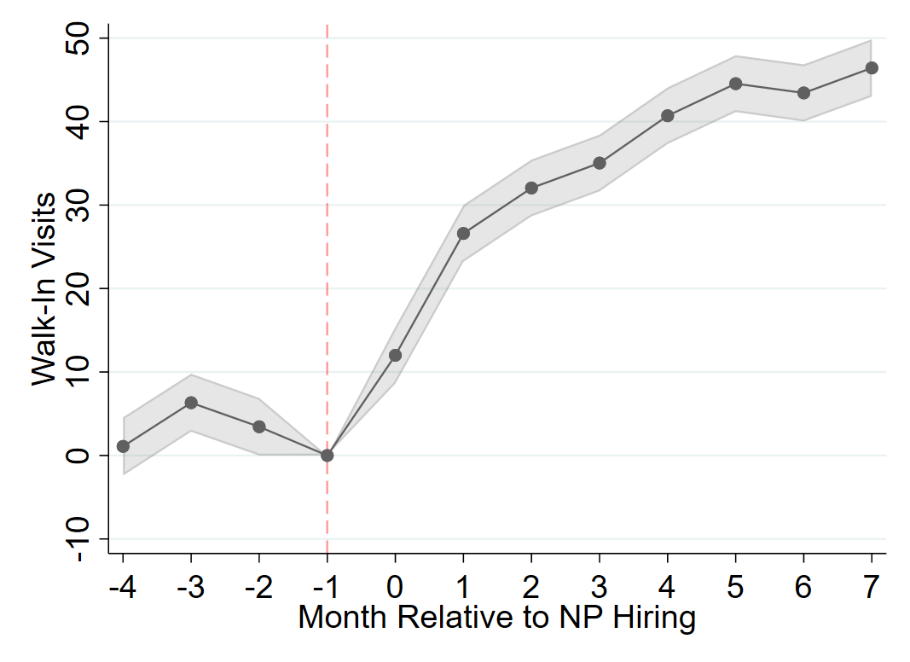
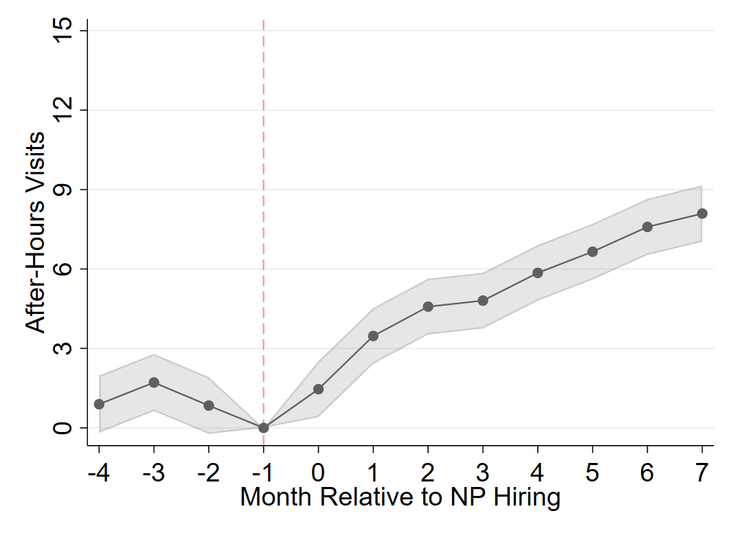
Findings: Care Convenience
Practices provide more walk-in and after-hours visits after hiring an NP.
These “convenient” visits were almost entirely provided by NPs.
Notes:
The figures show event study estimates of monthly walk-in visits (left) and after-hours visits (right), relative to the month before practices hired an NP.

Slide 22
Lesson Learned
As primary care practices increasingly hire NPs, access to care expands.
On average, hiring an NP means an additional 103 visits, 9 new-patient visits, 10 visits for Black patients, and 22 visits for uninsured/Medicaid patients, per month.
NPs improve the convenience of care, as measured by more walk-in visits and more after-hours visits.

Slide 23
Future Directions
What is it about interdisciplinary practice that enables physicians to provide more visits after their practice hires an NP?
Are access expansions driven by patient preferences (for NPs over physicians) and/or practice economics?
Is expanded access to care associated with changes in care quality and/or health outcomes?

Slide 24
Presentation 2
Primary Care Physician-Staff Dyads (“Teamlets”): A Simple, Efficient Means to Improve Healthcare Quality and Decrease Cost
Lawrence P. Casalino, MD, PhD
Weill Cornell Medical College, Department of Population Health Sciences
Notes:
Now I’d like to introduce our second presenter, Lawrence P. Casalino, MD, PhD, Weill Cornell Medical College, Department of Population Health Sciences, who is presenting on primary care physician staff dyads or “teamlets” – a simple, efficient means to improve healthcare quality and decrease cost. Welcome Dr. Casalino.

Slide 25
Our Research Team
Tom Bodenheimer, MD U.C. San Francisco
Melinda Chen, MD, MS U.C. San Diego
Ivan Diaz, Ph.D. Weill Cornell Medical College
Phyllis Johnson, MBA Weill Cornell Medical College
Hye-Young Jung, Ph.D. Weill Cornell Medical College
Eloise M O’Donnell MPH Weill Cornell Medical College
Yuting Qian, M.S. Yale University
Claude Rubinson, Ph.D. University of Houston
Mark A. Unruh, Ph.D. Weill Cornell Medical College
Rachel Willard-Grace, MPH U.C. San Francisco

Slide 26
Background
Providing good primary care is too much for one person.
Primary care teams are difficult, expensive, and time-consuming to create.
and probably beyond the capabilities of most small practices
Ditto and more so for patient-centered medical homes.
While teams and medical homes conceptually hold promise, evidence for their effectiveness is not that strong
except perhaps in special settings.

Slide 27
Background
“Teamlets” might be an alternative.
Teamlet = a dyad: 1 clinician + 1 staff member
Usually a medical assistant, but can be RN or LPN
Works with that clinician most of the time
Most teamlet members are not familiar with the term.
Simple, quick, inexpensive to create.
Teamlets can be created within teams, or teams created around teamlets.
Very little is known about the prevalence of teamlets or about their effectiveness.

Slide 28
Background
I had 3 medical assistants in 20 years.
Spent more time with them than with my wife.
Patients knew and trusted them. So did I.
MA catching me in the hall between patients: “Mr. X just called. I know, I know, I know that he calls almost every week . . but”
“Teamlets can transform a large, impersonal institution into a small practice environment within which patients know their teamlet members and the teamlet partners know their patients.”
Bodenheimer T, Willard-Grace R. Teamlets in Primary Care: Enhancing the Patient and Clinician Experience. Journal of the American Board of Family Medicine : JABFM. 2016;29(1):135-138.

Slide 29
Specific Research Aims
Identify the prevalence and characteristics of primary care teamlets in the U.S.
and determine the predictors of physician participation in a teamlet.
Estimate the relationship of primary care teamlets to physician burnout and to quality and cost of care.
Identify the configurations of characteristics that distinguish high-performing teamlets.
Overall goal: provide the first large scale evidence on the prevalence of primary care teamlets, the relationship between primary care teamlets and patient outcomes, and the characteristics of high-performing teamlets.

Slide 30
Methods
Survey a national sample of primary care physicians
Based on physician responses, assign each physician to one of four categories:
1. teamlet/no team
2. teamlet/team
3. team/no teamlet
4. no teamlet/no team
Final analytic sample: 688 physicians to whom 82,079 beneficiaries were attributed.

Slide 31
Methods
Primary analysis: test the association between the teamlet/team category and:
Patient outcomes (using Medicare claims)
Physician burnout (using survey responses)
Interview a sample of physicians and staff members to identify the characteristics of high-performing teamlets

Slide 32
Findings
 | Team | No Team | Percent in Teamlets
Teamlet | 28.3% | 49.1% | 77.4%
No Teamlet | 8.4% | 14.1%
Percent in Teams | 36.7%

Slide 33
Findings
 | Practice Size |  | Practice Ownership |  | Physician Specialty
 | 1-2 | 3-9 | Physicians | Hospital or AMC | GIM | FP
Teamlet/no team | 43.2 | 41.7 | 56.0 | 36.4 | 41.4 | 58.6
Teamlet/team | 21.0 | 55.4 | 36.4 | 58.0 | 34.9 | 65.1
No teamlet/team | 13.8 | 50.0 | 39.7 | 44.8 | 36.2 | 63.4
No teamlet/no team | 54.6 | 24.7 | 66.0 | 26.8 | 55.7 | 44.3
Cells show percentage of physicians compared to total number of physicians in each team/teamlet category. Teamlet/no team: smaller practices (pink); physician-owned (brown) Team: larger practices (blue); hospital/AMC owned (brown) No teamlet/no team: smaller practices (orange); physician-owned practices, GIM physician (brown)

Slide 34
Findings
Adjusted regression results for burnout and outcomes by teamlet/team category
Teamlet Category | Burnout | Ambulatory sensitive ED visits | Ambulatory sensitive admissions | Total spending
 | OR (95% CI) | OR (95% CI) | OR (95% CI) | Coefficient (CI)
No teamlet/no team | Reference | Reference | Reference | Reference
Teamlet/no team | 1.61 (1.25, 2.09) | 0.97 (0.82, 1.13) | 1.12 (0.95, 1.32) | 1441 (628, 2255)
Teamlet/team | 1.31 (1.00, 1.70) | 0.92 (0.77, 1.10) | 1.03 (0.84, 1.26) | 1090 (24, 2156)
No teamlet/team | 2.12 (1.62, 2.77) | 0.92 (0.71, 1.19) | 1.53 (1.19, 1.96) | 2664 (-319, 5648)

Slide 35
Findings
Percentage of physicians in perceived:
High collaboration teamlet: 15.7%
Medium collaboration teamlet: 47.4%
Low collaboration teamlet: 14.4%
Outcomes for patients did not consistently vary based on collaboration levels.
Perceived burnout more likely in low collaboration teamlets (? causal direction) and in no teamlet/team category.

Slide 36
Lessons Learned
Teamlets were common in practices of all sizes and ownership types.
No strong evidence for better outcomes for patients or less burnout for physicians with teamlets
(or any teamlet/team configuration).

Slide 37
Future Directions
Do more intensely implemented teamlets improve outcomes and reduce burnout? For example:
When placing patients in exam rooms:
review health maintenance screen in the electronic health record, advise patients of care gaps
enter orders based on protocols to address the care gaps.
Train MAs to do health coaching for patients with chronic illness
Bodenheimer T, Willard-Grace R, Ghorob A. Expanding the roles of medical assistants: who does what in primary care? JAMA internal medicine. 2014;174(7):1025-1026.

Slide 38
Future Directions
Do certain types of teamlets, teams, or teamlets within teams achieve higher performance?
Use different outcomes and/or a different method to assess burnout.
Is patient experience better with teamlets?
Is staff member experience better (and/or turnover lower) with teamlets?
Further interview-based work to explore characteristics of high-performing teamlets.
Consider using Qualitative Comparative Analysis (QC) as the analytic method to identify configurations of characteristics of high-performing teamlets.
Chen MA, Rubinson C, O'Donnell EM, Li J, Bodenheimer T, Casalino LP. High-Performing Teamlets in Primary Care: A Qualitative Comparative Analysis. Journal of the American Board of Family Medicine : JABFM. 2024;37(1):105-111.

Slide 39
Presentation 3
Impact of Team Configuration and Team Stability on Primary Care Quality
Sylvia Hysong, PhD
Baylor College of Medicine
Notes:
Now I’d like to introduce our third presenter, Sylvia Hysong, PhD Baylor College of Medicine, who is presenting on the impact of team configuration and team stability on primary care quality. Welcome Dr. Hysong.

Slide 40
Acknowledgements
Research Team
Principal investigator: Sylvia J. Hysong, Ph.D.
Co-investigators:
Kelley Arredondo, Ph.D.
Joshua Hamer, Ph.D.
Ashley M. Hughes, Ph.D.
Houston F. Lester, Ph.D.
Laura A. Petersen, M.D., M.P.H.
LeChauncy Woodard, L., M.D.,
Consultant: Frederick L. Oswald, Ph.D.
Study coordinator: Richard P. SoRelle, B.S.
Research assistant: Tran Pham, M.S., M.D.
Funding
Agency for Healthcare Research & Quality, grant # AHRQ 1 R01 HS 025982
U.S. Department of Veterans Affairs Health Services Research & Development Service, grant # CIN 13-413

Slide 41
Bottom Line Up Front
Primary care quality can be measured and prioritized according to value
Team configuration can be measured unobtrusively through network approaches
Team configuration matters and impacts primary care quality and access
Changes to team configurations over time impacts access of care

Slide 42
Study Objectives
Select a targeted set of clear, measurable, accountable, primary care performance metrics, prioritized according to their overall contribution and value to primary care.
Determine which primary care team configurations are associated with key clinical quality metrics indicative of high-quality primary care delivery.
Hypothesis 1: Teams that adhere more closely to the recommended team configurations will exhibit better clinical outcomes than teams who deviate more egregiously.
Examine the extent to which adherence, team stability, and role stability impact healthcare quality.
Hypothesis 2: Teams that are more stable over time relative to teams who are less stable; specifically, teams whose clinical manager (RN) is more stable over time relative to teams whose RN is less stable

Slide 43
Design and Participants
22,392 primary-care personnel
7,750 Patient Aligned Care Teams (PACTs)
1,050 VHA Healthcare Facilities
Observational database review over 24 months (January 2019 to December 2020)

Slide 44
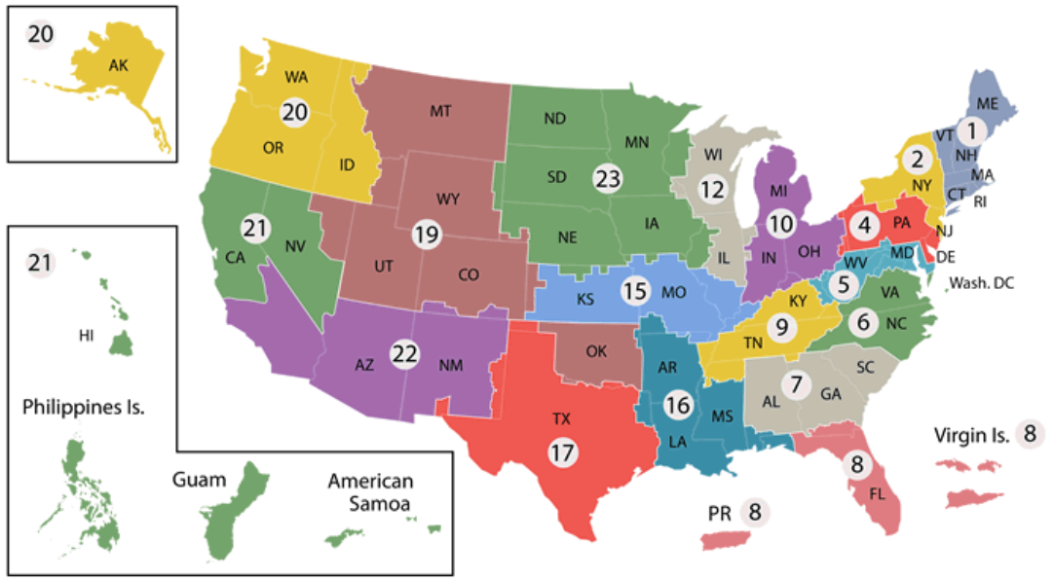
Overview of VHA and PACT Model
Veterans Health Administration (VHA)
1,293 health care facilities
171 VA Medical Centers
1,112 Outpatient sites of care
367,200 healthcare professionals & staff
> 9 million Veterans enrolled†
Veteran
PCP
RN (coordinator)
Clerk (scheduling)
LVN
Pt 5
Pt 6
Pt 5
Pt 2
Pt 3
Pt 8
Pt 1
Pt 7
Pt 9
PACT B
PACT A
PACT C
Ancillary Team Members (shared by every 3 teams) Pharmacist, Nutritionist, Social Worker
†Source: www.va.govhealth/aboutVHA.asp

Slide 45
Selecting Clinical Outcome Measures for Primary Care
Overview of ProMES Process
Participants and Data Sources
1. Design Team
2. Objectives
3. Indicators
4. Contingencies
5. Feedback Reports
6. Feedback Meetings
7. Periodically Review Systems
Design Team: 10-member expert panel representing relevant key stakeholder groups, (e.g., primary care team members, administrators, scientists, and patients)
Data Sources
eQM Metrics
HEDIS Metrics
VHA Corporate Data Warehouse (CDW)
Procedure: Modified ProMES expert elicitation process (Pritchard et al., 2012)
Notes:
SAY:

Slide 46
Selected Primary Care Outcomes
Domain 1: Access
Average third next available appointment
ER/urgent care (UC) utilization rate
Inbound to total outbound primary care secure messages ratio
Domain 2: Patient/care team partnership
Team 2-day post-discharge contact ratio
Domain 3: Quality
Hemoglobin A1c control
Diabetic nephropathy screening
Hypertension control
Source: Hysong SJ, Arredondo K, Hughes AM, Lester HF, Oswald FL, Petersen LA, Woodard L, Post E, DePeralta S, Murphy DR, McKnight J. An evidence-based, structured, expert approach to selecting essential indicators of primary care quality. PLoS One. 2022 Jan 18;17(1):e0261263.

Slide 47
Measuring Team Configuration from Existing Personnel Data
Data Source: VHA Team Assignments Report - lists who is assigned to what team at any given time.
Measures
Degree - the average number of teams to which each member of a given team is assigned
Blau’s index - the extent to which the team contains diversity of roles (primary care provider, registered nurse care manager, licensed vocational nurse, and scheduling clerk).
Team Size – number of individual people in a team
FTE – number of full-time equivalent people in a team
Overall adherence to recommended team configuration: average deviation from recommended degree, blau’s index, and Team size values

Slide 48
Measures of Team Stability
 | Variable | Definition
RN Role | RN Continuous Churn | RN role filled for the 24 months but by various individuals
 | RN Staffing Instability | RN role filled between 16.67%-99% of the 24 months
 | RN Vacancy | RN role was filled less than 16.67%% of the time
 | RN Stability | Same person in the RN role for the entire 24-month period
Team Characteristics | Full-time Equivalent (FTE) | Team-member’s scheduled hours on a team divided by the number of hours for a full-time workweek
Team Characteristics | Team Stability | Team's overall stability for the 24-month period, with a score of 1 indicating that the entire team remained unchanged
 | Team Size Change | The comparison of a team size at a given point relative to the team’s average size
 | Average Team Size | Average size of the team across the 24 months

Slide 49
Result Highlights: Team Configuration and Quality Outcomes
Overall adherence was unrelated to most outcomes
In most cases, teams with more FTEs exhibited better outcomes.
Different team characteristics were significantly associated with different outcomes:
Before the pandemic… | During the pandemic…
Greater role diversity was associated with lower emergency room/urgent care lutilization higher patient engagement | Teams with lower overall adherence exhibited higher ER utilization Teams with higher multiple-team membership exhibited lower ER utilization
Larger teams exhibited higher 2-day post-hospital discharge lcontact lower access (longer times to third next-lavailable appt.) | Larger teams exhibited lower ER utilization lower 2-day post-discharge contact

Slide 50
Result Highlights: RN Stability and Access
RN staffing instability and vacancy were unrelated to any access measures.
Teams with greater FTE over time had significantly better scores on all access measures.
Teams experiencing continuous RN churn had significantly worse access (third next available appointment times)
Teams with greater overall stability had significantly better scores on third next available, established patient wait times, and ER utilization

Slide 51
Limitations and Future Directions
Limitations
Areas for Expansion
Our method does not account for within-team interactions
Not suitable for team process assessment
Measurement / assessment of specific network configurations outside the recommended one (e.g., star, dense, decentralized)

Slide 52
Conclusions
A targeted set of performance measures can be curated systematically to track progress toward specific objectives in delivering high-quality primary care.
Primary care teams require a minimum amount of FTE capacity to deliver the level of access to health care and quality expected of them without danger of clinician burnout and turnover.
Suitably staffed and stable teams, specifically the RN role, are associated with improved access to care.
Staffing primary care teams with specific configural features may yield improvements in different aspects of access and quality
Notes:
Conclude something about aim 1

Slide 53
For Further Reading
Crawford, E. R., Reeves, C. J., Stewart, G. L., & Astrove, S. L. (2019). To link or not to link? Multiple team membership and unit performance. Journal of Applied Psychology, 104(3), 341.
Hysong, S. J., Amspoker, A. B., Hughes, A. M., Woodard, L., Oswald, F. L., Petersen, L. A., & Lester, H. F. (2019). Impact of team configuration and team stability on primary care quality. Implementation Science, 14, 1-9.
Hysong, S. J., Arredondo, K., Hughes, A. M., Lester, H. F., Oswald, F. L., Petersen, L. A., ... & Haidet, P. (2022). An evidence-based, structured, expert approach to selecting essential indicators of primary care quality. PLoS One, 17(1), e0261263.
Hysong, S.J., Arredondo, K., Lester, H.F., SoRelle, R., Pham, T., Oswald, F.L., Woodard, L., Petersen, L.A., Hamer, J., Hughes, A.M. (2023). Impact of Primary Care Team Configuration on Access and Quality of Care medRxiv; doi: https://doi.org/10.1101/2023.05.18.23290117
Pritchard RD, Ashwood E, Weaver SJ. Evidence-based productivity improvement: A practical guide to the Productivity Measurement and Enhancement System (ProMES). Routledge; 2012.

Slide 54
Questions
Please post your questions in the chat!

Slide 55
Thank you
Check the AHRQ Channels for announcements about the next webinar in the series
We value your feedback.
Please complete the short evaluation poll after this webinar!
Notes:
Check the AHRQ channels for announcements about the next webinar in the NCECPR webinar series.
Please take the short evaluation poll that will pop up after this webinar. Thank you to our excellent presenters and to all of you for joining us today!

