Slide 1
Provider Training Slides
Toolkit for Engaging Patients and Families To Improve Diagnosis
AHRQ Publication No. 21-0047-7-EF August 2021

Slide 2
"Just listen to your patient, he is telling you the diagnosis."¹
- Sir William Osler
Notes:
This quote from Sir William Osler, who is also commonly referred to as the Father of Modern Medicine, emphasizes the importance of communication in the patient-provider encounter, in particular the importance of listening to patients’ description of their illness, to arrive at an accurate diagnosis.¹
The patient is both an essential and often underutilized member of the diagnostic team. Our goal as providers must be to partner with patients to improve the accuracy, timeliness, and effective communication of our diagnoses to optimize the quality and safety of healthcare. One simple way to achieve this goal is to bridge some of the common communication challenges in our practice.

Slide 3
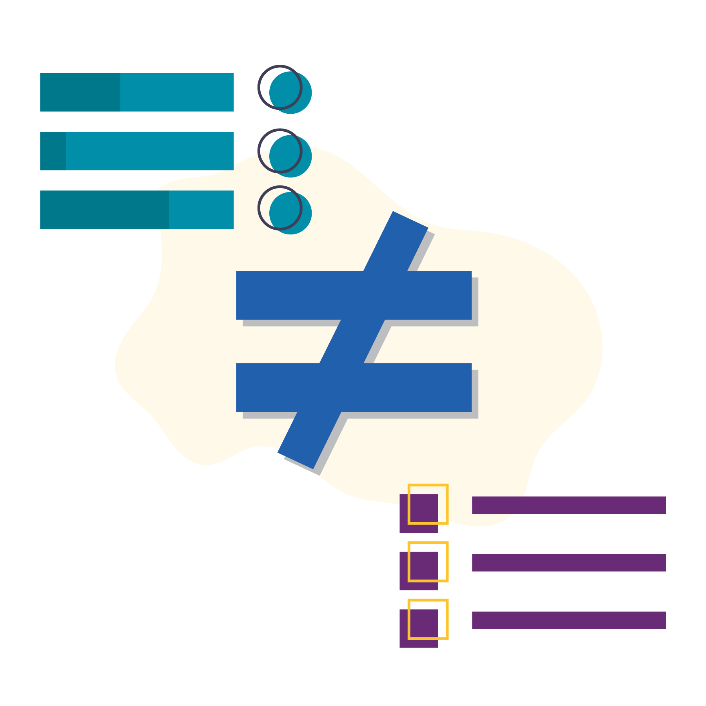
Reasons for Diagnostic Error
Patients are interrupted when telling their illness story to providers within 11-18 seconds.^{2,3}
This breakdown in collaborative communication may result in assumptions and premature closure.⁴
These breakdowns lead to diagnostic error in about 1 of every 20 patients you see.⁵
Notes:
According to the literature, good communication skills are associated with stronger patient-provider relationships, greater patient satisfaction, and better patient adherence to medical treatments and care plans.
While intuitively we know that good patient-provider communication is essential for achieving an accurate diagnosis, evidence suggests that we interrupt our patients within 11 to 18 seconds of their beginning to share the history of their present illness, their story.
These interruptions may result in a breakdown in communication, leading patients to feel unheard, uncared for, and rushed, and most importantly, that their contributions to the care team are unwanted and irrelevant. It can also leave clinicians without key information about the patient’s current illness trajectory and contributing factors, which may lead to premature closure and the wrong diagnosis.
Missed, delayed, and wrong diagnoses happen in 1 of every 20 patients in primary care settings. Some of these diagnostic errors lead to significant patient harm. We need effective interventions to overcome communication breakdowns in patient-provider encounters. One intervention that can be effective in improving patient history taking is giving patients the first minute of each clinic visit to tell their illness story.

Slide 4
An Eloquent Silence
"I had previously been an attentive listener but now he felt I wasn’t listening as well." - Provider
Notes:
[Facilitator: This is the story of a leading clinician scientist who conducts research on communication. Here, he articulates some of the challenges of being present during the clinical encounter. It is not intended that you teach the entire exchange but use it to provide context to your providers on why this intervention may be useful in the diagnostic process and how letting the patients use the first minute to share their care experiences may impact clinicians and patients in a positive way.]
Providers who use the strategy of giving patients the first 60 to 90 seconds of the clinical encounter to share their story, their concerns (worries), and the things they have tried to improve their health status, report that the benefits of this approach go far beyond the improvements in diagnosis. They can also improve patients’ satisfaction with their care team, patients’ satisfaction with communication, and clinician well-being and love of practicing.⁶
The following story is about a long-time patient of one of the providers we spoke to:
A few months after a new electronic health record had been introduced, one of my patients stopped me midsentence and said he’d noticed something different ever since the new computers had been installed in the exam rooms. He told me I had previously been an attentive listener but now he felt I wasn’t listening as well.
“It was like a dagger through my heart. Here I am, a researcher and teacher who has devoted his entire academic life to improving communication between doctors and patients, I had co-authored the study that showed that doctors interrupt patients after just a few seconds, and now a patient is showing me, well,… how I had failed.”
At that point I made a commitment to spend the first 90 seconds of every office visit just listening – not looking at the computer screen, not taking notes, not interrupting – just listening.
It has made all the difference. I came to enjoy my patients more, even with the distractions of the EHR. And visits weren’t any longer and I felt a greater sense of coherence at the end of the day.
This intervention, of listening deeply for 60 seconds, is about cultivating presence, attentiveness, and curiosity.^{7,8} The keys here are to listen more than you talk, ask questions that deepen your understanding, and avoid jumping prematurely to advice and judgment.⁶
This approach often involves silence.⁹

Slide 5
How Does 60 Seconds To Improve Diagnostic Safety Work?
Notes:
The 60 Seconds To Improve Diagnostic Safety strategy allows you the time to practice reflectively through deep and active listening. One reflective practice we recommend is the Ask, Listen, and Act strategy:
ASK: Questions are the path to discovery. Questions convey value, so how do I ask the right questions of the right people at the right time to achieve a safe diagnosis?
LISTEN: Questions are only meaningful if I listen actively through mindful engagement to the responses. What can I learn from actively listening? How do I integrate what I hear with what I already know to ask what else can it be?
ACT: Asking and listening are followed by thoughtful action with patient perspectives and a plan for assessment. What actions will help contribute to a safe diagnostic process to plan actions that can lead to better health?
The diagnostic process and reflection have similar goals. Both derive from a spirit of inquiry, that is, from asking questions. Reflection is a form of diagnostic calibration. It questions overconfidence, premature closure, confirmation bias, contrary evidence, and other barriers to reliable conclusions.
Have we asked the right questions? Have we leveraged information from all team members? Have we considered perspectives from the patient and family? This thoughtful deliberation can help make sense of the disparate pieces of information that are part of the diagnostic process and lead us to consider other sources of information and examine both consequences and alternatives. What do I see that I did not see before?
The 60 Seconds To Improve Diagnostic Safety allows you the TIME during the encounter to LISTEN and process so that you can ask deeper probing questions and reflect on the information patients share.

Slide 6
How Do I Get Started?
Ask
What brings you in today?
I would like to hear from you about how you are doing.
Listen
Actively listen, encouraging engagement with "uh huhs"
Write notes and make eye contact to show you are listening.
Act
Use the information shared to cocreate a care plan.
Ask additional questions to clarify information shared.
Notes:
At this point, you may be wondering how giving 60 seconds to a patient or family member to share their perspectives on their health concerns can help you with diagnosis.
Here is how it works:
ASK the patient "What brings you in today?" Remember, be curious. You can also use this opportunity to review the note sheet and thank the patient for completing it.
LISTEN deeply and reflectively to the patient. During this time, you can think about what the patient is relaying to you in context with what you know. This can be from the patient’s medical history or taking in contextual information about how the patient looks or sounds from a visual assessment. The silence allows you the space to take in more information than just what patients are saying. It allows you the time you need to formulate an action plan or your followup questions.
Mindful listening is listening with curiosity and inquiry, with the goal of getting information to help understand the patient's situation. It is hard to switch from our mode of listening to respond. Trust is the important byproduct of listening.
ACT on the information shared by the patient or family member. For example, ask additional probing questions or conduct a physical examination to help continue your information gathering. Either way the goal here is to cocreate the next steps of the diagnostic process in partnership with your patients. That way, they will understand their role and what to do next for a safe diagnosis.
Remember to encourage your patient to engage, for example, by making eye contact and encouraging more dialogue through "uh huhs" and "go ons." You can even encourage use of the Be The Expert On You note sheet to prompt additional discussion. Most patients do not take the full 60 seconds before they have finished, and many providers recognize that the 60 seconds they give the patient has a good return on investment and helps them be more connected during the visit.

Slide 7
What does 60 Seconds feel like?
Exercise 1:
Notes:
So now we are going to practice what it feels like to be silent for 60 seconds.
Remember that our purpose here is to listen deeply, actively, and reflectively for the full minute.
Cultivate presence, attentiveness, and curiosity. Visualize what this might feel like to do when you have a patient.

Slide 8
Be Silent for 60 Seconds
Get comfortable.
Put away phones and other distractions.
Close your eyes.
Notes:
First thing, let's get ready to be silent and present for our patients. Get comfortable, and put away our phones and other distractions. You might feel more comfortable if you close your eyes. I am going to set the timer for 60 seconds.
I will let you know when we are starting and when we are done. We will do a short debrief after we are done.
Are there any questions before we begin?
The goal is to be able to do this comfortably with every patient, every time.
The keys are to listen more than you talk, ask questions that deepen your understanding, and avoid jumping prematurely to advice and judgment.
Facilitator: Start the timer and monitor the room for the provider’s response to silence. When the minute is complete, ask everyone to open their eyes for a short debrief.

Slide 9
Debrief
Notes:
[Facilitator: Guide the team through a short debrief session probing on the feelings, the experience, and the lessons learned during the exercise. Some of the questions you can use to guide the debrief are included below.]
Was the minute longer than you expected?
Was the minute shorter than you expected?
Did you feel uncomfortable or experience any personal anxieties?
Why? Why not?
What do you think it would be like if patients were allowed one uninterrupted minute at the beginning of each appointment?
What do you think the impact would be on:
Time?
Production measures?

Slide 10
Tips for Effective Listening
Listen for meaning.
Pay attention to body language.
Cultivate empathy.
Avoid making judgments.
Look into others' eyes when they're speaking.
Pay attention to the feelings associated with the words.
Notes:
Evidence suggests that one of the greatest challenges with communication is that we do not listen to understand,; we listen to reply.
When it comes to patient care, this is demonstrated to the patient in both the speed and frequency of our interruptions.
To combat this tendency, studies suggest we use deep listening techniques.^{6,7,10,11} These include some of the following behaviors:
Put yourself inside the mind of the speaker.
Listen for meaning.
Pay attention to body language – this is important; contextual errors in care happen more frequently than biomedical errors.^{12,13}
Cultivate empathy.
Make eye contact when your patient is speaking.
Pay attention to the feelings associated with the words.
Sit down at the patient’s level and acknowledge “guests” in the room (e.g., family members, caregivers).
We are now going to practice these two skills together, listening for one minute and deep listening to improve diagnosis using some patient cases and role play.

Slide 11
Be Ready To...
Listen without filters or bias.
Reflect on what you hear.
Clarify what you hear.
Defer judgment.
Respond appropriately.
Notes:
When you are with your patients, be ready to:
Listen without filters or bias. Active listening is listening without filters. Hear what the person is saying without bias, assumptions, or judgment.
Reflect on what you hear. You may need time to reflect on what is said by saying, "I hear you saying..." "Those are good points.” "That is very useful information, and I need time to consider carefully what our options are."
Clarify what you hear. Also ask any clarifying questions. "What do you mean when you say you take your medication half the time?" Or paraphrase and say, "Is this what you mean?" Also ask for any additional information. "What else can you tell me about when you feel this pain in your left leg? "
Defer judgment. Recognize that interrupting is a waste of time. It limits the information you will receive. It frustrates the speaker, who may shut down. It also interrupts your own train of thought, limiting your understanding and focus.
Respond appropriately. Active listening is a sign of respect and promotes trust between speaker and listener. It is how you gather information and gain perspective for patient- and family- centered care. Recap the conversation and identify what you will do next.
The temptation to interrupt is strong, especially when the speakers may be having difficulty stating their message. Mentally press a MUTE button over your own mouth to remind yourself to not speak for at least one minute to allow the speakers to share their message in their way.

Slide 12
What Information can be shared and retained in 60 seconds?
Exercise 2:

Slide 13
Listening for Retention
Blank piece of paper
Pen or pencil
Listen for 30 seconds
Write for 30 seconds
Notes:
During this exercise, we are going to practice our 60 Seconds To Improve Diagnostic Safety strategy again but this time the goal is to practice your active listening skills.
For this exercise, you will need a blank piece of paper and something to write with.
In the first 30 seconds, I am going to read a list of words at a normal conversational pace. One word is repeated three times. Everyone else is going to listen actively without writing information down. We want to reflect on our ability to retain verbal information.
After the 30 seconds of listening in silence, you will have another 30 seconds to write down as many words as you can remember.
After the second 30 seconds, we will debrief.
Are you ready? Pens down.
itch
rash
red
swelling
hot
warm
rash
rough
bumps
blisters
seeps
oozes
rash
scrape
abrasion
bruise
hard
leaks
scab
prickle
Ok. Now I am going to set a 30-second timer and the goal is to write down all the words you remember. Ready? Start.

Slide 14
Which words did you remember?
itch
rash
red
swelling
hot
warm
rash
rough
bumps
blisters
seeps
oozes
rash
scrape
abrasion
bruise
hard
leaks
scab
prickle
Notes:
I am going to read the words again and you can check your list to see how you did.
itch
rash
red
swelling
hot
warm
rash
rough
bumps
blisters
seeps
oozes
rash
scrape
abrasion
bruise
hard
leaks
scab
prickle

Slide 15
Debrief
Notes:
Typically, 60 percent of team members will write down the first word in the list, 75 percent will write down the last word in the list, 80 percent will write down the word repeated three times, and many will write down at least one associated word not in the list. Below is an example of a list of words to use.
It will be interesting if anyone includes the word skin; note it is not in the list.
How did this feel for you all? Was it challenging?
What did you learn from this exercise?
Remember, active listening is not listening to form your response; it involves a conscious effort to hear not only the words but also the meaning behind them. Mentally, you can repeat back to yourself the words the person is saying.

Slide 16
Evaluating the Impact
Documenting 60 Seconds To Improve Diagnostic Safety
Measuring the impact of the toolkit
Customize this slide to match your practice's implementation strategy.
Notes:
[Planning Notes: This slide should be updated by the implementation planning team to address how providers/staff should document the use of the toolkit in the medical record. It should also cover expectations around measuring the impact. Help guiding these decisions is available in the planning and evaluation worksheets.]
As part of our improvement efforts, we are going to be seeking input from patients, staff, and our providers on how impactful the toolkit and implementation have been for our practice.

Slide 17
Tips for Success
My patient is talking too much.
How should I document?
My patient has too many problems for one visit.
How can I get patients to open up?
How do I time the 60 Seconds?
Customize this slide to match your practice's implementation strategy.
Notes:
During field testing of the toolkit, providers gave us several tips they used in their practice to help them be successful.
If your patients are going over the one-minute mark with their story, a good way to redirect them is to use the Be The Expert On You note sheet. Here, you can ask the patient a question about something on the note sheet specifically or use it to help cocreate action plans and next steps. You might say "I see here that you are concerned about X. I would like to talk about that for a minute." This lets the patient know how important the note sheet is and can help you get the visit back on track.
Several providers wanted to document the 60 Seconds To Improve Diagnostic Safety strategy in their medical record. These providers created quick phrases or Smart Phrases within their electronic medical records that allowed them to document the use of the strategy quickly. A phrase could be something simple like "Used the 60 Seconds To Improve Diagnostic Safety strategy with patient. Patient reported following concerns:" This would allow you to then document in your notes what the patient brought up and your plan for action. Other practices uploaded the Be The Expert On You note sheet directly to the medical record so that it became a part of the visit note.
Sometimes patients have too many issues for one visit. This is a challenge for many providers and not just those who are using the 60 Seconds To Improve Diagnostic Safety approach. This represents another opportunity to use the Be The Expert On You note sheet to help cocreate a plan with your patient. Setting an agenda for the visit is one of the key approaches to keeping patients on track, to set expectations for what is possible to cover during one visit, and to help the patient to better understand the information being shared.
Remember, a long visit is just as hard on the patient as it is on you and care can be less safe due to the potential for breakdowns in patient's understanding of information that is shared. By using the note sheet coupled with the 60- second story from the patient, you can help patients to prioritize their health concerns and make a reasonable followup plan for what can be handled during this visit and what tests or additional information you will need to help diagnose new problems, and to set expectations for the timeline of a next visit.
Some providers struggled with ways to time their 60 Seconds To Improve Diagnostic Safety. Be sure to identify different ways to time the patient's story sharing and your deep listening.
You may also run into the challenge of getting patients to "open up" or even to "get off their phone." One provider used the opportunity of the 60 Seconds To Improve Diagnostic Safety and the Be The Expert On You note sheet to level set expectations of phone use during the clinical encounter. By using the active listening skills we covered earlier, they were able to sit down, make eye contact with the patient, and discuss openly how to demonstrate a respectful exchange. Modeling "putting the technology away" fostered greater connection.
Sometimes patients may also struggle getting started. Using open-ended questions like "So, tell me what is going on with you" or "What brought you in to see me today?" encourages open communication compared with yes or no questions. Using other prompts, like saying "uh huh" or "tell me more" or providing positive feedback like "this is really helpful, keep going, I would like to hear more," will encourage conversation and trust. Other nonverbal cues like nodding your head, jotting down quick notes, and making eye contact will all tell the patient you are listening and engaged.

Slide 18
Next Steps: Small Tests of Change
Try giving the first minute of your encounter to the patient for the next 2 weeks.
This will take some adjustments for you and your patient.
Give it time.
Practice the listening and reflective practice skills we have discussed today.
Let's debrief during our next meeting.
Customize this slide to match your practice's implementation strategy.
Notes:
[Planning Notes: Modify the slide to fit your implementation plan.]
Any questions about next steps? If not, we will start our implementation of 60 Seconds To Improve Diagnostic Safety [insert date/time]. We will debrief about the intervention and our implementation challenges and successes at our next team meeting. We will keep 5-10 minutes on the agenda for our discussions.
You may also be asked to provide feedback more formally as part of our evaluation efforts.
Thank you for all that you do in engaging our patients to improve diagnosis.

Slide 19
Thank you

Slide 20
References
Bliss M. William Osler: A Life in Medicine. Oxford, UK: Oxford University Press; 2000.
Singh Ospina N, Phillips KA, Rodriguez-Gutierrez R, Castaneda-Guarderas A, Gionfriddo MR, Branda ME, Montori VM. Eliciting the patient’s agenda - secondary analysis of recorded clinical encounters. J Gen Intern Med. 2019;34(1):36-40. https://www.ncbi.nlm.nih.gov/pmc/articles/PMC6318197/. Accessed July 19, 2021.
Shields CG, Epstein RM, Fiscella K, Franks P, McCann R, McCormick K, Mallinger JB. Influence of accompanied encounters on patient-centeredness with older patients. J Am Board Fam Pract. 2005;18(5):344-54. https://www.jabfm.org/content/18/5/344.long. Accessed July 19, 2021.
Singh H, Giardina TD, Meyer AN, Forjuoh SN, Reis MD, Thomas EJ. Types and origins of diagnostic errors in primary care settings. JAMA Intern Med. 2013;173(6):418-425. https://www.ncbi.nlm.nih.gov/pmc/articles/PMC3690001/. Accessed July 19, 2021.
Committee on Diagnostic Error in Health Care; Board on Health Care Services; Institute of Medicine; The National Academies of Sciences, Engineering, and Medicine. Improving Diagnosis in Health Care. Balogh EP, Miller BT, Ball JR, eds. Washington, DC: National Academies Press; 2015. https://www.ncbi.nlm.nih.gov/books/NBK338596/. Accessed July 19, 2021.
Bartels J, Rodenbach R, Ciesinski K, Gramling R, Fiscella K, Epstein R. Eloquent silences: a musical and lexical analysis of conversation between oncologists and their patients. Patient Educ Couns. 2016 Oct;99(10):1584-94. https://www.ncbi.nlm.nih.gov/pmc/articles/PMC6100772/. Accessed July 19, 2021.
Ofri D, Trimboli O. Deep Listening: Impact Beyond Words - Why Your Doctor Needs To Listen Deeply. https://www.oscartrimboli.com/podcast/044/. Accessed July 19, 2021.

Slide 21
References
Zulman DM, Haverfield MC, Shaw JG, Brown-Johnson CG, Schwartz R, Tierney AA, Zionts DL, Safaeinili N, Fischer M, Thadaney Israni S, Asch SM, Verghese A. Practices to foster physician presence and connection with patients in the clinical encounter. JAMA. 2020 Jan 7;323(1):70-81. Erratum in: JAMA. 2020 Mar 17;323(11):1098. https://pubmed.ncbi.nlm.nih.gov/31910284/. Accessed July 19, 2021.
Goss AL. How becoming a doctor made me a worse listener. JAMA. 2020;323(11):1041. https://doi.org/10.1001/jama.2020.2051. Accessed July 19, 2021.
Swendiman RA. Deep listening. Acad Med. 2014;89(6):950. https://doi.org/10.1097/ACM.0000000000000238. Accessed July 19, 2021.
Doyle A. Important Active Listening Skills and Techniques. New York, NY: The Balance Careers; 2019. https://www.thebalancecareers.com/active-listening-skills-with-examples-2059684. Accessed July 19, 2021.
Schwartz A, Weiner SJ, Weaver F, Yudkowsky R, Sharma G, Binns-Calvey A, Preyss B, Jordan N. Uncharted territory: measuring costs of diagnostic errors outside the medical record. BMJ Qual Saf. 2012;21(11):918-24. https://pubmed.ncbi.nlm.nih.gov/22773889/. Accessed July 19, 2021.
Weiner SJ, Schwartz A, Weaver F, Goldberg J, Yudkowsky R, Sharma G, Binns-Calvey A, Preyss B, Schapira MM, Persell SD, Jacobs E, Abrams RI. Contextual errors and failures in individualizing patient care: A multicenter study. Ann Intern Med. 2010;153(2):69-75. https://www.acpjournals.org/doi/10.7326/0003-4819-153-2-201007200-00002. Accessed July 19, 2021.

