Slide 1
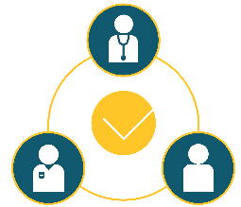
Engaging Patients To Improve Diagnostic Safety
Practice Orientation
AHRQ Publication No. 21-0047-8-EF August 2021

Slide 2
Diagnostic Errors Are a Big Challenge
Nearly every person will experience a diagnostic error in their lifetime.
Notes:
Diagnostic error is the leading patient safety challenge in the United States. We define diagnostic error as “the failure to (a) establish and accurate and timely explanation of the patient’s health problem(s) or (b) communicate that explanation to the patient.^{1,2}
Nearly every patient will experience a diagnostic error in their lifetime. In primary care settings, nearly 79 percent of the errors in diagnosis happen within the patient-provider encounter and 56 percent of these are related specifically to breakdowns in communication between the patient and the provider.³
Thus, resources to improve communication within the patient-provider encounter are needed in order to improve diagnostic accuracy.³⁻⁵

Slide 3
How can we improve diagnostic safety?
What can patients do?
Tell their story fully and completely and clearly​
Provide accurate information about their symptoms​
Speak up if they feel they have not been heard​
Ask questions to clarify the information shared​
Use a checklist of tests, symptoms, concerns, or physicians consulted​
What can clinicians do?
Listen to patient​s
Support patients in effectively sharing their symptoms.
Ask patients what they think is going on​
Conduct a thorough history and physical examination
Set a visit agenda
Know patients and their history, and read prior notes
Integrate "pre-work" for patients (e.g. symptoms; history of present illness; labs)
Notes:
There are several things patients and providers can do to improve diagnostic safety.
For patients, one of the key strategies that is recommended by both patients and providers is to ensure that the patients tells their illness story (or history) fully and completely²⁻⁷:
Providers often report that patients sometimes withhold information initially that could have helped them make a diagnosis faster or would have resulted in a different diagnosis.
Patients also report that they do not feel heard by their providers, which may also lead to a breakdown of information sharing during the clinical encounter. Strategies that have been recommended for patients to help them partner in diagnosis include using checklists or other structured communication tools that help patients remember and convey their symptoms, concerns, and history of their current problem to the provider in a clear and concise way.
In addition, there are things providers can do to help improve diagnosis, specifically related to engaging patients and their families^{2,3,8-13}:
Strategies such as deep and reflective listening are central to clear communication within the encounter. This strategy includes encouraging patients to share their story and reflecting on the information to ask clarifying questions, all leading to a more complete history taking.
Setting a visit agenda in collaboration with the patient also has been demonstrated to improve communication, particularly when that agenda allows patients to share what is most concerning to them.
Being prepared for the patient visit by checking any pre-labs and reviewing the patient’s clinical history before the encounter can also enhance diagnostic accuracy, particularly when coupled with time for reflective listening.
Interventions that can mutually support patient and provider engagement in the diagnostic process are needed to reduce the risk of diagnostic errors.

Slide 4
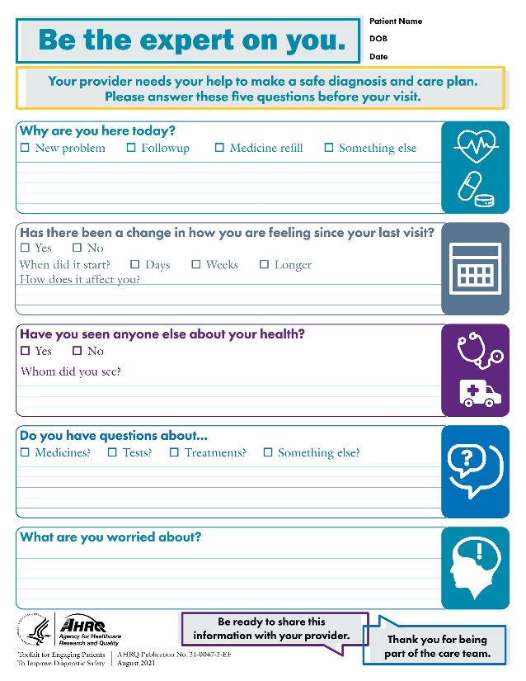
Toolkit Strategies
60 Seconds To Improve Diagnostic Safety
Be The Expert On You
Notes:
To effectively co-produce an accurate, timely, and communicated diagnosis, patients, providers, and researchers suggest two important things:
Give patients the opportunity to tell their whole story, uninterrupted.^{11,12,14-16}
Support patients so they are prepared to tell their story in a way that gives providers information they need.^{2,5,6,17}
The Toolkit for Engaging Patients To Improve Diagnostic Safety supports the co-production of an accurate and timely diagnosis by enhancing communication and information sharing within the patient-provider encounter. The goal is to use the Be The Expert On You note sheet to help prepare patients and their families to tell their story in a clear, concise way. The note sheet can also serve as a prompt for patients so they don’t forget important information.
Coupled with this note sheet, the 60 Seconds To Improve Diagnostic Safety strategy aims to support providers in fostering an environment for patients to share their story united with a receptive environment for active and reflective listening. By using the first minute of the encounter as the ”patient’s minute,” the provider can allow patients to share their story, their illness “history,” with their provider uninterrupted.
Together, these interventions support a collaborative dialogue and an accurate diagnosis.

Slide 5
The Be The Expert On You Strategy
Notes:
The Be The Expert On You strategy is aimed at patients and their family members. It is foundational to building diagnostic safety within the clinical encounter. The Be The Expert On You note sheet is an agenda setting tool that will help patients prepare for their visit.
The note sheet aims to solicit key information from patients, including why they are at the visit, what – if any – changes in their health they have had since their last visit, questions they may have about tests, treatments, medicines, or other health considerations, whether they have seen any other health providers since they were last at our clinic, and a final question to help patients share what is really on their minds, what is concerning them about their health.
When this note sheet was pilot tested, providers noted that the "What are you worried about" question elicited important information from patients they might not have otherwise shared.
It will be important for all of our staff and providers to be familiar with the note sheet and to be ready to help patients if they need it.
The Be The Expert On You note sheet allows patients and their families to prepare for and become more fully engaged in their medical appointments. The goal is to help patients and families to be ready for the appointment and share important information that will assist in finding an accurate and timely diagnosis.

Slide 6
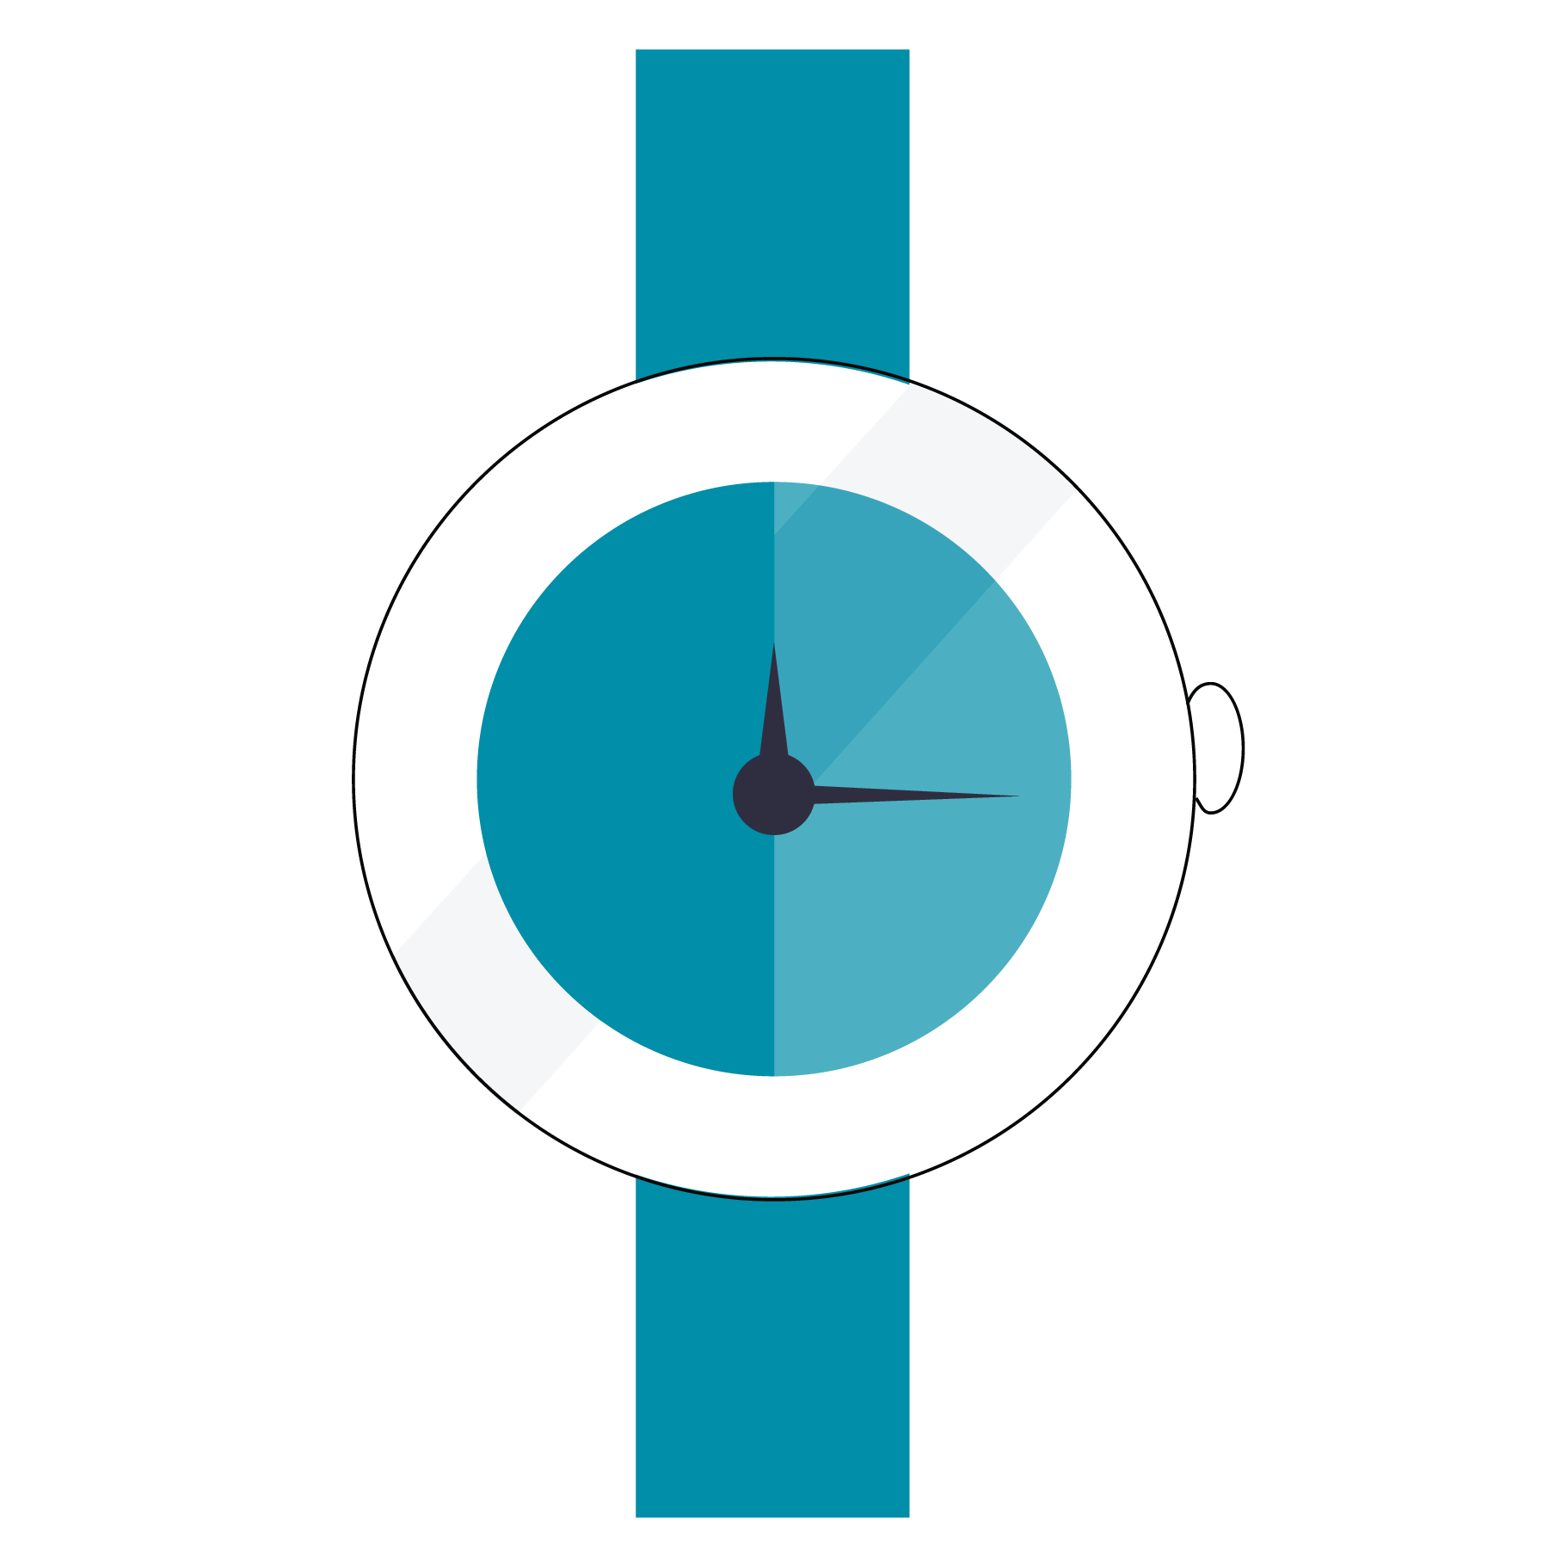
60 Seconds To Improve Diagnostic Safety
Notes:
Studies show that patients are interrupted by their providers in the first 11 to 18 seconds of telling their diagnostic story. Deep listening and reflective practice are components of mindful medical practice grounded in the adage that the patient’s story begins the diagnostic process. Even the best communicators and diagnosticians can fall short when they are faced with a huge patient panel and a busy schedule with competing administrative and clinical demands.^{6,10}
The goal with the 60 Seconds To Improve Diagnostic Safety strategy is to practice deep and reflective listening for one minute at the start of the encounter. Allowing the patient to tell his or her story without interruption gives providers the opportunity for a diagnostic pause, that point in the encounter where providers can reflect on the information the patient is sharing coupled with the information from the medical record and direct observation. In this way, providers can pick up on contextual cues that aid in establishing a working diagnosis or identifying when there may be changes in a patient's chronic health condition.^{10-12,14-16}
One provider, a communication scientist who co-authored the original publication on interruptions, reported that one of his patients stopped him and reported that since the computers came into the exam room, the provider had changed his practice. He had been an attentive listener, yet now he was falling short and not listening as well given the distraction of the EHR. At that point, the provider started having patients talk and share their story for the first 90 seconds of every office visit and he simply listened. It made a huge difference in his practice of medicine and created a greater sense of connection with his patients. The visits weren’t taking any longer, while patient satisfaction and communication improved.
The goal with the 60 Seconds To Improve Diagnostic Safety strategy is to listen more than talk, to ask questions that deepen understanding, and to avoid jumping prematurely to advice or judgments.^{12,15} This approach helps avoid premature closure and anchoring biases that lead to diagnostic errors in primary care.

Slide 7
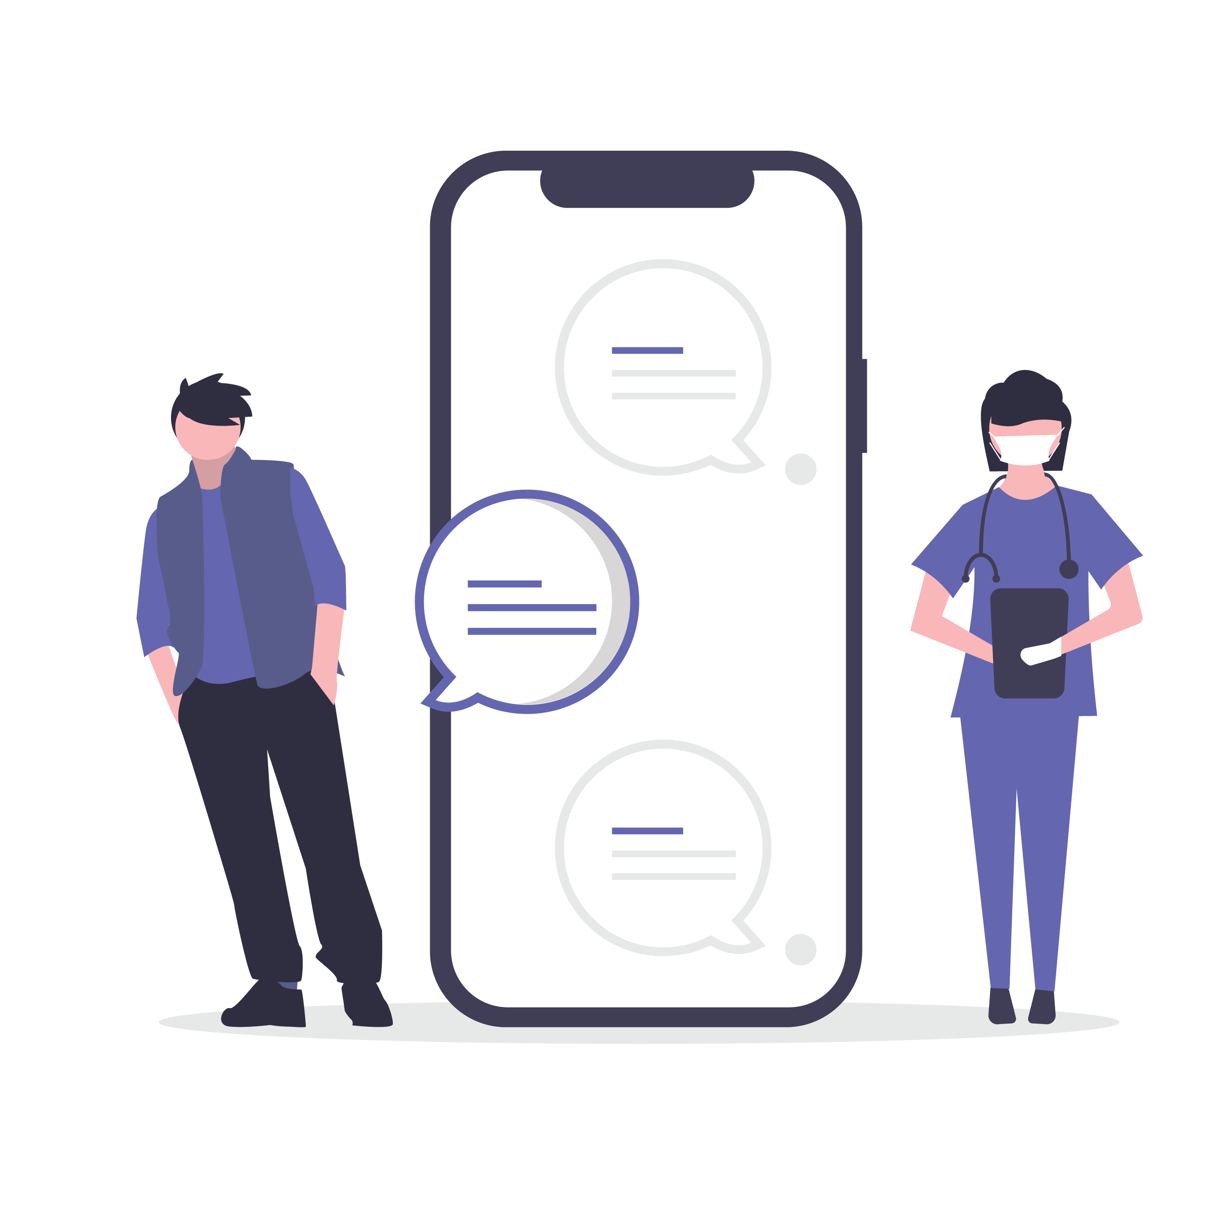
What should we expect?
Improved relationships with patients leading to improved experience and safety​
Clear, concise,
correct, and
complete information to make diagnostic decisions​​
Enhanced connection and reduced technical burnout​​
A return to the joy of healing​​
Notes:
In addition to improving patient-provider communication and mitigating pitfalls in the diagnostic process related to communication failures, our practice should experience other improvements in our patient and provider care experiences. These include:
Improved relationships with patients, leading to improved patient experience and patient safety,
A reduced propensity for diagnostic errors, which is linked directly to improvements in clear, concise, correct, and complete information sharing from the patient,
An enhanced connection with patients and reduced technical burnout, and
A return to the joy of healing.¹²
Practices that participated in the field testing of these interventions found that between 80 percent and 95 percent of their patients reported improved communication and greater listening, and that the note sheet was useful in preparing them for their visit.

Slide 8
What Patients and Providers Are Saying
“The form helped me remember why I came to the doctor and to remember other aches and pains or illnesses I have experienced in between doctor visits."
“As far as the one minute, I can say that for me it was a huge eye opener to my current practice. I didn't realize how long a minute was. [With this tool] I really was able to get information that I may not have, had I butted in, and so that's been a huge thing for me.”
"The note sheet allowed me to put things down that I am not comfortable saying out loud."
“When the note sheet and the 60 seconds are used together, it works really well. This is an enlightened approach to history taking given the growing constraints on physician's time.”
Notes:
Patients and providers also like the Be The Expert On You and the 60 Seconds To Improve Diagnostic Safety strategies.
Some feedback from patients included:
"The form helped me remember why I came to the doctor and to remember other aches and pains or illnesses I have experienced in between doctor visits.“
"The note sheet allowed me to put things down that I am not comfortable saying out loud."
Providers reflected that:
“’It is like the patient is writing their own note.”
“As far as the one minute, I can say that for me it was a huge eye opener to my current practice. I didn't realize how long a minute was. [With this tool] I really was able to get information that I may not have, had I butted in, and so that's been a huge thing for me.”
“When the note sheet and the 60 seconds are used together, it works really well. This is an enlightened approach to history taking given the growing constraints on physician's time.”

Slide 9
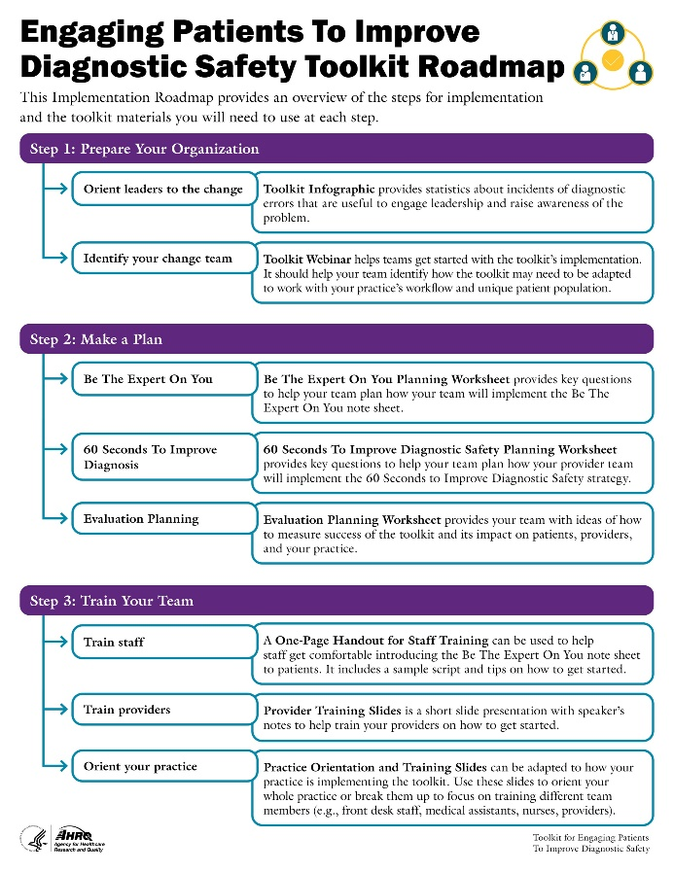
Our Planning Process
Customize this slide to match your practice's implementation strategy.
Notes:
Our planning team [worked/is working] to identify the optimal workflow for integrating the Be The Expert On You note sheet and the 60 Seconds To Improve Diagnostic Safety strategies into our practice.
The next few slides are dedicated to sharing with you how previous sites have approached implementation, as well as ideas for how we might implement the toolkit in the coming weeks.
Our goal will be to start the implementation pilot the week of [Insert date].

Slide 10
How it will work in our practice

Slide 11
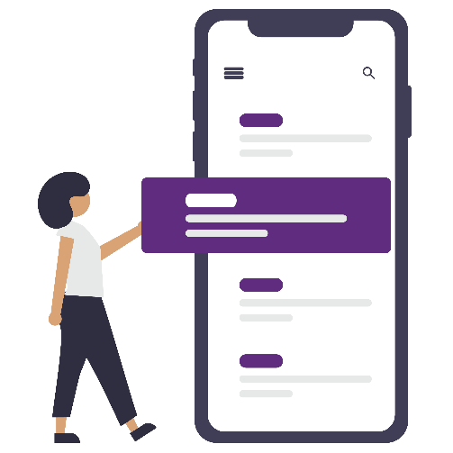
Sample Workflow: Be The Expert On You Note Sheet
In Person: Front Desk Team introduces the note sheet
Patients complete the note sheet
Patients use note sheet to share their story
Telehealth: Send the note sheet via the patient portal or e-mail
Notes:
[Planning Notes: Review and modify the slide and speakers' notes language to reflect how your practice plans to get the note sheet to the patient.]
Practices engaged in field testing the Be The Expert On You intervention recommended the following workflow:
For in-person visits, the front desk team should present the note sheet to patients and explain how to fill it out.
For telehealth encounters or phone visits with the provider, you can share the note sheet with patients via an email to the patient or via the patient portal.
Once patients have the note sheet, they will take some time to complete it while they are waiting to be roomed (for in-person visits) or prior to the appointment (for virtual visits).
The patients can then use the Be The Expert On You note sheet to help them share their story with their provider. Providers can use the note sheet to help prompt the patient to provide additional details or to ensure that all of the patient's concerns are acknowledged during the visit. The note sheet can also serve as a prompt to providers to remember to use the 60 Seconds To Improve Diagnostic Safety strategy.
Some helpful tips for implementing the toolkit include:
Tip #1: Focusing the intervention on select patient populations. For example, choosing patients who are coming in for acute/episodic clinic visits or new problems may be a good place to start.
Tip #2: It might be helpful to give the patients the note sheet after they finish all other previsit paperwork. This approach will help the note sheet stand out from the other papers and allow the patient to keep it with them during their encounter.
Tip #3: Some patients might have some difficulty completing the note sheet. When rooming patients (or online) it’s a good practice to quickly scan the note sheets. If there is nothing on the page, ask the patients if they might want some help and take a minute to help them complete it. This step works well for patients with low literacy. Be sure to do this after the patient is in the encounter room.
Tip #4: Providers may also use the Be The Expert On You note sheet to help prompt patients who may be slow to share or to redirect patients whose stories go too long. The note sheet can also be used to co-create a visit agenda, aiding the patient and the provider in organizing the visit and ensuring questions and concerns get addressed.

Slide 12
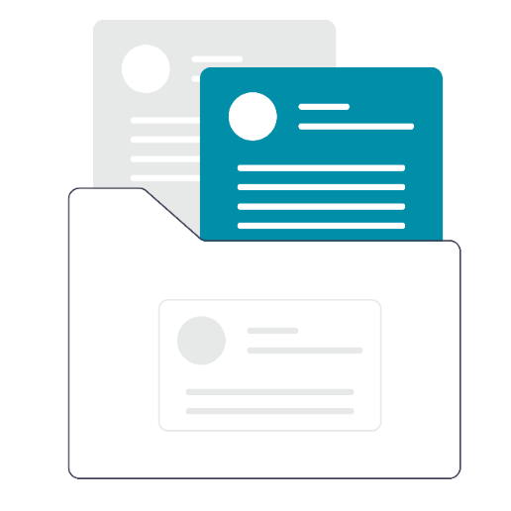
Sample Workflow: After the Visit
In Person: Patients return the completed Note Sheet to the front desk team
Team documents the completed Note Sheet in the patient’s medical record.
Customize this slide to match your practice's implementation strategy.
Telehealth: Patients send the completed note sheet to the practice via portal or email
Notes:
[Planning Notes: Review and modify the slide and speakers' notes language to reflect how your practice plans to get the note sheet from the patients if they are seen in person within the practice or via telehealth. Not all practices will choose to retain the patient's copy of the note sheet. If this does not pertain to your practice, delete this slide.]
Some practices may choose to keep copies of the note sheet to help with evaluation or document its use in the medical record.
Here, the front desk team (in person) can collect the completed note sheets. These can be used as simple counts or can be uploaded into the electronic health record. You can ask patients seen via telehealth to send the completed note sheet via the patient portal or through secure messaging. By collecting the note sheets, you can better understand the type of information patients are sharing.

Slide 13
Our Site’s Workflow
Give patient the note sheet
Assist patient as needed
Bring completed note sheet into room
Patient shares their story
Collect and document the note sheet
Customize this slide to match your practice's implementation strategy.
Notes:
[Planning Notes: This slide should be adapted to fit with the workflow your practice will be using to implement the interventions. These updates can be made based on the outcomes of your planning worksheets.]

Slide 14
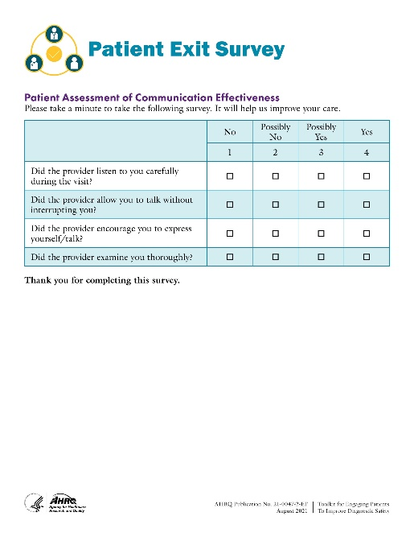
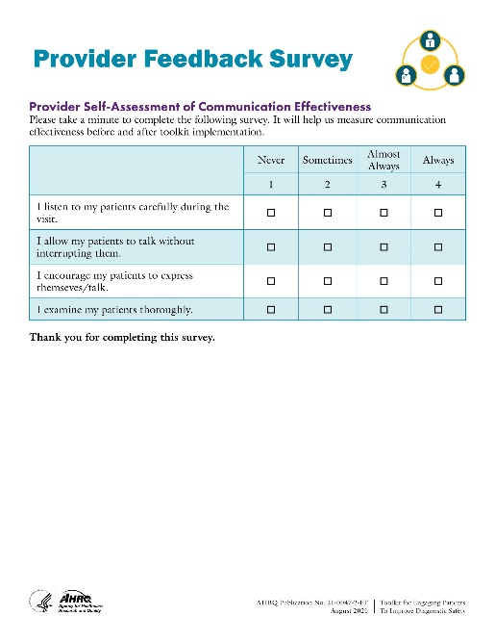
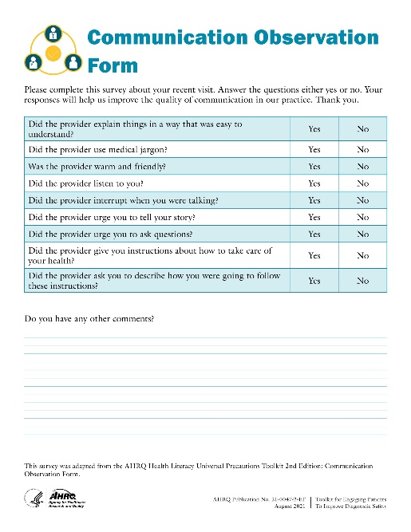
How are we measuring Impact?
Patient Surveys
Provider Surveys
AHRQ Diagnostic Safety Items (SOPS)
Patient Observation
Documentation in the medical record
Something else?
Customize this slide to match your practice's implementation strategy.
Notes:
[Planning Notes: This slide should be adapted to fit with how you will measure success of the interventions. These updates should be made based on the outcomes of your Evaluation Planning Worksheet.]
Our implementation team has determined that we will be using the following approaches to measure success: [Include any/all that apply.]

Slide 15
Next Steps
Baseline Evaluation
2 weeks
Training
2 weeks
1 month
Go Live
Debrief
Weekly - 4 weeks
Pulse evaluation
1 week
Update workflows
1 week
Redeploy
3 months
Post-evaluation
Every 3 months
Customize this slide to match your practice's implementation strategy.
Notes:
[Planning Notes: This slide should be modified with your timeline for deployment and evaluation.]
Our team is going to conduct a baseline evaluation that we are asking all of you to participate in. We will do this approximately 2 weeks before we "go live."
After the baseline evaluation is completed, we will work to conduct training for all the staff and providers. Our operations team will also order all the materials so we have everything ready to go live.
This plan would lead to a go live in the next month.
During the first month, we are asking for feedback on what is working and what isn't. We will do weekly huddles to debrief on the process. After a month, we will complete a pulse evaluation to elicit patient feedback and provider feedback as well. At that time, we will update any processes to help improve adoption of the strategies and streamline our workflow.
We will then complete an evaluation every 3 months.

Slide 16
Questions?

Slide 17
References
Hoffman J, ed. 2014 Annual Benchmarking Report: Malpractice Risks in the Diagnostic Process. Cambridge, MA: CRICO Strategies; 2015. https://www.rmf.harvard.edu/Malpractice-Data/Annual-Benchmark-Reports/Risks-in-the-Diagnostic-Process. Accessed July 20, 2021.
National Academy of Medicine. Improving Diagnosis in Health Care. Balogh EP, Miller BT, Ball JR, eds.. Washington, DC: National Academies Press; 2015. https://pubmed.ncbi.nlm.nih.gov/26803862/. Accessed July 20, 2021.
Singh H, Giardina TD, Meyer AN, Forjuoh SN, Reis MD, Thomas EJ. Types and origins of diagnostic errors in primary care settings. JAMA Intern Med. 2013;173(6):418-25. https://www.ncbi.nlm.nih.gov/pmc/articles/PMC3690001/. Accessed July 20, 2021.
Liberman AL, Skillings J, Greenberg P, Newman-Toker DE, Siegal D. Breakdowns in the initial patient-provider encounter are a frequent source of diagnostic error among ischemic stroke cases included in a large medical malpractice claims database. Diagnosis (Berlin, Ger. 2020;7(1):37-43. https://doi.org/10.1515/dx-2019-0031. Accessed July 20, 2021.
McDonald KM, Bryce CL, Graber ML. The patient is in: patient involvement strategies for diagnostic error mitigation. BMJ Qual Saf. 2013;22 Suppl 2(SUPPL.2):ii33-ii39. https://www.ncbi.nlm.nih.gov/pmc/articles/PMC3786634/. Accessed July 20, 2021.
Singh Ospina N, Phillips KA, Rodriguez-Gutierrez R, Castaneda-Guarderas A, Gionfriddo MR, Branda ME, Montori VM. Eliciting the patient’s agenda- secondary analysis of recorded clinical encounters. J Gen Intern Med. 2019;34(1):36-40. https://www.ncbi.nlm.nih.gov/pmc/articles/PMC6318197/. Accessed July 20, 2021.
Heyhoe J, Reynolds C, Dunning A, Johnson O, Howat A, Lawton R. Patient involvement in diagnosing cancer in primary care: a systematic review of current interventions. Br J Gen Pract. 2018;68(668):e211-e224. https://www.ncbi.nlm.nih.gov/pmc/articles/PMC5819987/. Accessed July 20, 2021.
Tudor Car L, Papachristou N, Bull A, Majeed A, Gallagher J, El-Khatib M, Aylin P, Rudan I, Atun R, Car J, Vincent C. Clinician-identified problems and solutions for delayed diagnosis in primary care: a PRIORITIZE study. BMC Fam Pract. 2016;17(1):131. https://www.ncbi.nlm.nih.gov/pmc/articles/PMC5017013/. Accessed July 20, 2021.
Shields CG, Epstein RM, Fiscella K, Franks P, McCann R, McCormick K, Mallinger JB. Influence of accompanied encounters on patient-centeredness with older patients. J Am Board Fam Pract. 2005;18(5):344-54. https://www.jabfm.org/content/18/5/344.long. Accessed July 20, 2021.

Slide 18
References
Bartels J, Rodenbach R, Ciesinski K, Gramling R, Fiscella K, Epstein R. Eloquent silences: a musical and lexical analysis of conversation between oncologists and their patients. Patient Educ Couns. 2016;99(10):1584-94. https://www.ncbi.nlm.nih.gov/pmc/articles/PMC6100772/. Accessed July 20, 2021.
Ofri D, Trimboli O. Deep Listening: Impact Beyond Words - Why Your Doctor Needs To Listen Deeply. https://www.oscartrimboli.com/podcast/044/. Accessed July 20, 2021.
Zulman DM, Haverfield MC, Shaw JG, Brown-Johnson CG, Schwartz R, Tierney AA, Zionts DL, Safaeinili N, Fischer M, Thadaney Israni S, Asch SM, Verghese A. Practices to foster physician presence and connection with patients in the clinical encounter. JAMA. 2020;323(1):70-81. https://pubmed.ncbi.nlm.nih.gov/31910284/. Accessed July 20, 2021.
Graber ML. The incidence of diagnostic error in medicine. BMJ Qual Saf. 2013;22(SUPPL.2):ii21-ii27. https://www.ncbi.nlm.nih.gov/pmc/articles/PMC3786666/. Accessed July 20, 2021.
Goss AL. How becoming a doctor made me a worse listener. JAMA. 2020;323(11):1041. https://doi.org/10.1001/jama.2020.2051. Accessed July 20, 2021.
Swendiman RA. Deep listening. Acad Med. 2014;89(6):950. https://doi.org/10.1097/acm.0000000000000238. Accessed July 20, 2021.
Doyle A. Important Active Listening Skills and Techniques. https://www.thebalancecareers.com/active-listening-skills-with-examples-2059684. Updated November 24, 2020. Accessed July 20, 2021.
Giardina TD, Haskell H, Menon S, Hallisy J, Southwick FS, Sarkar U, Royse KE, Singh H. Learning from patients’ experiences related to diagnostic errors is essential for progress in patient safety. Health Aff (Millwood). 2018;37(11):1821-27. https://www.ncbi.nlm.nih.gov/pmc/articles/PMC8103734/. Accessed July 20, 2021.

