Slide 1
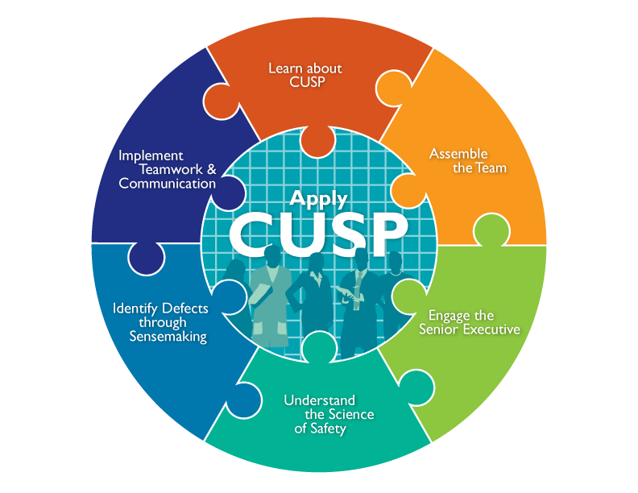

Slide 2
Learning Objectives
Review key steps of the CUSP Toolkit
Learn how Just Culture principles can augment CUSP
Introduce Just Culture principles

Slide 3
Introduction to Just Culture Principles

Slide 4
Understand Just Culture

Slide 5
Just Culture¹
A system that:
Holds itself accountable
Holds staff members accountable
Has staff members who hold themselves accountable

Slide 6
Understanding Risk and Human Behavior¹
Human Error: Inadvertently completing the wrong action; slip, lapse, mistake
At-Risk Behavior: Choosing to behave in a way that increases risk where risk is not recognized, or is mistakenly believed to be justified
Reckless Behavior: Choosing to consciously disregard a substantial and unjustifiable risk

Slide 7
Managing Error and Risk¹
Human Error
At-Risk Behavior
Reckless Behavior
Product of our current system design and behavioral choices
A choice: risk believed insignificant or justified
Conscious disregard of substantial and unjustifiable risk
Manage through:
Removal of incentives for at-risk behaviors
Creation of incentives for healthy behaviors
Situational awareness
Manage through:
Remedial action
Punitive action
Manage through changes in:
Choices
Processes
Procedures
Training
Design
Environment
Console
Coach
Punish

Slide 8
Systems and Behaviors Work Together To Improve Outcomes¹
System Design
Mission, Values, and Expectations
Improved Outcomes
Behavioral Choices
Learning Systems
Accountability and Justice

Slide 9
Accountability

Slide 10
Engineering System Design to Support Behavior Choices¹
Punitive Culture: Transparency is impossible
Blame-Free Culture: No accountability
Just Culture: Optimally supports a system of safety

Slide 11
Leadership Team’s Role in Applying Just Culture Principles
Have a procedure in place for employees to follow
Ensure employees are properly trained
Offer positive reinforcement at the monthly Learning from Defects meeting

Slide 12
Debrief on Accountability

Slide 13
CUSP Toolkit Modules
Learn About CUSP
Assemble the Team
Engage the Senior Executive
Understand the Science of Safety
Identify Defects Through Sensemaking
Implement Teamwork and Communication
Apply CUSP

Slide 14
CUSP Toolkit Review

Slide 15
Assemble the Team
Address the importance of the CUSP team
Develop a strategy to build a successful team
Identify characteristics of successful teams and barriers to team performance as identified in TeamSTEPPS
Define roles and responsibilities of CUSP team

Slide 16
Keys to Assembling the Team
Understands that patient safety culture is local
Composed of engaged frontline providers who take ownership of patient safety
Includes staff members who have different levels of experience
Tailored to include members based on clinical intervention
Meets regularly (weekly or at least monthly)
Has adequate resources

Slide 17
Engage the Senior Executive
Identify characteristics to search for when recruiting the senior executive
Describe the responsibilities of the senior executive
Explain the role of the senior executive in addressing technical and adaptive work
Explain how to engage the senior executive and develop shared accountability for the work

Slide 18
Keys to Engaging the Senior Executive
Acknowledge the senior executive’s perspective (“What’s in it for me?”)
Increase the visibility of your senior executive
Ensure an executive is assigned to each CUSP team and participates regularly in meetings
List identified safety issues in the Safety Issues Worksheet for Senior Executive Partnership or a tracking log

Slide 19
Understand the Science of Safety
Describe the historical and contemporary context of the science of safety
Explain how system design affects system results
List the principles of safe design and identify how they apply to technical work and team work
Indicate how teams make wise decisions when there is diverse and independent input

Slide 20
Keys to Understanding the Science of Safety
Develop a plan so all staff on your unit view the Understand the Science of Safety video
Video screening should be mandatory for all unit staff
Create a list of who has watched the video
Describe the three principles of safe design:
Standardize
Create independent checks
Learn from defects

Slide 21
Identify Defects Through Sensemaking
Introduce CUSP and Sensemaking tools to identify defects or errors
Discuss the relationship between CUSP and Sensemaking
Show how to apply CUSP and Sensemaking tools
Discuss how to share findings

Slide 22
Keys to Identifying Defects Through Sensemaking
CUSP and Sensemaking share several common themes
CUSP and Sensemaking tools help teams identify defects and identify ways to deter them from occurring in the future
The team should:
Share summaries of defects within the organization
Engage staff in conversations to enhance Learning from Defects

Slide 23
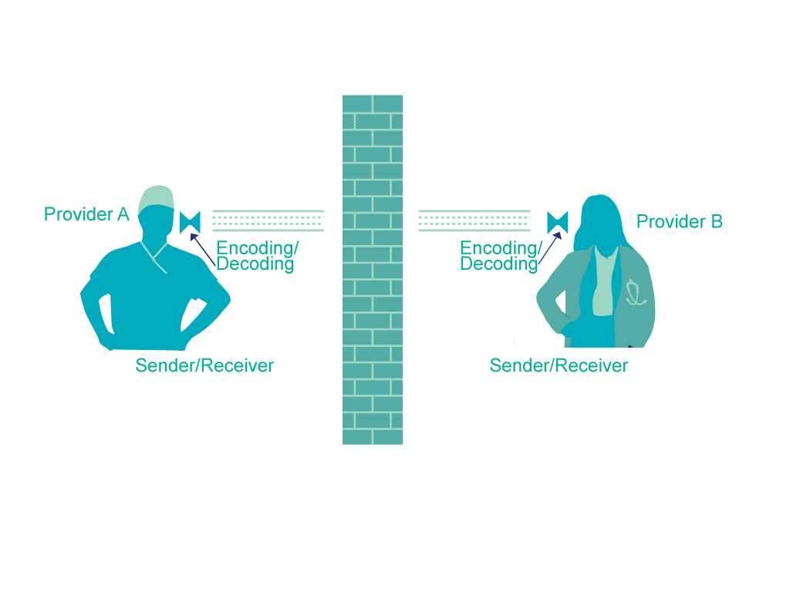
Implement Teamwork and Communication²
Recognize the importance of effective communication
Identify barriers to communication
Describe the connections between communication and medical error
Identify and apply effective communication strategies from CUSP and TeamSTEPPS®

Slide 24
The Keys to Effective Communication³
Complete
Clear
Brief
Timely
Notes:
Complete
Communicate all relevant information
2. Clear
Convey information that is plainly understood
3. Brief
Communicate the information in a concise manner
4. Timely
Offer and request information in an appropriate timeframe
Verify authenticity
Validate or acknowledge information

Slide 25
Summary
A Just Culture is a system that holds itself accountable, holds staff members accountable, and has staff members who hold themselves accountable.
A Just Culture environment is ruled by both transparency and accountability and supports improved outcomes by emphasizing both robust systems and appropriate behaviors.
Use the Just Culture principles along with the CUSP principles involved when assembling the team, engaging the senior executive, identifying defects through Sensemaking, and employing teamwork and communication.

Slide 26
References
Griffith, S. Just Culture. Plano, TX: Outcome Engineering; 2011
(Adapted from) Dayton E, Henricksen K. Communication failure: basic components, contributing factors and the call for structure. Joint Commission Journal. 2007;33(1):36.
Agency for Healthcare Research and Quality. TeamSTEPPS Fundamentals Course: Module 6 Communication. Available at: http://teamstepps.ahrq.gov/abouttoolsmaterials.htm Accessed August 18, 2011.

