Slide 1
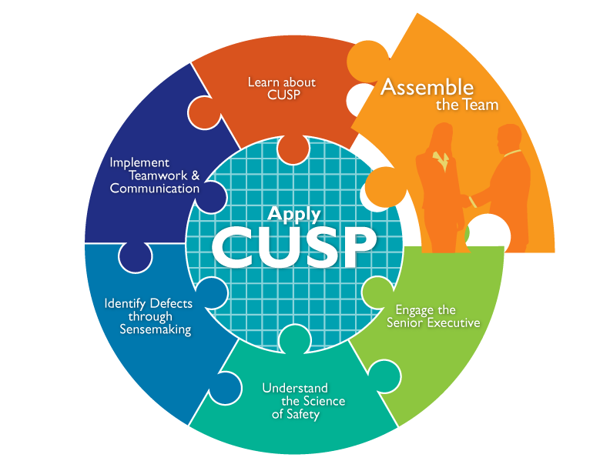

Slide 2
Learning Objectives
Define roles and responsibilities of team members
Identify characteristics of successful teams and barriers to team performance
Develop a strategy to build a successful team
Understand the importance of your CUSP team

Slide 3
The Unit-Based CUSP Team
Understands that patient safety culture is local
Composed of engaged frontline providers who take ownership of patient safety
Includes staff members who have different levels of experience
Tailored to include members based on clinical intervention
Meets regularly (weekly or at least monthly)
Has adequate resources

Slide 4
CUSP Team Members
Nurses (including Nurse educator, Nurse manager)*
Physicians*
Executive partners*
Infection preventionists
Medical directors
Pharmacists
Respiratory therapists
Patient safety officers
Chief quality officers
Ancillary staff
*Key team members

Slide 5
Unit Team Characteristics
CUSP
TeamSTEPPS¹
Has strong team leadership
Sets defined team roles and responsibilities
Maintains clear values and shared vision
Contains mechanisms for collaboration and feedback
Develops a strong sense of collaborative trust and confidence
Manages and optimizes performance outcomes
Develops a strong sense of collective trust, team identity, and confidence
Has diverse local “opinion leaders” and dissenters
Is willing to help to spread the intervention

Slide 6
Team Member Characteristics
CUSP
TeamSTEPPS¹
Maintain positive outlook
Emphasize dedication to project aims
Focus on a broader view
Practice attention to detail
Provide quality information and feedback
Skillful conflict management
Stress reduction for the whole team through better performance
Understand roles and responsibilities

Slide 7
Building Your CUSP Team

Slide 8
CUSP Teams’ Group Processes
Role Clarity
Norms
Effective Team
Communication
Effective Group Processes
Leadership
Buy-in and Support
Conflict Resolution
Education
and Engagement

Slide 9
Team Performance
Inputs
Environment
Hospital unit and context
Team composition
Task design
Outputs
Change in:
Performance
Attitudes
Behaviors
Processes
Inside team
Outside team
Team traits

Slide 10
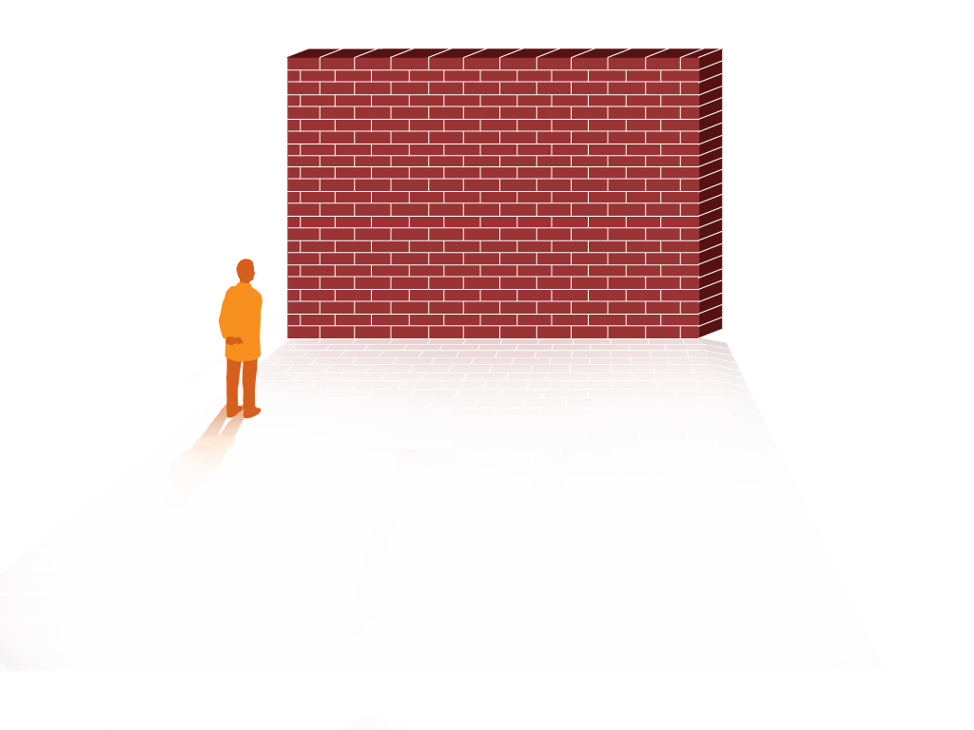
Barriers to Team Performance¹
Inconsistency in team membership
Lack of time
Lack of information sharing
Hierarchy
Varying communication styles
Presence of conflict
Lack of coordination and follow up
Misinterpretation of cues
Lack of role clarity

Slide 11
Stages of Engagement
Engagement: “To involve oneself or become occupied; to participate fully and deeply”
Active support of the project
Engaged
Apathy
Aversion
Uninvolved

Slide 12
Engage Team Members Using the 4 E’s²
How does this make the world a better place?
Engage (adaptive)
Senior leaders
Educate
(technical)
What do we need to know?
Execute (adaptive)
What do we need to do? What can we do with our resources and culture?
Team leaders
Evaluate (technical)
How do we know we improved safety?
Staff

Slide 13
Using the 4 E’s

Slide 14
The CUSP Project Leader’s Role
Encourages unit staff involvement
Obtains staff feedback
Manages documentation of CUSP activities
Educates staff about CUSP
Is a frontline provider, nurse educator, physician, or other staff member

Slide 15
Engage Physicians on the CUSP Team
Identify physician leaders
Create an understanding of this role
Listen to physician concerns
Develop plans to address concerns
Reward physician leaders
Create a vehicle for communication
Develop a plan for communications

Slide 16
The Physician Champion’s Role
Serves as role model for CUSP activities
Meets with CUSP team at least monthly
Participates in monthly senior executive partnership meetings
Communicates with physician group as needed
Assists with implementation of interventions

Slide 17
Physician Engagement

Slide 18
Engage Other CUSP Team Members
Executive partners
Nurses
Patient safety officers
Infection preventionists

Slide 19
The Senior Executive’s Role
Helps the team prioritize improvement efforts
Helps the team navigate organizational bureaucracy
Ensures the CUSP team has resources to fix problems
Makes rounds and meets monthly with members of health care team on the unit

Slide 20
The Nurse Manager’s Role
Supports CUSP activities
Ensures safety assessment results are shared with staff
Assigns project leaders to interventions
Assists with scheduling executive partnership
Manages local resources

Slide 21
The Patient Safety Coordinator/Patient Safety Officer’s Role
Serves as a senior executive partner in some institutions
Coordinates executive orientation with the initiative
Verifies that surveys are analyzed and results are reviewed in a timely manner
Monitors progress of the intervention
Disseminates results and shares stories

Slide 22
Psychological Safety³
Psychological safety is the degree to which team members feel that their environment supports the interpersonal risk involved in asking for help or learning from mistakes.
Team members who promote psychological safety will:
Invite input from all team members
Encourage team members to contribute
Promote active listening and learning from each other
Ensure all team members are accessible
Acknowledge the limits of current knowledge

Slide 23
Psychological Safety

Slide 24
Exercise
Create your team with attention to who is on the team.
Carefully plan how you will act as a unified group.
Do a “pre-mortem” assessment. If this project were to fail, why would it? What could the team have done to prevent failure?

Slide 25
Assemble the Team: What the Team Needs To Do
Recruit a team lead, nurse manager, physician, and executive partner along with any other team members
Meet with hospital departments (risk management, quality improvement, infection prevention) to ensure that CUSP efforts are integrated into overall hospital quality improvement and patient safety efforts.
List team member names and contact information on the Background Quality Improvement Team Information Form and post the form in a central location
Use the 4 Es to ensure team engagement:
Engage them in the process
Educate them about their roles
Execute the processes
Evaluate what you did

Slide 26
Summary
The CUSP team will include health care providers, support and leadership staff.
The “4 E’s” is a highly effective tool for recruiting team members.
Team members work together to identify barriers and address them as a group.
For teams to be successful, the roles and responsibilities of team members need to be clearly defined.

Slide 27
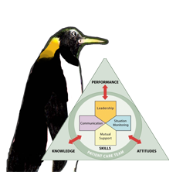
TeamSTEPPS Tools¹
Briefing Checklist
Debrief Checklist
*Please refer to the “Implement Teamwork and Communication” module for additional information*
As seen in TeamSTEPPS®

Slide 28
CUSP Tools
Background Quality Improvement Team Information Form
Culture Check-Up Tool

Slide 29
References
Agency for Healthcare Research and Quality, Department of Defense. TeamSTEPPS. Available at http://www.ahrq.gov/professionals/education/curriculum-tools/teamstepps/index.html
Pronovost PJ, Berenholtz SM, Goeschel CA, et al. Creating high reliability in health care organizations Health Serv Res 2006;41(4, pt 2):1599-1617.
Edmondson, AC. Managing the Risk of Learning: Psychological Safety in Work Teams. In West M, ed. International Handbook of Organizational Teamwork. London: Blackwell; 2003.

