Slide 1
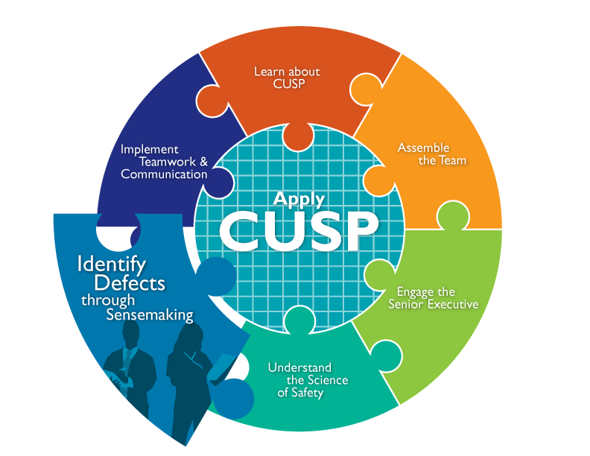

Slide 2

CUSP and Sensemaking Tools¹
CUSP Tools | Sensemaking Tools
Staff Safety Assessment | Discovery Form
Safety Issues Worksheet | Root Cause Analysis
Learn from Defects Form | Failure Mode and Effects Analysis
 | Probabilistic Risk Assessment
 | Causal Tree Worksheet

Slide 3
Learning Objectives
Discuss how to share findings
Show how to apply CUSP and Sensemaking tools
Discuss the relationship between CUSP and Sensemaking
Introduce CUSP and Sensemaking tools to identify defects or conditions

Slide 4
The Relationship Between CUSP and Sensemaking^{1,2,3}
Concept | CUSP | Sensemaking
Defect or failure identification | Defects | Human/active failure Latent/system conditions
Ways to identify defects or failure | -Staff Safety Assessment -Status of Safety Issues Worksheet | -Discovery Form -Root Cause Analysis -Failure Mode and Effects Analysis -Probabilistic Risk Assessment
Tools to examine defects or failures | Learn from Defects Form | Causal Tree Worksheet
Coding defects or failures | Learn From Defects Form | Eindhoven Model

Slide 5
Identify Defects and Use Sensemaking

Slide 6

Identify Defects Overview
Define defects
Identify sources of defects
Apply CUSP tools to identify defects

Slide 7
Sensemaking Overview⁴
A conversation among members of an organization involved in an event/issue
The purpose is to reduce the ambiguity about the event/issue -literally to make sense of it
Each person brings their experience of that event/issue to the discussion
The conversation is the mechanism that combines that knowledge into a new, more understandable form for the members
Members develop a similar representation in their minds that allows for action that can be implemented and understood by all who have participated in the conversation

Slide 8
Examples of Defects or Failures That
Affect Patient Safety
Defect | Intervention
Unstable oxygen tanks on beds | Oxygen tank holders repaired or new holders installed institution wide
Medication look-alike | Education conducted, medications physically separated, and letter sent to manufacturer
Missing equipment on cart | Checklist developed for stocking cart
Inconsistent use of Daily Goals rounding tool | Consensus reached on required elements of Daily Goals rounding tool
Inaccurate information by residents during rounds | Electronic progress note developed

Slide 9
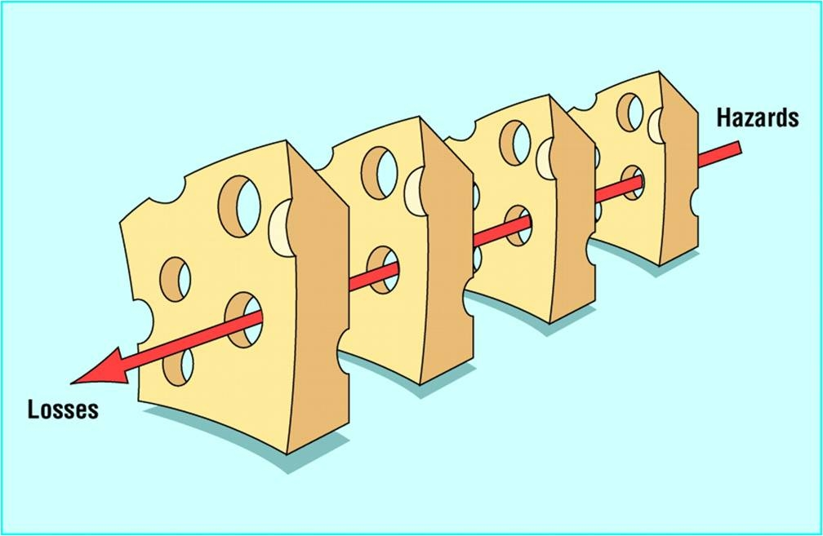
Reason’s Swiss Cheese Model⁵

Slide 10
CUSP Tools To Identify Defects

Slide 11
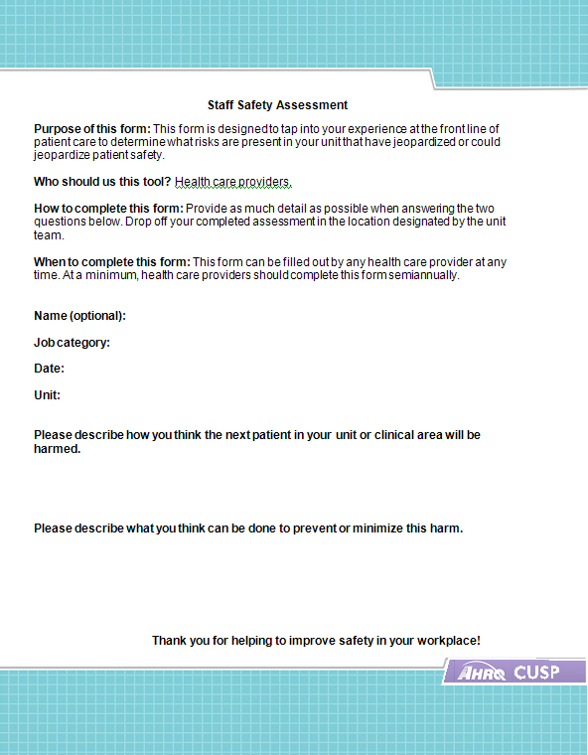
Staff Safety Assessment
Step 1. What are clinical or operational problems that have or could have jeopardized patient safety?
Step 2. How might the next patient be harmed in our unit?
Step 3. What can be done to minimize harm or prevent safety hazards?

Slide 12

Exercise
Please complete the following:
List all defects that have the potential to cause harm
Discuss the three greatest risks
Rank these factors

Slide 13
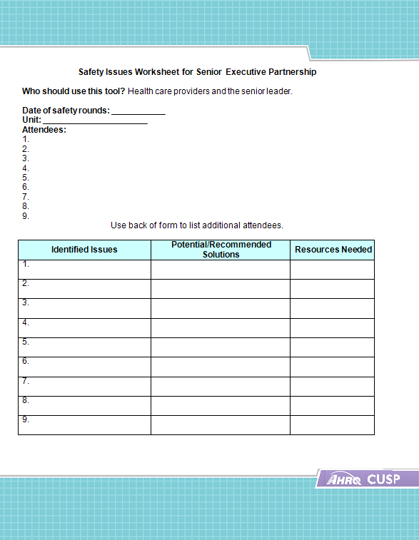
Use the Safety Issues Worksheet for Senior Executive Partnership
Step 1. Engage the senior executive in addressing the safety issues identified on the form.
Step 2. Use the form during safety rounds to identify safety issues, identify potential solutions, and identify resources.
Step 3. Keep the project leader apprised of the information on this form.

Slide 14
Sensemaking Tool To Identify Defects: Root Cause Analysis

Slide 15
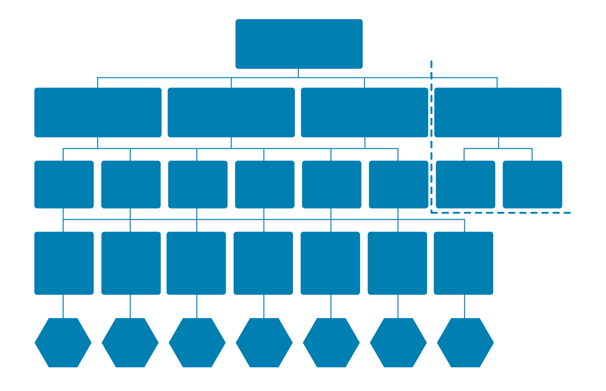
Root Cause Analysis: Causal
Tree Worksheet⁶
Discovery
Event
Recovery
Antecedent Events
Root Causes
Root Cause Classification Codes

Slide 16
Root Cause Analysis Example⁶
Discovery Event
Group O patient almost given Group A Blood
Recovery
A positive unit was hanging on the infuser
Transfusing nurse didn’t check blood type on hanging unit
Nurse interrupts transfusion
Antecedent Events
A positive unit not removed from prior case
Nurse was busy and distracted
Nurse sees that unit is A positive
Temp nurse unclear about procedure
Temp nurses need help
Other nurses on sick-out
Root Causes

Slide 17
Learning From Defects and Sensemaking

Slide 18
Learning From Defects Overview
Health care providers are adept at reacting to an event and finding a solution
Providers must also correct the factors that contribute to an event

Slide 19
Exercise
Think of an unexpected situation that you recently encountered:
When did you know it was not what you expected?
What were the clues?
What sense did you make of it?

Slide 20
CUSP Tools To Learn From Defects

Slide 21
Learning From Defects:
Four Questions
1. What happened?
2. Why did it happen?
3. What will you do to reduce the risk of recurrence?
4. How will you know the risk is reduced?

Slide 22

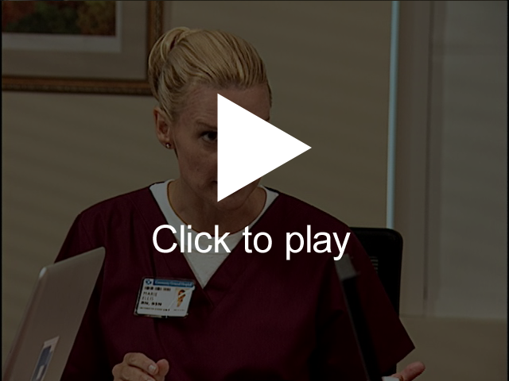
What Happened?

Slide 23
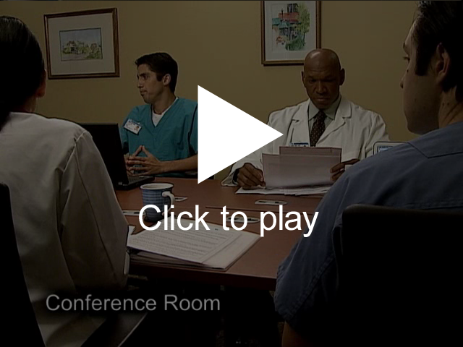
Why Did It Happen?

Slide 24

What Will You Do To Reduce the Risk of Recurrence?

Slide 25
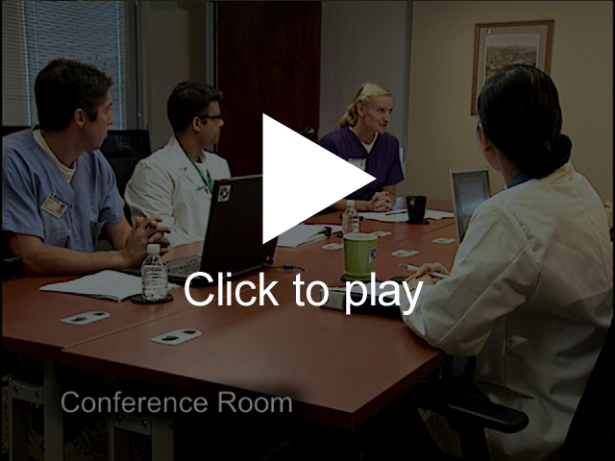
How Will You Know the Risk Is Reduced?

Slide 26
Sensemaking Tools To Learn From Defects

Slide 27
Causal Coding: Eindhoven Model⁶
20 separate event cause types in four categories:
Technical
Organizational
Human
Other
Aim for three to seven root cause codes for each event, a mixture of active and latent
All events involve multiple causes

Slide 28
Root Cause Analysis Example⁶
Nurse was busy and distracted
Temp nurse unclear about procedure
Nurse was busy and distracted
Nurse sees that unit is A positive
Root Causes
Root Cause
Classification Codes
OK
OM
HEX

Slide 29
CUSP and Sensemaking: Next Steps

Slide 30
Summarize and Share Findings
Create a one-page summary answering the four Learning from Defects questions
Share the summary within your organization
  Engage staff in face-to-face conversations to provide opportunities to learn from defects
Share de-identified information with others in your state collaborative (pending institutional approval)

Slide 31
Communicating the Learning
Team meetings - monthly
Meeting to review data - monthly
Meeting with executive partner - monthly or more often
Executive review of data - monthly
Presentations to hospital colleagues as needed, including leadership, frontline staff, and board

Slide 32
Summary: Sensemaking and
Identifying Defects
Identify defects and Sensemaking share several common themes
Defects or failures are clinical or operational events that you do not want to happen again
CUSP and Sensemaking tools help teams identify defects and identify ways to deter them from occurring in the future
Notes:
________

Slide 33
Summary of Sensemaking and Learning From Defects
Sensemaking and Learning from Defects share several common themes
The Learning from Defects tool can be used to facilitate a sensemaking conversation
The Causal Tree Worksheet and Eindhoven Model can help identify and target defects in your unit
Sensemaking and Learning from Defects are ongoing processes

Slide 34
References
Battles JB, Kaplan HS, Tjerk W Van der Schaaf, et al. The attributes of medical event-reporting systems: Experience with a prototype medical event-reporting system for transfusion medicine. Arch Pathol Lab Med 1998 March;122:231-238.
Battles JB, Dixon NM, Borotkanics RJ, et al. Sensemaking of patient safety risks and hazards. Hlth Svcs Res 2006;41(Aug 4 Pt 2.):1555-1575.
Sensemaking. Patient safety analysis training.
[Columbia University's Digital Knowledge Ventures is no longer in operation.]

Slide 35
References
Sensemaking. Patient safety analysis training.
[Columbia University's Digital Knowledge Ventures is no longer in operation.]
Pronovost PJ, Wu AW, and Sexton JB. Acute Decompensation after Removing a Central Line: Practical Approaches to Increasing Safety in the Intensive Care Unit. Ann Intern Med 2004 June;140(12):1025-1033.
Sensemaking. Patient safety analysis training.
[Columbia University's Digital Knowledge Ventures is no longer in operation.]

