Slide 1
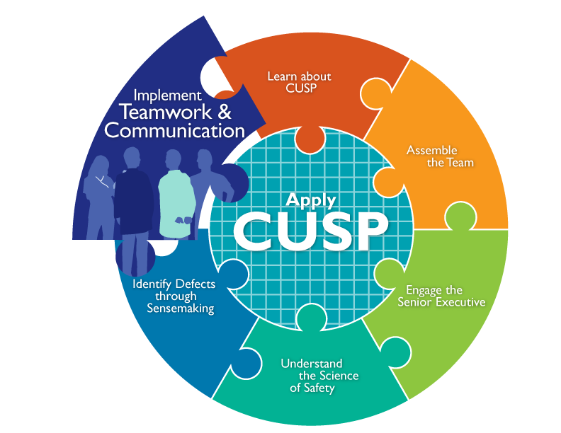

Slide 2
Learning Objectives
Identify and apply effective communication strategies from CUSP and TeamSTEPPS®
Describe the connection between communication and medical errors
Identify
barriers to communication
Recognize the importance of effective communication

Slide 3
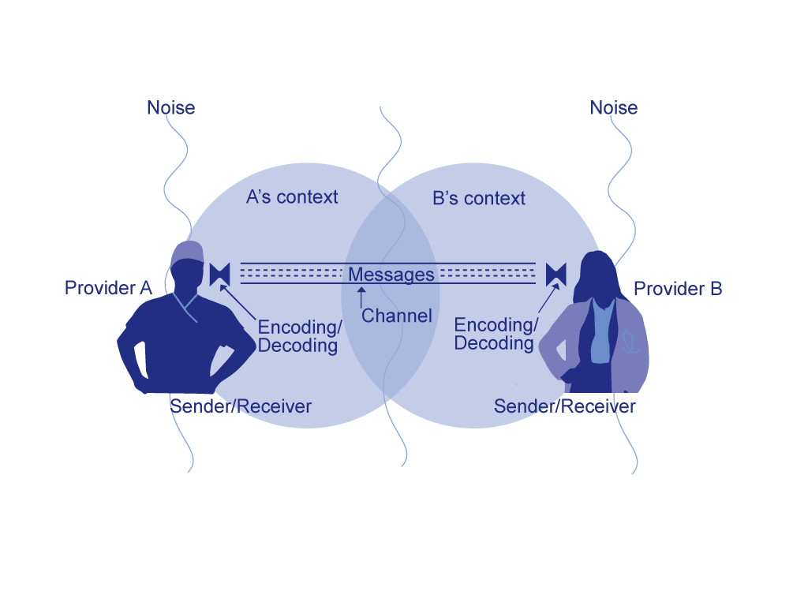
Basic Components and Process of Communication²

Slide 4
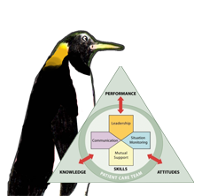
Four Key Components of Effective Communication¹
Complete
Clear
Brief
Timely
As seen in TeamSTEPPS®

Slide 5

Elements That Affect
Communication and Information Exchange
Interruptions
Task absorption
Verbal abuse
Fatigue
Not following plan of care
Ambiguous orders or directions
Change in team members
Work load

Slide 6
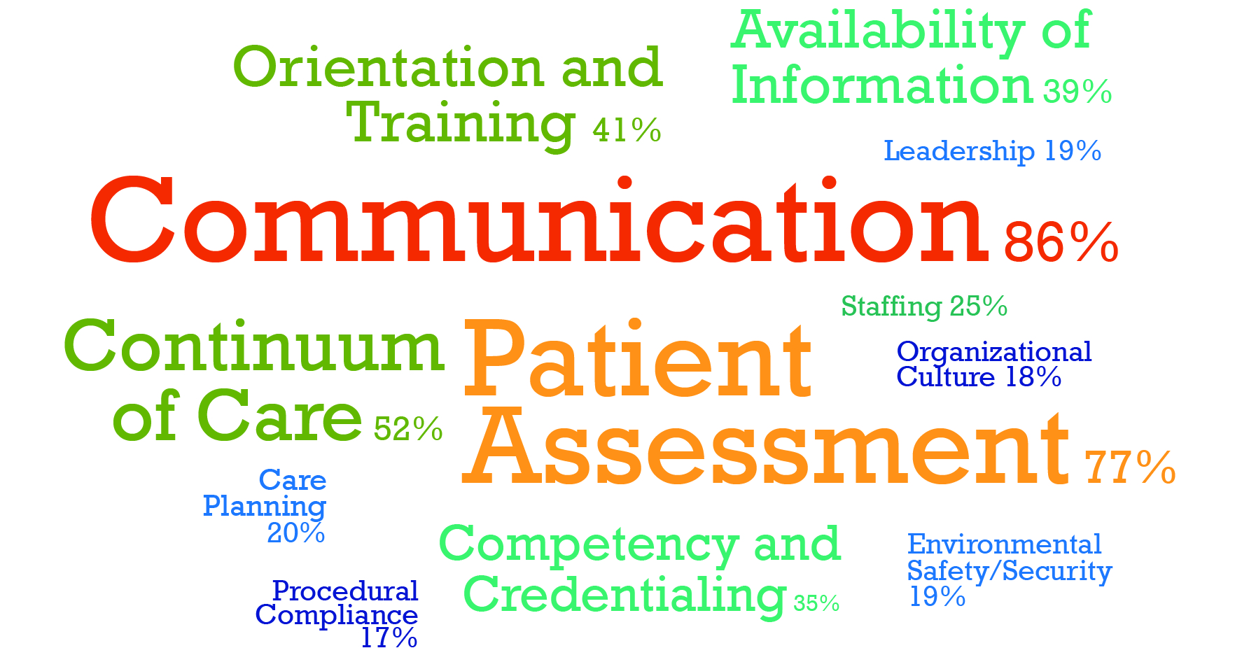
Communication Breakdowns Cause
Treatment Delays³
Root Causes of Treatment Delays (1995-2004)

Slide 7
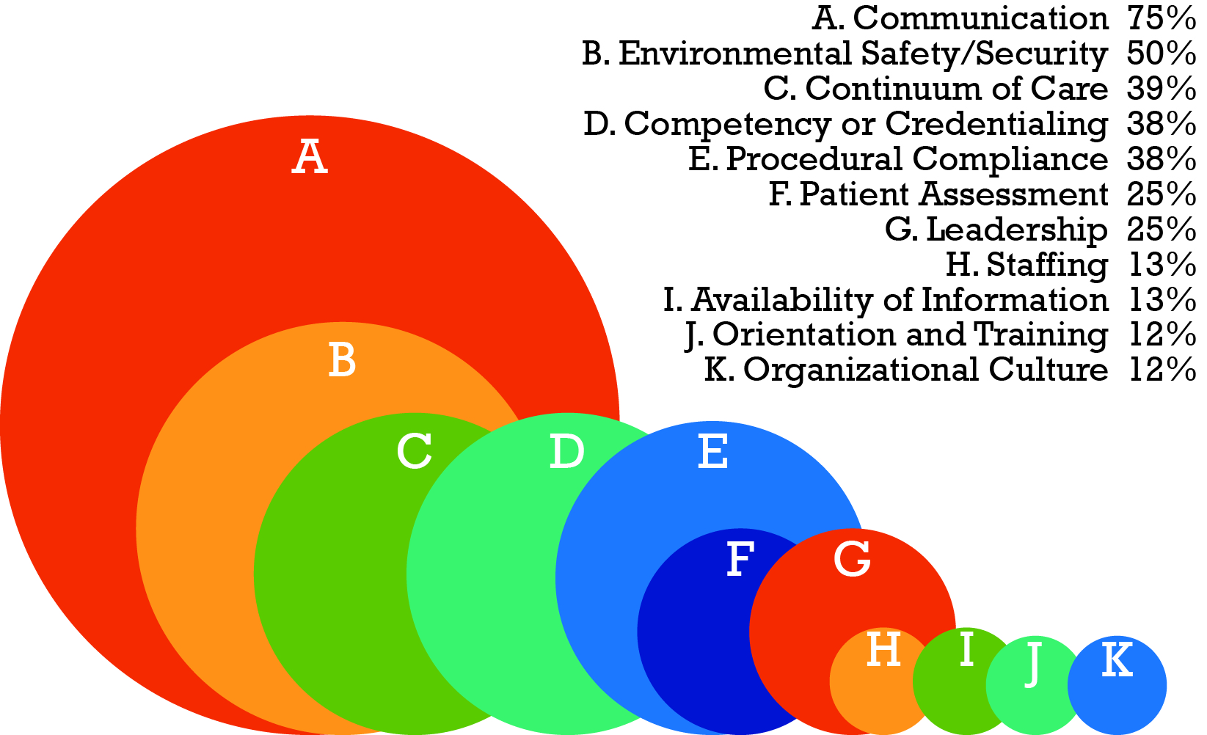
Communication Breakdowns Cause
Infection-Associated Events³
Root causes of infection-associated events (2005)

Slide 8

Exercise
Think of a defect that has occurred in your unit due to a communication breakdown.
  Using the standards of effective communication, list three or four ways in which communication could be improved to reduce the risk of similar defects occurring.

Slide 9
Barriers to Team Effectiveness¹
Working Conditions
  Lack of coordination or follow up
  Distractions
  Misinterpretation of cues
  Hierarchy
  Physical proximity
  Shift changes
Team Composition
  Inconsistency in team membership
  Lack of role clarity
  Defensiveness
  Conventional thinking
  Conflict
  Fatigue
  Complacency
  Varying communication styles
  Personality
Resources
  Lack of time
  Workload
  Processes
  Technology
As seen in TeamSTEPPS®

Slide 10

Positive Outcomes of Effective
Teamwork on Health Care⁴
Reduced length of stay
Higher quality of care
Better patient outcomes
Greater ability to meet family member needs
Improved patient experience with care scores
Lower nurse turnover

Slide 11

Shadowing
Helps:
Team members gain perspective of other roles
Identify issues affecting teamwork and communication that may affect patient care, patient care delivery, and outcomes
Who should shadow?
Unit teams using CUSP
Staff of patient care units where culture scores indicate a poor score in teamwork and safety
Units with little collaboration between disciplines

Slide 12
Daily Goals Checklist
This tool is used by team members to improve communication among the patient’s care team and family members regarding the patient’s plan of care
The checklist provides a care plan that prompts health care staff to focus on tasks to accomplish that day to safely progress the patient closer to discharge
People and organizations that create explicit objectives, and provide feedback toward goals, achieve more results than groups that do not communicate defects
Discussion during rounds is divergent (brainstorming) rather than convergent (following an explicit plan)

Slide 13

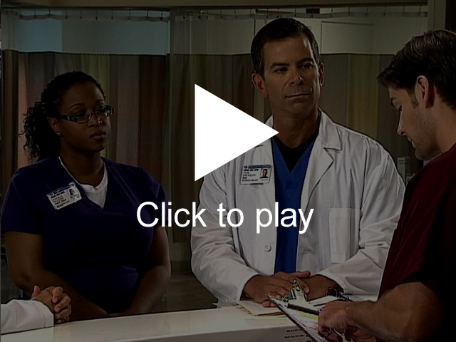
Daily Goals

Slide 14

How to Use the Daily Goals Checklist
Be explicit
Ask important questions:
  What needs to be completed for discharge?
  What do we hope to accomplish?
  What are patients’ greatest safety risks?

Slide 15

Using the Daily Goals Checklist

Slide 16
Selected TeamSTEPPS Tools¹
Four Components of Effective Teams
Leadership | Situation Monitoring | Mutual Support | Communication
Brief | STEP | Task Assistance | SBAR
Huddle | I’M Safe | Feedback | Call-Out
Debrief |  | Advocacy and Assertion | Check-Back
 |  | Two-Challenge Rule | Handoff (I-PASS the BATON)
 |  | DESC Script
 |  | CUS
 |  | Collaboration
As seen in TeamSTEPPS®

Slide 17

Briefing¹
A briefing is a discussion between two or more people, often a team, using succinct information pertinent to an event.
A briefing immediately:
  Maps out the care plan
  Identifies each team member’s role and responsibilities
  Heightens awareness of the situation
  Permits the team to plan for the unexpected
  Allows team members’ needs and expectations to be met
  Sets the tone for the day
  Encourages team members’ participation
As seen in TeamSTEPPS®

Slide 18

Briefing in Action

Slide 19

Huddle¹
Employs ad hoc planning to re-establish situational awareness, reinforce plans that are already in place, and assess any need to adjust the plan
Gathers team members to review patient data and decide on a course of action
Can be requested by any team member at any time
Uses the SBAR tool frequently
As seen in TeamSTEPPS®

Slide 20
Debriefing¹
Informal information exchange session designed to improve team performance and effectiveness after each review. Debriefings answer:
      What went well?
      What should change?
      What do we need to adjust?
Debriefing Checklist:
      Is communication clear?
      Are roles and responsibilities understood?
      Is situational awareness maintained?
      Is the workload distributed equally?
      Is task assistance requested or offered?
      Were errors made or avoided?
      Are resources available?
As seen in TeamSTEPPS®
20

Slide 21
STEP¹
Status of the patient
Team members
Environment
Progress toward goal
As seen in TeamSTEPPS®

Slide 22
I’M Safe¹
I = Illness
M = Medication
S = Stress
A = Alcohol and Drugs
F = Fatigue
E = Eating and Elimination
As seen in TeamSTEPPS®

Slide 23
Task Assistance¹
Team members protect each other from work overload situations
Effective teams place all offers and requests for assistance in the context of patient safety
Team members foster a climate where it is expected that assistance will be actively sought and offered
As seen in TeamSTEPPS®

Slide 24
Feedback¹
Timely—given soon after the target behavior has occurred
Respectful—focus on behaviors, not personal attributes
Specific—be specific about what behaviors need correcting
Directed toward improvement—provide directions for future improvement
Considerate—consider a team member’s feelings and deliver negative information with fairness and respect
As seen in TeamSTEPPS®

Slide 25
Advocacy and Assertion¹
Advocacy and assertion are used to support the patient when a team member’s viewpoints do not coincide with those of the decision maker
When advocating for the patient, team members should assert their opinion in a firm and respectful manner, providing evidence or data to support their concerns
An assertive statement should:
- Open the discussion
- State the concern
- State the problem—real or perceived
- Offer a solution
- Obtain an agreement
As seen in TeamSTEPPS®

Slide 26
Two-Challenge Rule¹
Used when there is an information conflict and an initial assertion is ignored
Rule requires team members to state their observation at least twice to ensure that their interests and observations are being addressed
The Two-challenge Rule empowers any team member to stop the action if he or she senses, or discovers, an essential safety breach that hinders patient well-being
As seen in TeamSTEPPS®

Slide 27
DESC Script¹
A constructive approach for handling and managing personal conflict, the DESC script helps unit teams resolve these disputes .
Describe the specific situation
Express your concerns about the action
Suggest other alternatives
Consensus should be stated
As seen in TeamSTEPPS®

Slide 28
CUS¹
I am CONCERNED!
I am UNCOMFORTABLE!
This is a SAFETY ISSUE!
As seen in TeamSTEPPS®

Slide 29
Collaboration¹
Achieves a mutually satisfying solution resulting in the best outcome
Win-Win-Win for patient care team (includes the patient, team members, and team)
Commitment to a common mission
Meet goals without compromising relationships
As seen in TeamSTEPPS®

Slide 30
SBAR¹
Provides a framework for effective communication between team members for the following information:
Situation―What is happening with the patient?
Background―What is the clinical background or context?
Assessment―What do I think the problem is?
Recommendation―What would I recommend?
As seen in TeamSTEPPS®
30

Slide 31
Call-Out¹
A strategy used to communicate critical information to all team members to prepare them for the upcoming procedures.
Informs all team members simultaneously
Helps team members anticipate next steps
Directs responsibility to a specific individual accountable for carrying out the task
As seen in TeamSTEPPS®

Slide 32
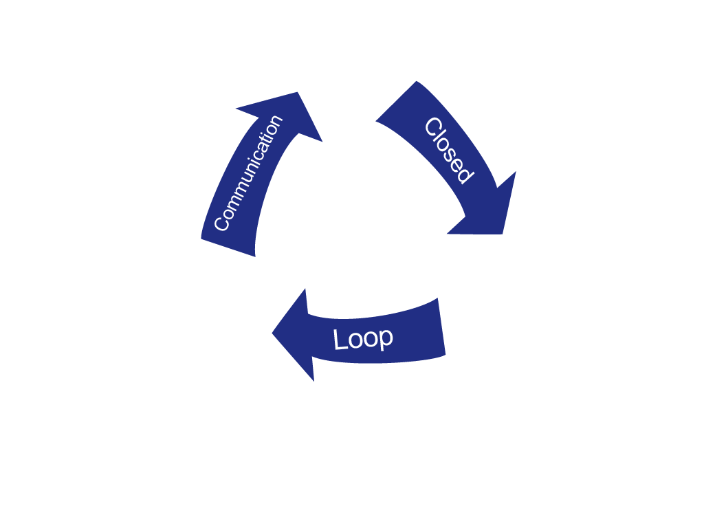
Check-Back¹
A strategy that ensures that messages are received.
Sender initiates message
Receiver accepts message, provides feedback confirmation
Sender verifies message was received
As seen in TeamSTEPPS®

Slide 33

Handoff¹
Transfer of information, along with authority and responsibility, during transitions in care across the continuum, and includes an opportunity to ask questions, clarify, and confirm
Tool used: I PASS the BATON
As seen in TeamSTEPPS®

Slide 34
I PASS the BATON¹
Introduction
Patient
Assessment
Situation
Safety Concern
(the)
Background
Actions
Timing
Ownership
Next
As seen in TeamSTEPPS®

Slide 35
Situational Awareness¹
When team members use situational awareness, they:
Know the game plan through briefings and team management (e.g., workload and workflow management, task coordination, policies, and procedures)
Have an understanding of what’s going on and what is likely to happen next
Check-back and verify information
Provide ongoing updates–briefings, call-outs, and check-backs
Implement team huddles
As seen in TeamSTEPPS®

Slide 36
Implement Teamwork and Communication:
What the Team Needs To Do
Identify opportunities to improve teamwork and communication by reviewing barriers the team identified while learning from a safety defect
Discuss with frontline providers how and where they want to improve communication
Select a tool that best addresses providers’ concerns
Use teamwork and communication tools and incorporate them into team meetings and other relevant project processes

Slide 37
Summary
Effective communication plays an integral role in the delivery of high-quality, patient-centered care
Barriers to efficient teamwork and communication influence the outcomes of the unit team
Research supports the connection between communication errors and patient care delivery
CUSP and TeamSTEPPS employ successful tools and strategies that unit teams can implement to improve the effectiveness of teamwork and communication on their units

Slide 38

Additional CUSP Tools
Morning Briefing
Observing Patient Rounds
Team Check-up Tool

Slide 39
References
Agency for Healthcare Research and Quality, Department of Defense. TeamSTEPPS. Available at http://www.ahrq.gov/professionals/education/curriculum-tools/teamstepps/index.html
(Adapted from) Dayton, E, Henriksen, K. Joint Commission Journal of Quality and Patient Safety. 2007 Jan;33(1):34-47.
Joint Commission on Accreditation of Healthcare Organizations. Sentinel Events Statistics. Root Causes of Sentinel Events, 2005. www.jointcommission.org/sentinel_event.aspx
Shortell SM, Marstellar JA, Lin M et al. The role of perceived team effectiveness in improving chronic illness care. Med Care 2004 Nov; 42:1040-1048.

