Slide 1
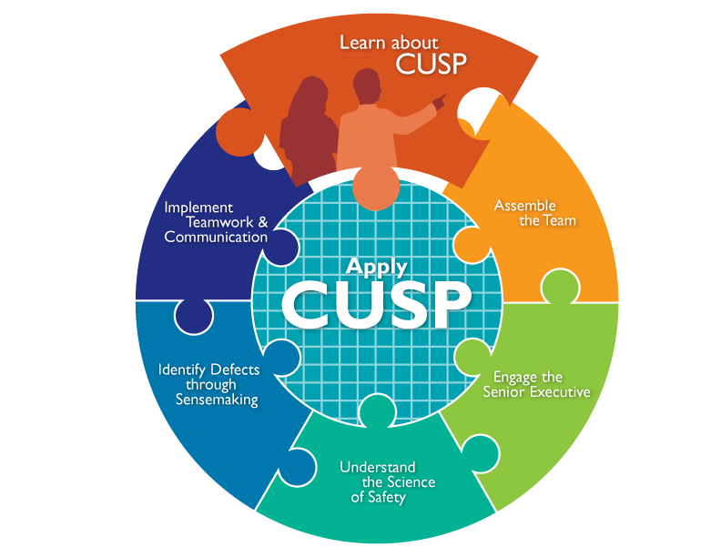

Slide 2
Learning Objectives
Review the impact of errors and patient harm and the underlying causes of errors
Demonstrate how to apply the CUSP Toolkit in a clinical environment
Describe Comprehensive Unit-based Safety Program (CUSP) framework and the goals of the CUSP Toolkit
Show how CUSP supports other quality and safety tools

Slide 3
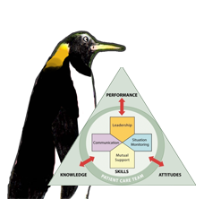
CUSP Supports Kotter’s Eight Steps of Change²
Kotter | CUSP Toolkit Modules
Step 1: Create a sense of urgency | Understand the Science of Safety
Step 2: Create a guiding coalition | Assemble the Team Engage the Senior Executive
Step 3: Develop a shared vision | Identify Defects Through Sensemaking
Step 4: Communicate the vision | Understand the Science of Safety Identify Defects Through Sensemaking
As seen in TeamSTEPPS®

Slide 4
CUSP Supports Kotter’s Eight Steps of Change²
Kotter | CUSP Toolkit Modules
Step 5: Empower others to act | Assemble the Team Identify Defects Through Sensemaking Implement Teamwork and Communication
Step 6: Generate short term wins | Implement Teamwork and Communication
Step 7: Consolidate gains and produce more change | Identify Defects Through Sensemaking
Step 8: Anchor new approaches in culture | Understand the Science of Safety Implement Teamwork and Communication
As seen in TeamSTEPPS®

Slide 5
CUSP Aligns With and Supports Other Quality and Safety Tools¹
TeamSTEPPS®
Six Sigma
Institute for Healthcare Improvement Model for Improvement
Plan-Do-Study-Act
Root Cause Analysis
Failure Mode Effect Analysis
As seen in TeamSTEPPS®

Slide 6
CUSP is Compatible with TeamSTEPPS³
TeamSTEPPS Step | CUSP Toolkit Modules
Step 1. Create a change team. | Assemble the Team Engage the Senior Executive
Step 2. Define the problem. | Identify Defects Through Sensemaking Understand the Science of Safety
Step 3. Define the aims. | Identify Defects Through Sensemaking
Step 4. Design an intervention. | Identify Defects Through Sensemaking Understand the Science of Safety
As seen in TeamSTEPPS®

Slide 7
CUSP is Compatible with TeamSTEPPS³
TeamSTEPPS Step | CUSP Toolkit Modules
Step 5. Develop a plan for testing the effectiveness. | Identify Defects Through Sensemaking
Step 6. Develop an implementation plan. | Engage the Senior Executive Identify Defects Through Sensemaking Understand the Science of Safety
Step 7. Develop a plan for sustained improvement. | Understand the Science of Safety
Step 8. Develop a communication plan. | Assemble the Team Engage the Senior Executive Identify Defects Through Sensemaking
As seen in TeamSTEPPS®

Slide 8
Is Your Hospital Safe?
Would you want a loved one to be a patient at your hospital? Your unit?
Would you want to be a patient in the unit where you work?
Can you say with 100 percent certainty that you believe that your hospital does everything it can to protect its patients?

Slide 9
Video

Slide 10
The CUSP Model
Created through a collaborative effort of the Agency for Healthcare Research and Quality and state and national-level innovators in patient safety
Dovetails with, and supports, a range of quality and safety improvement models
Encompasses a wide range of safety tools and approaches
Based on the understanding that all culture is local, and that work to improve culture must be owned at the unit level
Believes that harm is not an acceptable “cost of doing business”
Can be applied by anyone, anywhere

Slide 11
A Collaborative Effort⁴
Teams at the Johns Hopkins Quality and Safety Research Group originally developed the CUSP model with funding from the Agency for Healthcare Research and Quality
An infection reduction project of the Michigan Health and Hospital Association Keystone Center for Patient Safety and Quality proved that CUSP was successful
The Health Research & Educational Trust of the American Hospital Association led On the CUSP: Stop BSI and other national projects to apply the CUSP model
The CUSP Toolkit using Kotter’s change model combines the CUSP model, with existing frameworks like TeamSTEPPS, Just Culture, and others to provide complete tools to support units in improving culture

Slide 12
Toolkit Modules
Learn About CUSP
Assemble the Team
Engage the Senior Executive
Understand the Science of Safety
Identify Defects through Sensemaking
Implement Teamwork and Communication
Apply CUSP
Note: After a unit’s first implementation of CUSP, modules can be used in any order, depending on the needs of the unit or organization.

Slide 13
Toolkit Users
Senior executives
Help leaders prioritize improvement efforts
Provide resources for interventions to alleviate defects
Patient safety officers
Work with senior executives and managers to maintain an ongoing infrastructure for improvement activities
Nurse managers
Educate staff on the science of safety
Provide opportunities for staff to learn and practice using teamwork and communication tools
Work with senior executives and managers to maintain an ongoing infrastructure for improvement activities

Slide 14
Toolkit Users
Frontline staff
Engage with Stakeholders in safety improvement
Physician champions
Share knowledge on the immediate and long-term benefits of teamwork and communication tools

Slide 15
Implementation
Share videos with teams to spark engagement in staff safety assessments
Provide templates and discussion guides to project leads
Educate teams on the science of safety
Use videos and training modules to orient new clinical staff
Train teams in using teamwork and communication tools
Engage senior executives and physician champions

Slide 16
Challenges
Applicability and usability of CUSP within specialty units (i.e. NICU, oncology)
Senior executive engagement and participation
High staff turnover
Nurse empowerment

Slide 17
Assemble the Team
Understand the importance of your CUSP team
Develop a strategy to build a successful team
Identify characteristics of effective teams and barriers to team performance
Define roles and responsibilities of team members

Slide 18
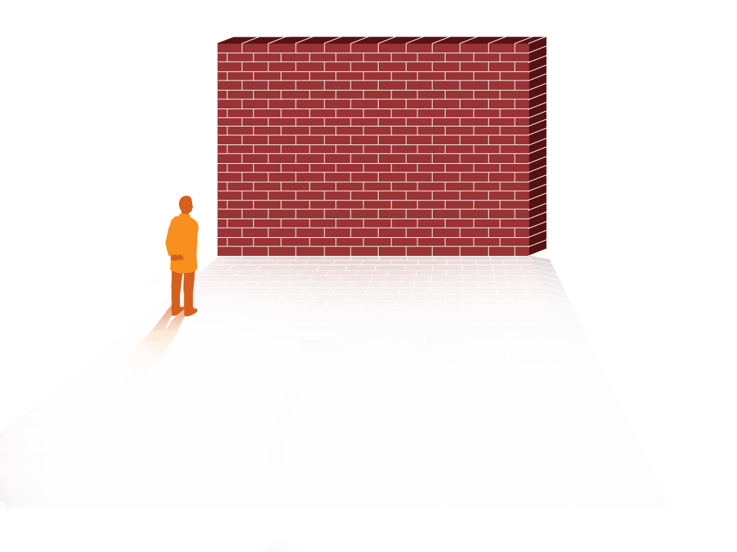
Barriers to Team Performance³
Inconsistency in team membership
Lack of time
Lack of information sharing
Hierarchy
Varying communication styles
Presence of conflict
Lack of coordination and follow-up
Misinterpretation of cues
Lack of role clarity

Slide 19
Engage the Senior Executive
Identify characteristics to search for when recruiting the senior executive
Describe the responsibilities of the senior executive
Explain the role of the senior executive in addressing technical and adaptive work
Explain how to engage the senior executive and develop shared accountability for the work

Slide 20
The Challenges of Partnering with a Senior Executive
May lack clinical background
May not recognize the value of CUSP
May not be able to meet with the CUSP team regularly

Slide 21
Understand the Science of Safety
Describe the historical and contemporary context of the Science of Safety
Explain how system design affects system results
List the principles of safe design and identify how they apply to technical work and teamwork
Indicate how teams make wise decisions when there is diverse and independent input

Slide 22
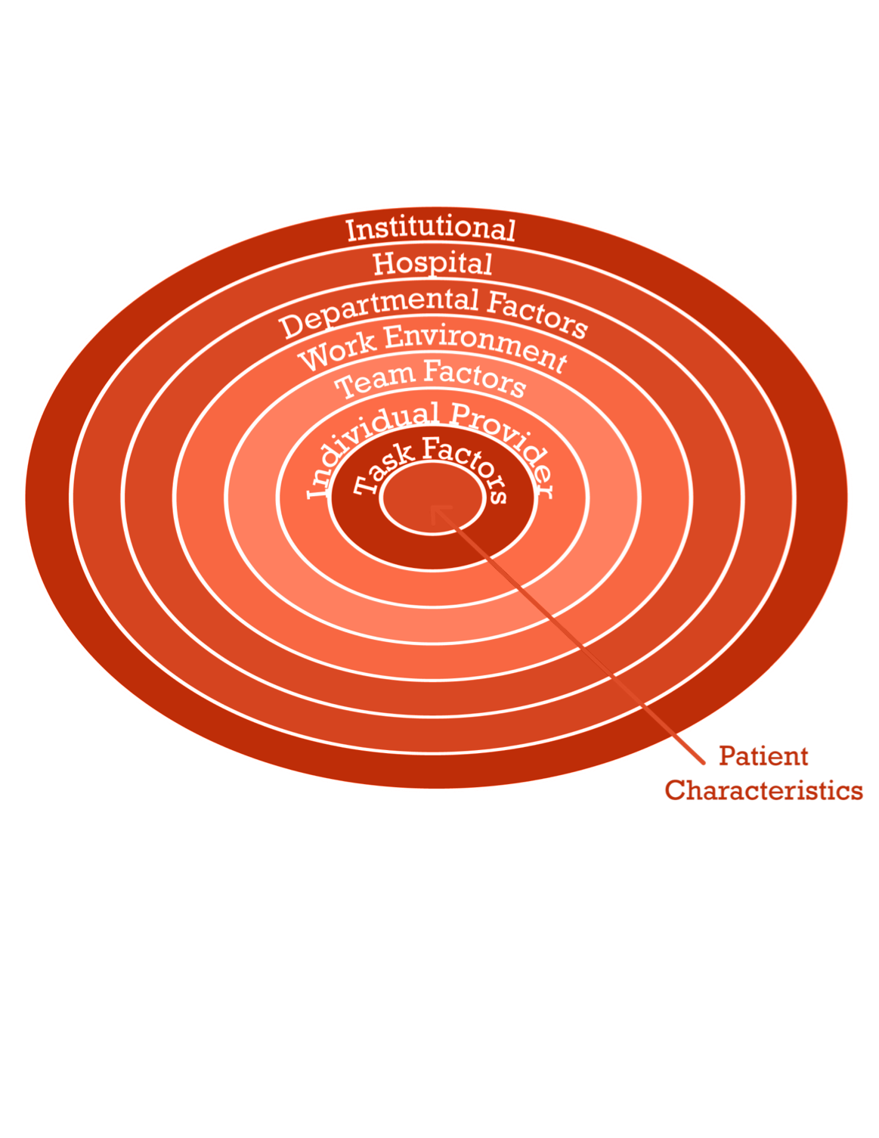
System-Level Factors Impact Safety

Slide 23
Identify Defects Through Sensemaking
Introduce CUSP and Sensemaking tools to identify defects and errors
Discuss the relationship between CUSP and Sensemaking
Show how to apply CUSP and Sensemaking tools
Discuss how to share findings
Note: This module combines the CUSP steps
Identify Defects and Learn from Defects

Slide 24
Examples of Defects or Errors That Affect Patient Safety

Slide 25
Implement Teamwork and Communication
Recognize the importance of effective communication
Identify barriers to communication
Describe the connection between communication and medical error
Identify and apply effective communication strategies from CUSP and TeamSTEPPS
As seen in TeamSTEPPS®

Slide 26
Elements That Affect Communication and Information Exchange
Interruptions
Task absorption
Verbal abuse
Fatigue
Not following plan of care
Ambiguous orders or directions
Change in team members
Work load

Slide 27
Apply CUSP
Introduce Just Culture principles
Learn how Just Culture principles can augment CUSP
Review key steps of the CUSP Toolkit
A Just Culture system⁶
Holds itself accountable
Holds staff members accountable
Has staff members that hold
themselves accountable

Slide 28
The CUSP Model Generates Measurable Results⁷
CUSP in Michigan ICUs
Correlated with significant improvements in safety climate in 71 units
Overall mean safety climate scores significantly improved from 42.5 percent (2004) to 52.2 percent (2006)
In 2009, more than 350 hospitals in 22 States reduced CLABSI rates by an average of 35 percent after implementing CUSP

Slide 29
CUSP Results
Heightened engagement of staff and senior leaders
Improved communication among care team members
Shared mental models
Expanded knowledge of potential hazards and barriers to safety
Collaborative focus on systems of care

Slide 30
Summary
CUSP integrates with and supports a broad range of quality and safety models
Communication is cited as a root cause of most errors
Individuals across an organization can use the CUSP Toolkit and expect measurable results

Slide 31
References
Agency for Healthcare Research and Quality, Department of Defense. TeamSTEPPS. Available at http://www.ahrq.gov/professionals/education/curriculum-tools/teamstepps/index.html
Kotter J, Rathgeber H. Our iceberg is melting: Changing and succeeding under any conditions: 1st ed. New York, St. Martin's Press; 2006.
Agency for Healthcare Research and Quality, Department of Defense. TeamSTEPPS. Available at http://www.ahrq.gov/professionals/education/curriculum-tools/teamstepps/index.html
Health Research and Educational Trust, Johns Hopkins University Quality and Safety Research Group, Michigan Health & Hospital Association Keystone Center for Patient Safety and Quality. Eliminating CLABSI: A national patient safety imperative a progress report on the National On the CUSP: Stop BSI project. Rockville, MD; Agency for Healthcare Research and Quality, April 2011. AHRQ Publication No: 11-0037-EF.

Slide 32
References
Vincent C, Taylor-Adams S, Stanhope N. Framework for analysing risk and safety in clinical medicine. BMJ. 1998;316:1154–7.
Griffith, S. Just Culture. Plano, TX: Outcome Engineering; 2011.
Pronovost P, Goeschel C, Colantuoni E, et al. Sustaining reductions in catheter related bloodstream infections in Michigan intensive care units: observational study. BMJ. 2010;340:c309.

