Slide 1


Slide 2
Learning Objectives
Discuss how to communicate an adverse event to a patient and family members
Present tools to improve communication among patients, families, and clinicians
Describe how to work with patients and family advisors
Explore the role of patient and family advisors

Slide 3


The Patient’s Hospital Experience¹
Clinicians and Hospital Staff | Patients
Know how the hospital works and how to achieve results | Are strangers in this environment Don’t understand the system or culture
Know who hospital staff are and what they do | Don’t know who different staff are and what they do
Are busy and under a lot of stress | Are often in pain or uncomfortable, vulnerable, or afraid Are aware that hospital staff are busy and may not want to bother you
Notes:
(Strategy 2 Tool 6 presentation)

Slide 4

Patient- and Family-Centered Care³
Involves “…collaborating with patients and families of all ages, at all levels of care, and in all health care settings … acknowledges that families, however they are defined, are essential to patients’ health and well-being…”
Core concepts of patient- and family-centered care are:
  Dignity and respect
  Information sharing
  Participation
  Collaboration

Slide 5
What is Patient Family Engagement?¹
Patient and family engagement:
  Is an important component of patient- and family-centered care
  Creates an environment where patients, families, clinicians, and hospital staff all work together as partners to improve the quality and safety of hospital care
Involves patients and family members as:
  Members of the health care team
  Advisors working with clinicians and leaders to improve policies and procedures

Slide 6

Who are Advisors and
What do they do?
Advisors are collaborative partners in developing and revising hospital policies, procedures, and practices
Patients and family members who have received care at our hospital and who want to help improve experiences for others
They help our hospital improve quality and safety of care by:
  Giving input and feedback
  Identifying potential changes and feedback
  Planning and implementing changes that
  matter to patients and families

Slide 7
Characteristics of an
Engaged Advisor¹
Listen well
Share your views
Draw on your communication skills
Ask questions
Be ready for disagreements

Slide 8


Characteristics of an
Engaged Advisor

Slide 9

How to Work with Patient and Family Advisors¹
Invite two or three patients and family members to a team meeting to discuss their hospital stay
Ask patients and families to give feedback on educational or informational materials
Invite patients and families to present at staff
orientations and in-service programs
Explore the hospital and unit through the
eyes of patients and their families by
conducting a “walk-about” with patients
and families

Slide 10
How to Engage Patients and Families¹
When you enter the room:
  Read chart before stepping in
  Make eye contact with the patient
  Introduce yourself by name and role
  Introduce new people in room by name, role, and what they will do
When you first assess the patient:
  Ask how the patient prefers to be addressed
  Identify family who should be partners in the patient’s care
  Highlight main points of communication tools
  Invite the patient and family to use the white board to “talk” with clinicians

Slide 11
How to Engage Patients and Families¹
(continued)
Ask about and listen to the patient and family’s needs
and concerns:
  Use open-ended questions
  Listen to, respect, and act on what the patient and family say
  Help patients articulate their concerns when needed
  Get a translator’s assistance if the patient or family member cannot understand you
Help the patient and family understand the diagnosis, condition, and next steps:
Give timely and complete information — take every opportunity to educate the patient and family
Use plain language
Invite the patient or family to take notes

Slide 12
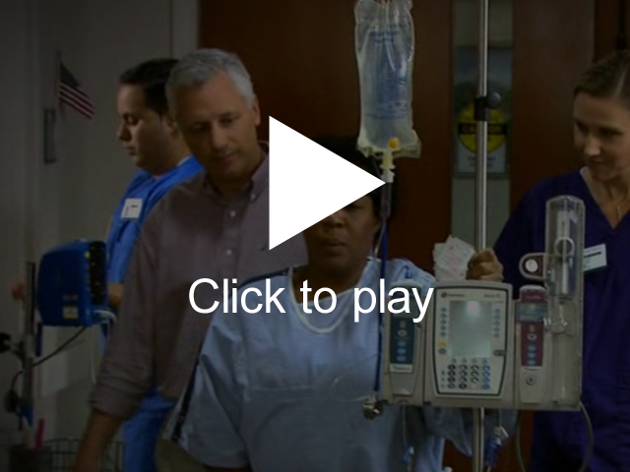
Effective Patient and
Family Communication

Slide 13

The Importance of Effective Communication

Slide 14

The Link Between Communication and Patient Safety¹
Patient outcomes
Patient safety
Perceptions of quality

Slide 15

Communication Tips¹
Speak slowly
Use plain language
Reassure patient and family by giving information
Thank patient or family for calling attention to any issue raised
Invite them to continue asking questions

Slide 16

IDEAL Discharge Planning

Slide 17
What is IDEAL Discharge Planning?¹
Include the patient and family as full partners
Discuss with the patient and family the five key areas
to prevent problems at home
Educate the patient and family throughout the hospital stay
Assess how well doctors and nurses explain the diagnosis, condition, and next steps in their care — use teach-back
Listen to and honor the patient and family’s goals, preferences, observations, and concerns

Slide 18
Benefits of IDEAL Discharge Planning for Clinicians¹
Improves accuracy of information about the patient’s condition
and discharge situation
Reduces risk and liability
Enhances quality of care for patient
Demonstrates that hospital staff consider patient perspective important
Shows teamwork among hospital staff
Patient and family have a better experience of care
  Ensures that patients and families know how and what to do and will be less anxious once discharged
Prevents postdischarge complications and avoidable readmissions

Slide 19

IDEAL Discharge

Slide 20
What if an Adverse Event Occurs on the Unit?

Slide 21
Engagement Strategies
Engaging in planning and design — Infrastructure advisory
Engaging in everyday care — How-to strategies
Engaging after an adverse event

Slide 22
Introduction to Adverse Events
Adverse event: An injury to a patient caused by medical intervention rather than by the underlying disease or condition of the patient
The mission of health care providers is to help and care for patients without harming them, but adverse events happen
When an adverse even occurs, it can be difficult for a health care worker to take ownership and communicate with the patient and family
Prompt, compassionate, and honest communication with the patient and family after an adverse event is essential

Slide 23
Immediate Response to an
Adverse Event⁴
Care for the patient
Report to the appropriate parties
Communicate with the patient (who, what, when, where, and why)
Document the event in the medical record

Slide 24
Next Steps in Responding to an
Adverse Event⁵
Investigation
Continued communication with the patient and family
Apology and remediation
System and process improvement
Measurement and evaluation
Education and training

Slide 25
How to Communicate About an Adverse Event⁶
Speak slowly and use clear language
Give an advance alert (“I’m afraid I have some news to share with you.”)
Give the news in a few, brief sentences
Quietly wait for the reaction
Watch and listen for response signals

Slide 26
The Second Victim:
Health Care Workers⁷
Health care workers involved in an adverse event experience their own trauma
Health care workers should request ongoing support from their hospital and peers
Hospitals have developed Employee Assistance Programs and Medically Induced Trauma Support Services

Slide 27
Summary
Advisors provide valuable insight about patient and family experiences and care delivery
Effective engagement and communication among patients, family members and other members of the health care team impacts health outcomes and patient and family satisfaction
IDEAL Discharge Planning is an effective tool for ensuring patient and family member engagement and education
Organizations should be prepared to respond and communicate proactively when adverse events occur

Slide 28

Tools
Am I Ready To Become an Advisor?¹
Working with Advisors¹
Be a Partner in Your Care¹
Get to Know Your Health Care Team¹
Care Transitions from Hospital to Home: IDEAL Discharge Planning¹
SBAR (Situation – Background – Assessment - Recommendation)²

Slide 29
References
Guide to Patient and Family Engagement in Hospital Quality and Safety. Rockville, MD: Agency for Healthcare Research and Quality; May 2013. AHRQ Publication No. 13-0033.
TeamSTEPPS Instructor Guide. Rockville, MD: Agency for Healthcare Research and Quality; June 2006. AHRQ Publication No. 06-0020.
Conway J, Johnson B, Edgman-Levitan S, et.al. Partnering with Patients and Families to Design a Patient- and Family-Centered Health Care System: A Roadmap for the Future. A work in progress. Bethesda, MD: Institute for Family-Centered Care; June 2006.

Slide 30
References
Bonacum D, Houk C, Moidel BI, et al. Communicating about episodes of harm to patients. In: Leonard M, ed. Achieving Safe and Reliable Healthcare. Chicago: Health Administration Press; 2004:93-112.
McDonald T, Helmche L, Smith K, et al. Responding to patient safety incidents: the ‘seven pillars.’ Qual Saf Health Care 2010;19:e11.
Hallenback JL. Palliative Care Perspectives. 1st ed. New York: Oxford University Press; 2003.
Wu AW. Medical error: the second victim. The doctor who makes the mistake needs help, too. BMJ. 2000 Mar 18;320(7237):726-727.

