Slide 1


Slide 2
Learning Objectives
Discuss myths and barriers to spread
Present the components of a spread plan
Examine external and internal factors that affect spread
Define spread and its role within an organization

Slide 3

Definition of Spread¹
“Spreading takes the process from the narrow, segmented population(s) or group(s) and broadens it to include all the population(s) or group(s) that will use the process.”
“Formalizing a process provides a reference to others; those new to the organization and those in the organization needing clarity about the specifics of the process.”

Slide 4
Why Spread?
Health care culture is local
Quality interventions target a process in small pilot projects usually on a local level (Lean Six Sigma, Plan-Do-Study-Act [PDSA])
Safety interventions targeted at the unit level (CUSP)
Shifting the paradigm—from hierarchical to team culture

Slide 5
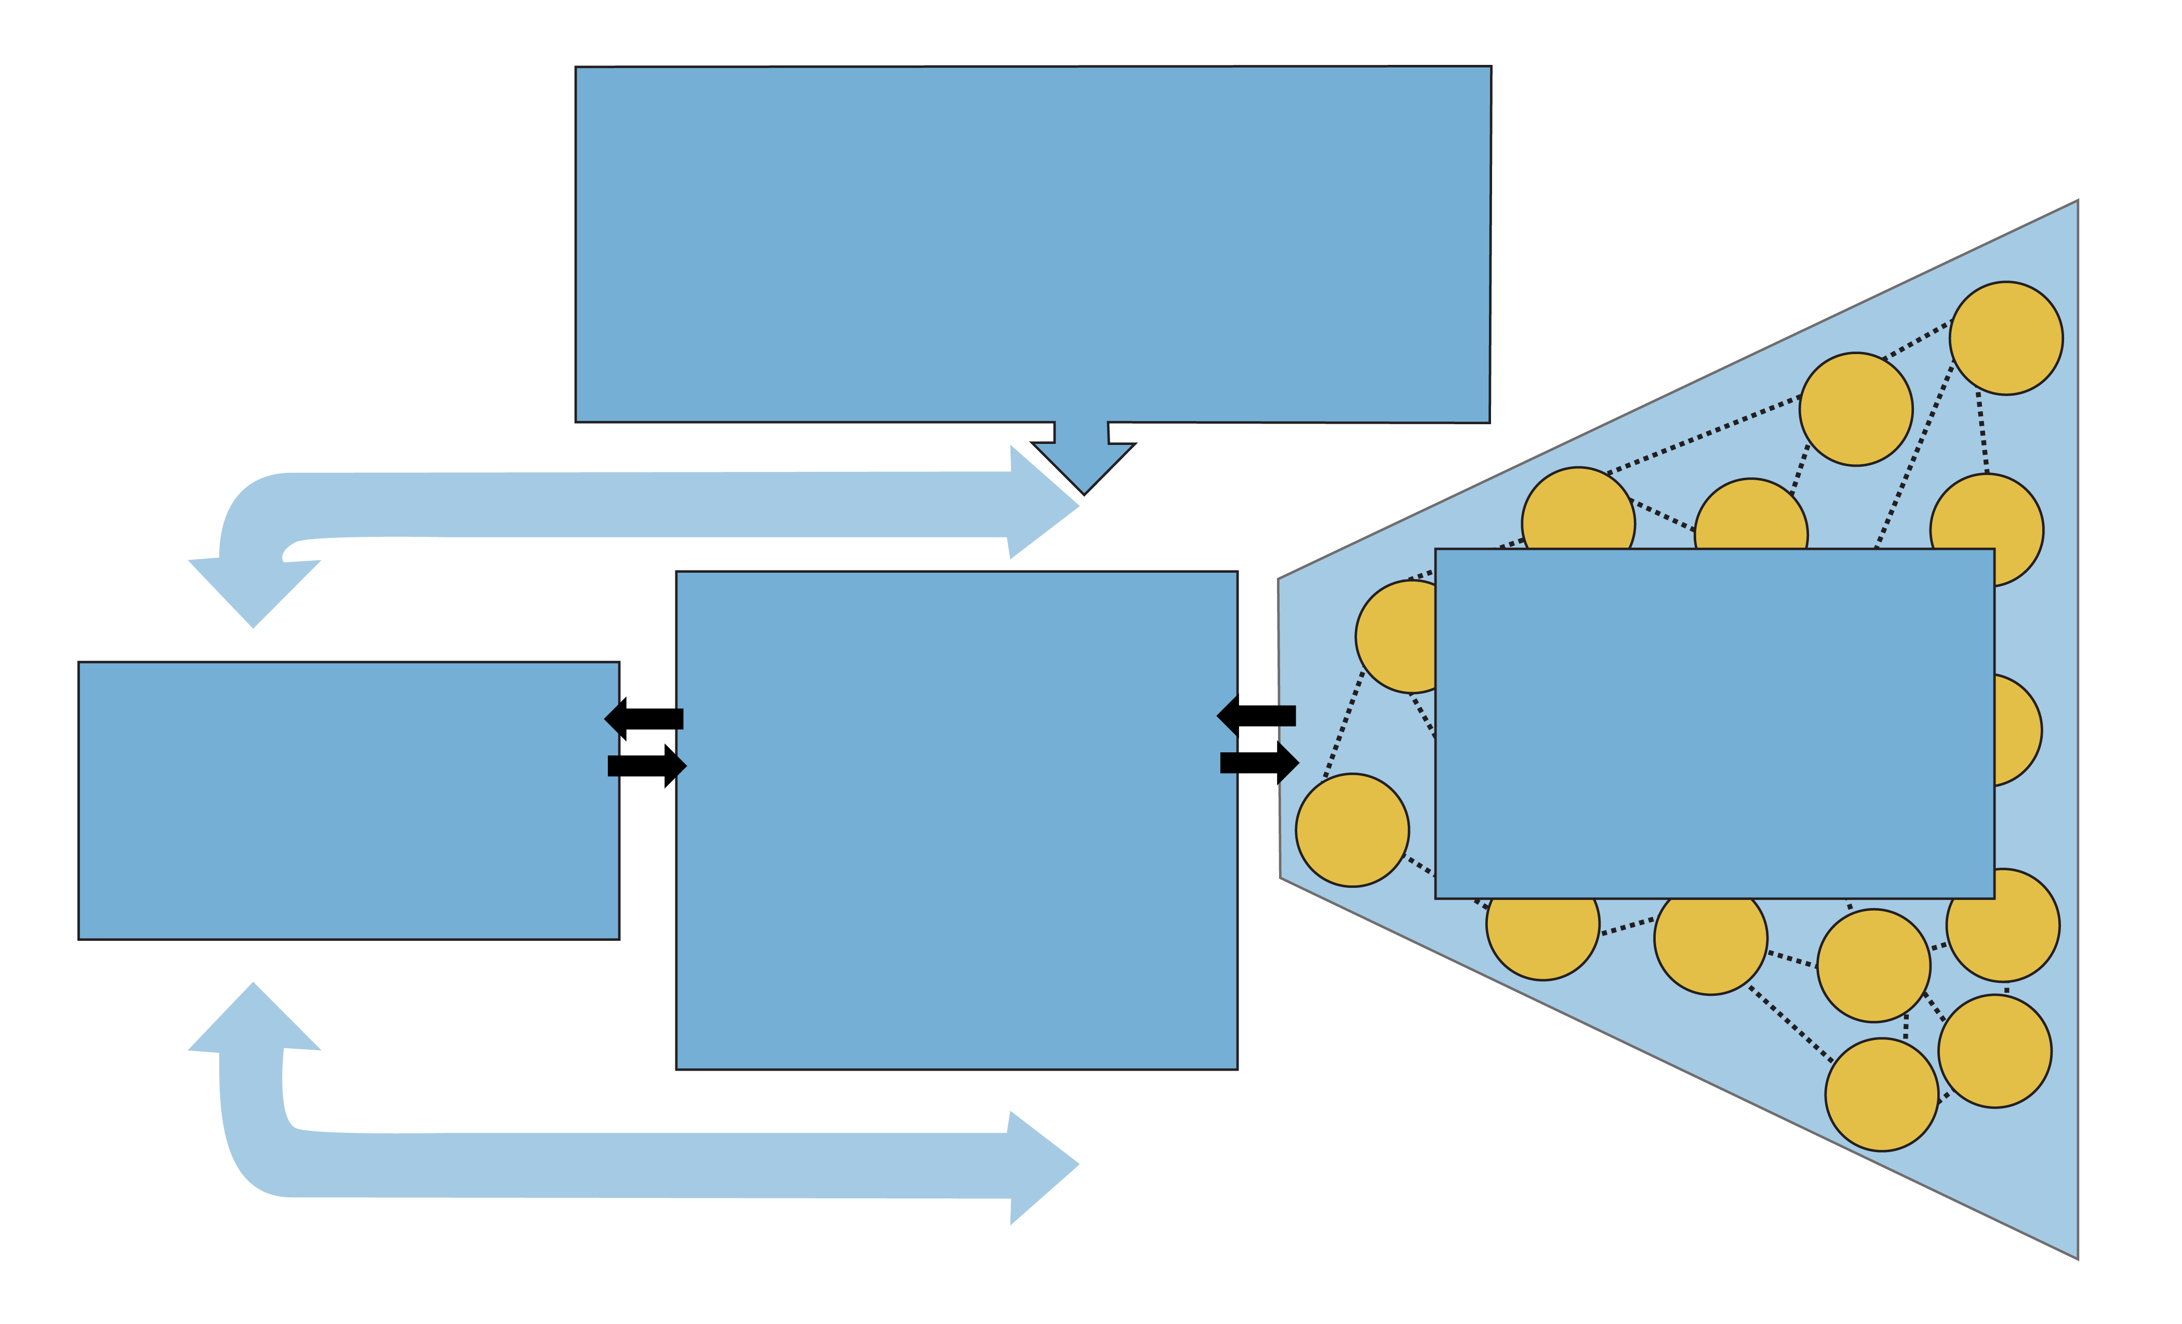
Spread Framework²
Leadership
Topic is a key strategic initiative
Goals and incentives aligned
Executive sponsor assigned
Day-to-day managers identified
Measurement and Feedback
Setup
Target population
Adopter audiences
Successful sites
Key partners
Initial spread strategy
Social System
Key messengers
Communities
Technical support
Transition issues
Better Ideas
Develop the case
Describe the ideas
Communication (awareness & technical)
Knowledge Management
Adapted from the IHI Framework for Spread. [Massoud MR, Nielsen GA, Nolan K, Schall MW, Sevin C. A Framework for Spread: From Local Improvements to System-Wide Change. IHI Innovation Series white paper. Cambridge, MA: Institute for Healthcare Improvement; 2006.] (Available at www.IHI.org)

Slide 6
External Factors Affecting Spread³
Financial
Legal
Regulatory
Public opinion
Moral
Organizational priorities

Slide 7

Internal Factors Affecting Spread³
Leadership
Availability of resources
Knowledge and skill set
Organizational culture
Ongoing improvement efforts
Other priorities

Slide 8



Factors That
Affect Spread

Slide 9

What Facilitates Spread Success?⁴
Evidence-based efforts, tools, and examples
Leadership support
Easy to adopt
Pertinent and relevant issue
Able to be piloted or tested on a small scale
Observable

Slide 10
Spread Sequencing⁵
Make part of
routine
operations
Sustaining and
spreading a change to other locations
Test under a
variety of
conditions
Implementing a
change
Theory
and
prediction
Testing a change
Act
Plan
Study
Do
Developing a
change
The Plan-Do-Study-Act cycle. Adapted from the Institute for Health Care Improvement (Available at www.ihi.org)

Slide 11
Developing a Plan for Spread
Inform the team
Work with the next unit to spread
Account for variability
Start with the units that can adopt easily

Slide 12

Work With the Next Unit

Slide 13

Account for Variability

Slide 14

Exercise: Develop a Spread
Plan To Decrease
CAUTI Rates
Goal: Decrease CAUTI rates on all floors
Care process: Use HICPAC Guidelines for catheter insertion and removal
Time: 3 months
Criteria to consider: Similar patient populations; similar physicians; staff receptiveness; unit leadership
www.cdc.gov.hicpac/projects_in_progress.html

Slide 15

Evaluate Spread
Quantitative and qualitative
approaches are essential
for evaluating spread

Slide 16
Seven Spreadly Sins⁵
Start with large projects
Find one person willing to do it all
Expect vigilance and hard work to solve a problem
If a pilot project works then spread it unchanged
Require the person and team who drove the pilot project to be responsible for system-wide spread
Look at process and outcome measures quarterly
Expect marked improvement in outcomes early on without attention to process reliability

Slide 17
Summary
Spread helps organizations build on processes that originate at the local level
Organizations need to be prepared to address external and internal factors that can affect spread
An effective spread plan involves:
Strong communication among the team
Collaboration with other units
Accounting for variability
Identification of units able to adopt the process easily
Spread plan evaluation is ongoing

Slide 18

Tools
Voice of the Customer Analysis⁶
Workflow Analysis⁶
Plan-Do-Study-Act (PDSA)⁷
Spread Checklist⁸

Slide 19
References
1. North Carolina Center for Hospital Quality and Patient Safety. North Carolina Prevent Catheter-Associated Urinary Tract Infections Collaborative. North Carolina; 2010.
2. Massoud MR, Donohue KL, McCannon CJ. Options for Large-Scale Spread of Simple, High-Impact Interventions (Prepared by University Research CO.,LLC under Contract No. GHN-01-01-07-00003-00 and GHN-0I-03-07-00003-00). Bethesda, MD: USAID Health Care Improvement Project; September 2010. www.hciproject.org/node/1650. Accessed April 15, 2012.
3. Edson B. Navigating the Fleet: Accelerating National Adoption. The Patient Safety Education Program (PSEP), Canada; February 2012.

Slide 20
References
4. Cooley L, Kohl R. Scaling Up—From Vision to Large-Scale Change: A Management Framework for Practitioners. Washington, DC: Management Systems International; 2006. www.msiworldwide.com/files/scalingup-framework.pdf. Accessed April 15, 2012.
5. Lloyd R. Applying the Science of Improvement to Daily Work. Chicago: HRET; 2012.
6. Hagg HW, Workman-German J, Flanagan M, et al. Implementation of systems redesign: approaches to spread and sustain adoption. In: Henriksen K, Battles JB, Keyes MA, et al., eds. Advances in Patient Safety: New Directions and Alternative Approaches Vol. 2: Culture and Redesign. Rockville, MD: Agency for Healthcare Research and Quality; 2008. Accessed April 14, 2012. www.ncbi.nlm.nih.gov/books/NBK43727.

Slide 21
References
7. Institute for Healthcare Improvement. Knowledge Center. How to improve. www.ihi.org/knowledge/Pages/HowtoImprove/default.aspx. Accessed April 10, 2012.
8. Massoud MR, Nielsen GA, Nolan K, et al. Framework for Spread: From Local Improvements to System-Wide Change. Cambridge, MA: Institute for Healthcare Improvement; 2006. IHI Innovation Series White Paper. www.IHI.org. Accessed April 10, 2012.

